Slide 1
Digital Transformation in health and social care professions
BMHP 6026: Freestyle Libre PowerPoint Presentation
Tutor: Martin Svejda
Submission date: 12th July 2026
Student: Precious Lewis 2328179

Slide 2

The growing burden of Diabetes
5.8 Million
People in the UK are affected by Diabetes
£10.07 Billion
Annual NHS Expenditure
(Diabetes uk 2026:NHS, 2025)

Slide 3
Diabetes Classification& Edibility
Type 2 Diabetes
Linked to lifestyle factors and insulin resistance.
Freestyle Libre eligibility requires insulin use plus one of the following indicators:
Server Hypoglycaemia
Impaired hypo awareness
Cognitive impairment/ Disability
Type 1 Diabetes
Autoimmune destruction of insulin producing cells. Requiring lifelong insulin therapy.
Can not be prevented via lifestyle changes.
Entitlement to universal access of the FSL
(NHS,2025: Abbott,2026)

Slide 4
Evolution of FSL Glucose Monitoring
2014
Original FSL
Flash Glucose Monitoring (isCGM) requiring manual sensor scanning (Nguyen and White 2022).
2020
FSL 2
Added integrated Bluetooth alarms for high/low glucose thresholds (Nguyen and White 2022).
2022
FSL 3
Real-time streaming (rtCGM) via Bluetooth Low Energy (BLE) with 1-minute updates (Alva et al. 2023).
Features a 70% reduction in size, roughly the size of a UK 2p coin (Alva et al. 2023).
2026
FSL 2 Plus
Enhanced sensor duration and advanced integration with automated insulin delivery systems (Alva et al. 2023).

Slide 5

NICE guidance for clinicians
Shared decision making- Recommend the lowest acquisition cost if clinical needs are met equally.
Mandatory back-up Testing- Manual finger pricks required during warm up period or when symptoms do not match readings.
Structured information- H&SC Teams must provide comprehensive training on data interpretations.
Improved patient control- Proven reduction in Hypoglycaemia and hospital addmissions.ed Decision-Making: Recommend the lowest acquisition cost device if clinical needs are met equally.
(NICE, 2022: Blissett et al, 2022)

Slide 6
NHS Digital Transformation Strategy
Prevention
Preventing health needs from escalating via early intervention tech.
Personalise
Reducing health disparities via data-driven care pathways.
Experience
Improving the provider impact and patient satisfaction scores.
Performance
Transforming clinical performance with IoT and remote monitoring
(Bennion et al 2025: Gov.uk, 2022)

Slide 7
Economic Evaluation: FSL vs SMBG
Cost Element (Annual) | Freestyle Libre System | Standard SMBG System
Acquisition Costs | £937 | £552
Healthcare Resource Utilization | £200 | £396
Downstream Costs Avoided | -£21 | £0
Annual Total per Patient | £1,116 | £948
(Blissett et al, 2022)

Slide 8
Clinical Impact on Hospitalization
Acute Diabetes Events 67% Reduction
Stroke Hospitalizations 52% Reduction
Acute Heart Attacks 36% Reduction
Retrospective data indicates a profound shift from reactive to proactive metabolic management.
(Abbott, 2025)

Slide 9
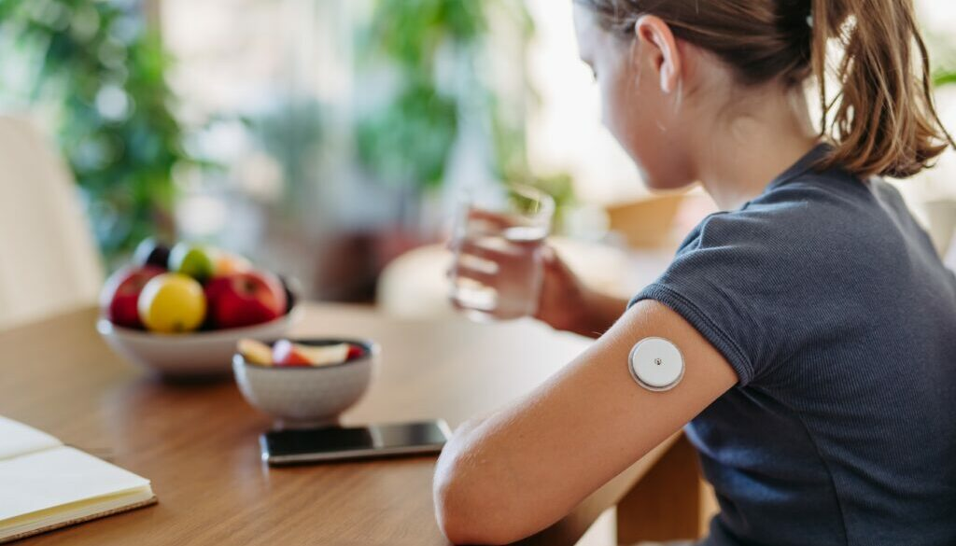
Quality of Life & User Insight
Reduced Distress: Eliminating finger-pricks improves mental health.
Work Attendance: 58% reduction in diabetes-related absenteeism.
Understanding: 95% of users report better understanding of fluctuations.
Care Networks: Real-time data sharing provides peace of mind.
(Proven outcomes, 2026: Abbott 2025)

Slide 10
Strategic Roadmap
Recommendations for 2026
Universal Access: Ensure FSL availability for all diabetes sufferers to enhance preventative care.
Workforce Capacity: Address the 24% rise in educator demand through automation and risk stratification.
Market Adoption: Target projected increase from 30% to 70% in the T1D population by Year 3.
(Abbott,2026)

Slide 11
The future of The Freestyle libre
Use of the Freestyle libre is on an upward trajectory
The FSL system will continue to evolve
Will continue to reduce distress and create collaborative support systems
(Abbott, 2026)

Slide 12
References
Abbott (2022) Clinical Impact on Hospitalization Study. Abbott.
Abbott (2025) Quality of Life & User Insight Dataset. Abbott.
Abbott (2026) FreeStyle Libre Eligibility and Classification Guidelines. Abbott.
Alva, S., Bailey, T., Brazg, R., Budiman, E. S., Castorino, K., Christiansen, M. P., Johns, G., Mode, D. and Tweden, K. S. (2023) Accuracy of a 14-Day Continuous Glucose Monitoring System with Advanced Algorithm in Pediatric and Adult Populations, Journal of Diabetes Science and Technology.
Bennion, M., Johnston, S. and Martin, L. (2025) Evaluating Digital Health Initiatives in Modern Healthcare Infrastructure, Journal of NHS Digital Innovation, 12(2), pp. 145–158.
Blissett, R., Harrison, D. and Smith, J. (2022) Economic Evaluation of FreeStyle Libre Flash Glucose Monitoring Versus Self-Monitoring of Blood Glucose (SMBG) Systems in the UK, Journal of Medical Economics, 25(1), pp. 312–321.
https://www.conwaymedicalcenter.com/wp-content/uploads/2024/08/CGMjpg-1024x683-1024x585.jpg
Source: www.conwaymedicalcenter.com
Diabetes UK (2026) The Growing Burden of Diabetes in the UK: 2026 Report. London: Diabetes UK.
Gov.uk (2022) NHS Digital Transformation Strategy and Infrastructure Investment. Available at: https://www.gov.uk (Accessed: 6 July 2026).
National Institute for Health and Care Excellence (NICE) (2022) NICE Guidance for Clinical Teams: Integrated Sensor-Based Continuous Glucose Monitoring Systems. London: NICE.
Nguyen, M. and White, P. (2022) Evolution of Glucose Monitoring Technology: From Flash Monitoring to Real-Time Continuous Streams, Diabetes Technology & Therapeutics, 24(5), pp. 389–397.
NHS (2025) Diabetes Management, Classification & Annual Expenditure Data. London: NHS England.
Proven Outcomes (2026) Patient App Tracking and Absenteeism Data Insights. Abbott/Proven Outcomes.

