Slide 1
AHAH 4005 AND HPHI 4011
INTRODUCTION TO FIELDWORK
LECTURE ONE - PART TWO
SOURCES

Slide 2
AIMS
To explore method and approach - ‘Methodology’ (within the discipline of History/ Medieval History)
Simply: ‘HOW WE DO HISTORY’:
How we write History
How we record History
How we collect/retrieve/store/ interpret historical fact

Slide 3
CHANGE
Exploring Method and Approach also means awareness of change and HISTORIOGRAPHY, around:
New facts and information
New narratives
New contexts
New interpretations
New stresses
OR SHOULD I STRESS ‘DIFFERING’?

Slide 4
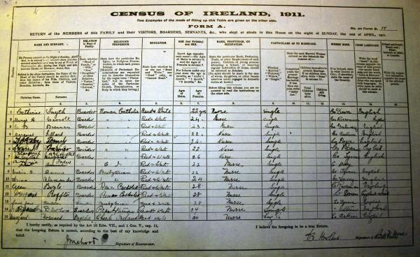
SOURCES

Slide 5
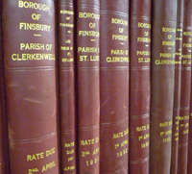
SOURCES
SOURCES remain key to historical study
The range and scope of both primary and secondary sources is immense
‘Hands on’ approach to sources, particularly primary sources, central to AHAH 4005 module

Slide 6
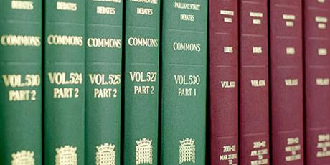
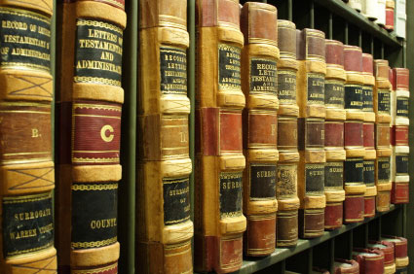
SOURCES -SCOPE

Slide 7
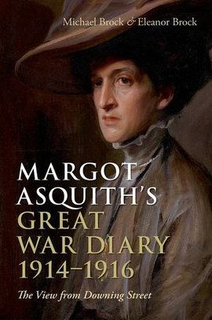
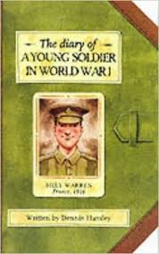
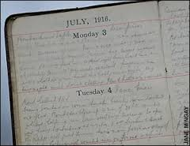
SOURCES - PERSONAL

Slide 8
THE STUDY OF MEMORY
Relationship between individual and social surroundings – the way human beings experience the world around them
Shaping of memory by ideologies, myths and culture – how the world is invested with meaning
Central is an understanding of the nature of memory and the conceptualisation of the relationship between ‘memory ‘and ‘history’

Slide 9
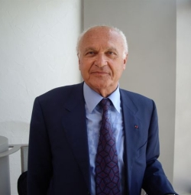
‘MEMORY’ AND ‘HISTORY’
Pierre Nora, Editor of Lieux de Memoire (Sites of Memory) – the impact of ‘History’ as an academic discipline on ‘Memory’ as a continuous narrative of a collective: English version: Realms of Memory, (New York, 1996-8)

Slide 10
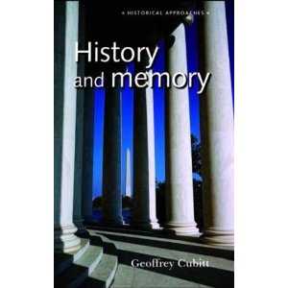
‘MEMORY’ AND ‘HISTORY’
Tracking historiography and critical reflection against the erosion of the influence of memory within its communal setting
What remains are ‘the Sites of Memory’ or ‘merely the lingering awareness of memories and traditions that once had social meaning’ Geoffrey Cubitt, History and Memory’ (Manchester, Manchester University Press, 2007), p.47

Slide 11
INDIVIDUAL AND SOCIAL MEMORY
Connection between personal knowledge and experience, and knowledge acquired as part of the collective
Individuals remember ‘not as isolated agents but as social beings’ (Cubitt, p.118)
‘Individuals remember in ways that are fluctuating and discontinuous, and this reflects the fact that the social environment they inhabit is a complex and shifting one’ (Cubitt, p.159)

Slide 12
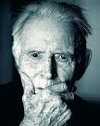
‘MEMORY’ AND WAR
The ‘Before’ and ‘After’ categorisation of war (e.g. The Great War), part of ‘a shared sense of the general significance of a particular event’ Ludmilla Jordanova, History in Practice (London: Arnold, 2000), p.122

Slide 13
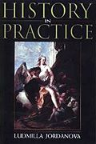
LUDMILLA JORDANOVA,
HISTORY IN PRACTICE, (LONDON: ARNOLD, 2000)

Slide 14
‘MEMORY’ AND WAR
Remembering war or other significant events e.g. The Holocaust, are linked to subsequent actions manifested through points of reference (memorials or museums)
Interpreting meaning attributed to such points of reference is not straight forward, as meaning given to, and taken from them are multi-layered and can change overtime
New meaning is brought on by the ‘constant give and take between memorials and viewers ...the responses of viewers to their own world in light of a memorialised past – the consequences of memory’ James Young, The Texture of Memory (London: Yale, 1993), p.ix

Slide 15
THE ‘AXES’ OF MEMORY
James Young refers to:
‘the many complicated historical, political, and aesthetic axes on which memory is constructed. For neither memory nor intention is ever monolithic: each depends on the vast array of forces – material, aesthetic, spatial, ideological – converging in one memorial site’
The Texture of Memory, p. x.

Slide 16
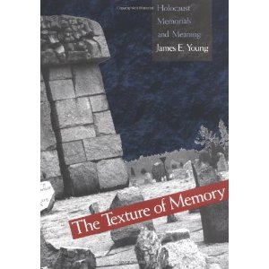
JAMES YOUNG:
THE TEXTURE OF MEMORY: HOLOCAUST MEMORIALS AND MEANING (YALE UNIVERSITY, 1993)

Slide 17

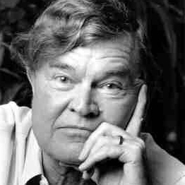
‘MEMORY’ AND ‘IRONY’
Paul Fussell’s modern classic: The Great War and Modern Memory (Oxford: OUP, [2nd Edition],1977)
Through wartime reminiscences of soldier-writers he explores ‘the application of mind and memory to the events of the Great War’ (page 35)
one dominant form of modern understanding - IRONY

Slide 18
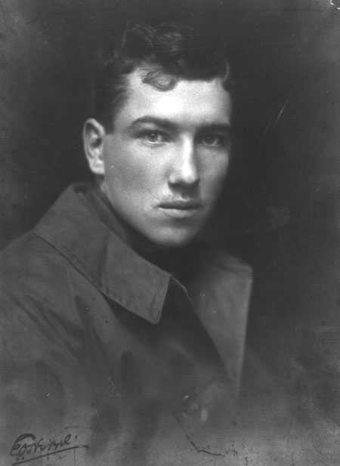
WAR AND IRONY
Robert Graves, Goodbye to All That (London: Penguin, 1960 [3rd Edition]).
Siegfried Sassoon, Selected Poems (London: Faber, 1979 [5th Edition]).
Edmund Blunden, The Undertones of War (London:Penguin,1982 [3rd Edition]).

Slide 19
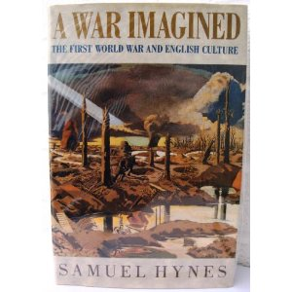
‘WAR MEMORY’ AND NEW MEANING
1918 – the ‘before’ and ‘after’ dichotomy (reflecting the contrast between a perceived pre-war idyll and wartime nastiness), and evident in Fussell’s modern understanding of the war – irony, highlighted in Samuel Hyne’s observations:
A breach ‘in the perceived continuity of history...was the war’s most striking legacy’ A War Imagined (Pimlico, 1990), p.78
Perceived discontinuity evolved through collective memory into myths about the war and what it was like

Slide 20
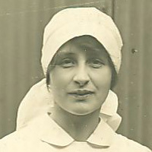
BRITTAIN
‘it seems to me that the war will make a big division of before and after in the history of the world, almost if not quite as big as the B.C. And A.D. division made by the birth of Christ’.
Vera Brittain, Testament of Youth: An Autobiographical Study of the Years 1900-1925 (London: Virago, 1978 [2nd Edition]).

Slide 21
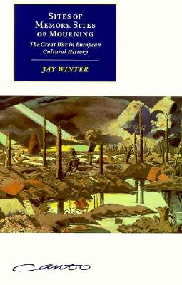
CRITIQUE
Traditional aspects of European culture proved resilient; hence communities after 1918 were able to reach back ‘into their traditional cultural heritage’ and make sense of the war
Jay Winter, Sites of Memory, Sites of Mourning: The Great War in European Cultural History (Cambridge: Cambridge University Press, 1995), p.9.

Slide 22
LOOKING FORWARD...LOOKING BACK!
‘Paul Fussell’s war generation faced forward to find its answers in modernism...Jay Winter’s turned back to seek neo-classical and romantic solutions from the past. Whereas Fussell emphasises catastrophe and discontinuity, Winter tends to highlight recovery and continuity’.
Peter Hoffenburg, ‘Landscape, Memory and the Australian War Experience, 1915-1918’, Journal of Contemporary History, (2001), Vol. 36, No. 1, pp. 111-31.

Slide 23
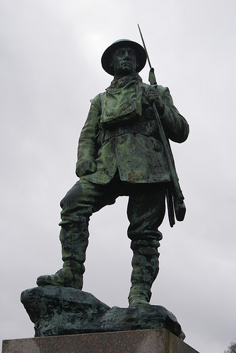
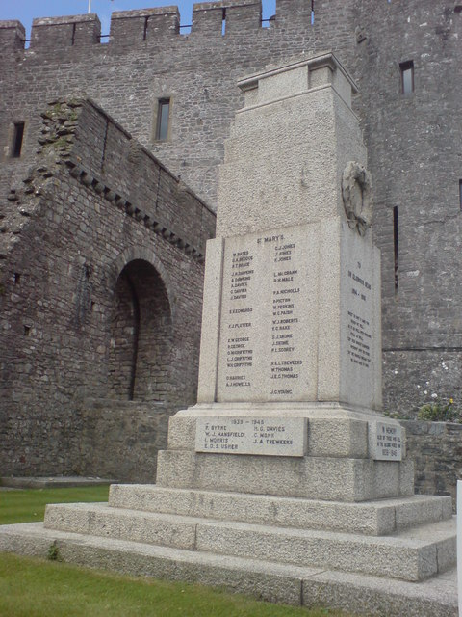
SITES OF MEMORY...

Slide 24
‘WAR MEMORY’ AND NEW MEANING
Respecting the dead – Pilgrimage, Battlefield Tourism and the search for meaning
‘Economy of sacrifice’ – those at home and those at the front
Memory of war was determined by ‘Existing predilections in the cultural, political, religious and communitarian, rather than the other way round’ – Adrian Gregory The Silence of Memory (Berg,1994), p.5. War memory is fluid in nature constantly shaped by political and economic events, as opposed to shaping events – reflecting Geoffrey Cubitt’s shifting environments (see above)

Slide 25
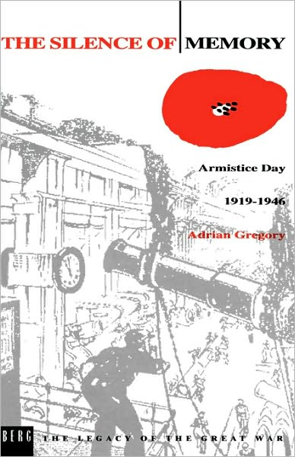
GREGORY

Slide 26
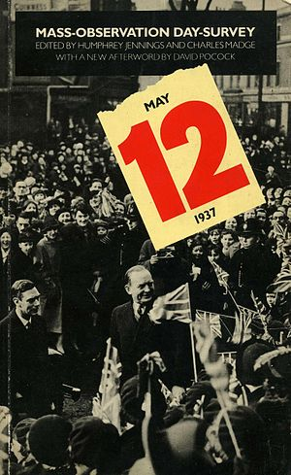
MASS OBSERVATION
Founded in 1937 by anthropologist Tom Harrison et al
Recorded everyday life in Britain through volunteer observers and open questionnaires – the views of the ‘man in the street’ - from saving habits to the Abdication!
Helped shaped social policy in Britain
The archive is housed at the University of Sussex; – re-launched in 1981 after decline in the 1960s

Slide 27
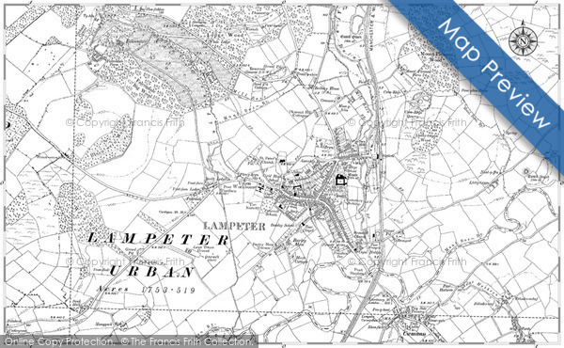
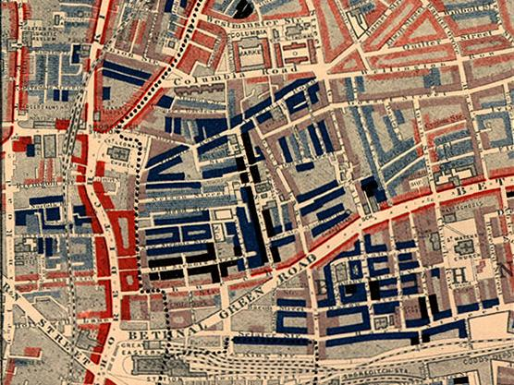
SOURCES - MAPS

Slide 28
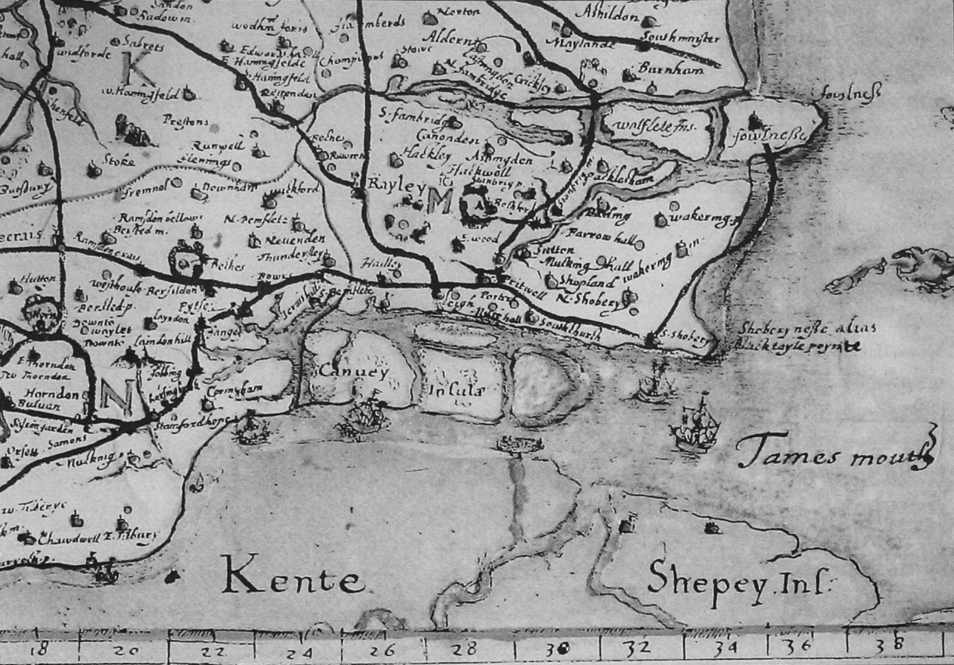
ESTATE MAPS

Slide 29
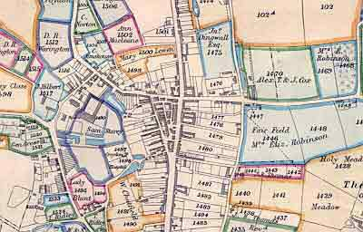
ENCLOSURE

Slide 30
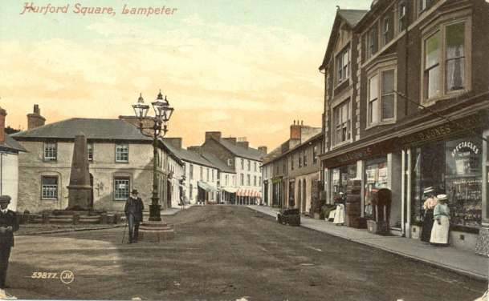
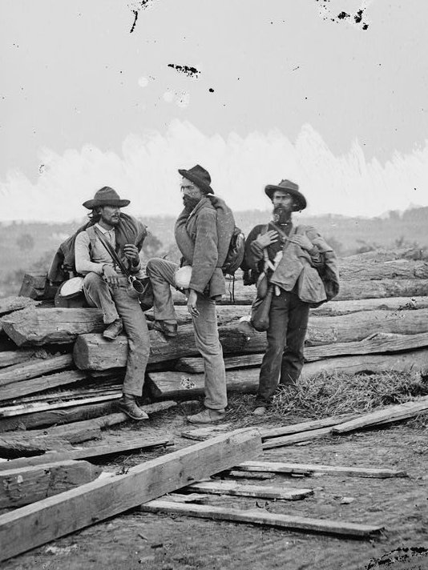
Sources - Photographs

Slide 31
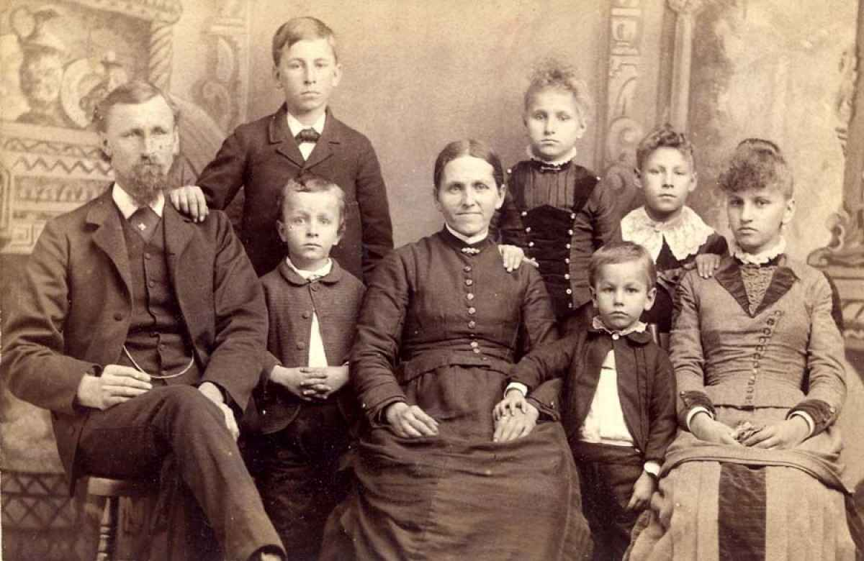
THE FAMILY

Slide 32
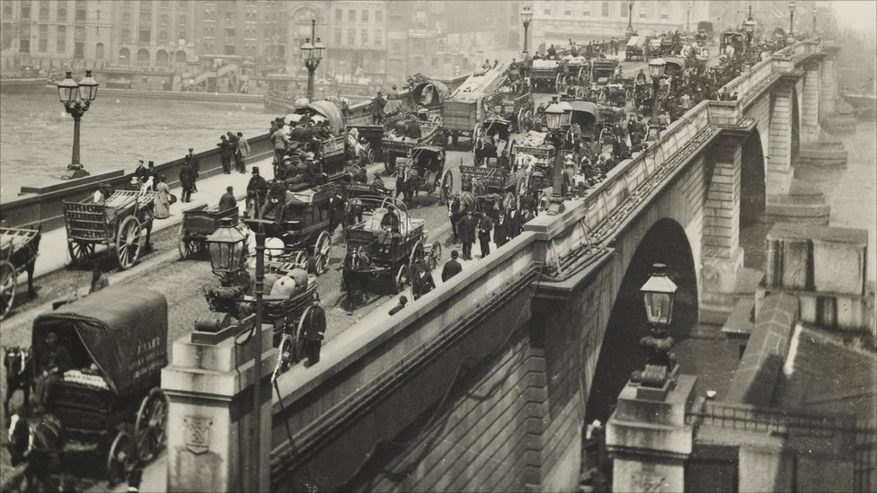
SCENES

Slide 33
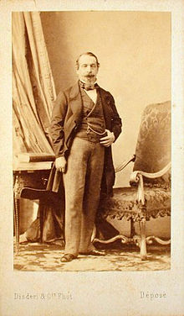
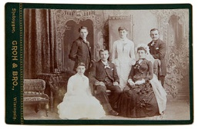
CARTE DE VISITE/CABINET CARDS

Slide 34
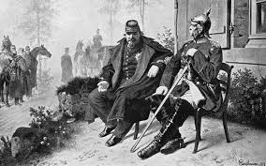
And on another day…

Slide 35
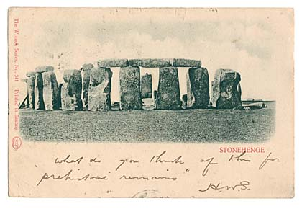
PICTURE POSTCARDS

Slide 36
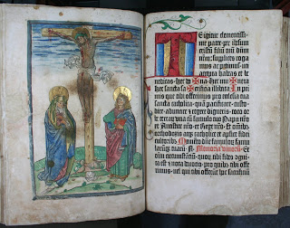
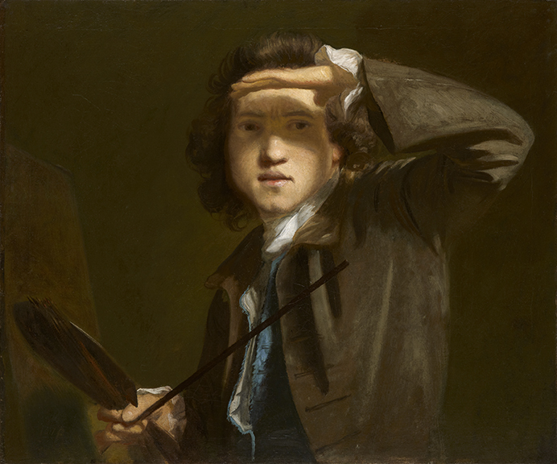
SOURCES - VISUAL

Slide 37
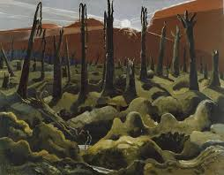
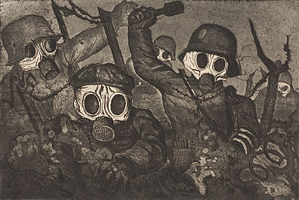
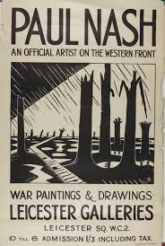
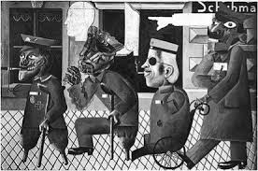
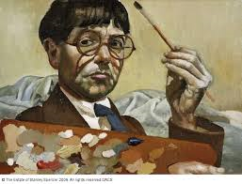
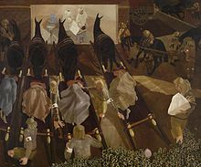
ART

Slide 38
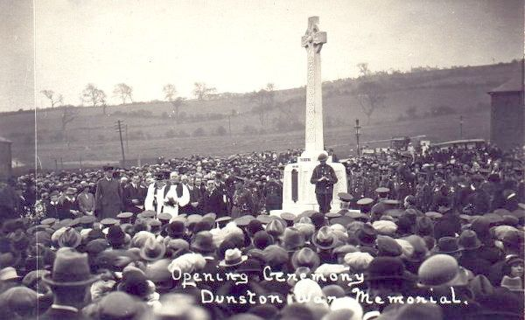
SOURCES - VISUAL

Slide 39
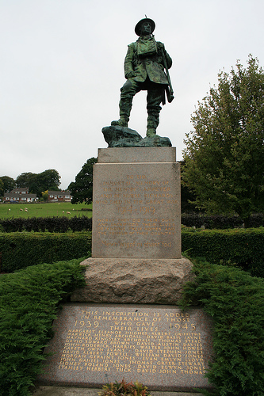
SOURCES - VISUAL

Slide 40
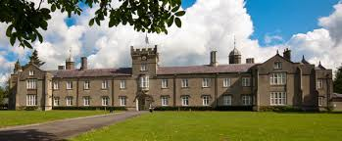
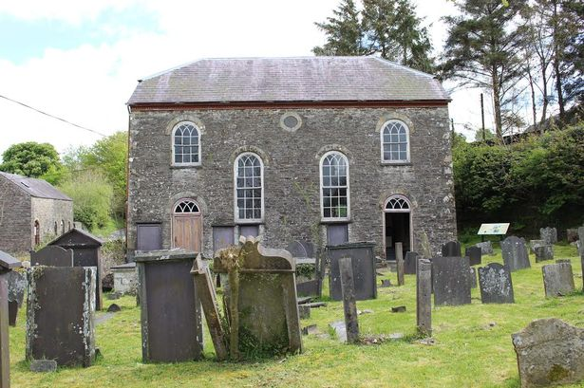
SOURCES - VISUAL

Slide 41
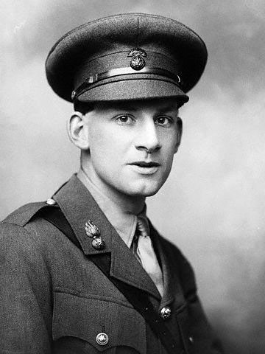

SOURCES - LITERATURE
SASSOON AND WILFRED OWEN (1893-1918)
MET AT CRAIGLOCKHART
FREQUENT MEETINGS
COLLABORATED ON SOME WORKS INCLUDING OWEN’S ANTHEM FOR DOOMED YOUTH
ALSO BY OWEN: DULCE ET DECORUM EST PRO PATRIA MORI; STRANGE MEETING

Slide 42
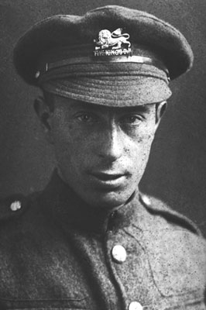
SOURCES - LITERATURE
ISAAC ROSENBERG 1890-1918
POETRY CLOSE TO DAILY REALITY
‘was to work up the horrifying experiences of war into stuff of immortal poetry’ GIDDINGS, P.52
MARCHING ; BREAK OF DAY IN THE TRENCHES; DEAD MAN’S DUMP.

Slide 43
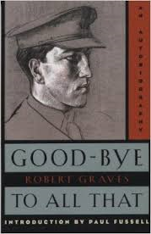
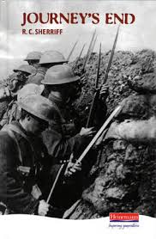
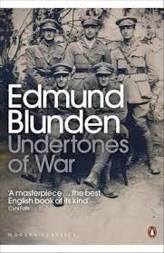





THE CLASSICS

Slide 44


SOURCES – LITERATURE

Slide 45



FILM AND DRAMA - ANGRY YOUNG MEN! AND WOMEN
A new realism - breakthroughs in Literature, Drama and Film
Alan Sillitoe (Angry Young Man) – Saturday Night Sunday Morning (1958); Loneliness of a Long Distance Runner (1959)
Shelagh Delaney A Taste of Honey (1958)

Slide 46



KITCHEN SINK!
JOHN OSBORNE - LOOK BACK IN ANGER (1956)
HAROLD PINTER - THE CARETAKER (1960); THE SERVANT (1963)
JOAN LITTLEWOOD’S – THEATRE WORKSHOP

Slide 47


IF!
Breakthrough in British film adaptations – Tony Richardson’s ‘Tom Jones’
Lindsay Anderson’s ‘If’ – ‘Which side will you be on?’

Slide 48


SOURCES - EPHEMERA

Slide 49

TYPES
1. PUBLIC RECORDS:
Records of law court proceedings
Records of births, marriages, and deaths
Statistics regarding population and the economic activity of a country

Slide 50

TYPES
2. OFFICIAL RECORDS:
Records of Local Government
  County Council/Borough Council/District Council records
  School Boards/Board of Guardians

Slide 51

TYPES
3. ECCLESIATICAL RECORDS:
Registers of baptisms, marriages and burials
Vestry minutes
Churchwardens' accounts,
Rate books
Parish tithe maps

Slide 52

TYPES
4. DEPOSITED RECORDS:
Individual Records – Diaries etc
Institutions or Companies
Groups and Societies
Solicitors records
Newspapers

Slide 53

THE CENSUS
Decennial Census first appeared in 1801
Aim?: Census/listing of men of fighting age – French/Napoleonic Wars
Malthusianism and links between population, poverty, famine and disease

Slide 54

THE CENSUS
1801 CENSUS LINK TO:
The Legislative:
Knowledge of Industrial might
Knowledge of potential military might/defensive capabilities
Establish population and sustenance needs
IMAGE FROM: LEEDS 1801 CENSUS

Slide 55

CENSUS - EVOLUTION
1801-31 - Statistical head count with enumerators notes (head of households noted)
1841 - List of all members of household or institution. Name, age, occupation, born in county of residence?
Image - 1841 Census (Buckingham Palace)

Slide 56

CENSUS – EVOLUTION
1851 Census expansion:
Relationship to head of household?
Marital status ?
Place of birth?
Language spoken?
Are you blind, deaf, dumb?
IMAGE: CENSUS 1851 FROM TWICKENHAM

Slide 57

RELIGION
Census 1851 (Sunday 30th March):
Survey of all places of worship – Anglican; Nonconformist; Roman Catholic; Jewish
Snapshot of attendance and hence religious belief
‘Hit and miss’ prone to optimistic returns
At TNA Kew – HO 129

Slide 58

CENSUS - EVOLUTION
1871 – Are you an imbecile, idiot, lunatic?
1881/1891 – Language spoken?
1891 – Employer? Employee ? Number of rooms occupied?
1911 – onus around the head of household

Slide 59

CENSUS EVOLUTION
1961 – Questions on Qualifications; on Migration; on household tenure?
1991 – Questions on Ethnic grouping?
2001 – Questions on civil partnerships?
100 YEAR RULE!

Slide 60

Births , Marriages, Deaths
1837 – Mandatory register of B,M,D, in England and Wales. Onus on registrars
1870 – still up to 10% of births not registered
1875 – compulsory registration more rigorous. Those present required to report

Slide 61

Births, Marriages, and Deaths
Where to find, try:
The National Archives:
http://www.nationalarchives.gov.uk/help-with-your-research/research-guides/birth-marriage-death-england-and-wales/

Slide 62

Births, Marriages, Deaths
Try:
http://www.archifdyceredigion.org.uk/catalogue.php

Slide 63

NEWSPAPERS
Try the National Library website:
http://newspapers.library.wales/
Also available from Ceredigion Archives are local newspapers:
The Cardigan and Tivyside Advertiser (1866-date)
and various issues of the Cambrian News (from 1871 -date, with gaps!)
and the Cardigan Bay Visitor (1890, 1905-1907).

