Slide 1
A selection of useful slides on Strategy
What is Strategy – some views
Mintzberg’s view of Strategy
Johnson and Scholes view of Strategy
Porter’s view of Competitive Strategy
Stakeholder Analysis (Mendelow’s Power and Interest Matrix) example
Bowman’s Strategic Clock example
SWOT and Porter’s Five Forces examples
Porter’s Five Forces example
Ansoff’s Matrix
Cultural Web

Slide 2
What is Strategy?
The Cambridge Dictionary defines corporate strategy as “the ideas and plans a company has for its future business activities or the process of deciding these ideas and plans” (dictionary.cambridge.org, 2019)
In the 1950s and 1960s Peter Drucker said that strategy was primarily concerned with competing on price (Ovans, A. 2015).
In 1979, Michael Porter developed the “Five Forces” model which takes into account not only pricing pressures, but pressures from threats of new entrants to the market, substitution, and the bargaining power of suppliers and consumers. Porter focusses on a traditional “Planned Strategy” approach.
Henry Mintzberg emphasises an “Emergent Strategy” approach.
Emergent strategy takes the view that strategy emerges over time as the environment changes and plans are adapted to meet the new reality. (Moore, K, 2011)
Notes:
The Cambridge Dictionary defines corporate strategy as “the ideas and plans a company has for its future business activities or the process of deciding these ideas and plans” (dictionary.cambridge.org, 2019)
In the 1950s and 1960s Peter Drucker said that strategy was primarily concerned with competing on price (Ovans, A. 2015).
In 1979, Michael Porter developed the “Five Forces” model which takes into account not only pricing pressures, but pressures from threats of new entrants to the market, substitution, and the bargaining power of suppliers and consumers. Porter focusses on a traditional “Planned Strategy” approach.
Henry Mintzberg has emphasised an "Emergent Strategy" approach.
Emergent strategy is the view that strategy develops or emerges over time as plans collide with and adapt to the emerging reality. Emergent strategy is that set of plans, not necessarily expressly intended in the original strategy, that has developed due to reality. It implies that an organisation learns what works in practice.
Emergent strategy is sometimes seen as more relevant in today's faster changing world. It gives more flexibility and faster response than rigid plans.

Slide 3
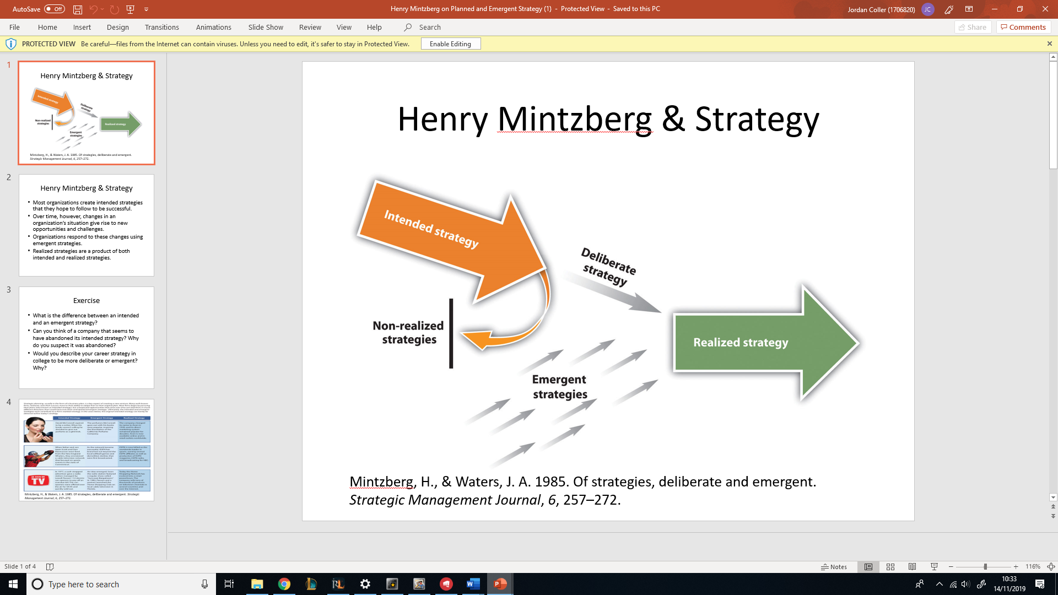
What is Strategy? - Mintzberg (1985)
Intended strategy
​
Emergent strategy
​
Realized strategy​

Slide 4
What is Strategy? - Johnson & Scholes
"Strategy is the direction and scope of an organisation over the long term, which achieves advantage in a changing environment through its configuration of resources and competences with the aim of fulfilling stakeholder expectations.” - Johnson & Scholes (2006)

Slide 5
What is Competitive Strategy? -Michael Porter
“What is driving the competition?”​
“What is the best response to competitors within the macroenvironment?”​
“How will the organisation evolve?”​
"Where will the organisation need to be positioned to compete long term?

Slide 6
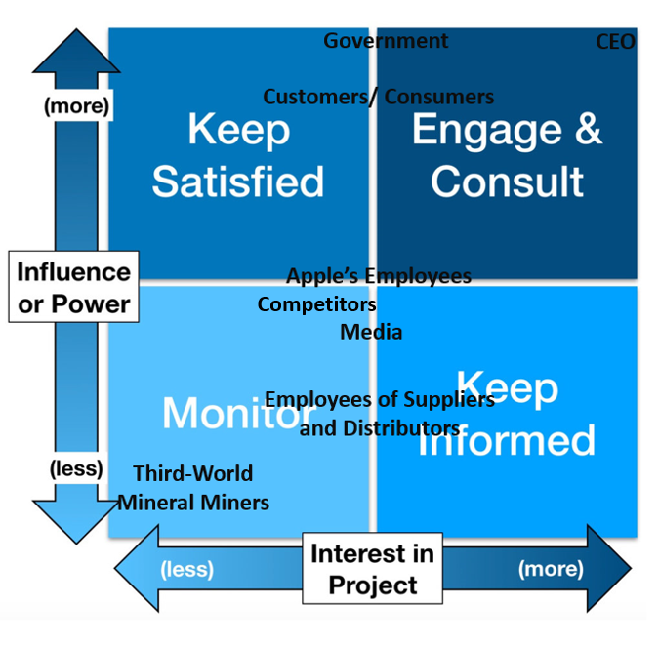
Stakeholder Analysis:
Mendelow’s (1981) Power/Interest Matrix
This allows businesses to identify
Stakeholder’s interests and influences towards a project
Which method and level of communication that is needed
How to increase stakeholder interests
However
It is a subjective viewpoint
Doesn’t identify whether interests are positive or negative

Slide 7

Bowman’s Strategic Clock
Bowman’s Strategic Clock is a management tool that was created by Cliff Bowman and David Faulkner which focuses on making companies aware of their market positions (Bowman & Faulkner, 1997).
This model highlights the characteristics on how a company can place its services and product offerings within the market based on these dimensions (Bhasin, 2019).
Differentiation
Hybrid
Focused Differentiation
Low Price
Risky High Margins
Low Price & Low Added Value
Monopoly Pricing
Loss of Market Share

Slide 8
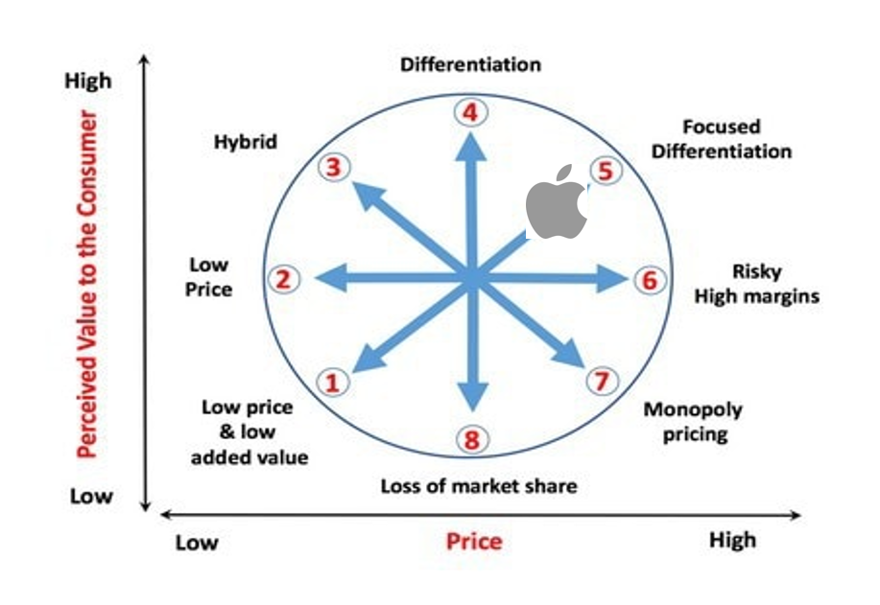
Another View of Bowman’s Strategic Clock
Identifies:
Where they are
Where they're going
Where they need to be
Subjective Perception
Between “Differentiation” & “Risky High Margins”

Slide 9
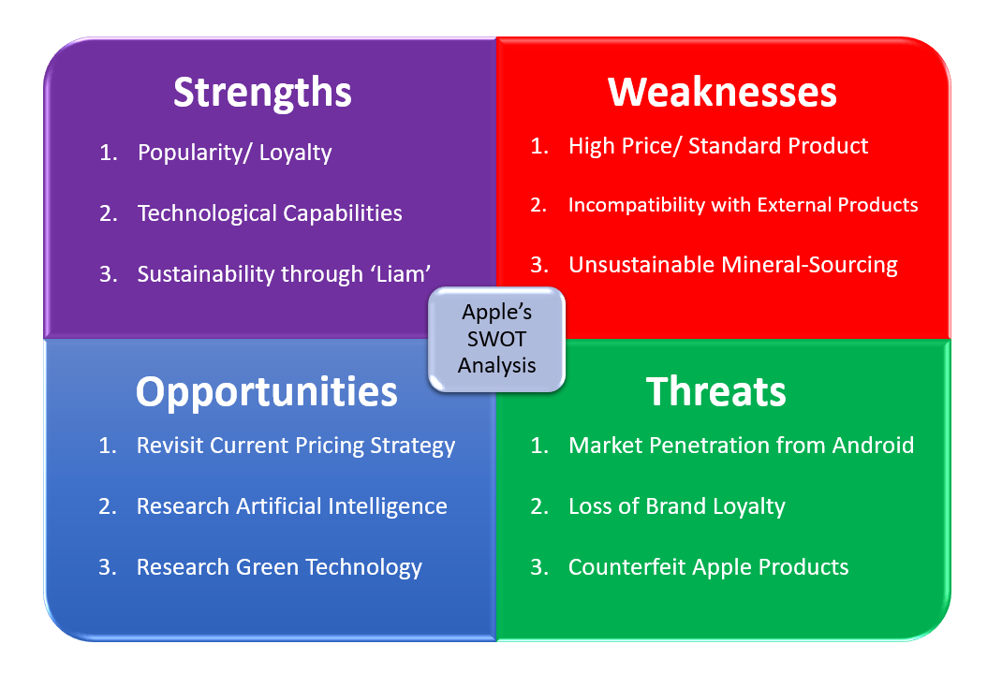
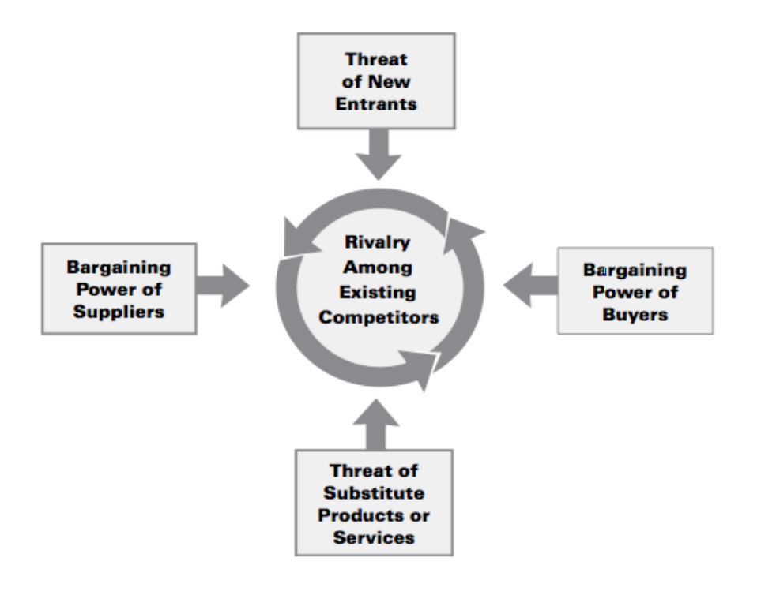
Example of SWOT & Porter’s 5 Forces
SWOT
Porter’s 5 Forces

Slide 10
Porter’s Five Forces
Threats of New Entrants
Porter’s Five Forces is a tool that was created by Michael Porter which is used to pinpoint and analyse 5 competitive forces that form and assists organisations with determining their strengths and weaknesses (Chappelow, 2019).
This model is often used to analyse an organisations structure to establish a corporate strategy (Porter, 2008).
Rivalry Among Competitors
Bargaining Power of Suppliers
Bargaining Power of Buyers
Threats of Substitution

Slide 11
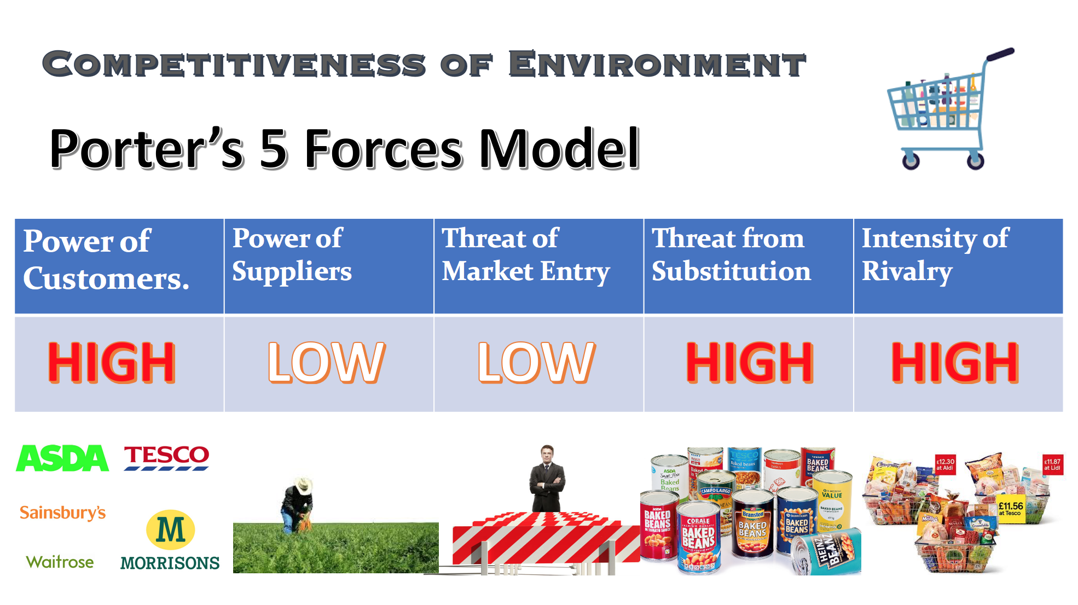

Slide 12
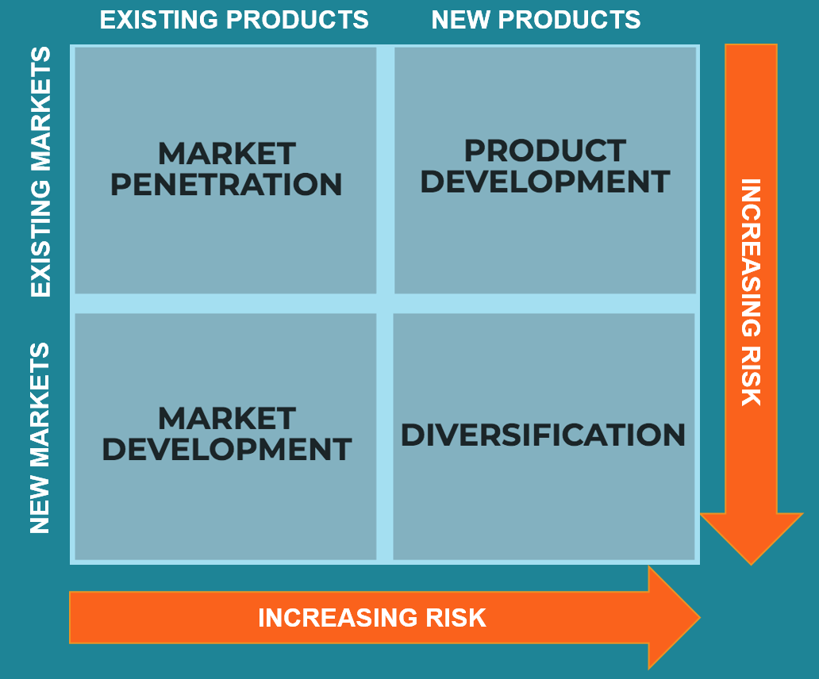
Ansoff’s Matrix
Igor Ansoff developed a matrix to help determine the direction of strategy.
He suggested that there were two ways to develop a growth strategy:
Vary what is sold (Product Growth) or
Vary who it is sold to (Market Growth)
(Oxford College of Marketing, 2016).
These elements can be mixed to develop strategies with varying degrees of risk.
Image: corporatefinanceinstitution.com, 2019)
Notes:
Igor Ansoff developed a matrix to help determine the direction of strategy.
He suggested that there were effectively only two approaches to develop a growth strategy:
Vary what is sold = Product Growth
Vary who it is sold to – Market Growth
Together, the matrix gives four strategic options, each with a differing level of risk.
The lowest risk is for a company to continue to sell existing products to existing markets. But this will only deliver growth if the market is still growing.
The second level of risk is to develop new products for existing markets. The risk is higher, because not every new product succeeds.
The third level of risk involves taking existing products to new markets. The higher risk here comes as the company would not necessarily understand the complexities of the new market.
Th final strategic level in Ansoff's Matrix is Diversification – This involves developing new products and selling them in new markets. The risk can be lessened if the diversification is related in some way to the company involved, such as a maker of pleasure boats venturing into the military market, they already understand how to build boats, but need to educate themselves on the new market and product..

Slide 13
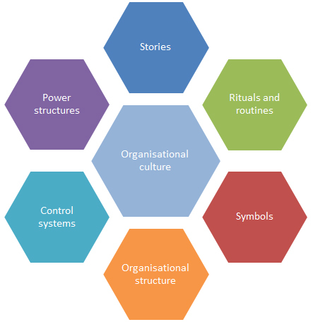
Cultural web
“Culture eats strategy for breakfast” Peter Drucker
Notes:
According to Indeed website employees Reviews TUI have 3.8 score and overall result is satisfied. However, there are comments regarding their organisational culture and room for improvement. As Johnson and Scholes cultural web support organisational culture refers to the relations between each other and their organisations. Also, it highlights what is good and what need to be improved in order to achieve TUI’s strategic goals and objectives( Indeed, 2019; Sun, 2008; Drucker 1998).

