Slide 1

Managing People (LCBB5004_BIRM)
-Component 1-
Student:Alexandru Csaba Eros(2008584)

Slide 2
Contents
Slide 3: Introduction
Slide 4: The role of an HR professional
Slide 6: Values governing the duties of the human resources
Slide 9: The types of relationships that can develop between the employer and employee
Slide 10: Factors that can influence a positive relationship between the employees and the employers
Slide 11: Conclusion

Slide 3

Introduction
The human resources regulate the employees of the organisation
Presentation of the role of human resource professionals
Evaluation of the values governing the human resources
Evaluation of the different relationships between the employees and employers

Slide 4

The role of an HR professional
Effective management of the talents
Ensuring health and safety to the associated workforce
Taking care of the factors of compliance for ensuring productivity
Training and development of the employees.

Slide 5


Performance Management
Administration of the payroll during and after services
Effective management of the relationships of the employees

Slide 6
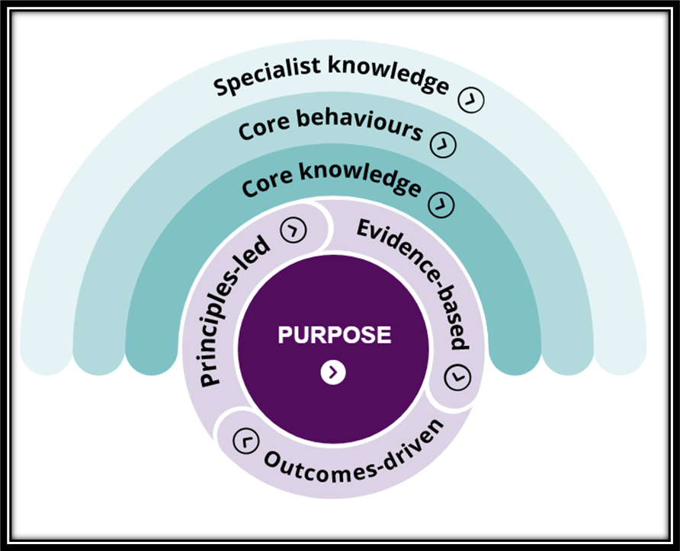
Values governing the duties of the human resources
Creation of a diverse working place
Improvisation of the structure of work
The healthy working environment for the benefit of the employees and the companies

Slide 7

Role of showing empathy to the employees and being governed by the 2nd band of the new CIPD model
Care and well being of the employees
Incorporating of cultural Changes
Management of organisational Behaviours and being governed by the 1st band of the new CIPD model

Slide 8

Management of the employees
Fostering creativity and innovation
Categorising in the 3rd band of the new CIPD model

Slide 9


The types of relationships that can develop between the employer and employee
Targeted Relationship
Transactional Relationship
Trusted Relationship

Slide 10
Factors that can influence a positive relationship between the employees and the employers
Wages and on-time salary
Effective communication and engagement
Assurance of health and safety

Slide 11

Conclusion
Human resources are responsible for managing the workforce.
Three different types of relationships play an important role in the organisational structure.
Effective communication can assist in motivating the employees for better relationships.

Slide 12
References
Beyens, I., Piotrowski, J.T. and Valkenburg, P.M. 2018. Which Came First? Assessing Transactional Relationships Between Children’s Violent Media Use and ADHD-Related Behaviors. Communication Research, p.009365021878230.
CIPD 2018. New Profession Map | CIPD Profession Map. [online] CIPD People Profession. Available at: https://peopleprofession.cipd.org/profession-map#gref [Accessed 23 Feb. 2022].
Easa, N.F. and Orra, H.E. 2020. HRM practices and innovation: an empirical systematic review. International Journal of Disruptive Innovation in Government, ahead-of-print(ahead-of-print).

Slide 13


