Slide 1


Community Sports Development
M5X02089

Slide 2
Community Sports Development
The aims of todays lecture:
To understand more into defining sports development
The birth of the Sports Council
Early Sporting Strategy / Sport For All
Explore Grant funding

Slide 3

Community Sports Development
Defining Sports Development:
What do we know?

Slide 4
Community Sports Development
Defining Sports Development:
Fischer (2003: 51) argues that 'To accurately explain social phenomena, the investigator must first of all attempt to understand the meaning of the social phenomenon from the actor's perspective ... the actor's own motives and values'. (What does that mean?)
There are a number of possible starting points for definition. One might take the statements of policy-makers as a logical starting point for specifying the objectives and activities that constitute the core aspects of sports development given that in many countries 'sport development', however we might eventually define it, is usually publicly funded

Slide 5
Community Sports Development
Defining Sports Development:
An alternative starting point is to examine the activities of those who self-define their work as 'sport development'. Many of these practitioners are employed by public sector organisations or by national sports organisations although a significant number are employed by non-sport organisations that use sport to attract young people so that personal or community development objectives can be addressed.
Taking practitioners as the starting point soon highlights the difficulties of this approach as a series of boundary problems rapidly emerge. There are many examples of practitioners who seek to achieve non-sports objectives through attracting people, young people in particular, into sport. The youth worker who uses sport to engage young people so that she can undertake personal development activity; the member of a religious body who uses sport as the basis for missionary work; and the political activist who uses sport as a way of attracting and retaining members.

Slide 6
Community Sports Development
Defining Sports Development:
One, perhaps wishfully simple, view of sport development is that it is about 'getting more people to play more sport'. However, this definition over-emphasises the role of sport in 'sport development' and underplays the instrumental attitude of most governments to sport (i.e. the non-sport objectives that sport is thought to be able to achieve).
Collins (1995: 21) expands on this definition and suggests that sport development is 'a process whereby effective opportunities, processes, systems and structures are set up to enable and encourage people in all or particular groups and areas to take part in sport and recreation or to improve their performance to whatever level they desire'

Slide 7
Community Sports Development
Defining Sports Development:
Since the 1990s a new dimension to the definition of sport development has emerged and is normative and moralistic - it is less 'sport for sports sake' and more 'sport for good'. Hylton and Bramham (2008: 2) argue that 'sport development is more accurately a term used to describe policies, processes and practices that form an integral feature of the work involved in providing sporting opportunities and positive sporting experiences‘
2006 by the then Minister for Sport, Richard Caborn who argued that 'if we are to prove that the [sport] sector can address government's agendas across the UK, and ... what it can do for others, be it tackling the obesity crisis in health, greater social inclusion in our communities and of course producing world class talent for our 2012 athletes and beyond - then it needs to be fit for purpose'

Slide 8
Community Sports Development
Defining Sports Development:
The ambiguity, uncertainty and tensions surrounding sport development policy and practice are, in part, a consequence of the adaptability of sport and its capacity to attract young people, but also a consequence of its attraction to government as a relatively low cost, high visibility and malleable response to a wide range of social policy issues.

Slide 9
Community Sports Development
Wolfenden Report what we learnt:
What were the recommendations?

Slide 10
Community Sports Development
The Birth Of the sports council:
Formed in 1972- Motto- ‘Sport For All’
Sports councils set up in- England, Wales, Scotland, Ireland
Sport For All – Review Document of a first sporting strategy from a Sports Council
Available on moodle. Can read for an understanding of sports development in the 1970’s. It lead to the creation of indoor leisure facilities many of which still exist today.

Slide 11
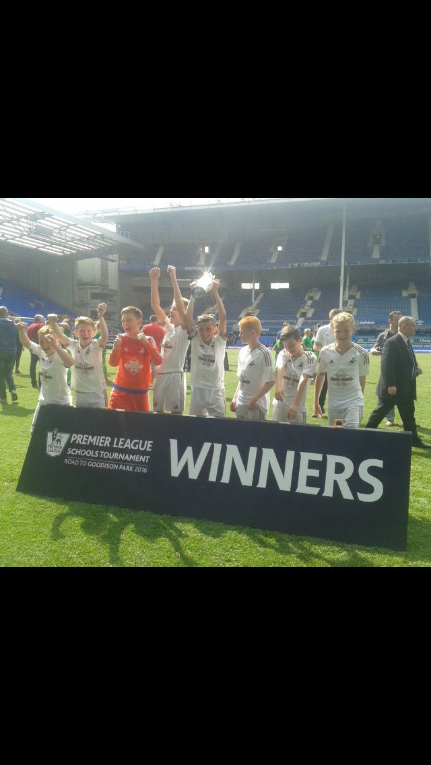
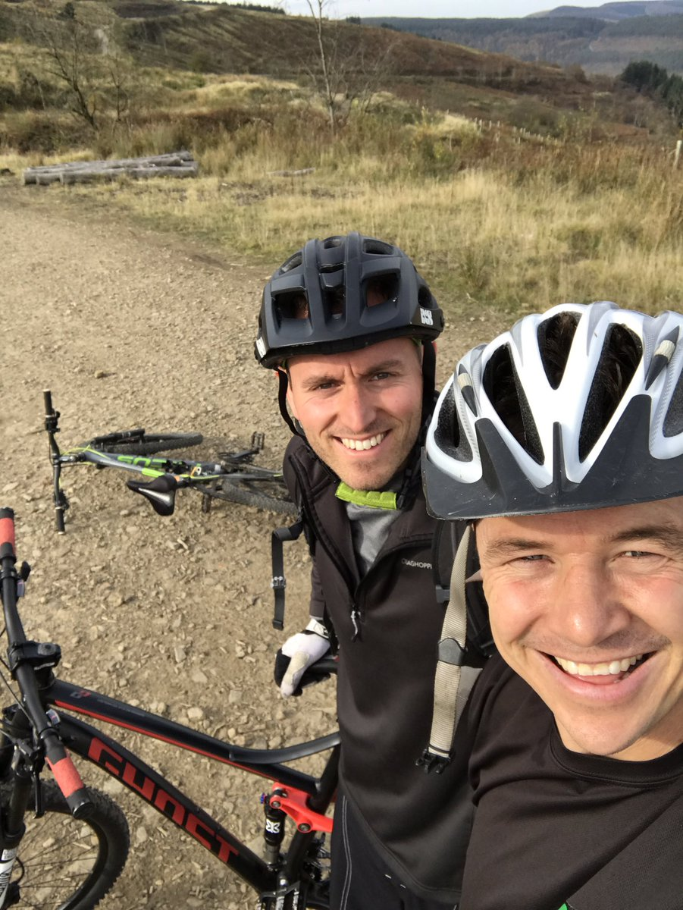
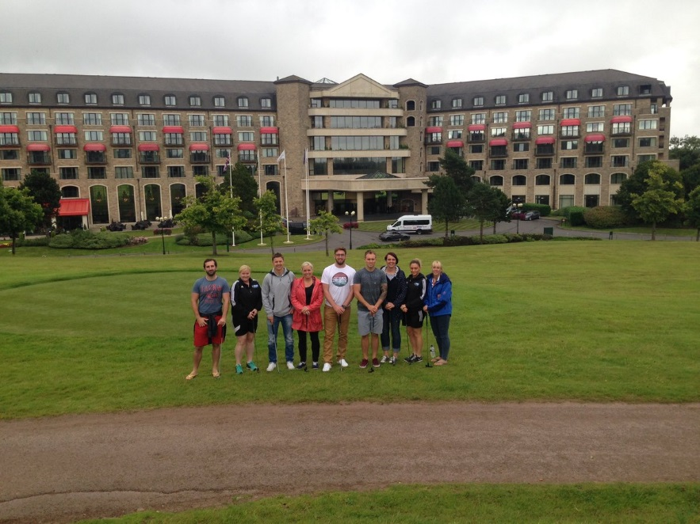
Community Sports Development
WHY ARE WE INVOLVED IN SPORTS DEVELOPMENT??
https://www.youtube.com/watch?v=iC76The-FMU

Slide 12
Grant Funding
Important as money, resources and staffing are needed to create new opportunities.
Thinking outside the box can create new funds to expand the offer or improve it.
There are certain activities that need very little money to start.
2 models to running sessions- volunteer or small enterprise

Slide 13
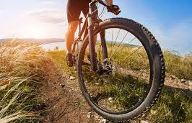
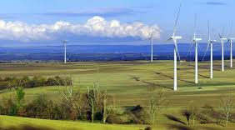
Recent funding

Slide 14
Community Sports Development
Grant Funding available to sports clubs in this area- Competition-
What grant is available from Sport Wales for the development of small community teams? How much is available? What are the two main grants?
Be Active Wales Protect- £300-£5000
Be Active Wales Progress- £300-£50000

Slide 15
Community Sports Development
Sport England Return to Play Small Grants Scheme- How much will it fund? Who can apply?
Small Grants Scheme £300-£10000
Activity Clubs, groups and organisations

Slide 16
Community Sports Development
Joanna Brown Trust Grant –
How much on offer and to who?
£100-£1000 to help young athletes excel in their sports

Slide 17
Community Sports Development
Task:
You have been asked to set up a sports session in town hill to help reduce anti social behaviour. Research what grant funding you may be able to access in this particular area. Explain what you will use this funding for. Cant be one of the ones we have mentioned.
Explain what grant you have chosen, why, who will be involved in the application and what will you use it for?
Verbal feedback to the group via written paper / summary

Slide 18
Community Sports Development
Next week- Planning in Sports Development this will help you when presenting for your assignment

Slide 19
Community Sports Development
Dates:
Week 5- 25th February- The Planning process / presenting
Week 6- 4th March- Presentation
Week 7- 11th March– No lecture - industry week / hand in date
3 weeks of lectures then - Easter
1 lecture when we return from Easter as a support session
Next assignment 13/5

Slide 20
Assignment
TASKS
Task A (35% weighting, 10 minute presentation). 10 slides maximum (500 words equivalent)
Students are required to work as an individual to produce a presentation that will be presented to peers and potential funding organizations and partners. Use audio and visual aids to support your presentation. Students must be persuasive and respond to questions from the audience.
Your task:
You have been asked to develop a new sustainable activity session to engage 7-11 year olds in physical activity / sport at the Ysgol Bae Baglan school facility. Highlight- your research, ideas for engaging this group, how you will develop the session, potential partners / funding and key recommendations.

Slide 21
Assignment
Task B (65% weighting, approximately 1000 words).
Students are required to complete a SWOT analysis on the Physical Activity and Sport Service Neath Port Talbot. Analyse its offer as a sports development team and carry out research in order to identify opportunities for future development whilst considering potential threats to the organisation.

