Slide 1
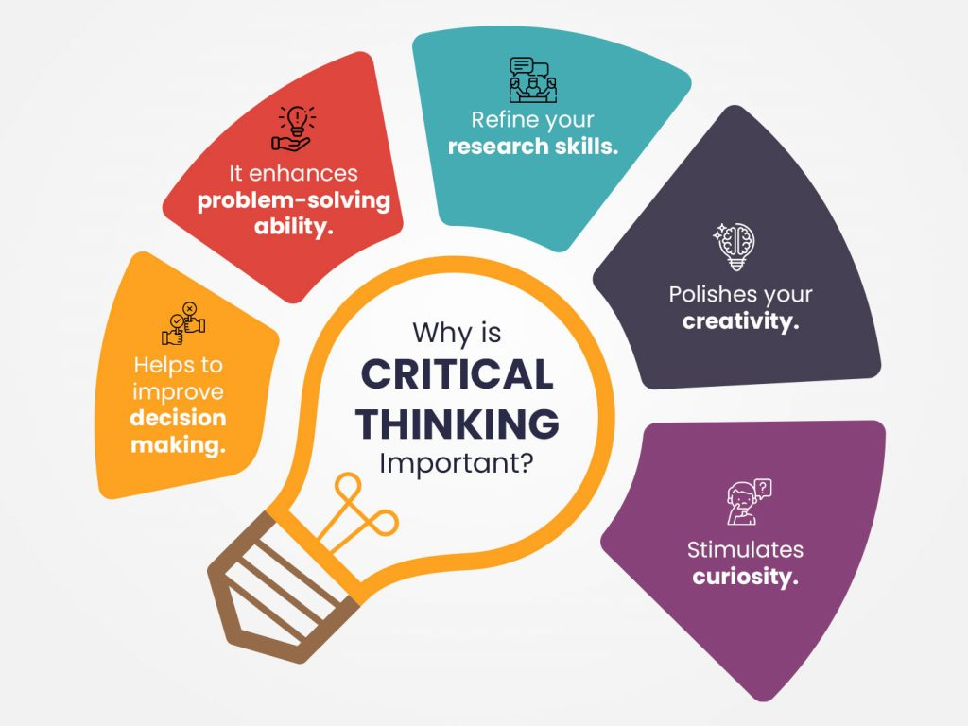
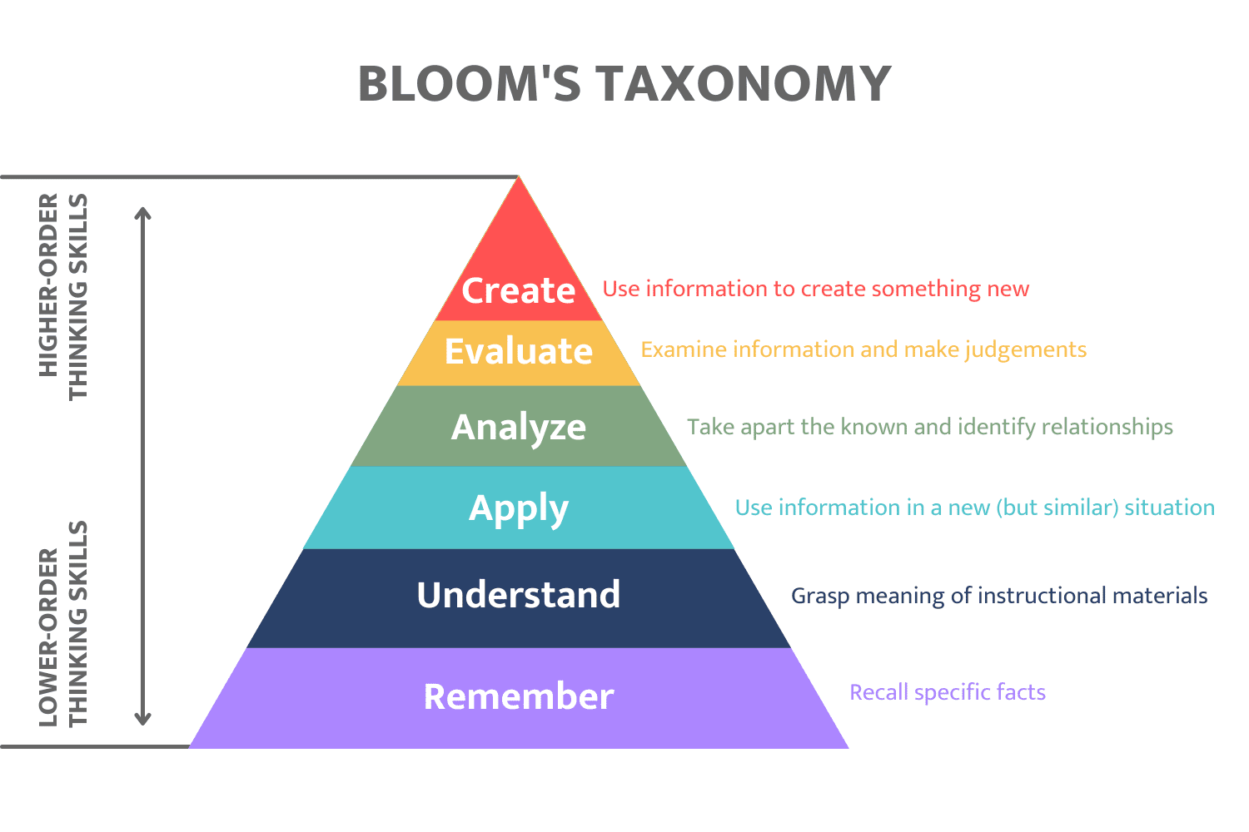
Introduction:
According to Cottrell (2011) critical thinking is a behavioural activity in which it is correlates with the mind. Critical thinking is defined as learning to analyse, evaluate and form a judgement. In addition to a lack of talent, many people who have the capacity to improve their critical thinking skills may be stopped from doing so for a variety of reasons, thus creating barriers. It assists in making wiser and more knowledgeable selections regarding what is most likely to be accurate, efficient, or beneficial. Critical thinking enables the learner to identify significance of question, and interpret data/evidence to answer (Cottrell 2011). This enables the learner to develop their own justified argument. (Cottrell 2011)
What skills/qualities could support critical thinking?
Time Management:
Time management is the awareness and effort to prioritise and organise time for important tasks, with the goal to enhance productivity, effectiveness of assigned tasks. Managing time may become a struggle for some, it only takes finding how to manage the time and using the time wisely (Cottrell 2013). Being able to manage time when dealing with day to day tasks is a need and will help with future tasks (Cottrell 2013). It is important to use time efficiently and effectively (Cottrell 2013). Time management supports critical thinking skills by allowing students to prioritise and understand the different techniques that are used to manage their time, which will enable students to put a stop a procrastination (Woldegiorgis, E. and Jonck, P. 2022). According to Information Resources Management Association (2020), student evaluation is an important aspect in critical thinking. When carrying out a student evaluation, it is important that students use their time wisely and analyse the important aspects of that lesson using their critical thinking skills. Time management skills are used daily. Using self-evaluation, learners can interact whilst also developing their critical thinking and time management skills. Inscape (2022) asserts that proper time management is crucial to the building the skills necessary to succeed academically because these skills are valuable and so is time dedicated to enhancing the skills.
Research:
Research is an important element of critical thinking as it enables the ability to identity credible sources. (Cottrell, S. 2013) It further enables creating new arguments and ideas. During research, it is important to only use credible sources, such as websites, publications and more to triangulate and argument. To use academic research skills at a certain level, using 'informed opinion' means to browse, discuss, analyse and to critically reflect. When researching, it is important to use critical thinking skills by displaying a deeper interpretation of the information gathered and using more accurate and detailed information. Cottrell, S. (2013)
In relation to University of Louisville (2021) the goal of academic research is to develop innovative viewpoints, theories and beliefs. Research methods involve more than gathering knowledge that has already been discovered. Furthermore, it entails asking the right questions whilst formulating a solution after careful consideration and meaningful deliberation using critical thinking skills.
Note Taking:
Note taking is an important skill to develop in order to capture important and relevant information. (Mehta, K. and Pitchers, R. 2018). It assists in critically disseminating and enables deeper engagement of discussion. (Mehta, K. and Pitchers, R. 2018). The importance of taking effective notes is to assist in memory retention and long term information retention. Learning how to employ these talents will help in the development of useful learning techniques and a deeper comprehension of a subject. (Mehta, K. and Pitchers, R. 2018). According to Western Sydney University (2017), using a note taking system assists students to organise their research so they can compare what various sources have to say about a given subject. Organising ideas when taking notes will help to think and write critically.
Note taking assists in collating information on topics and subtopics, to collate and contrast varying sources, and to consider others perspectives. When note taking, it involves asking questions, assessing data, reading a variation of opinions, paraphrasing others words, and developing an opinion about many topics. (Western Sydney University. 2017)
Thadomal Shahami Centre for Management (2022)
Conclusion:
In conclusion, critical thinking is an important skill to develop in order to analyse, interpret, infer, provide explanation, and enable problem solving. It is a key skill for University and is important to demonstrate in academic studies. It is important when engaging in critical thinking to identify both positive and negative arguments prior to reaching a judgement. These skills will enable students to further progress in their studies.
Market Games Inc (2021)

Slide 2
References
Alexander, B. (2022) Why take notes? Note-taking Stimulates Critical Thinking Skills. Available at: Why take notes? Note-taking stimulates critical thinking skills. - ppt video online download (slideplayer.com). (Accessed: 27th October 2022)
Cottrell, S. (2011) Critical Thinking Skills: developing effective analysis and argument. (2nd ed). Palgrave Macmillan
Cottrell, S. (2013) The Study Skills Handbook. (4th ed). Hampshire: Palgrave Macmillan
Elsevier. (2022) Triangulation. Available at: Triangulation - an overview | ScienceDirect Topics. (Accessed:25th October 2022)
Information Resources Management Association. (2020) Research Anthology on Developing Critical Thinking Skills in Students. IGI Global
Inscape Consulting Group. (2022) Why Time Management Is Critical to Your Professional Success. Available at: Why Time Management Is Critical to Your Professional Success - Inscape Consulting Group. (Accessed:22nd of August 2022)
IsEssay. (2022) Importance of Academic Writing. Available at: Importance of Academic Writing | IsEssay. (Accessed:25th October 2022)
Kallet, M. and Kallet, M (2014) Think Smarter: Critical Thinking to Improve Problem Solving and Decision-Making Skills. Wiley
Market Games Inc. (May 31st, 2021) The importance of Building Critical Thinking Skills. [On-line] Available at: The Importance of Building Critical Thinking Skills • Market Games (Accessed: 22nd October, 2022)
Mehta, K. and Pitchers, R. (2018) 'The Significance of effective note taking'. 7th June. Available at: The significance of effective note taking - London School of Science & Technology (lsst.ac). (Accessed:22nd October 2022).
Thadomal Shahani Centre for Management. (October 20th, 2022) The benefits of Critical Thinking and How to develop it. [On-line] Available at: The benefits of critical thinking for students and how to develop it (tscfm.org) (Accessed: 22nd October 2022)
University of Louisville. (2021) Critical Thinking and Academic Research: Intro. Available at: Intro - Critical Thinking and Academic Research - UofL Libraries at University of Louisville. (Accessed: 22nd October, 2022)
University of Manchester. (no date) Research and Critical thinking. Available at: Research and Critical Thinking (The University of Manchester). (Accessed: 27th October 2022)
Western Sydney University. (2017) Note making for Critical Thinking. Available at: Note-making for critical thinking (westernsydney.edu.au). (Accessed: 22nd October 2022)
Woldegiorgis, E. and Jonck, P. (2022) Higher Education in the Face of a Global Pandemic. Brill

