Slide 1
Development of a project or programme of work

Slide 2
Assessment Component 1 – 60%
Coursework: A Professional Journal (4500 words). The Journal will include the following:
An original risk assessment of the work setting,
An evaluation of the work placement
Ten reflective journals
A community profile
The analysis of a significant project or programme of work developed by the student.
A summary of your own learning and development, linked to your professional
development plan and underpinned with reference to examples from your practice and appropriate literature such as National Occupational Standards for Youth Work.

Slide 3
Please provide an individual update about your project or programme of work.
Take a few moments to note down your project or programme experience.
Feedback to the group.

Slide 4
Definition of Planning
Table indicating times, places of intended proceeding, scheme of arrangement
A formulated and organised method by which a thing is to be done
A project, design, way of proceeding
Make a plan of, scheme, arrange beforehand, conduct in accordance with plan
Wales Youth Agency, (2003 p41) Youth Work and Schools Partnership Toolkit

Slide 5
Why do we need to plan?
To prepare our work effectively
To formalise the way we think
To record the work we do
To ensure we meet our targets
To compile evidence of our youth work
To reflect, monitor and evaluate
To collect information for reports

Slide 6
Whose needs do we need to consider
Young people
Staff
Community
Authority
Governments

Slide 7
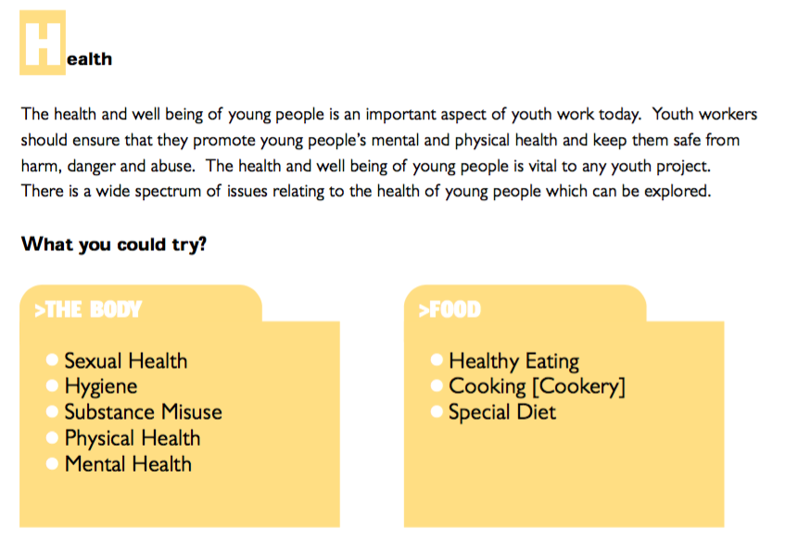
Organising and Planning Activities
The Youth Work Curriculum Statement for Wales Working Toolkit (2005)
Key activity areas

Slide 8
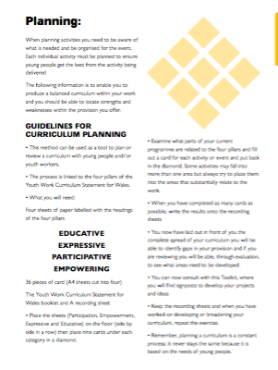

Slide 9
What other methods of planning are you aware of?

Slide 10
Planning Process NAOMIE
Identification of Need
Set Aims
Set Objectives
Establish Methods
Implement
Evaluate
Ingram and Harris (2001)

