Slide 1

Sacred Geography: Rhyzome Theory
Nick Campion

Slide 2
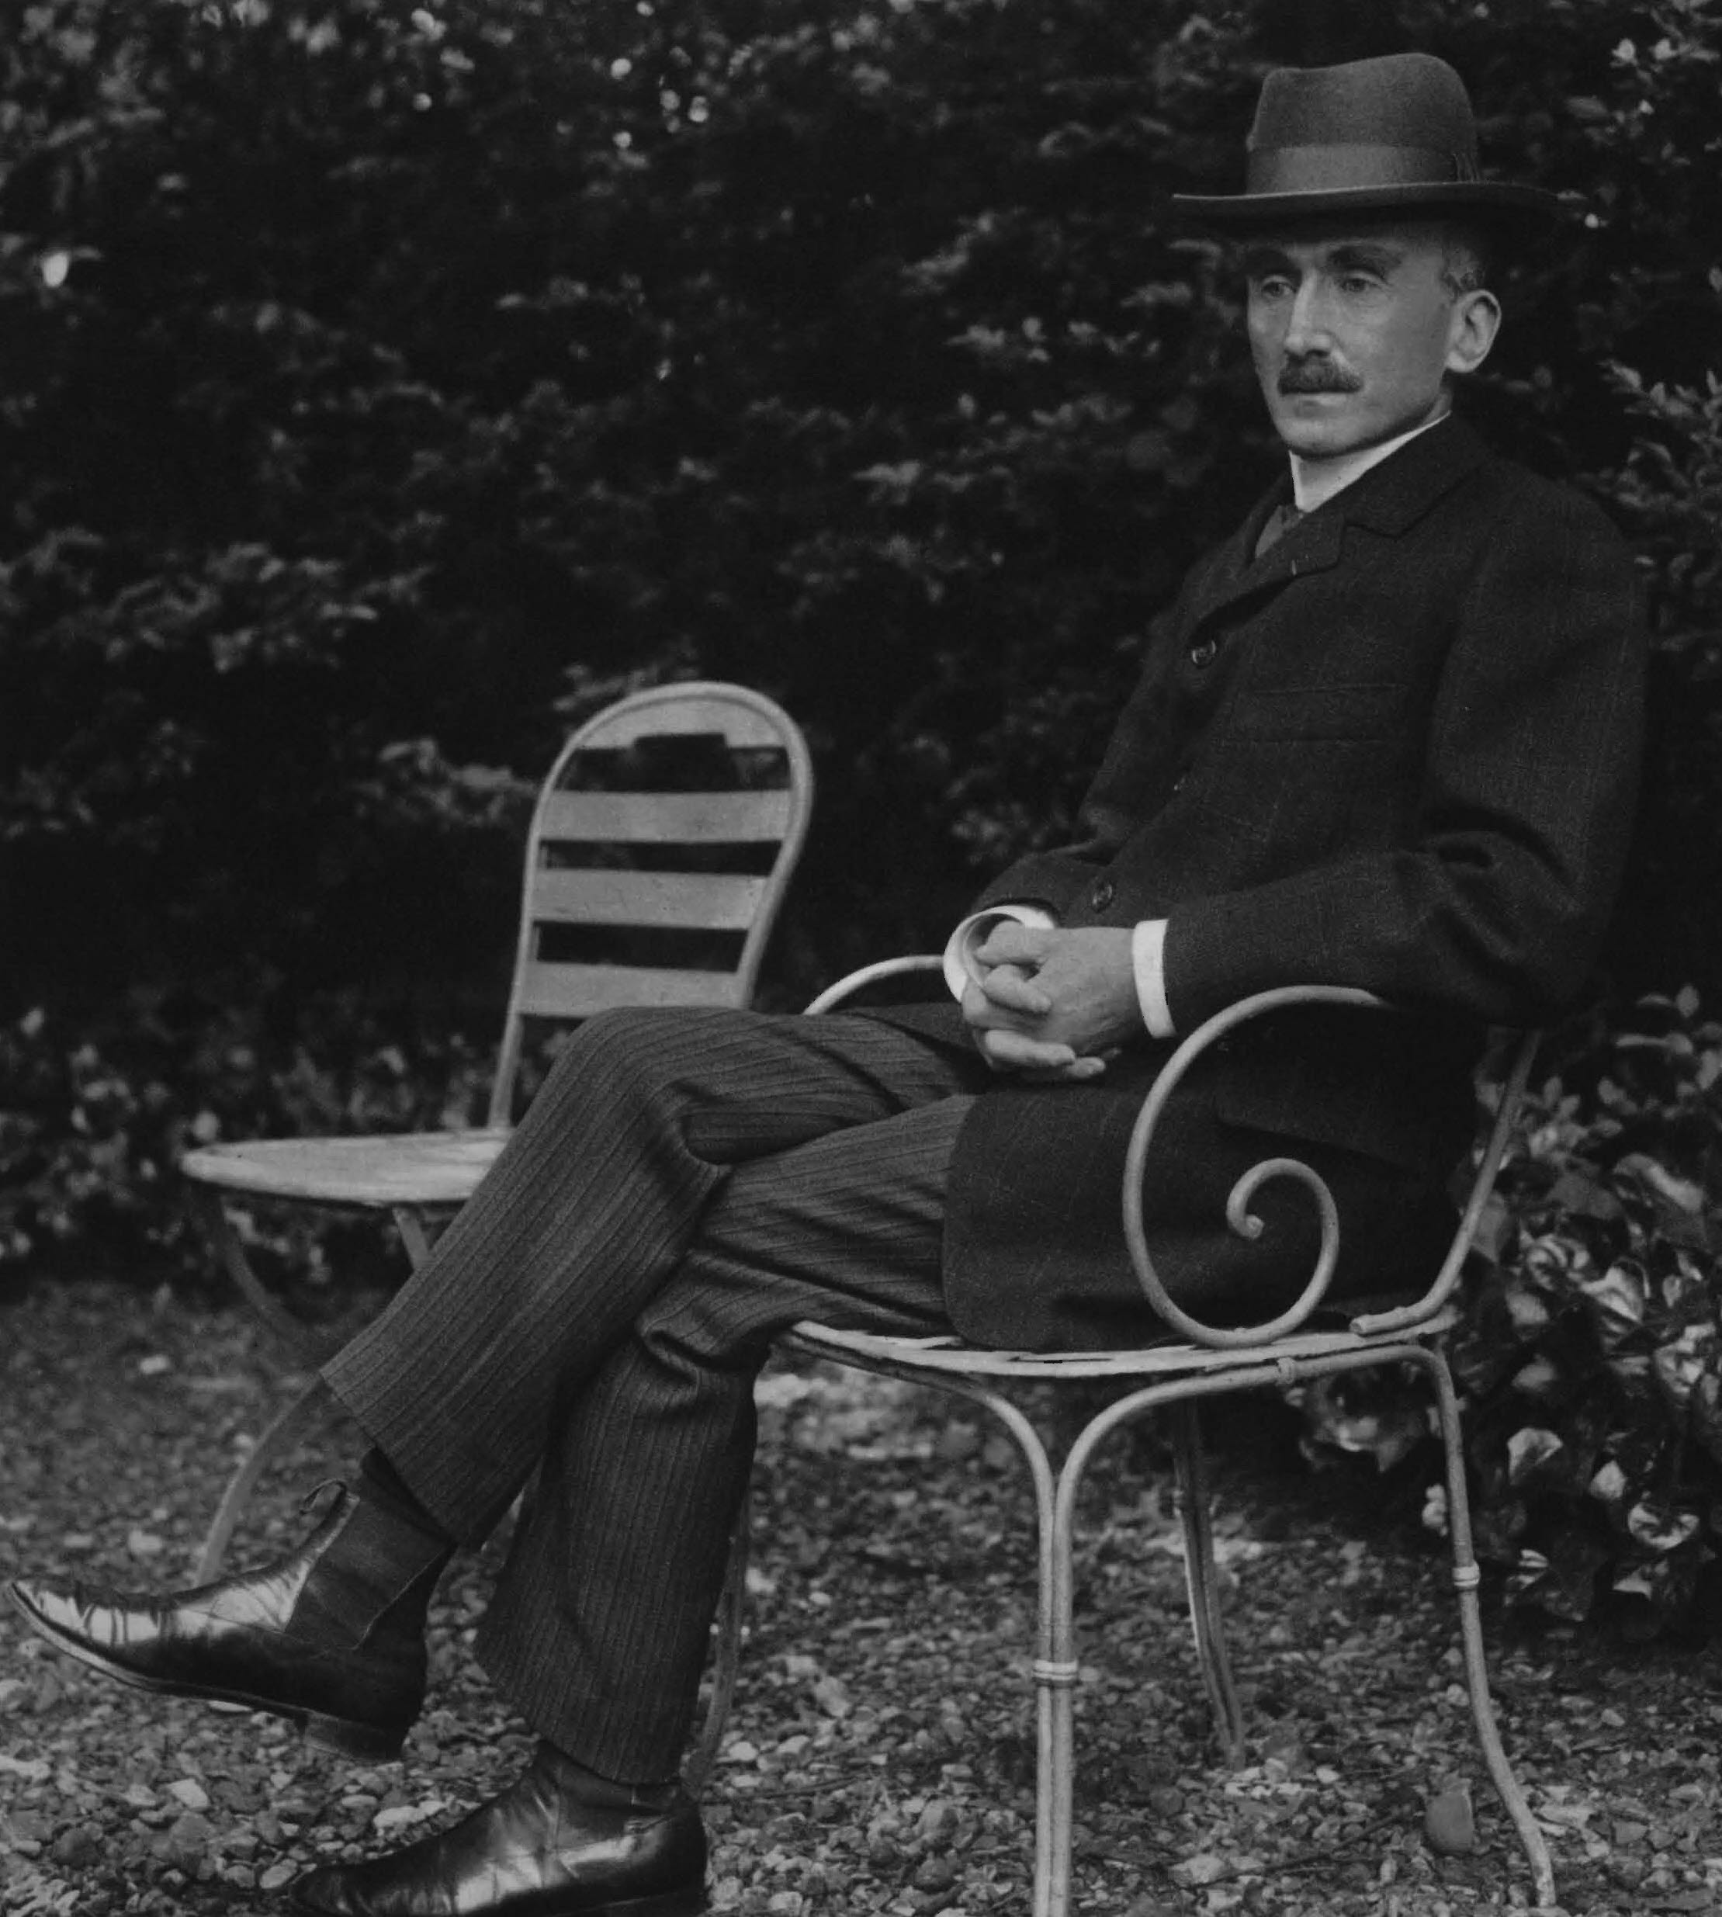
Henri Bergson(1859–1941) from the Stanford Encyclopaedia
Importance:
‘While such French thinkers as Merleau-Ponty, Sartre, and Lévinas explicitly acknowledged his influence on their thought, it is generally agreed that it was Gilles Deleuze’s 1966 Bergsonism that marked the reawakening of interest in Bergson’s work. Deleuze realized that Bergson’s most enduring contribution to philosophical thinking is his concept of multiplicity. Bergson’s concept of multiplicity attempts to unify in a consistent way two contradictory features: heterogeneity and continuity. Many philosophers today think that this concept of multiplicity, despite its difficulty, is revolutionary. It is revolutionary because it opens the way to a reconception of community.’
Multiplicity
‘For Bergson, we must understand the duration as a qualitative multiplicity — as opposed to a quantitative multiplicity. As the name suggests, a quantitative multiplicity enumerates things or states of consciousness by means of externalizing one from another in a homogeneous space. In contrast, a qualitative multiplicity consists in a temporal heterogeneity, in which “several conscious states are organized into a whole, permeate one another, [and] gradually gain a richer content” (Time and Free Will, p. 122).’

Slide 3
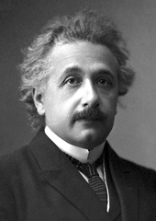
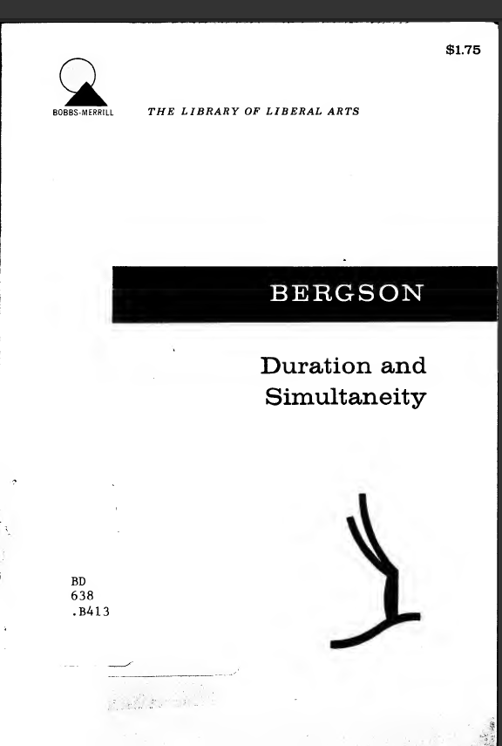
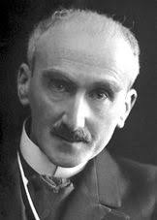
Bergson and Einstein
Bergson’s concerns included nature of free will and time
Debate with Einstein 1922 on implications of relativity
Duration and Simultaneity, Robin Durie (ed.), Manchester: Clinamen Press, 1999 [1927]

Slide 4
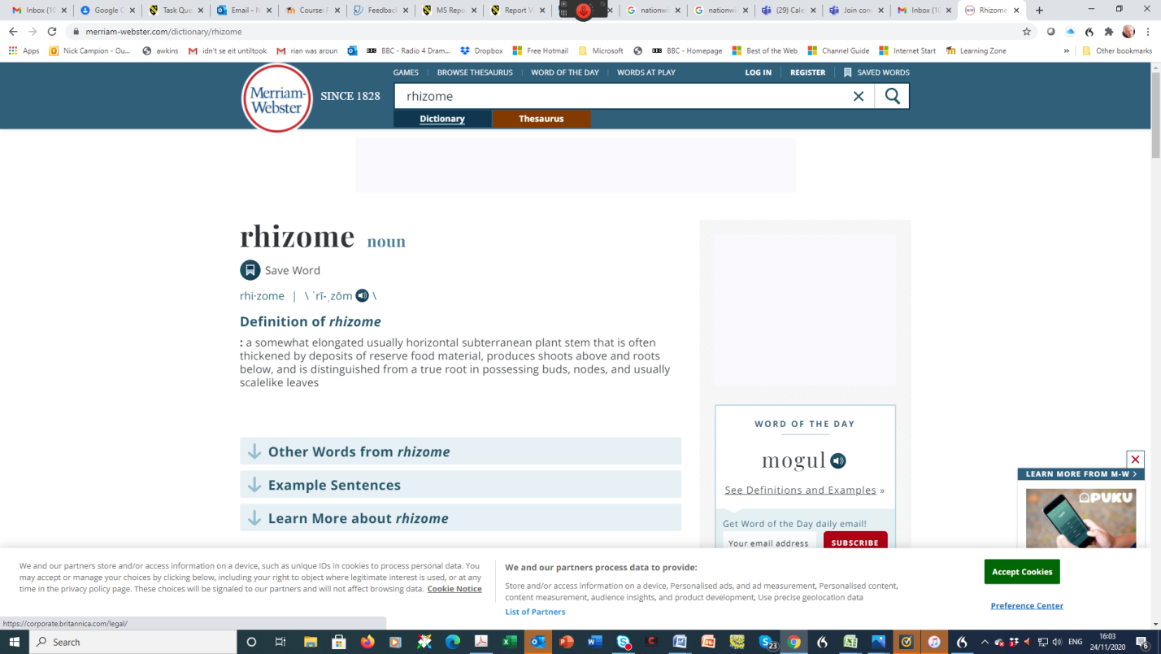
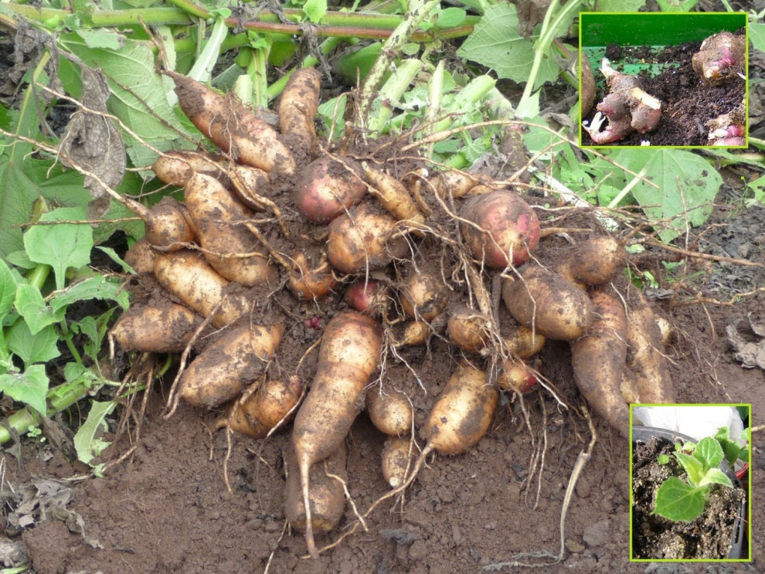
Rhyzomes

Slide 5
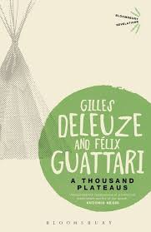
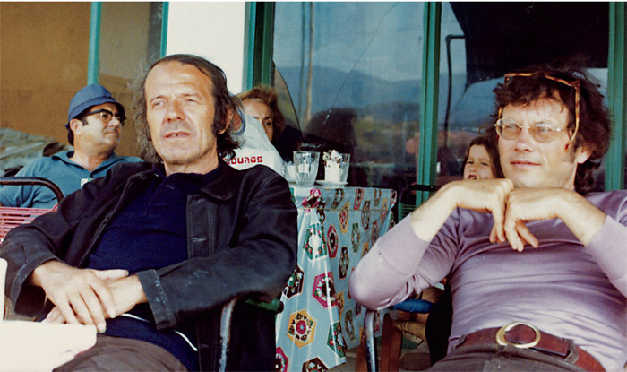
Gilles Deleuze and Félix Guattari: Rhyzome Theory
‘A rhizome ceaselessly establishes connections between semiotic chains, organizations of power, and circumstances relative to the arts, sciences, and social struggles. A semiotic chain is like a tuba, agglomerating very diverse acts, not only linguistic, but also perceptive, mimetic, gestural, and cognitive: there is no language in itself, nor are there any linguistic universals, only a throng of dialects, patois, slangs, and specialised languages. There is no ideal speaker-listener, anymore than there is a homogenous linguistic community. .. There is no mother tongue, only a power takeover by a dominant language within a political multiplicity. Language stabilises around a parish, a bishopric, the capital. It forms a ball. It evolves by subterranean stems and flows, along river valleys or train tracks; it spreads like a patch of oil.
Gilles Deleuze and Félix Guattari, A Thousand Plateaus (London: Bloomsbury 1999 [1988]), p. 6
* semiotics- the study of signs and symbols; a semiotic chain is a chain of meanings linked by signs and symbols

Slide 6
Rhyzome Theory
‘There is no difference between what a book is talks about and how it is made. Therefore a book also has no object. As an assemblage, a book has only itself, in connection with other assemblages and in relation to other bodies without organs’.
Gilles Deleuze and Félix Guattari, A Thousand Plateaus (London: Bloomsbury 1999 [1988]), p. 2
* semiotics- the study of signs and symbols; a semiotic chain is a chain of meanings linked by signs and symbols
‘In a book, as in all things, there are lines of articulation or segmentarity, strata and territories; but also lines of flight, movements of deterritorialization and destratification. Comparative rates of flow on these lines produce phenomena of relative slowness and viscosity, or, on the contrary, of acceleration and rupture. All this, lines and measurable speeds constitutes an assemblage. A book is an assemblage of this kind, and as such is unattributable. It is a multiplicity.
Gilles Deleuze and Félix Guattari, A Thousand Plateaus (London: Bloomsbury 1999 [1988]), p. 5

Slide 7
Rhizomes have six principles: of which three are….
1. connection; 2. heterogeneity
‘Any point of a rhizome can be connected to anything other, and must be. This is very different from the tree or root, which plots a point, fixes in order’.
Gilles Deleuze and Félix Guattari, A Thousand Plateaus (London: Bloomsbury 1999 [1988]), pp. 5-6.
*heterogeneity = diversity
3. multiplicities
‘Multiplicities are rhizomatic, and expose our arborescent pseudo-multiplicities for what they are’.
Gilles Deleuze and Félix Guattari, A Thousand Plateaus (London: Bloomsbury 1999 [1988]), p. 7
*arborescent = tree like

Slide 8
Rhyzome Theory: Assemblages
‘An assemblage is precisely this increase in the dimensions of a multiplicity that necessarily changes in nature as it expands its connections. There are no points or positions in a rhizome, such as those found in the structure tree or root. There are only lines. When Glenn Gould speeds up the performance of a piece, he is not just displaying virtuosity, he is transforming the musical points into lines, he is making the whole piece proliferate . The number is no longer a universal concept measuring elements according to their emplacement in a given dimension, but has become a multiplicity that varies according to the dimensions considered…’
Gilles Deleuze and Félix Guattari, A Thousand Plateaus (London: Bloomsbury 1999 [1988]), p. 7

Slide 9
Deleuze,Guattari and Bergson
‘This is the point to clarify: that a becoming lacks a subject distinct from itself; but also that it has no term, since its term in turn exists only as taken up in another becoming of which it is the subject, and which coexists, forms a block, with the first. This is the principle according to which there is a reality specific to becoming (the Bergsonian idea of a coexistence of very different durations, superior or inferior to ours, all of them in communication).’
Gilles Deleuze and Félix Guattari, A Thousand Plateaus (London: Bloomsbury 1999 [1988]), p. 278.

Slide 10
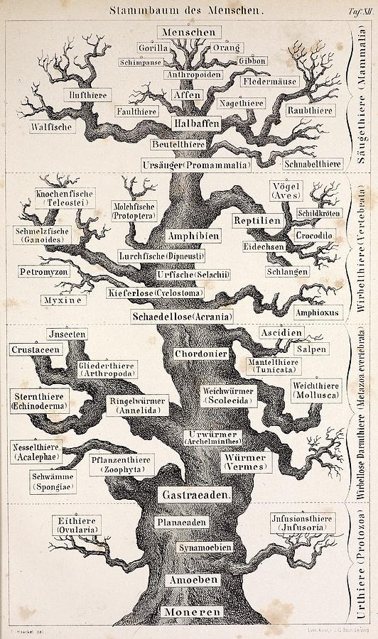
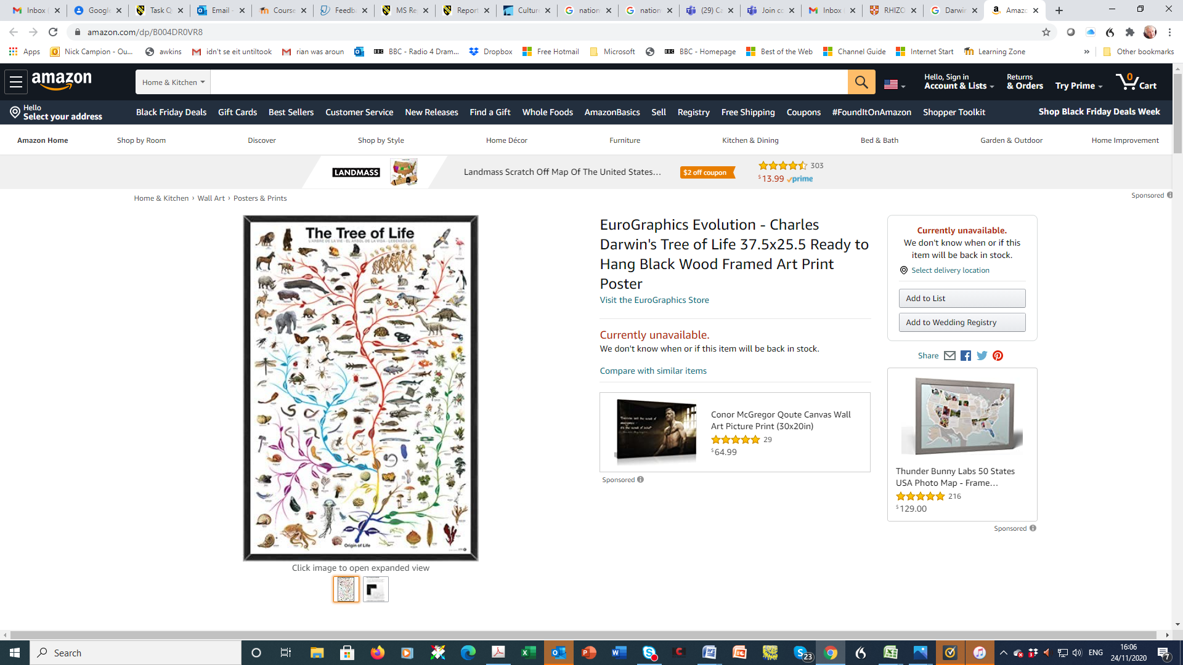
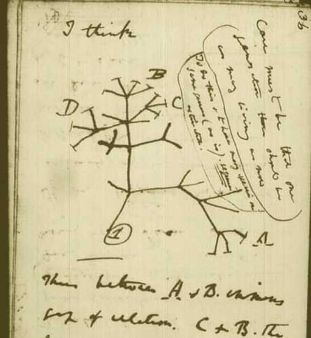
Tree models: Lamarck. Charles Wells, Patrick Matthew, Charles Darwin (left), Ernest Haeckel (middle)

Slide 11
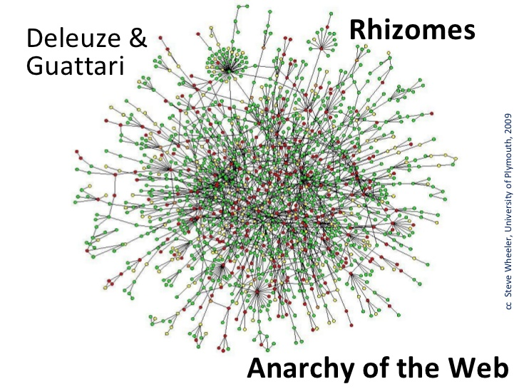
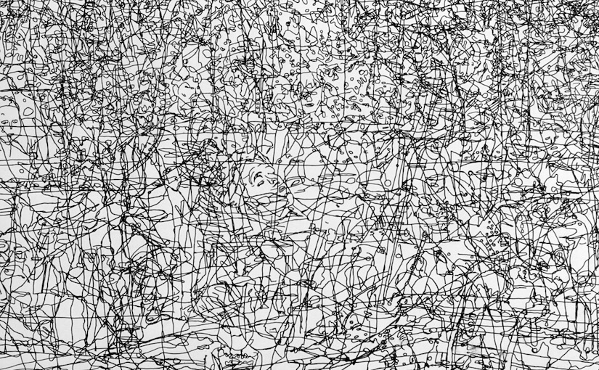
Rhyzome Theory
https://theartofcompost.com/2019/01/31/only-connect/

Slide 12
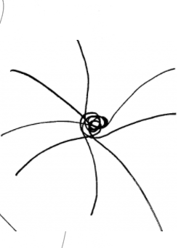
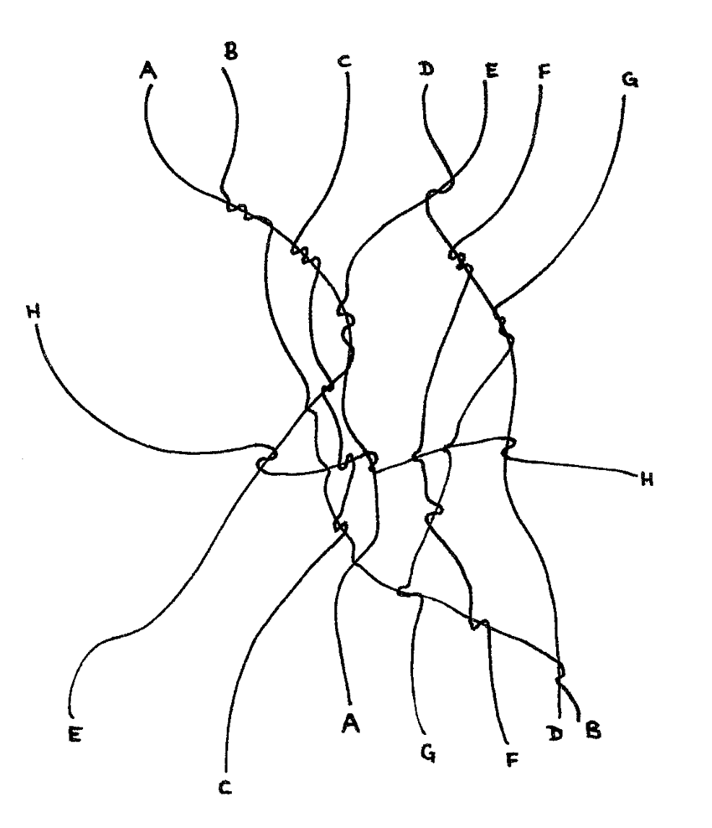
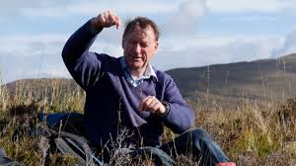
Tim Ingold: lines, wayfaring, knots (right top, Being Alive, p. 148), meshworks (below right, Lines, p. 82)
‘Thus rephrased, my contention is that wayfaring is the fundamental mode by which living beings inhabit the earth. Every such being has, accordingly, to be imagined as the line of its own movement or – more realistically – as a bundle of lines.
In reaching this conclusion I had – without realising it at the time – stumbled upon a key thought a key insight of one of the late twentieth century’s most influential, if idiosyncratic philosophers, Gilles Deleuze. This should have come as no surprise, in view of Deleuze’s debt to the philosophy of Henri Bergson. For my part, I had first come across the writings of Bergson, along with those of his philosophical contemporary, Alfred North Whitehead, two decades previously, while I was working on my book evolution and social life’.
Ingold, Tim, Being Alive: Essays on Movement, Knowledge and Description (London: Routledge, 2011), pp.12-13.

Slide 13
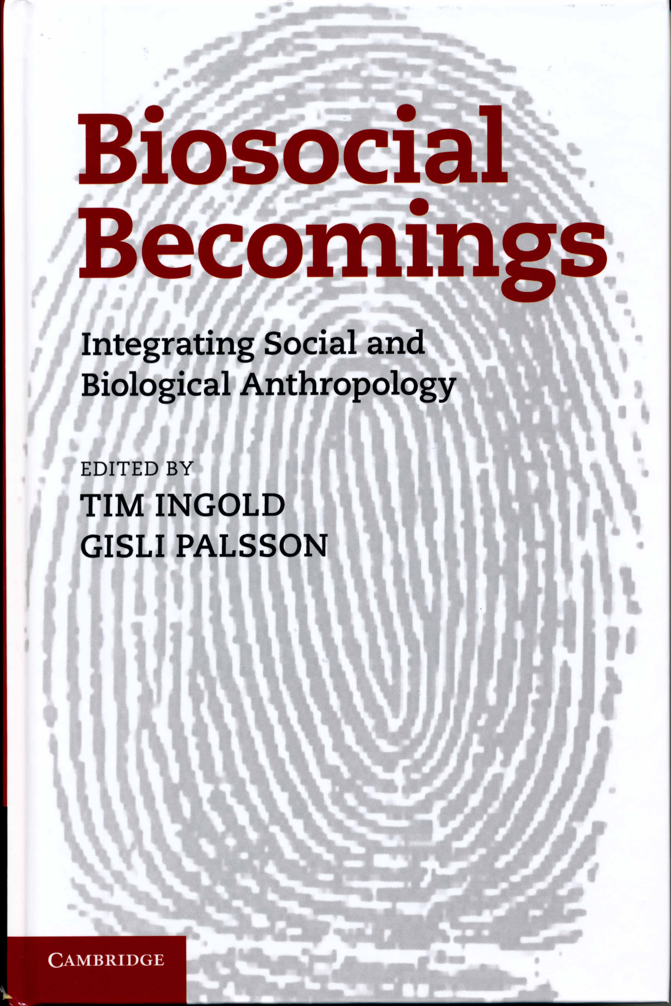
Tim Ingold and Gisli Palsson (eds) Biosocial Becomings: Integrating Social and Biological Anthropology (2013)
Ingold’s response to the ubiquitous intellectual presence of Neo-Darwinism (Richard Dawkins, Daniel Dennett etc).
Ingold’s first sentence is ‘Neo-Darwinism is dead.’ Constructs a new theory of evolution emphasising the total fusion of the biological and the social as biosocial.
‘The scale of the rethinking we are calling for can scarcely be overestimated....It is to rebuild our understanding of life and its evolution, and of our human selves, on entirely different ontological foundations....[I]t is akin to the replacement of classical mechanics by the general theory of relativity.’ pp. 9-10.
‘This is to acknowledge, however, that cultural forms arise within the weave of life, in conjoint activity. And evolution? This can only be understood topologically, as the unfolding of the entire tapestry – of the all-embracing matrix of relationships wherein the manifold forms of life that we call ‘cultural’ emerge and are held in place.’ p.8

Slide 14
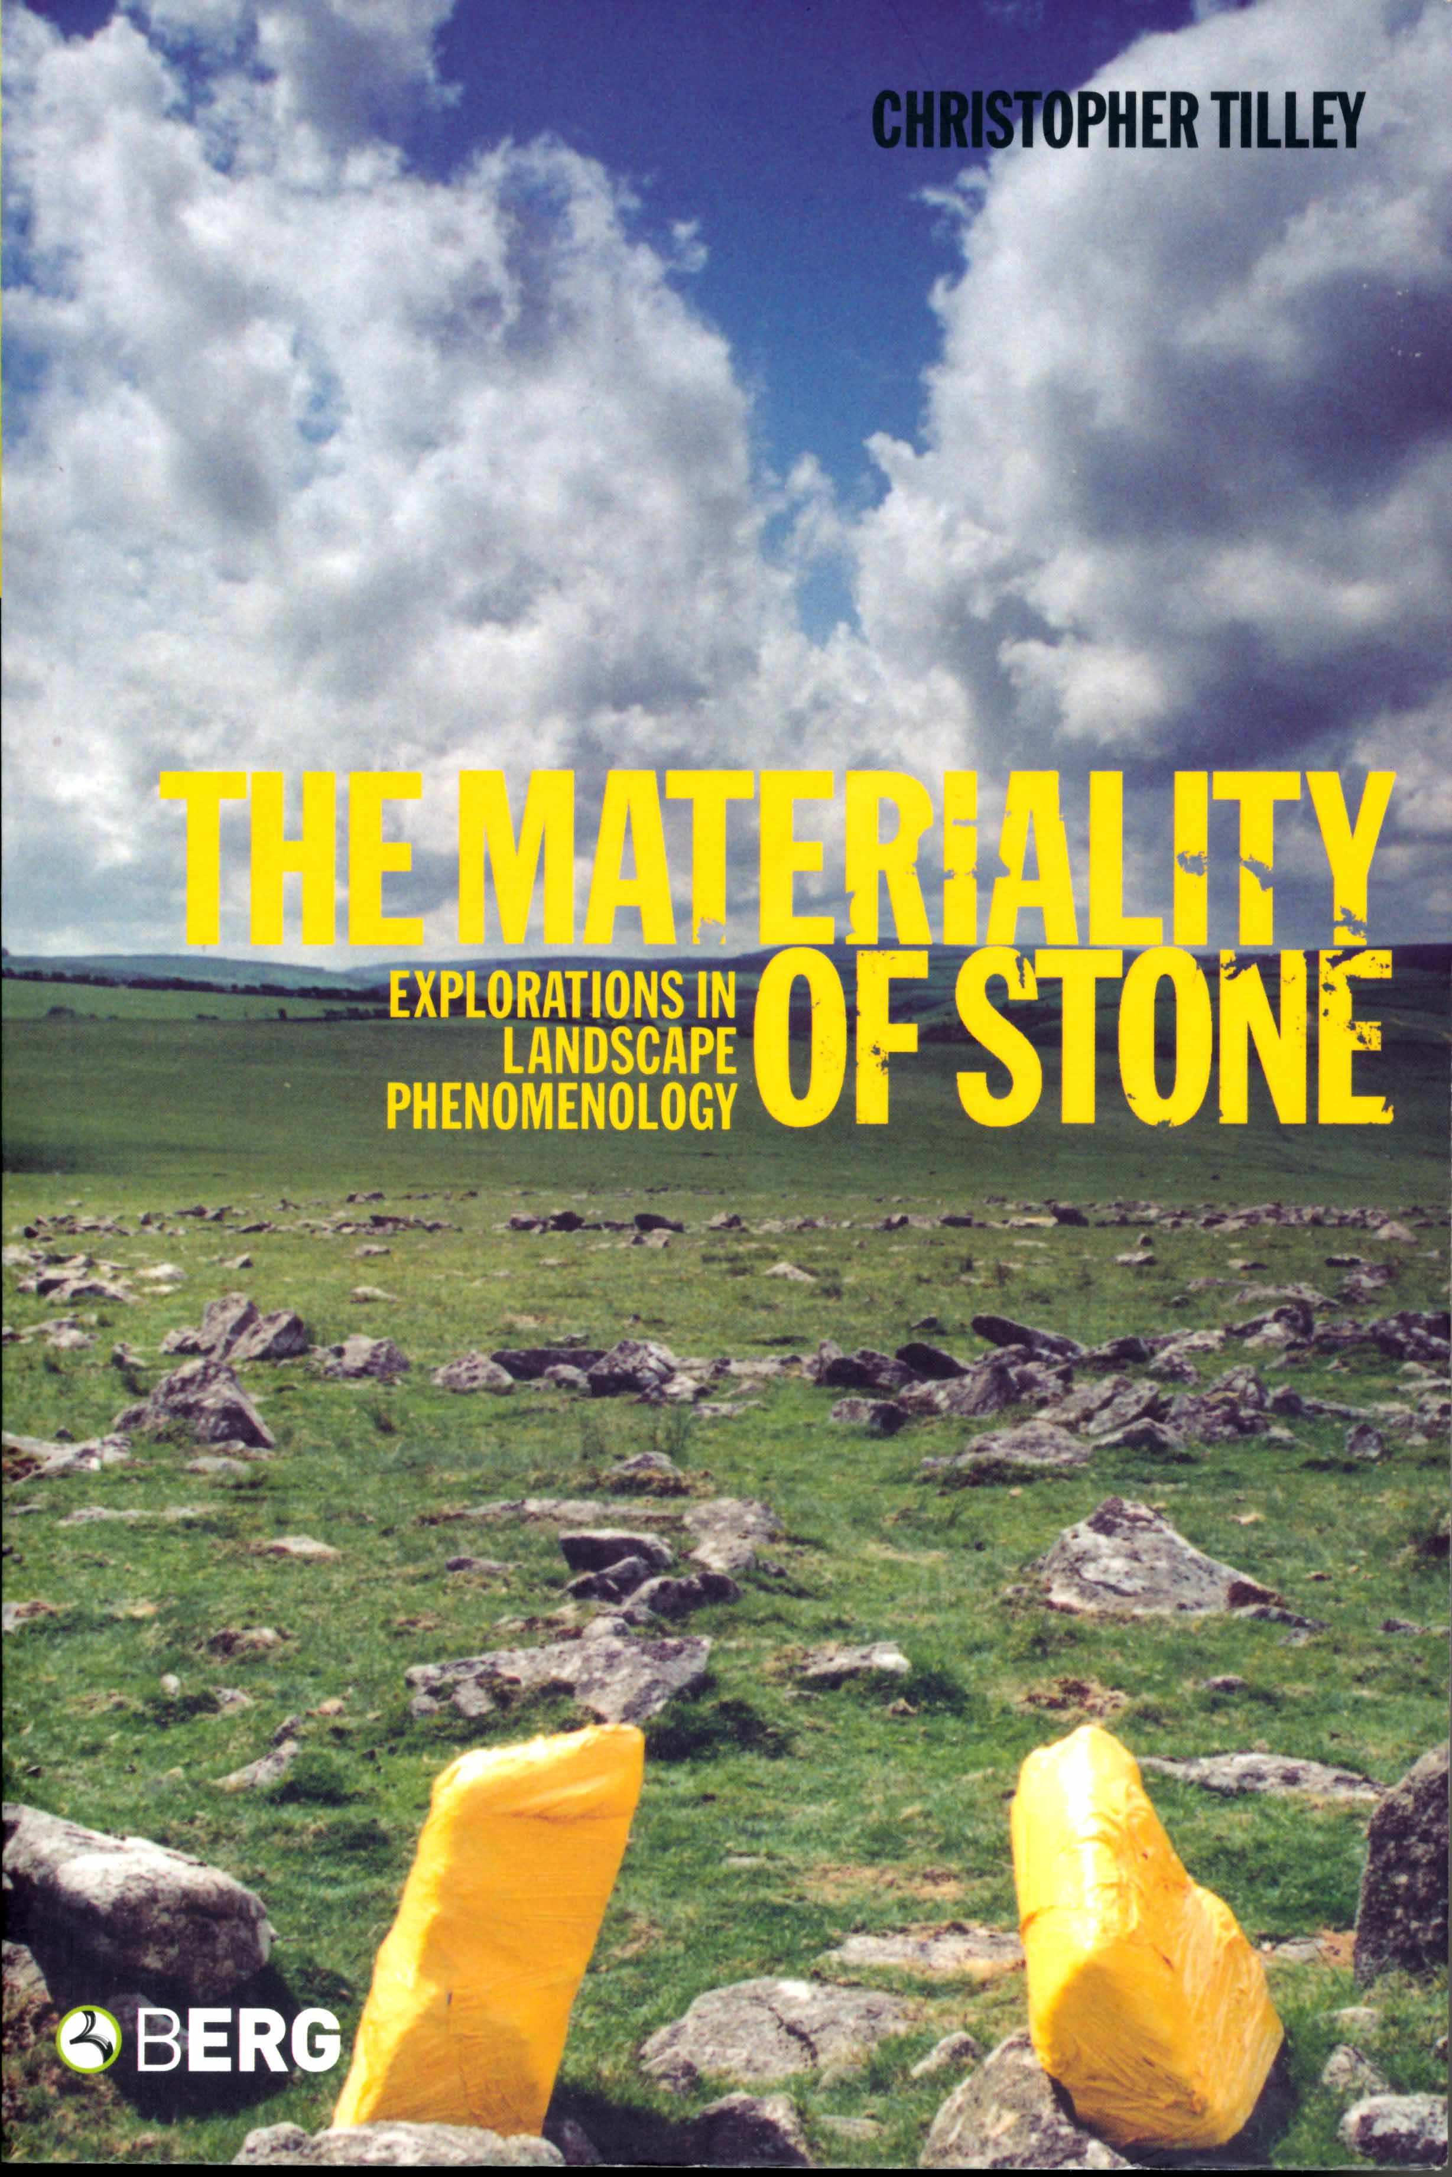
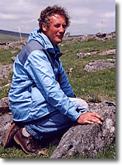
TILLEY: The Materiality of Stone: Explorations in landscape phenomenology (2004)
This is the first of three volumes dealing with landscape phenomenology.
Further development of Tilley’s ideas, both theoretically and practically.
Particular emphasis on the place of material metaphor.
Ch 1 From Body to Place in Landscape: a Phenomenological Perspective pp 1-33.
This is essential reading and a beautiful account of how Merleau-Ponty’s ideas are so important to the idea of embodied experience.
Also important is the idea of synaesthesia (fusion of the senses) in expressing experience. Builds on ideas of metaphor.

Slide 15
Chris Tilley: The importance of metaphor
‘To be human is to think through metaphors and express these thoughts through linguistic utterances and objectify them in material forms. The essence of metaphor is to work from the known to the unknown, to make connections between things so as to understand them. A Metaphorical logic is an analogical logic serving to map one domain in terms of another. This is precisely what we do in all interpretative work in the social sciences. Metaphors are thus the medium and outcome of any phenomenological analysis’.
Materiality of Stone, p.23.
Some Key Issues
‘Perception is not amenable to a clear cut subject-object dualism. If I touch my hands together, which hand touches which hand? If I touch a stone, I also feel its touch on my hands....’ p17 etc
Ch 2. Shooting Rhizomes and Giant Axes: experiencing Breton Menhirs pp33-86 emphasises the importance of interpreting human experience in a multidimensional and sensuous way, rather than through an abstract analytical gaze.

Slide 16

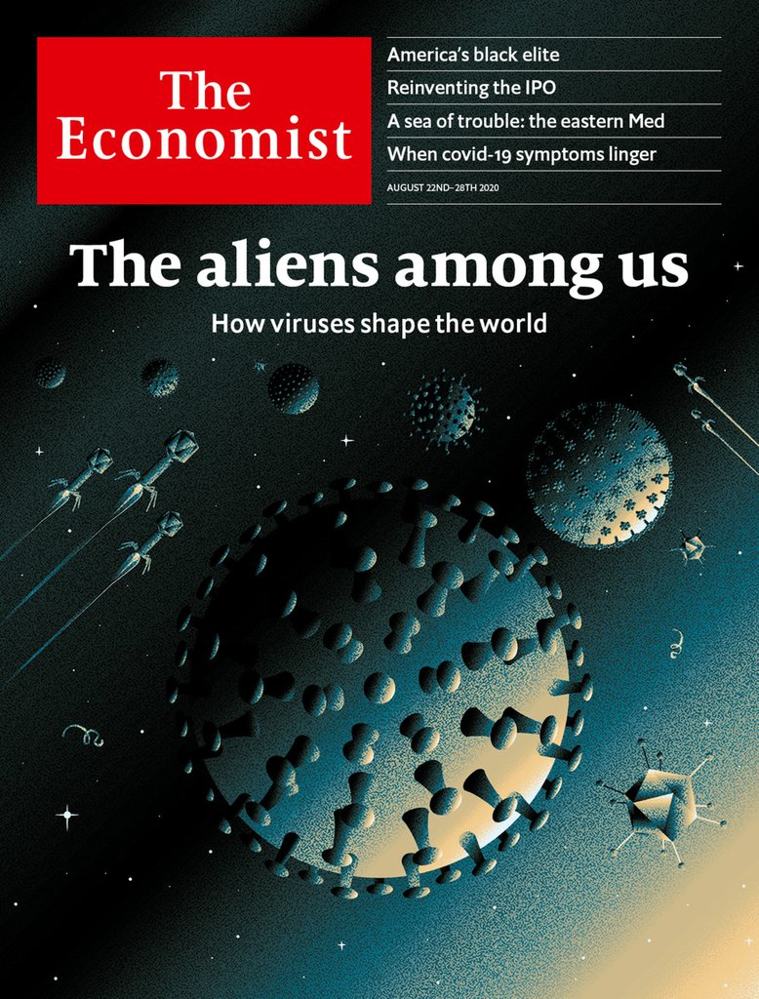
From whose view is the world seen?

