Slide 1
Patrik Camdzic Ilkovski 2538086
University of Wales trinity saint David
Digital skills, assessment 3

Slide 2
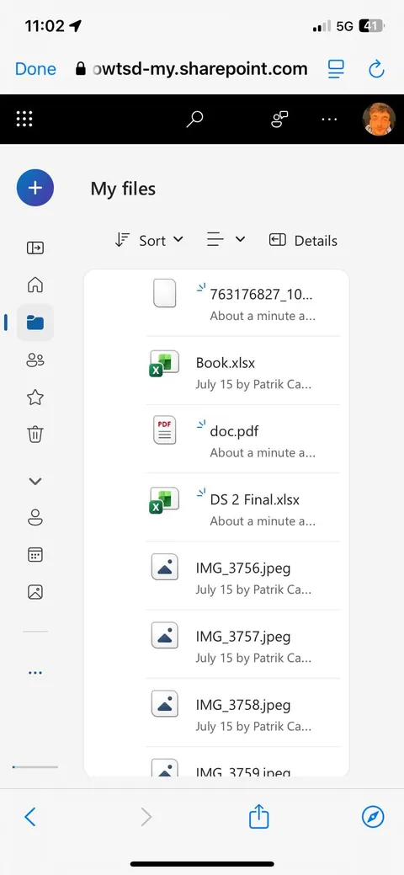
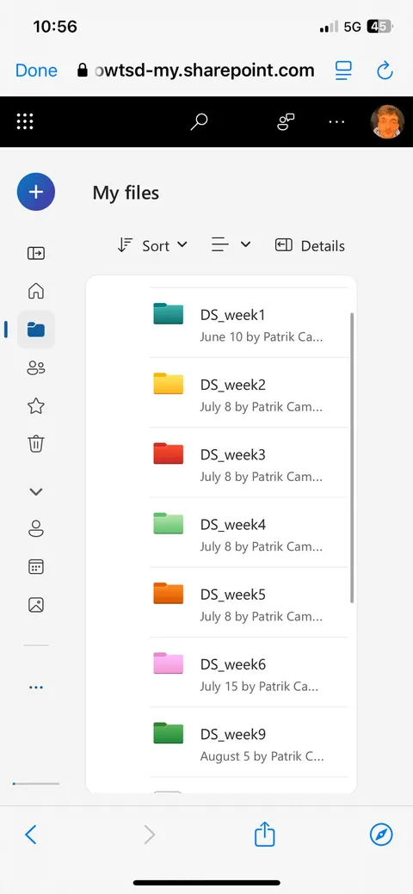
1. Messy folder vs tidy folder
This is a messy folder
This is a tidy folder

Slide 3
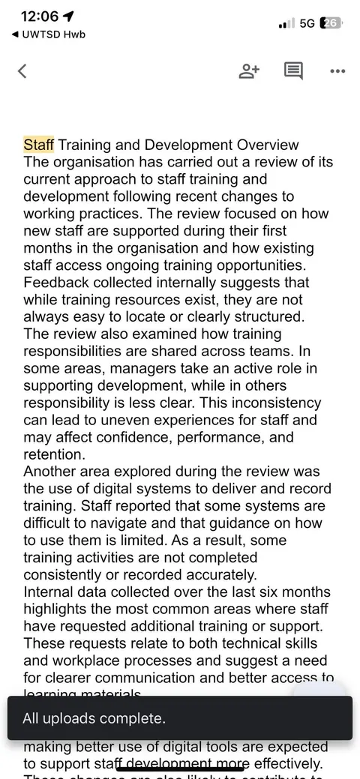
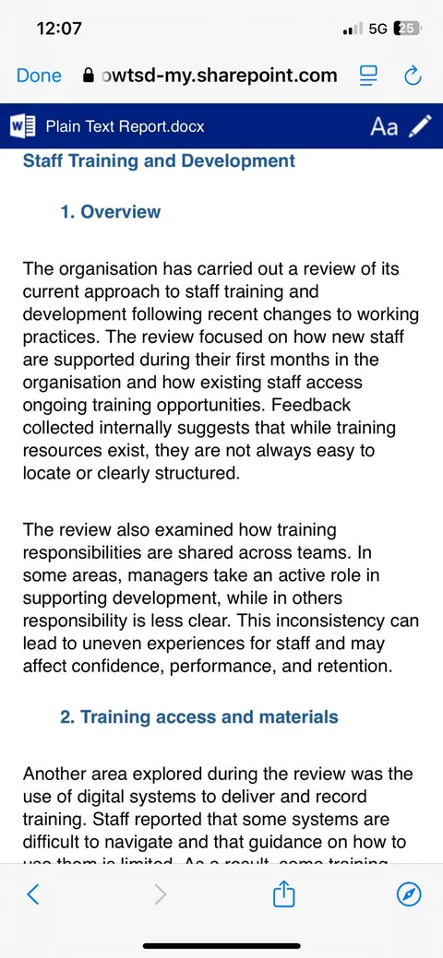
2. This is an example of 2 text,
I've changed the font, spaces between text and the color of the headings.

Slide 4
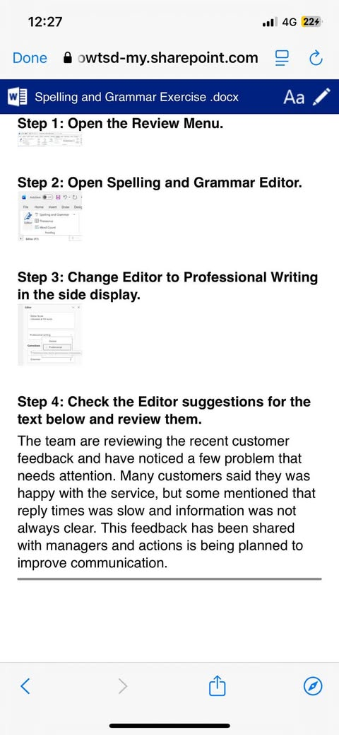
3. Spelling and grammar
Here I’ve learned how to use auto correction to be formal or rather professional.
And how to check spelling and grammar.

Slide 5
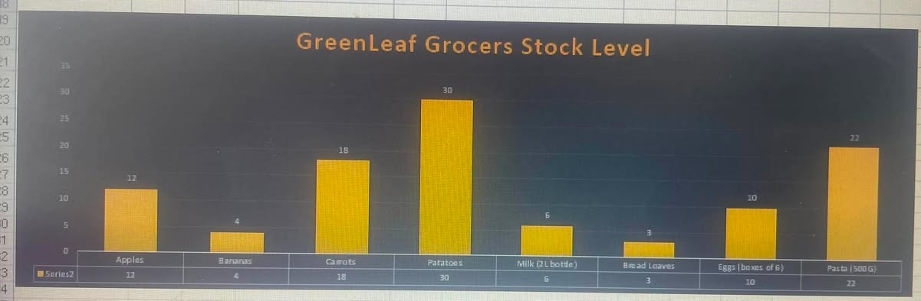
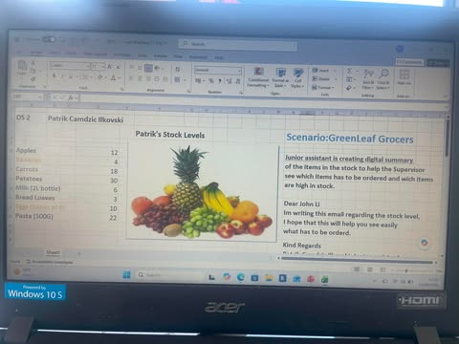
4. Stock chart and excel
I’ve learned how chart can help us sort the items by number so it could be ordered simpler.
Excel helped me learn about charts, organizing data in rows and columns and tracking lists or inventories.

