Slide 1
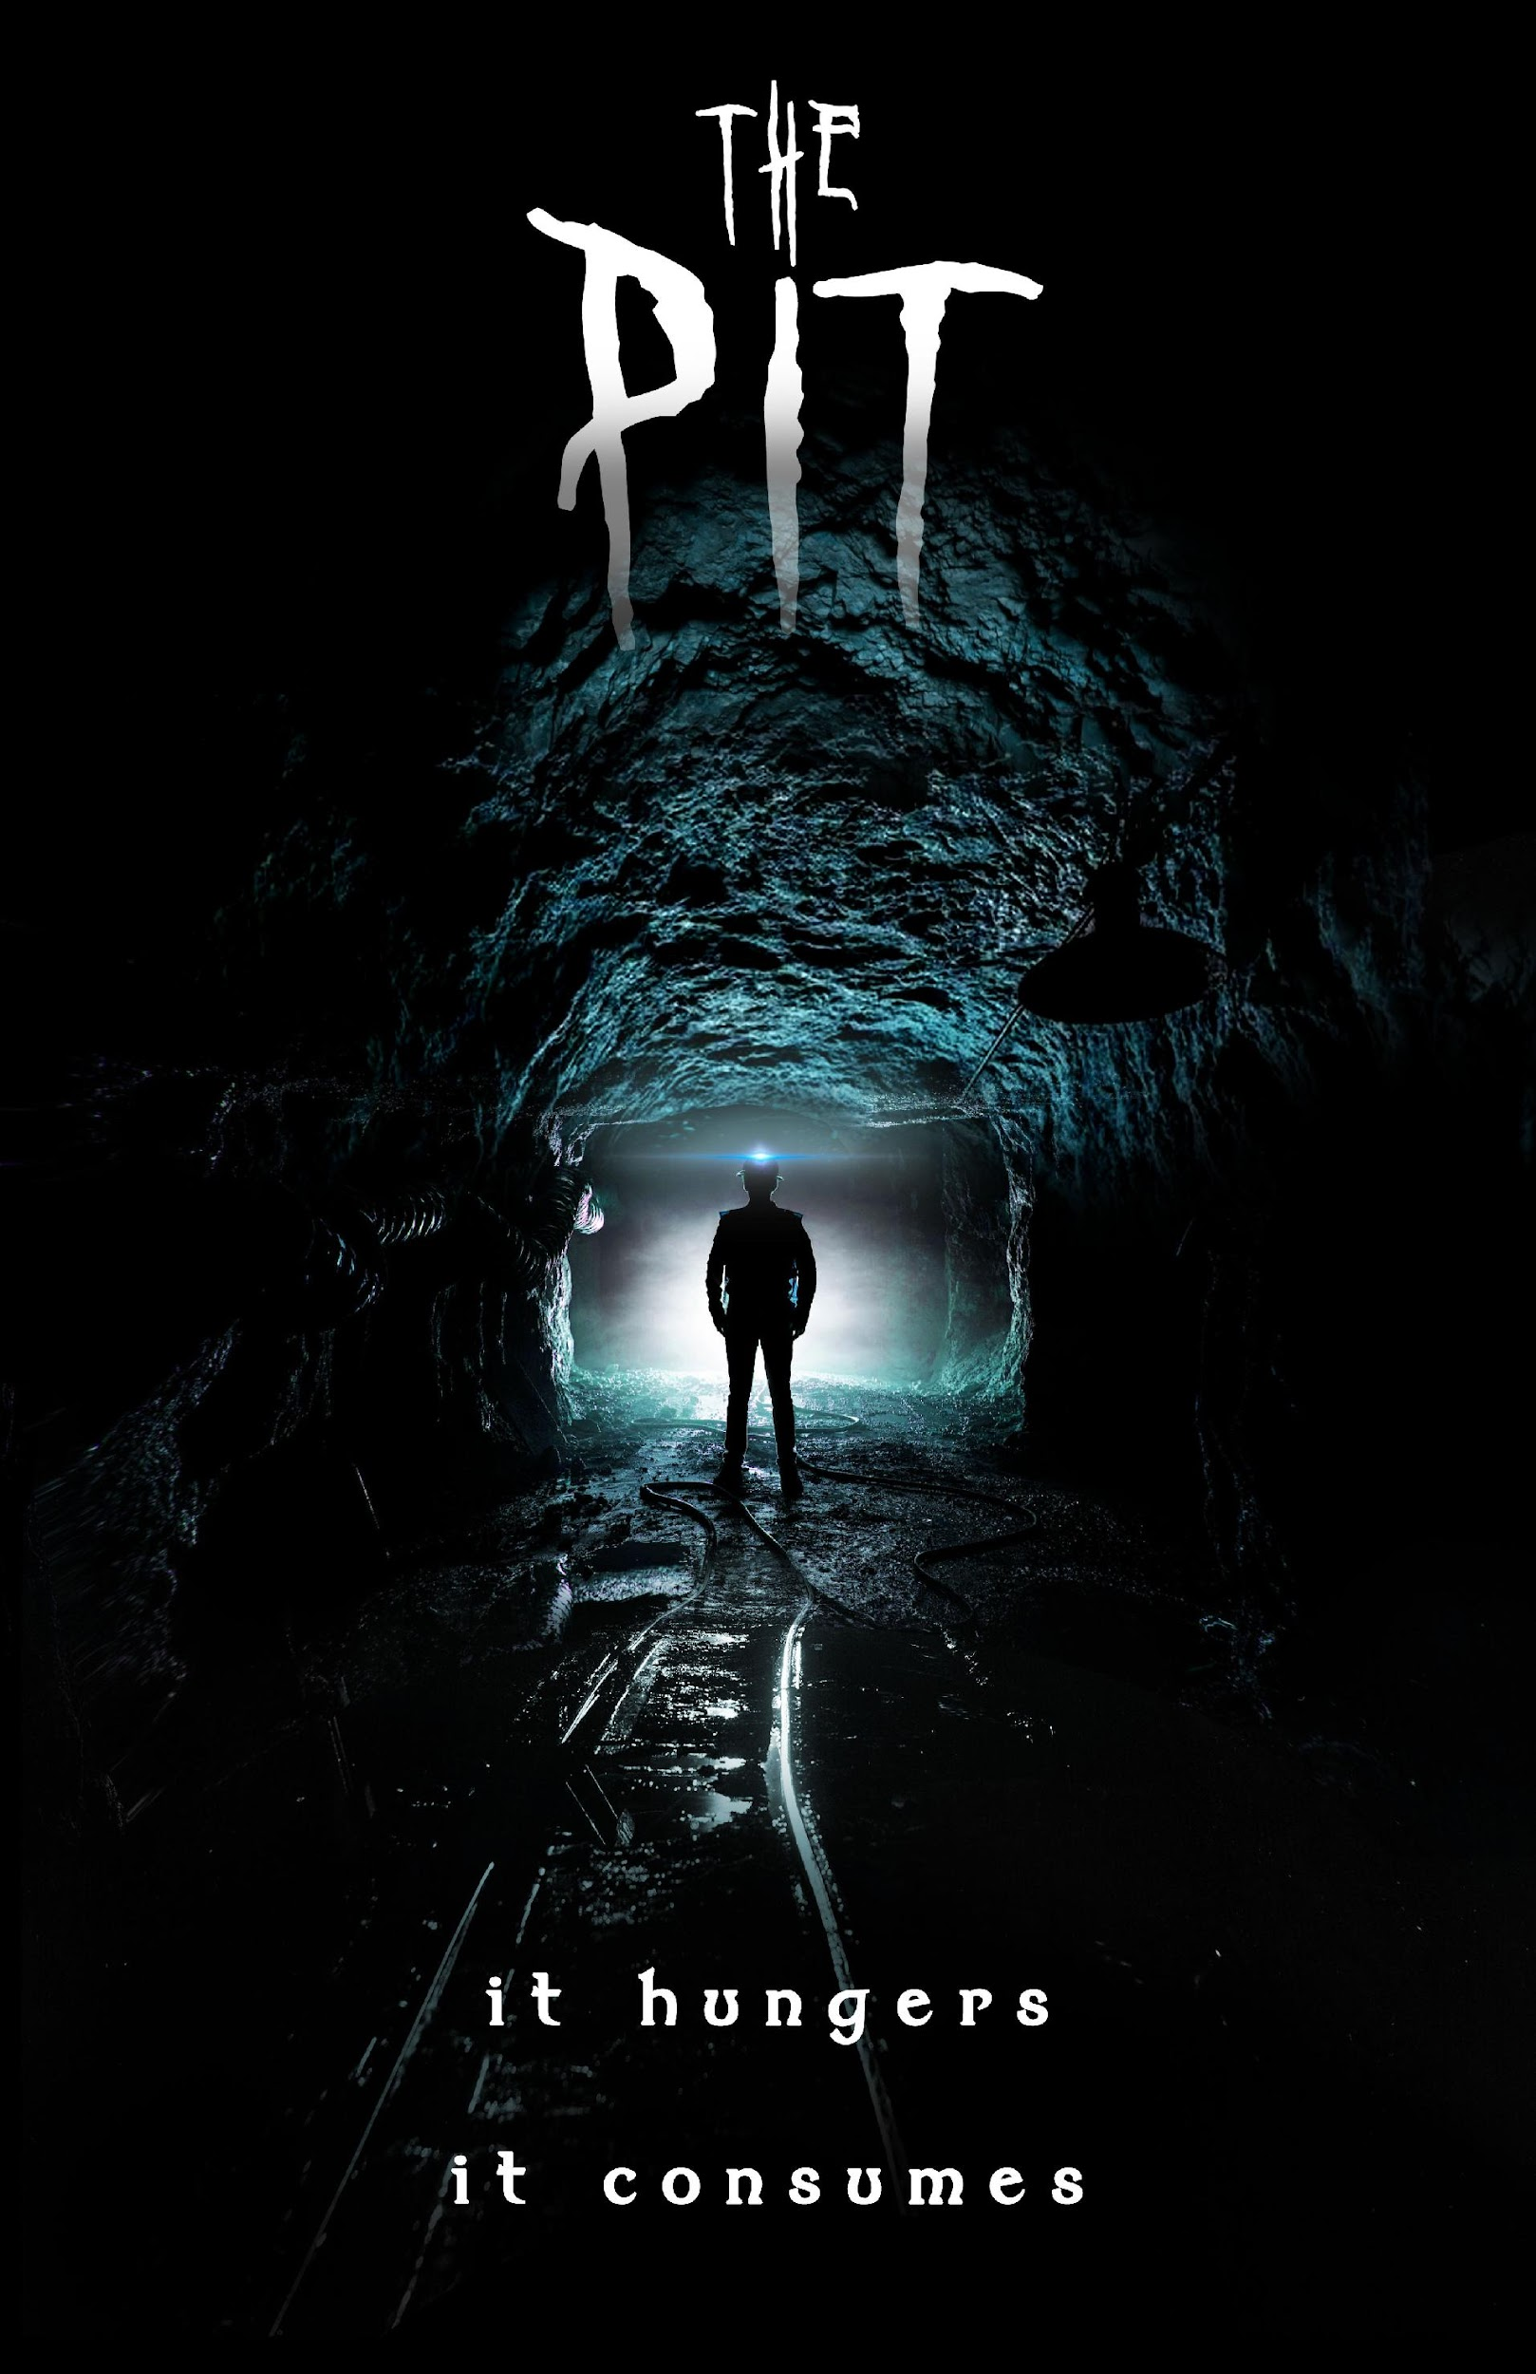

Slide 2
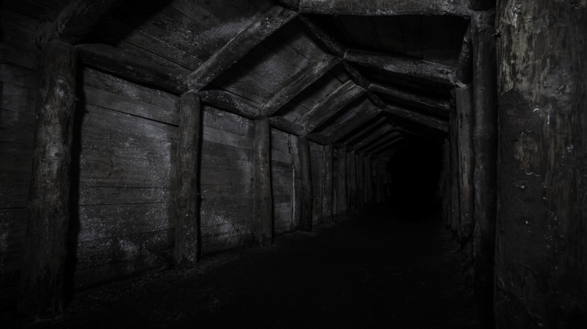
Marketing campaign and Prologue Webisodes for The Pit short film
This project serves as a marketing campaign for my upcoming Independent Project short film. It will take the form as any other promotional material released in the build up towards the release of a movie.
The forms of media I will use will be trailer posters, an official trailer released on Youtube/Vimeo, short reel trailers for Instagram and Facebook, and a Blu-ray dvd that contains the main film and bonus content (produced on a pre-order sale basis to save cost.)
Alongside all this I will release a short series of webisodes to act as a social experiment prologue to the main film. They will show minute long snippets of the protagonist’s life and personality and offer the audience a poll to fill in, these polls will ask the audience Yes/No questions about the protagonist (Are they a good person? Do they deserve to live? Etc)
After the polls are completed, the results will dictate the canonical outcome of the main film to be featured upon release. The dvd would include the option to view all other outcomes as bonus content.

Slide 3





POSTER
TRAILERS &
REELS
WEBISODES
MAIN RELEASE
JUNE
CONVENIENCE – Film released upon advertised date from trailers
CHARACTER – Audience have deeper understanding of protagonist
COMMUNITY – Audience have an investment into how their input affects the story
DVD RELEASE
JULY
CONVENIENCE – All content contained onto one piece of media
CHARACTER – All non-canon outcomes of the character are viewable
COMMUNITY – Audience gets the whole picture and a physical, tangible piece of merchandise
MAIN RELEASE
JUNE
MAY
CONVENIENCE – Cross platform delivery
CHARACTER – A more in-depth insight into protagonist and additional backstory
COMMUNITY – Opportunity for audience to cast votes and affect the outcome of the film

Slide 4


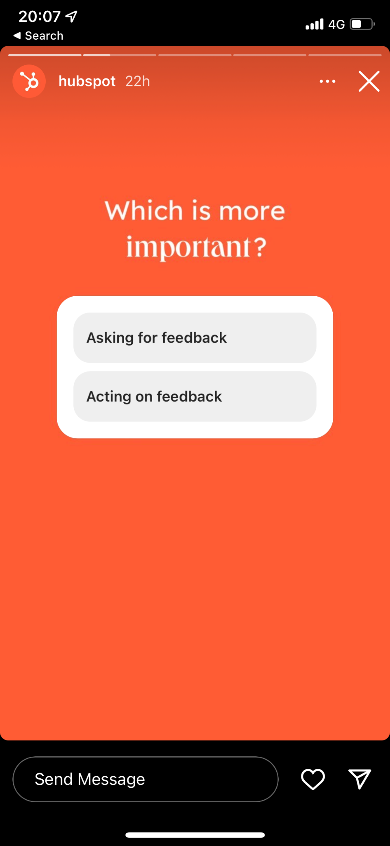
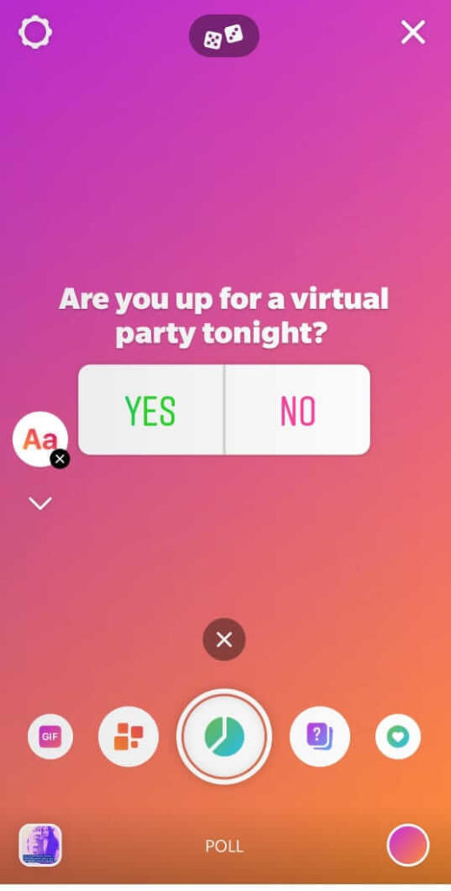
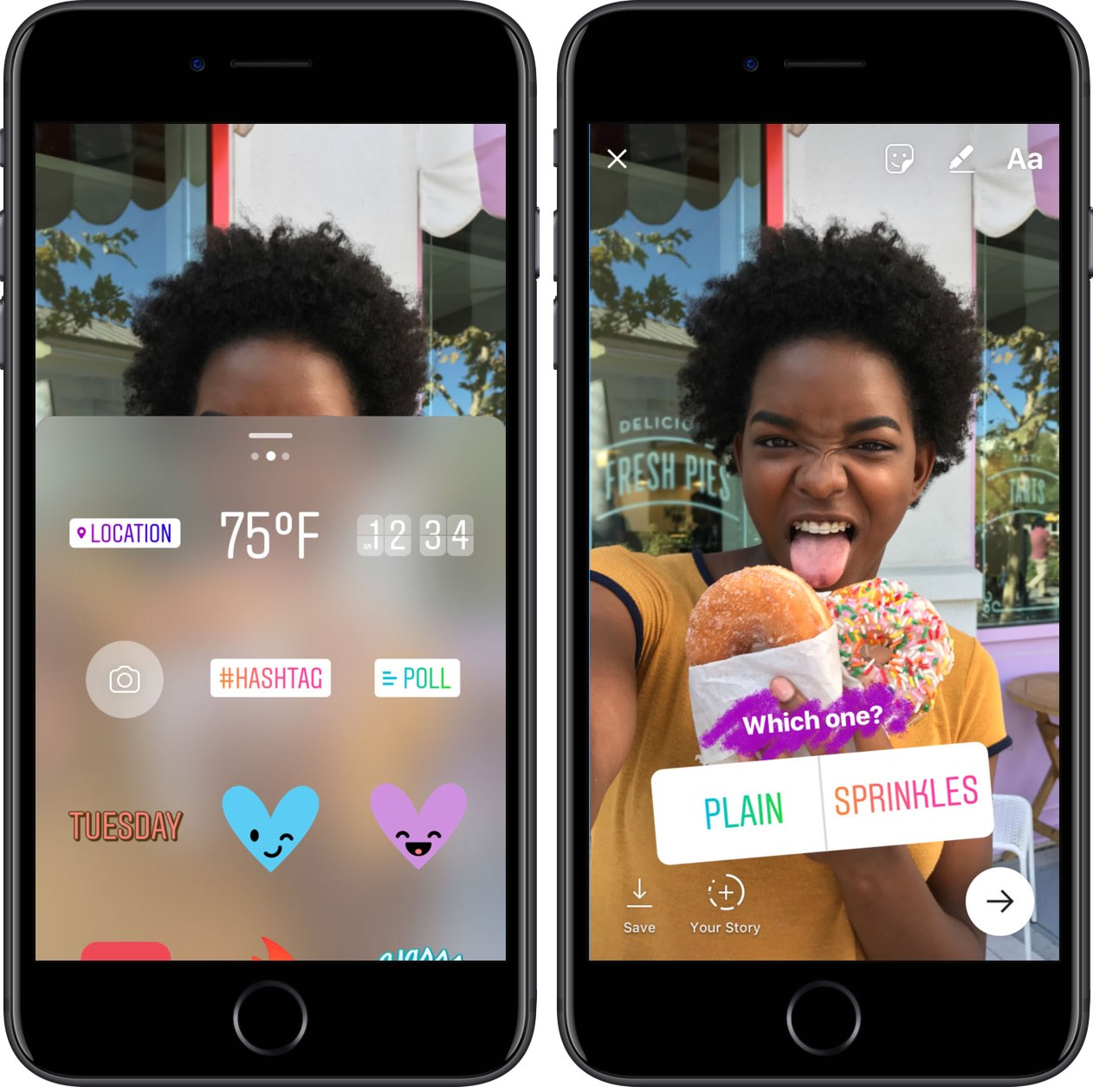
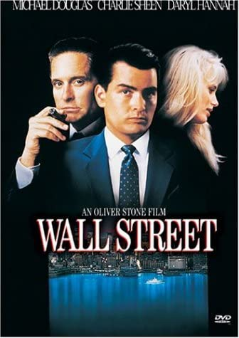

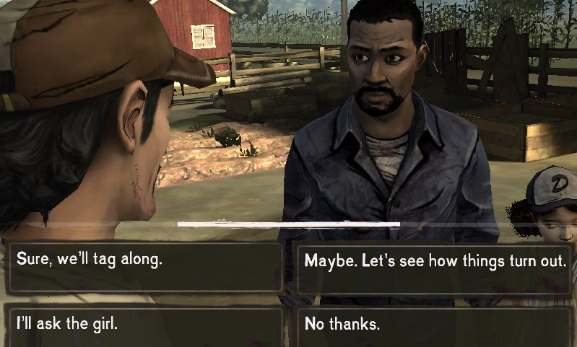
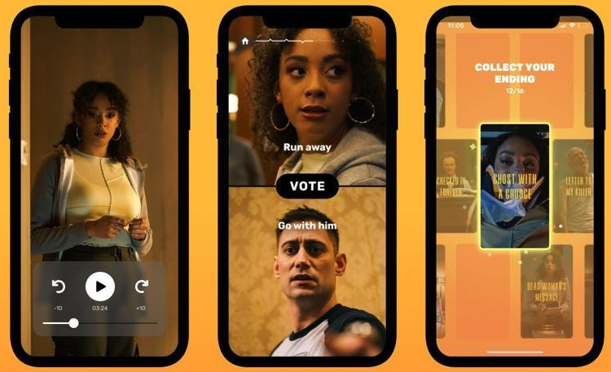


Slide 5

For Submission
Scripts and storyboards for reels, plus examples of poll questions, and the outcomes that the answers would lead to
A marketing campaign schedule with dates to assign when content is released in the run up to the movie premiere
A trailer poster
Design for website hosting all promotional content and a platform to watch movie
Design for DVD box, and the interactive menu to browse the content

Slide 6

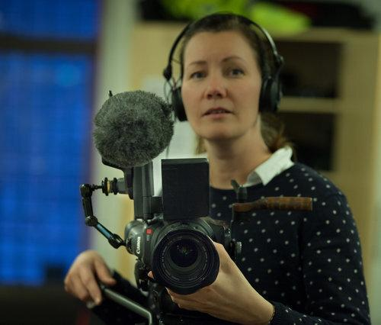
BYGDA SOM SA NEI
(THE VILLAGE THAT SAID NO) - 2015
https://www.nrk.no/bygda-som-sa-nei-1.12703629
THE DIAMOND (vertical video) 2020 – Adam Sebire

Slide 7
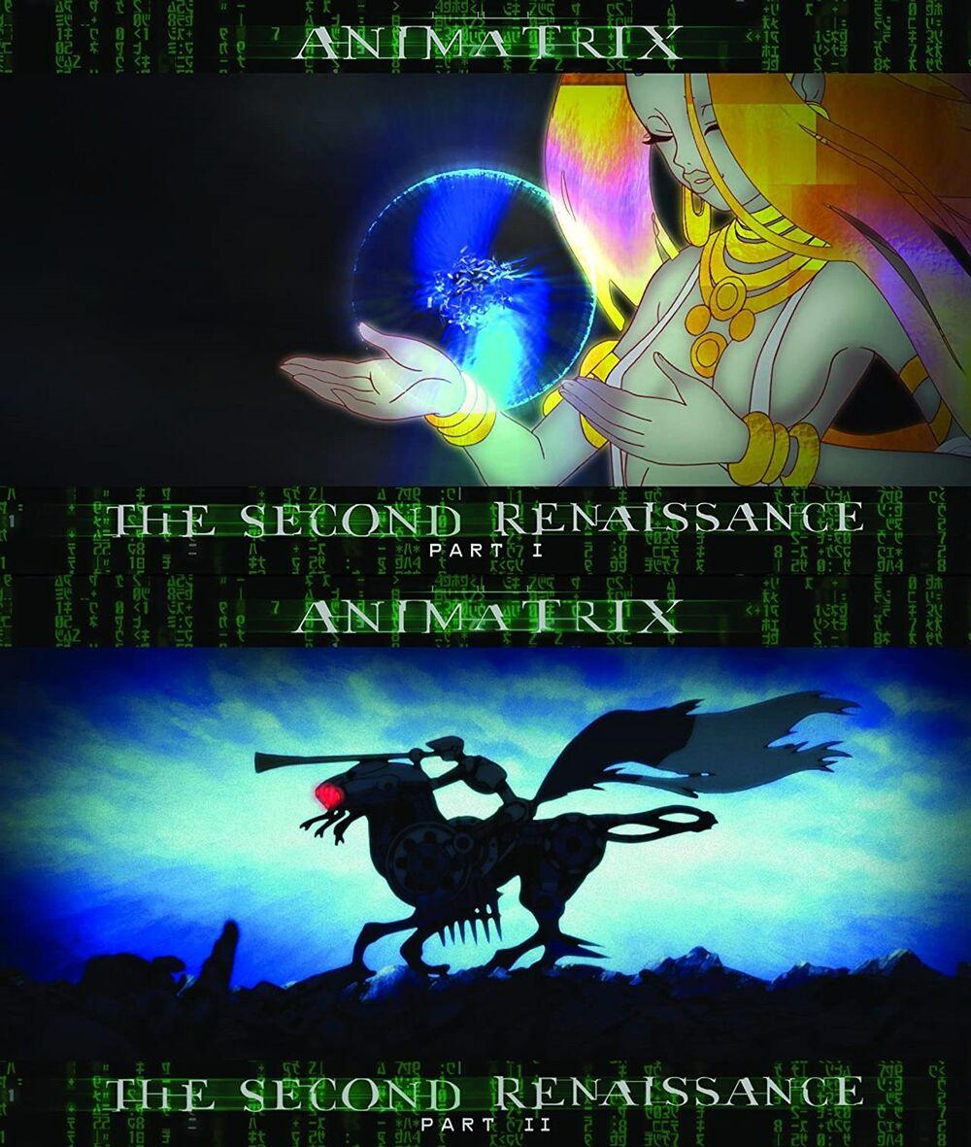




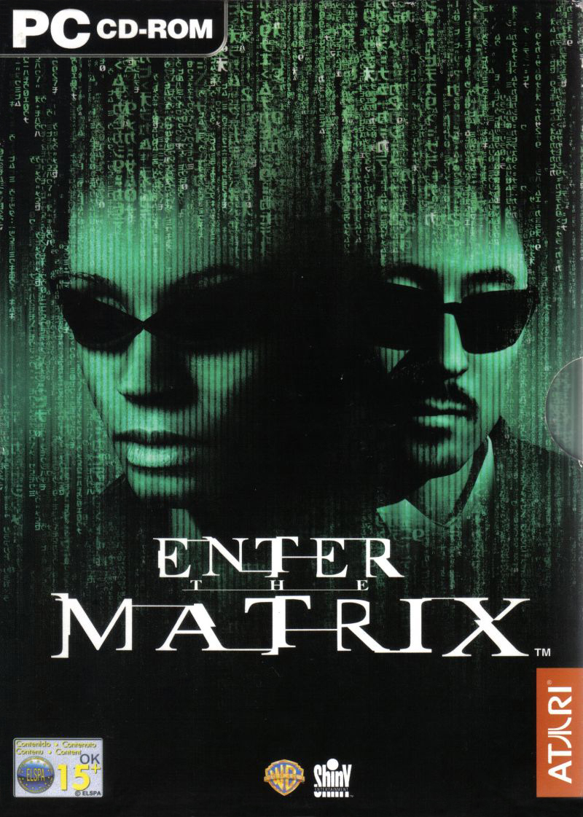








Slide 8





Slide 9




Slide 10
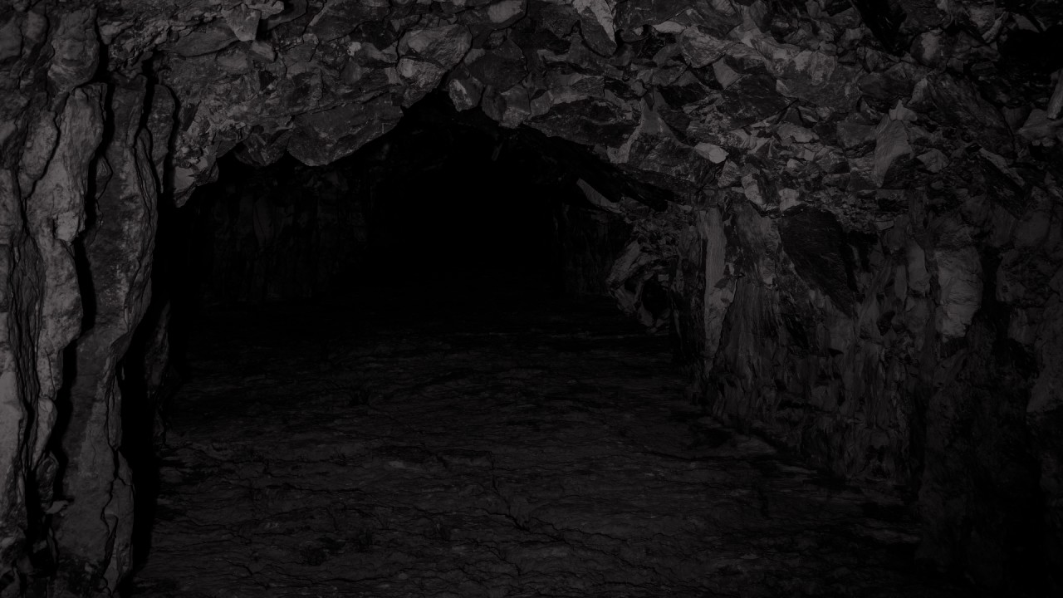
REFERENCES
E. Kjolleberg & G Karstad (2015) BYGDA SOM SA NEI (THE VILLAGE THAT SAID NO) Available at: https://www.nrk.no/bygda-som-sa-nei-1.12703629
The Diamond (Vertical Video) 2020 - Adam Sibere
The Matrix Timeline (2022) Available at: https://matrix.fandom.com/wiki/Timeline

