Slide 1
Module: Introduction to Public Health:LCHS4008
Sarah Campbell 2536765
Rachael Michael 2542002
Karla Menjivar 2535583
Ivy Owusu 2534721
Lecture name: Emmanuel Audu

Slide 2
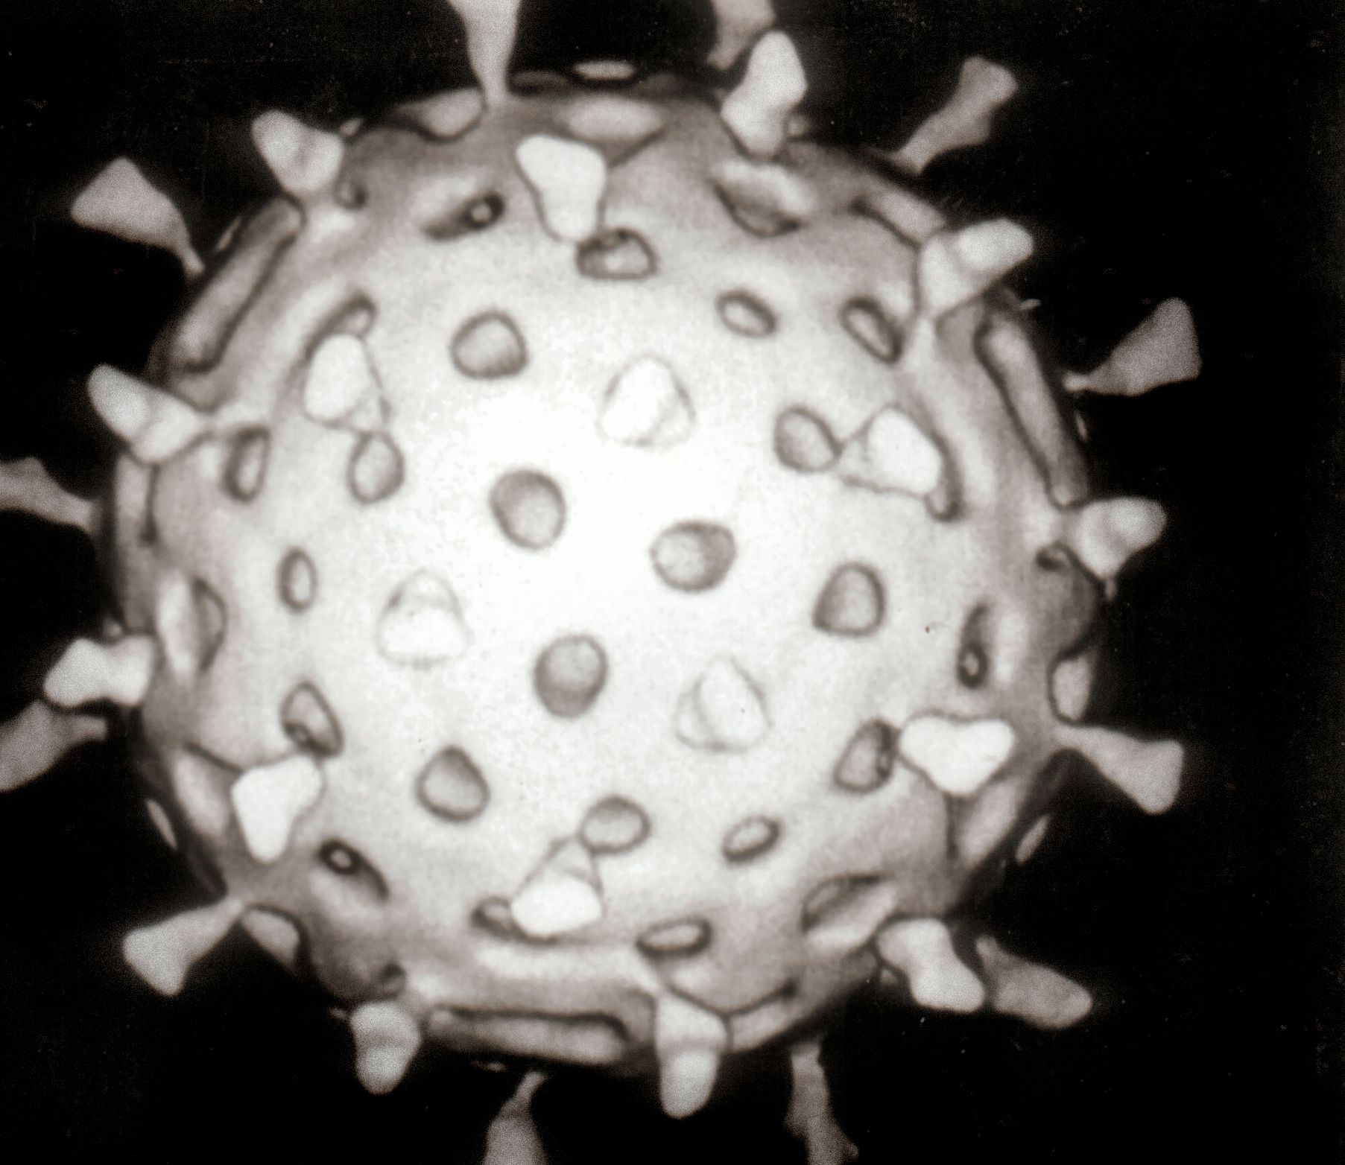
Rotavirus
ThePhoto by PhotoAuthor is licensed under CCYYSA.

Slide 3
Introduction:
What is the Rotavirus infection? (NHS.UK, 2026).
The Rotavirus infection spreads mainly via the faecal-oral route and causes gastroenteritis.
Symtoms include:
Severe watery diarrhoea, usually with vomiting, fever, and stomach cramps.
These usually lasts from 3 to 8 days and can cause dehydration.

Slide 4
Factors that may influence health and well-being in people affected by rotavirus:
Age: Babies and young children are at greater risk.
Nutrition: Poor nutritional status can make it harder for the body to cope with infection and recover.
Living conditions: Crowded households, nurseries, hospitals and other communal environments can increase exposure.
Underlying health conditions: Chronic illnesses or conditions affecting nutrition or immunity may increase vulnerability.

Slide 5
Health education for the community:
  How rotavirus spreads:It spreads mainly through the faecal–oral route. The virus can spread through contaminated hands, objects, surfaces, food and water.
  Promote effective handwashing:
  Prevent dehydration:Encourage frequent small amounts of fluid.
  Continue breastfeeding where applicable.
  Know the warning signs of dehydration: Very little or no urine; dry mouth; no tears when crying; unusual sleepiness, weakness or irritability
  Rotavirus vaccination:(GOV.UK, 2026) (NHS.UK,2026).

Slide 6
Conclusion:
Mary's case: Mary is only three years old and has confirmed rotavirus. With a high temperature of 40°C. She has persistent vomiting, diarrhoea and reduced fluid intake. Her parents should seek medical advice promptly if she is drinking poorly, continues to vomit, has frequent diarrhoea or develops signs of dehydration. Overall, Mary’s age, hydration, nutrition, and symptoms, can all influence how she is affected by rotavirus
Medical advice: Seek appropriate NHS medical advice.

Slide 7
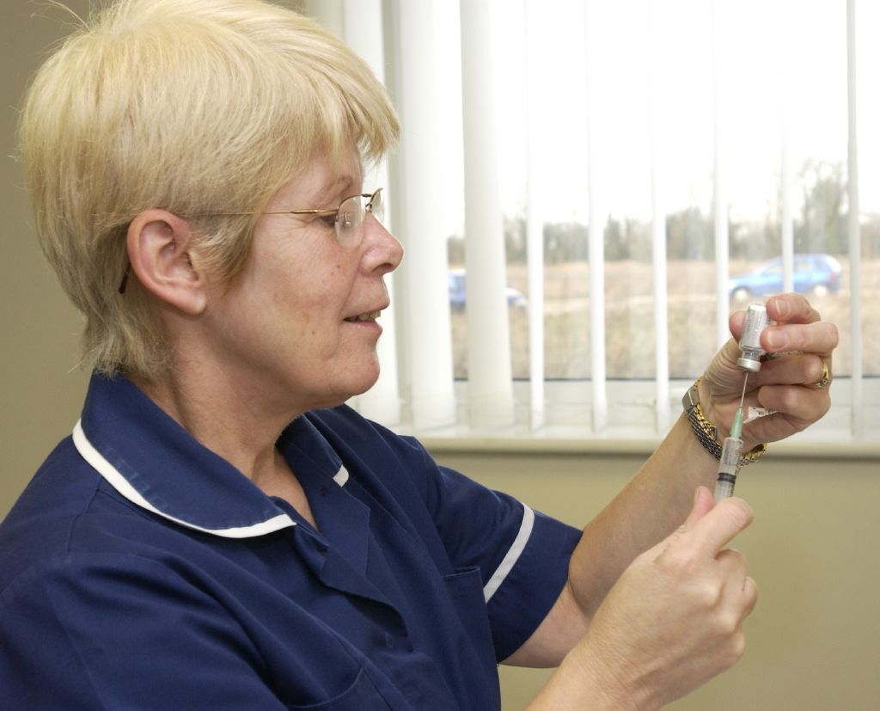
What Approach and Strategies Could Be Used to Monitor an Outbreak of Rotavirus?
Organization such as :
UK Health and Security Agency
NHS Services
Local Authorities
Laboratories
Figure 1: Rotavirus (UKHSA, 2026)

Slide 8
1. Counting Cases
Staff: How many people develop symptoms.
Mary's case should be documented
Accurate records.

Slide 9
2. Laboratory Testing
A stool sample
According to WHO (2024) Laboratory sample can help to identify other infections that can be confused with rotavirus.

Slide 10
3. Incidence and Attack Rate
Health Professionals record new cases
Attack rate
Transmission is increasing or decreasing.

Slide 11
4. Monitoring Contacts
Close Contact Identification
Monitoring Contacts
Supporting Outbreak Investigation
(UKHSA,2019)

Slide 12
5. Infection Prevention and Control
Key measures to Reduce Spread
Good hand washing
Appropriate cleaning and disinfection
Contaminated materials
Exclusion from communal settings

Slide 13
6. Monitoring the Outbreak
Regular Case Monitoring
Reporting New Symptoms
UKHSA Guidance

Slide 14
Conclusion
In Mary’s case, early identification, accurate record keeping, laboratory testing, contact monitoring and infection-control measures can help determine whether there is a rotavirus outbreak and prevent further spread. Continuing to monitor new cases and sharing relevant information with appropriate health protection professionals can help assess the development of the outbreak and the effectiveness of control measures (UKHSA, 2026; WHO, 2024).

Slide 15

Approaches and strategies could be used to control an outbreak of rotavirus
BREAK THE CHAIN INFECTION
Prevent Further transmission.
Protect vulnerable people.
Figure 1: Breaking the chain of infection (Geneseo, 2026)

Slide 16
Infection Prevention and Control (IPC)
Rotavirus is highly contagious and it spreads through the faecal-oral route.​
Key actions :​
Handwashing with soap​
Frequent cleaning of toilets, toys and surfaces​
Safe disposal nappies and contaminated waste.​
High temperature washing​
Ventilation ​

Slide 17
Exclusion and Isolation
According to Public Health England (2017), in children settings states that anyone with diarrhoea or vomiting must stay away.
48 hours after symptoms stop.

Slide 18
Vaccination (Primary Prevention)
According to UKHSA(2025-2026) To reduce outbreak of rotavirus the vaccination is the most effective method.
Babies at 8 week and 16 weeks.

Slide 19
Outbreak Identification, investigation and Risk Assessment
Confirm diagnosis through stool testing.
Identify links between cases(among nursery)
Assess severity and spread using outbreak‑risk assessment tools.
Map cases to identify possible sources.
UKHSA

Slide 20
Communication and public Awareness
Clear communication is important to control outbreaks.​
Parents-Staff

Slide 21
Conclusion
Mary is a three years old and has confirmed rotavirus.​
Hydration is vital ​
Parents should be educated about alimentation ​
Further symptoms seek medical advice.​
Mary should stay at home after 48 hours vomiting and diarrhoea have stopped.​

Slide 22

Measuring the Size and Impact of a Rotavirus Outbreak

Slide 23
Assessing the Scale and Impact of the Rotavirus Outbreak
In Mary’s case, health professionals can measure the size and impact of the rotavirus outbreak by collecting information. about Mary and checking whether other children or staff at her nursery have developed similar symptoms.

Slide 24
Identify and count cases
Health professionals should record Mary as a confirmed case because she has been diagnosed with rotavirus and has symptoms including vomiting, watery diarrhoea, stomach cramps and a high temperature.
The nursery should identify and record any other children or staff experiencing similar symptoms to establish how many people are affected.
(UKHSA, 2026)

Slide 25
Laboratory test
Mary’s confirmed diagnosis provides evidence that rotavirus is responsible for her illness.
If other children develop similar symptoms, stool samples may be tested to confirm whether they also have rotavirus.

Slide 26
Calculate incidence.
Health professionals can calculate the number of new rotavirus cases among children and staff at Mary’s nursery over a specific period.
This would show whether the infection is spreading and how quickly new cases are occurring.

Slide 27
Measure hospital admissions and severity.
Mary’s vomiting, diarrhoea and reduced fluid intake could put her at risk of dehydration.
Health professionals should monitor whether she requires medical treatment or hospital admission.
They should also record whether other affected children develop dehydration, require intravenous fluids or need hospital care.

Slide 28
Identify patterns:
Cases can be examined by age, nursery room, date symptoms started and contact with Mary.
Example, if several children who shared the same room or toys as Mary become ill, this may indicate possible transmission within the nursery.
(UKHSA, 2026)

Slide 29
Create a epidemic curve:
The dates when Mary and other affected children developed symptoms can be recorded on an epidemic curve.
This can show when the outbreak began, whether cases are increasing and when transmission starts to decline.

Slide 30
Measure outcome
Health professionals should monitor Mary’s recovery, including her hydration, symptoms and whether she develops complications.
Similar information should be collected for other affected children to assess the overall severity of the outbreak.
(UKHSA, 2026)

Slide 31
Compare with normal level:
The number of cases at Mary’s nursery can be compared with the usual number of gastrointestinal infections expected in the setting.
If there are significantly more cases than normal, this would provide evidence of an outbreak.
(UKHSA, 2026)

Slide 32
Conclusion
Overall, applying these measures to Mary’s case would help health professionals determine how many people have been affected, how severe and how the infection may be spreading.
This information can support decisions about protecting other children and preventing further transmission.

Slide 33
Reference List
Blog.gov.uk. (2026). Rotavirus – UK health security agency. [photograph] Available at: https://ukhsa.blog.gov.uk/tag/rotavirus/ (Accessed: 13 October 2026).
Geneseo (2026), Breaking the chain of infection [photograph]. Available at: https://www.geneseo.edu/dean_students/breaking-chain-infection/ (Accessed:13 October 2026).
GOV.UK (2026) Available at: https://www.gov.uk/government/publications/rotavirus-qas-for-healthcare-practitioners/rotavirus-vaccination-programme-information-for-healthcare-professionals (Accessed:13 October 2026)
.
Gov.UK (2025). Communicable disease outbreak management guidance: Principles to support local Health Protection Systems. (online) GOV.UK. Available at: https://www.gov.uk/government/publications/communicable-disease-outbreak-management-guidance/communicable-disease-outbreak-management-guidance-principles-to-support-local-health-protection-systems (Accessed 13 October 2026).
NHS.UK (2026) Available at: https://www.nhs.uk/vaccinations/rotavirus-vaccine (Accessed:13 October 2026).
NHS website (2018). Diarrhoea and vomiting. [online] nhs.uk. Available at: https://www.nhs.uk/symptoms/diarrhoea-and-vomiting/ (Accessed:13 October 2026).

Slide 34
Public Health England (2017). Health protection in schools and other childcare facilities. (online) GOV.UK. Available at: https://www.gov.uk/government/publications/health-protection-in-schools-and-other-childcare-facilities (Accessed: 13 October 2026).
UK Health Security Agency (UKHSA) (2019). Gastrointestinal infections: Recommendations for public health management 2019. GOV.UK. Available at: https://www.gov.uk/government/publications/gastrointestinal-infections-guidance-for-public-health-management (Accessed:13 October 2026).
UK Health Security Agency (UKHSA) (2026). Communicable disease outbreak management guidance. GOV.UK. Available at: https://www.gov.uk/government/publications/communicable-disease-outbreak-management-guidance (Accessed:13 October 2026).
UK Health Security Agency (UKHSA) (2025). Rotavirus: Guidance, data and analysis. GOV.UK. Available at: https://www.gov.uk/government/collections/rotavirus-guidance-data-and-analysis (Accessed:13 October 2026)

Slide 35
UKHSA (2019) Managing outbreaks and incidents in children and young people's settings. Availible at: https://www.sciencedirect.com/science/article/pii/S0195670125002361 (Accessed: 13 October 2026)
WHO (2024)–Rotavirus: Vaccine Preventable Diseases Surveillance Standards Available at: https://www.who.int/publications/m/item/vaccine-preventable-diseases-surveillance-standards-rotavirus (Accessed: 13 October 2026).
World Health Organization (WHO) (2024). Rotavirus: Vaccine-preventable diseases surveillance standards. WHO. Available at: https://www.who.int/teams/global-programme-on-immunization/standards (Accessed:13 October 2026).

