Slide 1


Problem Solving and
Decision making
Task 1 – Presentation
Student ID
2127550

Slide 2

Nature & Impact of the problem
COVID-19 aftereffect
BREXIT aftereffect
COST OF LIVING

Slide 3

COVID 19
The COVID-19 pandemic has severely impacted the fashion industry, particularly clothing retailers.
As a result of the quarantine measures:
Reduced foot-traffic leading to decline in sales.
Shift in consumer clothing priorities
EU citizens left the country
Affected vocational training
People leave work voluntarily.

Slide 4

BREXIT
BREXIT limited immigration by putting a boundary between EU and the UK
In order to get a visa the EU citizen has to receive a salary above a certain threshold.
Reduced the trade with the Continent.
Created employees deficit

Slide 5
COST OF LIVING
Inflation at
41-year peak of 11.1%
In the UK, the cost of living rose significantly in 2021 and 2022
As a result of the quarantine measures:
affects the affordability of goods and services for households.
essential goods and services, such as food, housing, and energy, has risen significantly
financial wellbeing of employees has a direct impact on their productivity, job satisfaction, and overall performance

Slide 6
PESTLE analysis of the macro-environmental factors contributing to the complex problem
Political
Economic
  COVID lockdowns
  BREXIT made it harder for UK firms to recruit from the EU
  The war in Ukraine.
Trade with EU has fallen.
Qudrupled energy prices (gas & electricity)
Rising expenses (salaries, services and goods)
Social
Technological
changing consumer preferences and lifestyle trends
Shift towards remote working
Consumer purchase intention and behavior have also been impacted by the pandemic and the cost-of-living crisis (Kachela et al., 2021).
The use of virtual platforms for meetings and events has reduced the demand for formalwear, which has impacted the profitability of T M Lewin (Lehto et al., 2021).
Environmental
Shift in priorities due to the cost of living crisis

Slide 7
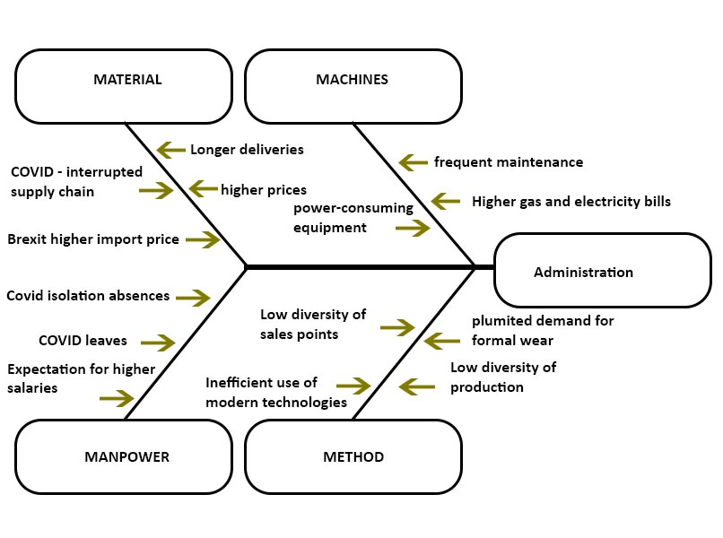
Cause-and-effect analysis
Fish-bone diagram

Slide 8
PMI
Strong points, Minuses and weak points, Usage of the strengths for improving the negatives, Analysis of the implications

Slide 9

Image SLide
Solutions
Effective usage of the social media
Implementing all possible digital tools for improving the sustainability of the company
Focus over the new demands and clients needs
Implementing changes and decisions for the new trends and customers desires.
Focus over opportunities and growth instead only over the savings and cost decreasing

Slide 10
THANK YOU
WOODGROVE BANK

Slide 11
references
Ashton, E. (2021) U.K. Firms Brace for a Great British Resignation in 2022, Bloomberg, 20 December, Available at: www.bloomberg.com/news/articles/2021-12-20/u-k-firms-fear-great-british-resignation-after-staff-departures (Accessed: 01 April 2023)
Baker, L. (2023) How Much Will Salaries Increase in 2023?, Employer News. 24 January. Available at: https://employernews.co.uk/pay-reward/how-much-will-salaries-increase-in-2023/ (Accessed: 01 April 2023)
Baron, R. A. (1997). The sweet smell of…helping: Effects of pleasant ambient fragrance on prosocial behavior in shopping malls. Personality and Social Psychology Bulletin, 23(5), 498–503. https://doi.org/10.1177/0146167297235005
Clauss, T. et al. (2021) Organizational ambidexterity and competitive advantage: The role of strategic agility in the exploration-exploitation paradox, Journal of Innovation & Knowledge, 6 (4), pp. 203-213
Cole, R., & Shirgholami, Z. (2022). The outlook for modern slavery in the apparel sector in a post-lockdown economy. Supply Chain Management: An International Journal, 27(4), 526-537.
Eustice, G. (2021) Labour shortages in the food and farming sector. Environment, Food and Rural Affairs Committee, 16 November. Available at: www.parliamentlive.tv/Event/Index/e4b0365f-1d36-4f17-8c3c-9368de782999 (Accessed: 04 April 2023)
Flanders, J. (2023) ‘CLOSING TIMES Full list of shops and chains closing down including M&S and Wetherspoons – is your high street favourite gone for good?’, The Sun, 20th February. Available at: https://www.thesun.co.uk/money/21417876/full-list-shops-chains-closing-down-high-street/
Harari, D. et al. (2023) Rising cost of living in the UK. House of Commons Library. 27 March. Available at: http://library2.nics.gov.uk/pdf/dof/2022/PDF220089.pdf (Accessed: 01 April 2023)
Inman, P. (2023) Business insolvencies jump 30% as 22,000 firms go bust in 2022. The Guardian. 31 January. Available at: https://www.theguardian.com/business/2023/jan/31/business-insolvencies-firms-go-bust-2022-england-wales (Accessed: 01 April 2023)
Institute for Government (2021) Supply chain problems, Institute for Government, 19 Nivember. Available at: https://www.instituteforgovernment.org.uk/explainer/supply-chain-problems#footnoteref18_88t3xzc (Accessed: 02 April 2023)

Slide 12
JM Allwood."An approach to scenario analysis of the sustainability of an industrial sector applied to clothing and textiles in the UK."https://www.sciencedirect.com/science/article/pii/S0959652607001643
Kachela, K., Lodh, S. and Nandy, M. (2021) 'Post-Pandemic Sustainable Business Solution', Journal of Business and Management Studies, 3 (1), pp. 47 - 57 (11). doi: 10.32996/jbms.2021.3.1.5..
Kim V., Krauss, C. and Troianovski, A. (2022) ‘Western Move to Choke Russia’s Oil Exports Boomerangs, for Now’, New York Times, 22 June. Available at: https://www.nytimes.com/2022/06/21/world/europe/ukraine-russian-oil-embargo.html (Accessed: 30 March 2023)
Lehto, M.R., Nanda, G. and Nanda, G. (2021) Decision‐making models, decision support, and problem solving. Handbook of human factors and ergonomics, pp.159-202.
Li, T.J., Cao, K., Liu, Z.C., Yuan, Z.Y., Li, P.J. and Li, Y., 2022. Linking Consumer's Needs with Product Performance on E-shopping Platforms with Fashion Big Data (FBD) API Plugins. In 15th Textile Bioengineering and Informatics Symposium, TBIS 2022 (pp. 205-215).
Mahrinasari, M.S., Hussain, S., Yapanto, L.M., Esquivel-Infantes, S.M., Untari, D.T., Yusriadi, Y. and Diah, A., 2021. The impact of decision-making models and knowledge management practices on performance. Academy of Strategic Management Journal, 20, pp.1-13.
Meslier-Crouzille, C., Tacneng, R., & Tarazi, A. (2013). Is Bank Income Diversification Beneficial? Evidence from an Emerging Economy.
Office for National Statistics (2021) The impacts of EU exit and the coronavirus on UK trade in goods, 25 May, Available at; www.ons.gov.uk/businessindustryandtrade/internationaltrade/articles/theimpactsofeuexitandthecoronavirusonuktradeingoods/2021-05-25 (Accessed: 02 April 2023)

Slide 13
Office for National Statistics (2022) Employment in the UK: February 2022, 15 February. Available at: www.ons.gov.uk/employmentandlabourmarket/peopleinwork/employmentandemployeetypes/bulletins/employmentintheuk/latest (Accessed: 05 April 2023)
Patel, N. (2019). The importance of diversifying revenue streams. Forbes. Retrieved from https://www.forbes.com/sites/neilpatel/2019/08/21/the-importance-of-diversifying-revenue-streams/?sh=2787ac9f23cd
Rana, S. (2023) Closure of Lloyds Pharmacy branches will wake-up ministers to reality of funding crisis faced by community pharmacy. Pharmacy Business. 7 March. Available at: https://www.pharmacy.biz/closure-of-lloyds-pharmacy-branches-will-wake-up-ministers-to-reality-of-funding-crisis-faced-by-community-pharmacy/ (Accessed: 01 April 2023)
Reuters (2022) ‘Putin says large Russian grain harvest to support higher exports’, Reuters, 12 May. Accessible at: https://www.reuters.com/markets/commodities/putin-says-large-russian-grain-harvest-support-higher-exports-2022-05-12/ (Accessed: 30 March 2023)
Smith, J. (2020). How SMEs can survive in a world of digital transformation. Small Business Trends. Retrieved from https://smallbiztrends.com/2020/01/smes-digital-transformation.html

Slide 14
Strauss, D. (2022) UK businesses report doubling of staff absences as Omicron cases surge, Financial Times, 13 January, Available at: www.ft.com/content/72d6311a-ecfa-4b0c-ae0f-09c795ae582f (Accessed: 01 April 2023)
Sulich, A., Sołoducho-Pelc, L. and Ferasso, M. (2021). Management styles and decision-making: Pro-ecological strategy approach. Sustainability, 13(4), p.1604.
Zhang, H., Veltri, A., Calvo-Amodio, J. and Haapala, K.R., 2021. Making the business case for sustainable manufacturing in small and medium-sized manufacturing enterprises: A systems decision making approach. Journal of Cleaner Production, 287, p.125038.

