Slide 1
Impact of External Forces on the Organisation – PESTLE and SWOT Analysis
Week 9 – 12th March 2020

Slide 2
Learning Outcomes for this session
To identify external forces that impact on the organisation using two environmental analysis tools (PESTLE & SWOT).
To identify learning points from part 1 of the assignment – the presentation.
To understand the requirements of part 2 of the assignment – the report.

Slide 3
‘The world out there influences the world in here’ (Buchanan and Huczynski, 2017)
External Environmental Factors, Trends and Developments
Internal organisation structures, processes and behaviours (and therefore the culture)
Lead to change in

Slide 4
Analysing External Factors
To inform strategy
To remain competitive
To ensure sustainable organisational performance

Slide 5
PESTLE Analysis
A PESTLE analysis is an audit of an organisation's environmental influences, with the purpose of using this information to guide strategic decision-making (CIPD, 2015).
Notes:
A PESTLE (Political, Economic, Sociological, Technological, Legal, Environmental) analysis is an audit of an organisation's environmental influences, with the purpose of using this information to guide strategic decision-making (CIPD, 2015).
A PESTLE analysis is a useful tool for understanding the ‘big picture’ of the environment in which an organisation is operating. Specifically a PESTLE analysis is a useful tool for understanding risks associated with market (the need for a product or service) growth or decline, and as such the position, potential and direction for an individual business or organisation.
PESTLE analysis can be used for business and strategic planning, marketing planning, organisational change, business and product development and research reports. It can also be used from a departmental or individual perspective to look at what you deliver, to whom and how you do it.

Slide 6
PESTLE
Political
Economic
Sociological
Technological
Legal
Environmental
Notes:
Political: what is happening politically in the environment in which you operate, including areas such as tax policy, employment laws, environmental regulations, trade restrictions and reform, tariffs and political stability.
Economic: what is happening within the economy, for example; economic growth/ decline, interest rates, exchange rates and inflation rate, wage rates, minimum wage, working hours, unemployment (local and national), credit availability, cost of living etc.
Sociological: what is occurring socially in the markets in which you operate or expect to operate, cultural norms and expectations, health consciousness, population growth rate, age distribution, career attitudes, emphasis on safety, global warming.
Technological: what is happening technology-wise which can impact what you do, technology is leaping every two years, how will this impact your products or services, things that were not possible five years ago are now mainstream, for example mobile phone technology, Web 2.0, blogs and micro-blogs (Twitter), social networking websites. New technologies are continually being developed and the rate of change itself is increasing. There are also changes to barriers to entry in given markets, and changes to financial decisions like outsourcing and insourcing.
Legal: what is happening with changes to legislation. This may impact employment, access to materials, quotas, resources, imports/ exports, taxation etc.
Environmental: what is happening with respect to ecological and environmental issues. Many of these factors will be economic or social in nature.

Slide 7
Video - PESTLE
https://www.cipd.co.uk/knowledge/strategy/organisational-development/pestle-analysis-factsheet

Slide 8
The Working World in 2020 (CMI, 2014)
Technology – we will be more connected
Managers need people skills to manage more of a variety of working – at home, different locations, flexible hours
Managers will use more data to recruit, engage, performance manage and retain staff
Diversity will become even more important – more women in the workforce, ageing population, globalisation
Implications – managers need to develop a culture that prioritises ethics, social responsibility, sustainability and flexibility.

Slide 9
The Fourth Industrial Revolution
2 views – pessimistic/optimistic
Likely – a time lag between jobs going and jobs being created
https://www.youtube.com/watch?v=khjY5LWF3tg

Slide 10
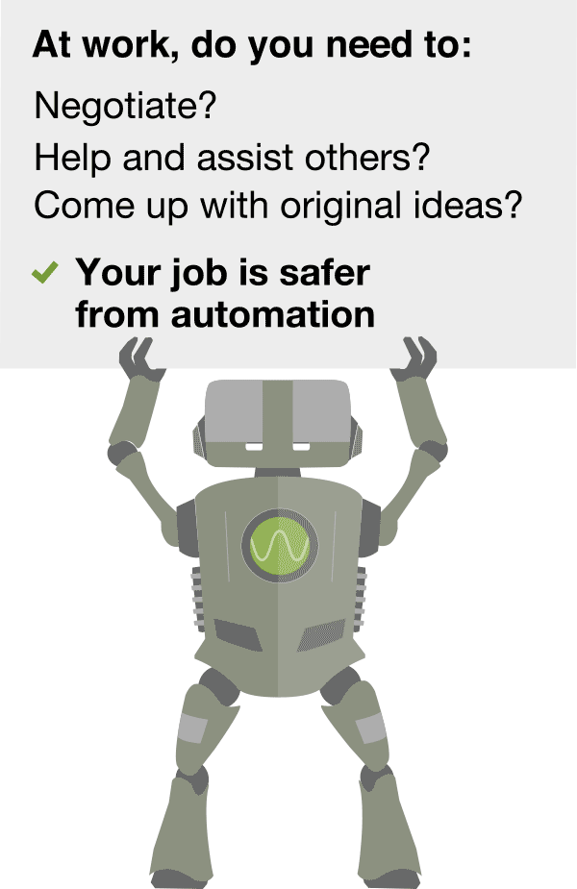
What makes a job susceptible to Automation?
Notes:
What makes a job susceptible to automation?
Certain aspects of a job are simpler to automate than others.
Social workers, nurses, therapists and psychologists are among the least likely occupations to be taken over as assisting and caring for others, which involves empathy, is a crucial part of the job.
Roles requiring employees to think on their feet and come up with creative and original ideas, for example artists, designers or engineers, hold a significant advantage in the face of automation.
Additionally, occupations involving tasks that require a high degree of social intelligence and negotiating skills, like managerial positions, are considerably less at risk from machines according to the study.
In contrast, while certain sales jobs like telemarketers and bank clerks may involve interactive tasks they do not necessarily need a high degree of social intelligence, leaving them exposed to automation.
As more advanced industrial robots gain improved senses and the ability to make more coordinated finger and hand movements to manipulate and assemble objects, they will be able to perform a wider range of increasingly complex manual tasks.
However, manipulation in unstructured environments — like the tasks that must be performed by a house cleaner — are still beyond the scope of automation for the foreseeable future.
Sophisticated algorithms are challenging a number of office and administrative support roles, particularly in legal and financial services.
Machines are already beginning to take on a number of tasks carried out by legal professionals by scanning thousands of documents to assist in pre-trial research.
(BBC, 2015)

Slide 11
Will Robots take my Job?
https://willrobotstakemyjob.com/

Slide 12
SWOT analysis
A SWOT analysis is a planning tool used to understand the Strengths, Weaknesses, Opportunities, and Threats involved in a project or in a business. It involves stating the objective of the business or project and identifying the internal and external factors that are either supportive or unfavourable to achieving that objective. SWOT is often used as part of a strategic or business planning process, but can be useful in understanding an organisation or situation and decision-making for all sorts of situations.

Slide 13
SWOT
Strengths (internal factor)
Weaknesses (internal factor)
Opportunities (external factor)
Threats (external factor)
Notes:
Strengths: positive tangible and intangible attributes, internal to an organisation and within the organisation’s control
Weaknesses: internal factors within an organisation’s control that detract from the organisation’s ability to attain the desired goal. Which areas might the organisation improve?
Opportunities: external attractive factors that represent the reason for an organisation to exist and develop. What opportunities exist in the environment, which will propel the organisation? Identify them by their ‘time frames’.
Threats: external factors beyond the organisation’s control which could place the organisation mission or operation at risk. The organisation may benefit by having contingency plans to address them if they should occur. Classify them by their severity and probability of occurrence.

Slide 14
Group Activity (pairs or 3’s) – 30 minutes
1. Identify an organisation of your choice, and using PESTLE, identify the current external factors impacting on the organisation.
2. When you have completed stage 1 of the analysis (point 1 above), you should further consider how the specific forces impacting on the organisation, might affect the organisation’s culture.
Notes:
Organisations:
Penyrheol Comprehensive School
Amazon
Morriston Hospital
Asda
Admiral Insurance

Slide 15
PESTLE
Political: what is happening politically in the environment in which you operate, including areas such as tax policy, employment laws, environmental regulations, trade restrictions and reform, tariffs and political stability.
Economic: what is happening within the economy, for example; economic growth/ decline, interest rates, exchange rates and inflation rate, wage rates, minimum wage, working hours, unemployment (local and national), credit availability, cost of living etc.
Sociological: what is occurring socially in the markets in which you operate or expect to operate, cultural norms and expectations, health consciousness, population growth rate, age distribution, career attitudes, emphasis on safety, global warming.
Technological: what is happening technology-wise which can impact what you do, technology is leaping every two years, how will this impact your products or services, things that were not possible five years ago are now mainstream, for example mobile phone technology, Web 2.0, blogs and micro-blogs (Twitter), social networking websites. New technologies are continually being developed and the rate of change itself is increasing. There are also changes to barriers to entry in given markets, and changes to financial decisions like outsourcing and insourcing.
Legal: what is happening with changes to legislation. This may impact employment, access to materials, quotas, resources, imports/ exports, taxation etc.
Environmental: what is happening with respect to ecological and environmental issues. Many of these factors will be economic or social in nature.

Slide 16
Changing the Culture
External factors may mean an internal culture change is needed to ensure long term sustainability. For example, when digitalisation of services needs to happen (DVLA).
Cultural Web can be used to assess the culture at the present time and to describe the culture required in the future.

Slide 17
Activity – 20 minutes
As a group reflect on your performance last week for assignment 1.
Consider - How well did you work as a group? How good was your contribution? What did you think of your presentation? What were its strengths and weaknesses? What would you do differently next time?

Slide 18
Learning Points from Presentation
Guidance said 10 references, yet some students used less. For the next part – use 30 sources.
Use UK English – spell ‘organisation’ and ‘behaviour’ correctly.
Underpin all your points with good sources – newspaper articles, annual reports, articles from the library catalogue, the organisation’s website.
Use articles to demonstrate the link between positive culture and success.
Paraphrase! Do not cut and paste.
Demonstrate critical analysis – consider lots of sources, compare.
Spend time on how your presentation/report looks. Professional = credible.
Present as a team – stand together, support each other.
Practice more so that the presentation flows, don’t use notes.

Slide 19
Assignment – Part Two (report)
Your task is to produce a 3500 word report that demonstrates your detailed understanding of the workplace culture and context of one organisation.

Slide 20
Task 1
An analysis of the internal and external context of the organisation, using appropriate models and tools.
Internal – sector, size, structure, culture – use a model such as the cultural web.
External – use PESTLE/SWOT
The analysis should include a discussion regarding how the organisation’s culture and other aspects have influenced its success.

Slide 21
Task 2
An analysis of the organisation’s ethical stance and whether or not employee or management behaviour matches their rhetoric.
Cover corporate responsibility, business case for managing ethically. Describe ethical stance and whether their actions reflect this.

Slide 22
Task 3
An analysis of the skills, knowledge and behaviour of an employee who is likely to perform well at the organisation, with reference to the organisation’s values.
Describe the values, explain (with references) that organisations tend to perform better when individual/organisations’ values align, describe attributes of employee who is likely to do well at the organisation you have chosen.

Slide 23
Task 4
At least 2 recommendations to further enhance the organisation’s culture, using examples from research or other organisations.
Discuss link between positive culture and success. Use peer reviewed articles/CIPD reports, for example to make recommendations.
The report should contain a title, executive summary, contents list, introduction, findings, conclusions, recommendations and reference list.

Slide 24
Guidance specific to this assessment
You should include at least 30 references. These should be taken from appropriate journals, textbooks and reliable websites. A reference list should be provided using Harvard referencing conventions.
You should provide appropriate definitions and should demonstrate your knowledge of environmental and cultural analysis tools and models such as PESTLE, SWOT and the Cultural Web. You should demonstrate your knowledge of how culture affects organisational efficiency. Furthermore you should demonstrate your understanding of business ethics and corporate social responsibility.

Slide 25
Guidance continued
You should demonstrate your ability to analyse the culture of your organisation and identify how this affects organisational efficiency, either positively or negatively. You should propose solutions to enhance the culture of your organisation, using research or examples from other organisations. You should also demonstrate your ability to analyse the external context of an organisation.
You should effectively apply models and theory relating to culture (Cultural web, Handy and other models) and environmental analysis (PESTLE, SWOT, for example) to an organisation.
You should demonstrate appropriate written skills – your report should be structured appropriately and be well written.

