Slide 1

Methods and Approaches in Interfaith Studies
Dr Angus M Slater

Slide 2
Critical Theory and Hermeneutics

Slide 3
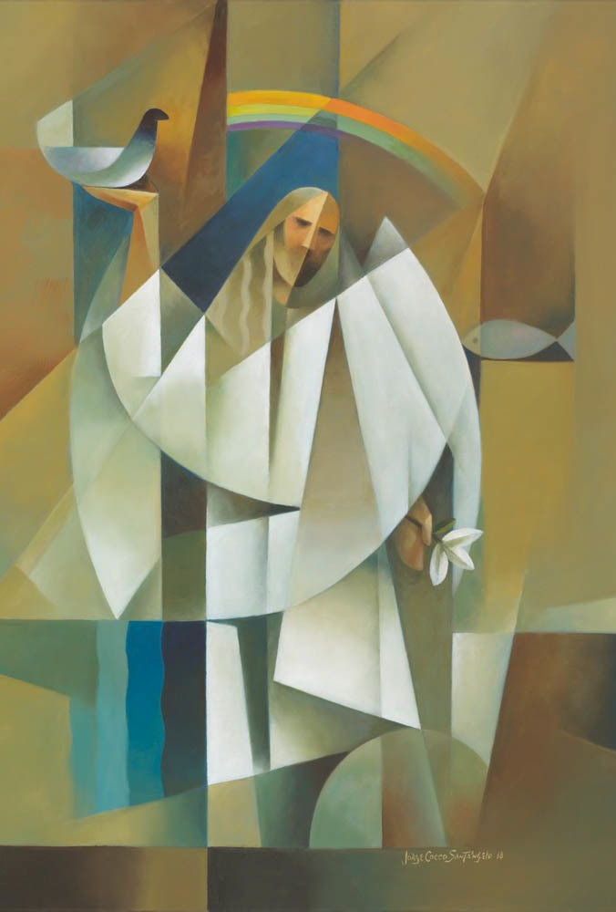
Revision
In the last section we examined the notion of ‘contextual’ hermeneutics and looked in more detail at two particular approaches, feminism and postcolonialism, which mount a challenge to the supposedly universal accounts often offered in interfaith studies.
Both of these approaches share similar concerns with redressing the balance of accepted discourse towards concerns that are particular to them – for example, feminist approaches aim to redress the overwhelmingly male discourse that currently exists.
In each case, the approaches operate by highlighting the extent to which our current discourse is contingent on assuming a particular viewpoint as universal, and the problematic outcomes that flow from this.

Slide 4

Revision
You also had four readings to complete (Tanner, Egnell, Gross, & Soumala).
Two of these readings aimed to give you examples of the connection of feminist approaches to specific issues of interfaith studies – Egnell explored the general methodological impact of a feminist approach, while Gross narrowed in specifically on the implications of a feminist position for the theology of religions.
The other two readings (Tanner and Soumala) both addressed issues of colonialism and post-colonialism, but from different perspectives.
Take the time to read through the set readings and work through the implications for the knowledge you have acquired during this module so far. Remember the discussion fora on the Moodle page too.

Slide 5
Critical Theory and HErmeneutics

Slide 6

Critical Theory and HErmeneutics
In the last section of this module, I want to extend the breadth of the methods and approaches discussed in the preceding sections by bringing them into conversation with some prominent forms of what is known as ‘critical theory’.
Critical theory is the generic term for a philosophical approach to culture, and especially to literature, that considers the social, historical, and ideological forces and structures which produce and constrain it.
Particularly influenced by post-modernist thinking, critical theory seeks to interrogate the operation of our contemporary world, with a focus on the role of texts, power, and ideology.

Slide 7
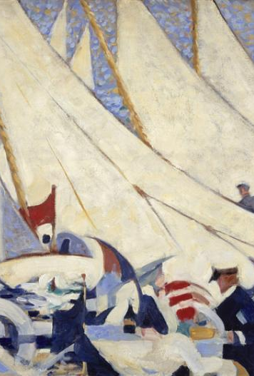
Critical Theory and HErmeneutics
In this section, I want to look at the work of three theorists – Paul Ricoeur, Jacques Derrida, and Michel Foucault – some of whose work you may already be familiar with.
Obviously we cannot examine their work in any great detail in a single section, but I hope the introduction to their work offers you some possibilities for critically examining the field of interfaith studies and potential routes for your own exploration.
Each scholar we look at has a different focus: Ricoeur has a focus on texts and interpretation; Derrida has a focus on text and context; Foucault has a focus on issues of truth, power, and knowledge

Slide 8
Paul Ricoeur (1913-2005)

Slide 9
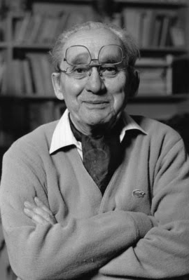
Paul Ricoeur
Ricoeur is most well known for his work on the nature of texts and the way in which we associate meaning with them.
This is particularly important when we have differing and conflicting interpretations of the text – how do we distinguish between them?
Ricoeur develops a theory of hermeneutics that addresses the need for suspicion in the processes of our reading and the problem of deception for determining meaning within texts.
For Ricoeur, our innermost thoughts and reflections occur within linguistic structures that can be interpreted and analysed and theses linguistic structures can restrict and facilitate the interpretation of texts.

Slide 10

Paul Ricoeur
Ricoeur is more sympathetic than Gadamer to the idea of the securing of objective meaning within a text – that a text does have a set meaning, that can be figured out - but does not agree that the basic principle for interpretation is the original intent of the author, which is the location that Gadamer places his foundation on.
However, the reconstruction of the meaning of texts (especially complex ones such as religious texts which articulate diverse worlds of human experience) requires the integration of details into a coherent whole. This is undertaken through an act of the imagination based on personal experience.

Slide 11
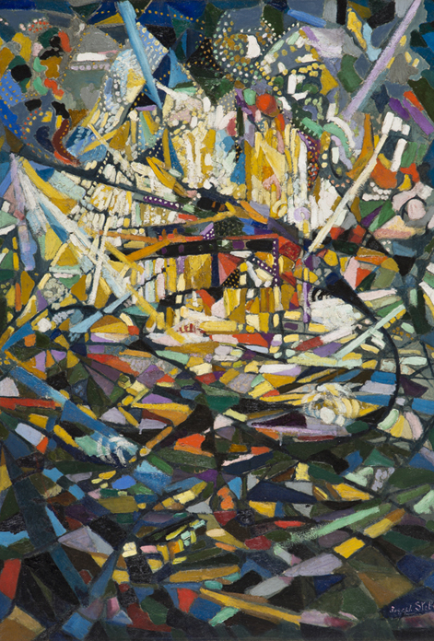
Narrative and Plot
This is critical as, for Ricoeur, interpretation depends on personal choices made by the interpreter with choice and value integral to the construction of meaning, that is determining the meaning of a text.
Interpretation involves a personal act of integrating textual details into a meaningful whole. It is narrative that projects a world in which the disparate elements within the text acquire coherence through ‘plot’ (Time and Narrative, 1983)

Slide 12

Narrative and Plot
In addition to the working of narrative in the production of meaning within and through a text, Ricoeur also suggests that the self discovers coherence in the emplotment of narrative.
The random actions achieve coherence as part of a single, larger action, which constitutes our conception of the self – it is only by placing our momentary decisions within the overarching constant of our own plot that they come to make sense.

Slide 13
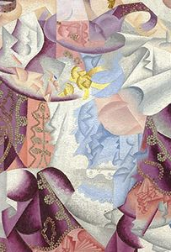
Suspicion and Retrieval
Ricoeur (contrary to Gadamer) recognizes the place of explanation alongside understanding and adopts a willingness to suspect and a willingness to listen (the ‘second naïveté’).
The revealing moment in reading is not something outside the text, nor the historical referent of the text, but ‘the world of the text’ that is the interconnection that unfolds when one reads the text.
The object of interpretation is not experience as felt by the author, but the meaning of such experiences as inscribed in linguistic and symbolic expressions.

Slide 14
Jacques Derrida (1930-2004)
#

Slide 15
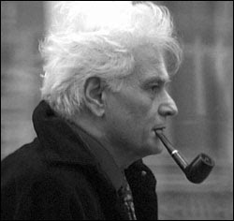
Jacques Derrida
Jacques Derrida was born in 1930, to Algerian Jewish parents, before being educated at the Ecole Nationale Superieur in Paris.
He is best known for his development of deconstruction as a method of critical analysis of philosophical and literary language, which emphasizes the internal workings of language and conceptual systems, the relational quality of meaning, and the assumptions implicit in forms of expression.
His major works include Of Grammatology and Speech and Phenomena, almost all of which are exceptionally difficult reads.

Slide 16
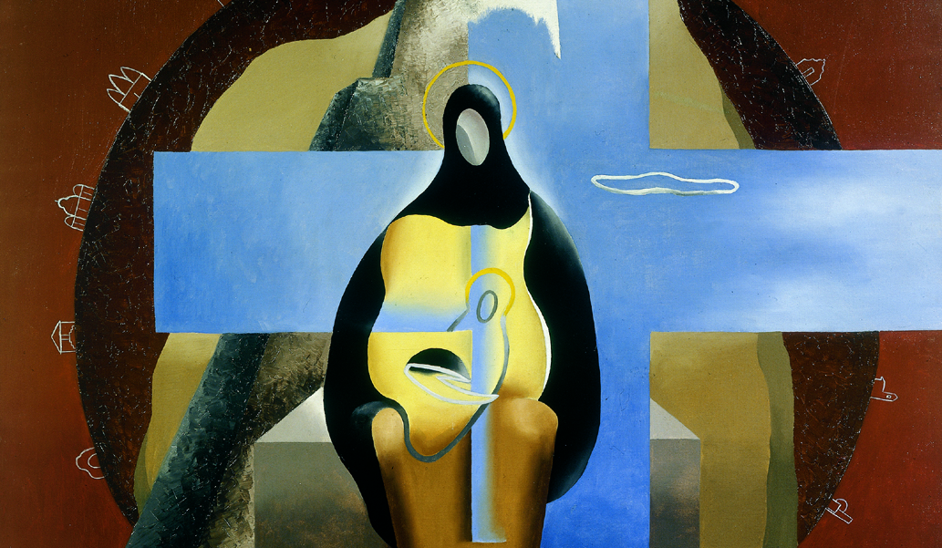
Hors-Texte
In the specific hermeneutical context, he is perhaps best known for a short phrase, which is often misapplied and misinterpreted:
‘il n'y a pas de hors-texte’
It is usually mistranslated as ‘There is nothing outside the text’ – suggesting the ability to produce meaning from the text alone
However, it is better translated as: ‘There is no outside-text’ – suggesting that the line between text and con-text cannot be properly distinguished at all.

Slide 17
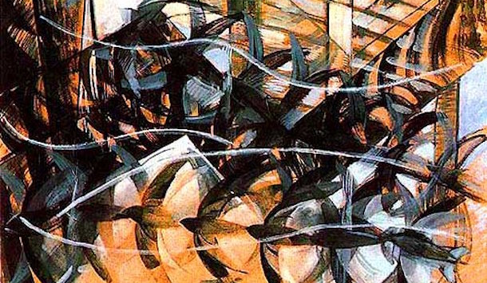
Hors-Texte
According to Michael Wood in the London Review of Books:
"It did not hold, as many of its detractors thought it did, that there was no reality apart from language, and it’s wrong to translate Derrida’s famous ‘Il n’y a pas de hors-texte’ as ‘there is nothing outside the text.’ A hors-texte is an unnumbered page in a printed book. Derrida is saying that even the unnumbered pages count, just as an outlaw, in French an hors-la-loi, has everything to do with the law, since it makes him what he is."
LRB Vol 38, 3, emphasis added.

Slide 18
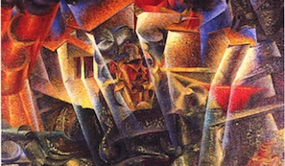
Hors-Texte
Understood as such, it's not really such a strange idea, that the things outside of the text itself can and do give meaning to it in an ever-evolving way. Critically, these things outside the text can often be more important than the actual content of the text itself – particularly in the context of religious texts.
In a philosophical context we can understand it to assert the idea that context is always present, isn't necessarily stable, and is always bound up with our attempts to interpret the meaning of the text alone.

Slide 19
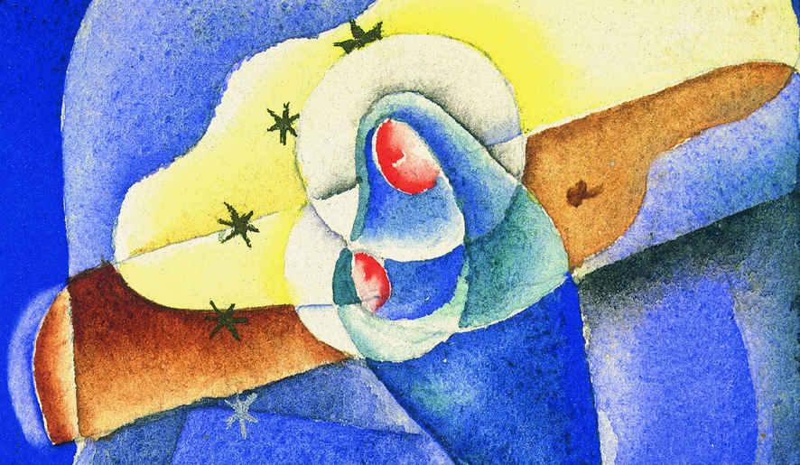
Deconstruction
For Derrida, this awareness of the hors-texte extends beyond those things we would generally consider ‘texts’ – to include aspects of our social system, our philosophies, and our cultural assumptions.
Each aspect of our reality, for Derrida, depends for its meaning on other aspects and the relationship between them – just as words depend for their meaning on other words to define them.
Deconstructing these relationships between aspects of our reality was the keystone of Derrida’s work.

Slide 20
Michel Foucault (1926-1984)

Slide 21
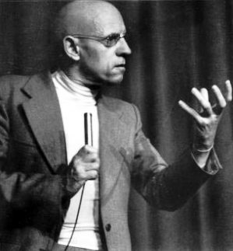
Michel Foucault
Michel Foucault is perhaps the most influential scholar in the field of critical theory, tying together many of the approaches we have looked at so far in this section.
He was born to a wealthy family from French provinces, before studying at the Ecole Normale Superieur in Paris, earning his doctorate in 1961.
Foucault’s work builds on the notion of deconstruction, but applies it to the political and social construction of our society – particularly the relationship of truth, knowledge, and power.

Slide 22
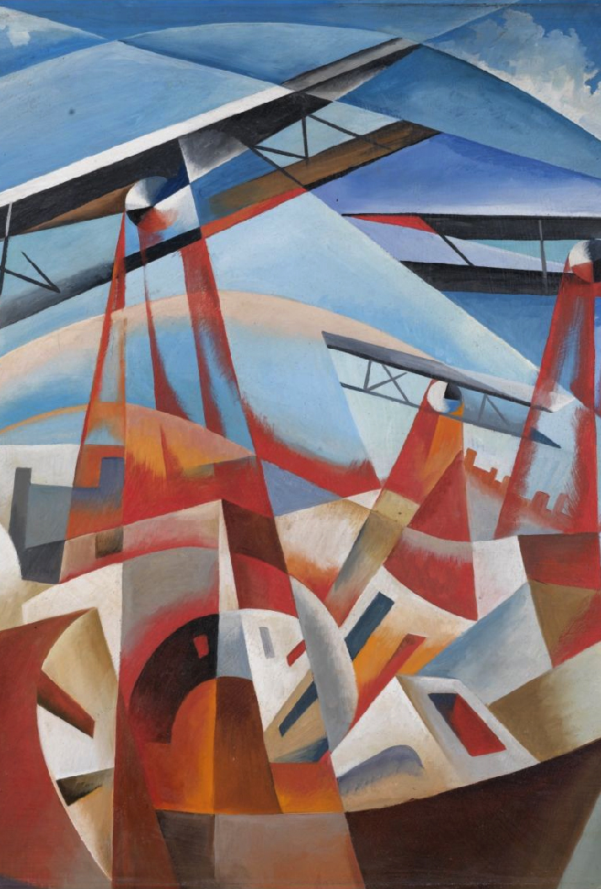
Truth / knowledge / power
Foucault examines the relation between truth and power.
For him, “truth isn’t outside power, or lacking in power. … [Truth] isn’t the reward of free spirits, the child of protracted solitude … Truth is a thing of this world: it is produced only by virtue of multiple form of constraint” (1984, 72-73).
What, then, does Foucault mean by ‘truth’?

Slide 23
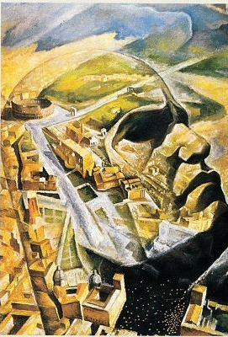
Truth / knowledge / power
Truth is to be understood as “a system of ordered procedures for the production, regulation, distribution, circulation and operation of statements” (1984, 133).
Truth is linked with discourses within which propositions have truth value—i.e. either true/false.
In addition, Foucault tells us that ‘truth’ “is linked in a circular relation with systems of power which produce and sustain it, and to effects of power which it induces and which extend it” (1984, 133).

Slide 24

Truth / knowledge / power
Foucault’s conception of ‘truth’ is not typical of traditional philosophy or most aspects of inter-religious dialogue.
Traditional epistemology is concerned with the necessary and sufficient conditions for someone to know a state of affairs—e.g. “there is a red car across the street”
The picture gets muddied when we consider much more complex examples, such as the claim that “children between ages 2 and 4 do not have abstract principles guiding classification”

Slide 25
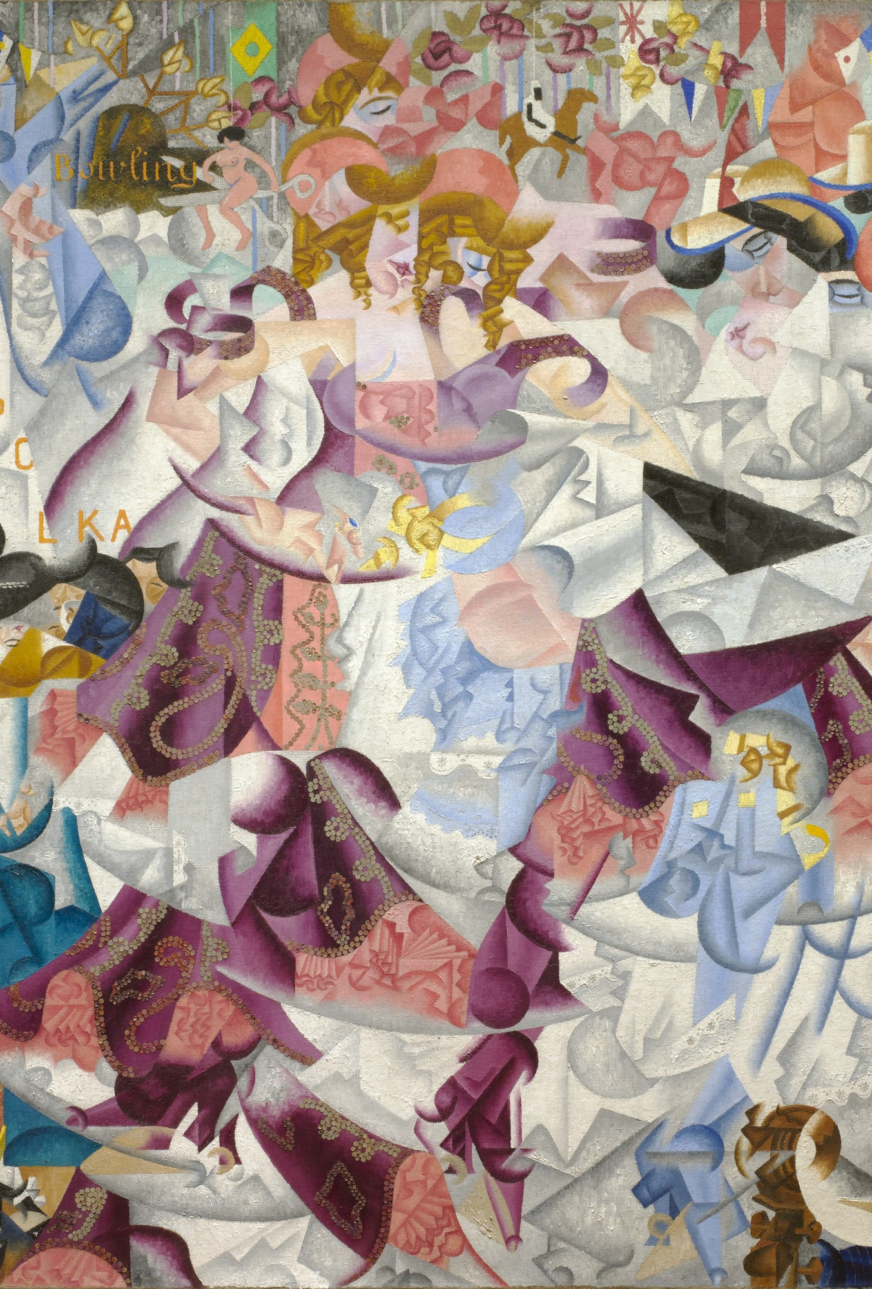
Truth / knowledge / power
Similarly, inter-religious discussions often focus on mediating, resolving, or erasing discussions of truth.
Often these truth claims are incredibly complicated and relying on a distinguishing system of discourses in order to make sense and operate effectively.
It is difficult to conceive of a religious truth as epistemologically detached from surrounding truths.

Slide 26
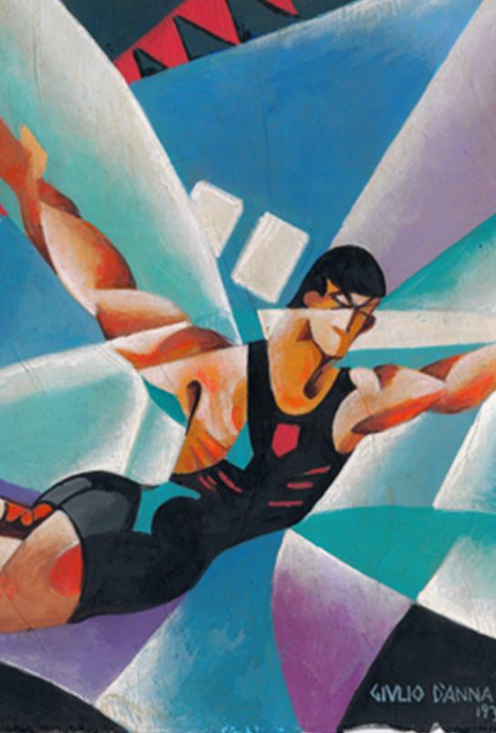
Truth / knowledge / power
These are the examples that interests Foucault. Why?
“Truth isn’t outside power, or lacking in power. … [It] induces regular effects of power” (131).
He wants to examine the effects of the social relations that sustain bodies knowledge on individuals – that produce the ‘truths’ with which we all work.

Slide 27
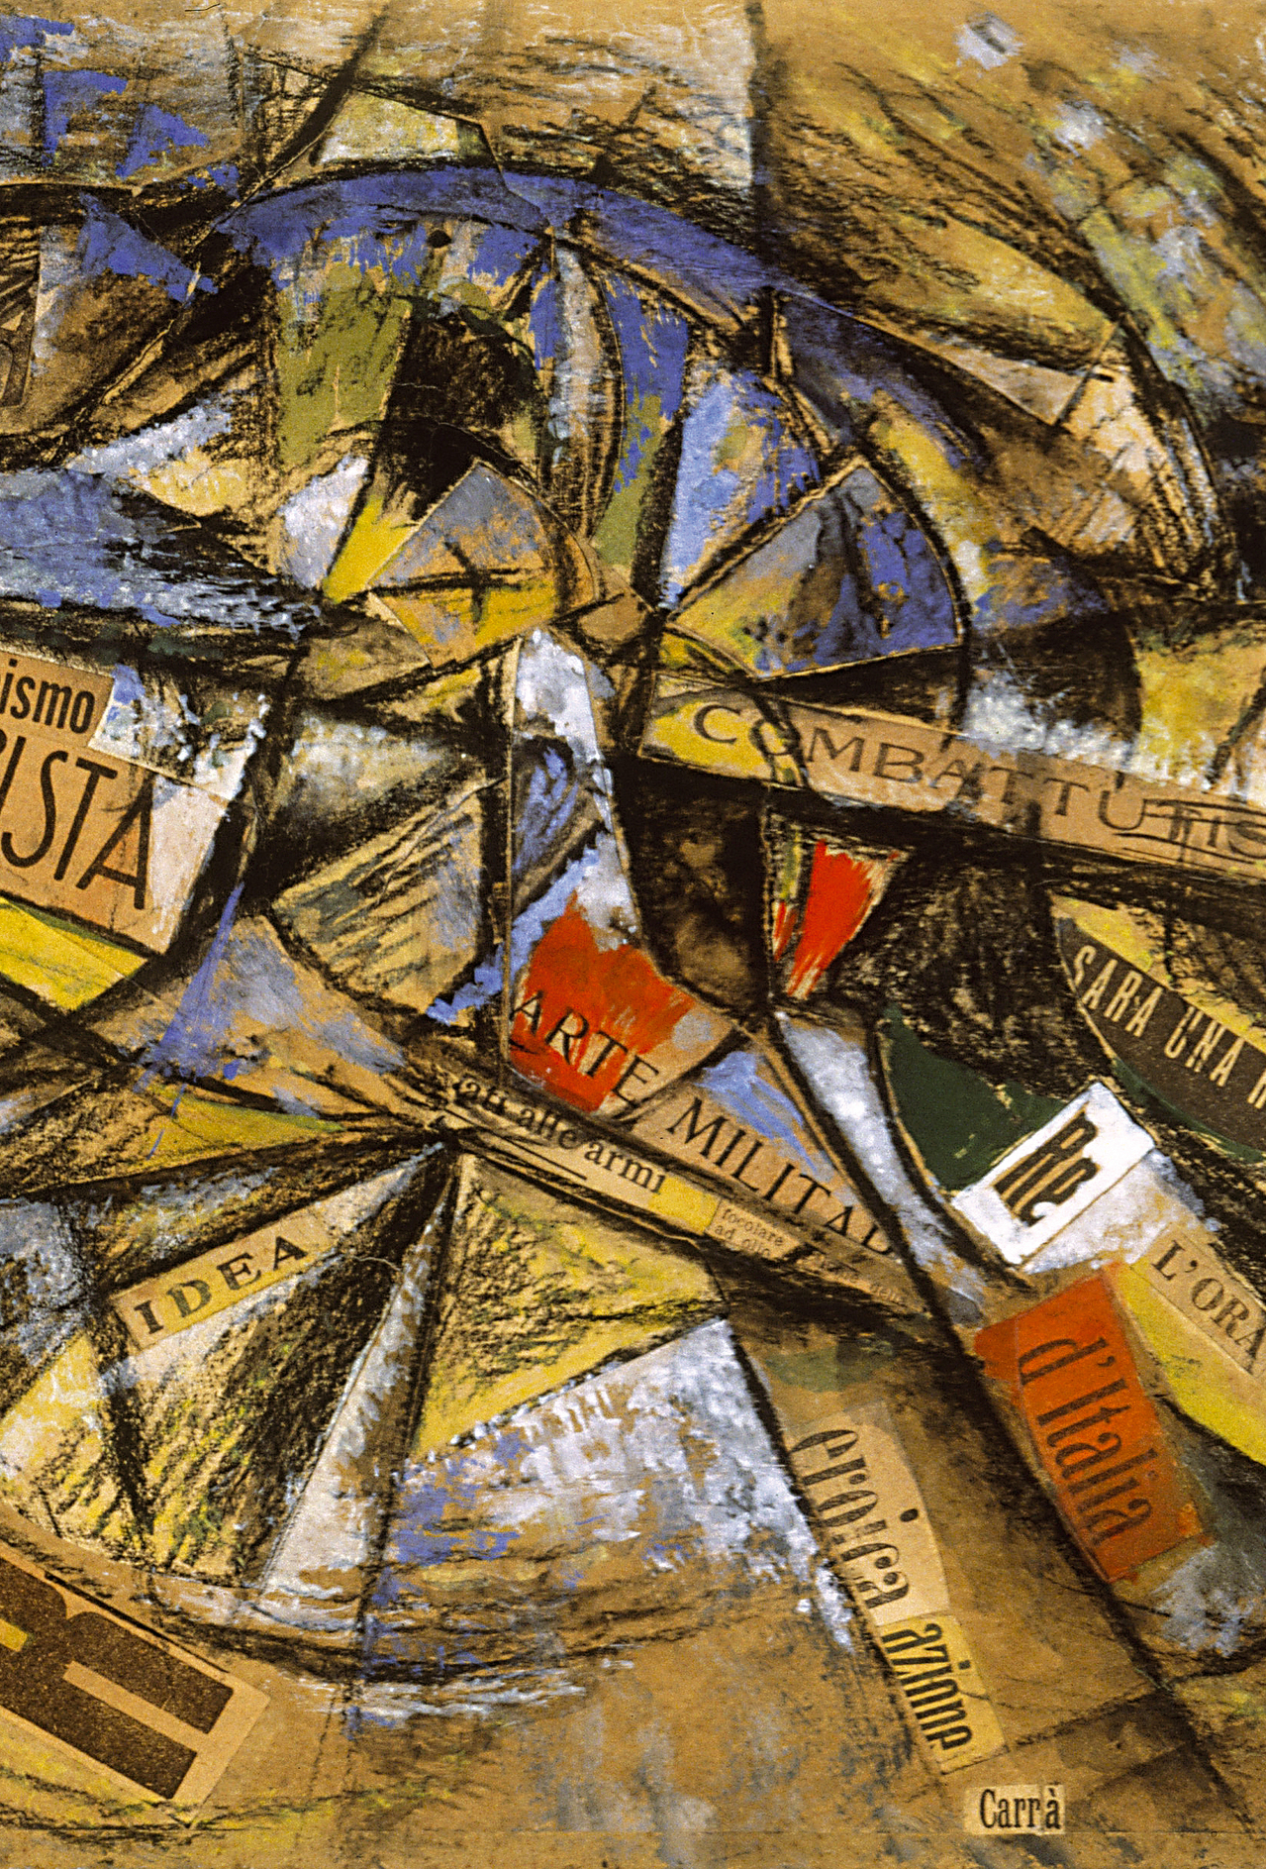
Truth / knowledge / power
Basic idea: Truth is produced by power.
What counts as knowledge differs across societies and across time, and what counts is determined by systems of power.
Foucault argues that the idea of progress is illusory: Knowledge does not make one free.
Each society has its own discourse about truth which presupposes certain social power relationships and what we think of as progress is really just a different form of domination and control.

Slide 28
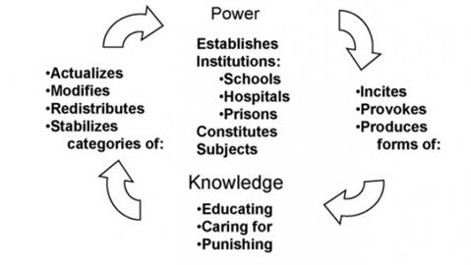

Slide 29

Ideology
There is an important overlap of this insight with the notion of ideology.
Sociologists define ideology as “cultural beliefs that justify particular social arrangements, including patterns of inequality” (Macionis, 2005).
Dominant groups use these sets of cultural beliefs and practices to justify the systems of inequality that maintain their group's social power over non-dominant groups.
The dominant ideology in a society is passed along through the society's major social institutions, such as the media, the family, education, and religion. As societies changed throughout history, so did the ideologies that justified systems of inequality.

Slide 30
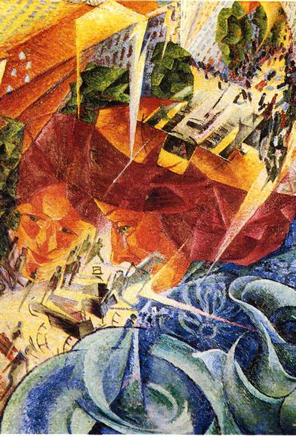
Foucault and Ideology
Foucault’s conception of truth has implications for critical theory with its emphasis on a critique of universal ideologies, e.g. Marxism.
Why?
Ideologies systematically distort social reality. This implies there is true view behind ideology.
For Foucault, the workings of modern relations of power cannot be explained by a ruling class generating a set of beliefs that systematically distorts social reality. Why is that?

Slide 31
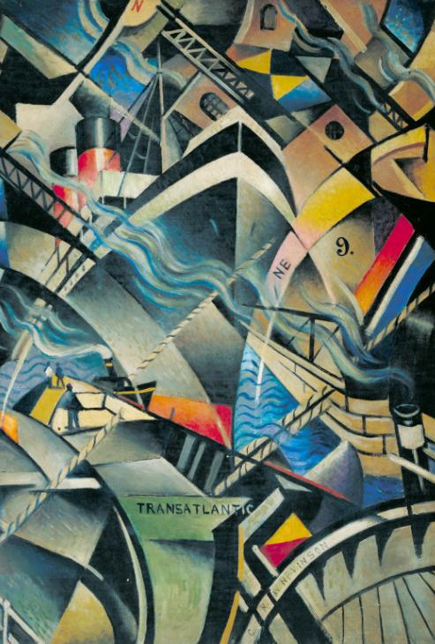
Foucault and Ideology
Ideology presupposes truth is opposite to power. Truth can undermine ideological distortions and their power over individuals.
However since in Foucault’s view, truth and power are interrelated, the question is not “a matter of emancipating truth from … power (which would be a chimera, for truth is already power) but of detaching the power of truth from hegemony. … The political question … is not error, illusion … it is truth itself” (133).

Slide 32
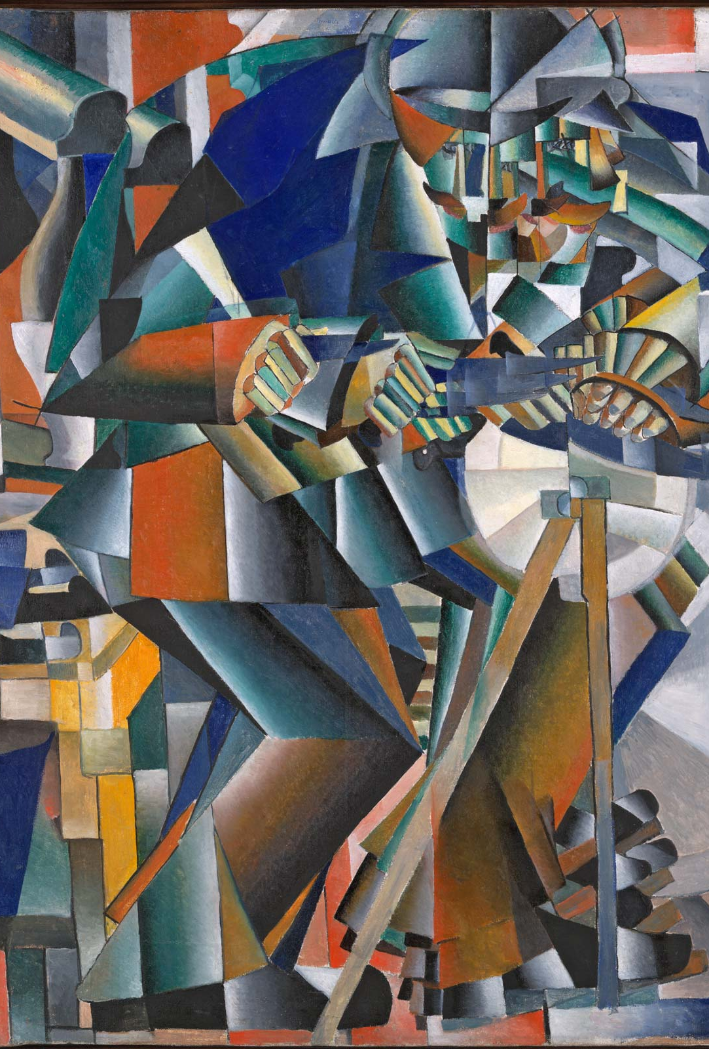
Foucault and Ideology
Furthermore, Foucault sees ideology critique as focusing on the beliefs and intentions of individuals.
The problem for him is not about “changing people’s consciousness– or what’s in their heads—but the political, economic, institutional regime of the production of truth” (133).
This is because of the connection between social systems of meaning production and individual choices and beliefs.

Slide 33
Round-Up

Slide 34

Round-Up
In this section, we have introduced three examples of the connection of critical theory to our interaction with interfaith studies and hermeneutics.
Each scholar offers a new angle for questioning our assumptions in interfaith studies and a new angle for seeking understanding of the complexity of interfaith relations.
If you are specifically interested in these approaches and the broader work of these scholars then I would recommend engaging with their core works initially before attempting to engage with the particular material on religious matters.

Slide 35
Readings
I would recommend the film ‘A Pervert’s Guide to Ideology’ featuring Slavoj Zizek, clip here: https://www.youtube.com/watch?v=TVwKjGbz60k
Moyaert, M. (2008). The (Un-)translatability of Religions? Ricœurs Linguistic Hospitality as Model for Inter-religious Dialogue, Exchange, 37(3), 337-364.
Moyaert, M. (2010). Ricoeur on the (Im)Possibility of a Global Ethic Towards an Ethic of Fragile Interreligious Compromises, Neue Zeitschrift für systematische Theologie, 52, 440-461.
Foucault, Michel. “The Subject and Power.” In Beyond Structuralism and Hermeneutics, edited by H. Dreyfus and P. Rabinow, 208-226. The University of Chicago Press, 1983.
David Newheiser, Derrida and the Danger of Religion, Journal of the American Academy of Religion, Volume 86, Issue 1, March 2018, Pages 42–61
S. Walker, “Challenging Deconstruction: A Look at Persons, Texts and Hermeneutics,” Churchman 111 (1997): 239–48

