Slide 1

Language Development
By Imogen Fish, Jada Lynch, Carys Messer, Sinead Cherrington

Slide 2
Introduction
Language development is the process of which children come to understand and communicate language during their early childhood (Encyclopedia of Children's Health, 2020).
We are going to discuss 4 theorists who have explored language development.
Encyclopedia of Children's Health. (2020) Language Development. Available at: http://www.healthofchildren.com/L/Language-Development.html (Accessed: 20th April 2020).

Slide 3
Who is B.F Skinner?
B. F Skinner is an American Behaviorist psychologist from the 1950s, who interlinks with Language development.
ER Services (2020), says that Skinner was best known for his theory of “Operant Conditioning.” The Key element of Skinners Theory is reinforcement.
ER Services- Child Development (2020), Key Points, Human Language Development, ER Services

Slide 4
What is reinforcement?
According to the Oxford Dictionary (1929), is “additional men and ships in the military,” which means having back up. Skinner believes that language is learnt through coping and modelling behaviours.
Fowler. W. H, Fowler. F. G (1929), Reinforcement, Oxford Dictionary, New Edition (2nd Edition), p944

Slide 5
What is Operant Conditioning?
McLeod (2018), says that children best learn “through rewards and punishment.”
Huitt (1997), believes that operant conditioning is “influenced by the environment.”
McLeod. S (2018), Skinner – Operant Conditioning, Simply Psychology
Huitt, W., & Hummel, J. (1997). An introduction to operant (instrumental) conditioning. Educational Psychology Interactive. Valdosta, GA: Valdosta State University.

Slide 6
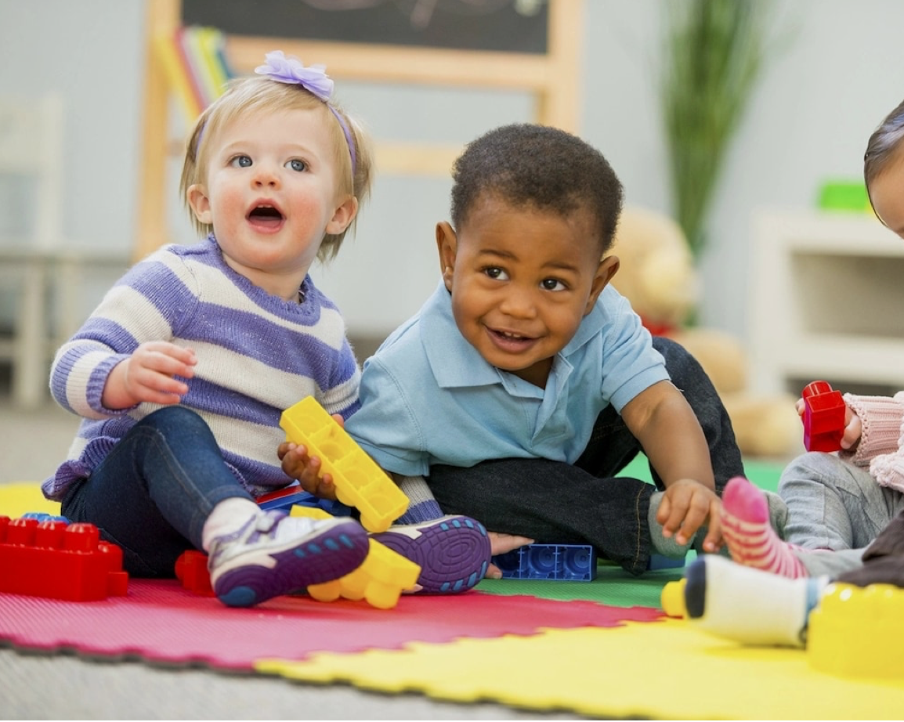


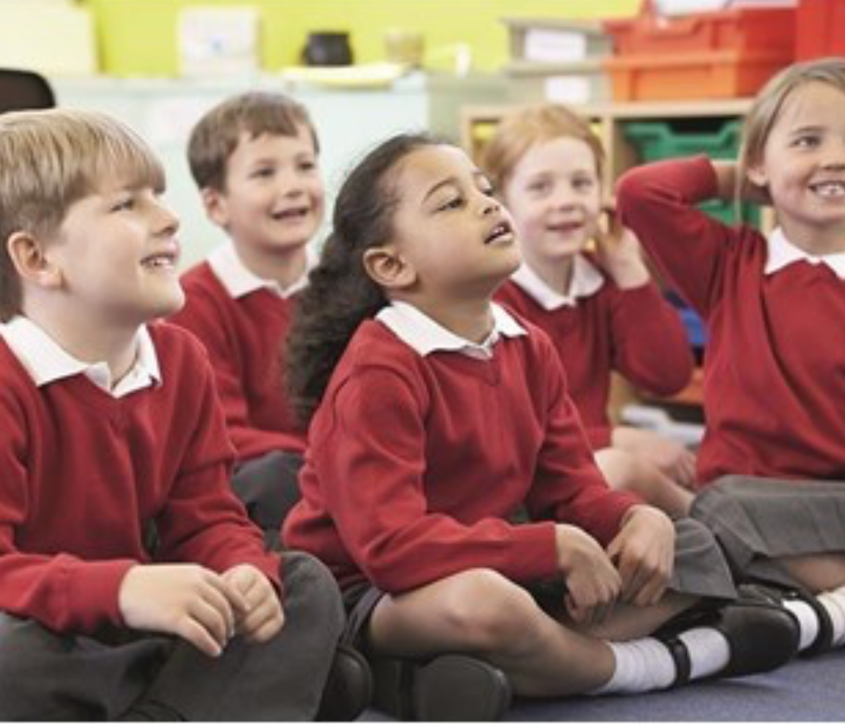
What is our environment around us?
Our environment is not just the outdoors. It is:
- The toys you have/ don’t have
- Friends
- Your local area
- Your school
- Your parents

Slide 7
There are three types of responses within Skinner’s theory, which are:
Neutral Operants- response from the environment
Reinforcement- the environment that increase the probability of behaviors being repeated
Punishers- the environment that decrease the likelihood of behavior being repeated.
McLeod. S (2018), Skinner – Operant Conditioning, Simply Psychology

Slide 8
Types of reinforcement
Krishnan (2014) says that there are 2 types of reinforcement. Positive and negative.
What is reinforcement in regards to children?
He says that a reinforcement is when “people learn behaviour and learn how to act.”
Krishnan. I. A (2014). A Review of B. F. Skinner’s ‘Reinforcement Theory of Motivation, Journal of Research in Education Methodology. 5, p682- p683

Slide 9
Positive Vs Negative reinforcement
Positive reinforcement according to Krishnan (2014) is “that if someone gives a positive response to something or do some positive action he or she should be rewarded positively.”
Negative reinforcement according to Krishnan (2014), is sometimes, wrongly considered as a punishment. However, they are completely different, punishment is “the application of aversive stimuli in order to reduce the chance of being a behaviour repeated”. Whereas, negative reinforcement is “the removal of aversive stimuli in order to increase the probability of being a behaviour repeated”.
Krishnan. I. A (2014). A Review of B. F. Skinner’s ‘Reinforcement Theory of Motivation, Journal of Research in Education Methodology. 5, p682- p683

Slide 10
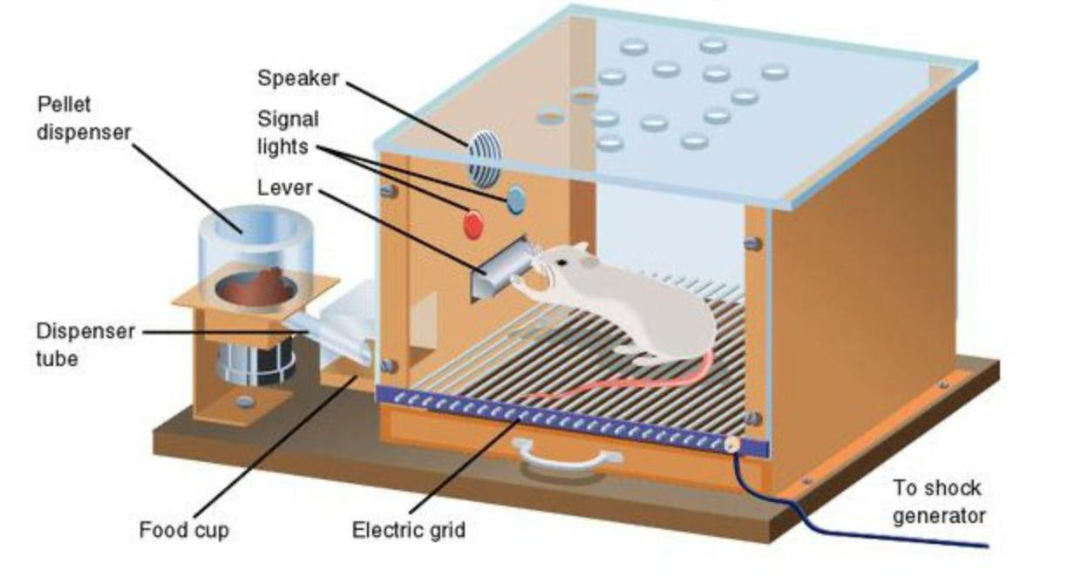
Skinners Box
Image from McLeod. S (2018), Skinner’s Box, Operant Conditioning

Slide 11
Limitations to Skinner’s Theory
Khalidah (2014), there are a number of limitations of Skinners theory. One being that children are unable to repeat and copy what an adult says, especially, if what the adult has said includes words that the child has not yet learnt and started to use. Another limitation of skinners theory is because Skinner says children learn by coping and imitating from adults, however, Brown and Hanlon (1970) says that there is research too show that parents rarely reinforce correct language and grammar in what a child says, but they tend to focus on things such as truthfulness or accuracy of statements.
Khalidah. N (2014), Limitations, Chomsky’s and skinner’s theory of language acquisition, SlideShare, p8 [

Slide 12
Conclusion
There are several positives and negatives of Skinner’s theory.
The child's environment has a huge impact on their development, along with the concept of rewards and punishments.

Slide 13
References
Arora. M (2018), Image, 5 Important Factors That Influence Early Childhood Development, First Cry Parenting [Online] Available at: https://parenting.firstcry.com/articles/5-environmental-factors-influencing-early-childhood-development/ [Accessed on; 15/04/20]
Compass. B (2018), Image, 4 Ways To Teach Kids To Care About The Environment, Baltic Compass [Online] Available at: https://balticcompass.org/4-ways-to-teach-kids-to-care-about-the-environment/ [Accessed on: 15/04/20]
ER Services- Child Development (2020), Key Points, Human Language Development, ER Services [Online] Available at: https://courses.lumenlearning.com/atd-hostos-childdevelopment/chapter/human-language-development/ [Accessed on: 14/03/20]
Fowler. W. H, Fowler. F. G (1929), Reinforcement, Oxford Dictionary, New Edition (2nd Edition), p944 [Book]
Huitt, W., & Hummel, J. (1997). An introduction to operant (instrumental) conditioning. Educational Psychology Interactive. Valdosta, GA: Valdosta State University. [Online] Available at: http://www.edpsycinteractive.org/topics/behavior/operant.html [Accessed on: 14/03/20]
Khalidah. N (2014), Limitations, Chomsky’s and skinner’s theory of language acquisition, SlideShare, p8 [Online] Available at: https://www.slideshare.net/nurkhalidah1/chomskys-and-skinners-theory-of-language-acquasition [Accessed on: 18/03/20]
Knight. S (2018), Image, A calming, therapeutic classroom environment, Headteacher Update [Online] Available at: https://www.headteacher-update.com/best-practice-article/a-calming-therapeutic-classroom-environment/167066/ [Accessed on: 15/04/20]
Krishnan. I. A (2014). A Review of B. F. Skinner’s ‘Reinforcement Theory of Motivation, Journal of Research in Education Methodology. 5, p682- p683 [Article online] Available at: https://www.researchgate.net/publication/306091479_A_Review_of_B_F_Skinner's_'Reinforcement_Theory_of_Motivation [Accessed on: 19/03/20]
McLeod. S (2018), Skinner’s Box, Operant Conditioning, Simply Psychology [Online] Available at: https://www.simplypsychology.org/operant-conditioning.html [Accessed on 6/04/20]
McLeod. S (2018), Skinner – Operant Conditioning, Simply Psychology [Online] Available at: https://www.simplypsychology.org/operant-conditioning.html#shape [Accessed on: 14/03/20]
Shrestha. P (2017), Skinner’s theory on Operant Conditioning, Operant Conditioning, Psychestudy [Online] Available at: https://www.psychestudy.com/behavioral/learning-memory/operant-conditioning/skinner [Accessed on: 16/03/20]
Tersoo. A, Image, What is physical environment in childcare, Legit [Online] Available at: https://www.legit.ng/1177703-what-physical-environment-childcare.html [Accessed on: 15/04/20]

Slide 14
Noam Chomsky
American theoretical linguist
1950’s criticised Skinner’s theory
Universal Grammar
Language Acquisition Device
Human nature
Language and Mind – 1972
Language acquisition theories
generative, transformational or transformational-generative
Modern science linguistics

Slide 15
Universal Grammar
Instinctive, biological grammatical groups
Syntactic Structures - 1957
Innate knowledge
Genetically programmed

Slide 16
Where did Chomsky’s idea come from?
Language shares fundamental characteristics
Language is learnt without much effort
Language is leant in the same sequence (Language acquisition)
Language is learnt even with lack of incentive

Slide 17
First Language Acquisition STAGES
Identify and make speech sounds
Babble
Basic words
Vocabulary expands
Two-word sentences

Slide 18
How Chomsky’s theory affects language learning in classrooms
No optimal age
Learning new language is easier when younger
Natural language acquisition
Second language

Slide 19
References
Ambridge, B. and Lieven, E.V.M. (2011). Child Language Acquisition: Contrasting Theoretical Approaches. Cambridge: Cambridge University Press, pp. 103-136.
Chomsky, N. (2005). Three Factors in Language Design. Linguistic Inquiry, [online] Volume 36(1), pp. 1-22. Available at: http://citeseerx.ist.psu.edu/viewdoc/download?doi=10.1.1.174.4334&rep=rep1&type=pdf [Accessed: 29 Mar. 2020].
Field, J. (2005). Language and the Mind. Semantic Scholar, [online] pp. 1-29. Available at: https://pdfs.semanticscholar.org/31c0/4743c625dab9171eb6462b5efc8616ab675e.pdf?_ga=2.236184003.358722366.1585230573-282017970.1579468262 [Accessed 27. Mar 2020].
Lemetyinen, H. (2012). Language Acquisition. Simplypsychology, [online] pp. 1-4. Available at: https://www.simplypsychology.org/simplypsychology.org-Language.pdf [Accessed: 18 Mar. 2020].
McGilvray, J. (2019). Noam Chomsky. [online] Encyclopædia Britannica, pp. 3-6. Available at: https://www.britannica.com/biography/Noam-Chomsky [Accessed: 28 Mar. 2020].
Singhal, V. (2020). Noam Chomsky Language Acquisition Theories Explained. Bright Hub Education, [online] Available at: https://www.brighthubeducation.com/language-learning-tips/71728-noam-chomsky-language-acquisition-theories/ [Accessed: 26 Mar. 2020].
Stanborough, R. (2019). Born This Way: Chomsky’s Theory Explains Why We’re So Good at Acquiring Language. Healthline, [online] Available at: https://www.healthline.com/health/childrens-health/chomsky-theory#innate-skill [Accessed: 26 Mar. 2020].

Slide 20
Jerome Bruner
Jerome Bruner was an ‘American psychologist’ born in New York in 1915 (Pritchard, 2018. Smidt, 2011).
It wasn’t until 1972, after he had “transferred from Harvard to the University of Oxford…where he studied child agency and children’s language” (Aubrey and Riley, 2019, p.119), that Bruner really focused on language acquisition. Prior to this he viewed “language only as a window on cognition” (Bakhurst and Shanker, 2001, p.31), initially underestimating its significance.
(The Washington Post, 2016)

Slide 21
Chomsky’s Influence
Bruner partly supported Chomsky’s language development theory in terms of “innate grammar” (Smidt, 2011, p. 44), however, he took a much more constructivist view.
Bruner believed that language is acquired through “social interaction that takes place between child and adult” (Harris, 1992, loc.695), and in order to “generate the rules of grammar [children must have] … a history of social and conceptual experience” (Smidt, 2011, p.45) in order to do so .
It was Chomsky’s lack of attention towards the impact of social interaction on language development, that influenced Bruner’s Language Acquisition Support System, which he believed assisted the child to ‘move form prelinguistic to linguistic communication’ (Smidt, 2011, p.45).

Slide 22
Formats & Routine Interactions
Language is largely acquired through the “context of formats” and “routine interactions” between children and adults, whereby the adult incorporates the use of language when addressing the child (Jerome Bruner, language culture and self p.47-48).
Adults that interact with the child are the Language Acquisition Support System.
Interactions can range from day to day tasks such as feeding, changing, bathing and bedtime routines, to activities and games such as “peek a boo” or reading.

Slide 23
How is Language Acquired Through Formats and Routine Interactions?
Repetition of Formats and Routine Interactions
Enables the child to map the linguistic knowledge they have obtained, through the familiarity and predictability of the social context
Over time, as result of continued repetition the child will begin to interpret and create meaning from the language used within the social context.
This will aid the transition from non-linguistic communication (gestures, shouting, crying etc) to linguistic communication (using words).
Allows the child to “crack the code” (Harris, 1992, loc.817) of language.
Bakhurst and Shanker, 2001. Harris, 1992. Clibbens, 1993. Smidt, 2011.

Slide 24
What makes a format an opportunity for language acquisition?
Format | Example of Routine Interaction | Example of Activity
”Delimited number of significant elements (objects and actions)”. (Bakhurst and Shanker, 2001, p.46) | Feeding: The elements involved would be the food, caregiver, child and the process of feeding. | Game of peek-a-boo: the elements involved would be the caregiver, the child, the action of hiding behind hands and saying peek-a-boo when reappearing.
”A clearly repetitive structure allowing for the anticipation of elements but with some possibilities for substitution of elements”. (Bakhurst and Shanker, 2001, p.46) | The child is most likely to feed at similar times of the day creating the repetitive structure, elements that could be substituted would be the caregiver and food. | The game is very repetitive and consists of the same actions.
Spoken language, which enables learning to take place. | The language included would be the caregiver, confirming what the child wants to eat to establish a connection between the word and the food. | The language involved would be the use of the word ‘peek-a-boo’.
”Reversible role relationships between adult and child”. (Bakhurst and Shanker, 2001, p.46) | In reverse, rather than the caregiver asking ”Do you want milk?” the child could ask for the milk themselves. | When the child understands the game they may swap roles with the caregiver and hide behind their hands and say ‘peek-a-boo’.
(Bakhurst and Shanker, 2001. Smidt, 2011)

Slide 25
The importance of scaffolding
Bruner believed that adults provide a “linguistic version of scaffolding” (Smidt, 2011, p.46).
Initially, during the pre-linguistic stage the adult will take full control (scaffold) of the language used within social interactions with the child. Gradually, as the child begins to use language, the parents will metaphorically begin to remove the scaffolding bit by bit until the child is comfortably in control and no longer needs to be supported in the social interaction (Smidt, 2011, p.46).

Slide 26
The impact of the environment
Bruner’s theory would suggest that a child deprived of opportunities for adequate social interaction, would struggle with language acquisition as they would lack the “social and conceptual experience” needed to support it (Smidt, 2011, p.45).
Bruner’s theory on the social interactions between a child and their primary caregivers, can be applied to relationships they will develop with adults and peers in alternative settings, where they will continue to experience routine social interactions and activities.

Slide 27
Bruner’s theory provides a useful and relevant explanation of language acquisition.
It cannot fully explain the technicalities of learning of language.
Summary
There isn't clear development stages in Bruner’s theory, so there is no indication of where a child will be with their language development based on their age.

Slide 28
References
Aubrey, K. and Riley, A. (2019) Understanding and Using Educational Theories. 2nd edn. Sage.
Bakhurst, D. and Shanker, S. G. (2001). Jerome Bruner: Language, Culture, Self. London: Sage.
Bishop, D. and Mogford, K. (1997) Language Development in Exceptional Circumstances. Psychology Press.
Clibbens, J. (1993) From theory to practice in child language development. Available at: https://library.down-syndrome.org/en-gb/research-practice/01/3/from-theory-practice-child-language-development/ (Accessed: 16 April 2020).
Gray, C. and MacBlain, S. (2015) Learning Theories in Childhood. 2nd edn. London: Sage.
Harris, M. (1992) Language Experiences and Early Language Development. Psychology Press.
Olson, D. R. (2014) Jerome Bruner: The Cognitive Revolution in Educational Theory. London and New York: Bloomsbury Publishing.
Smidt, S. (2011) Introducing Bruner: A guide for practitioners and students in early years education. London and New York: Routledge.
The Washington Post. (2016) Jerome Bruner. [image] Available at: https://images.app.goo.gl/3c2hCiDjErLHSE2g6 (Accessed 20 April 2020).

Slide 29
Piaget’s theory
Mental structures of children as they develop from infants to adults, also known as, “SCHEMAS”.
“… a cohesive, repeatable action sequence possessing component actions that are tightly interconnected and governed by a core meaning” Piaget (1952, p.7)
Interactions with their environment instruct their own understanding.
Language reflects their logical thinking and reasoning skills in ‘periods’ or stages.

Slide 30
Assimilation and Accommodation
Assimilation
– Using an existing schema to deal with a new object or situation.
Accommodation
– The existing schema doesn’t work and needs to be changed to deal with a new object or situation.
Equilibration
– The force which moves development along.

Slide 31
Egocentric and Socialized speech
Piaget observed three 6-year-olds between 1921-1922.
Institute Rousseau
Children were in an open classroom setting.
Observers noted that children expressed out loud what they were doing, with very little need for response from their companions.
Children’s conversation could be divided into 2 categories;
Egocentric speech
Socialized speech
But what do they mean?

Slide 32
Egocentric Speech
Repetitive phrases, like echolalia.
Monologue of ideas which do not require a listener.
More likely in children aged 5/7 whilst describing the actions of their toys.
The verbalization is similar to that of people who live alone.
Parallel play.
The Child Development Institute; behaviour is normal for 3-year-olds to late kindergarten.

Slide 33
Socialized Speech
Give-and-Take between people.
“The Language and Thought of the Child” – cries of desire.
The word ‘mama’ comes from a labial motion to do with sucking.

Slide 34
Sensory-Motor period
Birth – 2y
Children are born with basic “action schemas”.
Schemas are used to assimilate information about their world.
“The Language and thought of the Child”; egocentric and socialized language.
During this period a child’s language is egocentric.

Slide 35

Pre-Operational period
2y – 7y
Children’s language makes raid progress.
Development of their mental schemas; accommodate new words and situations.
Begin to construct simple sentences.
“Animism”.
  “A child’s tendency to consider everything, including inanimate objects, to be alive.”

Slide 36
Operational period
2 parts
The period of concrete operations. (7y – 11y)
The period of formal operations. (11y – adulthood)
Movement of thought from immature to mature, and illogical to logical.
View things from a different perspective.
Their language becomes more socialized.

Slide 37
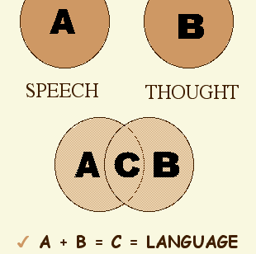
Vygotsky’s view of language
Before language, a child has 2 developing skills;
  Speech; a motor act
  Thought; a nonverbal process of problem solving
A (Speech without thought)
B (Thought without words)
C (Verbal thought)

Slide 38
Criticism
Piaget underestimated the abilities of children.
Failure to distinguish between competence and performance.
His ‘schema’ theory fails to comply with the theories of Bruner (1966) and Vygotsky (1978).
Behaviorism.
Studied his and his colleague’s children.
  Small sample
  European children
  High socio-economic status

Slide 39
Conclusion
Language is secondary to action.
Vygotsky; Origin of reasoning is our ability to communicate.

Slide 40
References
Fearnchild. D, Jean Piaget’s Theory on Child Language Development, Hello Motherhood 2017.
  Available at; https://www.hellomotherhood.com/article/231931-list-of-the-cognitive-development-of-early-childhood/
Serious Thinkers about language development
  Available at; http://www.csun.edu/~vcoao0el/webct/de361s121_folder/tsld001.html
The Sociocultural Theory of Lev Vygotsky, Literacy and Numeracy in Secondary.
  Available at; https://litnuminsecondary.weebly.com/vygotskys-theories.html
McLeod. S, Jean Piaget’s Cognitive Development Theory, Simply Psychology, 2018
  Available at; https://www.simplypsychology.org/piaget.html
Long, M et al. (2011) The Psychology of Education, 2nd edn, Routledge, Oxon.

Slide 41
Conclusion
In conclusion, whilst each theorist has different views on the language development theory, it's clear that they have each made a significant contribution on children's language development.
In the 21st Century these theories continue to influence the area of language development and new theories today.
To each theorist language is an important goal and based of foundation for a child's education (Long, 2011)

