Slide 1
Leadership Programme
Leadership Academy
Fieldbay
and
The GWLAD Project, Wales Institute for Work-based Learning, UWTSD

Slide 2
Welcome/Croeso
Registration and enrolment
Introduction to the Virtual Learning Environment
Insights
The Context of Leadership
Mindfulness

Slide 3
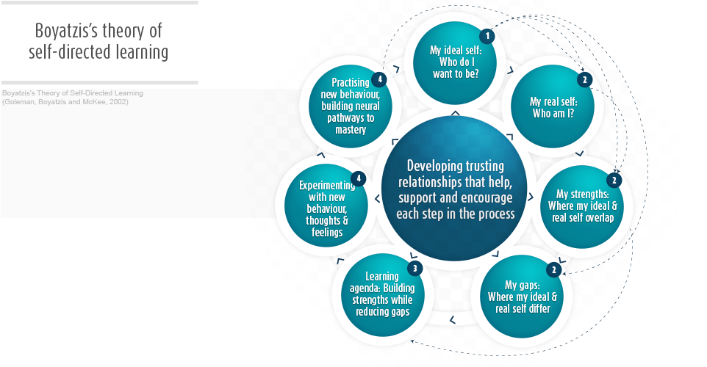
Theory of Self-Directed Learning

Slide 4
Leadership
“If you want to be a leader, you have to be a real human being. You must recognise the true meaning of life before you can become a great leader. You must understand yourself first.”
Senge, P., Scharmer, C.O., Jaworski, J. and Flowers, B.S. (2004) Presence Cambridge MA: Society of Organizational Learning

Slide 5
Mindfulness
Mindful minute
Mindful eating/walking/driving (choose one)
fofboc

Slide 6
Mindful Mice
http://www.mindful.org/adorable-animated-mice-explain-meditation-in-2-minutes/

Slide 7
Module Descriptor
Overall requirements of the module
Support available from tutors, mentor lecturers and Fieldbay
Action plans and work between sessions help to build towards assignments
Academic writing guidance will be provided at the next session.

Slide 8

Action Plan

Slide 9
Review
Insights
The Context of Leadership
Mindfulness
The module
University processes

Slide 10

Wishing You a Great Journey

