Slide 1
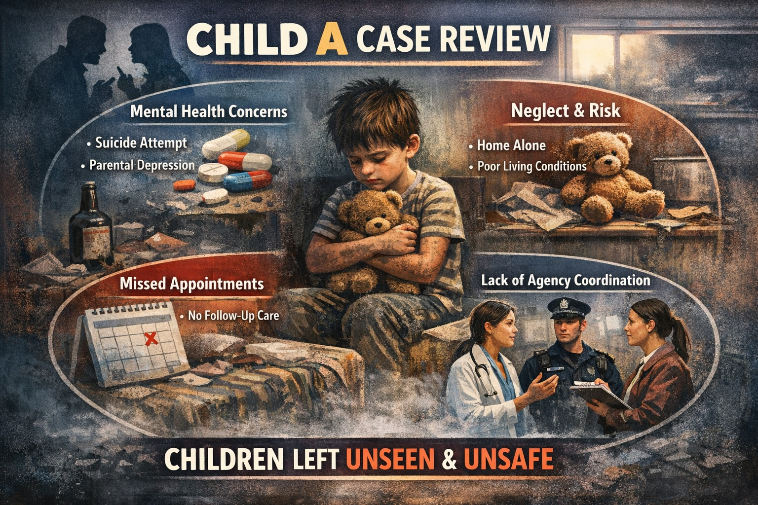

Slide 2
Protecting and Supporting Families in Health and Care (BMHP5021_BIRM)
Component 1 – Presentation Group Discussion
Lecturer name: Robert Nartowski
Students names: Zamzam Abdallah (Police Officer)
Rawan Abushamma (Social Worker)
Ola Abusaid (Teacher)
Nashwa Elbouhy (GP Doctor)

Slide 3
References
Bradford Partnership (2023) Child Safeguarding Practice Review: Child A. Bradford: The Bradford Partnership. Available at: https://learning.nspcc.org.uk/case-reviews/national-case-review-repository (Accessed: 30 January 2026).
Bradford Safeguarding Children Partnership (2023) Local Child Safeguarding Practice Review: Child A. Bradford: Bradford Safeguarding Children Partnership.
Brandon, M., Sidebotham, P., Belderson, P., Dodsworth, J., Garstang, J., Harrison, E., Retzer, A. and Sorensen, P. (2020) Complexity and challenge: A triennial analysis of serious case reviews 2014–2017. London: Department for Education.
Department for Education (2018) Working Together to Safeguard Children: A guide to inter-agency working to safeguard and promote the welfare of children. London: HM Government.
Department for Education (2023a) Working together to safeguard children: Statutory guidance. London: HM Government. Available at: https://assets.publishing.service.gov.uk (Accessed: 30 January 2026).
Department for Education (2023b) Keeping children safe in education. London: Department for Education.
Felitti, V.J., Anda, R.F., Nordenberg, D., Williamson, D.F., Spitz, A.M., Edwards, V., Koss, M.P. and Marks, J.S. (1998) ‘Relationship of childhood abuse and household dysfunction to many of the leading causes of death in adults: The Adverse Childhood Experiences (ACE) Study’, American Journal of Preventive Medicine, 14(4), pp. 245–258.
General Medical Council (n.d.) 0–18 years: Guidance for all doctors. Available at: https://www.gmc-uk.org (Accessed: 30 January 2026).
General Medical Council (n.d.) Confidentiality and sharing information (Protecting children and young people). Available at: https://www.gmc-uk.org (Accessed: 30 January 2026).

Slide 4
Great Britain (1984) Police and Criminal Evidence Act 1984. London: HMSO.
Great Britain (1989) Children Act 1989. London: HMSO.
Great Britain (2004) Children Act 2004. London: The Stationery Office.
HM Government (1989) Children Act 1989. London: HMSO.
Hughes, K., Bellis, M.A., Hardcastle, K.A., Sethi, D., Butchart, A., Mikton, C., Jones, L. and Dunne, M.P. (2017) ‘The effect of multiple adverse childhood experiences on health: A systematic review and meta-analysis’, The Lancet Public Health, 2(8), pp. e356–e366.
Munro, E. (2011) The Munro Review of Child Protection. London: Department for Education.
National Institute for Health and Care Excellence (2014; last reviewed 2024) Domestic violence and abuse: Multi-agency working (PH50). Available at: https://www.nice.org.uk (Accessed: 30 January 2026).
National Institute for Health and Care Excellence (2022a) Self-harm: Assessment, management and preventing recurrence (NG225). Available at: https://www.nice.org.uk (Accessed: 30 January 2026).
National Institute for Health and Care Excellence (2022b; last reviewed 2026) Depression in adults: Treatment and management (NG222). Available at: https://www.nice.org.uk (Accessed: 30 January 2026).
NHS England (2022) Safeguarding children and young people. Available at: https://www.england.nhs.uk (Accessed: 30 January 2026).
NHS England (2023) Safeguarding children and young people. London: NHS England.
NSPCC (2021) Neglect: Learning from case reviews. London: NSPCC Learning.
NSPCC (n.d.) Neglect (types, signs and effects). Available at: https://www.nspcc.org.uk (Accessed: 30 January 2026).
Royal College of General Practitioners (n.d.) RCGP safeguarding toolkit: Information sharing and the law. Available at: https://elearning.rcgp.org.uk (Accessed: 30 January 2026).

