Slide 1
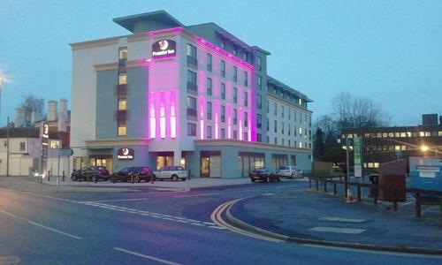

BMIH4006 Operating Hotel Facilities
Presentation
Premier Inn Hotel Loughborough
Student Name: Khalilur Rahman
Student ID: 2211971
Tutor Name: Muhammad Cassamo

Slide 2
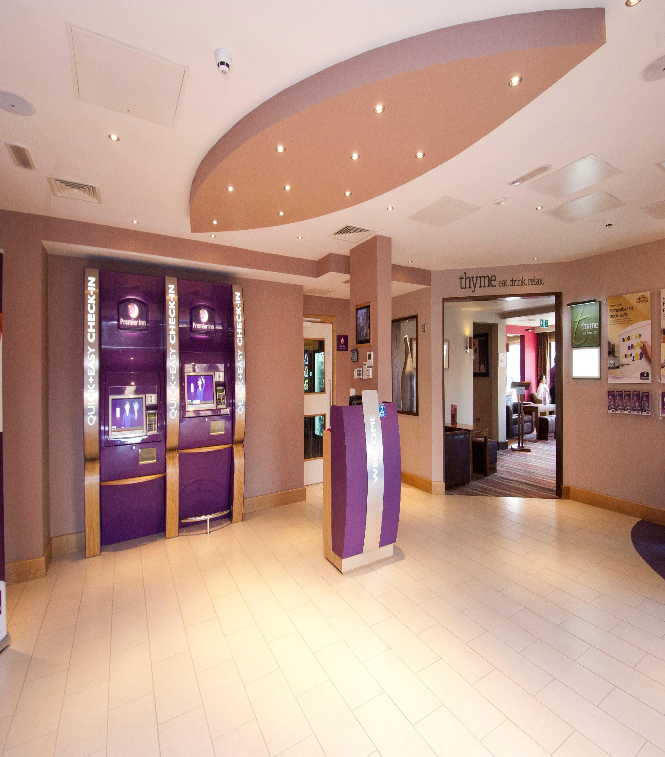
Introduction
The challenge confronting the hotel and resort industry is to develop housekeeping staff capable of providing effective services that will increase guest satisfaction ratings (Andrews, 2016).
The Hotel Premier Inn's management has thus made the decision to provide the cleaning staff extensive managerial power and assistance.
In order to create a productive housekeeping team, each member will get a variety of training opportunities that will enhance their knowledge and abilities.
Notes:
The challenge confronting the hotel and resort industry is to develop housekeeping staff capable of providing effective services that will increase guest satisfaction ratings (Andrews, 2016). In Loughborough, Leicestershire, the Premier Inn's floor care personnel and cleaning crew are the most important departments. The Hotel Premier Inn's management has thus made the decision to provide the cleaning staff extensive managerial power and assistance. In order to create a productive housekeeping team, each member will get a variety of training opportunities that will enhance their knowledge and abilities in the areas of daily tasks and responsibilities, cleaning supplies and expertise, performance, attitude, customer service, health and safety, and general knowledge.

Slide 3
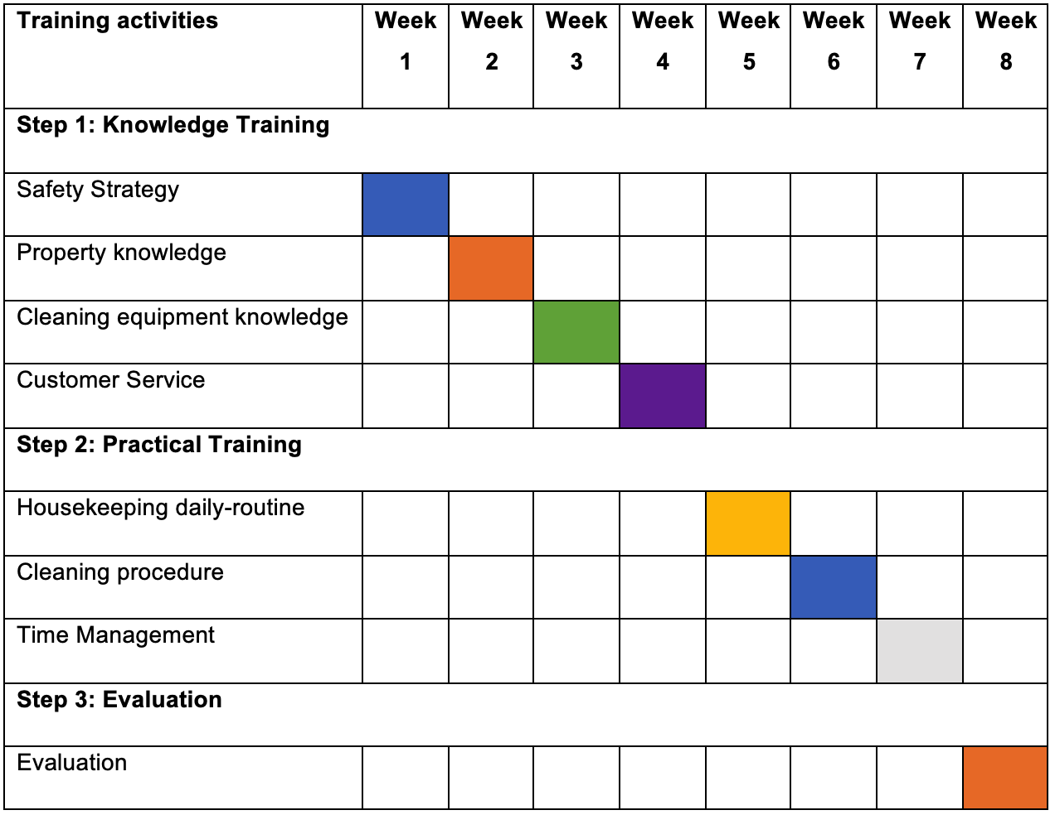
Schedule for training activities
The Gantt chart for the training is the following:

Slide 4
Work safety and health
At Premier Inn, we set the standard for health and safety.
Learn about the Workplace Regulations of 1992, the Health and Safety at Work Act of 1974, and the Health and Safety Work Regulation of 1999 (Nash, 2019).
These laws demonstrate our dedication to ensuring the welfare of each and every person who enters Hotel Premier Inn.
When engaging in physical activity, use caution, particularly when handling heavy machinery.
Arm yourself with information on different substances, how to use them, and any possible hazards.
Notes:
At Premier Inn, we set the standard for health and safety. Learn about the Workplace Regulations of 1992, the Health and Safety at Work Act of 1974, and the Health and Safety Work Regulation of 1999 (Nash, 2019). These laws demonstrate our dedication to ensuring the welfare of each and every person who enters Hotel Premier Inn. Examine the specifics of dressing appropriately for services. When engaging in physical activity, use caution, particularly when handling heavy machinery. Arm yourself with information on different substances, how to use them, and any possible hazards.

Slide 5
Property knowledge
Our lodgings accommodate a wide range of tastes, with 1500–1600 beds that include foam, queen-size mattresses, waterbeds, and Renaissance mattresses.
Our dedication to visitor happiness is evident in every accommodation type we provide, ranging from elegant Suit rooms to Single Rooms for single travelers to Double Rooms with 4.6" x 6.3" double beds to Twin Rooms with 3.3" x 6.3" single mattresses (Levin, 2022).
In order to provide a complete grasp of Hotel Premier Inn's property and service requirements, the training emphasizes the significance of cleaning in areas like the laundry, minibar, and public spaces (Levin, 2022).
Notes:
The extensive instruction at Hotel Premier Inn covers bed kinds, cleaning regions, and different sorts of rooms. Our lodgings accommodate a wide range of tastes, with 1500–1600 beds that include foam, queen-size mattresses, waterbeds, and Renaissance mattresses. Our dedication to visitor happiness is evident in every accommodation type we provide, ranging from elegant Suit rooms to Single Rooms for single travelers to Double Rooms with 4.6" x 6.3" double beds to Twin Rooms with 3.3" x 6.3" single mattresses (Levin, 2022). In order to provide a complete grasp of Hotel Premier Inn's property and service requirements, the training emphasizes the significance of cleaning in areas like the laundry, minibar, and public spaces (Levin, 2022).

Slide 6
Cleaning equipment
The foundation of Premier Inn's heritage are our guests.
Learn how to greet and communicate with guests in a professional manner, paying particular attention to cultural sensitivity and making a good first impression.
Your best ally is effective communication, so develop it to manage last-minute modifications, guest requests, and precise scheduling information.
Presentation abilities are crucial since they represent Hotel Premier Inn's brand image as well as personal cleanliness (Chakravarti, 2018).
Notes:
The foundation of Premier Inn's heritage are our guests. Learn how to greet and communicate with guests in a professional manner, paying particular attention to cultural sensitivity and making a good first impression. Your best ally is effective communication, so develop it to manage last-minute modifications, guest requests, and precise scheduling information. Presentation abilities are crucial since they represent Hotel Premier Inn's brand image as well as personal cleanliness (Chakravarti, 2018).

Slide 7
Consumer Service Excellence
Guest Interaction and Etiquette
Communication
Presentation
Guest Interaction and Etiquette: Housekeeping employees get training in polite conversation and manners.
Communication: Good communication is essential for enabling smooth interactions between the housekeeping division and other hotel departments.
Presentation: The hotel and brand image are reflected in the refined presentation abilities.
Notes:
Guest Interaction and Etiquette: Housekeeping employees get training in polite conversation and manners. To make a good first impression, cultural sensitivity is stressed. A knowledge of appropriate posture and body language fosters confidence and improves communication skills (Tanji, 2019).
Communication: Good communication is essential for enabling smooth interactions between the housekeeping division and other hotel departments. Effective communication is essential for the success of any organization, from managing last-minute adjustments to resolving guest requests and providing precise scheduling information (Hughes and Ferrett, 2017).
Presentation: The hotel and brand image are reflected in the refined presentation abilities. Building a favorable brand image is essential, from visitor behavior to maintaining personal cleanliness. The instruction promotes the growth of presenting abilities, which are essential for creating a strong brand impression (Jackson, 2018).

Slide 8
Daily Housekeeping Routine
Uniform
Maintenance
Laundry
Evaluation
Uniform: Uniforms have two purposes: they guard against toxins and stains and give off a polished image consistent with Hotel Premier Inn's brand (Tanji, 2016) .
Maintenance: Housekeeping employees are essential because they quickly report problems such as broken TV remotes and equipment repair needs
Laundry: Housekeeping employees are given instructive training on laundry techniques even if they are not in charge of the services directly (Jaszay and Dunk, 2023) .
Evaluation: The training program comprises written and practical exams to gauge how well staff members have understood the course's goals (Jackson, 2018) .
Notes:
Uniform: Uniforms have two purposes: they guard against toxins and stains and give off a polished image consistent with Hotel Premier Inn's brand.
Maintenance: Housekeeping employees are essential because they quickly report problems such as broken TV remotes and equipment repair needs, even if they are not directly engaged in maintenance tasks. By taking a proactive stance, guest complaints are decreased and the settlement process is accelerated (Tanji, 2016).
Laundry: Housekeeping employees are given instructive training on laundry techniques even if they are not in charge of the services directly. In order to provide in-room services and maintain a high level of care, this involves having the ability to fold a variety of clothing materials, make beds, and hang towels (Jaszay and Dunk, 2023).
Evaluation: The training program comprises written and practical exams to gauge how well staff members have understood the course's goals. Through this evaluation, the Human Resources Department can better comprehend the information that each member of the housekeeping staff has learned, which promotes continuous learning and development (Jackson, 2018).

Slide 9
Safety Strategy
Fire Safety
COSHH
Health and Safety
Fire Safety: In Wales and England, the Regulatory Reform (Fire Safety) Act 2005 is applicable; in Scotland, the Safety Regulation Act 2006 is pertinent (Jones, 2018).
COSHH: Control of Substances Hazardous to Health is the process of storing, using, and transporting dangerous materials safely in order to reduce worker exposure.
Health and Safety: Hotel Premier Inn's management complies with the Health and Safety Regulation Act 1974 by making every reasonable effort to safeguard the health and safety of housekeeping and other employees (Rutherford, 2019).
Notes:
Through a thorough safety plan and strict adherence to standards, Hotel Premier Inn's management places a strong priority on the security of its cleaning personnel.
Fire Safety: In Wales and England, the Regulatory Reform (Fire Safety) Act 2005 is applicable; in Scotland, the Safety Regulation Act 2006 is pertinent (Jones, 2018). A complete Fire danger Assessment is carried out in order to reduce the danger of fire. This entails locating potential dangers like fuel sources and ignition points, viewing every person as potentially dangerous, removing risks whenever it is practical, making sure that flammable materials are stored safely, setting up emergency protocols, and routinely assessing and reporting Fire Plan findings (Jones, 2018).
COSHH: Control of Substances Hazardous to Health is the process of storing, using, and transporting dangerous materials safely in order to reduce worker exposure. The management group recognizes dangerous materials, evaluates the hazards involved, and puts safety precautions in place (Nash, 2019). Along with the creation of emergency plans and health monitoring, training courses on managing these compounds are held.
Health and Safety: Hotel Premier Inn's management complies with the Health and Safety Regulation Act 1974 by making every reasonable effort to safeguard the health and safety of housekeeping and other employees. By offering induction programs, training, and the required equipment, they foster a safe work environment. It is safe to handle, transport, and store hazardous materials (Rutherford, 2019).

Slide 10
Branding statement for hotel Premier Inn
Branding Statement
The core of our hotel is our employees. They inject spirit, charm, and reason into routine processes and services. In order to become the finest versions of themselves, they are impacted by ongoing personal and learning mastery. Our essential personnel achieve their professional aspirations and advance their careers via the Goals and Vision program.
Notes:
Branding Statement: The core of our hotel is our employees. They inject spirit, charm, and reason into routine processes and services. In order to become the finest versions of themselves, they are impacted by ongoing personal and learning mastery. Our essential personnel achieve their professional aspirations and advance their careers via the Goals and Vision program.

Slide 11
References
Andrews, S. (2016). Hotel housekeeping a training manual. 3rd ed. New Delhi [Und 19 Weitere] Mcgraw Hill Education (India) Private Limited.
Chakravarti, B.K. (2018). Hotel management. 2nd ed. New Delhi: A.P.H. Pub. Corp.
Hughes, P. and Ferrett, E. (2017). Introduction to International Health and Safety at Work. 3rd ed. Routledge.
Jackson, E. (2018). Hotel management. 5th ed. New York, Ny: Larsen & Keller.
Jaszay, C. and Dunk, P. (2023). Training design for the hospitality industry. 3rd ed. Clifton Park, Ny: Delmar Learning.
Jones, T.J.A. (2018). Professional management of housekeeping operations. 2nd ed. Hoboken, N.J.: John Wiley & Sons.
Levin, L. (2022). Premier Inn City Centre - Leicester - Visit Leicester. [online] www.visitleicester.info. Available at: https://www.visitleicester.info/stay/premier-inn-city-centre-p694121 [Accessed 9 Nov. 2023].
Nash, C. (2019). Health and safety in hotels and catering. 3rd ed. London: Hotel & Catering Training Board.
Rutherford, D.G. (2019). Hotel management and operations. 4th ed. Hoboken, N.J.: Wiley.
Tanji, H. (2016). Hotel Room Service Training Manual. 3rd ed. Createspace Independent Publishing Platform.
Tanji, H. (2019). Hotel front office training manual with 231 SOP. 2nd ed. Brothers.v
192.com(2022). Images, Premier Inn Loughborough Hotel. Available at: https://www.192.com/atoz/business/loughborough-le11/hotels/premier-inn-loughborough-hotel/7d64c66b9ffc968082e26a3b2e259a9fcd7064dc/ugc/

