Slide 1








Reducing Digital
Distractions​
Conceptual Design of the
WiseFocus App
Armando Forgione
BSc (Hons) Cloud Computing
Supervisor: Suneth Fernando
30 October 2025

Slide 2











The Problem: Notifications Distract. WiseFocus Responds.
The Rationale
The Gap
Smartphones have become essential tools for students, but constant connectivity presents a significant challenge: digital distractions.
Existing focus apps are too generic and lack academic-specific features.
Generic Solutions
Student Needs
2/3 of U.S. students reported being distracted by digital devices in class
Project Aim
Teenagers receive a median of 273 notifications daily, with a substantial portion occurring during school hours
To design a concept for WiseFocus, a mobile app made just for students.
Impact on Academic Performance:
Reduced focus and concentration
Provide rigorous and personalized control over smartphone notifications
Reduced Learning Quality
Increased task-switching, ultimately undermining educational outcomes
To boost student focus and production.

Slide 3














Simple Flow: Total Block and Statistical Reward
Core Flow: Strict Focus Mode
Behavioral Reinforcement
1
Initiate Session
From the dashboard, the user taps the "START FOCUS & LOCK" button to begin a focus session.
Emergency Exit
The "Emergency Exit" feature allows users to prematurely end a focus session but comes with an enforced penalty:
2
30-Minute Lock
Progress Reset: All focus session progress is lost
The device enters a 30-minute lock state. During this period, all notifications are blocked, with the sole exception of incoming calls, ensuring critical communication is not missed.
Behavioral Science Behind This Design:
3
Session Complete
Imposing a deterrent for undesirable actions reinforces commitment to self-imposed goals
Once the 30-minute timer is completed, a dedicated success screen appears to validate the achievement and present the user's updated session statistics
Leverages loss aversion to encourage sustained focus and discipline
Creates a psychological barrier that increases the perceived cost of distraction
4
Unlock
The device automatically unlocks, returning full functionality to the user.
This mechanism is informed by research showing that people are more likely to maintain effort when there's a cost to abandoning a goal.

Slide 4
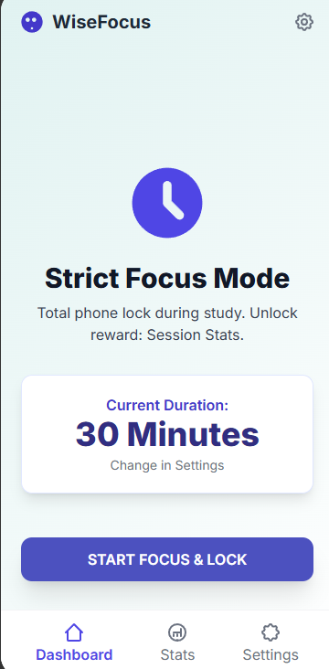

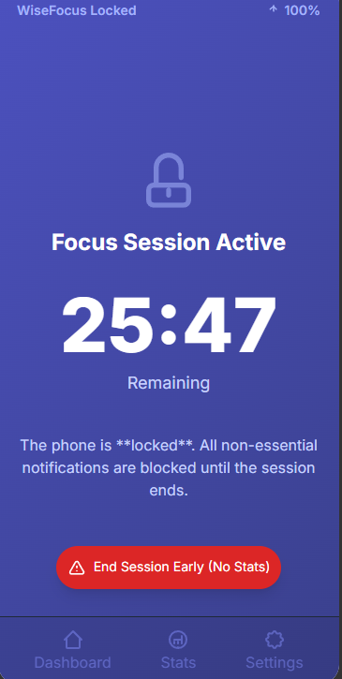
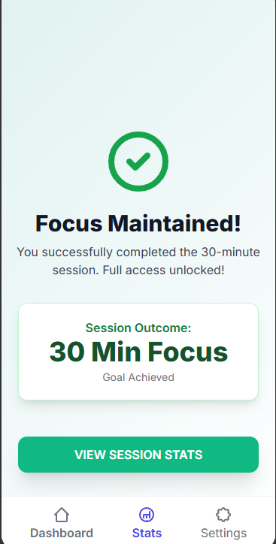
The user starts the "Strict Focus Mode" with a single tap from the Dashboard, setting a timer
01
Once started, the app completely blocks phone usage and focused-mutes pre-selected notifications.

Slide 5
















An Intelligent and Adaptable Block
Customizable Duration
Selective Blocking
Adjustable Rigor
Adjust focus session length from 15 to 120 minutes based on study task requirements.
Whitelist essential applications like Notion while blocking all other distracting apps.
Enable or disable early exit penalty to reinforce commitment to focus goals.
Progress Reset
Rigorous Mode
Notion
Early exit resets progress
15 min
60 min
120 min
Calendar
Messaging
Flexible Mode
Flexible session lengths for various study tasks
Early exit allowed without penalty
Keep academic tools accessible

Slide 6










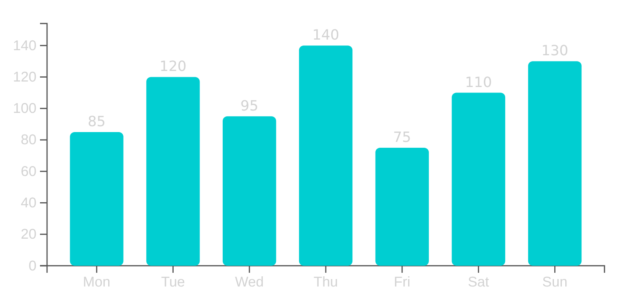








Measuring Progress: Statistics and Motivation
Tracking System
Statistics Dashboard
WiseFocus includes a comprehensive statistics screen designed to track and display usage data, offering motivational feedback and visualizing progress.
Weekly Focus Time Trends
Day
Week
Month
Total Focus Time
Quantifies cumulative time spent in focused sessions, providing a clear overview of productivity.
Session Success Rate
Indicates the percentage of completed focus sessions, offering insight into consistency and adherence to goals.
Focus Time (minutes)
Weekly Average: 142 min
User Benefits
Current Streak: 5 days
Identify patterns in focus habits
Celebrate achievements
Maintain motivation for sustained digital well-being

Slide 7
















Results and Future Implications
Outcome Achieved
Critical Success Factor
Next Steps
Successfully delivered a comprehensive conceptual design for the WiseFocus app.
Plan for future evaluation and development:
The design is firmly rooted in academic literature and directly addresses student needs.
Differentiation from Generic Tools:
Week 7
Week 8
Design Evaluation
Final Report
Targeted approach specific to academic contexts
Addresses nuanced needs of students
Thorough literature review on digital distractions
Evaluation Focus:
"This targeted approach differentiates WiseFocus from more generic productivity tools, ensuring its relevance and potential effectiveness."
Effectiveness of the 30-minute lock mechanism
Comparative analysis of existing focus applications
User experience with the Emergency Exit feature
Complete set of UI mock-ups illustrating core functionalities

Slide 8

Justification: Addressing Gaps in Existing Solutions
To address this problem, I analyzed the existing Literature. My research confirmed the need for a new approach.
Studies by researchers like Rosen et al. clearly demonstrate the correlation between excessive smartphone notifications and reduced cognitive concentration. However, current application-based solutions fail to meet the specific demands of academic environments.
For instance, while gamification apps like Forest are effective for short focus sessions, they lack necessary features for comprehensive study planning or granular control over specific academic apps. Similarly, general-purpose blockers like FocusMe, although capable of app blocking, are not optimized for the university learning context, as their generic nature was highlighted by Zhao et al.
My project, WiseFocus, therefore builds upon the conceptual frameworks of Ahmed and Patel. It proposes a student-focused interface that directly bridges these functional gaps by combining rigorous, customizable distraction blocking with detailed statistics relevant to academic performance.

Slide 9
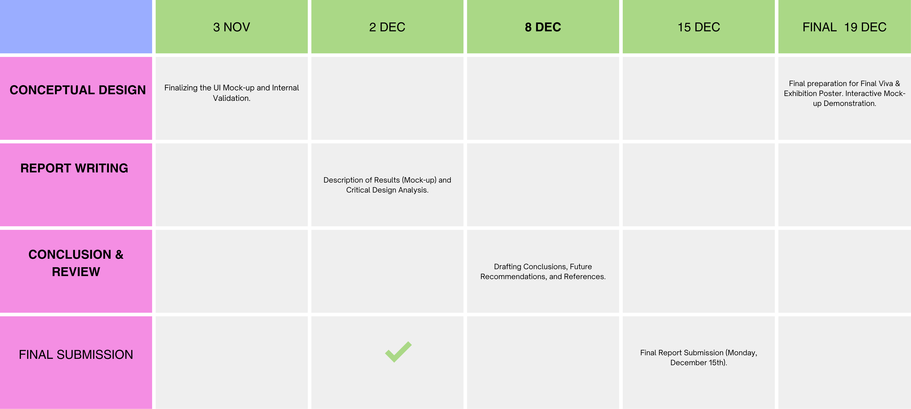
GANTT CHART

