Slide 1
Hebrew Bible: Introduction
Judaism: Texts and Traditions - Professional Doctorate Programme
Week 1
Dr Jessica M. Keady
j.keady@uwtsd.ac.uk

Slide 2
Introduction to the Module
Introductions to the class
Teaching Timetable
Assessment
Resources

Slide 3
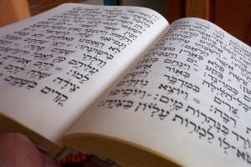
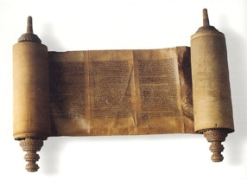
The Hebrew Bible / The Hebrew Scriptures
The Old Testament
Tanakh / Mikra

Slide 4
How many books are in the Bible?
Canon - definition: A collection or list of sacred books accepted as genuine.
New Testament = 27 books (usually)
What about the Hebrew Bible/ Old Testament?
Pair / Group Work – Examine the handout. Take 5 minutes to spot as many differences as you can.

Slide 5
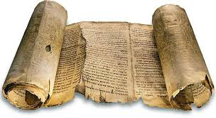
Multiple Canons?
Jewish Tanakh and the Protestant Bible = same books but (i) divided differently, AND (ii) ordered differently.
Catholic Bible = same order as Protestant Bible, but (i) additional books, AND (ii) some longer versions.
Orthodox Bible = same order as Protestant Bible and Catholic Bible, but further additional books.

Slide 6
Which language is the Bible written in?
Ancient (original) languages
Hebrew (most of the HB/OT)
Greek (NT)
Aramaic (parts of HB/OT and transliterated terms in the New Testament)
Ezra 4:8 – 6:18 and 7:12-26
Daniel 2:4-7:28
Jeremiah 10:11
Genesis 31:47

Slide 7
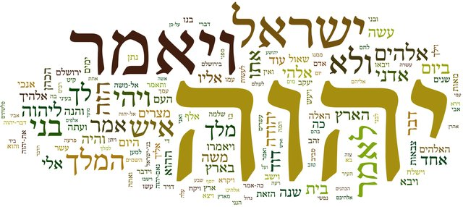

Slide 8
Date(s) and author(s)
Hebrew Bible / Old Testament writings: ca. 1000 BCE – 164 BCE
New Testament writings: ca. 50 CE – 200 CE
Therefore, the Bible contains writings spanning over 1,000 years and can be related to multiple dates, multiple authors and multiple contexts.

Slide 9
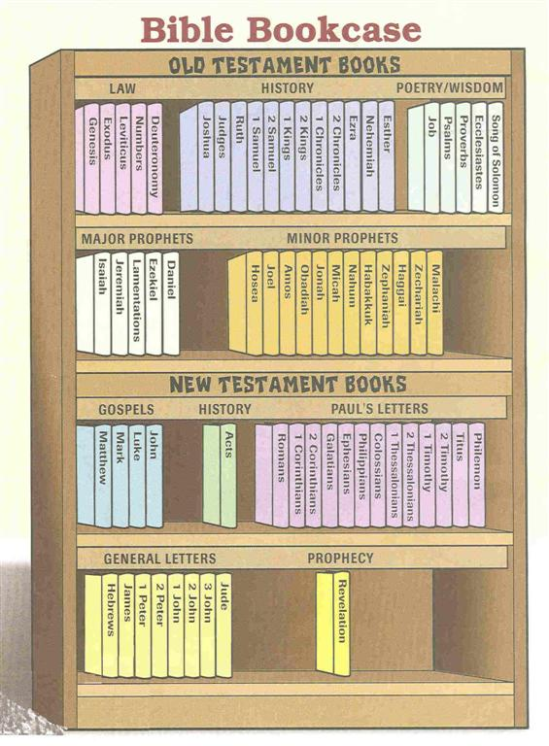
What is the Bible?
Genres
Law
Prophecy
Prayer
Poetry
Wisdom
Narrative

Slide 10
The Hebrew Bible
The main foundation of Judaism: its body of sacred scriptures.
An anthology of different writings.
Until today recited from a handwritten scroll in Hebrew (without vowels).
Intended to be read aloud (mikra)

Slide 11
The Hebrew Bible and Judaism
Markers of Judaism:
Worship of a personal and transcendent God
Code of laws and commandments
Institutional and communal structures (Temple, shrine, synagogue)
Revealed Scripture

Slide 12
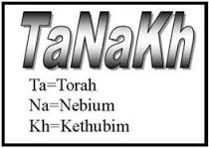
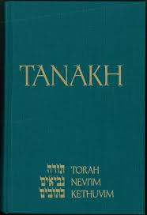
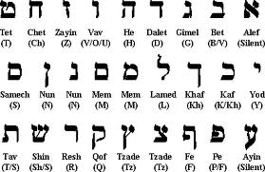
TaNaKh

Slide 13
TaNaKh
Torah / Law: Five books of Moses (Genesis, Exodus, Leviticus, Numbers, Deuterononmy)
Nevi’im / Prophets: (8 books)
Ketuvim / Writings: (11 books)

Slide 14
Books of the Law Pentateuch / Torah | Historical Books | Poetry and Wisdom Books / Ketuvim | Prophetic Books / Nevi’im
Genesis | Joshua | Job | Isaiah
Exodus | Judges | Psalms | Jeremiah
Leviticus | Ruth | Proverbs | Lamentations
Numbers | I Samuel | Ecclesiastes | Ezekiel
Deuteronomy | II Samuel | Song of Solomon | Daniel
 | I Kings |  | Hosea
 | II Kings |  | Joel, Amos
 | I Chronicles |  | Obadiah, Jonah
 | II Chronicles |  | Micah, Nahum
 | Ezra |  | Habakkuk
 | Nehemiah |  | Zephaniah
 | Esther |  | Haggai
 |  |  | Zechariah
 |  |  | Malachi

Slide 15
Interpreting the Hebrew Bible
From a historical perspective: a collection of 39 writings composed by different authors from several historical periods (interest in historical, social, political and cultural issues)
Texts composed in Hebrew and Aramaic.
Various religious and social movements, cultural practices, political developments.
Responses to specific circumstances.

Slide 16
Interpreting the Hebrew Bible
From a literary perspective: what are the literary features of the biblical texts?
Narrative: about humankind and the nation of Israel.
Prophecy: a revelation from God mediated through a prophet (‘and the word of the Lord came to Isaiah/Jeremiah/Amos…’).
Psalm: expression of praise/lament of a group/individual.
Apocalypse (‘revelation’): disclosure of the heavenly mysteries about God and the world to come.

Slide 17
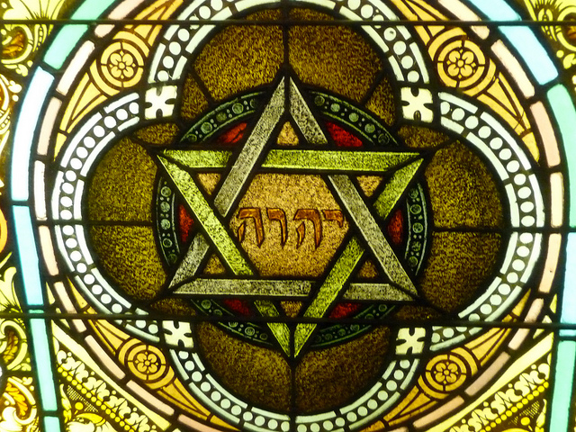
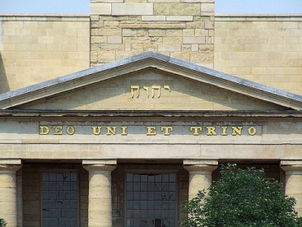
The Tetragrammaton
The tetragrammaton (“four letters”)יהוה is the personal name of God.
Because it is considered too holy to pronounce, when יהוה is read, the word אֲדֹנָי (= “Lord”) is spoken instead.

Slide 18
Group Exercise
  Reading One: The Nature of Jewish Studies (M. Goodman)
  How has history affected the study of Judaism?
  After reading this chapter, what do you think Jewish Studies is?
  Reading Two: Old Testament (J.W. Rogerson)
  Which sub-section do you think had the largest effect on the study of the HB/OT:
  Up to 1945?
  Between 1945 – 1970?
  From 1970?
From an interfaith perspective, are there any other areas of thought that you would add as being significant to the study of the HB/OT?

Slide 19
Hebrew Bible: Pentateuch
From Genesis to Deuteronomy

Slide 20
What is the Pentateuch?
The first five books of the Hebrew Bible and of the Christian Scriptures.
Torah, Nevi’im, Ketuvim = Tanakh.
Torah – ‘teaching/instruction’ attributed to Moses (main figure from Exodus onwards).
‘Pentateuch’ – Greek: pentateuchos.
Genesis, Exodus, Leviticus, Numbers, Deuteronomy.

Slide 21
What is the Pentateuch?
It includes several literary forms: history, poetry, genealogy, homilies.
Narrative: history of the world, humankind, nation of Israel.
Laws: divine commandments

Slide 22
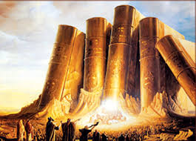
What is the Pentateuch?
Collection of originally disparate sources and/or books (around 5th century BCE).
Traditional view: revealed by God through Moses on Mount Sinai

Slide 23
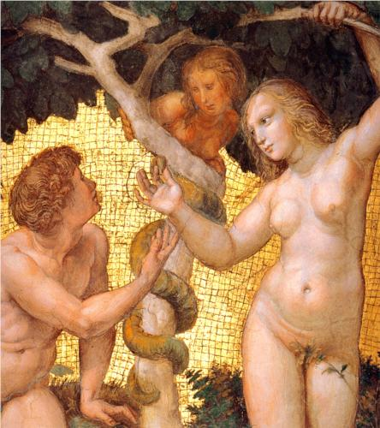
Genesis 1-11: Account of Origins
‘Primeval history’ or ‘primal history’.
Genesis 1-2: Two different accounts of creation.
Genesis 1: separation and life (creation in 6 days, followed by a day of rest – Sabbath/Shabbat).
Genesis 2: the Garden of Eden.

Slide 24
Two Creation
Narratives in Genesis
I would like you to read the two creation narratives in Genesis and note any striking differences:
Think about:
The use of God’s voice
The different way that man is created
The different way that woman is created
Genesis 1: 1 - 2:4
Genesis 2:4 - 25

Slide 25
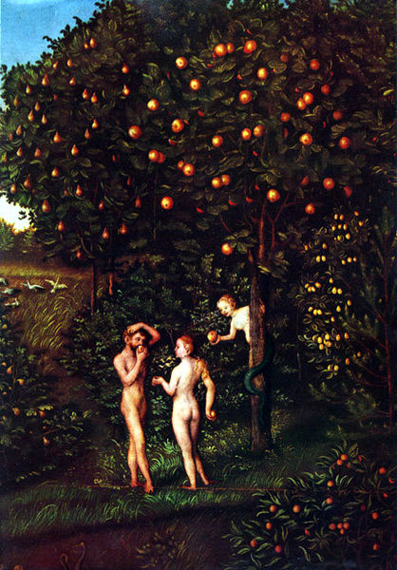
Genesis 3: Disobedience in the Garden
They heard the sound of the Lord God walking in the garden at the time of the evening breeze, and the man and his wife hid themselves from the presence of the Lord God among the trees of the garden. But the Lord God called to the man, and said to him, ‘Where are you?’ He said, ‘I heard the sound of you in the garden, and I was afraid, because I was naked; and I hid myself’. He said, ‘Who told you that you were naked? Have you eaten from the tree of which I commanded you not to eat?’ The man said, ‘The woman whom you gave me to be with me, she gave me the fruit from the tree, and I ate’. Then the Lord God said to the woman, ‘What is this that you have done?’ The woman said, ‘The serpent tricked me, and I ate’.

Slide 26
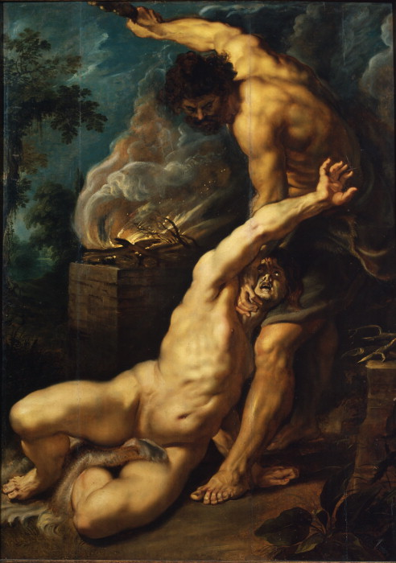
Genesis 1-11: Origins
Origins of humanity and its development into nations.
Cain and Abel
Then the Lord said to Cain, ‘Where is your brother Abel?’ He said, ‘I do not know; am I my brother’s keeper?’
Genesis 4:9

Slide 27
Genesis 1-11: A New Start
The Story of Noah (Genesis 6:9-9:29)
Punishment of the sins of human beings – great flood
The Lord saw that the wickedness of humankind was great in the earth, and that every inclination of the thoughts of their hearts was only evil continually. And the Lord was sorry that he had made humankind on the earth, and it grieved him to his heart. So the Lord said, ‘I will blot out from the earth the human beings I have created – people together with animals and creeping things and birds of the air, for I am sorry that I have made them. But Noah found favour in the sight of the Lord.
Genesis 6:5-8

Slide 28
Genesis 12-50
Patriarchal History (and matriarchal history)
4 Generations
Abraham (Gen. 12-25)
Isaac (Gen. 25-26)
Jacob (Gen. 27-35)
12 sons of Jacob (Gen. 35-50)

Slide 29
The Call of Abraham: Genesis 12:1-3
Movement from humankind to generations to one individual. Abram (later Abraham) is commanded to leave his birthplace – Ur of the Chaldeans – with his wife Sarah and travel to a new land (Canaan).
‘Now the Lord said to Abram, ‘Go from your country and your kindred and your father’s house to the land that I will show you. I will make of you a great nation, and I will bless you, and make your name great, so that you will be a blessing. I will bless those who bless you, and the one who curses you I will curse; and in you all the families of the earth shall be blessed’.

Slide 30
The Story of Abraham
God’s covenant with Abraham (Genesis 15 and 17)
The birth of Isaac (Genesis 21)
Sacrifice of Isaac (Genesis 22)
A wife for Isaac – Rebekah – and son, Jacob (Genesis 24)
The death of Abraham (Genesis 26)

Slide 31
Reading: Abraham and Interfaith
Questions to answer for next week based on the reading:
What are your thoughts on the article?
Do you agree with the direction Harold Washington is taking the interfaith discussion in?
What are your own views/opinions on adopting Abraham and his family as a prototype for interfaith dialogue?

