Slide 1
Women and Peasants in the Middle Ages

Slide 2
Misconceptions about Medieval Women
They did not have political power.
They were not educated.
They did not make a significant cultural impact.

Slide 3
Medieval Women in Power
They could rule in their own right (“suo jure”).
They could rule as regents for underage kings.
They could rule on behalf of kings.

Slide 4
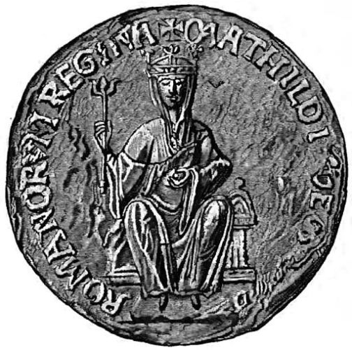
Ruling in Her Own Right
Empress Matilda (1102-1167)
She became the only legitimate heir to Henry I after the death of her younger brother, William in 1120.
Henry I made his court swear loyalty to her as his heir in 1127.
After Henry’s death in 1135, her cousin Stephen took the throne.
She arrived in England with her army in 1139; she tried to be crowned in Westminster in 1141.
A truce was reached in 1153; Stephen acknowledged her son Henry (by her second husband) as his heir.
The Great Seal of Empress Matilda

Slide 5
Ruling in Her Own Right
Empress Matilda (1102-1167)
“She with a grim look, her forehead wrinkled into a frown, every trace of a woman’s gentleness removed from her face, blazed into unbearable fury …”—Gesta Stephani, mid 12th-century
The Great Seal of Empress Matilda

Slide 6
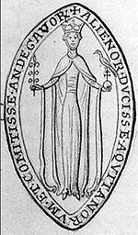
Ruling in Her Own Right
Eleanor of Aquitaine (c.1122-1204)
Inherited the Duchy of Aquitaine in 1137; she married the future French king Louis VII in the same year.
After her marriage to Louis was annulled in 1152, she married the future English king Henry II (the Empress Matilda’s son).
She became a patron of the arts at her court in Poitiers.
The troubadour Bernard de Ventadour described her as “gracious, lovely, the embodiment of charm,” with “lovely eyes and noble countenance.”
The Seal of Eleanor of Aquitaine

Slide 7
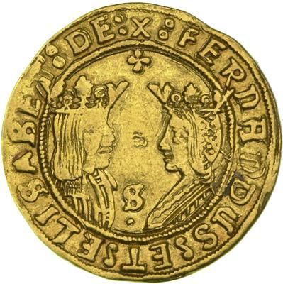
Ruling in Her Own Right
Isabella of Castile (1451-1504)
She became presumptive heiress after the death of her younger brother Alfonso in 1468. He was in rebellion against their older half-brother, Enrique IV, at the time.
Isabella negotiated peace on the condition that Enrique recognize her as his heiress and not his daughter, Juana “la Beltraneja,” who was rumored to be illegitimate.
She married Ferdinand of Aragon in 1469, ensuring the future union of the two Spanish kingdoms.
Together, they sponsored Christopher Columbus’s exploration.
Coin of Ferdinand and Isabella

Slide 8
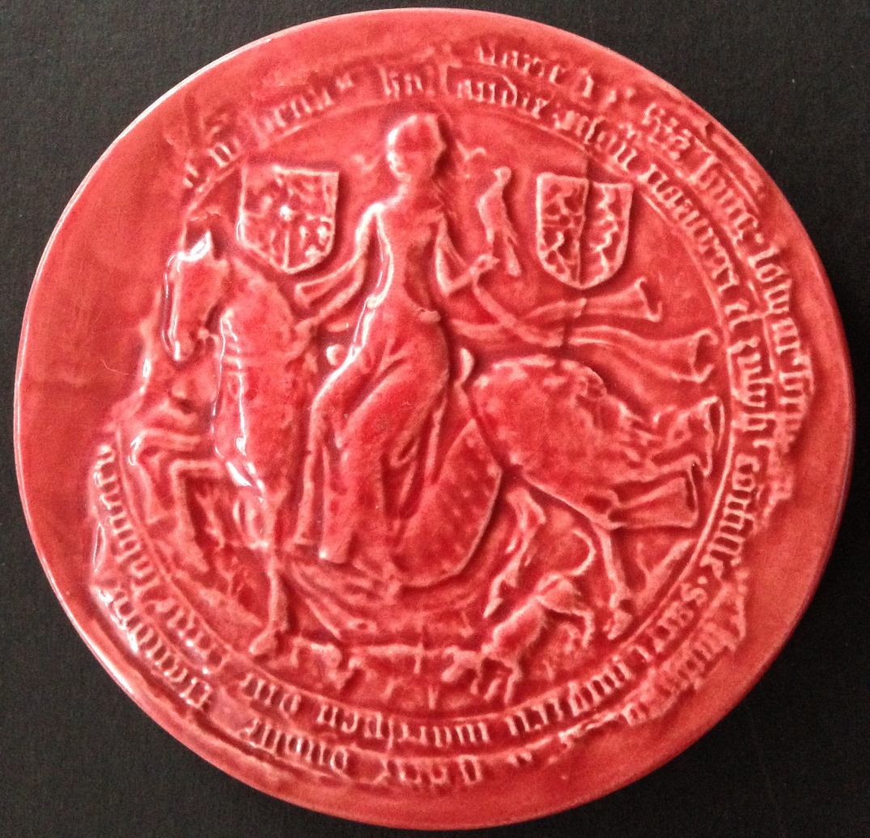
Ruling in Her Own Right
Mary of Burgundy (1457-1482)
She was the only legitimate child of Duke Charles the Bold of Burgundy. She inherited the Duchy of Burgundy in 1477.
After witnessing the executions of two of her father’s former ministers, Mary signed a charter known as the Great Privilege.
She married Maximilian, the son of the Holy Roman Emperor, later that same year.
Their children, Philip and Margaret, married two of Ferdinand and Isabella’s children, Juana and Juan.
The Seal of Mary of Burgundy

Slide 9
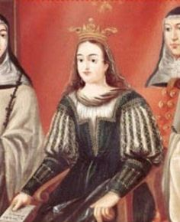
Regents for young kings
María de Molina (c.1265-1321)
She married the future Sancho IV of Castile in 1282.
When Sancho died in 1295, their son Fernando IV was only ten years old. Sancho supposedly designated María as their son’s regent.
The law of Sancho’s father, Alfonso X, stated that: “But where the mother of the infant King is living, she must rank first, and be chief guardian over others: for she must naturally love him more than anything.”
When Fernando died in 1312, his son Alfonso XI was one year old. María again served as regent.

Slide 10
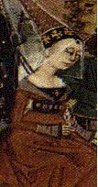
Regents for young kings
Isabella of France (1295-1358)
She married Edward II of England in 1308.
Their son, the future Edward III, was born in 1312.
She invaded England with her lover, Roger Mortimer, in 1326; her husband was murdered a year later.
She remained in power until 1330, when Edward III took power and had Mortimer executed.

Slide 11
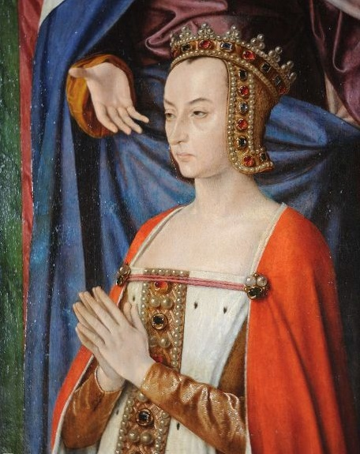
Regents for young kings
Anne de Beaujeu (1461-1522)
She was the daughter of Louis XI of France; he once described her as “the least foolish woman in France.”
She married Peter, Duke of Bourbon, in 1473.
When her father died in 1483, her younger brother, Charles VIII, was only 13. She and her husband served as Charles’s regents until 1491.

Slide 12
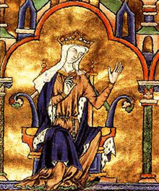
Regents for young kings
Blanche of Castile (1188-1252)
She married the future Louis VIII in 1200.
When Louis died in 1226, their son, Louis IX, was only twelve years old. Before his death, her husband designated her as their son’s regent.
She had to deal with multiple rebellions by the nobility and invasions from Henry III of England.
She served as her son’s regent again when he left on the Seventh Crusade in 1248, raising money to ransom him after his capture in Egypt.

Slide 13
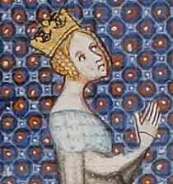
Regents for absent or incapacitated kings
Adela of Champagne (c.1140-1206)
She married King Louis VII in 1160. Their son, the future Philip II, was born in 1165.
Philip became king in 1180.
She acted as one of Philip’s regents (with her brother, the archbishop of Rheims) when he went on the Third Crusade between 1190-1192.

Slide 14
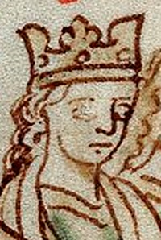
Regents for absent or incapacitated kings
Eleanor of Provence (c.1223-1291)
She married Henry III of England in 1236.
She acted as regent during Henry’s absence in Gascony from 1253-1254.

Slide 15
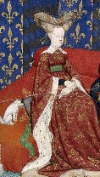
Regents for absent or incapacitated kings
Isabeau of Bavaria (c.1370-1435)
She married Charles VI of France in 1385.
Charles suffered his first attack of severe mental illness in 1392.
During a period of recovery, Charles made Isabeau the primary guardian of their son and heir, Louis. She sat on the regency council and eventually became its leader.
She was briefly sole regent in 1417.

Slide 16
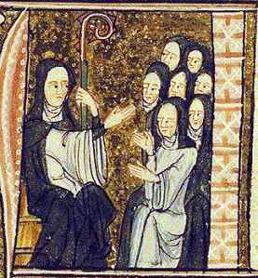
Religious women
Hildegard of Bingen (1098-1179)
She joined a Benedictine convent when she was eight years old, under the care of a nun named Jutta.
Hildegard experienced visions, and wrote three works of visionary theology: Scivias; Liber Vitae Meritorum; and Liber Divinorum Operum; she also wrote music, and works on science and medicine.
She described herself as unlearned and ignorant, yet was vocal in her opposition of corrupt Church practices.
She was beatified, but not canonized.
She was named a Doctor of the Church in 2012.

Slide 17
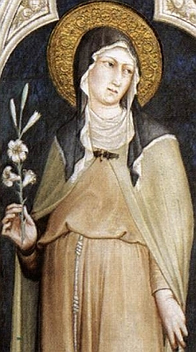
Religious women
St Clare of Assisi (1194-1253)
She was one of St Francis of Assisi’s earliest followers, becoming a Benedictine nun in 1212.
She wrote the Rule for a new religious order, which was approved the day before her death in 1253. It is now known as the Order of St Clare, or the Poor Clares.
She was canonized in 1255.

Slide 18
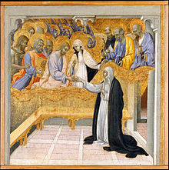
Religious women
St Catherine of Siena (1347-1380)
She became a Dominican tertiary, meaning that she did not live in a convent, but with her family.
She experienced a mystic marriage with Christ in c.1368.
She received the stigmata in 1375.
She became involved in papal politics, asking Pope Gregory XI to return the papacy to Rome from Avignon, France. After the schism resulting from the election of Pope Urban VI in 1378, she worked to establish his legitimacy.
She was canonized in 1461 and made a Doctor of the Church in 1970.

Slide 19
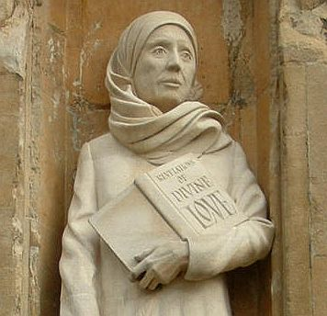
Religious women
Julian of Norwich (c.1342-c.1416)
Little is known about her life; even her name is uncertain.
She was an anchoress attached to a church in Norwich, and became known as a spiritual authority and adviser.
During a period of illness in 1373, she experienced a series of visions. Written down around 1395, these became her work Revelations of Divine Love, which is the first English-language theological work by a woman (first ever English-language published work by a woman?)
She was visited by Margery Kempe c.1414.

Slide 20
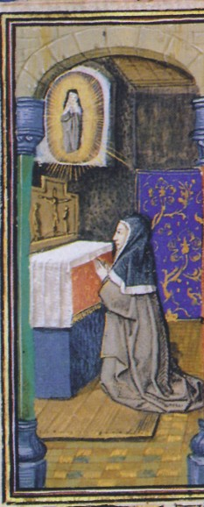
Religious women
St Colette of Corbie (1381-1447)
She became a Franciscan nun in 1402 and lived as a hermit.
A series of dreams and visions convinced her she was meant to reform the Order.
The Antipope Benedict XIII allowed her to become a Poor Clare, to reform the order, and to found new communities.
She was canonized in 1807.

Slide 21
Women of influence
Marguerite Porete (c.1250-1310)
She wrote The Mirror of Simple Souls in the 1290s. It was deemed heretical some time between 1296 and 1306.
She was arrested in 1308 for continuing to circulate the book and was burned at the stake as a heretic in 1310.
Despite the book’s origins, it continued to circulate widely during the medieval period and was translated into multiple languages.

Slide 22
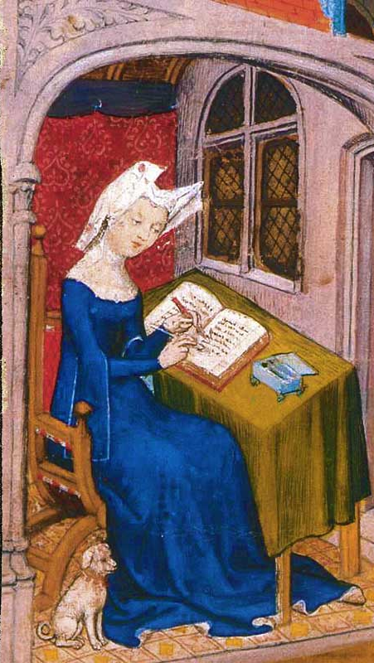
Women of influence
Christine de Pizan (1364-c.1430)
She was Italian by birth, but grew up in the French court where her father was a royal physician.
She was widowed in 1387. With a family to support, she started writing ballads, which became popular at the French court.
She became involved a literary controversy surrounding the 13th-century Le Roman de la rose, supported by Jean Gerson, the Chancellor of the University of Paris.
Her most famous works are The Book of the City of Ladies and The Treasure of the City of Ladies.

Slide 23
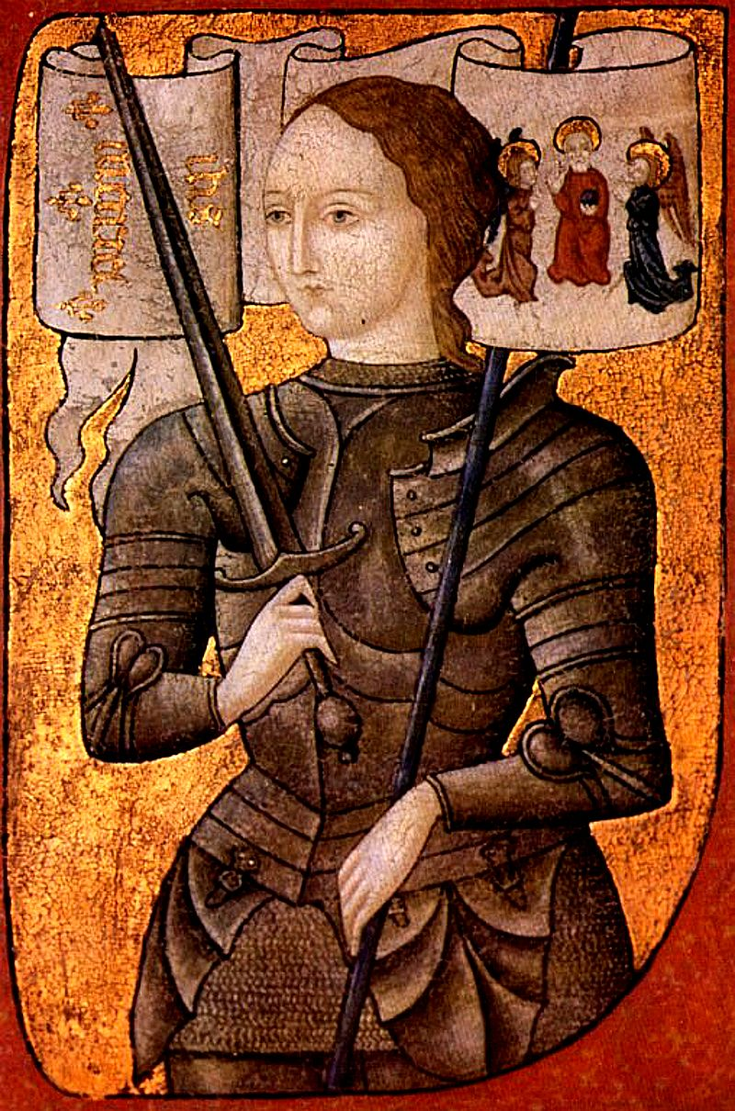
Women of influence
Joan of Arc (c.1412-1431)
She started experiencing visions of saints at age 13.
She became a military strategist and leader associated with the army of Charles VII, seeing him crowned in 1429.
She was captured by the Burgundians and transferred to the English in 1430.
She was tried for heresy and later burned at the stake.

Slide 24
Women of influence
Margery Kempe (c.1373-after 1438)
She dictated The Book of Margery Kempe sometime in the 1430s. It is generally considered to be the first English-language autobiography.
The sole surviving manuscript copy of the entire work was discovered only in 1934.
She appears to have been illiterate; she describes having things read to her and books that she “heard read.”
She made pilgrimages to Jerusalem, Rome, and Santiago de Compostela, among other places.

Slide 25
Who were the peasants?
Bellatores (“those who fight”—the large landowners and aristocracy)
Oratores (“those who pray”—priests, monks, and nuns)
Laboratores (“those who work”—peasants)

Slide 26
Potential sources:
Manorial surveys
Manorial accounts
Manorial court records

Slide 27
Who were the peasants?
Slaves
Villeins/bordars/cottars
Freemen

Slide 28
Slaves
The laws of King Ine (688-694):
“If a slave works on Sunday at his master’s command he is to be free and the master is to pay 30 shillings as a fine.”
“If, however, the slave works without his [master’s] knowledge, he is to be lashed or pay the fine in lieu.”
“If then a freeman works on that day without his lord’s command, he is to forfeit his freedom or [pay a fine of] 60 shillings.”

Slide 29
Slaves
Slaves made up a small percent (about 10%) of the population during the Anglo-Saxon period.
Slavery in England was virtually gone by the mid-12th century.

Slide 30
Some important terms:
  A hide was the unit of land considered to be enough to provide for a family (30 acres). It was used as the unit of taxation for land holdings.
  Demesne land was kept by the landowner for his own use and maintenance. The rest was usually rented out to tenants.
  Villeins (Latin villani) made up most (about 40%) of the rural population; they might each rent a hide or half a hide from a lord.
  Cottars (cottagers) or bordars made up about 30% of the rural population; they might rent about 3-5 acres which would not have sustained a family; a cottar would therefore have hired out his labour to his better-off neighbours.

Slide 31
Domesday Book 1086: Oxfordshire
“The same Robert holds Bicester as two manors. There are 15½ hides. There is land for 22 ploughs. Of this land 5 hides are in demesne, and there are 6 ploughs and 5 slaves, and 28 villeins with 14 bordars have 16 ploughs. There are two mills rendering 40s, and 12 acres of meadow and woodland one furlong long and 1 broad. It was worth £15, now £16.”

Slide 32
The effect of the Black Death:
“At that time a quarter of wheat sold for 12d…a good horse, once valued at 40s, for 6s, a good cow for 2s or 18d; and even at this price buyers were rarely found…. By the time the plague ceased at the divine command it had caused such a shortage of servants that men could not be found to work the land, and women and children had to be used to drive ploughs and carts, which was unheard of.”—Eulogium Historiarum sive Temporis, compiled at Malmesbury Abbey, Wiltshire, in the 1350s
“In this year [1350] the harvest was late, the crops scanty, barns empty and haystacks small – all the grain gathered did not suffice to meet the expenses of the manors. And this want and the harshness of the days began to stiffen men’s malice. No workman or labourer was prepared to take orders from anyone, whether equal, inferior or superior, but all those who served did so with ill will and a malicious spirit.”—Historia Roffensis, the chronicle of Rochester Cathedral from 1314-1350

Slide 33
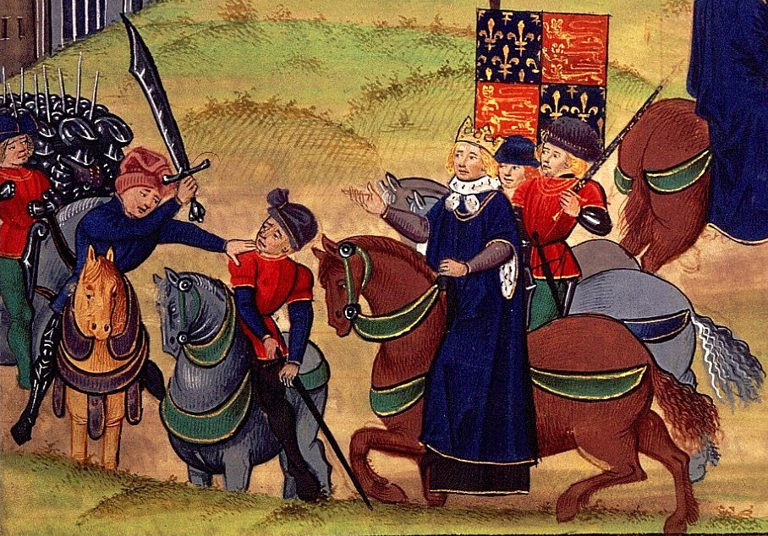
The Peasants’ Revolt:
Main factors: --tensions created by the Black Death
--high taxes to pay for war with France
--unstable local leadership
The revolt was sparked by an attempt to collect taxes in Essex.
Let by Wat Tyler, in 1381 a group of rebels from Kent entered London, demanding lower taxes and the end of serfdom.
King Richard II initially met with the rebels and granted their demands, but his supporters killed Tyler at a second meeting and Richard rescinded what he had granted.

Slide 34
The Peasants’ Revolt:
“Never was any land or realm in such great danger as England at that time. It was because of the abundance and prosperity in which the common people then lived that this rebellion broke out... The evil-disposed in these districts began to rise, saying, they were too severely oppressed... [that their lords] treated them as beasts. This they would not longer bear, but had determined to be free, and if they laboured or did any other works for their lords, they would be paid for it.”—Jean Froissart, Chronicles, written 1370s-1380s

Slide 35
Peasants in Manuscripts:
The Luttrell Psalter (British Library, MS Add.42130): commissioned by Sir Geoffrey Luttrell, a landowner in Lincolnshire, between 1320-1340.
The Très Riches Heures du Duc de Berry (Musée Condé, MS 65): commissioned by Jean, Duc de Berry, from the Limbourg brothers in the early 15th century. It was incomplete when both the duke and the artists died in 1416. It was completed in the 1480s by Jean Colombe.

Slide 36
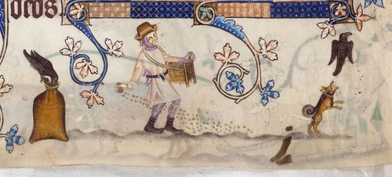
The Luttrell Psalter, fol.170v

Slide 37
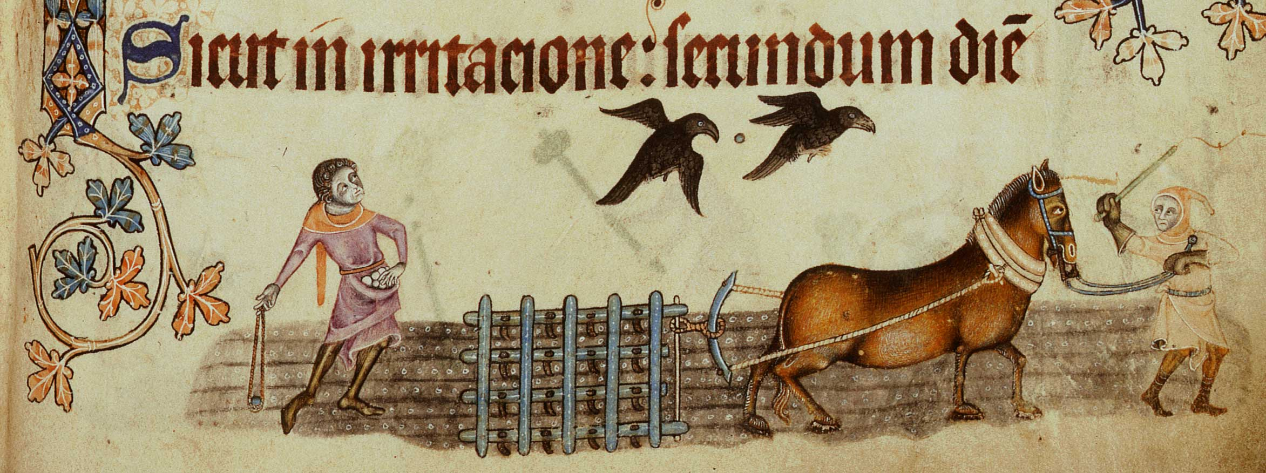
The Luttrell Psalter, fol.171r

Slide 38
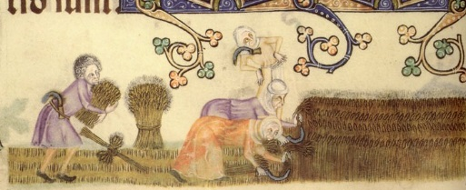
The Luttrell Psalter, fol.172v

Slide 39
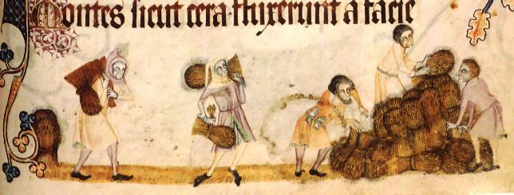
The Luttrell Psalter, fol.173r

Slide 40
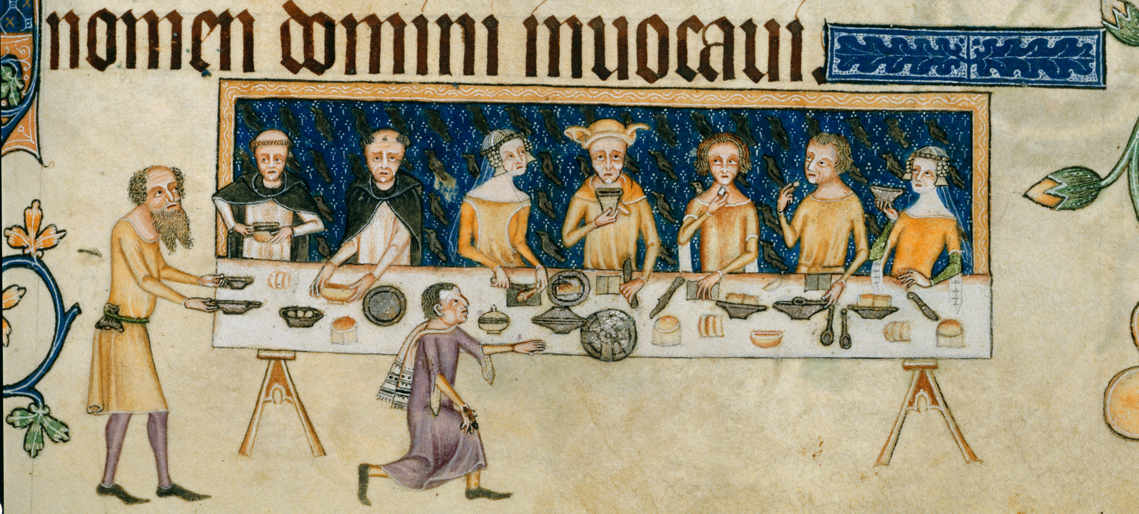
The Luttrell Psalter, fol.208r

Slide 41
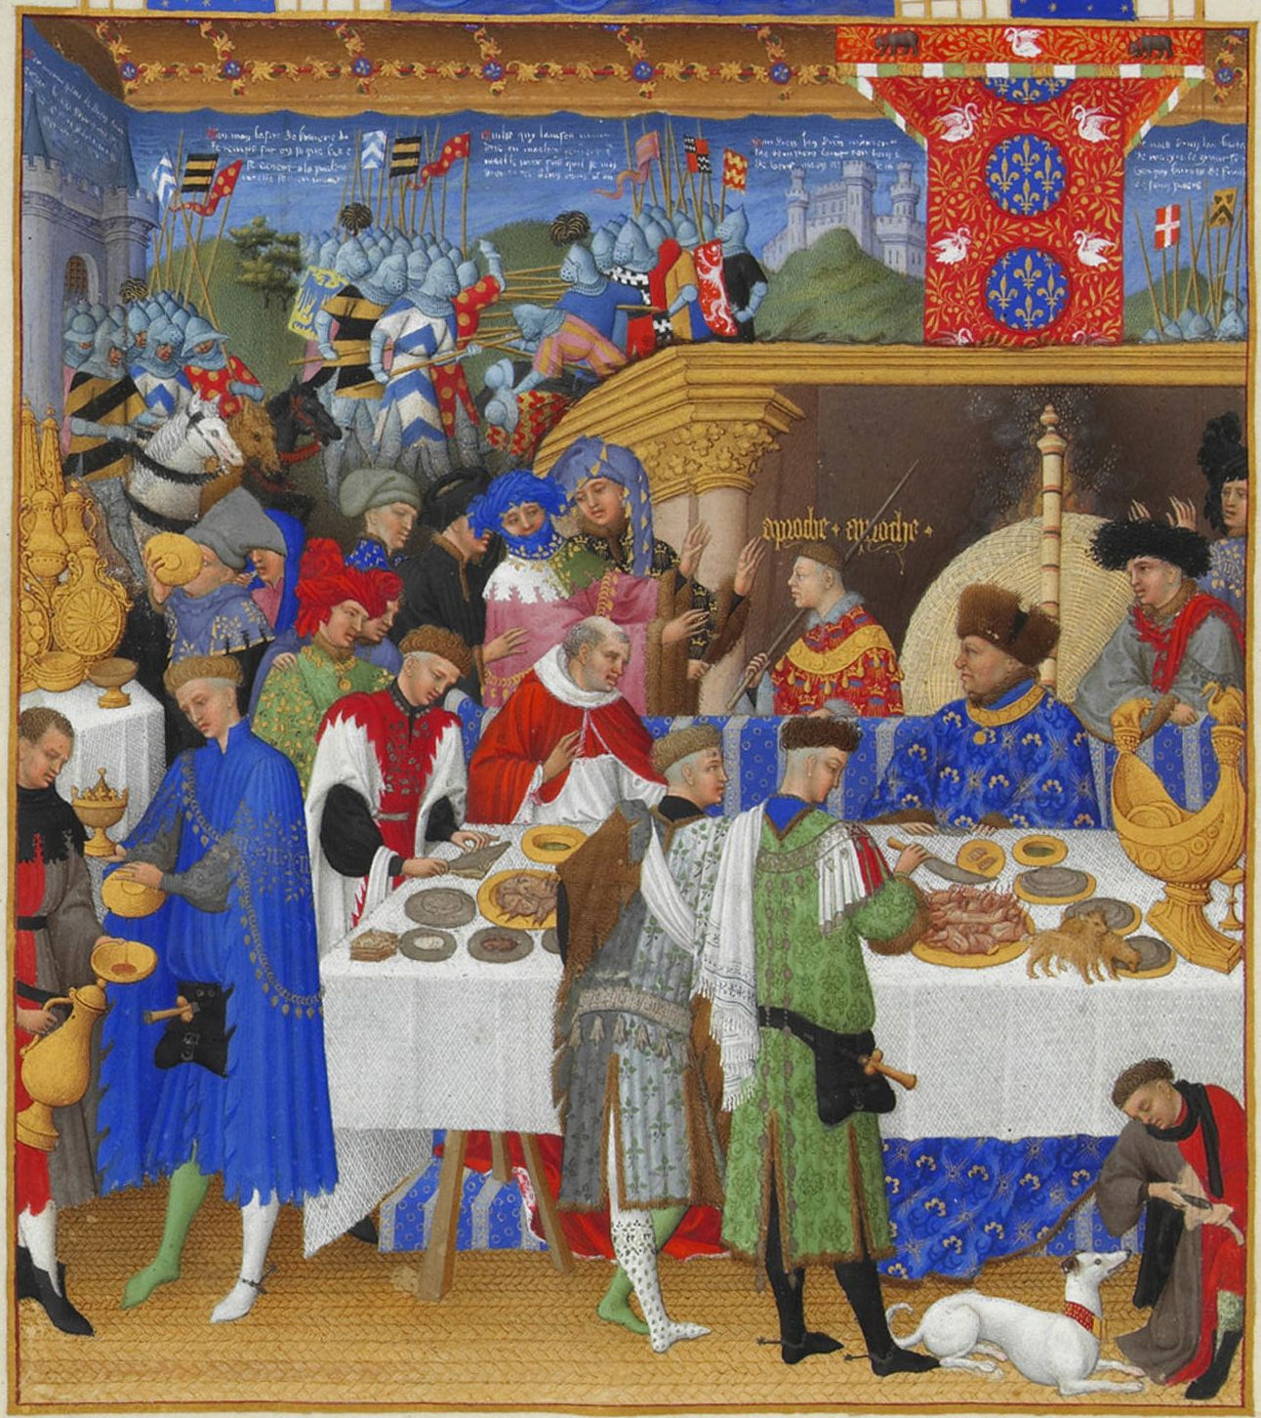
January (feasting), Très Riches Heures, fol. 1v

Slide 42
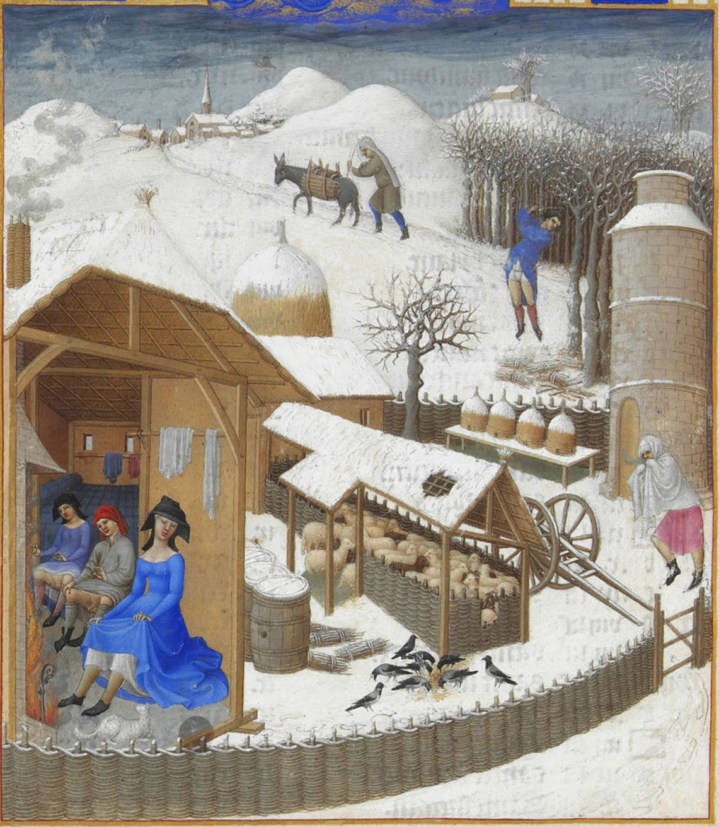
February (warming by the fire), Très Riches Heures, fol. 2v

Slide 43
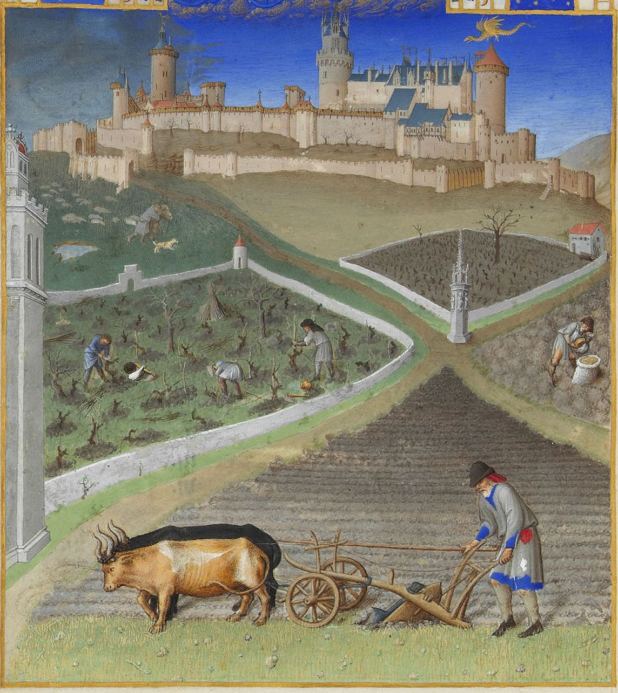
March (ploughing), Très Riches Heures, fol. 3v

Slide 44
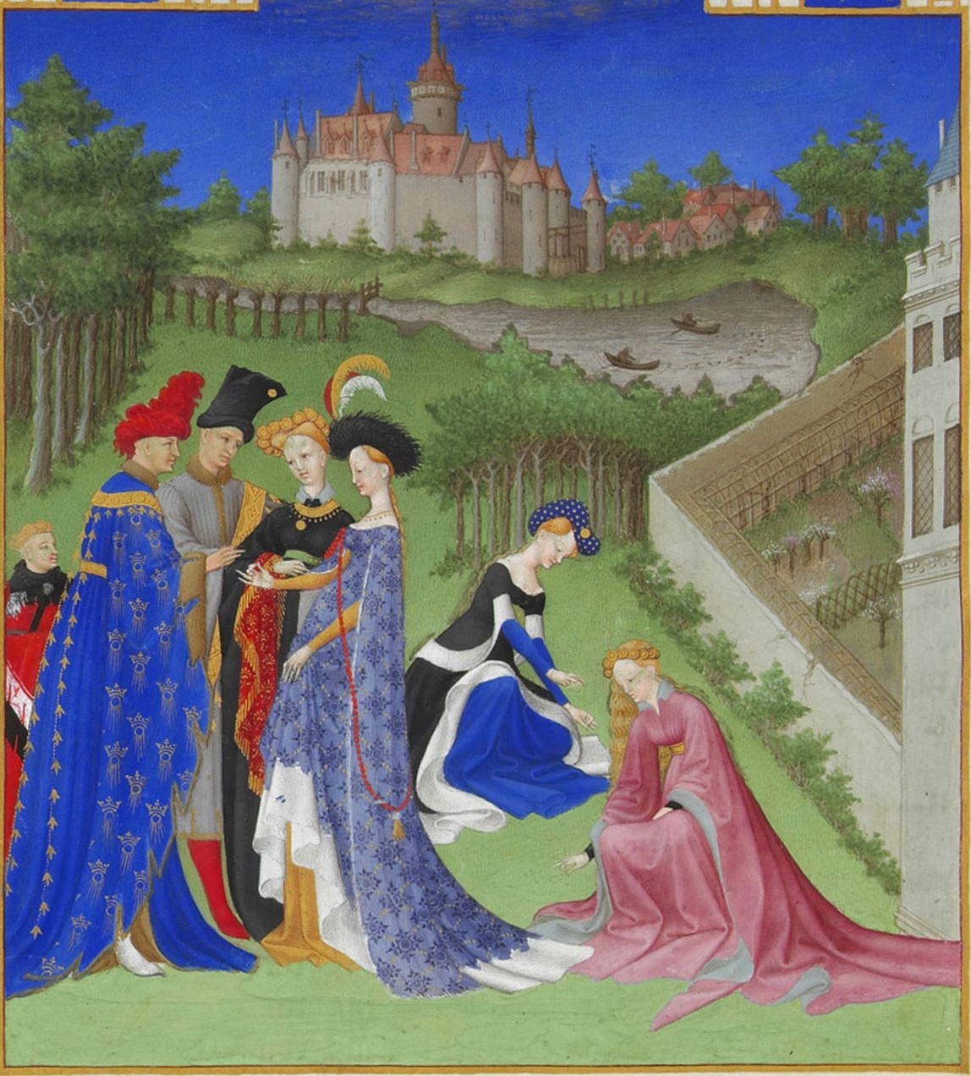
April (betrothal),Très Riches Heures, fol. 4v

Slide 45
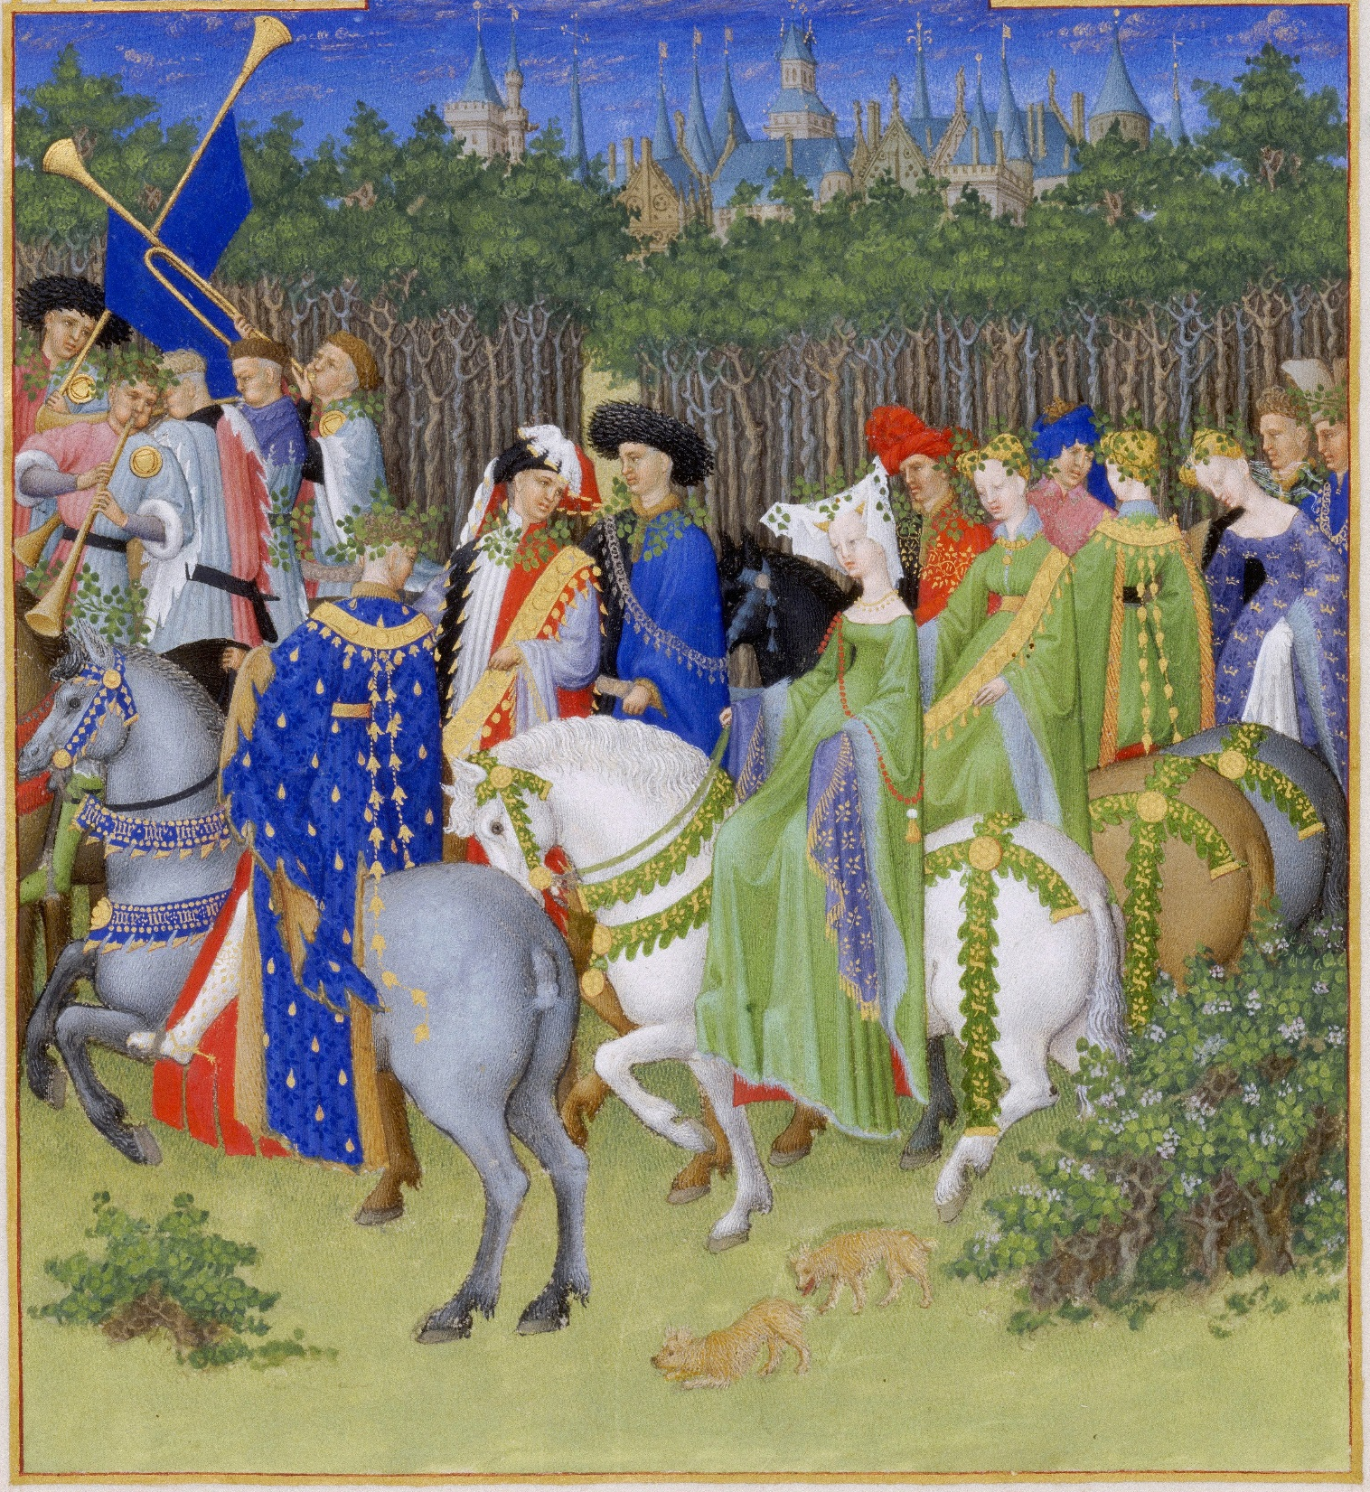
May (riding or hunting),Très Riches Heures, fol. 5v

Slide 46
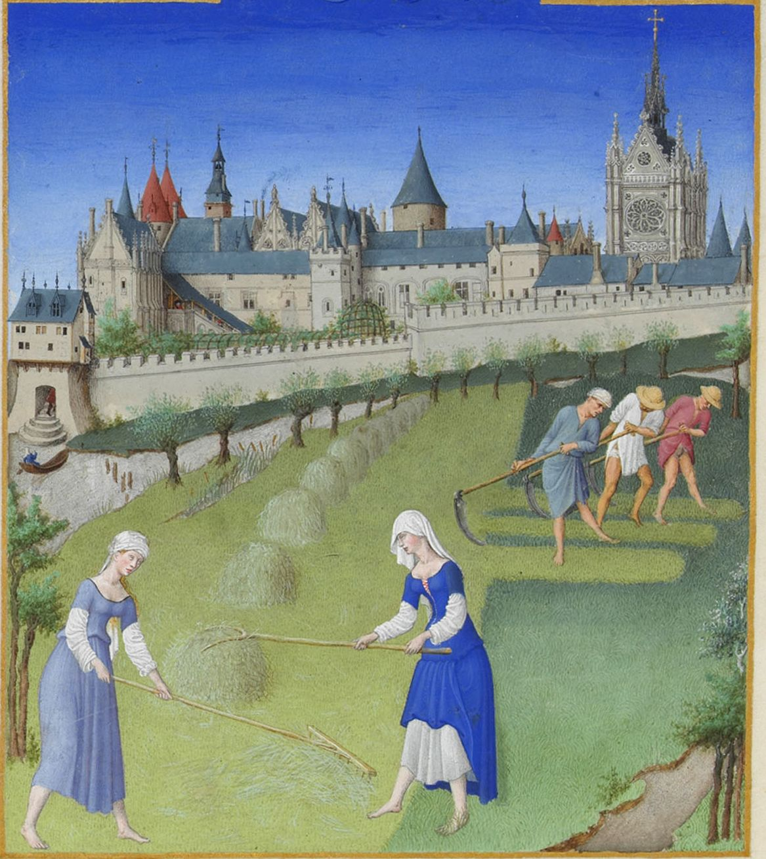
June (haymaking),Très Riches Heures, fol. 6v

Slide 47
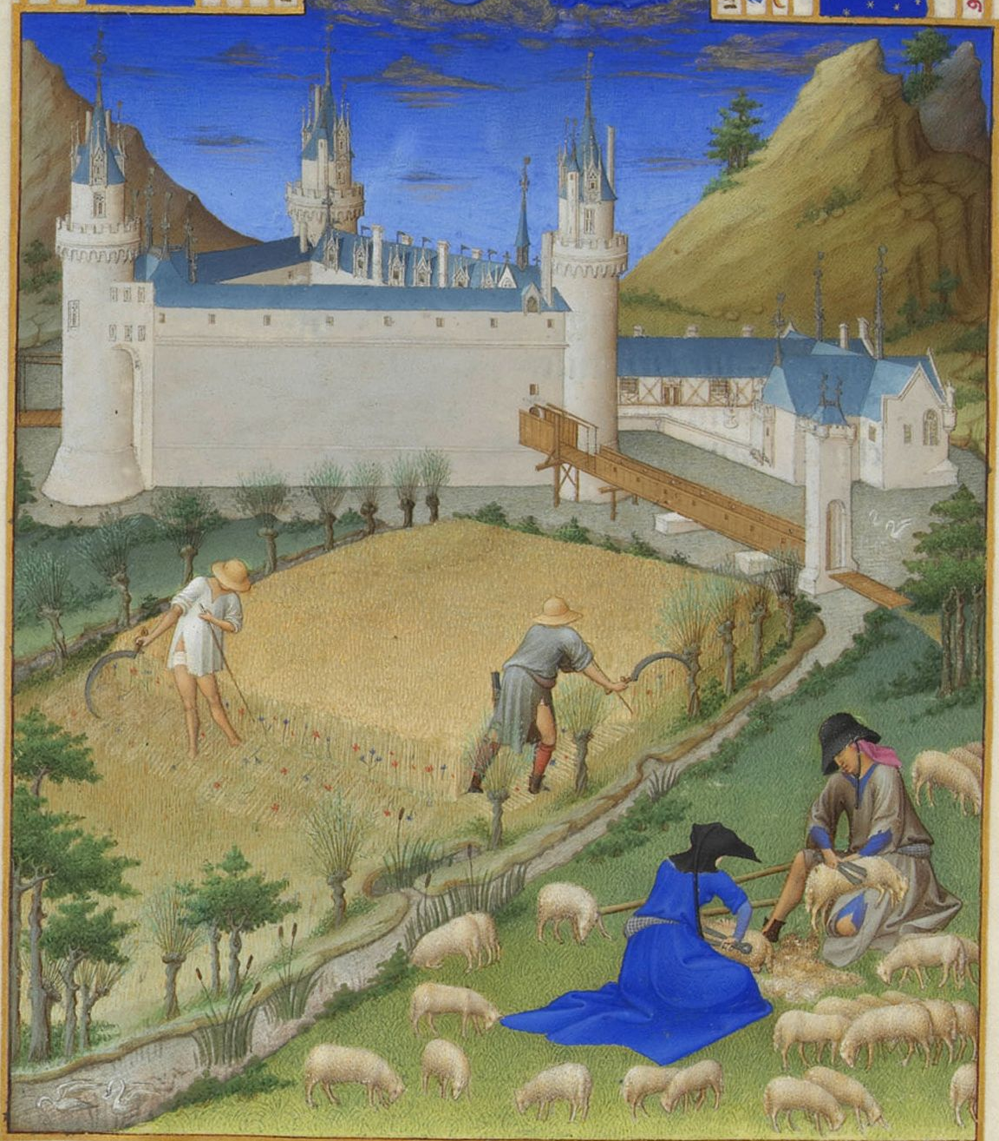
July (harvesting, shearing),Très Riches Heures, fol. 7v

Slide 48
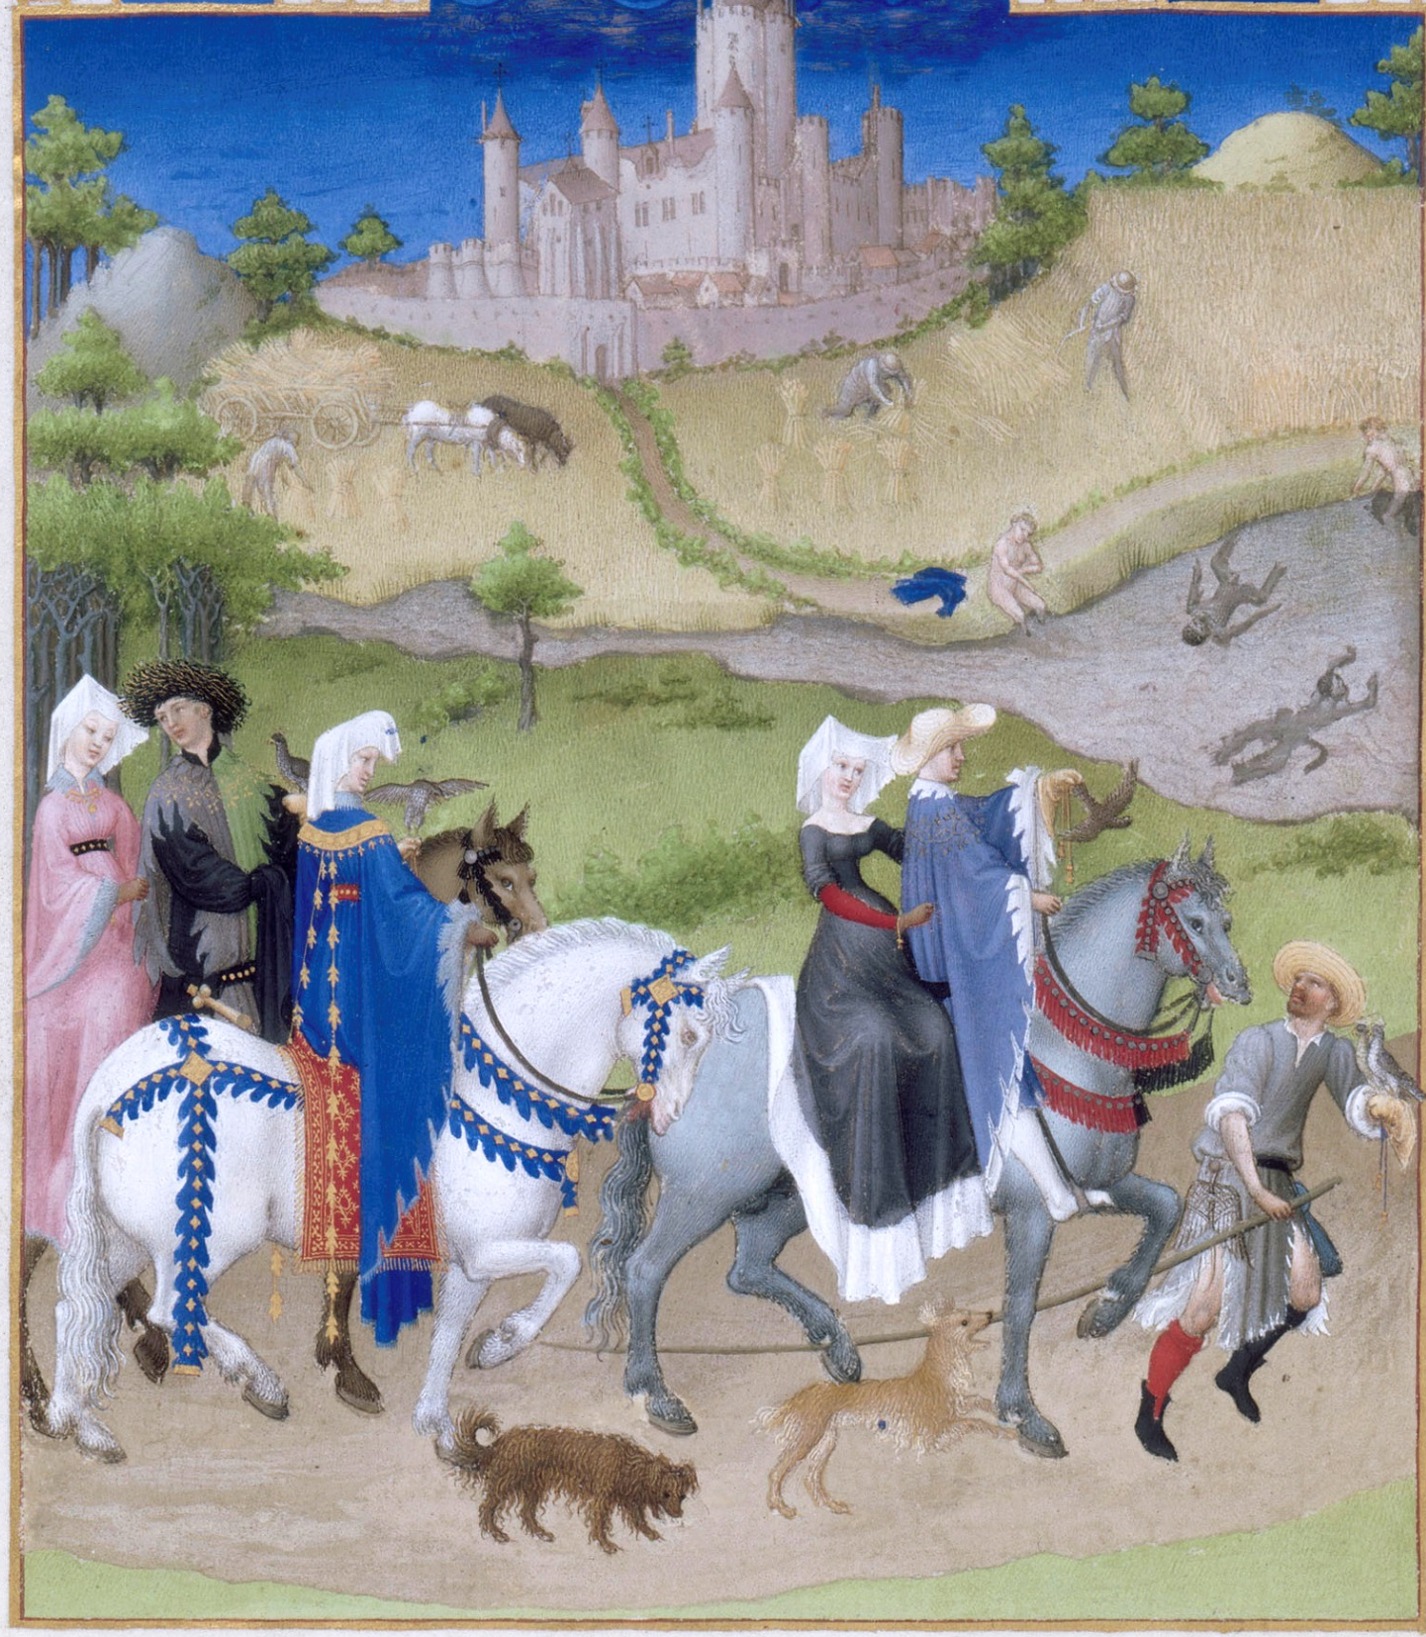
August (hawking),Très Riches Heures, fol. 8v

Slide 49
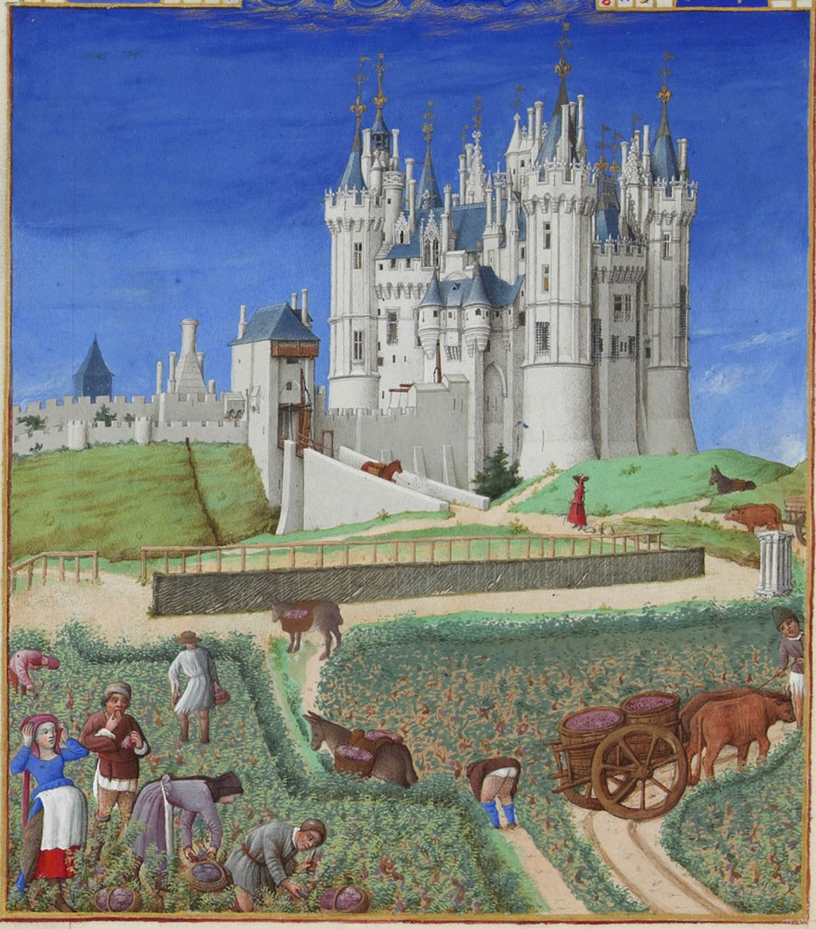
September (harvesting grapes),Très Riches Heures, fol. 9v

Slide 50
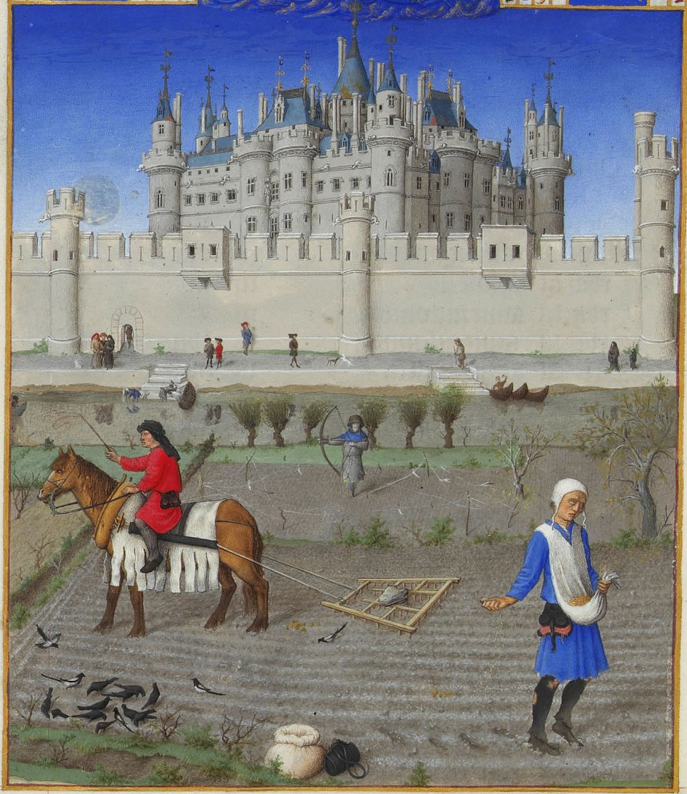
October (sowing seeds),Très Riches Heures, fol. 10v

Slide 51
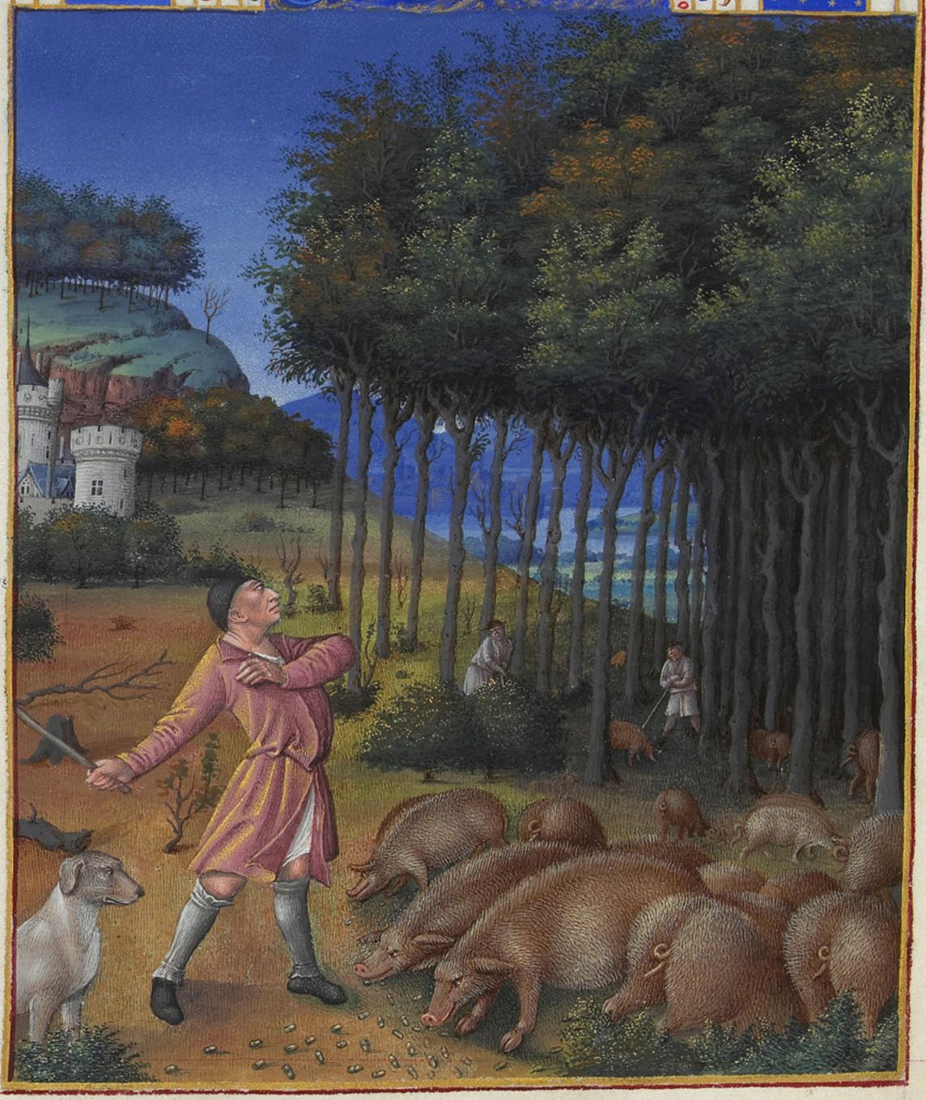
November (fattening pigs),Très Riches Heures, fol. 11v

Slide 52
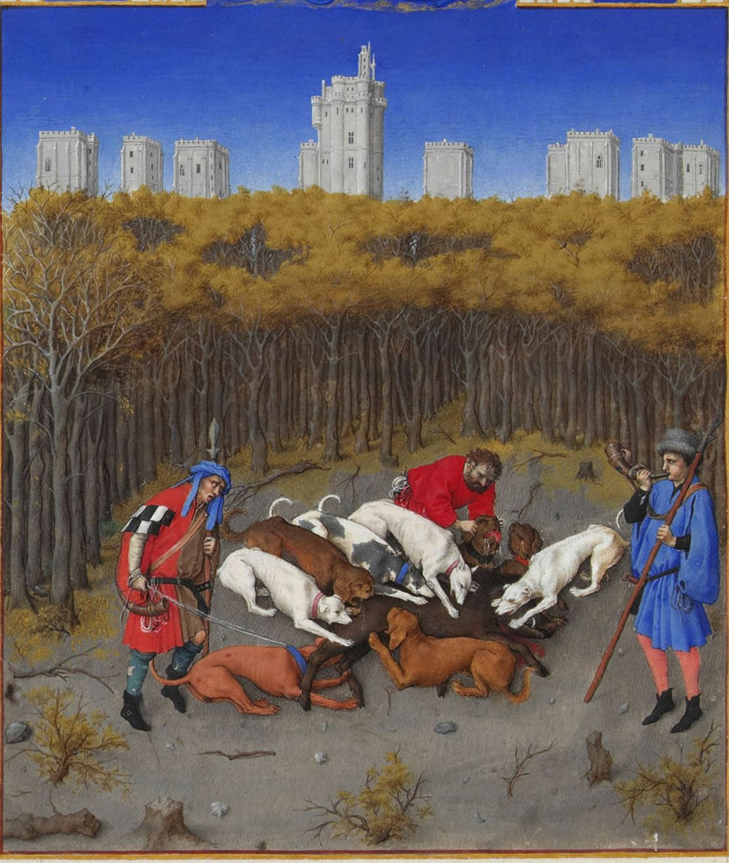
December (slaughtering pigs),Très Riches Heures, fol. 12v

