Slide 1
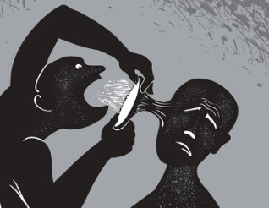
Radicalisation

Slide 2
Aims and Objectives
Examine the terms, terrorism, extremism and radicalisation.
Examine the signs of radicalisation.
Introduction to Prevent.
Introduction to the Channel Programme.

Slide 3
What is extremism?
Extremism is the promotion or advancement of an ideology based on violence, hatred or intolerance, that aims to:
Negate or destroy the fundamental rights and freedoms of others; or
Undermine, overturn or replace the UK’s system of liberal parliamentary democracy and democratic rights; or
Intentionally create a permissive environment for others to achieve the results in (1) or (2)
(Home Office, 2024)
Notes:
Extremism can lead to the radicalisation of individuals.

Slide 4

What is terrorism?
The Terrorism Act 2006 defines
“terrorism as an action or threat designed to influence the government or intimidate the public. Its purpose is to advance a political, religious or ideological cause”.
Notes:
terrorism is an action that:
endangers or causes serious violence to a person or people
causes serious damage to property, or seriously interferes with or disrupts an electronic system
is designed to influence the government or to intimidate the public

Slide 5

What is radicalisation?
Radicalisation is the process that takes place when an individual develops extreme views or beliefs that support terrorist groups or activities.

Slide 6
Signs of radicalisation
Accessing extremist content online or downloading propaganda material
Justifying the use of violence to solve societal issues
Altering their style of dress or appearance to accord with an extremist group
Being unwilling to engage with people who they see as different
Using certain symbols associated with terrorist organisations
Notes:
Everyone is different, and there is no checklist that can tell us if someone is being radicalised or becoming involved in terrorism. But these signs may mean someone is being radicalised

Slide 7
Terrorism Act 2000
The Terrorism Act 2000 defines terrorism, both in and outside of the UK, as the use or threat of one or more specific actions:
serious violence against a person;
serious damage to property;
endangering a person's life (other than that of the person committing the action);
creating a serious risk to the health or safety of the public or a section of the public; and
action designed to seriously interfere with or seriously to disrupt an electronic system.

Slide 8
Statistics
Extreme Right - Wing terrorism and Islamist terrorism are the most common in the UK.
In the year ending 31 March 2020, there were 6,287 referrals to Prevent. This is an increase of 10% compared to the record low in the previous year (5,737 in the year ending March 2019).
The Police made the highest number of referrals (1,950; 31%), followed by the Education sector (1,928; 31%) (Home Office, 2020)

Slide 9

Research findings
The internet appears to play a prominent role with the radicalisation process.
There has been a move from specific extremist websites to the use of open social media.
The widespread use of the internet has led to increased risks relating to extremism.
Notes:
Research carried out by the HM Prison and Probation Service

Slide 10

Terrorism content
Online terrorism content is any content which, by uploading it or otherwise making it available to others online, a person is committing an offence under UK terrorism laws.
Includes videos, images (including GIFs), voice recordings, posters.
Terrorist Operated Websites (TOW) set up for recruitment purposes and to share extremist content.

Slide 11
Who is targeted?
Anyone can be radicalised.
Teenagers and young people are at greater risk – this may because of identity struggles.
Contact online from an extremist group may provide a sense of belonging.
They are “pulled” towards the sense of community and united goals.
Radicalisers are trained to identify people who maybe be vulnerable (Action Counter Terrorism, 2024)

Slide 12
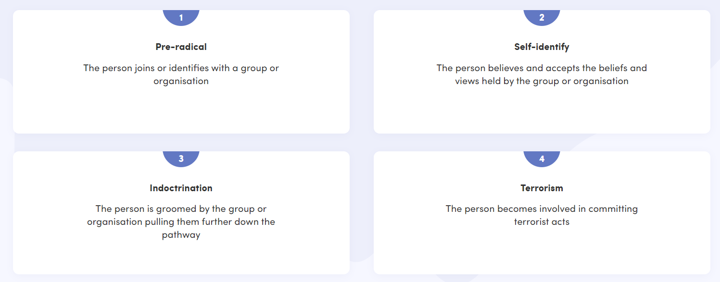
Radicalisation process

Slide 13
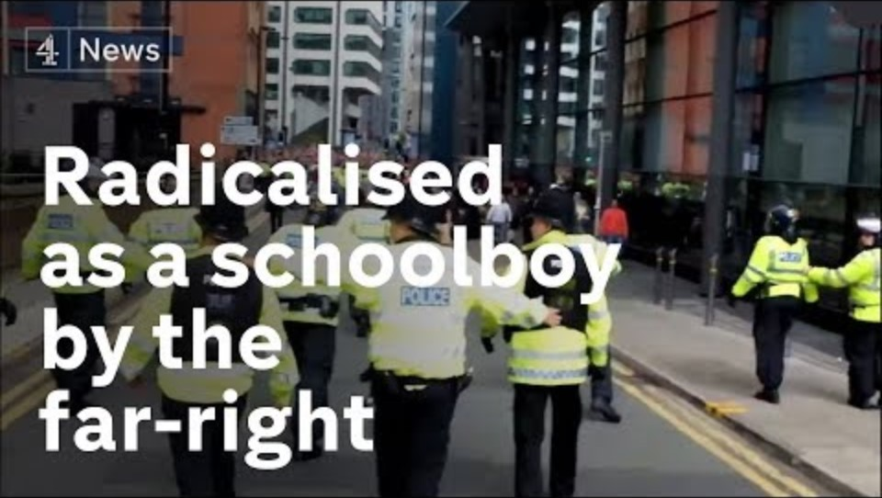
Radicalisation case example

Slide 14

The extent of internet use promoting radicalisation and terrorism has been described as
“…one of the greatest threats that countries including the UK face”
(UK House of Commons Home Affairs Committee, 2017)

Slide 15
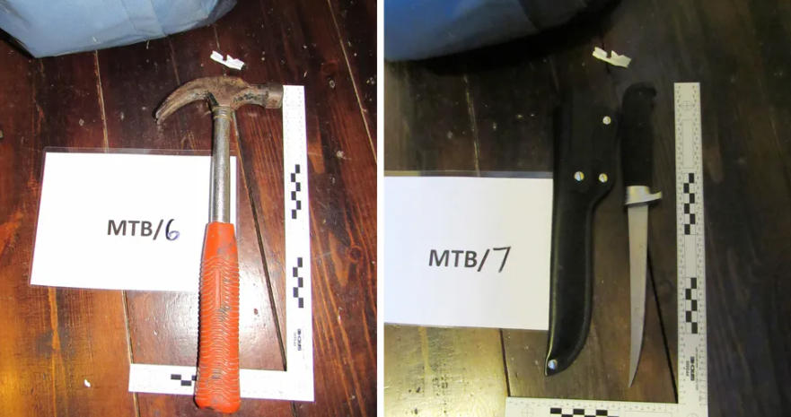

Case Study – Lloyd Gunton 2018
Radicalised online
From Cardiff, planned a “lone wolf” attack in the name of Islam.
Posted social media content supporting Al- Qaeda.
Posted photos encouraging attacks in Cardiff.
His laptop contacted IS propaganda.
He had searched You Tube for terrorist videos.
A martyrdom letter was recovered alongside weapons in his bedroom.
Notes:
Evidence recovered from his web searches showed an eight-month interest in terrorism, researched Cardiff target sites and concerts.
He was given a life sentence with a minimum term of 11 for planning an Islamic State-inspired vehicle attack in Cardiff

Slide 16
Sec 1 TA 2006 Encouragement etc of Terrorism
A person commits an offence if—
(a)he publishes a statement to which this section applies or causes another to publish such a statement; and
(b)at the time he publishes it or causes it to be published, he—
(i)intends members of the public to be directly or indirectly encouraged or otherwise induced by the statement to commit, prepare or instigate acts of terrorism or Convention offences; or
(ii)is reckless as to whether members of the public will be directly or indirectly encouraged or otherwise induced by the statement to commit, prepare or instigate such acts or offences.
Notes:
A person guilty of an offence under this section shall be liable—
(a)on conviction on indictment, to imprisonment for a term not exceeding or to a fine, or to both;
(b)on summary conviction in England and Wales, to imprisonment for a term not exceeding the general limit in a magistrates’ court] or to a fine not exceeding the statutory maximum, or to both;

Slide 17

Introducing Prevent
A national programme which aims to stop people becoming and or supporting terrorism.
Prevent addresses all types of terrorism.

Slide 18
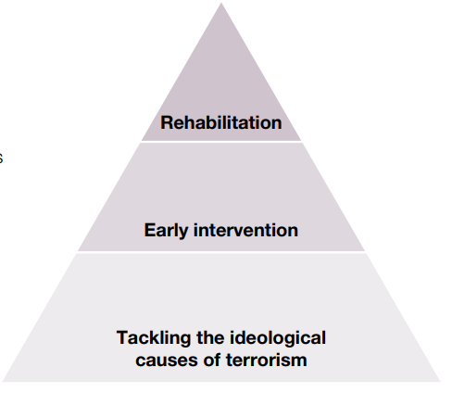
Prevent delivery model
Notes:
The model outlines how Prevent aims to address ideological causes that lead to radicalisation
Early intervention to support those vulnerable to radicalisation
Rehabilitation for those already subjected to it.

Slide 19

Tackling ideological causes
Reducing the influences of radicalisers on vulnerable persons.
Reduce the availability and access to terrorist material.
Prevent work across several areas including education, government, industry and within the community.
Working with others to address the threat.

Slide 20
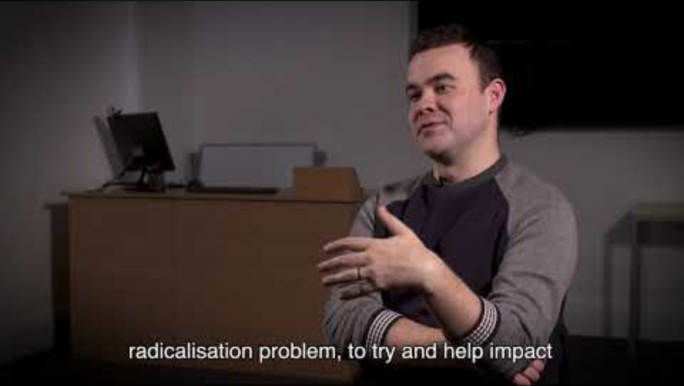
Prevent : An Introduction

Slide 21

Chanel Programme
Once referred to Prevent individuals are assessed to to see if they are suitable for the Channel Programme.
A specialist support scheme.
Mult agencies such as health professionals and local authority then create a tailored package of support.
Support offered includes addiction and mental health support.
Ideological mentoring.
Individuals are not given a criminal record.

Slide 22
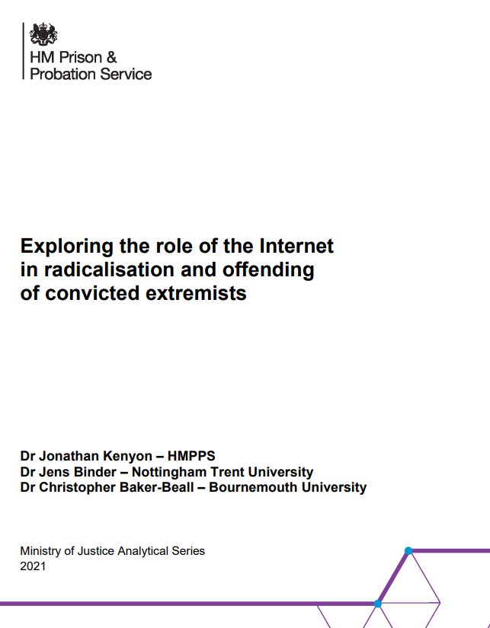
Further Reading
https://assets.publishing.service.gov.uk/media/614088c2e90e070442fbdde2/exploring-role-internet-radicalisation.pdf

Slide 23

Podcasts – Action Counter Terrorism
https://www.counterterrorism.police.uk/advice-for-young-people/
For further information on Counter Terrorism Policing please see Pods casts from Action Counter Terrorism.

Slide 24

Any Questions

