Slide 1
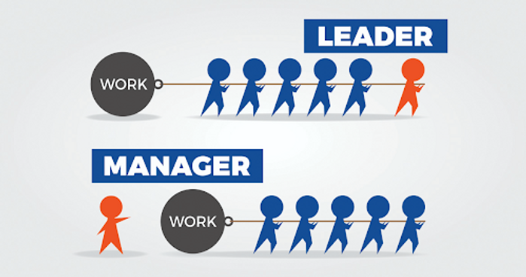
LCBB6003
Leadership and Management Theory and Practice
Component 2
Practical Group Presentation
Group Members
Member 1 : Viorica Birloiu
Member 2 : Cristina Solomon
Member 3 : Andrea Caba
Member 4 : Adriana Dobozi

Slide 2
Table of Contents
Introduction
The present context of Leadership
Scenario & Quote
What is Emotional Intelligence?
Goleman’s EI Model
Why EI Matters in Leadership
Strengths and Limitations of EI
What is Cultural Intelligence?
Earley & Ang’s CQ Model
Why CQ Matters in Leadership
Strengths and Limitations of CQ
EI + CQ = Holistic Leadership
Traditional vs Horizontal Leadership
Case Study 1: Satya Nadella (Microsoft)
Case Study 2: Indra Nooyi (PepsiCo)
Case Study 3: Howard Schultz (Starbucks)
Case Study 4: Paul Polman (Unilever)
Challenges in Applying EI and CQSlide textual content:
Opportunities in Global Leadership
Conclusion
References
Notes:
Introduction 2
The present context of Leadership 2
Scenario & Quote 3
What is Emotional Intelligence? 4
Goleman’s EI Model 4
Why EI Matters in Leadership 5
Strengths and Limitations of EI 5
What is Cultural Intelligence? 6
Earley & Ang’s CQ Model 6
Why CQ Matters in Leadership 7
Strengths and Limitations of CQ 7
EI + CQ = Holistic Leadership 8
Traditional vs Horizontal Leadership 9
Case Study 1: Satya Nadella (Microsoft) 9
Case Study 2: Indra Nooyi (PepsiCo) 10
Case Study 3: Howard Schultz (Starbucks) 10
Case Study 4: Paul Polman (Unilever) 11
Challenges in Applying EI and CQSlide textual content: 11
Opportunities in Global Leadership 12
Conclusion 12
References 13

Slide 3
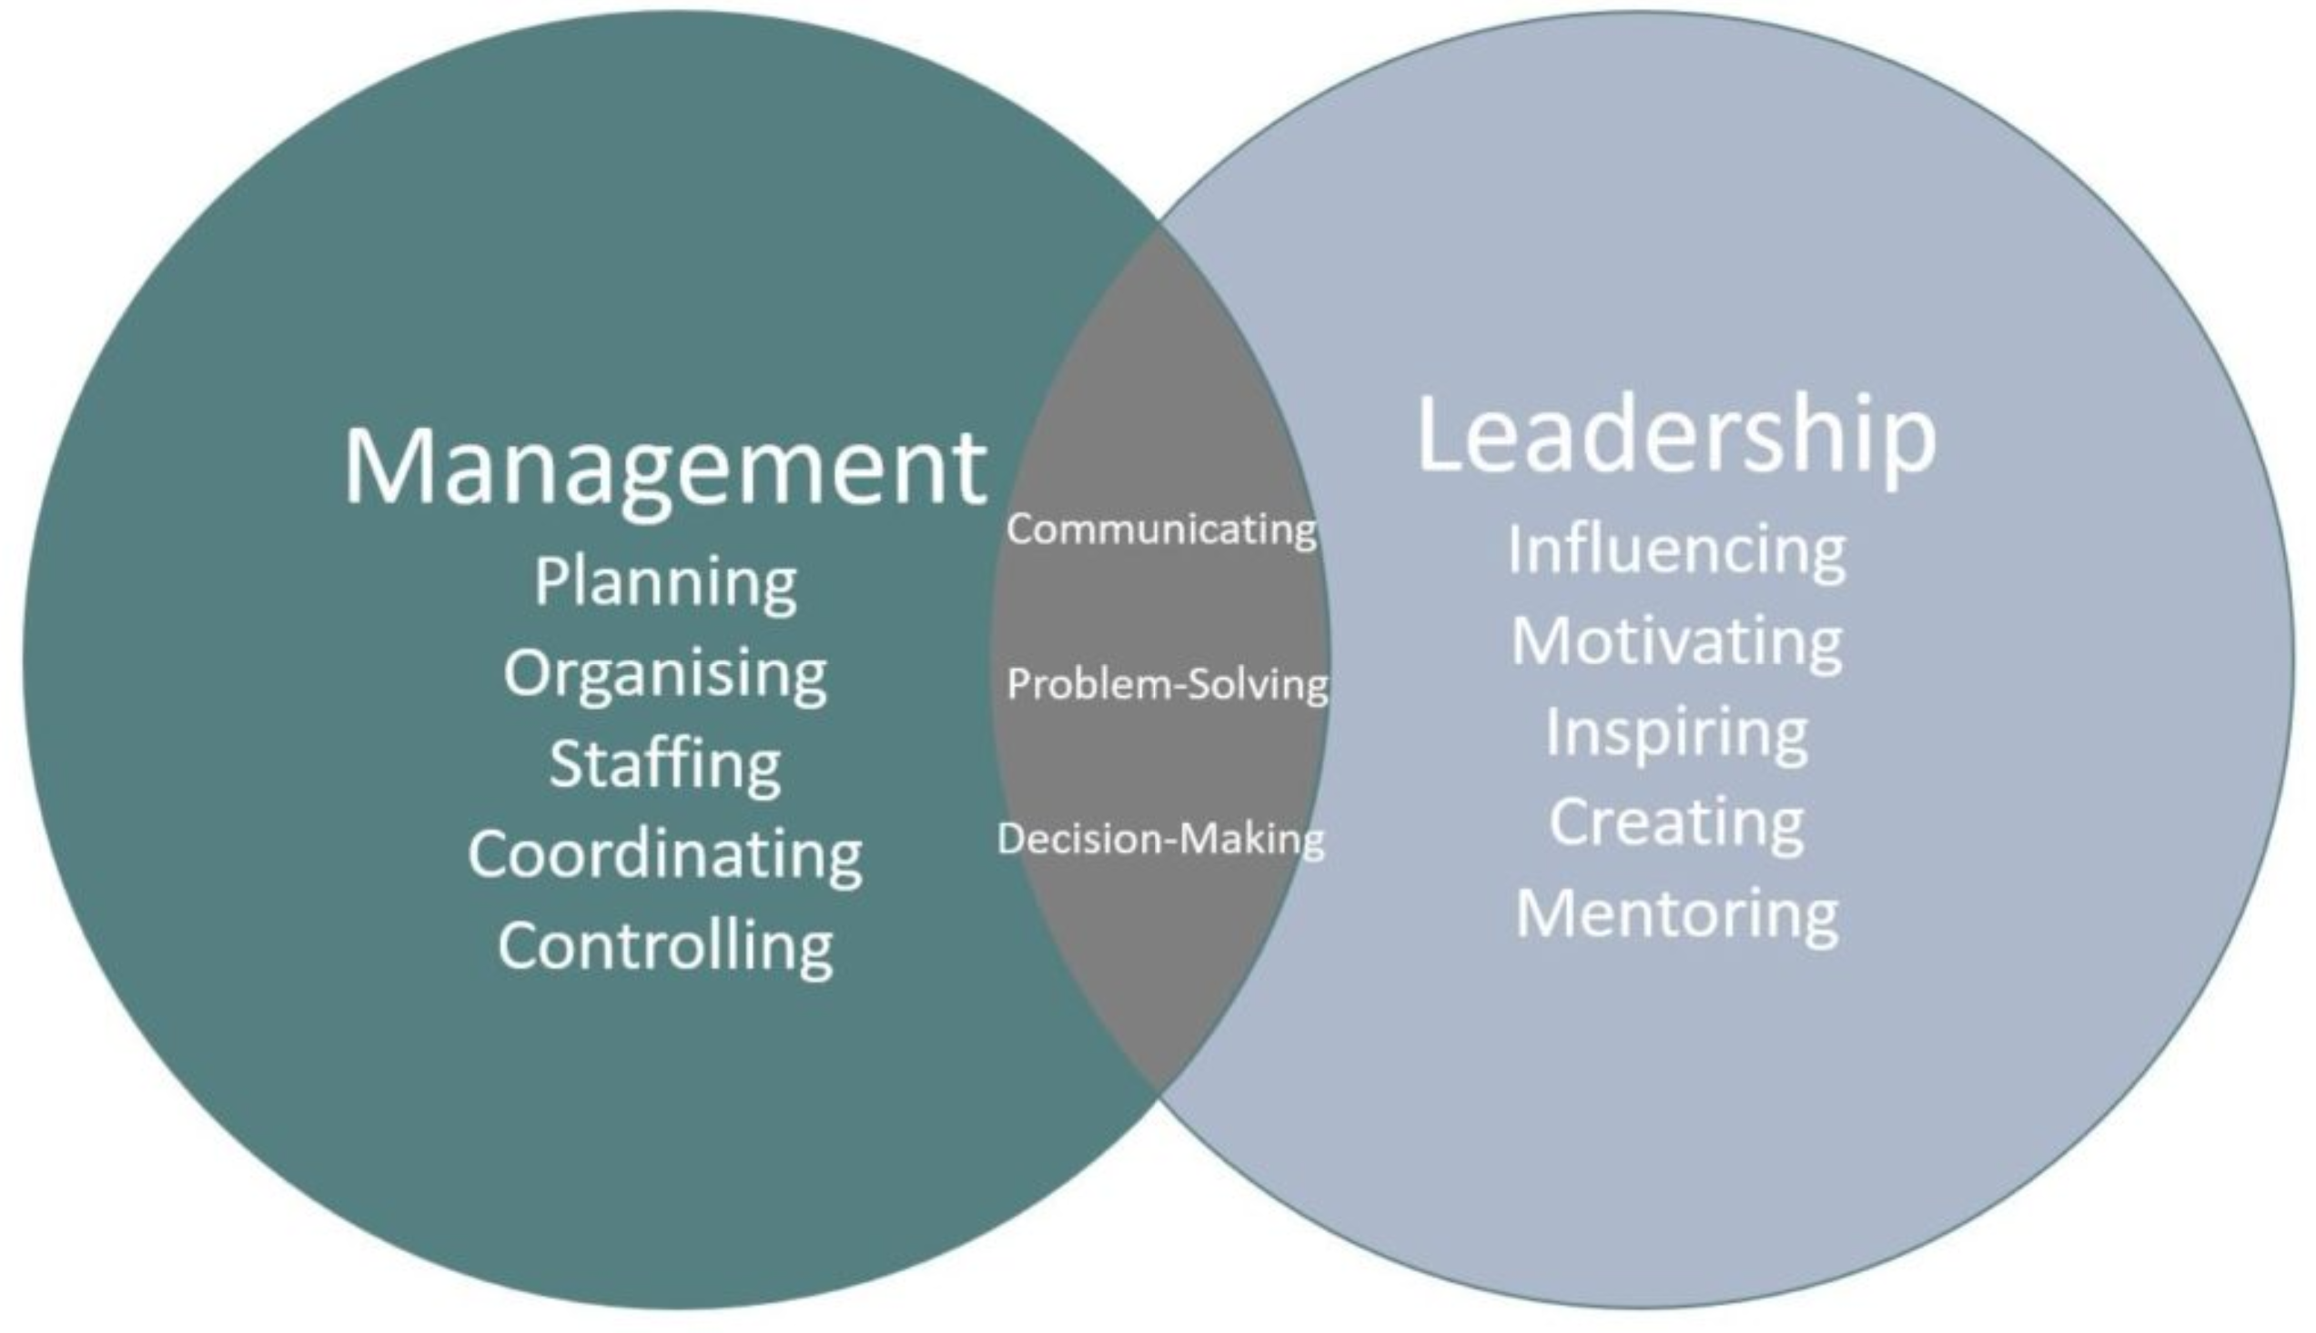
Introduction
Literally, in a global of global teams and various workforces, traditional leadership tactics are now not enough.
The objective of this presentation is to seriously discover the significance of EI and CQ in effective leadership, with a selected emphasis on collaborative and multicultural environments.
Notes:
Literally, in a global of global teams and various workforces, traditional leadership tactics are now not enough. At Present, leaders have to navigate complex interpersonal and pass-cultural dynamics, which requires a new set of abilities—Emotional Intelligence (EI) and cultural intelligence (CQ). The objective of this presentation is to seriously discover the significance of EI and CQ in effective leadership, with a selected emphasis on collaborative and multicultural environments. We take thought from Edith Heard, Director-fashionable of the EU Molecular Biology Laboratory, who describes leadership as a horizontal, empathetic, and inclusive practice.
We are able to begin by means of defining and studying the theoretical foundations of each EI and CQ. Subsequent, we are able to explore how those intelligences work together to shape effective, people-focused management. Using 4 real-world commercial enterprise examples, we reveal how leading with empathy and cultural attention can pressure tremendous organizational outcomes.

Slide 4
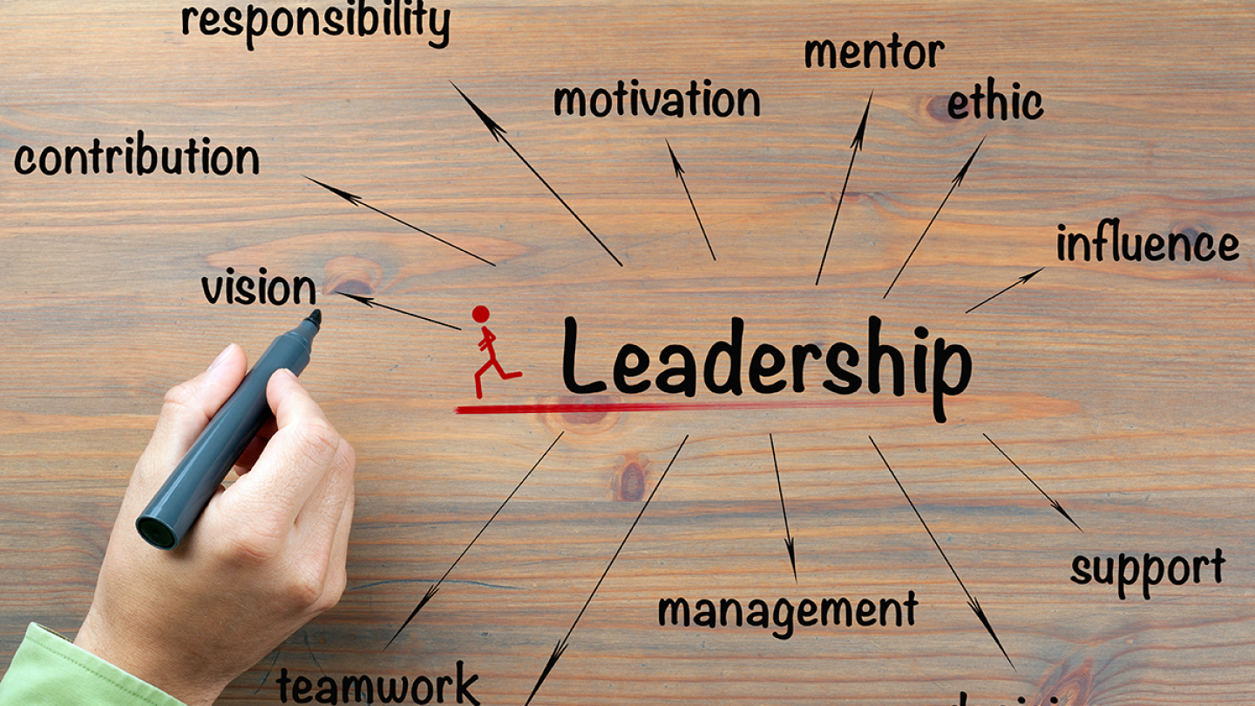
The present context of Leadership
Collaborative, inclusive, and empathetic
Emphasizes relationships, no longer simply effects
Engages various perspectives and shared selection-making
Shifts from command-and-control to steer and emotional connection (Liu et al, 2022)
Notes:
Collaborative, inclusive, and empathetic
Emphasizes relationships, no longer simply effects
Engages various perspectives and shared selection-making
Shifts from command-and-control to steer and emotional connection (Liu et al, 2022)
Current leadership has advanced dramatically from the traditional command-and-manipulate fashion. Leaders nowadays are predicted to persuade in place of instruct, to encourage in preference to impose. They foster environments where every body’s voice subjects, and choice-making is shared and horizontal, not top-down (Nani et al, 2021)

Slide 5
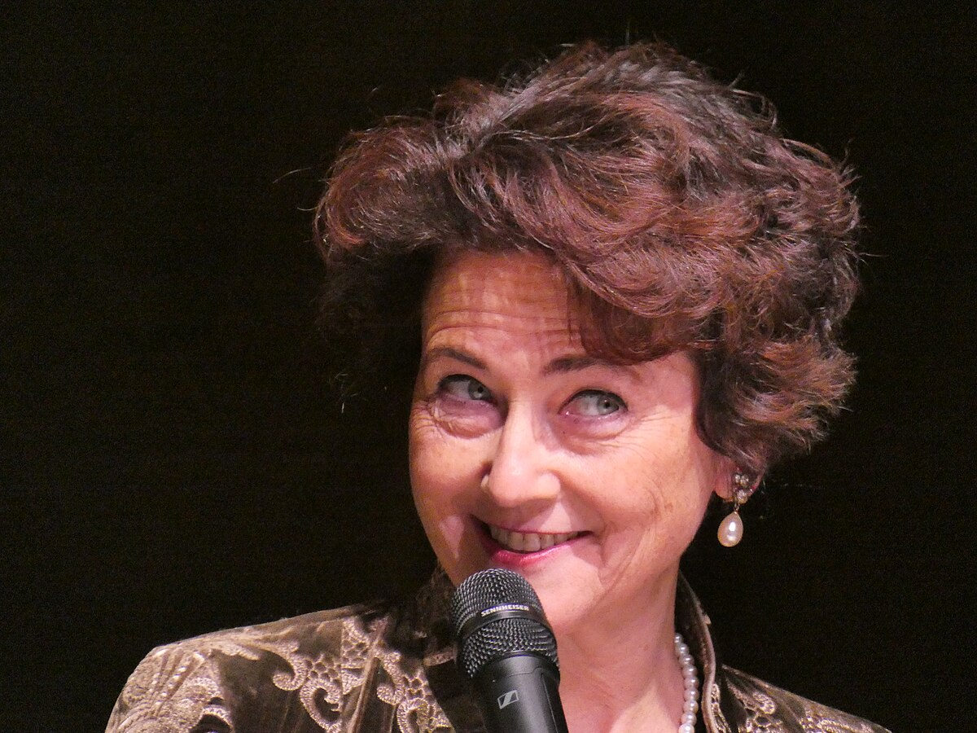
Scenario & Quote
“I observe the equal management principles to every a part of my lifestyles. I tend to be very horizontal in my method. I do not think of my lab participants as running for me; I am running with them ... I agree with inside the significance of empathy, of trying to listen and tune into people to carry them on board.”
— Edith Heard, Director-fashionable, European Molecular Biology Laboratory (Economic instances, 27 February 2022)
Notes:
“I observe the equal management principles to every a part of my lifestyles. I tend to be very horizontal in my method. I do not think of my lab participants as running for me; I am running with them ... I agree with inside the significance of empathy, of trying to listen and tune into people to carry them on board.”
— Edith Heard, Director-fashionable, European Molecular Biology Laboratory (Economic instances, 27 February 2022)
This quote via Edith Heard bureaucracy the muse of our dialogue. She redefines management as a horizontal relationship, primarily based on empathy, energetic listening, and cultural atonement. Her leadership technique was fashioned via her formative years, growing up as a solely child in a multicultural, multilingual environment (Lavigne et al, 2022)

Slide 6
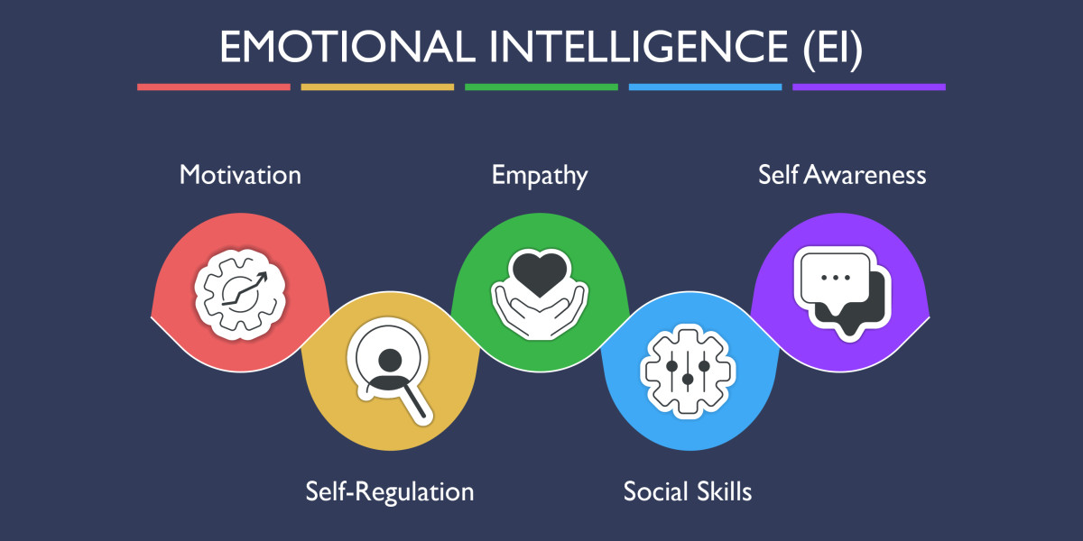
What is Emotional Intelligence?
Emotional intelligence (EI)
“The capability to understand, apprehend, and manage our own feelings, and to recognize, understand, and have an effect on the emotions of others.” – Daniel Goleman
Key aspects:
Empathy
Active listening
Social attention and interpersonal capabilities (Labrague, 2021)
Notes:
Emotional intelligence (EI)
“The capability to understand, apprehend, and manage our own feelings, and to recognize, understand, and have an effect on the emotions of others.” – Daniel Goleman
Key aspects:
Empathy
Active listening
Social attention and interpersonal capabilities (Labrague, 2021)
Daniel Goleman, a renowned psychologist, popularized the concept of Emotional intelligence (EI) within the Nineties. According to Goleman, EI is the potential to apprehend and manage your very own feelings and to track into and influence the feelings of others. Emotional intelligence permits leaders to do simply that—making them more approachable, responsive, and powerful.

Slide 7
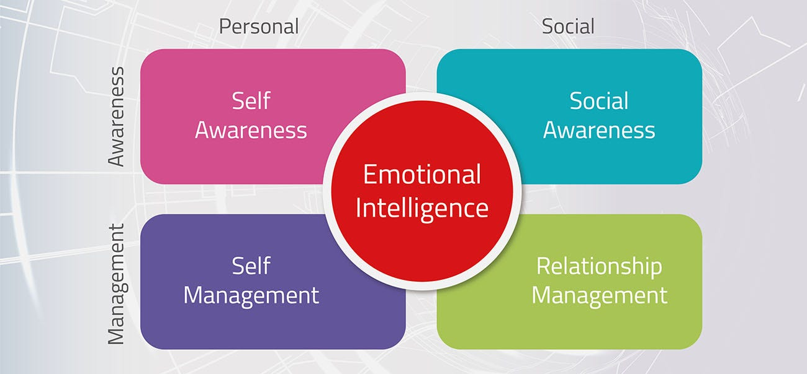
Goleman’s EI Model
Goleman’s five components of EI:
Self-recognition – knowing your very own emotions and effect
Self-law – handling emotions and impulses
Motivation – internal power to reap and improve
Empathy – appreciation others’ feelings
Social skills – coping with relationships, have an impact on, conversation (Kim et al, 2022)
Notes:
Goleman’s five components of EI:
Self-recognition – knowing your very own emotions and effect
Self-law – handling emotions and impulses
Motivation – internal power to reap and improve
Empathy – appreciation others’ feelings
Social skills – coping with relationships, have an impact on, conversation (Kim et al, 2022)

Slide 8
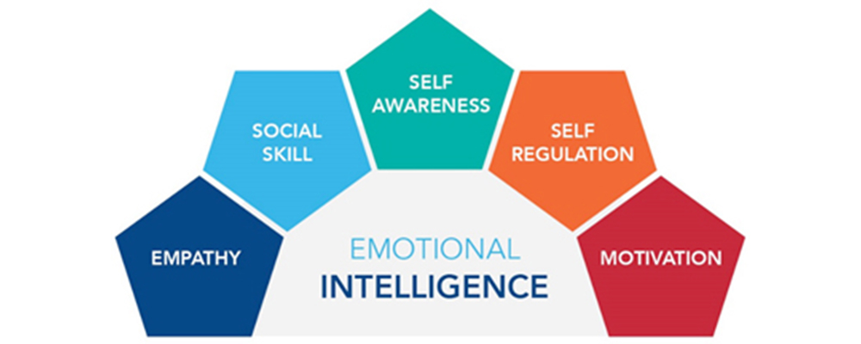
Why EI Matters in Leadership
Advantages of EI in leadership
Builds belief and psychological protection
Fosters crew brotherly love and morale
Improves verbal exchange and collaboration
Enables hostilities resolution and resilience (Karakose et al, 2021)
Notes:
Advantages of EI in leadership
Builds belief and psychological protection
Fosters crew brotherly love and morale
Improves verbal exchange and collaboration
Enables hostilities resolution and resilience (Karakose et al, 2021)
Leaders with excessive emotional intelligence foster open communication, mutual admire, and a supportive lifestyle. They are higher prepared to address team tensions, inspire human beings, and adapt to emotional climates—whether in a lab, boardroom, or digital team. Edith Heard exemplifies this through her emphasis on “operating with” instead of directing others.

Slide 9
Strengths and Limitations of EI
Strengths | Limitations
Builds empathy & rapport | Challenging to measure objectively
Complements group motivation | May be culturally biased
Helps manage strain & combat | Not always teachable/formalized
Supports inclusive management | Misused manipulation chance (Jones et al, 2022)
Notes:
Strengths
Limitations
Builds empathy & rapport
Challenging to measure objectively
Complements group motivation
May be culturally biased
Helps manage strain & combat
Not always teachable/formalized
Supports inclusive management
Misused manipulation chance (Jones et al, 2022)
At the same time as EI gives effective benefits, it’s no longer except challenges. At the strengths side, it promotes deeper connections, higher group dynamics, and stepped forward adaptability—especially important in diverse, high-pressure environments. But, its boundaries include the problem of measuring EI constantly.

Slide 10
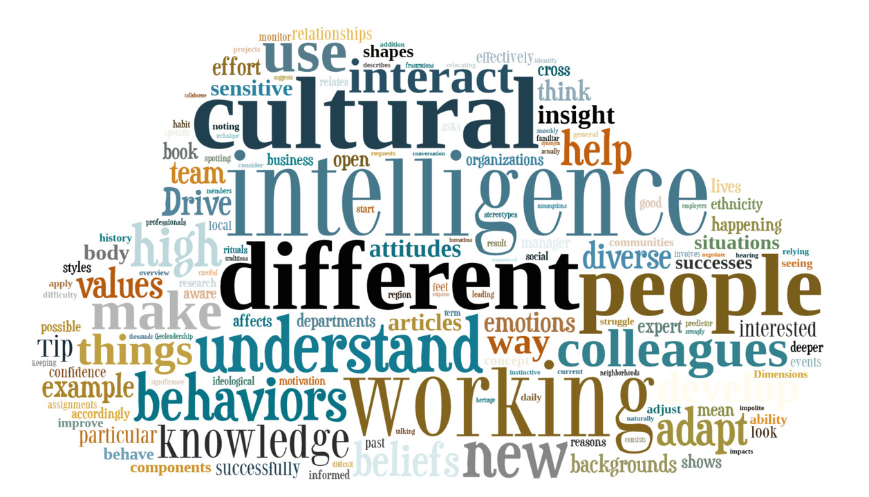
What is Cultural Intelligence?
Cultural intelligence (CQ)
“The capability to relate and work correctly across cultures.”
Why it matters:
Fundamental for global and numerous teams
Enables respectful collaboration
Bridges cultural differences in verbal exchange and behaviour (Heckman et al, 2022)
Notes:
Cultural intelligence (CQ)
“The capability to relate and work correctly across cultures.”
Why it matters:
Fundamental for global and numerous teams
Enables respectful collaboration
Bridges cultural differences in verbal exchange and behaviour (Heckman et al, 2022)
Cultural intelligence, or CQ, was delivered via Earley and Ang in 2003. It refers to a person’s capability to feature efficiently in culturally various settings. Not like IQ or even emotional intelligence, CQ focuses on go-cultural competence—how properly a leader can adapt their conduct, choice-making, and conversation when working with humans from unique backgrounds.

Slide 11
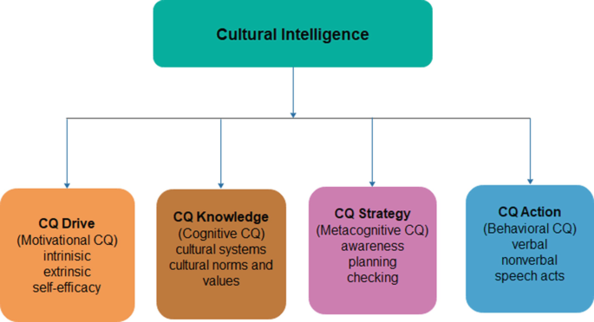
Earley & Ang’s CQ Model
The 4 Dimensions of CQ:
CQ Drive – Interest and confidence in multicultural condition
CQ Knowledge– grasp of cultural systems and norms
CQ Strategy– potential to graph and interpret throughout cultures
CQ Action – potential to evolve verbal and non-verbal behaviors
Notes:
Earley & Ang’s CQ Model
The 4 Dimensions of CQ:
CQ Drive – Interest and confidence in multicultural condition
CQ Knowledge– grasp of cultural systems and norms
CQ Strategy– potential to graph and interpret throughout cultures
CQ Action – potential to evolve verbal and non-verbal behaviors
CQ drive is about the incentive to engage across cultures—barring it, there’s no attempt to understand others. CQ Knowledge entails learning about one of a kind norms, values, and conversation patterns. CQ strategy specializes in planning and reflecting on cultural interactions. CQ action is the potential to adjust conduct and speech to fit the cultural context (Haslam et al, 2021)

Slide 12
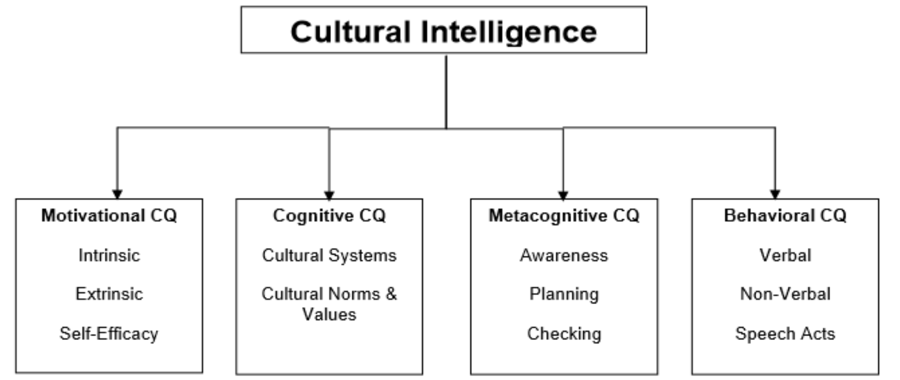
Why CQ Matters in Leadership
When Culture Clashes
A topic that offends in a single subculture can be funny in every other
Eye contact norms differ (e.g., Western vs. East Asian contexts)
Hierarchical vs. Egalitarian expectations in conferences (Hanna, 2021)
Leaders with excessive CQ:
✔ Are bendy and inclusive
✔ promote cultural concord
✔ lessen miscommunication
Notes:
When Culture Clashe
A joke that offends in a single subculture can be funny in every other
Eye contact norms differ (e.g., Western vs. East Asian contexts)
Hierarchical vs. Egalitarian expectations in conferences (Hanna, 2021)
Leaders with excessive CQ:
✔ Are bendy and inclusive
✔ promote cultural concord
✔ lessen miscommunication
Leaders without cultural intelligence frequently run into miscommunication and conflict. For example, direct comments can be seen as honest in a single way of life, however rude in another. Or silence may imply settlement in a single context, and disagreement in some other.

Slide 13
Strengths and Limitations of CQ
Strengths | Limitations
Promotes worldwide management | Cultural norms may also oversimplify
Enhances group inclusivity | nonetheless a developing discipline
Allows keep away from stereotyping chance of assuming | One-length-suits-all” lifestyle regulations
Builds trust throughout borders | Requires non-stop studying
Notes:
Strengths
Limitations
Promotes worldwide management
Cultural norms may also oversimplify
Enhances group inclusivity
nonetheless a developing discipline
Allows keep away from stereotyping chance of assuming
One-length-suits-all” lifestyle regulations
Builds trust throughout borders
Requires non-stop studying
The strengths of CQ are clear—it equips leaders with adaptive techniques for operating across cultural obstacles. It enables multinational group leadership, promotes cultural inclusiveness, and lessens cultural misunderstandings. An over-reliance on "tradition policies" may also cause stereotypes or generalisations. CQ is also a totally young and growing concept, and there are non-stop discussions over how top it is to teach and grade it.

Slide 14
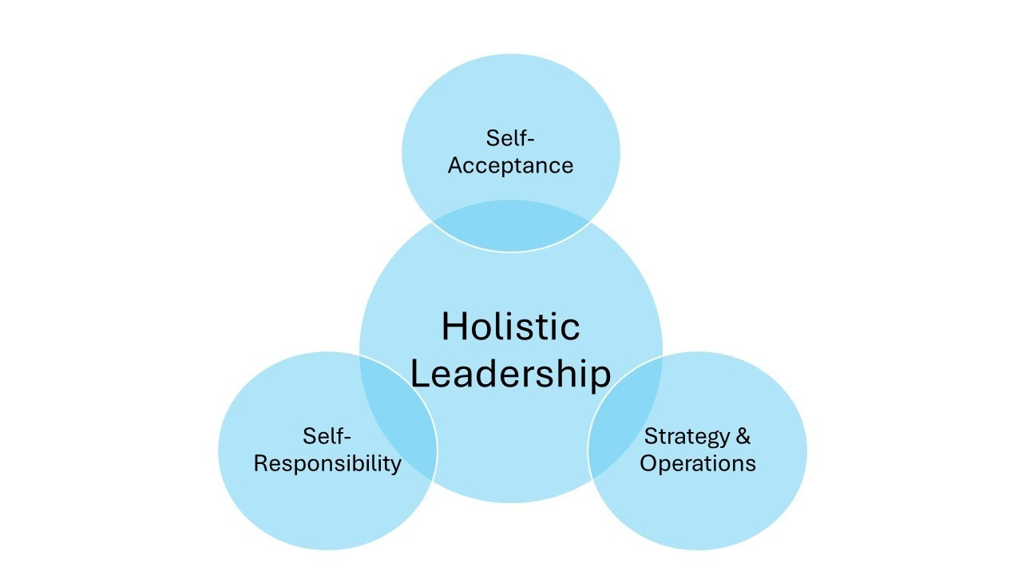
EI + CQ = Holistic Leadership
The Synergy of Emotional and Cultural Intelligence
Emotional intelligence (EI): Empathy, relationship building
Cultural Intelligence (CQ): Adaptability, go-cultural focus
Collectively: construct inclusive, powerful, globally-minded leadership (Fikri et al, 2021)
Notes:
The Synergy of Emotional and Cultural Intelligence
Emotional intelligence (EI): Empathy, relationship building
Cultural Intelligence (CQ): Adaptability, go-cultural focus
Collectively: construct inclusive, powerful, globally-minded leadership (Fikri et al, 2021)
Speaker Notes:
Although each cultural Genius (CQ) and emotional Genius (EI) are useful on their very own, their genuine power is in mixture. Leaders can traverse cultural differences with the help of CQ, at the same time as EI allows them to realize and control feelings. In modern day numerous offices, especially the ones regarding faraway or international cooperation, leaders who education both EI and CQ are more likely to promote trust, intellectual protection, and creativity.

Slide 15
Traditional vs Horizontal Leadership
Traditional (Top-Down) | Horizontal (Collaborative)
Chief gives orders | leader works with the team
Hierarchical authority | Shared responsibility
Awareness on control | attention on empathy & inclusion
One-way conversation | Open dialogue & listening
Cultural uniformity | Embraces variety (Berkovich et al, 2021)
Notes:
Traditional (Top-Down)
Horizontal (Collaborative)
Chief gives orders
leader works with the team
Hierarchical authority
Shared responsibility
Awareness on control
attention on empathy & inclusion
One-way conversation
Open dialogue & listening
Cultural uniformity
Embraces variety (Berkovich et al, 2021)
In assessment, horizontal leadership, as practiced with the aid of Edith Heard, is built on collaboration, empathy, and mutual respect. It promotes collective possession and honours many contributions. Cultural intelligence plays a fundamental role in this case. Emotional talent ensures that an inventor will connect with human beings with empathy and responsiveness, and an grasp of particular cultural conventions will prevent them from enforcing their very own standpoint.

Slide 16

Case Study 1: Satya Nadella (Microsoft)
Satya Nadella – CEO, Microsoft
Prioritized empathy as core management cost
Converted company subculture from “recognize-it-all” to “analyse-it-all”
Drove cloud-first, cellular-first method with inclusive leadership
Recommended for accessibility and neurodiversity in the place of job
Notes:
Satya Nadella – CEO, Microsoft
Prioritized empathy as core management cost
Converted company subculture from “recognize-it-all” to “analyze-it-all”
Drove cloud-first, cellular-first method with inclusive leadership
Recommended for accessibility and neurodiversity in the place of job
Satya Nadella took over as CEO of Microsoft in 2014, inheriting a segmented and competitive legacy. Developing empathy in control was Nadella's fundamental intention. He recommended for leaders to emerge as "look at-it-alls" in preference to "recognise-it-alls," encouraging a lifestyle of inquiry and humility. Nadella recommended cultural inclusiveness at the same time via supporting with many hires, developing multinational groups, and focussing on accessibility (Wojtak et al, 2021)

Slide 17
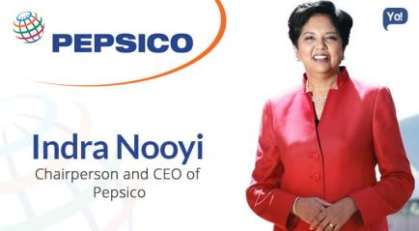
Case Study 2: Indra Nooyi (PepsiCo)
Indra Nooyi – Former CEO, PepsiCo
Conducted “listening tours” with personnel
Wrote handwritten letters to families of senior leaders
Promoted girls into management roles globally
Advocated for performance with motive approach (Berkovich et al, 2021)
Notes:
Indra Nooyi – Former CEO, PepsiCo
Conducted “listening tours” with personnel
Wrote handwritten letters to families of senior leaders
Promoted girls into management roles globally
Advocated for performance with motive approach (Berkovich et al, 2021)
Indra Nooyi developed each cultural and emotional talent throughout her tenure as PepsiCo's CEO. To better apprehend her group of workers and customers, she carried out listening excursions around the enterprise, which is a sign of excessive emotional involvement. Culturally, Nooyi used to be attuned to global dynamics. She led a multinational body of workers and advanced the representation of ladies and minorities in management, displaying clear cultural sensitivity.

Slide 18

Case Study 3: Howard Schultz (Starbucks)
Howard Schultz – Former CEO, Starbucks
Constructed business enterprise subculture on dignity and recognize
Invested in worker advantages (healthcare, tuition)
Engaged in social impact problems (race, veterans, education)
Recommended open speak between leadership and team of workers (Wojtak et al, 2021)
Notes:
Howard Schultz – Former CEO, Starbucks
Constructed business enterprise subculture on dignity and recognize
Invested in worker advantages (healthcare, tuition)
Engaged in social impact problems (race, veterans, education)
Recommended open speak between leadership and team of workers (Wojtak et al, 2021)
Howard Schultz of Starbucks constantly emphasised empathy and dignity. His leadership focused on taking note of personnel, addressing their needs, and treating them as companions, now not just employees. He furnished comprehensive healthcare benefits and training investment—even for part-time personnel—primarily based at the faith that valuing people leads to stronger overall performance. This is an immediate software of emotional intelligence (Abcouwer et al, 2021)

Slide 19
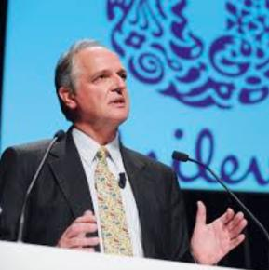
Case Study 4: Paul Polman (Unilever)
Paul Polman – Former CEO, Unilever
Led various, multinational groups
Encouraged for lengthy-term sustainability over quick-term income
Centered on stakeholder capitalism: employees, surroundings, society
Included EQ & CQ into global strategic selections
Notes:
Paul Polman – Former CEO, Unilever
Led various, multinational groups
Encouraged for lengthy-term sustainability over quick-term income
Centered on stakeholder capitalism: employees, surroundings, society
Included EQ & CQ into global strategic selections
Paul Polman is thought for revolutionizing Unilever by putting sustainability and human values on the middle of business. His leadership displays a deep dedication to both empathy and cultural grasp. He led Unilever with the trust that an organisation have to serve all stakeholders—not just shareholders.

Slide 20
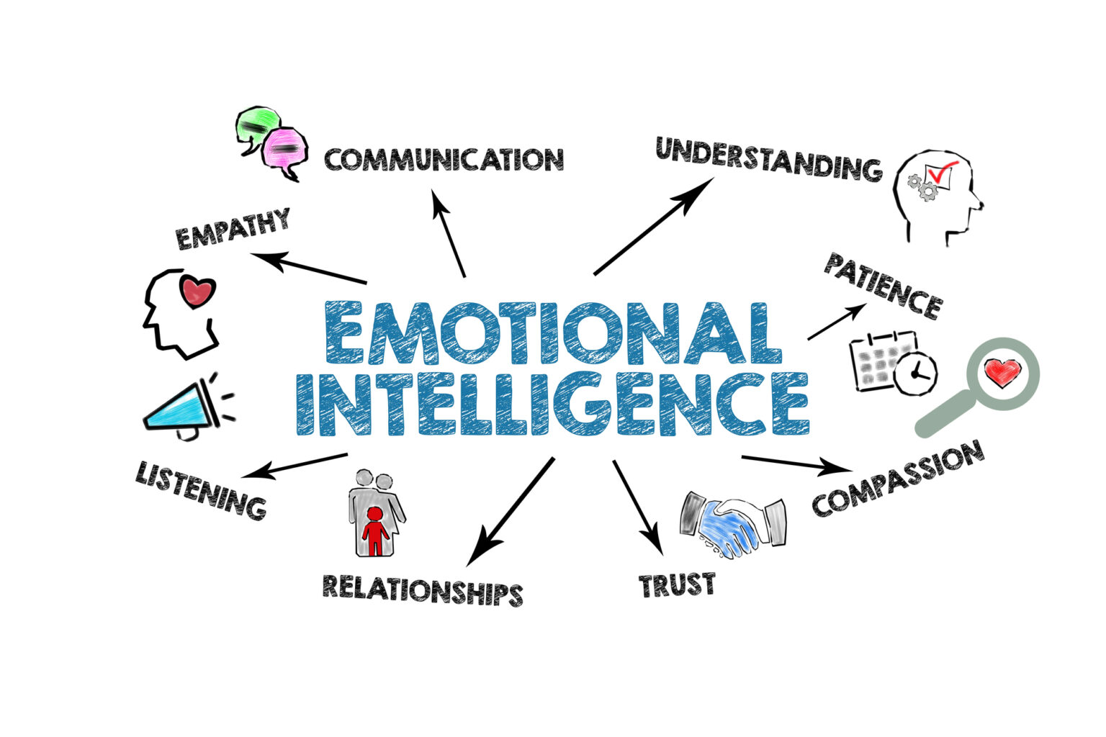
Challenges in Applying EI and CQ
Key challenges
Over-empathizing: chance of emotional burnout or blurred limitations
Cultural misinterpretation: Misreading norms can result in offense or alienation
Resistance in conventional sectors: Hierarchical industries can also view EI/CQ as “gentle” or non-fundamental
Size troubles: challenging to assess EI and CQ always and objectively
Notes:
Key challenges
Over-empathizing: chance of emotional burnout or blurred limitations
Cultural misinterpretation: Misreading norms can result in offense or alienation
Resistance in conventional sectors: Hierarchical industries can also view EI/CQ as “gentle” or non-fundamental
Size troubles: challenging to assess EI and CQ always and objectively
While Emotional intelligence (EI) and Cultural intelligence (CQ) are effective leadership tools, applying them in real-global settings isn't except demanding situations. One key issue is over-empathizing—leaders with excessive EI may additionally grow to be emotionally overextended, making it challenging to hold objectivity or make difficult selections.
Regardless of right intentions, leaders might also misinterpret or overgeneralize cultural behaviours, leading to accidental exclusion or offense. In conventional or hierarchical industries, EI and CQ can be undervalued or misunderstood. A few agencies nevertheless equate leadership with authority and decisiveness, viewing empathy as a weakness in place of a power (Abcouwer et al, 2021)

Slide 21
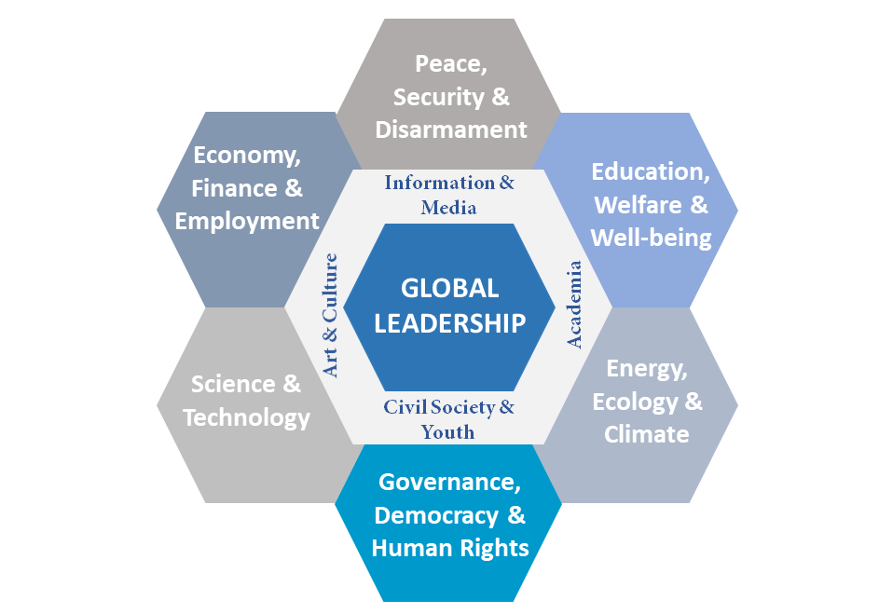
Opportunities in Global Leadership
Opportunities for EI & CQ
Remote and hybrid effective teams
Dealing with multicultural, international workforces
Selling variety, equity, and inclusion (DEI)
Developing psychologically secure, innovative cultures
Responding to social and ethical expectations (Wojtak et al, 2021)
Notes:
Remote and hybrid effective teams
Dealing with multicultural, international workforces
Selling variety, equity, and inclusion (DEI)
Developing psychologically secure, innovative cultures
Responding to social and ethical expectations (Wojtak et al, 2021)
No matter the challenges, the relevance of EI and CQ in management has in no way been extra. The contemporary place of job is increasingly virtual, various, and distributed. Leading hybrid or faraway groups calls for emotional sensitivity and cultural adaptability. As businesses function globally, leaders must manipulate multicultural groups, navigate time zones, and respect unique verbal exchange norms and work ethics. Here, cultural Intelligence turns into imperative (Takács et al, 2021)

Slide 22
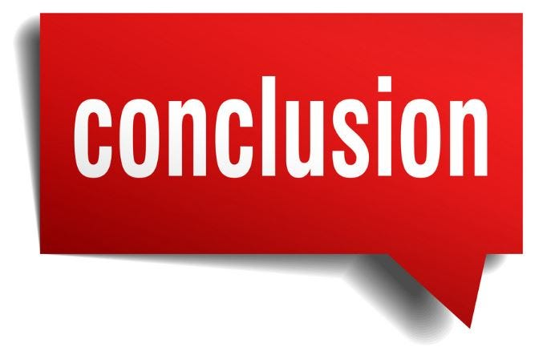
Conclusion
To summarize our presentation, we have explored how Emotional intelligence (EI) and Cultural Intelligence (CQ) empower leaders to reach a globalized and numerous place of job.
EI fosters empathy, emotional awareness, and communication, while CQ brings cultural sensitivity and adaptability into leadership practice.
As management will become extra collaborative and much less hierarchical, those capabilities are extra than smooth—they are vital.
Notes:
To summarize our presentation, we have explored how Emotional intelligence (EI) and Cultural Intelligence (CQ) empower leaders to reach a globalized and numerous place of job. EI fosters empathy, emotional awareness, and communication, while CQ brings cultural sensitivity and adaptability into leadership practice. These are not summary ideas—they're actual, strategic equipment used by international leaders like Edith Heard, Satya Nadella, and Indra Nooyi. Together, EI and CQ allow leaders to construct inclusive cultures, make considerate selections, and align people toward shared desires in both neighbourhood and global settings. As management will become extra collaborative and much less hierarchical, those capabilities are extra than smooth—they are vital.

Slide 23
References
Abcouwer, T., Takács, E. and Rácz, C., (2021), November. Innovating Management and Leadership in Contemporary Times: Motivation and Evaluation in Learning. In ECMLG 2021 17th European Conference on Management, Leadership and Governance (p. 1). Academic Conferences limited.
Berkovich, I. and Grinshtain, Y., (2021). A review of rigor and ethics in qualitative educational administration, management, and leadership research articles published in 1999-2018. Leadership and Policy in schools, pp.1-16.
Fikri, M.A.A., Pramono, T., Nugroho, Y.A., Novitasari, D. and Asbari, M., (2021). Leadership Model in Pesantren: Managing Knowledge Sharing through Psychological Climate. International Journal of Social and Management Studies, 2(3), pp.149-160.
Hanna, A.A., (2021). The impression management-emergent leadership relationship: The mediating role of trustworthiness. In Academy of Management Proceedings (Vol. 2021, No. 1, p. 10226). Briarcliff Manor, NY 10510: Academy of Management. MU
Haslam, S.A., Steffens, N.K., Reicher, S.D. and Bentley, S.V., (2021). Identity leadership in a crisis: A 5R framework for learning from responses to COVID‐19. Social Issues and Policy Review, 15(1), pp.35-83.
Heckman, S. and Minnes, M., (2022), March. Academic Middle Management: Undergraduate Leadership in Computing Programs. In Proceedings of the 53rd ACM Technical Symposium on Computer Science Education V. 2 (pp. 1184-1184).
Jones, B., Horton, T. and Home, J., (2022). Strengthening NHS management and leadership: priorities for reform. The Health Foundation.
Karakose, T., Yirci, R., Papadakis, S., Ozdemir, T.Y., Demirkol, M. and Polat, H., (2021). Science mapping of the global knowledge base on management, leadership, and administration related to COVID-19 for promoting the sustainability of scientific research. Sustainability, 13(17), p.9631.
Kim, D.H., Fitchett, G., Anderson, J.L. and Garman, A.N.,(2022). Management and leadership competencies among spiritual care managers. Journal of Health Care Chaplaincy, 28(1), pp.128-137.
Labrague, L.J., (2021). Use of simulation in teaching nursing leadership and management course: An integrative review. Sultan Qaboos University Medical Journal, 21(3), p.344.
Lavigne, E., Cowley, S. and Sá, C.M., (2022). Scholarship, management, and leadership in academic administration: The case of Canadian university presidents and provosts. Tertiary Education and Management, pp.1-14.
Liu, W., Wei, W., Choi, T.M. and Yan, X., (2022). Impacts of leadership on corporate social responsibility management in multi-tier supply chains. European Journal of Operational Research, 299(2), pp.483-496.
Nani, D.A. and Safitri, V.A.D., (2021). Exploring the relationship between formal management control systems, organisational performance and innovation: The role of leadership characteristics. Asian Journal of Business and Accounting, 14(1), pp.207-224.
Takács, E., Abcouwer, T. and de Boer, R., (2021), November. Management and Leadership Skills and Attitude in Uncertainty. In ECMLG 2021 17th European Conference on Management, Leadership and Governance (p. 401). Academic Conferences limited.
Wojtak, A., Stein, V., Goldhar, J. and Miller, R., (2022). The new era of management and leadership competencies for integrated care. International Journal of Integrated Care, 22(S1).
Notes:
Abcouwer, T., Takács, E. and Rácz, C., (2021), November. Innovating Management and Leadership in Contemporary Times: Motivation and Evaluation in Learning. In ECMLG 2021 17th European Conference on Management, Leadership and Governance (p. 1). Academic Conferences limited.
Berkovich, I. and Grinshtain, Y., (2021). A review of rigor and ethics in qualitative educational administration, management, and leadership research articles published in 1999-2018. Leadership and Policy in schools, pp.1-16.
Fikri, M.A.A., Pramono, T., Nugroho, Y.A., Novitasari, D. and Asbari, M., (2021). Leadership Model in Pesantren: Managing Knowledge Sharing through Psychological Climate. International Journal of Social and Management Studies, 2(3), pp.149-160.
Hanna, A.A., (2021). The impression management-emergent leadership relationship: The mediating role of trustworthiness. In Academy of Management Proceedings (Vol. 2021, No. 1, p. 10226). Briarcliff Manor, NY 10510: Academy of Management. MU
Haslam, S.A., Steffens, N.K., Reicher, S.D. and Bentley, S.V., (2021). Identity leadership in a crisis: A 5R framework for learning from responses to COVID‐19. Social Issues and Policy Review, 15(1), pp.35-83.
Heckman, S. and Minnes, M., (2022), March. Academic Middle Management: Undergraduate Leadership in Computing Programs. In Proceedings of the 53rd ACM Technical Symposium on Computer Science Education V. 2 (pp. 1184-1184).
Jones, B., Horton, T. and Home, J., (2022). Strengthening NHS management and leadership: priorities for reform. The Health Foundation.
Karakose, T., Yirci, R., Papadakis, S., Ozdemir, T.Y., Demirkol, M. and Polat, H., (2021). Science mapping of the global knowledge base on management, leadership, and administration related to COVID-19 for promoting the sustainability of scientific research. Sustainability, 13(17), p.9631.
Kim, D.H., Fitchett, G., Anderson, J.L. and Garman, A.N.,(2022). Management and leadership competencies among spiritual care managers. Journal of Health Care Chaplaincy, 28(1), pp.128-137.
Labrague, L.J., (2021). Use of simulation in teaching nursing leadership and management course: An integrative review. Sultan Qaboos University Medical Journal, 21(3), p.344.
Lavigne, E., Cowley, S. and Sá, C.M., (2022). Scholarship, management, and leadership in academic administration: The case of Canadian university presidents and provosts. Tertiary Education and Management, pp.1-14.
Liu, W., Wei, W., Choi, T.M. and Yan, X., (2022). Impacts of leadership on corporate social responsibility management in multi-tier supply chains. European Journal of Operational Research, 299(2), pp.483-496.
Nani, D.A. and Safitri, V.A.D., (2021). Exploring the relationship between formal management control systems, organisational performance and innovation: The role of leadership characteristics. Asian Journal of Business and Accounting, 14(1), pp.207-224.
Takács, E., Abcouwer, T. and de Boer, R., (2021), November. Management and Leadership Skills and Attitude in Uncertainty. In ECMLG 2021 17th European Conference on Management, Leadership and Governance (p. 401). Academic Conferences limited.
Wojtak, A., Stein, V., Goldhar, J. and Miller, R., (2022). The new era of management and leadership competencies for integrated care. International Journal of Integrated Care, 22(S1).

