Slide 1
Academic and Communication Skills for policing students
(BMPL4014)
Week 8

Slide 2
Aims for today
Presentation task
Understand how operational policing can affect mental health and wellbeing
Stress
Trauma
Resilience
Coping strategies
Support available

Slide 3

Teamworking task- 1 Hour
In teams, come up with an idea of a new innovative way of policing.
This could include:-
Hi- tech gadgets
New strategies for policing
New laws
Explain the idea, why you have chosen it, the strengths and weaknesses and how it can be funded.
Explain your role within the task- Collaborator, Contributor, Communicator, Challenger
Present this to the class using PP

Slide 4

Session 2

Slide 5
Aims for today
Top tips for presentations
Draft sessions- next Mon & Tue
Understand how operational policing can affect mental health and wellbeing
Stress
Trauma
Resilience
Coping strategies
Support available

Slide 6

Assignment 2
TOP TIPS ON:-

Slide 7
There are 3 parts to a presentation
Beginning –
ideal to grab the attention of the audience
Middle –
main part of the presentation – to get your message across
End –
to wrap things up or to end with a finale

Slide 8
Make sure you plan and rehearse
What are your key messages?
How are you going to illustrate?
If the presentation is a ‘group’ then who is conveying what?
Remember ‘less is more’
Use visual aids wherever possible and avoid too much text

Slide 9
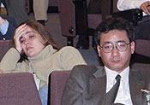
Rehearse, Rehearse, Rehearse
This could make the difference between a good and an average presentation
Do you want your audience like this??!!

Slide 10
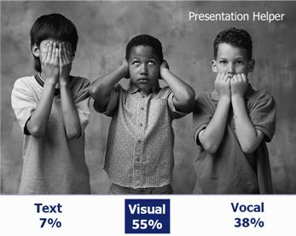
How do we take things in?

Slide 11
Visual Aids
Professor Albert Mehrabian did a lot of research into how we take in information during a presentation. He concluded that 55% of the information we take in is visual and only 7% is text.
If you want your audience to remember then use VISUAL aids........

Slide 12
Visual Aids
HANDOUTS
FLIP CHARTS
WHITE BOARDS (CHECK WHAT TYPE)
POWER POINT
DISPLAY BOARDS/PROPS/Videos/Hyperlinks.
Any of the above should use pictures, graphs, tables, props etc.

Slide 13
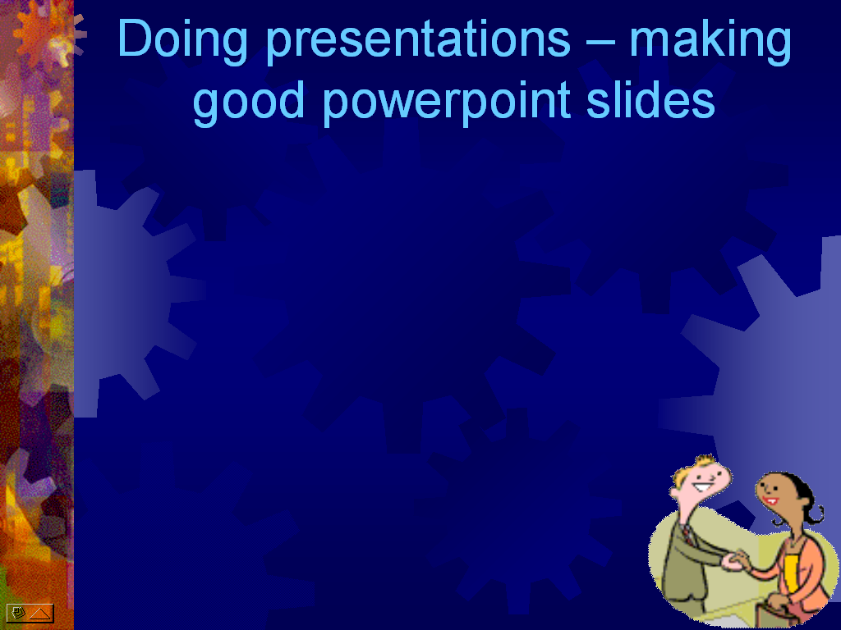

Slides need to be colourful to keep people’s attention in case the talking gets a little boring
Speling miztakes? Wot speling miztakes?!
What do you mean ‘some people might struggle to read certain colour combinations’? I think they’re attractive…
Being creative with my slides has got to get me more marks – hasn’t it?!
Oh come on, everyone loves animated characters!
Gosh these lines are whizzing in quickly…!

Slide 14
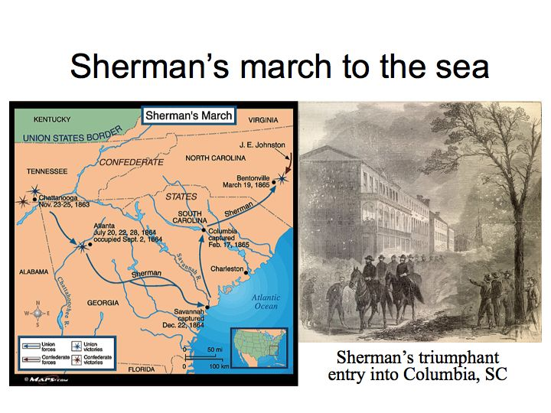

Slide 15


Slide 16
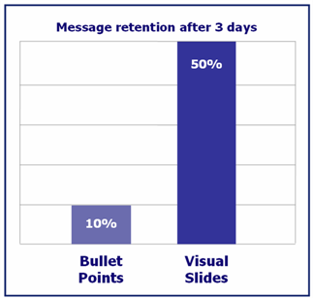
The effects of using visuals is staggering!
Study at the Wharton research Centre showed the effects of visual slides on message retention

Slide 17
Presentation Rules
DO
CHECK YOUR POSITION
CHECK THE POSITION OF YOUR VISUAL AIDS
ALWAYS INTRODUCE YOURSELF (AND YOUR GROUP)
ALWAYS INTRODUCE THE SUBJECT OF THE PRESENTATION
PROVIDE YOUR AUDIENCE WITH BACKGROUND MATERIAL
MAKE-EYE CONTACT WITH YOUR AUDIENCE
USE VISUAL AIDS, GRAPHS, TABLES ETC. FOR COMPLEX INFORMATION
ACT CONFIDENTLY

Slide 18
Presentation Rules (cont)
DO
MAKE SURE YOUR VISUAL AIDS ARE CLEAR
KEEP TO YOUR ALLOCATED TIME
KEEP YOUR PRESENTATION FACTUAL
ALWAYS KNOW YOUR SUBJECT
BE PREPARED FOR QUESTIONS
APPOINT A LEADER IN GROUP PRESENTATIONS
ALWAYS THANK THE AUDIENCE FOR THEIR ATTENTION
KNOW YOUR AUDIENCE (IF POSSIBLE)
ASK ‘ARE THERE ANY QUESTIONS?’ AT THE END

Slide 19
Presentation Rules (cont)
DON’T
CARRY ON A CONVERSATION WITH OTHER TEAM MEMBERS DURING A PRESENTATION
LEAVE VISUAL AIDS ON WHEN NOT IN USE
BE AGGRESSIVE
WORRY ABOUT YOUR PRESENTATION (IT IS NOT LIFE OR DEATH)!

Slide 20
Group Presentations
Your participation will have an impact on others in the group and may result in others under achieving.
It is therefore important that all group members ‘pull their weight’, take part in all aspects (including planning) and TURN UP for the presentation
A good presentation will NOT have gaps..

Slide 21
Some things to remember!
Odds are that people will only remember three things from your presentation – what three things do you want them to remember?
Make your presentation memorable!
Good luck!

Slide 22

Task
Research into sickness rates of police officers and answer the following:-
How prevalent is it?
What are the main themes with officer sickness?
What is the average time that an officer is off on sick leave?
Why is this happening?

Slide 23
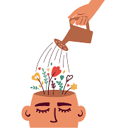
Officer wellbeing
Officers deal with members of the public who are often at their lowest point. It is widely acknowledged that dealing with trauma and high stress situations on a daily basis can have a cumulative effect.
Psychological ill health, trauma, and stress has nearly doubled in the past 10 years
The College of Policing - recognises both the rewards as well as the challenges of a career in policing and states that ‘we must look after our people so they are best able to look after the public’.
Notes:
Absences caused by ‘psychological ill health, trauma, and stress had nearly doubled in the past 10 years’ when analysing data from just over half of the police workforce.

Slide 24
Workplace experiences and how they impact on wellbeing
Landscape of policing is recognised as ever more complex, creating unprecedented demands on officers and presenting progressively broader challenges.
Officers will need to possess a corresponding range of skills and knowledge to meet those challenges.
Police services are therefore becoming more aware of the importance of, and the impact, mental wellbeing can have on individuals, teams, and police organisations.

Slide 25
Mental, physical and spiritual wellbeing
To provide an effective service officers need to be mentally and physically able to carry out their duties.
Wellness covers aspects of mental, physical, and spiritual health, as well as social and financial wellbeing, while resilience can be described as an individual’s ability to combat and recover quickly from life’s difficulties.
Each of these areas of wellbeing interlink, influence, and impact the others, therefore understanding and recognising stressors in policing, and other impacts on health and wellbeing will support the maintenance of wellbeing and resilience.

Slide 26

Mental wellbeing
Is about both how well we feel and how well we function and everyone experiences good or poor mental health throughout life, while understanding mental health leads to seeking appropriate support.
As part of a Trauma Informed Policing response, Goodall (2022) suggests that having a better appreciation of your own mental health will also lead to a better understanding of complex issues affecting victims, witnesses, and suspects, such as Adverse Childhood Experiences (ACEs).
Childhood or adult trauma can be a motivation for joining a service such as the police, where protecting the public has significant appeal. However exposure to traumatic and distressing incidents can have a cumulative negative impact on mental health.

Slide 27

Physical wellbeing
Needed to meet the physical demands of the role officers.
The job related fitness test (JRFT), as well as being part of the recruitment process, will be completed from the outset of a career in policing, and each year thereafter as part of personal safety training.
The JRFT comprises a bleep test, made up of 35, 15 metre shuttles between two points, with the time allowed for each shuttle gradually decreasing across levels.
While the standard test requires officers to achieve level 5.4, if moving to a specialist role such as Authorised Firearms Officer (AFO) or Air Support there may be different requirements.
Where an officer has an injury or disability, they can be offered an adapted test.

Slide 28

Spiritual wellbeing
Refers to the need for purpose and meaning, while encompassing an individual’s beliefs and values.
Where there are personal challenges such as change or disruption to plans, or where a person’s values or beliefs are challenged, spiritual wellbeing can be eroded. This can have consequences for mental wellbeing and physical health.
Spiritual practices such as prayer, meditation, and mindfulness can help individuals manage stress more effectively, and spiritual wellbeing can contribute to mental wellbeing by promoting coping skills, providing a sense of purpose, offering social support, and fostering compassion.

Slide 29

Identifying stress & trauma
As a police officer, many skills are learned in relation to operational policing, the law, and policy and procedure.
It is important to also learn how to identify and recognise stress and trauma, not only in yourself, but in others.
Policing is fast paced and dynamic with the potential to have to deal with many multi-faceted situations.
Includes dealing with other people’s issues, worries, stress, and trauma, therefore it is imperative your own wellbeing is looked after with as much care as that of those you serve.

Slide 30
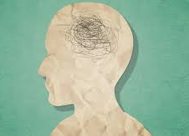
Causes of stress
Stress can be caused by many things in life including personal health, relationships, work, homelife, and financial difficulties.
Policing can have a significant impact on stressors but overall the following could lead to stress:-
•Going through periods of uncertainty
•Facing big life changes
•Feeling under lots of pressure
•Lacking control over situations
•Having responsibilities that are overwhelming
•Experiencing discrimination, hate, or abuse

Slide 31
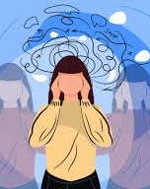
How stress makes you feel
•Neglected or lonely
•A sense of dream
•Uninterested in life
•Unable to enjoy yourself
•Anxious, nervous, or afraid
•Irritable, angry, impatient, or wound up
•Over burdened or overwhelmed
•Depressed
•Worried or tense

Slide 32
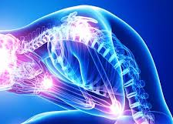
How stress effects you physically
Panic attacks or difficulty in breathing
•Fatigue and sleep problems
•Muscle aches
•Chest pains and high blood pressure
•Indigestion and heartburn
•Change in weight both gain or loss
•Sweating
•Blurred eyesight or sore eyes
•Constipation or diarrhoea
•Change in menstrual cycle

Slide 33
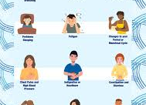
How stress makes you behave
Difficulty making decisions
Lack of concentration
Snapping at people
Grinding your teeth or clenching your jaw
Eat too much or too little
Smoke, drink, or use drugs
Restless
Cry or feel tearful
Withdraw from people around you
Experience sexual problems
Loss of memory

Slide 34
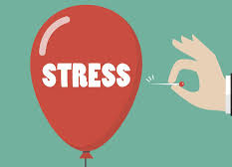
Coping with stress
Everyone is different and everyone copes with stress and trauma in their own way.
Recognising personal vulnerabilities is important so that officers can develop positive coping strategies to deal with this, thus improving personal wellbeing and resilience.

Slide 35
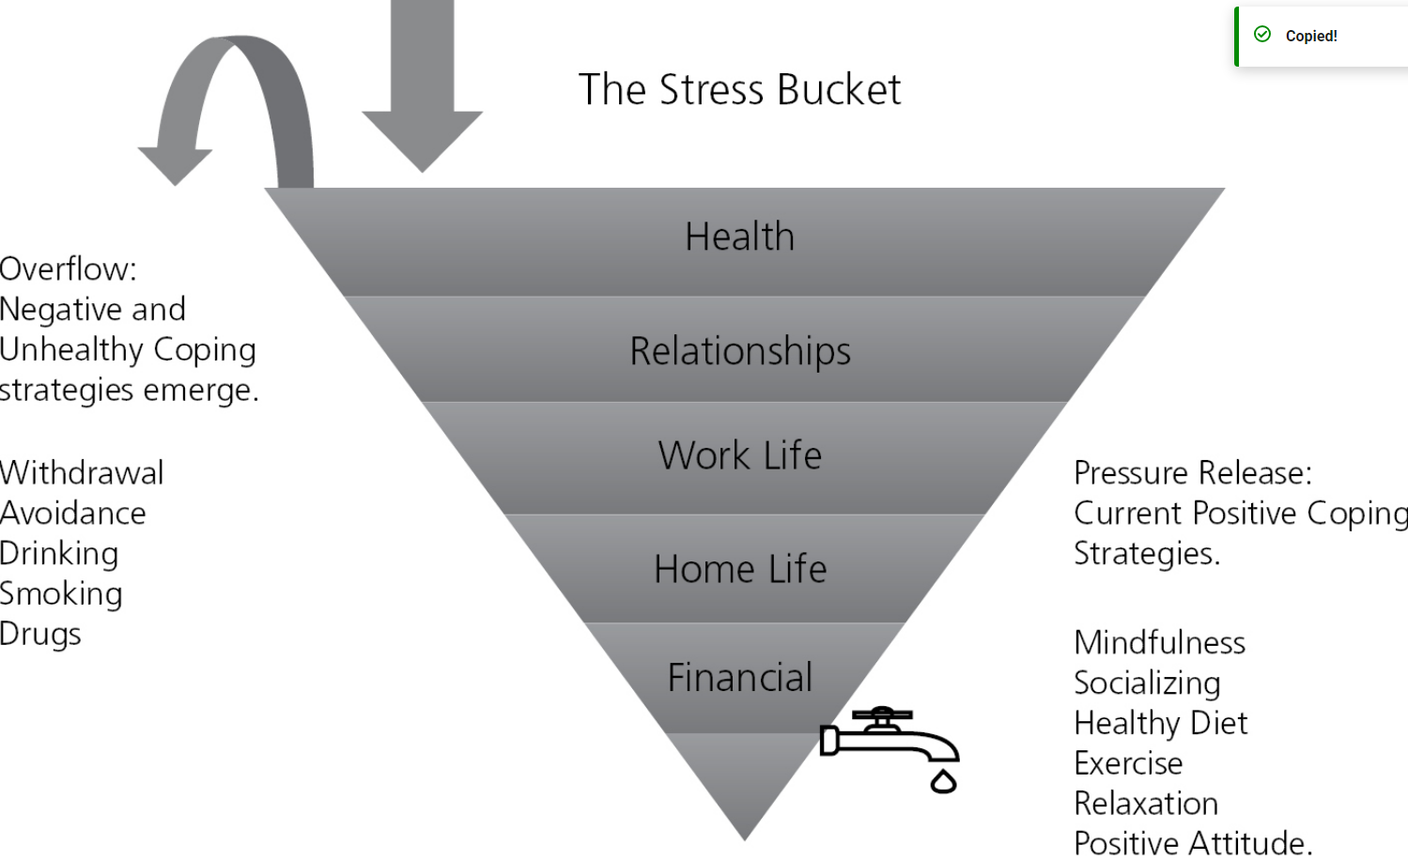
The stress bucket
(Brabban and Turkington, 2002)
Notes:
The principles of the Stress Bucket could help answer some questions around how different people may deal in varying ways with their own vulnerabilities. For example, an officer may have experienced something very similar to a colleague, but they may have reacted in a very different way. This may be because people have varying degrees of vulnerability, or just that some are more resilient than others, but either way the Stress Bucket principle, which has been adapted from ideas by Brabban and Turkington (2002), can go a long way to explaining this.
The Stress Bucket here depicts numerous things that can affect stress throughout life, not simply work related; issues outside of work may also affect how an individual reacts to things that happen within work, and keeping a healthy balance is important for personal wellbeing and resilience. Everyday stressors can continue to fill up this bucket and sometimes it may not be obvious this is happening until the bucket overflows. This is why it is important to use positive coping strategies on a regular basis to allow the bucket to drain, thus avoiding an overflow.
Humans are very adaptable, however there are limits to this and it is now being recognized that stress, trauma, and mental health are significant issues within the police service. Sometimes stress might become too much, and putting it back to the Stress Bucket idea, the bucket fills more quickly than the pressure can be released, coping strategies might stop working. If this becomes the case, it is important to recognize this, or recognize this in others, so that referrals can be made to Police National Wellbeing services.

Slide 36

Recognising trauma
‘The way that some distressing events are so extreme or intense that they overwhelm a person’s ability to cope, resulting in lasting negative impact’ (UK Trauma Council (no date)
Trauma can be caused by many things and often it is caused by things that are out of a person’s control. This could include things such as:-
sexual abuse,
physical abuse,
war,
natural disasters,
terrorist attacks,
serious car accidents,
Police officers are sometimes put into positions where they themselves will experience traumatic events such as being first to the scene of a fatal car accident, or being involved with a person who commits suicide.
The witnessing of traumatic events can be just as impactive as being involved in the traumatic event

Slide 37
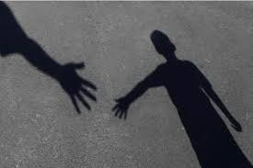
Secondary trauma (Vicarious Trauma)
Far more prevalent and can happen on a daily basis. An indirect experience of, or exposure to a traumatic event.
Police officers attend incidents on a daily basis where a person may have called the police due to a traumatic experience. Officers may experience some indirect trauma from empathetic engagement.

Slide 38

Signs of secondary trauma
The British Medical Association (2022a) provides details of common signs of secondary trauma to look out for:
Experiencing lingering feelings of anger, rage, and sadness about the person’s victimisation
•Becoming overly involved emotionally with the victim or witness
•Experiencing bystander guilt, shame, and feelings of self-doubt
•Being preoccupied with thoughts for the person outside of work
•Over identification with the victim or witness
•Becoming distanced, detached, or numb to other people when describing traumatic experiences
•Difficulty in maintaining professional boundaries

Slide 39
Post Traumatic Stress Disorder (PTSD)
PTSD is used to describe a particular profile of symptoms that is sometimes developed after someone has experienced or witnessed a traumatic event.
There are many reactions a person can have, and PTSD may not describe the full range of reactions to traumatic events, therefore sometimes people can react to traumatising events without being diagnosed with PTSD.
But how do you recognise someone who may be suffering from PTSD, and how could you recognise this in yourself?

Slide 40
Core symptoms of PTSD
The UK Trauma Council (no date) describes three groups of symptoms that are sometimes considered to be the core symptoms of PTSD:-
•Re-experiencing of the event, such as intrusive memories, flashbacks, nightmares, repetitive play of certain aspects of the event and distress triggered by reminders of the event.
•Avoidance, such as avoiding people, places, or conversations associated with the event, or avoiding feelings, thoughts, and memories of the event.
•Arousal and reactivity or sense of current threat, such as being over vigilant, irritability, being easily startled, and experiencing concentration and sleep problems.
There are interventions that are recommended including Trauma-Focused Cognitive Behaviour Therapy (TF-CBT) and Eye Movement Desensitisation and Reprocessing (EMDR).

Slide 41

Fostering Personal Resilience
It is clear that being a police officer can have some effects in relation to stress and trauma.
Resilience refers to maintaining psychological well-being in the face of adversity by having the ability to adapt to stressors successfully.
Everyone is born with a level of inbuilt resilience but it can be built on through time and experience, and on a personal level characteristics such as adaptability, flexibility, effective problem solving skills, and independence assist in building resilience.
This can be improved through maintaining positive coping strategies. As detailed in the Stress Bucket, positive strategies are essential in relieving that stress.
A combination of effective leadership and a harmonious working environment that supports employee wellbeing, enhances subsequent organisational performance.

Slide 42
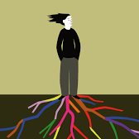
Developing effective coping strategies
Building effective coping strategies is the best way of relieving stress or dealing with trauma, compassion fatigue, or even PTSD.
Different people will have very different coping strategies and it can be as simple as doing regular exercise or enjoying a regular hobby outside of work.

Slide 43

Coping strategies
Being Active - Exercise can help reduce some of the emotional intensity that you may be feeling and can help clear your thoughts allowing you to problem solve more effectively.
Connecting with people- Have a good support network of colleagues or friends and family. These can ease your troubles and help you see things in a different way. Activities with friends and family can also help you to relax and relieve stress.
Have some personal time - Having time to yourself is important. Time away from the things that cause you stress can help, this could be socializing, taking exercise, or enjoying a hobby which is away from work and possibly home.
Challenge yourself - Setting yourself goals and challenges whether in or outside of work, can help build confidence and also may help deal with stress. An example could be something as simple as learning a new language, or learning to play an instrument.
Help other people - Evidence has shown that helping other people either as a volunteer or through community work can often help build resilience. If volunteering is not something that is accessible, maybe try helping someone with something each day, like a simple task in the workplace, or helping someone with their bags in the supermarket.
Try to be positive - Try to look for positives in life, or look around you and find the beauty in other things. Think of what makes you grateful in life. A simple exercise for this is writing down three things at the end of each day that made you feel good.

Slide 44
Research into the support available to police officers

Slide 45

Available support
Police services have counselling facilities as well as occupational health support (through the Occupational Support Unit).
The advice typically centres on dealing with both the symptoms (which may require specialist medical help) and the causes of stress.
The College of Policing provides a wide range of support through its Authorised Professional Practice for those in need of mental and emotional support, and the Samaritans provide 24-hour, 7-day-a-week support helplines.

Slide 46

Occupational health—Oscar Kilo
Police Occupational Health practitioner network which is committed to improving the provision of occupational health in policing.
The network aims to act as the voice of occupational health professionals in policing to help communicate, influence, and inform national developments, and is home of the National Police Wellbeing Service.
Sources are provided for wellbeing at work, individual resilience, mental health, and peer support.
Individual police services’ Occupation Health Support teams are there to provide support around health and wellbeing, which can be as a result of self-referral, or through a third party referral.

Slide 47
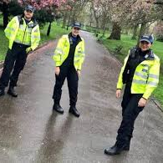
TRIM
Trauma Risk Incident Management (TRIM) is a welfare led process which is intended to assess the response of a member of staff exposed to a potentially traumatic incident.
This can be done on an individual basis or within a whole team and acts as a form of debrief of a situation.
The aim is to assist officers or the team to discuss the incident, understand the impact of this, and explore the next steps within a safe environment.
TRIM should be offered by constabularies after any potentially traumatic incident that their officers attend.

Slide 48

Police Care UK
Police Care UK is a charity for veterans, serving police officers, staff, volunteers, and their families who may have suffered physical or psychological harm as a result of policing. Services include the following:-
•Counselling
•Ill health retirement peer support
•Assistance grants
•Support around working with indecent or extreme material
•Self support techniques after traumatic incidents

Slide 49

Mind Blue Light
Blue Light Together and the Mind Blue Light Programme provide support and advice to all members of the emergency services such as tips and advice for looking after mental health as an emergency responder.

Slide 50

Employee Assistance Programme
The Employee Assistance Programme provides around-the-clock mental health support to officers and their immediate family. The service provides:-
•24/7 confidential helpline
•up to six sessions of structured counselling
•24/7 crisis assistance and manager support
•in-house legal and financial information
•access to a healthy advantage wellbeing app

Slide 51

Support for neurodivergent officers
Police services have policies to support neurodivergent officers and officers with Specific Learning Difficulties, with some offering screening which can provide indicators of dyslexia.
The Equality Act 2010 protects employees with disabilities of health conditions, including a legal obligation to make reasonable adjustments in the workplace, and not to treat these individuals less favourably.
This duty is ‘anticipatory’, which requires employers to explore reasonable changes to remove or reduce a disadvantage in advance.

Slide 52
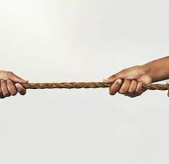
Managing conflict
Managing conflict appropriately and effectively is an essential skill in a police officer’s arsenal and can literally save a person’s life, including your own.
Beyond being operationally effective, ‘Managing Conflict in a Professional Policing Context’ is also a named Area of Operational Competence required to achieve Full Operational Competence (FOC).
Appropriate and effective conflict management is a vital part of achieving the public’s consent to exercise policing authority, and ensure procedural justice.

Slide 53
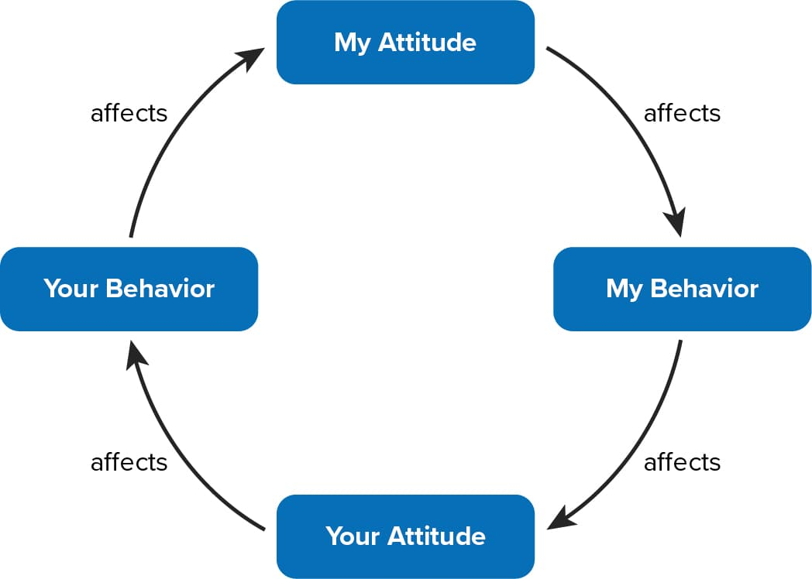
Betari's box

Slide 54

Self-awareness
Self-awareness is the knowledge that you experience as an individual and your thoughts, or reactions are specific to you and may be different from another person.
Emotional awareness, self-regulation, active listening, and communication skills are key in determining success in a conflict situation.
Decision-making relies upon both your emotional and rational brain.
EG- Visting a mother to deliver news here son has been found deceased, you would avoid laughing. This decision, though seemingly unconscious, is a self-regulation that you have made because of your self-awareness and desire to avoid an unnecessary conflict.

Slide 55

Being self-directed
There are many benefits to being self- directed as a police officer:-
Effective Decision Making:
Public Trust and Accountability:
Problem-Solving Skills:
Leadership Development:
Operational Efficiency:
Stress Management and Resilience:
Community Engagement:

Slide 56

What is self evaluation?
Why is this important?
Why is it important within policing?
How can this be achieved?
Self reflection!

Slide 57
What is self- reflection?
(Gibbs, 1988)
The process of examining and contemplating one's thoughts, feelings, experiences, and actions in order to gain insight into oneself.
It involves looking inwardly to understand one's motivations, beliefs, strengths, weaknesses, and personal growth.
Self-reflection is a valuable practice for personal development, learning, and self-awareness.

Slide 58
Key aspects of self- reflection
Self-Awareness: Self-reflection allows individuals to become more aware of their emotions, thoughts, and behaviours. It helps uncover patterns and tendencies that might not be immediately apparent in the midst of daily life.
Personal Growth: Through self-reflection, individuals can identify areas in their lives where they want to improve or change. This can involve setting goals, adjusting behaviours, and cultivating new habits to promote personal growth.
Decision-Making: Taking time to reflect on a situation before making a decision allows for a more thoughtful and balanced approach. Reflecting on potential consequences and one's values can lead to more informed choices.

Slide 59
Learning from Experiences: Self-reflection involves examining past experiences, both positive and negative, to extract lessons and insights. This can help individuals avoid repeating mistakes and build on successes.
Problem Solving: By reflecting on challenges and setbacks, individuals can assess what went wrong, identify contributing factors, and develop strategies to overcome similar challenges in the future.

Slide 60
Emotional Regulation: Self-reflection can help individuals better understand their emotional responses to various situations. This awareness can aid in managing emotions effectively and responding more thoughtfully to stressors.
Empathy and Understanding: Reflecting on one's own experiences can cultivate empathy and a better understanding of others' perspectives. This, in turn, can improve interpersonal relationships.
Creativity and Innovation: Self-reflection provides a space to generate new ideas and creative solutions. It encourages individuals to think critically about problems and explore unconventional approaches.

Slide 61

Think of a time where you have used self- reflection
Why did you use it?
What did you learn from it?
If you had to carry out the task again, would you do it differently and why?

Slide 62
Self- reflective cycles
Written in the first person- "I, me,"

Slide 63
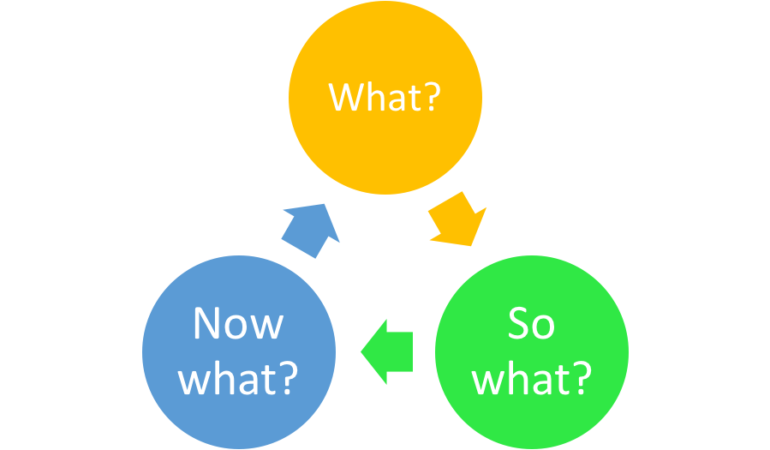
Borton’s reflective model
What happened?
What was I doing?
What was I trying to achieve?
What would I do differently in this situation again?
Where can I get more information to help with these situations?
What is the main learning that I take from this?
What did I feel at the time?
What were the effects of what I did/did not do?
What positive aspects emerge from the event?

Slide 64
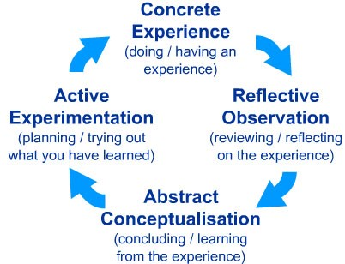
Kolb's reflective model

Slide 65
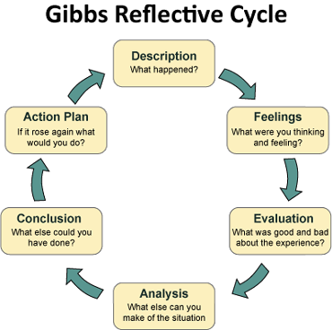
Gibbs self- reflection
https://youtu.be/-gbczr0lRf4

Slide 66
Description
Here you have a chance to describe the situation in detail. The main points to include here concern what happened. Your feelings and conclusions will come later.
Helpful questions:
What happened?
When and where did it happen?
Who was present?
What did you and the other people do?
What was the outcome of the situation?
Why were you there?
What did you want to happen?

Slide 67

Example of Gibbs self-reflection
Description
For an assessed written group-work assignment, my group (3 others from my course) and I decided to divide the different sections between us so that we only had to research one element each. We expected we could just piece the assignment together in the afternoon the day before the deadline, meaning that we didn’t have to schedule time to sit and write it together. However, when we sat down it was clear the sections weren’t written in the same writing style. We therefore had to rewrite most of the assignment to make it a coherent piece of work.

Slide 68
Feelings
Here you can explore any feelings or thoughts that you had during the experience and how they may have impacted the experience.
Helpful questions:
What were you feeling during the situation?
What were you feeling before and after the situation?
What do you think other people were feeling about the situation?
What do you think other people feel about the situation now?
What were you thinking during the situation?
What do you think about the situation now?
https://www.ed.ac.uk/reflection/reflectors-toolkit/reflecting-on-experience/gibbs-reflective-cycle

Slide 69

Feelings
Before we came together and realised we still had a lot of work to do, I was quite happy and thought we had been smart when we divided the work between us. When we realised we couldn’t hand in the assignment like it was, I got quite frustrated. According to NHS (2022), frustration is a normal reaction to situations of stress.
I was certain it was going to work, and therefore I had little motivation to actually do the rewriting. Given that a couple of people from the group had to cancel their plans I ended up feeling quite guilty, which actually helped me to work harder in the evening and get the work done faster. Looking back, I’m feeling satisfied that we decided to put in the work.

Slide 70
Evaluation
Here you have a chance to evaluate what worked and what didn’t work in the situation. Try to be as objective and honest as possible. To get the most out of your reflection focus on both the positive and the negative aspects of the situation, even if it was primarily one or the other.
Helpful questions:
What was good and bad about the experience?
What went well?
What didn’t go so well?
What did you and other people contribute to the situation (positively or negatively)?

Slide 71

Evaluation
The things that were good and worked well was the fact that each group member produced good quality work for the agreed deadline. Moreover, the fact that two people from the group cancelled plans motivated us to work harder in the evening. That contributed positively to the group’s work ethic. The things that clearly didn’t work was that we assumed we wrote in the same way, and therefore the overall time plan of the group failed.

Slide 72
Analysis
The analysis step is where you have a chance to make sense of what happened. Up until now you have focused on details around what happened in the situation. Now you have a chance to extract meaning from it. ​
Helpful questions:​
​
Why did things go well?​
Why didn’t it go well?​
What sense can I make of the situation?​
What knowledge – my own or others (for example academic literature) can help me understand the situation?​

Slide 73

Analysis
I think the reason that our initial division of work went well was because each person had a say in what part of the assignment they wanted to work on, and we divided according to people’s self-identified strengths. I have experienced working this way before and discovered when I’m working by myself I enjoy working in areas that match my strengths. It seems natural to me that this is also the case in groups. I think we thought that this approach would save us time when piecing together the sections in the end, and therefore we didn’t think it through. In reality, it ended up costing us far more time than expected and we also had to stress and rush through the rewrite.

Slide 74
Conclusion
In this section you can make conclusions about what happened. This is where you summarise your learning and highlight what changes to your actions could improve the outcome in the future. It should be a natural response to the previous sections.​
Helpful questions:​
What did I learn from this situation?​
How could this have been a more positive situation for everyone involved?​
What skills do I need to develop for me to handle a situation like this better?​
What else could I have done?​

Slide 75

Conclusion
I learned that when a group wants to divide work, we must plan how we want each section to look and feel – having done this would likely have made it possible to put the sections together and submit without much or any rewriting. Moreover, I will continue to have people self-identify their strengths and possibly even suggest using the ‘Belbin team roles’-framework with longer projects. Lastly, I learned that we sometimes have to challenge the decisions we seem to agree on in the group to ensure that we are not agreeing just because of groupthink.

Slide 76
Action plan
At this step you plan for what you would do differently in a similar or related situation in the future. It can also be extremely helpful to think about how you will help yourself to act differently – such that you don’t only plan what you will do differently, but also how you will make sure it happens. Sometimes just the realisation is enough, but other times reminders might be helpful.
Helpful questions:
If I had to do the same thing again, what would I do differently?
How will I develop the required skills I need?
How can I make sure that I can act differently next time?

Slide 77

Action Plan
When I’m working with a group next time, I will talk to them about what strengths they have. This is easy to do and remember in a first meeting, and also potentially works as an ice-breaker if we don’t know each other well. Next, if we decide to divide work, I will insist that we plan out what we expect from it beforehand. Potentially I would suggest writing the introduction or first section together first, so that we have a reference for when we are writing our own parts. I’m confident this current experience will be enough to remind me to suggest this if anyone says we should divide up the work in the future. Lastly, I will ask if we can challenge our initial decisions so that we are confident we are making informed decisions to avoid groupthink. If I have any concerns, I will tell the group.

Slide 78

Task....
Using the Gibbs reflective cycle, reflect on starting university and becoming a student or Industry Week

Slide 79

Any questions?

Slide 80

Next session....
Draft session- please book in!

