Slide 1
Student Name: Ana-Ecaterina Pirvu
Student Number: 2326148
Module: Managing Enterprise
Module Number: (BMSW4011)
Lecturer: Melanie Squire

Slide 2

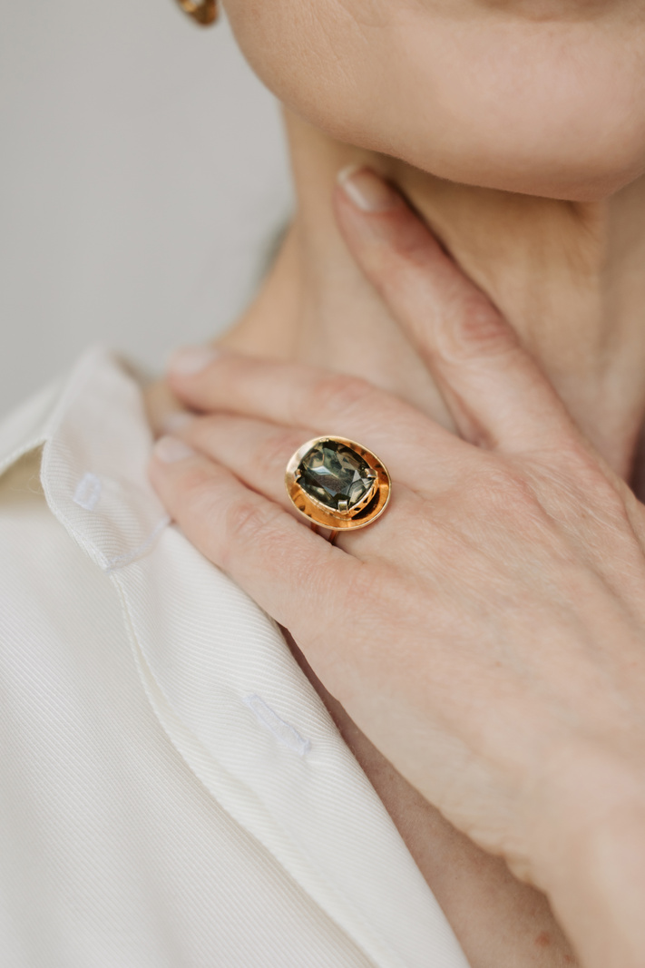
Ana_Belle_Cardiff
Presentation

Slide 3
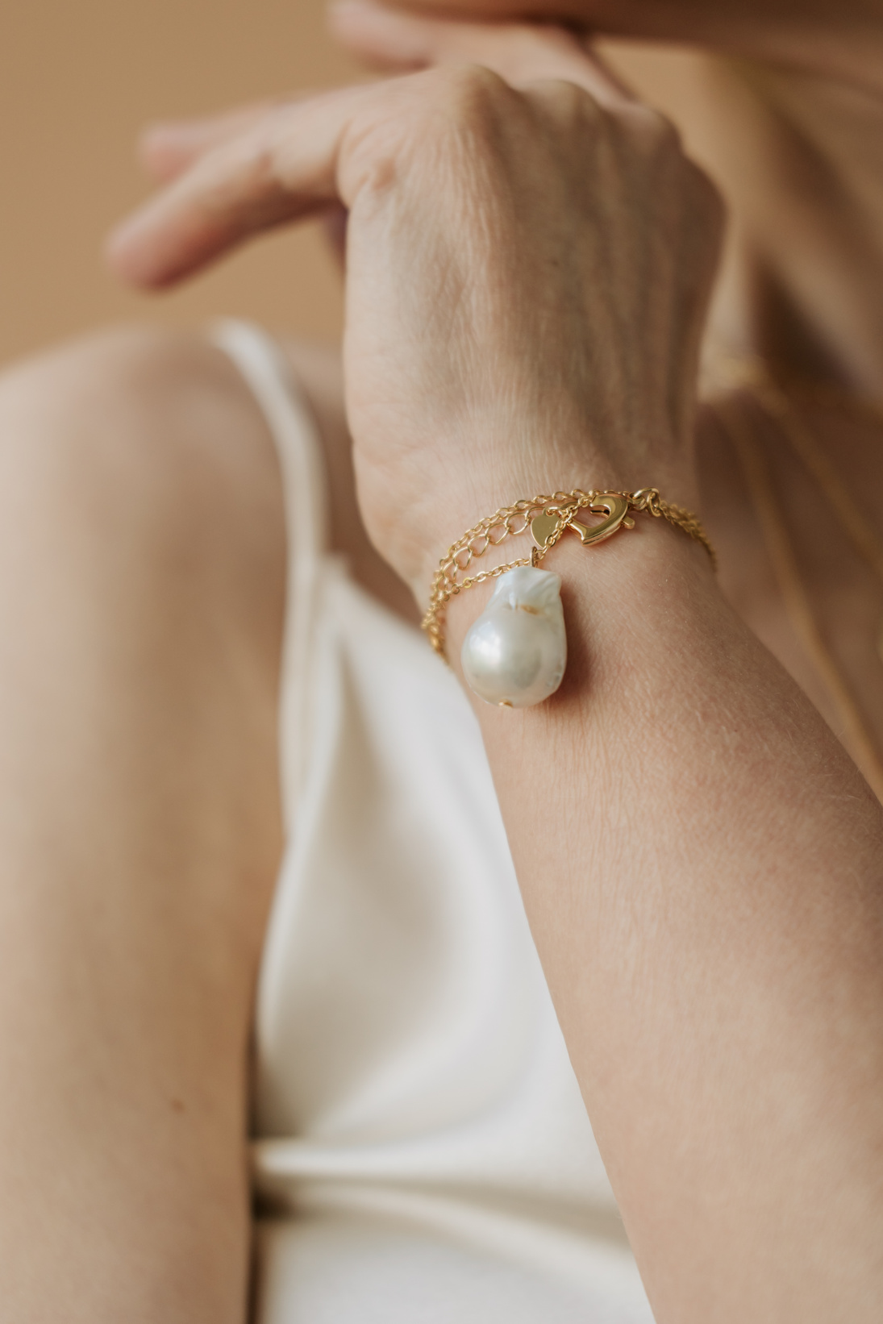
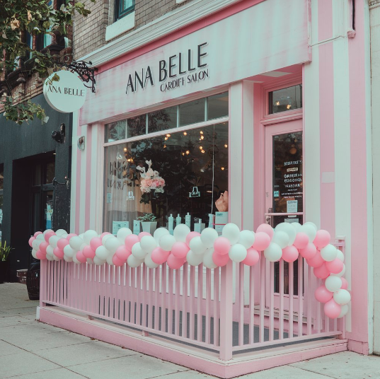
  Business Proposition
Product and services description
Ana_Belle is a beauty salon that offers various services including face and body treatments, manicures, hair treatments, waxing, and makeovers.
Aims and objectives
The presentation of Ana_Belle_Cardiff aims to become the number one beauty salon body in Cardiff with a focus on providing superior beauty services offered by knowledgeable beauticians in serene surroundings.
Mission Statement
'To offer clients a contingency of luxury treatments from the hassles of city life.'
Notes:
Product and services description
Ana is a beauty salon that has face and body treatments, manicures, hair treatments, waxing, and makeovers. The major business idea of the salon is to ensure that the clients get a royal feeling during their time with the salon. In detail, each service should ensure that anyone who is going to receive it is looking for rest as well as for a change in their looks and self-perception.
Mission Statement
'To offer clients a contingency of luxury treatments from the hassles of city life.' Ana_Belle_Cardiff aims to provide outstanding customer relations in a calm and business-like setting. Our goal is to let every client know they are important to us and that they want to leave feeling comfortable.
Aims and objectives
The aim of the presentation is to Ana_Belle_Cardiff is set to become the number one beauty salon body in Cardiff with the focus on providing superior beauty services offered by knowledgeable beauticians in serene surroundings.
To launch an online store for beauty products for more diversification of income and ensure it earns not less than 15% of the center’s revenue in the first year.
To raise repeat customer visits by 20% within the next 6 months mainly with added credibility and certain levels of diner satisfaction.
To launch an online store of beauty products and reach at least 15% of revenue from the online store in the first year.

Slide 4
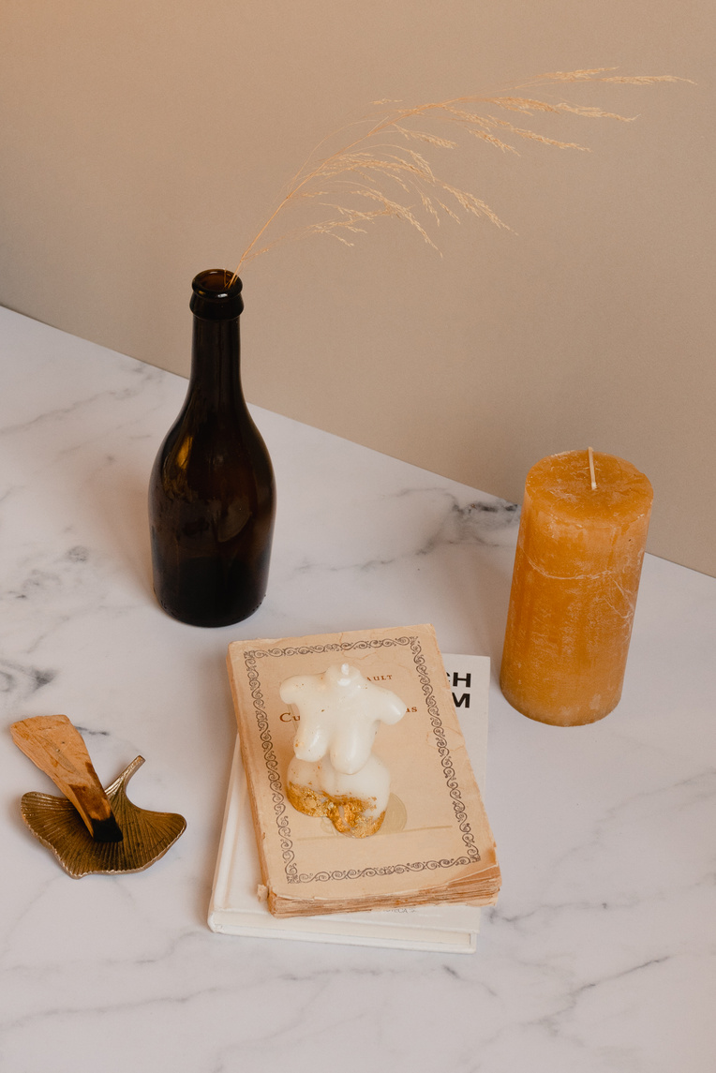
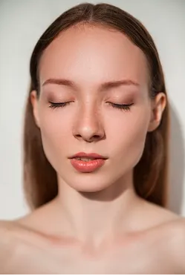

USP
The environment of the salon is also great with warm colors and great music which set the salon apart from competitors
Legal Structure
The legal structure is sole proprietorship
The benefits of this sort of legal structure are less initial expense, fewer requirements from laws, and less complicated formation.
Notes:
USP
The major unique selling point of Ana_Belle_Cardiff is that it focuses on offering effective treatments mainly for the working and exhausted professionals in Cardiff. The environment of the salon is also great with warm colors and great music which set the salon apart from competitors. While the designs are competitive with other beauty parlors, our main goal is to provide a sanctuary for our clients.
Legal Structure
Ana_Belle_Cardiff will be established as a sole trader business because of its simplified and convenient management structure. This means full control of the decision-making process so that quick and dynamic responses to business needs can be made (Szromek and Polok, 2022). The benefits of this sort of legal structure are less initial expense, fewer requirements from laws, and less complicated formation. Thus, the disadvantages include the availability of personal liability, which implies that the owner is legally responsible for its obligations to the business and its creditors (Fortunati et al., 2020). However, sole trader has some difficulties in obtaining large amounts of external financing meaning that little capital is available for expanding and developing the business. Nevertheless, this structure possesses a definite advantage of relative flexibility in operations for a small business.

Slide 5
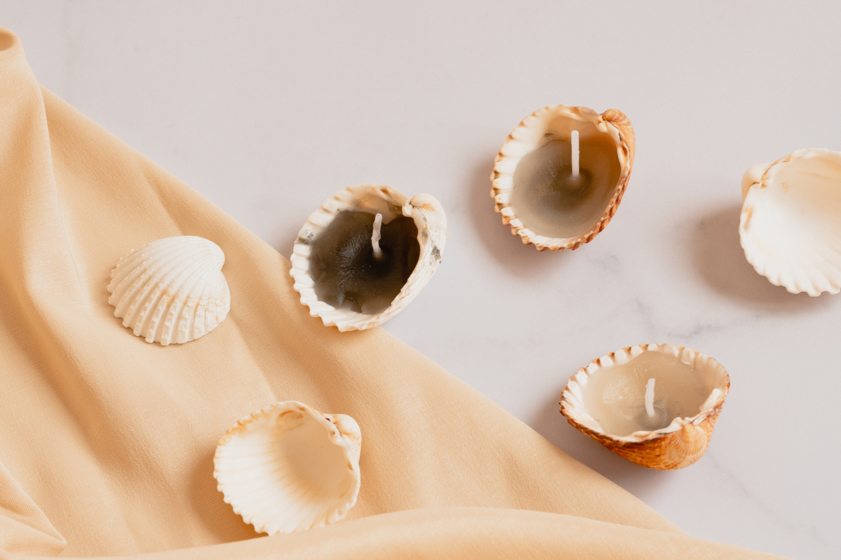

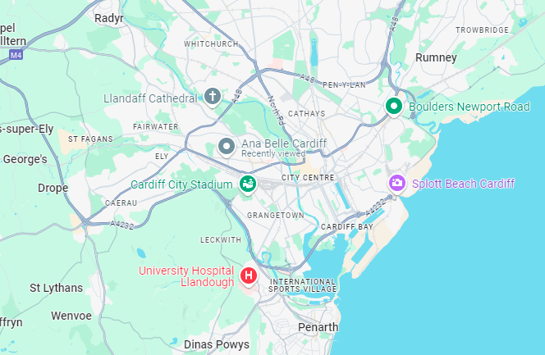
Proposed location
The salon will be established in Cardiff's core business district, which is marked by an increased flow of traffic, especially from business people, tourists, and residents (Pati et al., 2021).
HRM Strategies
The staffing plan is to have 5-7 employees including beauticians, hair stylists, nail technicians and receptionists.
Notes:
Proposed location
The salon will be established in Cardiff's core business district, which is marked by an increased flow of traffic, especially from business people, tourists, and residents (Pati et al., 2021). This explains that Ana_Belle_Cardiff enjoys strategic access to office workers, shopping centers, and residential places hence clients are easily sourced especially during lunchtime, after work, or on the weekends.
HRM Strategies
The staffing plan is to have 5-7 employees including beauticians, hair stylists, nail technicians, and a receptionist. Every staff member who will work on the site will be well qualified, and refresher courses will be offered to guarantee that a high-quality service to the customer will be offered at all times (Mandviwalla and Flanagan, 2021). In the area of recruitment, the salon will seek to employ people of high standard, and quality and who have good customer handling skills. Moreover, staff development for now and shortly will guarantee that the team is abreast with the current industry trends as well as render high-standard services (Sirajuddin et al., 2023).
Financial Overview
The estimated startup cost of the Ana is £50,000. This comprises the cost of rent, equipment, advertising and promotion, and the salaries paid to the personnel. The breakdown is as follows: Equipment costs should amount to £20,000, rent £15,000, salaries £10,000, and £5,000 for marketing expenses. From services and product sales, we expect to generate a monthly of £15,000, which makes it possible to cover the costs of operation in the first six months. Within the first year of operation, we forecast reaching a profit margin of 15%, an opportunity for growth and expansion.

Slide 6
  Financial Plan
Financial Resource | Details
Startup Costs
Estimated Startup Cost | £50,000
Cost Breakdown
Rent | £2,500/month (Cardiff core business district)
Staff Salaries | £3,500/month
Beauty Products | £2,000/month
Equipment | £10,000 (one-time)
Utilities | £750/month
Marketing | £1,000/month
Sources of Finance
Personal Savings | £15,000
Small Business Loan | £25,000
Government Grant | £10,000
Revenue Projections
Cash Flow Forecast | 18-month projection
Revenue Growth | Focus on online bookings and loyalty programs
Profitability Expectation
Expected Break-Even | Month 8
Budgeting Strategy
Operational Plan | Sustainable growth and reinvestment strategy

Slide 7



  Marketing Strategy and Branding
Platforms like Instagram and TikTok should be used in an attempt to attract potential clients via the use of short videos featuring beauty tips and tutorials, as well as before and after transformation results (Hutt and Speh, 2021).
The main concepts of branding are linked with luxury, relaxation, and recreation (Park, 2021).
Theme colour for the brand: soft, warm, and rather evoking a pleasant feeling of cosiness.

Slide 8
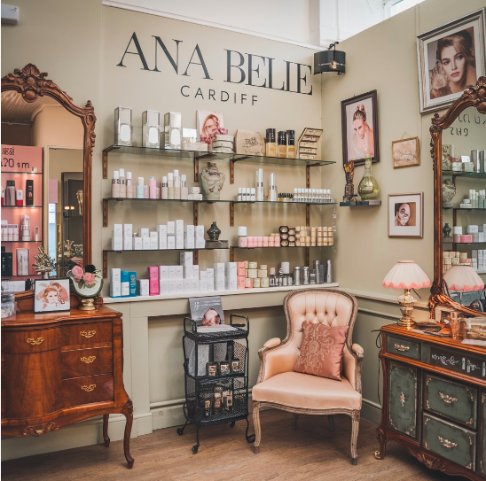
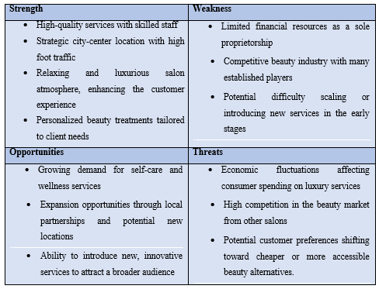


SWOT ANALYSIS
Notes:
In the context of the viability and reliability of the business, the proposal is valid for its proper location, focusing on the quality of services. However, efficient management of cash flows and constructive marketing approaches will be significant determinants of the feasibility of the salon in the beauty niche.

Slide 9

References
Akter, M. and Sultana, N., 2020. Digital marketing communication and consumer buying decision process in pandemic standpoint (Covid-19): an empirical study of Bangladeshi customers’ in branded cosmetics perspective. Open Journal of Business and Management, 8(06), p.2696.
Choedon, T. and Lee, Y.C., 2020. The effect of social media marketing activities on purchase intention with brand equity and social brand engagement: Empirical evidence from Korean cosmetic firms. Knowledge Management Research, 21(3), pp.141-160.
Fortunati, S., Martiniello, L. and Morea, D., 2020. The strategic role of corporate social responsibility and circular economy in the cosmetic industry. Sustainability, 12(12), p.5120.
Hutt, M.D. and Speh, T.W., 2021. Business marketing management: B2B. South-Western, Cengage Learning.
Mandviwalla, M. and Flanagan, R., 2021. Small business digital transformation in the context of the pandemic. European Journal of Information Systems, 30(4), pp.359-375.
Park, H., Kim, S., Jeong, Y. and Minshall, T., 2021. Customer entrepreneurship on digital platforms: Challenges and solutions for platform business models. Creativity and Innovation Management, 30(1), pp.96-115.
Pati, R., Ghobadian, A., Nandakumar, M.K., Hitt, M.A. and O’Regan, N., 2021. Entrepreneurial behavior and firm performance: The mediating role of business model novelty. R&D Management, 51(5), pp.551-567.
Runyan, R.C. and Covin, J.G., 2019. Small business orientation: A construct proposal. Entrepreneurship theory and practice, 43(3), pp.529-552.
Sirajuddin, R.S.B., Senathirajah, A.R.B.S. and Haque, R., 2023. Marketing Mix Influence On Consumer Buying Behavior: A Case Study On The Cosmetics Industry. International Journal of Professional Business Review, 8(5), pp.e01499-e01499.
Szromek, A.R. and Polok, G., 2022. A business model for spa tourism enterprises: transformation in a period of sustainable change and humanitarian crisis. Journal of Open Innovation: Technology, Market, and Complexity, 8(2), p.72.

