Slide 1

Foreign Languages and Cultural Awareness
BMIH5009
ELEMENT FIVE-PRESENTATION
LECTURER: LISA BASSLER
AUTHOR: NICOLETA ANDREEA ROSCA
STUDENT NUMBER: 2009573
This Photo by Unknown Author is licensed under CC BY-NC-ND

Slide 2
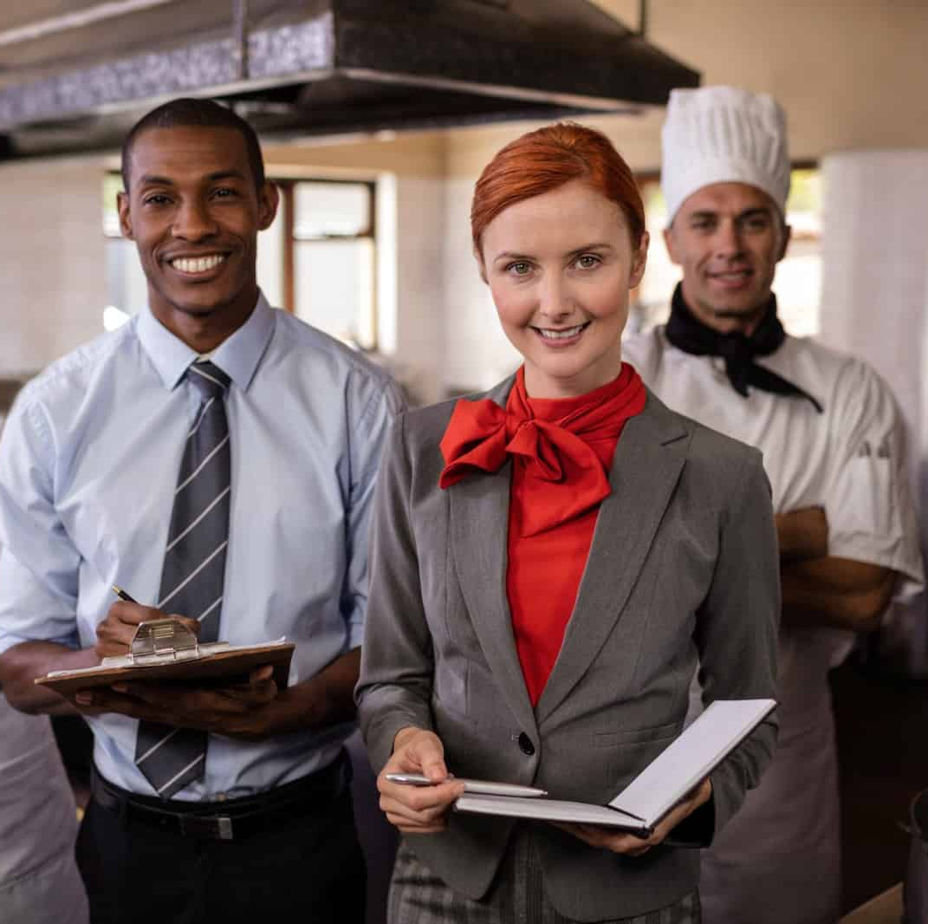
Introduction
The success of hospitality is based on cultural awareness.
My culture has influenced who I am, how I behave as well as my worldview.
Recognition of cultural diversity enhances satisfaction by guests.
Notes:
Good morning, everyone. I will be giving some knowledge about my cultural background and how it influences my attitude towards hospitality. Cultural awareness assists the professionals in relating well with people of other regions staying at their hotels. Through self-cultural reflection, I have gained empathy and flexibility - core values of establishing an inclusive and respectful relationship with guests.

Slide 3

My Cultural Background
I was born in Romania but due to a long time living in England I started to feel part of the British people that are a multicultural country and have different languages and religions.
Community and family are the key areas that influence identity.
Hospitality and respect for the aged are social values.
Cultural diversity helps to be open-minded and flexible in daily interactions.
Notes:
I have been living in England, and I was exposed to cultural richness, festivals, traditions, and multilingual communication. These experiences helped me to value the difference and establish a common ground with others. The nature of my life in such diversity trained my skill in communicating in a respectful way hence it became easy to approach guests of various cultural backgrounds when working in hospitality.

Slide 4

Traditions and Customs
Both Christmas and New Year are festivals that involve unity, color and light.
Socialising food is a sign of unity and hospitality (Schmalz et al., 2020).
Meetings are also characterised by shaking hands with respect.
In traditional hospitality, warmth, care, and attitude towards the guest like a member of the family are considered.
Notes:
The British culture touches on kindness and respect. As an illustration, serving drinks in a pre-discussion to the visitors is a symbol of good hospitality (Schmalz et al., 2020). These traditions affect my interactions with people in the workplace setting - any guest should feel appreciated. Learning the customs of others will also enable me to provide services in a respectful way that builds culture and emotional bonding in the hospitality settings.

Slide 5

Communication Styles
Communication is also oblique and respectful to ensure harmony.
The use of tone and gestures is done with dignity.
The eye contact and personal space are relative.
Active listening and empathy play an important role in cross-cultural communication.
Notes:
In my society, communication is expected to shun conflict. Words are as nothing to do with politeness and tone. I have also learnt how to interpret non-verbal communication, and it proves to be helpful when working with international visitors. As I learn more about the ways emotions or requests are expressed in various cultures, I am able to communicate effectively and in a respectful way, contributing to the satisfaction of guests and the positive effectiveness of my team.

Slide 6

Core Values and Beliefs
Guiding values are respect, humility, and compassion.
Collectivism encourages teamwork and corporate good.
Mindfulness and patience are formed through spirituality (Schnitker et al., 2017).
Professional and personal behavior is characterised by integrity and sympathetic behavior.
Notes:
Cultural values of mine inform me to be useful to others and to be in harmony in relationships (Schnitker et al., 2017). These value systems are reflected in the form of polite service and sincere concern of the guests in hospitality. Compassion and teamwork do not only improve the quality of services but also provide a respectful workplace where diversity is admired and honored.

Slide 7
Expectations as a Guest
I appreciate respectful and polite interactions of service.
Cultural awareness and personal concern adds comfort.
The impression is good due to cleanliness, punctuality and warm welcome.
I like it when employees consider my preferences and change the style of communication to suit me.
Notes:
Being a guest, I would demand professionalism and honest care. I feel respected by being treated politely, served in time and recognised by culture. Recalling preferences (dietary needs or style of communication) when hotel personnel remember them is a sign of emotional intelligence. Such a high level of attention makes a mere stay look more meaningful and personalised.

Slide 8
Cultural Sensitivity in Hospitality
The knowledge of various practices eliminates misinterpretations.
Empathy and respect are developed through cultural training.
Diverse language as well as behavior improves guest satisfaction (Ilieva, 2024).
Sensitivity spreads equality and builds brand reputation.
Notes:
Cultural sensitivity implies the understanding that each of the guests has his or her own traditions and expectations. Trust can be achieved when hospitality employees change their strategy, such as learning about religious demands or etiquette. Comfort and a sense of belonging are produced by sensitivity and all guests, no matter their culture, would feel fairness, respect and the warmth of the true hospitality service (Ilieva, 2024).

Slide 9

Shared Experiences and Learning
The interaction with multicultural peers helped me to communicate better.
The collaboration created mutual understanding in learning (Baker, 2015).
Experiences that were shared proved to be similar across cultures.
Feedback would enhance culture flexibility and group work.
Notes:
It was witnessing the interaction with classmates of different cultural backgrounds. We exchanged experiences, compared cultures, and realised that common values such as respect and kindness make people similar (Baker, 2015). These experiences made me learn to accept differences as positives. Team learning was a learning experience that did not only enhance my communication but also trained me on teamwork, which is important in the context of hospitality.

Slide 10
Professional Reflection
I gained self-confidence in intercultural communication.
The practical awareness was improved by knowledge of theory.
My service approach was enhanced by emotional intelligence (Moscardo, 2019).
The reflection was used to determine areas that would be continuously improved.
Notes:
This module taught me to be more considerate when it comes to communication. The analysis of cultural theories will allow me to change my behavior to fit various guests and colleagues (Moscardo, 2019). The reflection has made me realise that professionalism in hospitality does not consist of service delivery alone- it is empathy, being flexible and ensuring that there are good interpersonal relationships.

Slide 11
Conclusion
Service changes to connection through cultural awareness.
Courtesy and flexibility develop international hospitality excellence.
The reflection promotes growth and development on a personal and professional level.
The adoption of diversity guarantees ad hoc, guest-centered service provision.
Notes:
In conclusion, cultural diversity is best understood and respected in order to constitute modern hospitality. Any encounter is a learning and bonding experience. The professionals should remain open, reflective, and empathetic to ensure they provide guests with memorable experiences and to encourage equality and respect at the workplace, which is the key to the global hospitality success.

Slide 12
References
Baker, M.J., (2015) ‘Collaboration in collaborative learning’, Interaction studies, 16(3), pp.451-473.
Ilieva, G., (2024). ‘The effect of culture on guest experience’. Известия на Съюза на учените-Варна. Серия Икономически науки, 13(1), pp.242-252.
Moscardo, G., (2019). ‘Encouraging hospitality guest engagement in responsible action: Building comprehensive theoretical models to support effective action (invited paper for ‘luminaries’ special issue of International Journal of Hospitality Management)’. International Journal of Hospitality Management, 76, pp.61-69.
Schmalz, D.L., Joyner, L., Duffy, L.N., Bricker, K.S. and Blomquist, K.K., (2020).’ The cycle of food socialization’: Leisure as resistance. Annals of leisure research, 23(4), pp.510-529.
Schnitker, S.A., Houltberg, B., Dyrness, W. and Redmond, N., (2017). ‘The virtue of patience, spirituality, and suffering: Integrating lessons from positive psychology, psychology of religion, and Christian theology’. Psychology of Religion and Spirituality, 9(3), p.264.

