Slide 1
Module Code and Title:
LCLM5002 Developing and Managing Individuals and Teams
Component 1 - Presentation

Slide 2
Table of Contents
Introduction to Balfour Beatty
Recruitment Process
Exploring 3 Different Types of Interviews
Justification of Appropriate Questioning Techniques
Comparison & Contrast: Face-to-Face vs Online Interviews
Conclusion
References

Slide 3

Introduction
Balfour Beatty is a global construction and engineering firm with over a century of expertise in complex infrastructure projects (Xu and Shi, 2018).
The company operates in the infrastructure sector and leads major projects such as the Bromford Tunnel Construction, improving national transport networks.
Effective recruitment and selection processes are essential for aligning workforce planning with productivity and project efficiency.
Notes:
Introduction to Balfour Beatty
Balfour Beatty is an international construction and development group with over 100 years’ experience in complex construction and engineering projects. (Xu and Shi, 2018). The company is present in the infrastructure business sector and actively engaged in the development of some major projects, including the Bromford Tunnel Construction, which is a significant development aimed at improving the transport network of the country. It is imperative that companies have effective recruitment and selection processes to hire candidates that are appropriate and functional to their strategies of workforce planning to boost productivity and project efficiency.

Slide 4

Recruitment Process
Job analysis is a structured method for identifying key skills, qualifications, and experience needed for a role (Maraveas, 2020).
Methods such as observation, interviews, and questionnaires help define core responsibilities and technical proficiencies (Kibert, 2016).
A well-defined job description outlines responsibilities, expectations, and working conditions to attract qualified candidates (Habibi, 2017).
Notes:
Recruitment Process
Recruitment involves very fundamental aspects such as job analysis which is a structured approach adopted to identify the essential skills, qualification and experience for a particular role. It acts as the starting point for the creation of job descriptions and person specifications which need to reflect the organisation’s goals (Maraveas, 2020). As is the case for large scale projects such as the Bromford Tunnel Construction, the competencies required for a IT Technician at Balfour Beatty are paramount for completion of a project on time. It goes about with various methods - observation, interviews, and questionnaires - to collect understanding regarding the role prerequisites from existing employees and managers (Kibert, 2016). They aid in defining the core responsibility, technical proficiencies and behavioural competencies which are expected while shortlisting the candidates.

Slide 5

Recruitment Process (Cont.)
Clearly structured job descriptions reduce hiring risks by setting clear performance criteria and technical requirements (Billington et al., 2017).
A person specification distinguishes essential and desirable qualifications, ensuring candidates meet key role requirements (Ng et al., 2019).
Essential skills for an IT Technician at Balfour Beatty include networking, cybersecurity, and troubleshooting expertise.
Notes:
A job description is a structured outline of a role, it is provided by the employer of the position, it contains the responsibilities, the expectations plus the working conditions associated with the role. With regards to Balfour Beatty, having a clear and well defined job description for an IT Technician helps to a lesser orDesigner increases the probability of attracting good candidates who would understand the scope of work and required expertise (Habibi, 2017). The role involves maintaining and troubleshooting IT systems, ensuring security of the system and driving digital transformation within the company. Job descriptions that clarify the job require less risk of hiring, because they define clear performance criteria and streamline the technological needs defined for the project (Billington et al., 2017). The mission statement of the document provides the key information which involves the job title, the department which the person is going to work, their reporting structure, and the primary responsibilities that the person will be responsible for. Furthermore, the recruitment process is transparent in terms of working conditions, salary expectations as well as contractual terms.

Slide 6
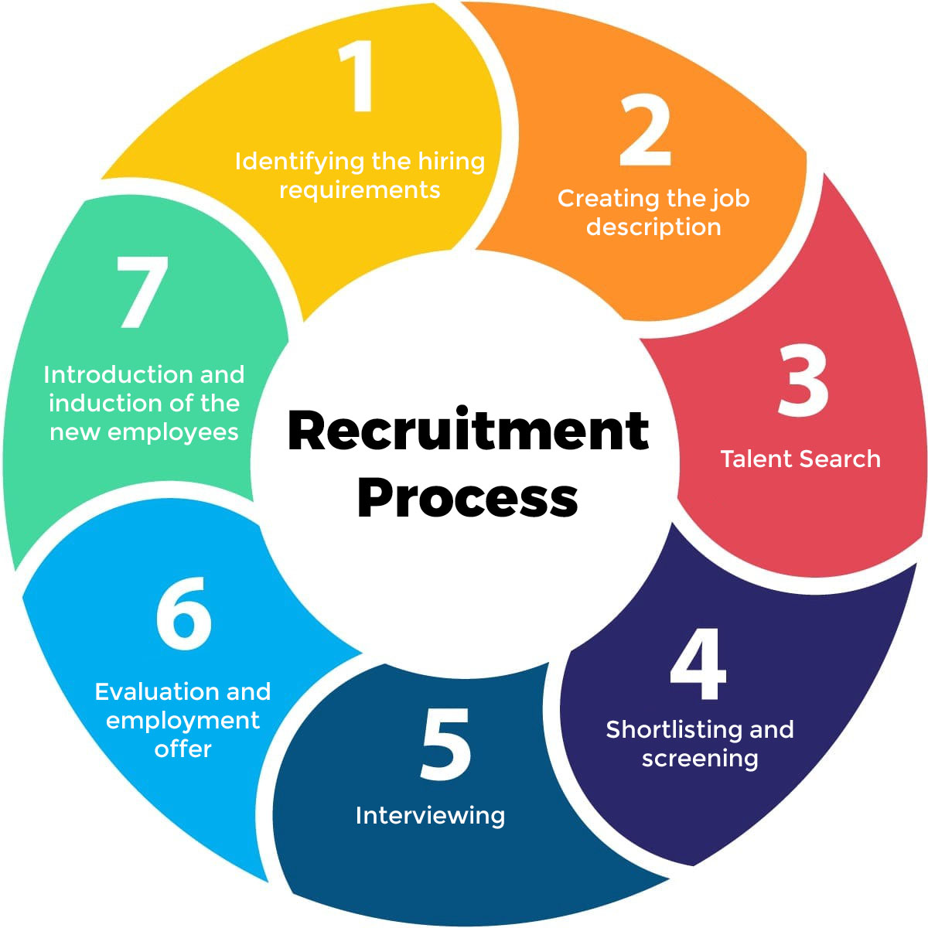
Recruitment Process (Cont.)
Desirable attributes may include experience in the construction sector and proficiency in project management software.
The recruitment process ensures transparency regarding working conditions, salary expectations, and contractual terms.
Effective recruitment enhances project efficiency by aligning workforce skills with strategic objectives.
Notes:
A person specification consists of a list of qualifications, skills and attributes essential and desirable for roles, and distinguishes the two. Essential qualifications for an IT Technician at Balfour Beatty are networking, cybersecurity, and software troubleshooting which are required to keep the facility running (Ng et al., 2019). Moreover, it has a strong knowledge of data security as well as cloud computing, in the hope of safeguarding digital assets. Not only are the standard 21st century kind of using skills like problem solving, teamwork, and adaptability vital, but also they should be able to respond to soon changing technological challenges. Some desirable characteristics may be prior experience in the construction sector or with project management software.

Slide 7

Exploring 3 Different Types of Interviews
Structured Interviews: Candidates answer predetermined questions in a set order, ensuring fairness and comparability (Manggat et al., 2018).
This method ensures unbiased evaluation and helps assess technical knowledge and troubleshooting abilities (Skorobogatova and Kuzmina-Merlino, 2017).
A structured format enables objective comparison of candidates based on standardised responses.
Notes:
Exploring 3 Different Types of Interviews
It is a formal and standardised method that is used in the recruitment process wherein we use same set of questions, same set of predetermined questions to every candidate and we ask them in a specific order (Manggat et al., 2018). This is done in order to keep consistency and to be able to rate responses using a scoring system to lessen bias. Structured Interviews are also highly recommended at Balfour Beatty for recruitment for IT Technician posts as they are a good way to assure fair assessment on the basis of technical knowledge and trouble shooting abilities (Skorobogatova and Kuzmina-Merlino, 2017). This constraint had one major advantage that its promotes fairness and transparency in the selection of candidates allowing recruiters to compare objectively. Structured interviews also serve the purpose of finding the persons fitting all job requirements.

Slide 8

Exploring 3 Different Types of Interviews (Cont.)
Behavioural Interviews: Candidates use the STAR technique to demonstrate past behaviour as an indicator of future performance (Klinc and Turk, 2019).
This approach is useful for evaluating problem-solving, teamwork, and adaptability in a fast-paced construction environment (Tetik et al., 2019).
Behavioural interviews provide insight into candidates’ decision-making and ability to handle real-world challenges.
Notes:
This is called a behavioural interview, and for this, the premise is that past behaviour is good predictor of future behaviour. This is the STAR technique approach for this where a candidate would describe a particular condition, the duty allocated, actions taken and results achieved (Klinc and Turk, 2019). These behavioural interviews are especially relevant for IT Technicians at Balfour Beatty because they give an indication of someone’s ability to solve technical problems, work within a team, and adapt to the changes occurring in the fast pace of the construction environment. This interview type has a huge advantage as it enables your recruiters to understand a candidate a bit better on how they think and how they dealt with a practical problem (Tetik et al., 2019). Additionally, this also enables us in predicting how they would do as far as performance is concerned in such similar setup inside the company.

Slide 9

Exploring 3 Different Types of Interviews (Cont.)
Panel Interviews: Multiple interviewers assess a candidate simultaneously, reducing individual bias and ensuring a balanced evaluation (Ding et al., 2019).
Representatives from different departments evaluate candidates’ technical, communication, and cultural fit (Woodhead, Stephenson and Morrey, 2018).
This method offers a comprehensive assessment by incorporating diverse perspectives.
Notes:
However, a panel interview involves a number of interviewers selecting an individual at the same time to get a more thorough overview of the candidate’s suitability for the role. However, for high stakes positions such as IT Technicians at Balfour Beatty, this approach is very beneficial as technical skill and ability to solve problems are imperative (Ding et al., 2019). A panel interview helps reduce the risk of one individual’s bias by ensuring that there are many different perspectives considered in the hiring decision. This method involves a representative from various departments to assist them in judiciously conducting the candidate’s assessment for their technical proficiency, communication skills and his/her cultural fit in the organisation (Woodhead, Stephenson and Morrey, 2018). Well, one of the main advantages here is that it offers a holistic evaluation because different interviewers will have different views about the role.

Slide 10

Justification of Appropriate Questioning Techniques
Probing and Socratic questioning help assess problem-solving and technical skills by encouraging candidates to elaborate on responses (Kibert, 2016).
Socratic questioning challenges candidates to justify decisions, testing critical thinking and cybersecurity awareness (Habibi, 2017).
Competency-based questions evaluate practical skills, ensuring candidates can handle IT security challenges (Ng et al., 2019).
Notes:
Justification of Appropriate Questioning Techniques
Probing and Socratic questioning are needed for assessing a candidate's knowledge and skills for problem solving. Probe enquiries invite applicants to go on to elaborate to give the pictures and depth that normal questioning would not. This is a good method for an IT Technician interview at Balfour Beatty, where the candidate needs technical skills and the ability to troubleshoot (Kibert, 2016). Interviewers may ask questions allowing them to check the candidates’ ability to cope with tight deadlines in construction industry, for instance that they describe any IT issues they’ve resolved in stressful situations. As argued above, Socratic inquiry requires candidates to justify their reasoning and decisions, using their critical thinking ability, to test the students (Habibi, 2017). Questions pertaining to UK cybersecurity concerns and how one would minimise them can be used for evaluating a candidate’s strategic thinking and industry awareness.

Slide 11

Justification of Appropriate Questioning Techniques (Cont.)
Leading questions may guide responses but risk bias, potentially affecting recruitment outcomes.
Well-structured competency questions help assess candidates’ real-world expertise and problem-solving ability.
A combination of questioning techniques ensures thorough evaluation of technical and behavioural competencies.
Notes:
Candidates are assessed by means of competency and leading questions. Leading questions guide candidates to respond as the desired response. But this method may clarify a candidate’s experience, but this can create bias and fake answers. In this scenario, Balfour Beatty IT Technicians might hire applicants who do not possess any; however, they can provide the expected interview answers (Ng et al., 2019). More competency based questions are better to actually measure a candidate’s practical and behavior capability. Interviewers can test candidates' ability to solve problems in IT security risk management by asking them about their successes in such an area in the past.

Slide 12

Comparison & Contrast: Face-to-Face vs Online Interviews
Face-to-Face Interviews: Enable direct interpersonal communication, allowing assessment of body language, confidence, and professionalism (Billington et al., 2017).
This method helps determine cultural fit and collaboration skills, which are essential in construction projects (Manggat et al., 2018).
However, in-person interviews can be costly and time-consuming for large-scale recruitment.
Notes:
Comparison & Contrast: Face-to-Face vs Online Interviews
As Technical roles such as IT Technicians at Balfour Beatty are relatively new and therefore the organisation is not fully aware of exactly what and how they need to be done, face to face interviews remain a traditional, yet highly effective method of candidate assessment (Billington et al., 2017). As the main advantage, this approach provides the possibility of direct interpersonal communication, which gives an interviewer the opportunity of speaking with the candidates on a more personal level. This is a format that allows in measuring a candidate’s non-verbal cues like body language, confidence and professionalism that are important indicators as to whether a person is fit for the job. In a construction based organisation where teamwork and collaboration is key, in person interaction is also an opportunity to learn how the candidate can work in the company culture (Manggat et al., 2018). Face to face interviews are however expensive and time consuming meanwhile for large organisations that handle a multitude of recruitment process simultaneously.

Slide 13

Comparison & Contrast: Face-to-Face vs Online Interviews (Cont.)
Online Interviews: Provide a cost-effective, efficient solution, expanding the talent pool and allowing global recruitment (Ng et al., 2019).
The method is useful for IT roles but presents challenges such as technical issues and limited non-verbal communication assessment (Skorobogatova and Kuzmina-Merlino, 2017).
While convenient, online interviews may lack the depth of face-to-face interaction in assessing a candidate’s personality and engagement.
Notes:
An online interview has taken root as a modern and efficient way to reduce their efforts both for employers and candidates. An obvious benefit is cost-effective: no need to explore travelling and logistical challenges and thus, expand the talent pool (Ng et al., 2019). Additionally, Balfour Beatty now has the power to channelise global talent into the company through this method, particularly in an industry like IT that is heavily dependent on remote work abilities. Admittedly, as stressful as the online interviews are, the chances of technical reliability cannot be guaranteed. Poor internet connectivity or audio disruptions can interfere with the smooth process of communication and therefore the assessment as a result (Skorobogatova and Kuzmina-Merlino, 2017). Beyond that, the inability to accurately assess body language and soft skills could limit the potential to judge how confident, engaged and fit for culture a candidate may be in the corporation.

Slide 14

Conclusion
A structured recruitment process ensures Balfour Beatty hires skilled personnel for complex infrastructure projects.
Interview methods and questioning techniques improve decision-making while online interviews enhance accessibility.
Effective hiring supports major projects like the Bromford Tunnel Construction and strengthens Balfour Beatty’s position in the UK construction sector.
Notes:
Conclusion
Through a structured recruitment process, Balfour Beatty can seek to hire skilled personnel for its complex projects. Methods and techniques of interviews and questioning contribute to a better decision making, while the interviews online are more accessible. Hiring supports the Bromford Tunnel Construction project as well as the company’s continued presence in the UK construction sector.

Slide 15
References
Billington, M.J., Barnshaw, S.P., Bright, K.T. and Crooks, A. (2017) The building regulations: explained and illustrated. John Wiley & Sons.
Ding, Z., Liu, S., Liao, L. and Zhang, L. (2019) ‘A digital construction framework integrating building information modeling and reverse engineering technologies for renovation projects’, Automation in construction, 102, pp. 45–58–45–58.
Habibi, S. (2017) ‘The promise of BIM for improving building performance’, Energy and Buildings, 153, pp. 525–548–525–548.
Kibert, C.J. (2016) Sustainable construction: green building design and delivery. John Wiley & Sons.
Klinc, R. and Turk, Ž. (2019) ‘Construction 4.0–digital transformation of one of the oldest industries’, Economic and Business Review, 21(3), p. 4.
Manggat, I., Zain, R., Jamaluddin, Z. and others (2018) ‘The impact of infrastructure development on rural communities: A literature review’, International Journal of Academic Research in Business and Social Sciences, 8(1), pp. 647–658–647–658.
Maraveas, C. (2020) ‘Production of sustainable construction materials using agro-wastes’, Materials, 13(2), p. 262.
Ng, C.P., Law, T.H., Jakarni, F.M. and Kulanthayan, S. (2019) ‘Road infrastructure development and economic growth’, in IOP conference series: materials science and engineering, p. 12045.
Skorobogatova, O. and Kuzmina-Merlino, I. (2017) ‘Transport infrastructure development performance’, Procedia Engineering, 178, pp. 319–329–319–329.
Tetik, M., Peltokorpi, A., Seppänen, O. and Holmström, J. (2019) ‘Direct digital construction: Technology-based operations management practice for continuous improvement of construction industry performance’, Automation in construction, 107, p. 102910.
Woodhead, R., Stephenson, P. and Morrey, D. (2018) ‘Digital construction: From point solutions to IoT ecosystem’, Automation in Construction, 93, pp. 35–46–35–46.
Xu, G. and Shi, X. (2018) ‘Characteristics and applications of fly ash as a sustainable construction material: A state-of-the-art review’, Resources, conservation and recycling, 136, pp. 95–109–95–109.

