Slide 1
TAR-C / P-PGCE
29-10-2018

Slide 2
Croeso - Welcome
Amcanion y sesiwn – Session objectives
Ystyried strwythur a chynllun gwers mathemateg
Trafod egwyddorion cynllunio
Gwerthuso adnoddau mathemategol
Consider lesson structure and mathematics lesson plan
Discuss planning principles
Evaluate mathematics resources

Slide 3
Cynllunio gwers – Planning a lesson
Pa nodweddion effeithiol sydd wedi eu cynnwys yn y wers?
Ystyriwch brif nodweddion gynllunio effeithiol
What effective features of mathematics have been incorporated into the lesson?
Consider the main features of effective planning

Slide 4
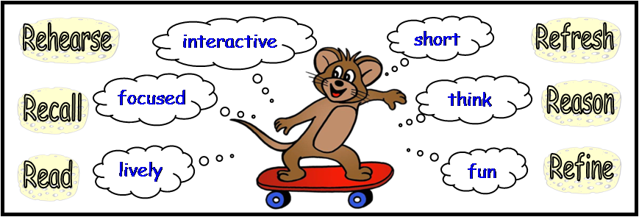
Dechrau’r wers: Gwaith Pen / Llafar
Ymarfer
byr
Atgoffa
rhyngweithiol
Mae’n weithgaredd sionc
Ymarfer ac atgyfnerthu sgiliau sydd eisoes yn bodoli
Mae’r dysgwyr yn rhyngweithio gyda’i gilydd a’u hathro
Ailgyflwyno ac ailymweld â dysgu blaenorol
ffocws
meddwl
Rheswm
Cofio
Cadw i ganolbwyntio
Annog dysgwyr i feddwl yn
fathemategol
Sicrhau gwybodaeth o’r ffeithiau
Meddwl yn fathemategol
bywiog
hwyl
Gwella
Darllen
Mae angen symud
ac adnoddau
Mae gêmau ac adnoddau yn helpu ei wneud yn sbri
Mireinio dulliau a gweithdrefnau
Defnyddio geirfa fathemategol a
dehongli gwybodaeth fathemategol

Slide 5
THE MENTAL/ORAL STARTER
Learners interact with each other and teacher
Moves with pace
Practise and Consolidate existing skills
To bring in and revisit previous learning
Sticks to focus
Learners encouraged to think mathematically
To secure knowledge of facts
To think mathematically
involves movement and resources
games and resources help make it fun
To refine methods and procedures
To use mathematical vocabulary and interpret mathematical information

Slide 6
TASG - TASK
Edrychwch ar yr adnodd addysgu sydd wedi ei rhoi i chi
Yn eich grŵp, trafodwch yr adnodd yn feirniadol. Meddyliwch am y manteision a’r anfanteision.
Gwnewch yn siwr fod pob aelod o’r grwp yn hyderus ac yn mynd i fedru rhoi trosolwg o’r dasg i eraill, yn ogystal ag amlygu’r cysylltiadau ymresymu.
Look at the teaching resource you have been allocated
In your group discuss the resource critically. Think about advantages and disadvantages.
Make sure everybody in the group is able to confidently give an overview of the task to others and be able to highlight the reasoning links
Notes:
NRICH tasks https://nrich.maths.org/
2. Challenge tasks (on Moodle – PowerPoints WM and EM) the related book is here: https://www.egfl.org.uk/sites/default/files/maths%20puzzles%20all.pdf
3. Reasoning in the classroom
WM
http://learning.gov.wales/resources/learningpacks/reasoning-in-the-classroom/?skip=1&lang=cy
EM
http://learning.gov.wales/resources/learningpacks/reasoning-in-the-classroom/?skip=1&lang=en
4. NNEM Zone on HWB

Slide 7
Adolygu rhannu – Division revision
972 ÷ 36
Sut gallech wneud amcangyfrif?
Pa ddull gallech ei ddefnyddio?
Sut gallech chi wirio eich ateb?
How could you make an estimate?
What would be a method you could use?
How could you check your answer?
Llawlyfr Cyfrifo NSP Calculations Booklet (on Moodle)

