Slide 1
LCBB6015
Strategic Management and Sustainability
Week 5
Business Strategy and Corporate Strategy

Slide 2
Learning Objectives
Assess business strategy in terms of the generic strategies of cost leadership, differentiation, focus and hybrid strategy.
Assess the benefits of cooperation in business strategy.
Identify alternative strategy options, including market penetration, product development, market development and diversification.
Distinguish between different diversification strategies (related and conglomerate diversification) and evaluate diversification drivers.
Analyse the ways in which a corporate parent can add or destroy value for its portfolio of business units.

Slide 3

Business-Level Strategy
Business-level Strategy - A business’s overall competitive theme; the way it positions itself in the marketplace to gain a competitive advantage, and the different positioning strategies that it can use in different industry settings.
Business-level strategy is about whom a company decides to serve (which customer segments), what customer needs and desires the company is trying to satisfy, and how the company decides to satisfy those needs and desires.
Business-level strategy refers to the overarching competitive theme of a company in a given market.

Slide 4




Cost-leadership Strategy
Cost-leadership Strategy involves becoming the lowest-cost organisation in a domain of activity.
There are four key cost drivers that can help deliver cost leadership:
    Input costs are often very important, for example labour or raw materials.
    Economies of scale refer to how increasing scale usually reduces the average costs of operation over a particular time period, perhaps a month or a year.
    Experience can be a key source of cost efficiency.
    Product/process design also influences cost.

Slide 5



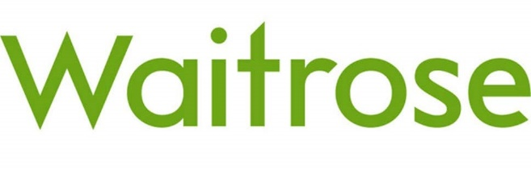
Differentiation Strategy
Differentiation Strategy involves uniqueness along some dimension that is sufficiently valued by customers to allow a price premium.
Three primary differentiation drivers:
    Product and service attributes
    Customer relationships
    Complements (linkages to other products or services)
Notes:
Product and Service Attributes:
Example: Apple Inc. Apple is known for its focus on innovation and unique product attributes. Their product differentiation includes sleek design, user-friendly interfaces, and a seamless integration of hardware and software, setting their devices apart from competitors. For instance, the iPhone's distinctive features, such as Face ID, ecosystem connectivity, and proprietary software like iOS, contribute significantly to their differentiation strategy.
Customer Relationships:
Example: Zappos Zappos, an online shoe and clothing retailer, is renowned for its exceptional customer service and strong customer relationships. They differentiate themselves by providing outstanding customer experiences, offering free shipping both ways, a generous return policy, and a 24/7 customer support team known for going above and beyond to satisfy customers. This commitment to exceptional service fosters strong customer loyalty and sets them apart in the retail industry.
Complements (Linkages to Other Products or Services):
Example: Amazon Amazon's differentiation strategy revolves around its vast ecosystem of products and services. They excel not only in their core e-commerce platform but also in complementary services like Amazon Web Services (AWS), Prime membership benefits (such as streaming services and expedited shipping), Kindle devices, and their own line of consumer electronics like Echo devices. By creating linkages between these various offerings, Amazon builds a comprehensive and interconnected ecosystem that reinforces customer loyalty and engagement.

Slide 6




Focus Strategy
Focus Strategy (sometimes called niche strategy) targets a narrow segment or domain of activity and tailors its products or services to the needs of that specific segment to the exclusion of others.
Focus strategies come in two variants, according to the underlying sources of competitive advantage, cost or differentiation.
The focuser achieves competitive advantage by dedicating itself to serving its target segments better than others that are trying to cover a wider range of segments.
Notes:
Gaming-Centric Focus: Razer specializes in gaming hardware and peripherals, including gaming mice, keyboards, headsets, and laptops. Their primary target audience is gamers, and their products are specifically designed to meet the demands of this niche market.
Specialized Product Line: Razer's products are tailored for gamers seeking high-performance and customizable gaming equipment. Rather than catering to a broad consumer base, Razer concentrates on creating cutting-edge, specialized technology for gamers.
Brand Identity and Community Engagement: Razer has cultivated a strong brand identity within the gaming community. They actively engage with gamers through sponsorships, partnerships, and community events, fostering a sense of belonging among their target audience.
Innovation and Technology: Razer emphasizes innovation in its products, introducing cutting-edge technologies specifically for gaming purposes. Features like customizable RGB lighting, high-precision sensors, and ergonomic designs are geared toward gamers seeking an immersive gaming experience.
Limited Market Share within the Gaming Industry: While Razer is a prominent player in gaming peripherals, it holds a relatively smaller market share compared to more diversified tech giants. Its focus on a specific segment of the gaming industry contributes to its characterization as a niche player.

Slide 7


Hybrid Strategy
Hybrid Strategy combines different generic strategies.
There may be particular circumstances in which the strategies can be combined:
    Organisational separation - It is possible for a company to create separate strategic business units (SBUs), each pursuing different generic strategies and with different cost structures.
    Technological or managerial innovation - Sometimes technological innovations allow radical improvements in both cost and quality.
    Competitive failures - Where competitors are also stuck in the middle, there is less competitive pressure to remove competitive disadvantage.
There are real dangers for the fi rm that engages in each generic strategy but fails to achieve any of them – it is stuck in the middle.

Slide 8

1. Do Porter’s generic strategies provide any useful insights in structuring the strategic opportunities in global pharmaceutical?
2. If you were developing strategy options for a small company, what strategy options would you consider? What problems might you encounter?
Questions?
Notes:
Porter’s Generic Strategies in the Global Pharmaceutical Industry:
1. Porter’s Generic Strategies:
Porter's generic strategies—cost leadership, differentiation, and focus—can be applied in the global pharmaceutical industry, offering insights into structuring strategic opportunities:
Cost Leadership: Some pharmaceutical companies aim to become cost leaders by efficiently producing generic drugs or reducing manufacturing expenses. For instance, Teva Pharmaceutical Industries focuses on producing generic medications at lower costs, aiming to capture market share by offering more affordable alternatives to branded drugs.
Differentiation: Certain pharmaceutical firms differentiate their products through innovation, branding, or unique formulations. Companies like Novartis or Pfizer invest heavily in R&D to create new, patented drugs that address unmet medical needs or offer superior therapeutic outcomes, setting them apart from competitors.
Focus Strategy: In a vast industry like pharmaceuticals, a focus strategy could involve targeting specific therapeutic areas or niche markets. Biogen, for instance, concentrates on neurology and immunology, developing drugs for conditions like multiple sclerosis and Alzheimer's disease.
2. Strategy Options for a Small Company and Potential Challenges:
When developing strategy options for a small company, several approaches could be considered:
Niche Market Focus: Concentrating on a specialized niche within the pharmaceutical industry, such as rare diseases or specific drug formulations, can be a viable strategy for a small company.
Partnerships or Alliances: Collaborating with larger pharmaceutical firms, academic institutions, or research organizations can provide access to resources, expertise, and markets that a small company might lack.
Innovation and Differentiation: Emphasizing innovation to develop unique drugs or novel delivery systems can help differentiate the small company's offerings in the market.
However, small companies in the pharmaceutical industry might encounter various challenges:
Regulatory Hurdles: Complying with stringent regulations and obtaining approvals from regulatory bodies can be time-consuming and costly for smaller companies with limited resources.
Capital Constraints: R&D, clinical trials, and marketing in the pharmaceutical industry require significant investment. Small companies may face challenges in securing sufficient funding for these activities.
Competition and Market Access: Competing with larger, established pharmaceutical companies with extensive market reach and resources can be daunting for smaller firms.
Intellectual Property Protection: Protecting intellectual property rights is crucial in the pharmaceutical sector. Small companies might face difficulties in safeguarding their innovations from infringement or unauthorized use.
In summary, while there are strategic options available for small companies in the pharmaceutical industry, challenges such as regulatory hurdles, limited resources, and competition from larger firms need to be carefully addressed and navigated to succeed in this complex and highly regulated sector.

Slide 9
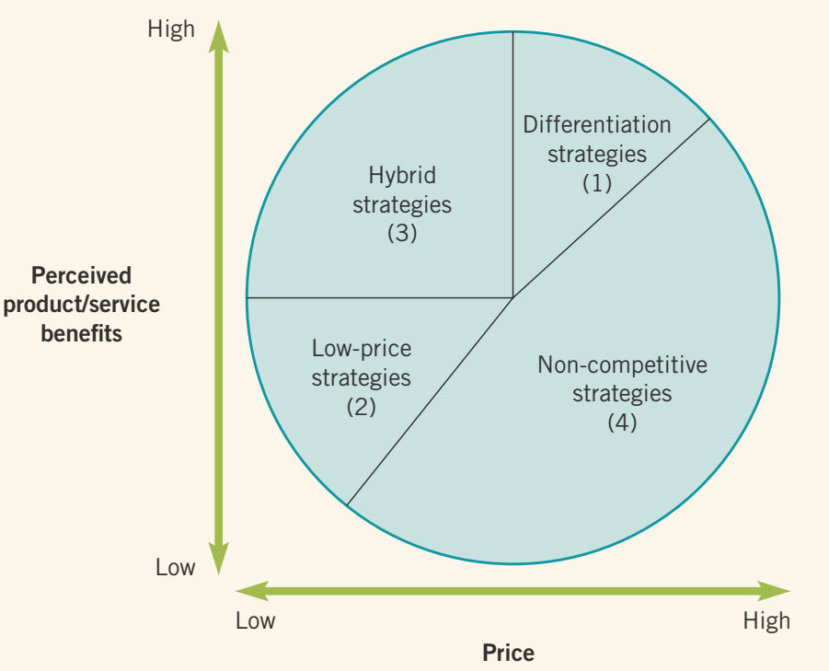
The Strategy Clock
The Strategy Clock provides another way of approaching generic strategies, one which gives more scope for hybrid strategies.
The Strategy Clock has focused on prices to customers rather than costs to the organisation: because prices are more visible than costs.
Organisations may travel around the clock, as they adjust their pricing and benefits over time.
Non-competitive strategies (zone 4). The final set of strategies occupies a zone of unfeasible economics, with low benefits and high prices. Typically these strategies lead to failure.
Notes:
https://www.youtube.com/watch?v=HMRJ8bFt5AU

Slide 10
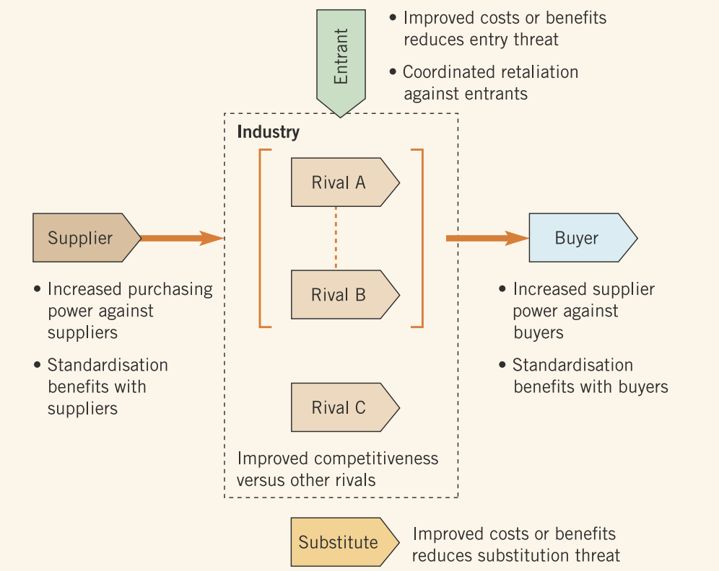
Cooperative Strategy
Collaboration between some organisations in a market may give them advantage over other competitors in the same market, or potential new entrants.
Collaboration can be explicit in terms of formal agreements to cooperate, or tacit in terms of informal mutual understandings between organisations.
Key benefits of cooperation are:
  Suppliers – will increase their purchasing power against suppliers
  Buyers – will decrease their customers’ purchasing power
  Rivals – will create competitive advantage
  Entrants – will create entry barriers
  Substitutes – will reduce the incentives for buyers to look to substitutes

Slide 11
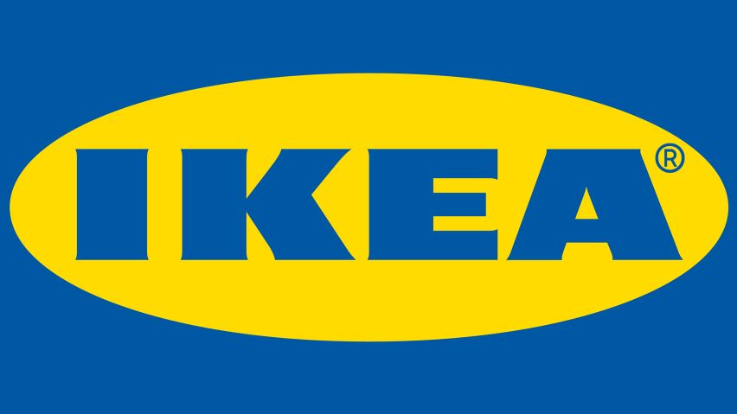
Case Study
The IKEA Approach
Identify where (in their value system) and how IKEA have achieved cost leadership.
Identify how IKEA have achieved differentiation from their competitors.
Explain how IKEA tries to ensure that their ‘hybrid’ strategy remains sustainable and does not become ‘stuck-in-the-middle’.

Slide 12
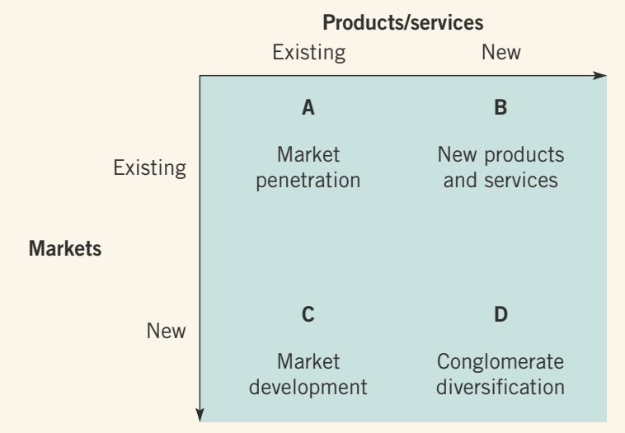
Strategy Directions
Ansoff’s product/market growth matrix is a classic corporate strategy framework for generating four basic directions for organisational growth.
Typically an organisation starts in zone A – penetrating existing markets/products.
The market options matrix not only considers the possibility of launching new products and moving into new markets, but also explores the possibility of withdrawing from markets and moving into unrelated markets.

Slide 13



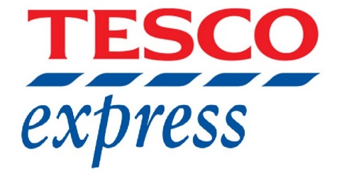
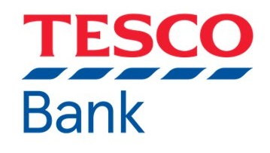
Diversification Strategy
Diversification involves increasing the range of products or markets served by an organisation.
Related diversification involves expanding into products or services with relationships to the existing business.
Super Sport
SUV
Conglomerate (unrelated) diversification involves diversifying into products or services with no relationships to existing businesses.
Retailing Industry
Banking Industry

Slide 14

Case Study
From Sat Nav To Driverless Cars
Explain the ways in which relatedness informed TomTom’s post-2008 strategy.
Were there alternative strategies open to TomTom post 2008?
Notes:
TomTom, a company known for its navigation and mapping products, underwent strategic shifts post-2008, utilizing relatedness in various ways to shape its strategy:
Diversification through Related Products and Services:
TomTom expanded its product offerings beyond standalone GPS devices. It ventured into related areas such as in-dash navigation systems for automobiles, fitness wearables (e.g., sports watches), and location-based services. This diversification leveraged its expertise in GPS technology and mapping data, extending its reach into adjacent markets.
Acquisitions and Partnerships:
To enhance its relatedness and capabilities, TomTom made strategic acquisitions. For instance, in 2011, it acquired Tele Atlas, a digital mapping company, to strengthen its mapping database, ensuring accuracy and comprehensive coverage for its navigation solutions.
TomTom also formed partnerships with automobile manufacturers like Fiat Chrysler Automobiles (FCA) and others to integrate its navigation technology directly into vehicles, tapping into the automotive market.
Focus on Software and Services:
Recognizing the shift in consumer preferences towards smartphone-based navigation, TomTom transitioned from predominantly hardware-based products to software and services. It developed navigation apps for mobile devices, providing navigation solutions compatible with smartphones, thereby capitalizing on the changing market trends.
Enterprise Solutions:
TomTom expanded into providing location-based services for businesses and enterprises. It offered fleet management solutions, traffic data services, and geospatial analytics, leveraging its mapping and navigation expertise to cater to commercial and governmental entities.
Alternative Strategies Post-2008 for TomTom:
Several alternative strategies could have been considered by TomTom:
Focus on Core Business:
Rather than diversifying, TomTom could have concentrated solely on refining and innovating its GPS devices and navigation solutions. This strategy would involve maximizing market share in its core market segment and potentially gaining a competitive edge through technological advancements.
Partnership with Tech Companies:
Instead of shifting to software-based solutions, TomTom could have established stronger partnerships or collaborations with smartphone manufacturers or tech companies to integrate its navigation technology directly into mobile devices.
Global Expansion Strategy:
TomTom could have pursued an aggressive international expansion strategy, focusing on penetrating emerging markets where navigation technology adoption was growing rapidly, aiming to become a dominant player in those regions.
Specialization in B2B Services:
Alternatively, TomTom might have chosen to focus solely on enterprise solutions, emphasizing its B2B offerings and becoming a leader in providing location-based services for businesses and governments globally.

Slide 15
Diversification Drivers
Diversification might be chosen for a variety of reasons, some more value-creating than others. Five potentially value-creating drivers for diversification are as follows:
    Exploiting economies of scope
    Spreading risk across a range of markets
    Stretching corporate management competences
    Exploiting superior internal processes
    Increasing market power
Notes:
Value-creating drivers for diversification are as follows:
Exploiting economies of scope. economies of scope refer to efficiency gains made through applying the organisation’s existing resources or competences to new markets or services.
Stretching corporate management competences (‘dominant logics’). This is a special case of economies of scope and refers to the potential for applying the skills of talented corporate-level managers to new businesses.
Spreading risk across a range of markets is another common justification for diversification.
Exploiting superior internal processes. Internal processes within a diversified corporation can often be more efficient than external processes in the open market. This is especially the case where external capital and labour markets do not yet work well, as in many developing economies.
Increasing market power.9 Being diversified in many businesses can increase power vis-à-vis competitors in at least two ways. First, having the same wide portfolio of products as a competitor increases the potential for mutual forbearance.

Slide 16
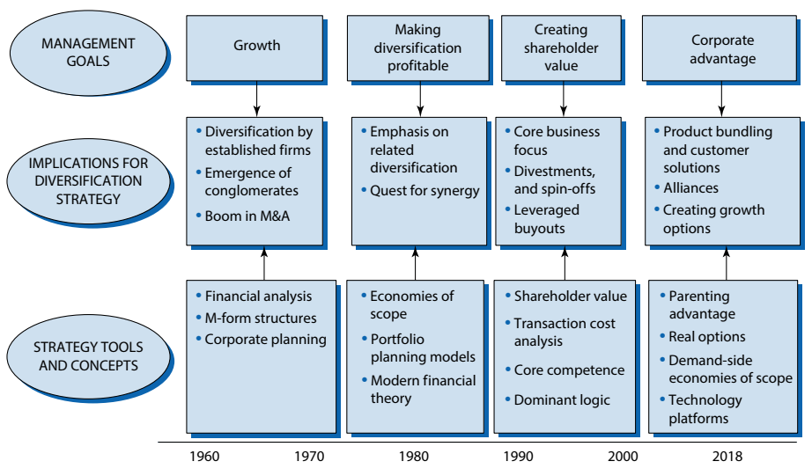
The Evolution of Diversification Strategies, 1960–2018
Notes:
Value-creating drivers for diversification are as follows:
Exploiting economies of scope. economies of scope refer to efficiency gains made through applying the organisation’s existing resources or competences to new markets or services.
Stretching corporate management competences (‘dominant logics’). This is a special case of economies of scope and refers to the potential for applying the skills of talented corporate-level managers to new businesses.
Spreading risk across a range of markets is another common justification for diversification.
Exploiting superior internal processes. Internal processes within a diversified corporation can often be more efficient than external processes in the open market. This is especially the case where external capital and labour markets do not yet work well, as in many developing economies.
Increasing market power.9 Being diversified in many businesses can increase power vis-à-vis competitors in at least two ways. First, having the same wide portfolio of products as a competitor increases the potential for mutual forbearance.

Slide 17
Vertical and Horizontal Integration
Vertical integration describes entering activities where the organisation is its own supplier or customer. Vertical integration can go in either of two directions: forward and backward integration.
Vertical integration often appears attractive as it seems to ‘capture’ some of the profits gained by retailers or suppliers in a value network – the retailers’ or suppliers’ profits.
Thus vertical integration is like diversification in increasing corporate scope. The difference is that it brings together activities up and down the same value network, while diversification typically involves more or less different value networks. However, because realising synergies involves bringing together different value networks, diversification (especially related diversification) is sometimes also described as horizontal integration.

Slide 18
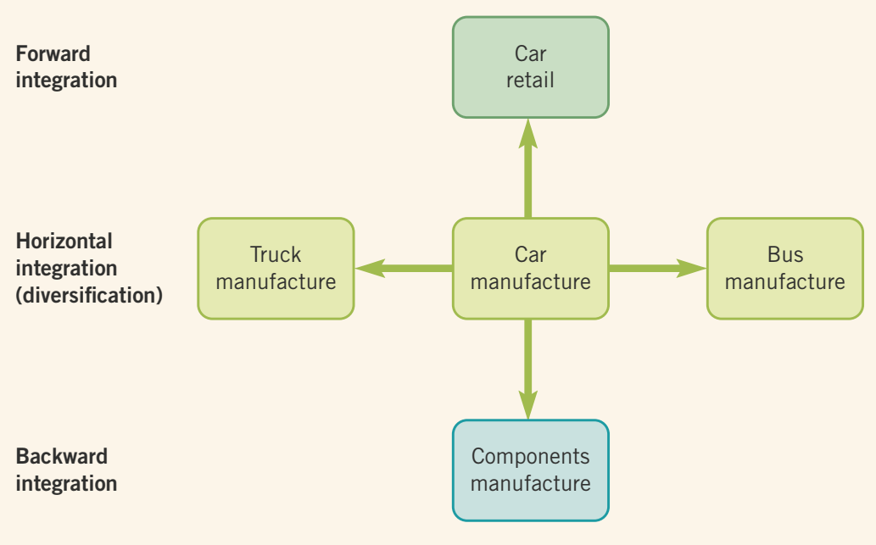
Diversification and Integration Options:
Car Manufacturer Example

Slide 19




Value Creation And The Corporate Parent
Value-adding Activities
Envisioning
Facilitating synergies
Coaching
Providing central services and resources
Intervening
Value-destroying Activities
Adding management costs
Adding bureaucratic complexity
Obscuring financial performance
Notes:
In 2005, eBay Inc. (NASDAQ: EBAY) purchased Skype for $2.6 billion.﻿ The purchase price was extremely high considering that Skype had only $7 million in revenues. Meg Whitman, eBay's CEO, justified the acquisition by arguing that Skype would improve the auction site by giving its users a better platform for communicating. Ultimately eBay's users rejected Skype's technology considering it unnecessary for conducting auctions, and the rationale for the purchase dissipated. Two years after the acquisition, eBay informed its shareholders that it would write down the value of Skype by $900 million.﻿ In 2011, eBay was fortunate to find a higher bidder for Skype. It sold Skype to Microsoft and realized a $1.4 billion profit.﻿ While the eBay and Skype merger failed because eBay miscalculated its customers' demand for Skype's product, other M&A deals have failed for completely different reasons.

Slide 20
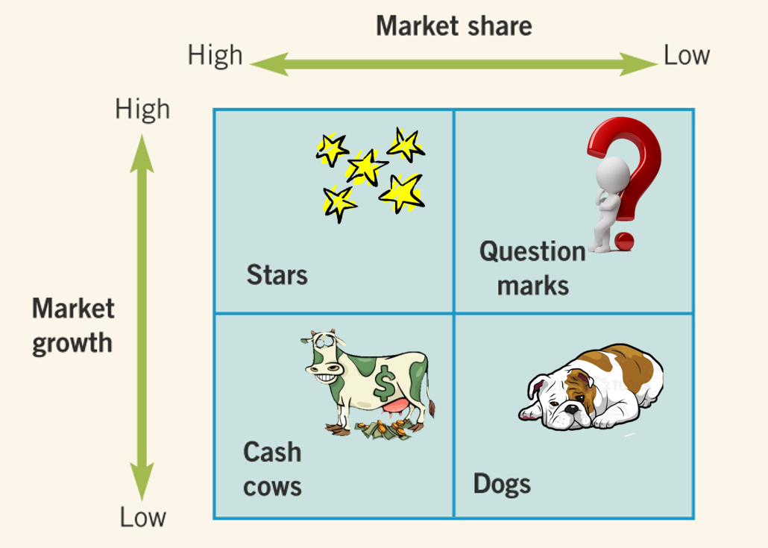
The BCG (or growth/share) Matrix
One of the most common and longstanding ways of conceiving of the balance of a portfolio of businesses is the Boston Consulting Group (BCG) matrix.
The BCG matrix uses market share and market growth criteria for determining the attractiveness and balance of a business portfolio.
Notes:
The growth/share axes of the BCG matrix define four sorts of business:
A star is a business unit within a portfolio that has a high market share in a growing market. The business unit may be spending heavily to keep up with growth, but high market share should yield sufficient profits to make it more or less self-sufficient in terms of investment needs.
A question mark (or problem child) is a business unit within a portfolio that is in a growing market, but does not yet have high market share. Developing question marks into stars, with high market share, takes heavy investment. Many question marks fail to develop, so the BCG advises corporate parents to nurture several at a time. It is important to make sure that some question marks develop into stars, as existing stars eventually become cash cows and cash cows may decline into dogs.
A cash cow is a business unit within a portfolio that has a high market share in a mature market. However, because growth is low, investment needs are less, while high market share means that the business unit should be profitable. The cash cow should then be a cash provider, helping to fund investments in question marks.
Dogs are business units within a portfolio that have low share in static or declining markets and are thus the worst of all combinations. They may be a cash drain and use up a disproportionate amount of managerial time and company resources. The BCG usually recommends divestment or closure.

Slide 21
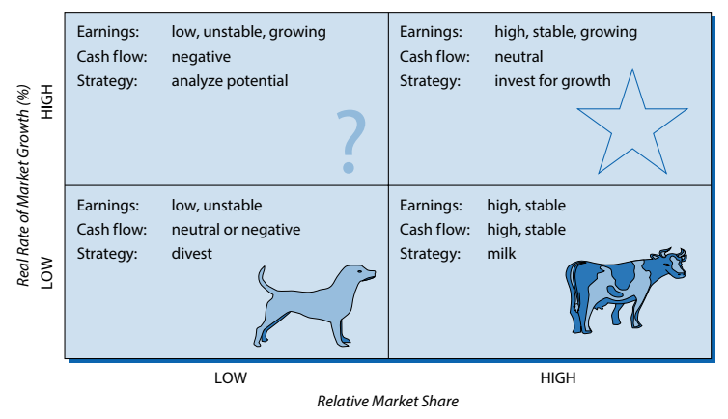
The BCG Growth-Share Matrix
Notes:
The growth/share axes of the BCG matrix define four sorts of business:
A star is a business unit within a portfolio that has a high market share in a growing market. The business unit may be spending heavily to keep up with growth, but high market share should yield sufficient profits to make it more or less self-sufficient in terms of investment needs.
A question mark (or problem child) is a business unit within a portfolio that is in a growing market, but does not yet have high market share. Developing question marks into stars, with high market share, takes heavy investment. Many question marks fail to develop, so the BCG advises corporate parents to nurture several at a time. It is important to make sure that some question marks develop into stars, as existing stars eventually become cash cows and cash cows may decline into dogs.
A cash cow is a business unit within a portfolio that has a high market share in a mature market. However, because growth is low, investment needs are less, while high market share means that the business unit should be profitable. The cash cow should then be a cash provider, helping to fund investments in question marks.
Dogs are business units within a portfolio that have low share in static or declining markets and are thus the worst of all combinations. They may be a cash drain and use up a disproportionate amount of managerial time and company resources. The BCG usually recommends divestment or closure.

Slide 22

Any Questions?
Thank You ☺

Slide 23
Sources:
Grant, R. M., 2018. Contemporary Strategy Analysis. 10 ed. NJ : John Wiley & Sons, Inc.
Hill, C. W. L., Schilling, M. A. & Jones, G. R., 2017. Strategic Management, Theory. 12 ed. Boston: Cengage Learning.
Johnson, G. et al., 2017. Exploring Corporate: Text and Cases. 11 ed. Harlow: Pearson Education Limited.
Lynch, R., 2015. Strategic Management. 7 ed. Harlow: Pearson Education Limited.
Whittington, R. et al., 2020. Exploring Strategy. 12 ed. Harlow: Pearson Education Limited.

