Slide 1
An Investigation into the Efficacy of an Online Vocal Training Platform for Neurodivergent Singers

Slide 2
Background and Justification
Background in classical singing, training as a countertenor
Background in LEA music service
Former Stagecoach teacher and principal
Estill Master Trainer and Vocal Process Accredited Teacher
Taught singing at undergraduate and postgraduate level since 2009
Formerly head of singing
Entering 25th year of teaching
It turns out that I’m autistic!

Slide 3
Background and Justification
A previous module explored developing an autistic-friendly voice studio
Literature review demonstrated a lack of literature about 1:1 singing training for autistic singers
Preferences for asynchronous forms of communication
This led to reflection on the benefits of asynchronous teaching resources delivered via an online learning platform

Slide 4
Statement of Aims and Objectives
To design a study to address the needs of neurodivergent singers that is sound in methodology, ethical issues, including a continuous re-evaluation of insider researcher issues
To develop the skills to gather, analyse, and evaluate data collected from stakeholders in neurodivergent singing education, understanding the potential for conflicting needs between neurotypical-to-neurodivergent and neurodivergent-to-neurodivergent students and teachers.
To make recommendations for the development of the prototype online learning platform, based on the evidence provided by stakeholders in neurodivergent singing tuition
To critically reflect upon the experience of conducting research, and the outcomes of the research, to inform future professional development needs
Personal learning outcomes
To develop a further breadth and depth of knowledge of neurodivergence.
To improve research techniques when studying the effects of an intervention with neurodivergent singers.

Slide 5
Key Findings from the Literature
Neurodivergence is an umbrella term for many conditions (Asasumasu in Walker, 2021 )
Language of impairment is prevalent in the terminology (DSM-5-TR, 2022; ICD-11, 2024)
The trend of voice pedagogy towards a broadly medical approach, such as Estill Voice Training (Steinhauer and McDonald Klimek, 2017)

Slide 6
Key Findings from the Literature
Universal Design was designed to provide access for disabled people at the point of conception (Mace, 1998)
Universal Design for Learning (CAST, 2018) emerged to provide access for all learners (Meyer Rose, and Gordon (2014)
UDL is commonly used in university settings (
UDL has moved beyond the scope of Mace (1998), who acknowledge that not everybody will be accommodated for everything (Meyer, Rose, and Gordon (2014).

Slide 7
Methods
The research has been conducted through the constructivist paradigm
The aim of the inquiry is to develop an understanding (Guba and Lincoln, 1994, p.112) of neurodivergent learners
From the perspective of epistemology, the work is subjectivist (Guba and Lincoln, 1994, p109), as the findings emerge through the research process
Methodology who what where when how why
Questionnaire and interviews
Synthesized with literature findings

Slide 8
Methods
The participants were formed of two groups- singing teachers and neurodivergent singers
18 singing teachers were recruited to undertake a questionnaire to gain an overview of online teaching habits over time; this did not cover the needs of neurodivergent singers
4 singing teachers and 6 neurodivergent singers were recruited to take part in a semi-structured interview

Slide 9
Insider Research
Insider research is neither good nor bad, but needs to be acknowledged if objectivity is to be maintained (Umler, 2012)
I have insider knowledge of teaching, autism, and neurodivergence, and neurodiversity
I am an outsider researcher in the context of neurotypical people

Slide 10
Ethical Considerations
Constant reevaluation of insider researcher role to maintain objectivity
Considering neurodivergent peoples’ potential vulnerability
Providing a more objective perspective through the means of a questionnaire
The use of semi-structured interviews to allow the voice of other neurodivergent people to provide a different perspective
Project was granted ethical approval by UWTSD

Slide 11

The Questionnaire
Examining Online Trends

Slide 12
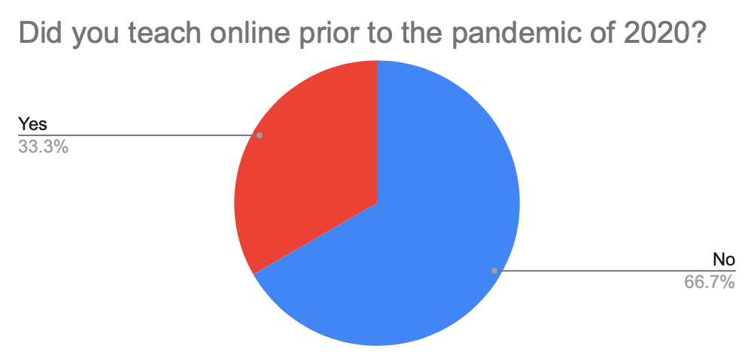
Online Teaching
Pre-COVID

Slide 13
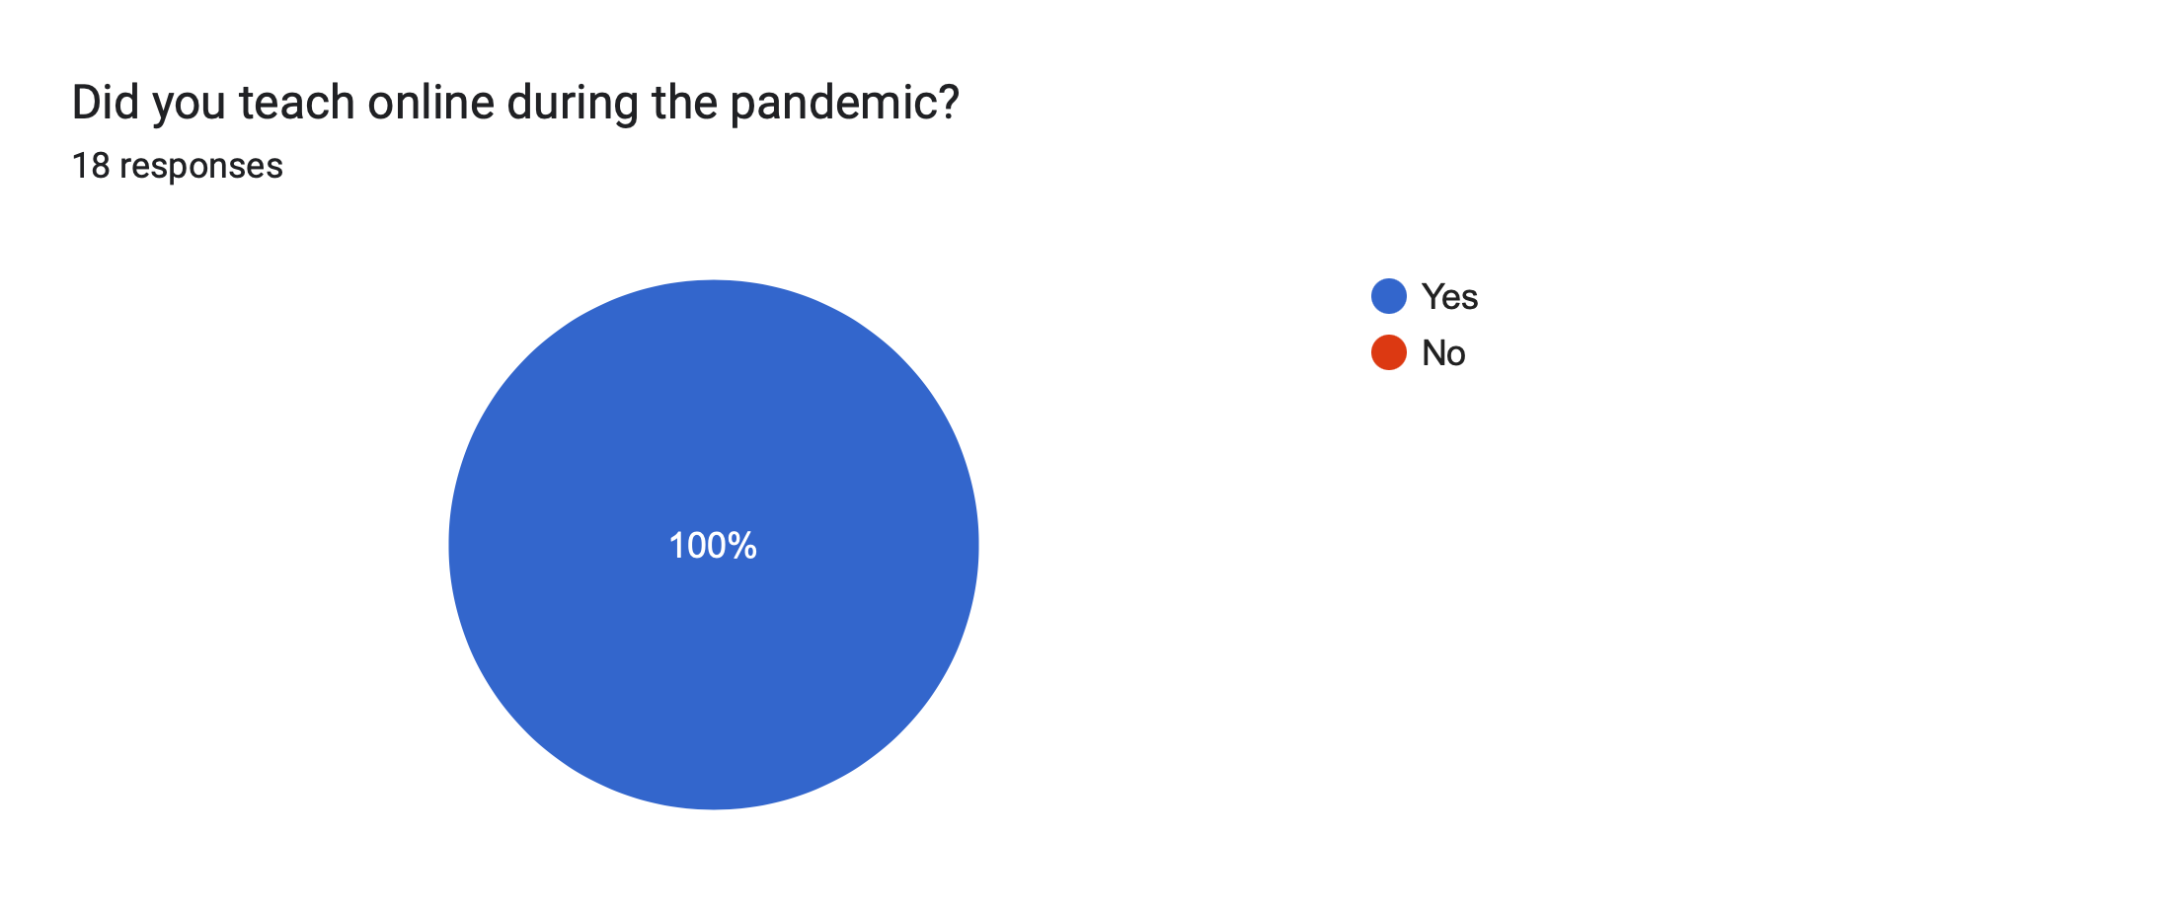
Online Teaching
During COVID

Slide 14
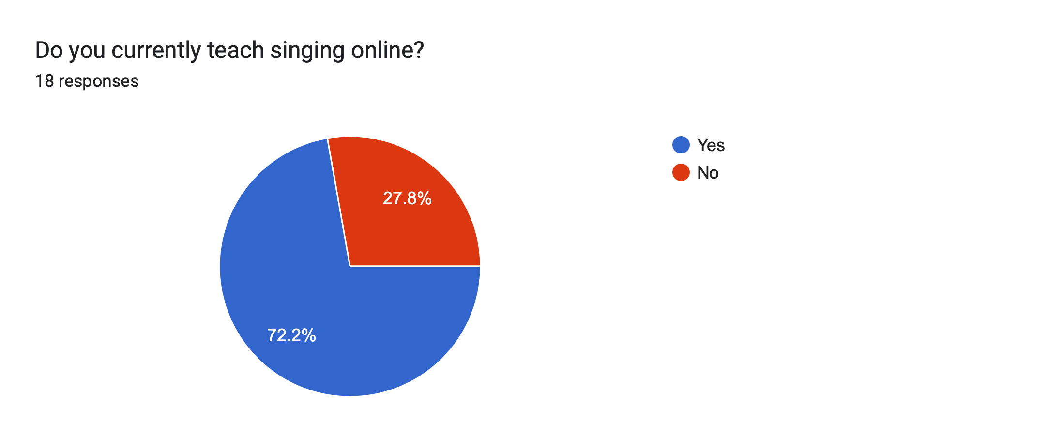
Online teaching post-COVID

Slide 15
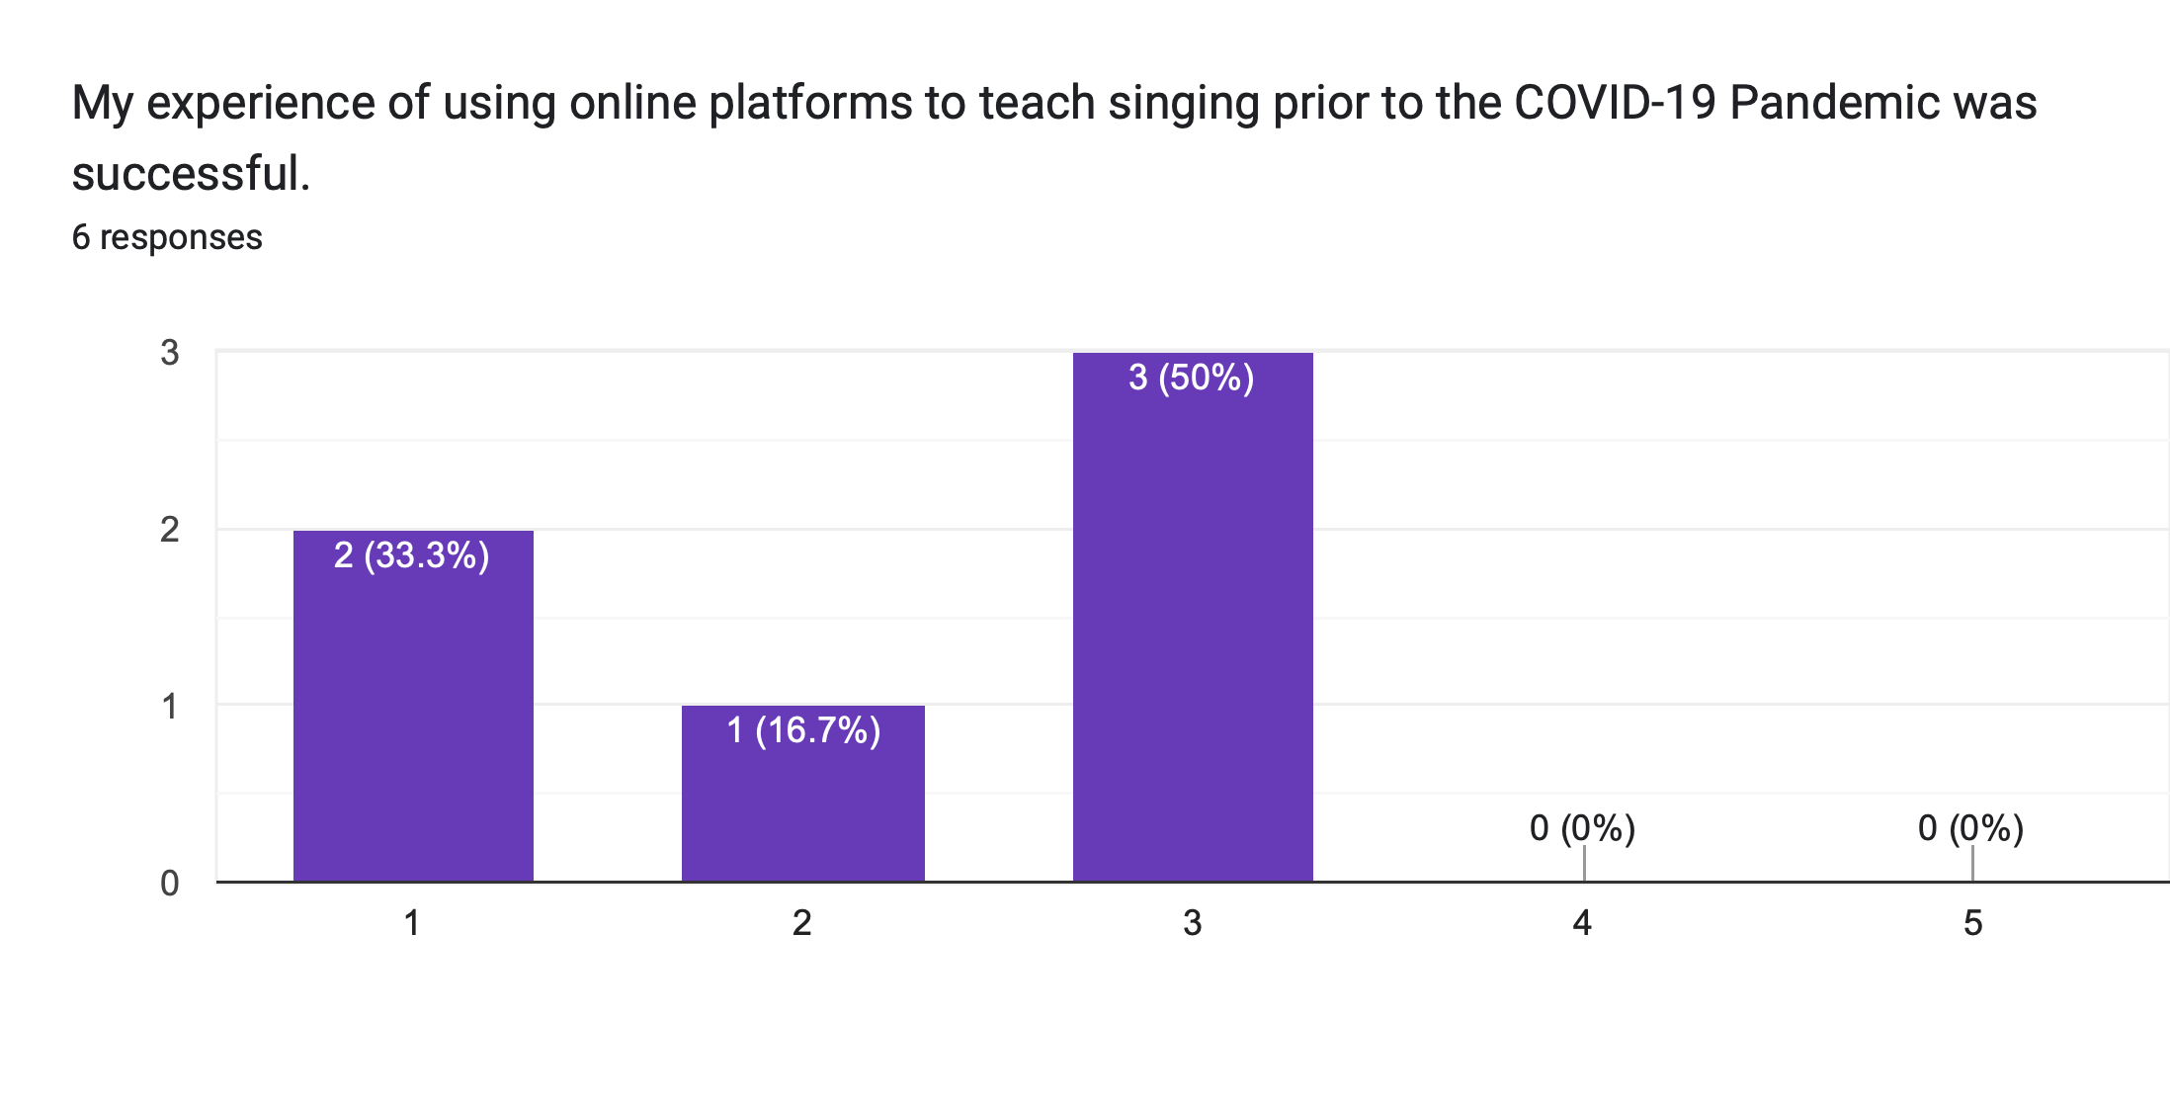
Successful online teaching pre-COVID

Slide 16
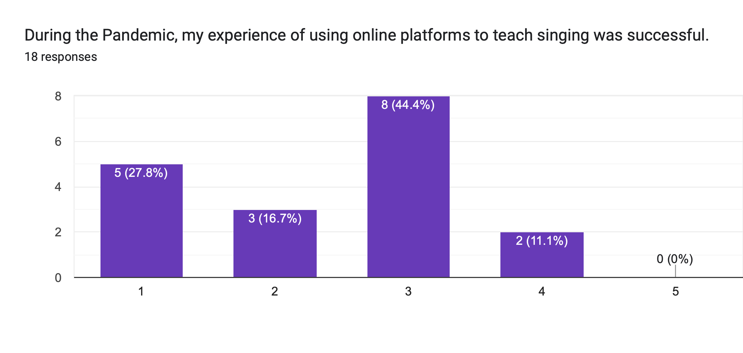
Successful online teaching during COVID

Slide 17
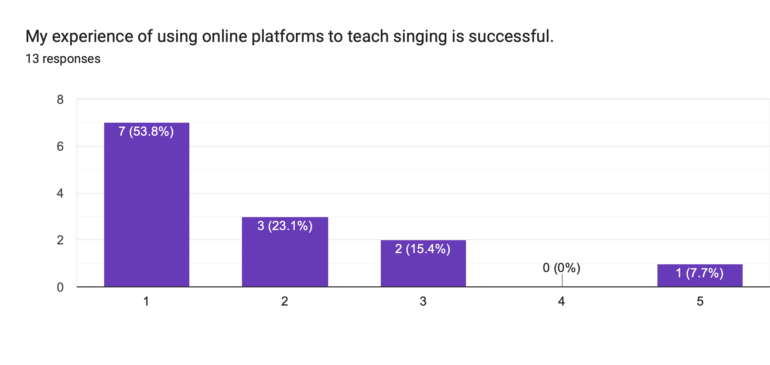
Successful online teaching post-COVID

Slide 18
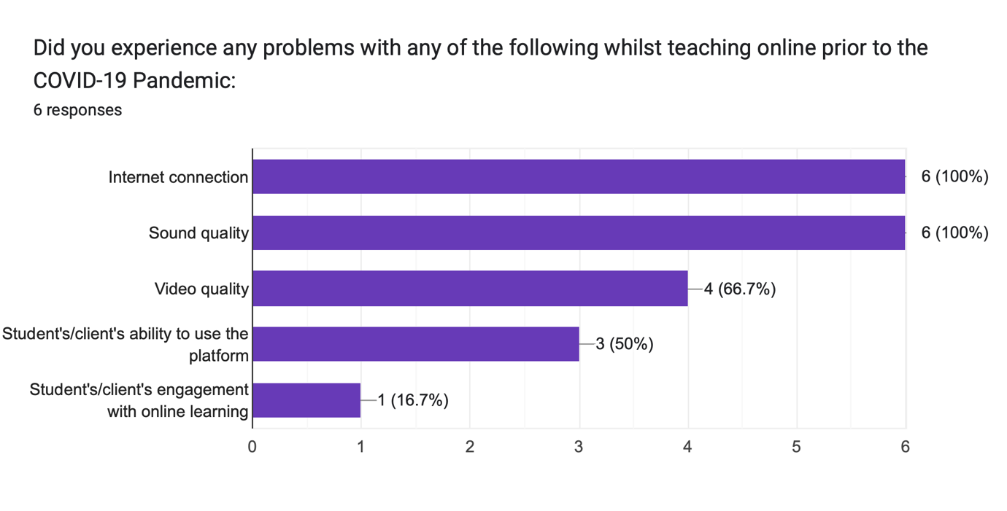
Problems with online learning pre-COVID

Slide 19
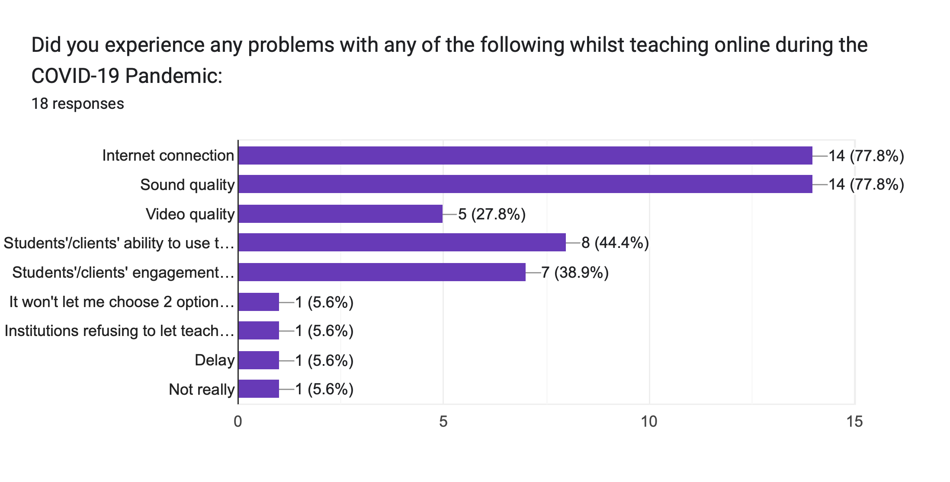
Problems with online learning during COVID

Slide 20
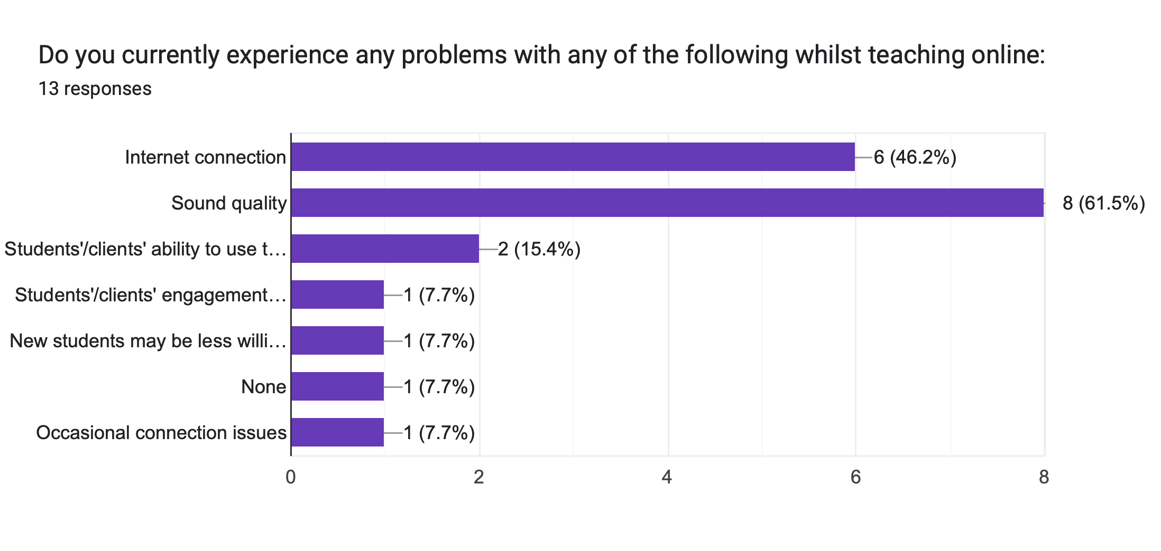
Problems with online learning post-COVID

Slide 21
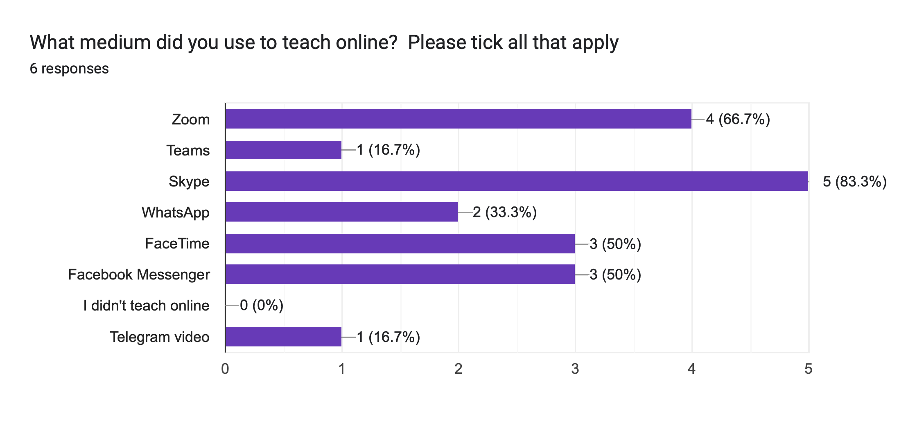
Online platforms pre-COVID

Slide 22
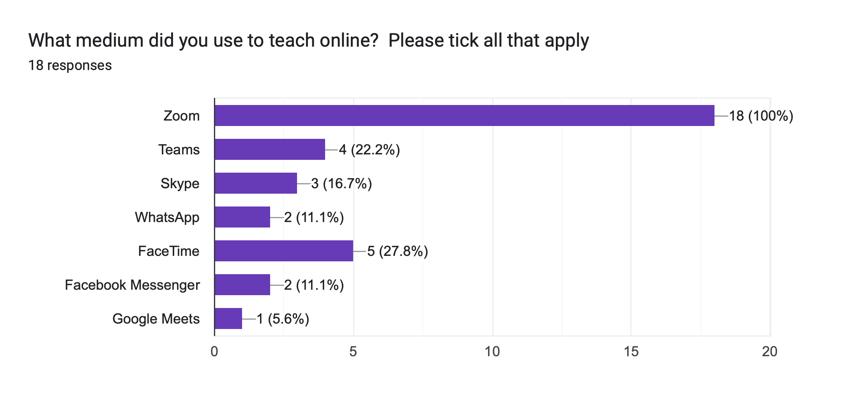
Online platforms during-COVID

Slide 23
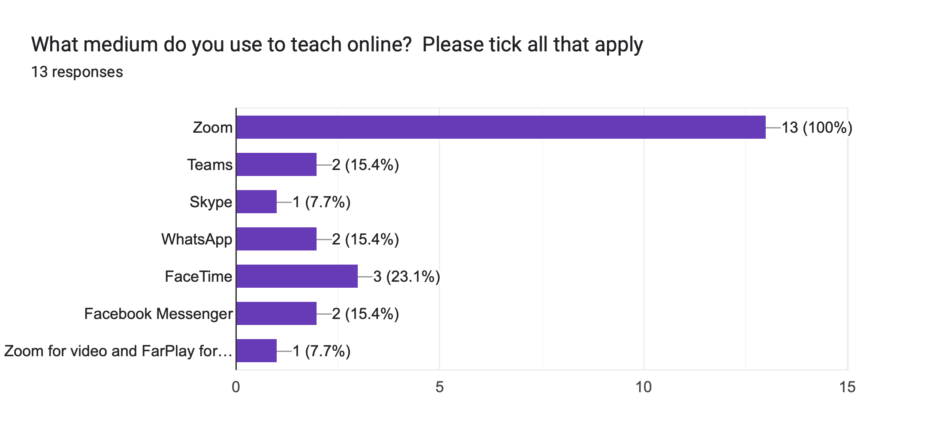
Online platforms during COVID

Slide 24
The Questionnaire

Slide 25
Interview Findings
NAME THEMES

Slide 26
Theme 1: Neurodivergent Identity
Theme 1 discusses ND identity from the view of conditions, the effects of comorbidity, and advocacy
The process of diagnosis ‘shifted a lot of my perception. Like a lot to do with that mental health crisis was the sheer amount of workload that I had in my last year changed everything’.
‘So, I’ve been clinically diagnosed with, I’m autistic and I’ve also got ADHD. So that’s a really fun combination because I think that’s potentially why it took me quite a while to notice’ (S1)
‘And I found that since having that kind of diagnosis to tell people it's made my life a lot easier in terms of in professional environments, just being able to kind of outline my boundaries and not just seem like or not feel like I'm just being difficult’ (S4)

Slide 27
Theme 2: Accessiblity Needs
Theme 2 discusses the widely varying needs of ND learners
“I think, when it comes to online learning specifically, I find reading things more more challenging that listening or watching. I even know myself, like on my phone, if I have a piece of reading I’m supposed to do, I will, like, copy it all and then press ‘speak’’ (S1
‘I would have that feedback verbalised to me and I’m like, “okay, I really don’t know what it is you’re saying, and then because. And then, because you’re under the pressure, and you’ve got lots of people watching you, you kind of just wing it. But then winging it either meant that I did it wrong, or I did it right, but I didn’t know how I did it right’.
‘TEACHER had printed a whole load of pink and blue ones, just on the off-chance that someone would need them, and when I was presented with two options and I looked at a pink copy and I looked at a blue copy, I was like “oh, that looks really clear to me...I think it just quiets the noise’ S2
‘I don't use it very often, but if there's a big chunk of text and I'm finding It hard to like concentrate. I think that's something that you can build into a site but you can obviously, like, if you know about it, you can get the extensions. So yeah, potentially that’s like an accessibility thing of just having like text-to-speech if it’s written information (S5)

Slide 28
Theme 3: Discussions of Prior Experiences (Online)
Theme 3 explores teacher’s experiences of online learning and ND
‘I think that the immediacy of a lessons is quite important. So I think that even when you’re giving feedback, there’s like…a social perception thin that if you wait a couple of seconds before you go “that was really good”, that has a completely different connotation than the second that somebody’s finished something going “well done”.
‘So I’d have the track and I’d be singing the song, and then I finished and there’d be an awkward three-second pause…I stopped myself every single time. I was like “she’s going to say that I was awful. Like, every single time without fail”.
‘I am now trying to practice radical visibility, being openly autistic to my students and going “hey. This is how I am. This is what I need to function. This is how I like to work”. And that, hopefully, gives them an invitation to open up about what they need as well. And I find that kind of works. And I’ve had a few students…come to me and go “hey, you know, I think I’m autistic. What do I do’, which has been really lovely’.

Slide 29
Theme 4: Discussions of Prior Experiences (In-Person)
Theme 4 explores teacher’s experiences of online learning and ND
I was trying to work out what was going on and quite, quite a good. Quite technically gorge. He liked all the technical stuff and found it almost impossible work in the imagination, you know. And I would often say, well, how would this character feel? You know, saying, you know, if I'd known that he'd had a diagnosis, I would have taught him a different way. If I had a diagnosis, I would have taught him in a different way”]
But there was one lad I had some years ago and this was before the days of being told that and if anybody had any sort of special kind of educational needs. But when it was all a big secret, I was really struggling with teaching this lad and all the other teachers had complained about him. [Knowledge of ND not being shared leads to staff complaining and misunderstanding the student]And I thought, I'm really not going to complain about him.

Slide 30
Limitations
Sample size- 6 ND singers, 4 singing teachers interviewed; 18 respondents to the questionnaire
Formation of a resource is a fluid development
Demographic- all female singers, all graduates or students in HE
Bias- interviews

Slide 31
Conclusions and Recommendations
The original intention…
Students and teachers believed that the project is necessary, although not a completely asynchronous model
ND views generally aligned with the UDL framework
A completely asynchronous model wouldn’t allow for multiple methods of assessment
There is a training need for singing teachers in institutions and private practice
One learning platforms can be valuable, with some element of teacher input

Slide 32
Personal Reflection
I need to develop an awareness of my own processing speed in relation to others
I need to develop an awareness of managing my own needs as an autistic person during research
I need to overcome procrastination and take steps to build the research into a tangible resource for neurodivergent people

Slide 33
Reading List
American Psychiatric Association ed., 2022. Diagnostic and statistical manual of mental disorders: DSM-5-TRTM. Fifth edition, text revision edn. Washington, DC: American Psychiatric Association Publishing.
Anon. 2024. Clinical Descriptions and Diagnostic Requirements for ICD-11 Mental, Behavioural and Neurodevelopmental Disorders. 1st ed edn. Geneva: World Health Organization.
Follette Story, M, Mueller, J.L, and Mace, R.L. (1998). The Universal Design File Designing for People of All Ages and Abilities. North Carolina: NYC State University.
Guba, E.G., & Lincoln, Y.S. (1994). Competing paradigms in qualititative research. Thousand Oaks, CA: Sage
Meyer, A., Rose, D.H. and Gordon, D., 2014. Universal design for learning: theory and practice. Wakefield, MA: CAST Professional Publishing, an imprint of CAST, Inc.
Steinhauer, K., McDonald Klimek, M. and Estille, J., 2017. The Estill voice model: theory & translation. Pittsburgh, Pennsylvania: Estill Voice International.
Walker, N., 2021. Neuroqueer heresies: notes on the neurodiversity paradigm, autistic empowerment, and postnormal possibilities. Fort Worth: Autonomous Press.

