Slide 1
Workshop for BSc Health, Nutrition and Lifestyle
Chris Cashin RD, MSc, SENr

Slide 2
Welcome
The aim of today :-
Look at AFN and your prospects post degree
Listen to Nutritionists who work in the industry
Review some aspects of practice.
Ask as many questions as you like!

Slide 3
Next step
First – well done everybody you have achieved some excellent results!
So what are you going to do now –rest or look for a job
It will always be competitive but you have to stand out!

Slide 4
Practical things to do
Make sure you CV is up to date – plenty of practical advice available
Use the opportunities you have had at the University – if you think you are good at communication don’t just say you are show an example – talks given , meetings chaired – use them!

Slide 5
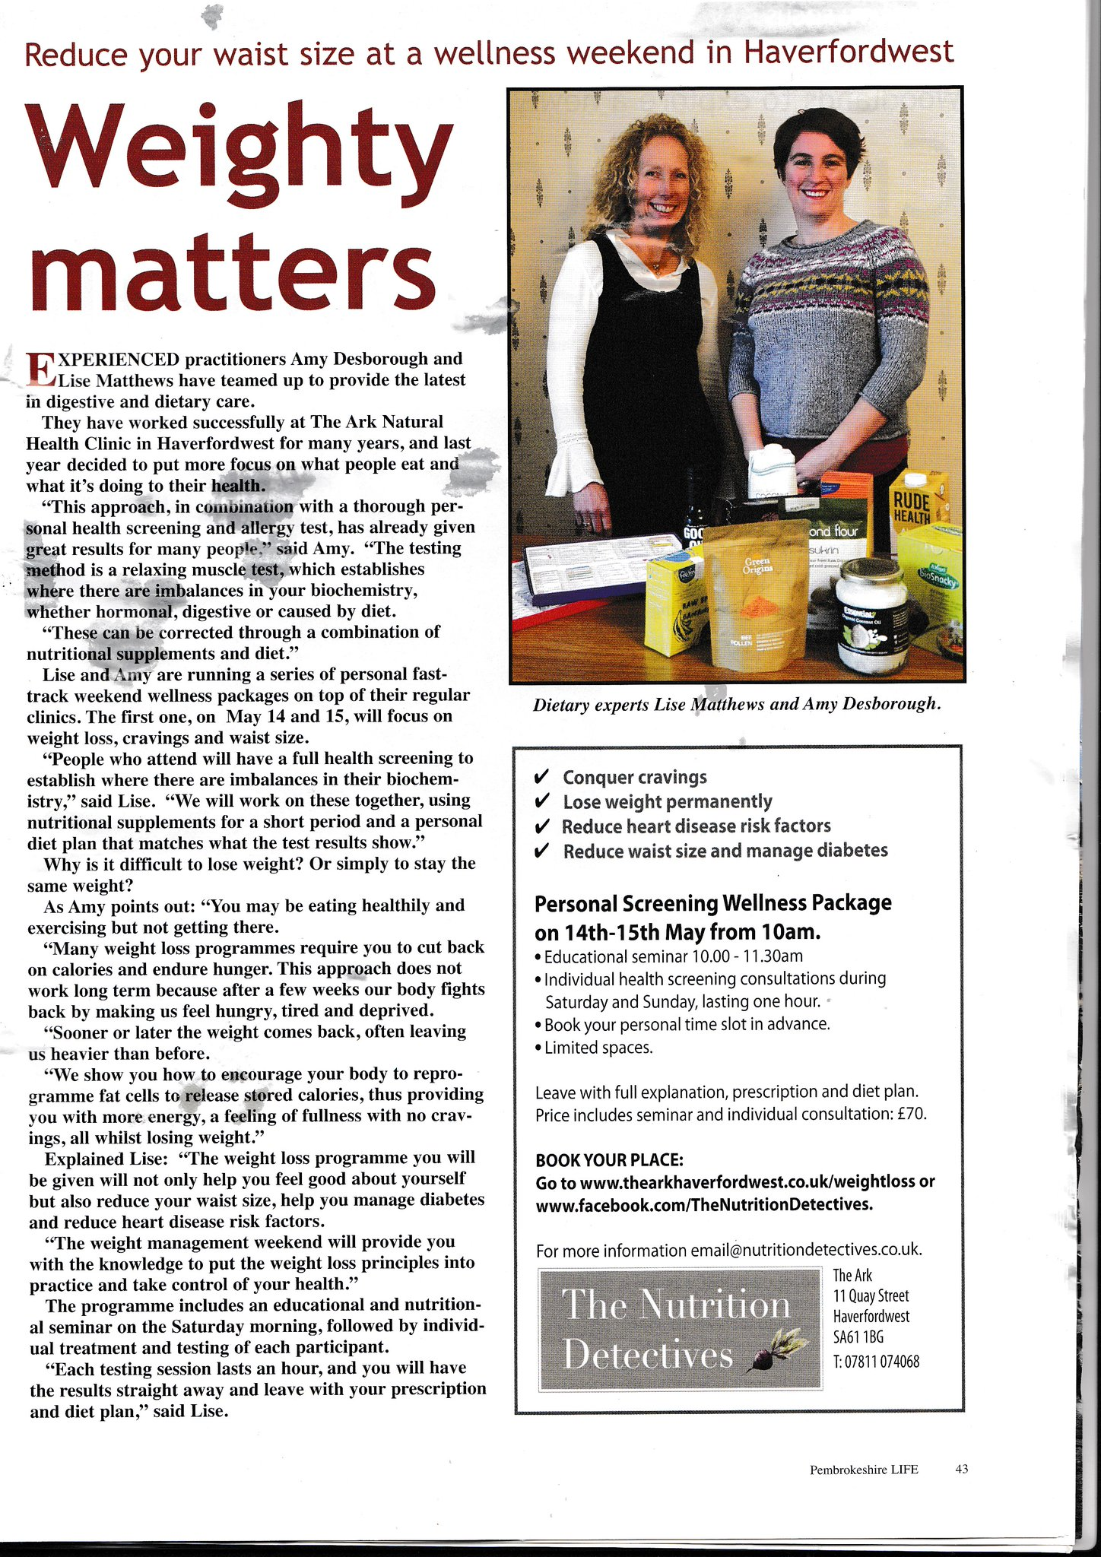

Slide 6
Association for Nutrition
Get yourself registered
http://www.associationfornutrition.org/Default.aspx?tabid=223
It will take you some time!

Slide 7
What will you need
Evidence – module specs, evidence of work placements etc.
If you are struggling then ask us – I will act as a mentor

Slide 8
Why join?
Professional standards
Code of Conduct
Professional Insurance – a must!
Guidance from your profession
Professional register – if you work freelance

Slide 9
Where to look for a job?
Refer to list – it is not endless you may find some jobs will appear in the oddest places!
Register with job agencies

Slide 10
What if you work freelance?
Same standards – all the more reason to become a Reg Nutritionist
Premises
Computer and software
Information for clients
Storage

Slide 11
Important Issues
Professional Insurance
Data protection – register with Data Protection Agency if you use a computer
Paper notes must be stored in a safe and secure place
Food Hygiene Certificate
Good quality literature

Slide 12
What to give to clients?
Over to you!
Some examples of information
http://www.ndr-uk.org/
https://www.bda.uk.com/foodfacts/home

Slide 13
Produce your own!
Cheaper option but may be easier these days!
Build up a database of meal plans etc.
Recipes
Have an update plan
Always date and sign !

Slide 14
Record Keeping
Very important – I use NHS standard of keeping records for 8 years.
Aim to have all of the information on a client
Stored safely – locked away
Care when travelling as well
Always record phone calls , home visits, clinic visits etc.

Slide 15
Being Freelance
Means that you set the same standards as anyone working for an organisation
Use Social Media – care of course!

Slide 16
What if you want to become a Dietitian?
Ask yourself – do you know what a Dietitian does?
If you do you have 2 options
1) 3-4 year undergraduate degree
2) 2 year Masters degree but you need 50 credits of physiology to include 20 credits of biochemistry
You need a 2:1 or above for the masters.
You will need to do a Biochemistry module !

Slide 17
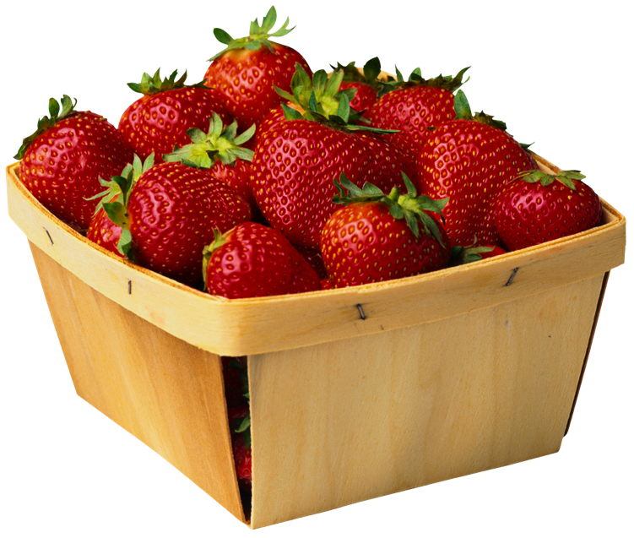
Any Questions?
Any Questions?

