Slide 1
Work Fighters
By Ryan williams

Slide 2
Game Overview
Hi, I'm Ryan. And I'm here to talk about my game concept, Work Fighters. Work Fighters is a game where many different people from every day careers decide to take part in a fighting tournament in hopes to win enough money to quit their jobs.
It's a great game for anyone who wants to relieve some stress after work, or even just while on break with the portability of the console it's designed for.

Slide 3
Player's Role
In the game, the player will fight different opponents in one on one fights, using a character they choose based on their specific tastes.
Each of said characters have different "Special" and "Stress" moves. A special move is a normal attack that only a certain character can use, and a stress move is a special move that can only be used when the "Stress bar" is full. The stress bar fills slowly over time, but fills faster when the opponent starts a new combo.
The characters to choose from are as follows:

Slide 4
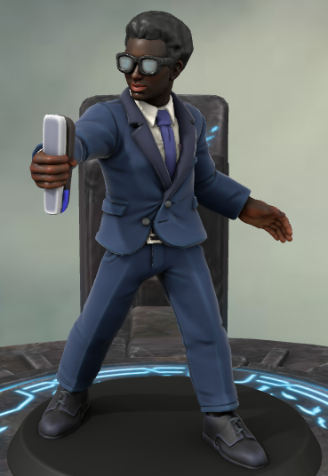
Characters
Arlen
Arlen is an office worker who joined the tournament so that he wouldn’t have to stress himself out every day.
His special move is "Stapler", which adds a damage multiplier to an opponent, and his stress move is "Bluescreen" which freezes the opponent if they're nearby.

Slide 5
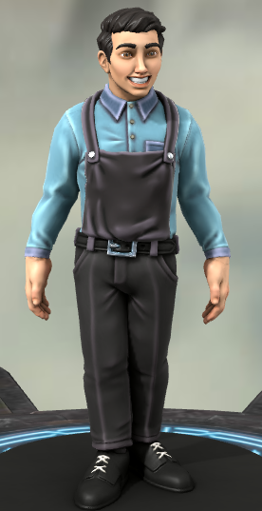
Characters
Jack
Jack is a fed-up grocery store worker who wants to win the tournament to live a more exciting life.
His special move is "Change" which throws a low damage but fast acting projectile, and his stress move is "Stocking Mishap" where he topples some cans onto the opponent to deal heavy damage.

Slide 6
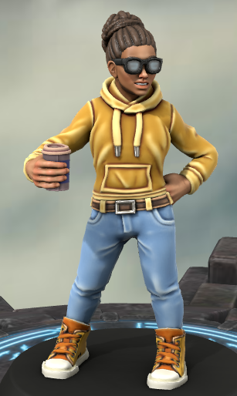
Characters
Addie
Addie is a university student who wants to fight in the tournament for a chance to quit university.
Her special move is "All-Nighter" where she buffs her speed and attack speed, and her stress move is "Burnout" which heavily buffs her attack temporarily, then debuffs her speed temporarily afterwards.

Slide 7
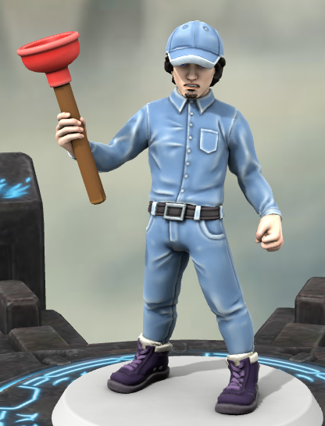
Characters
Simon
Simon is a freelance plumber who wants to win the tournament so he can relax at home without anyone bothering him.
His special move is "Plunger" in which he grabs the opponent and flings them away, and his stress move is "Sprung-A-Leak" where he launches opponents upwards.

Slide 8
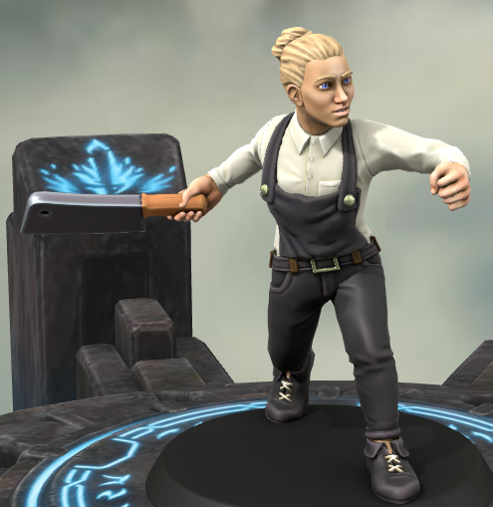
Characters
Helena
Helena is a butcher who wants to use the prise money to retire from being a butcher and get protesters off her back.
Her special move is "Knife-Throw" where she launches a slow but high damage projectile, and her stress move is "Chop" which deals heavy damage to opponents in its range.

Slide 9
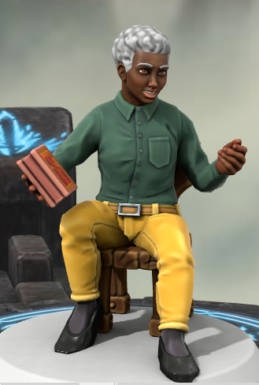
Characters
Roseanne
Roseanne is an underpaid teacher who wants to win the tournament to retire and live a peaceful life.
Her special move is "Homework" which puts a poison effect on opponents hit, and her stress move is "QUIET!" Which stuns opponents with a large range.

Slide 10
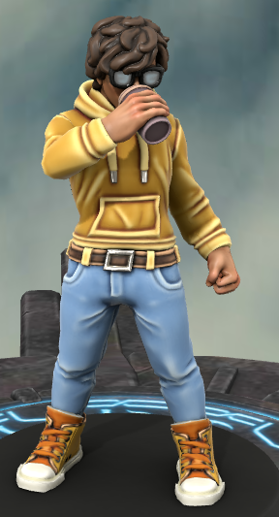
Design Iterations
During the design, there were a few changes that were made.
Firstly, all the characters were originally planned as all white
males. This was changed quite quickly, before they were even
made, as it would have been very bad for inclusion, as these
characters are meant to be people everyone can relate to.
It was similarly planned to have the character Addie be male
for a while longer than the others. This was changed to make
a more balanced cast of characters.

Slide 11
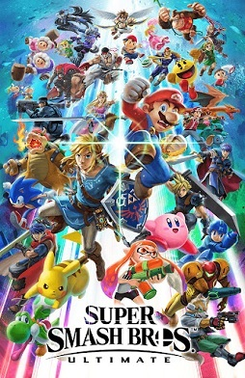
Background Research
While doing research, I found that there is another fighting game made to be easy for beginers that's popular on the Nintendo Switch, and that game is called Super Smash Bro's Ultimate. IGN states "Smash Bros. has a rare accessibility that keeps its high skill cap from feeling intimidating.".

Slide 12
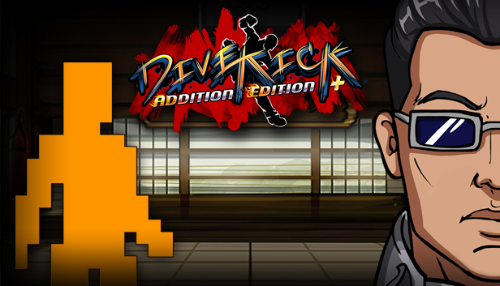
Background Research
Another fighting game I found with a similarly basic control scheme is Divekick. Although it seems to be more complex to pick up as Metacritic states "Divekick is a game of intense depth, strategy, and action"

Slide 13
Intended Demographic
This game is aimed towards people looking to release stress from their careers. The game markets to these people by being relatively easy to pick up when compared to many other fighting games. The fighting game genre is also a good choice for helping people let out their frustrations, as they can take them out on the enemy's character.

Slide 14
Design Justification
I chose to design the game this way because it can be hard to find ways to deal with the stress of daily life, and a lot of people need some way to relieve that stress. That, and there aren't many fighting games that are built to accommodate people's busy lives.
This does so by being playable on the Nintendo Switch so it can be carried around for whenever you might want to relieve some stress, and also being easy to pick up while not marketing to younger audiences, so people will have the time to play it without having to face the controversy of playing a "Children's Game"

Slide 15
Proposed Implementation
3 Weeks to design the stages
8 Weeks to draw and animate the main characters and any of their items
3 Weeks to draw stages
6 Weeks to design and create the soundtrack
2 Weeks to draw background characters
4 Weeks to animate cutscenes
3 Weeks buffer to fix problems

Slide 16
Thank you for listening
Any questions?

Slide 17
Bibliography
IGN Review: Marks, T. (2020). Super Smash Bros. Ultimate Review - IGN. Retrieved 5 January 2022, from https://www.ign.com/articles/2018/12/06/super-smash-bros-ultimate-review
Metacritic Review: Divekick. (2013). Retrieved 5 January 2022, from https://www.metacritic.com/game/pc/divekick

