Slide 1
LCHS4001
Academic and Employability Skills
Paraphrasing

Slide 2
Aims of the session
To understand what paraphrasing is and why it is important for academic success.
To learn the main steps to effective paraphrasing.
To practice paraphrasing a range of sources.

Slide 3
In groups, discuss the following questions:
What is paraphrasing?
When do we use paraphrasing?
Why is paraphrasing important for academic success?
How can I paraphrase a text?

Slide 4
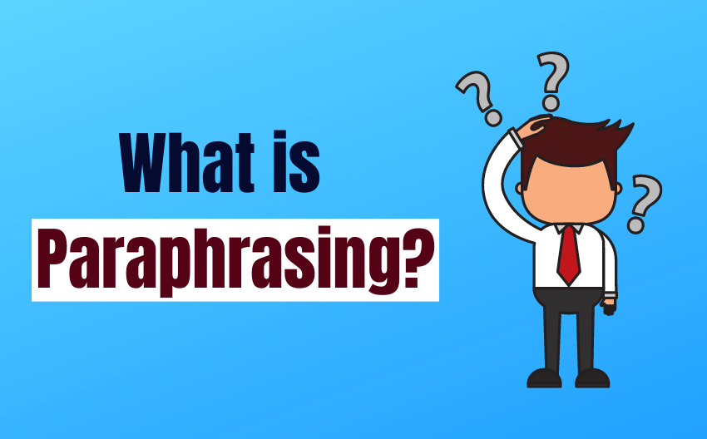
Paraphrasing

Slide 5
REMINDER
REMINDER: To write an assignment, you will have to read a range of sources (e.g., books, journal articles). This will allow you to understand a topic better.
There are three ways in which you can use ideas from external sources in your assignment:
Paraphrasing
Summarizing
Quoting

Slide 6
What is paraphrasing?
Paraphrasing is using the ideas of another person in your own words. Paraphrasing is useful when you are using the work of others to support your own view.
When paraphrasing, you need to change the words and the structure but keep the meaning the same.
Please remember, though, that even when you paraphrase someone's work, you must always acknowledge it by providing an in-text citation.

Slide 7
Example 1
Source
It has long been known that Tokyo is the most populous city on earth, but no-one knew exactly how populous it was until last month.
Paraphrase
Although Tokyo has been the world's most heavily populated city for many years, the precise population was not known until four weeks ago (Smith, 2018).

Slide 8
Example 2
Direct quote: Brown (2020, p.72) argues that “Understanding how people learn best is important to help them learn more easily”.
Paraphrase:
  Brown (2020) is a keen advocate of recognising different learning styles.
  Learning styles are critical to reaching learners (Brown, 2020).
Note that the brackets depend upon whether the emphasis is on the author (a) or the information (b)
Note that in (b) the full stop comes after the citation – the citation is always part of the sentence. No page number is needed with a paraphrase.

Slide 9

Why should you paraphrase ?
Paraphrasing provides support for your claims and adds credibility to your writing.
It is a way of showing your understanding of the information you have read in a source.
To avoid plagiarism.
Please remember that in your assignments you cannot simply provide a list of quotations (copy of the exact words). Instead, you should explain ideas in your own words (paraphrasing).

Slide 10
Activity 1
Go to the Paraphrasing Worksheet and complete Activity 1 on the sheet

Slide 11
Activity 1 Answers/Paraphrasing Techniques
  1) Using synonyms
  2) Changing word class (and making any other necessary changes)
  3) Changing word order (and making any other necessary changes)
  4) Change the subject of the sentence/ Switch voices from Active to Passive and vice versa (and making any other necessary changes)
NOTE: Doing one of these on its own is usually not enough to paraphrase well-Good paraphrasing is often a combination of these!

Slide 12
The Use of Synonyms
The most common technique is the use of synonyms.
Students highlight important nouns, verbs or adjectives and provide a synonym.
The use of thesaurus can help you find synonyms:
Synonyms and Antonyms of Words | Thesaurus.com
Please remember that you cannot use synonyms as the only technique when paraphrasing. You should also change the structure of the original text.

Slide 13
Example - Synonyms
Source
Many well-known multinational companies are located in London.
Suggested Paraphrase
Many famous multinational companies are situated in London.

Slide 14
Another Synonym Example
Source
“One major problem confronting coursebook writers, is the enormous number of phrasal verbs in the language” (Koprowski, 2005, p.322).
Paraphrased Example
According to Koprowski (2005) a significant problem confronting textbook writers, is the great number of phrasal verbs in the language.

Slide 15
Changing word class
Source
You are required to complete your coursework before the end of the term.
Paraphrased Example
The completion of your coursework is required before the end of the term.

Slide 16
Another Word Class Example
Source
Approximately 80% of low-income families will be assisted by the proposed ‘free lunch’ program. (Health Canada, 2015)
Paraphrased Example
According to Health Canada (2015), the suggested ‘free lunch’ campaign will provide assistance to roughly 80% of poor families.

Slide 17
Active and Passive voice
Source
A lot of people do not know the effect of antibiotics.
Paraphrased Example
The effect of antibiotics is not known by a lot of people.

Slide 18
Active / Passive voice Example
Source
Approximately 80% of low-income families will be assisted by the proposed ‘free lunch’ program (Health Canada, 2015).
Paraphrased Example
According to Health Canada (2015), the suggested ‘free lunch’ campaign will assist / help roughly 80% of poor families.

Slide 19
Paraphrasing
Whichever techniques you use, remember that your sentences must:
  Retain the meaning of the original
  Have a different structure
  Be grammatically correct
  Have correct spelling
  Include a reference

Slide 20
Activity 2
Go to the worksheet and work with your group to complete the activity

Slide 21
Activity 2 Answer Exercise1
TEXT 1: Paraphrase B is better for the text on ancient Egypt because:
Paraphrase A is vague as to the nature of the changes in weather
Paraphrase A does not maintain the specificity of time
Paraphrase A does not mention any research findings.

Slide 22
Activity 2 Answer Exercise 2
TEXT 2: Paraphrase B is better for the text on globalisation as it:
Reorders the sentence structure
Uses synonyms
Changes word class while also keeping the key source material
Paraphrase A’s sentence structure mimics the original text too closely
Paraphrase A omits the citation.

Slide 23
Steps to paraphrasing
Read and understand the text.
Make a list of the main ideas.
  Find the important ideas/the important words/phrases. In some way mark them - write them down, underline or highlight them.
  Find alternative words/synonyms for these words/phrases - do not change specialised vocabulary and common words.

Slide 24
Steps to paraphrasing
Change the structure of the text.
  Identify the meaning relationships between the words/ideas - e.g. cause/effect, generalisation, contrast.
  Express these relationships in a different way.
  Change the grammar of the text: change nouns to verbs, adjectives to adverbs, etc., break up long sentences, combine short sentences.

Slide 25
Steps to paraphrasing
Rewrite the main ideas in complete sentences. Combine your notes into a piece of continuous writing.
Check your work.
  Make sure the meaning is the same.
  Make sure the length is the same.
  Make sure the style is your own.
  Remember to acknowledge other people's work.

Slide 26
What not to do when paraphrasing
Use the same sentence structure as the original source: for example, only changing a few words.
Use parts of the original sentence(s) without referencing these appropriately following Harvard Guidelines.
Changing the meaning of the original text.
Forget or neglect to include an in-text citation, because you have used your own words. If it didn’t come from your head, it’s not yours and must be cited!

Slide 27
TOP TIPS
Use your notes as the basis for your paraphrases. Don’t paraphrase directly from your source!
Use your own words and style so as not to lose your voice.
Make sure that the paraphrase supports the point that you want to make, not someone else’s.
Make it clear to your reader how the paraphrase you are using supports your overall point.
Don’t forget to add an in-text citation.
Use pronouns (he, she, they) or nouns (researchers, scientists, authors) if paraphrase consists of more than one sentence.

Slide 28


Slide 29
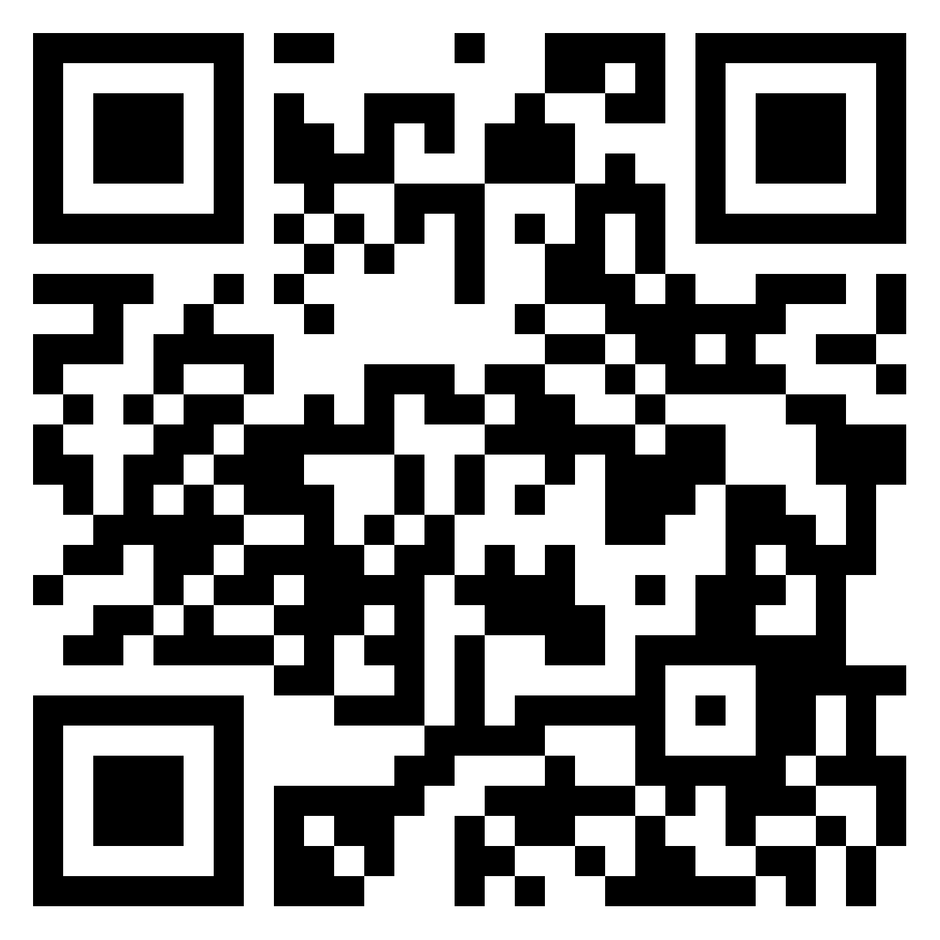
Now You Try!
Scan the QR code or head to https://padlet.com/ndoerge1/allclasses and try to paraphrase a few extracts! Remember to post your Group Number as all groups will post on here! You can work in pairs or threes! Comment on other posts to give feedback!

Slide 30
References
British Council (2022) Top five paraphrasing techniques. Available at: Top Five Paraphrasing Techniques (video included) | British Council (accessed 2nd November 2022)
Strongman, L. (2013) Academic writing. Cambridge: Cambridge scholars publishing.
UEfAP (2019). ‘Academic Writing: Reporting - paraphrase, summary & synthesis’. Online. http://www.uefap.net/writing/writing-reporting/writing-reporting-paraphrase (accessed 2nd November 2022)

Slide 31
Further Reading
UCL (2021) ‘Paraphrasing for Beginners.’ Online. https://www.ucl.ac.uk/ioe-writing-centre/reference-effectively-avoid-plagiarism/paraphrasing (accessed 2nd of November 2022)
University of Bristol (2015). ‘Paraphrasing.’ Online. https://www.bristol.ac.uk/arts/exercises/referencing/page_05.htm (accessed 05.03.2021)
Future Learn (n.d.) ‘Techniques for paraphrasing.’ Online. https://www.futurelearn.com/info/courses/english-for-study-intermediate/0/steps/35241 (accessed 2nd November 2022)

