Slide 1
Field and Laboratory Skills
ACNA4005
17/01/22
LICHENS

Slide 2
Discovering and
Exploring Lichens
An Inquiry Based
Learning Approach
Field Trip Follow Up
and Completion

Slide 3
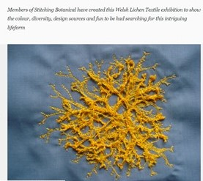
In Tune with the Lichen ‘Zeitgeist’!? (Spirit of the season)
National Botanic Garden Wales has an exhibition on Lichens I Spy Lichen Exhibition
For its size, Wales may have the most diverse lichen population on Earth.
So it’s vital role for the National Botanic Garden of Wales to help our visitors understand and care for this amazing and complex life-form. We’re lucky to have a large variety of naturally occurring lichen here to help us – the clean air, and large variety of trees and rock surfaces means that over 200 lichen species have so far been recorded here
https://botanicgarden.wales/visit/whats-on/event/lichen/

Slide 4
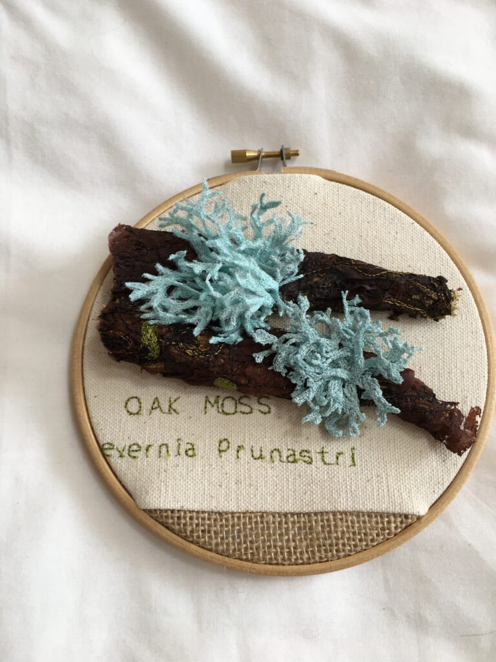
Where Art meets Natural History and engages an ‘holistic approach to science’ and an example of a wider engagement across the population
I Spy Lichen Sketchbook
This amazing artist sketchbook was created by Brenda Dayson and shows her research, exploration, design and preparation for her beautiful embroideries for the ‘ I Spy Lichen’ exhibition
Stitching Botanical: creating textile artwork
https://botanicgarden.wales/about-the-garden/art/stitching-botanical-creating-textile-artwork-in-the-garden/

Slide 5
Discovering and Exploring Lichens:
Field Trip to Singleton Park - Sharing your curiosity, inquiry; early findings and learning:
How would you present your ‘answers’ (understanding) / findings to the different ‘stakeholders’
What a conservation student might ask; find interesting; needs to know
What a 10 year old might ask; find interesting
What a 17 year old interested in creative arts, history and folklore might ask; find interesting
What an unemployed Swansea resident might ask; find interesting
What professionals interested in air quality might ask; find interesting; needs to know
How have you Recorded your Lichen Fieldwork
in your Field Work Notebook?

Slide 6
Resources available for finding answers (and probably forming more questions!)
Lovely Lichens ppt presentation available for personal use to download via: http://www.freetiiupix.com/SlidePresentations/PPT_Lichens.htm
Forestry Commission Handbook 4 Lichens in Southern Woodlands Broad 1989 (pdf uploaded)
British Lichen Society https://www.britishlichensociety.org.uk/
Natural History Museum https://www.nhm.ac.uk/discover/nature-and-pollution-what-lichens-tell-us-about-toxic-air.html
Natural Resources Wales Lichen surveys to investigate ammonia impacts. Evidence report no298. Bosanquet, S (2019) (pdf uploaded)
OPAL Citizen Science The OPAL Air Survey Imperial College London https://www.imperial.ac.uk/opal/surveys/airsurvey/
UK Air Pollution Information System (APIS) Impacts of air pollution on Lichens and Bryophytes (mosses and liverworts) http://www.apis.ac.uk/impacts-air-pollution-lichens-and-bryophytes-mosses-and-liverworts
Lichens and Air Quality: Lichen Biomonitoring and GIS Analysis of Atmospheric Pollution and Air Quality in Manchester (Manchester Met Uni) https://www.mmu.ac.uk/environmental-science-research/urban-environments-research-group/research-themes/projects/lichens-and-air-quality.php

