Slide 1
Crystal Therapy (Group 3)
Student Name and Number:
Gulnaz Begum (1907551)
Dilruba Khatun (1709434)
Hussain Ahmed (1907013)
Arlene Antoinette Lawrence (1907245)
Shelim Islam (1714298)
Module Title and Code:
Complementary Therapies (BMHP5001_BIRM)
Assignment Title:
Task 1 – Group Teaching
Lecturer:
Dr Mark Gallagher-Read

Slide 2
Introduction
To gain an understanding of a segment of a type of healing therapy – Crystal Therapy
The history of the Crystal therapy
The purpose of its uses of Crystal Therapy
The effectiveness of crystal therapy
The contraindications of your complementary therapy outlining how it compares to more traditional treatments
Evaluating crystal therapy
Class task - what you have learnt today

Slide 3
Learning Outcome
L/O: 1) What is Crystal Therapy?
L/O: 1) The efficacy and effectiveness of Crystal therapy

Slide 4
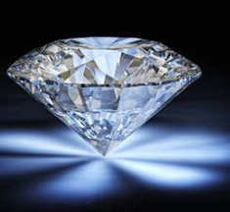
The origins of crystal healing
Is tied to Ancient Egypt and Mesopotamia, India, Ancient Greece, or Ancient Rome. Ancient Egyptians mined for crystals and used them to make jewellery. Crystals or precious stones were also used in practice, for their supernatural properties.

Slide 5
4 Types of Crystals and Their Different Structures
Covalent Crystals. Covalent crystals are those crystals that are attached together with covalent bonds. ...
Ionic Crystals. Since covalent crystals use covalent bonds, it only makes sense that ionic crystals are created of ionic bonds.
Metallic Crystals. Metallic crystals are made of metals and held together using metallic bonds.
Molecular Crystals. Molecular crystals have low boiling points and break apart relatively easily.
(Crystal therapy: the power of placebo? | Living, 2021)

Slide 6
The first historical use of crystals come from the Ancient Sumerians (4th millennium BC), who included crystals in sorcery formulas. Crystals were (and are) likewise utilized for mending in conventional Chinese Medicine, which returns in any event 5000 years.
During the 1980s, there was a development in prevalence of precious stones. This decade began the brilliant time of "gem treatment". This elective helpful methodology is frequently characterized as a comprehensive and non-obtrusive recuperating technique dependent on the utilization of precious stones to deliver pressure and instigate profound unwinding (Gienger, 2009).

Slide 7
Uses of crystal therapy
Why do we use Crystal Therapy
How can Crystal Therapy be used in current orthodox treatment.
It can be used when introducing positive aspect for specific negative emotion. (Thompson 2019)
Why crystal therapy is used in the orthodox treatment.
It help releases tension and help the body to detox.
(Deby 2021).

Slide 8
Pros of Crystal Therapy
The efficacy of this therapy is not used as a common therapy due to limited or non-existence clinical trials.
Crystals heals your Chakra.
Chakra (energy field) is a text from the Hindu Sanskrit (butler, 2016).
There are several different types of crystals, each filled with their own healing abilities for the mind, body, and soul. They’re thought to promote the flow of good energy and help rid the body and mind of negative energy for physical and emotional benefits (Rekstis, 2018).

Slide 9
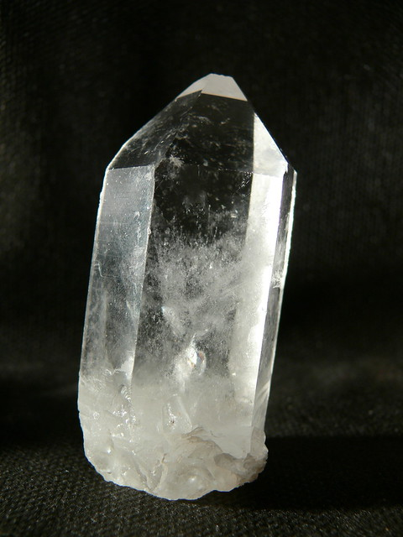
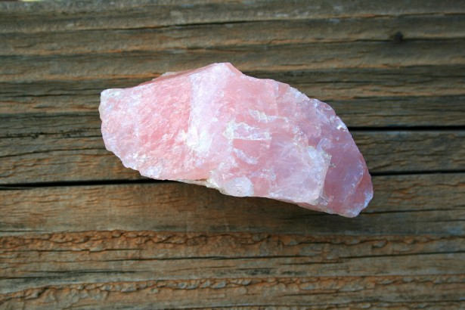
Pros of Crystal Therapy
Different types of Healing Crystals
Clear quartz
Rose quartz
(Rekstis, 2018)

Slide 10
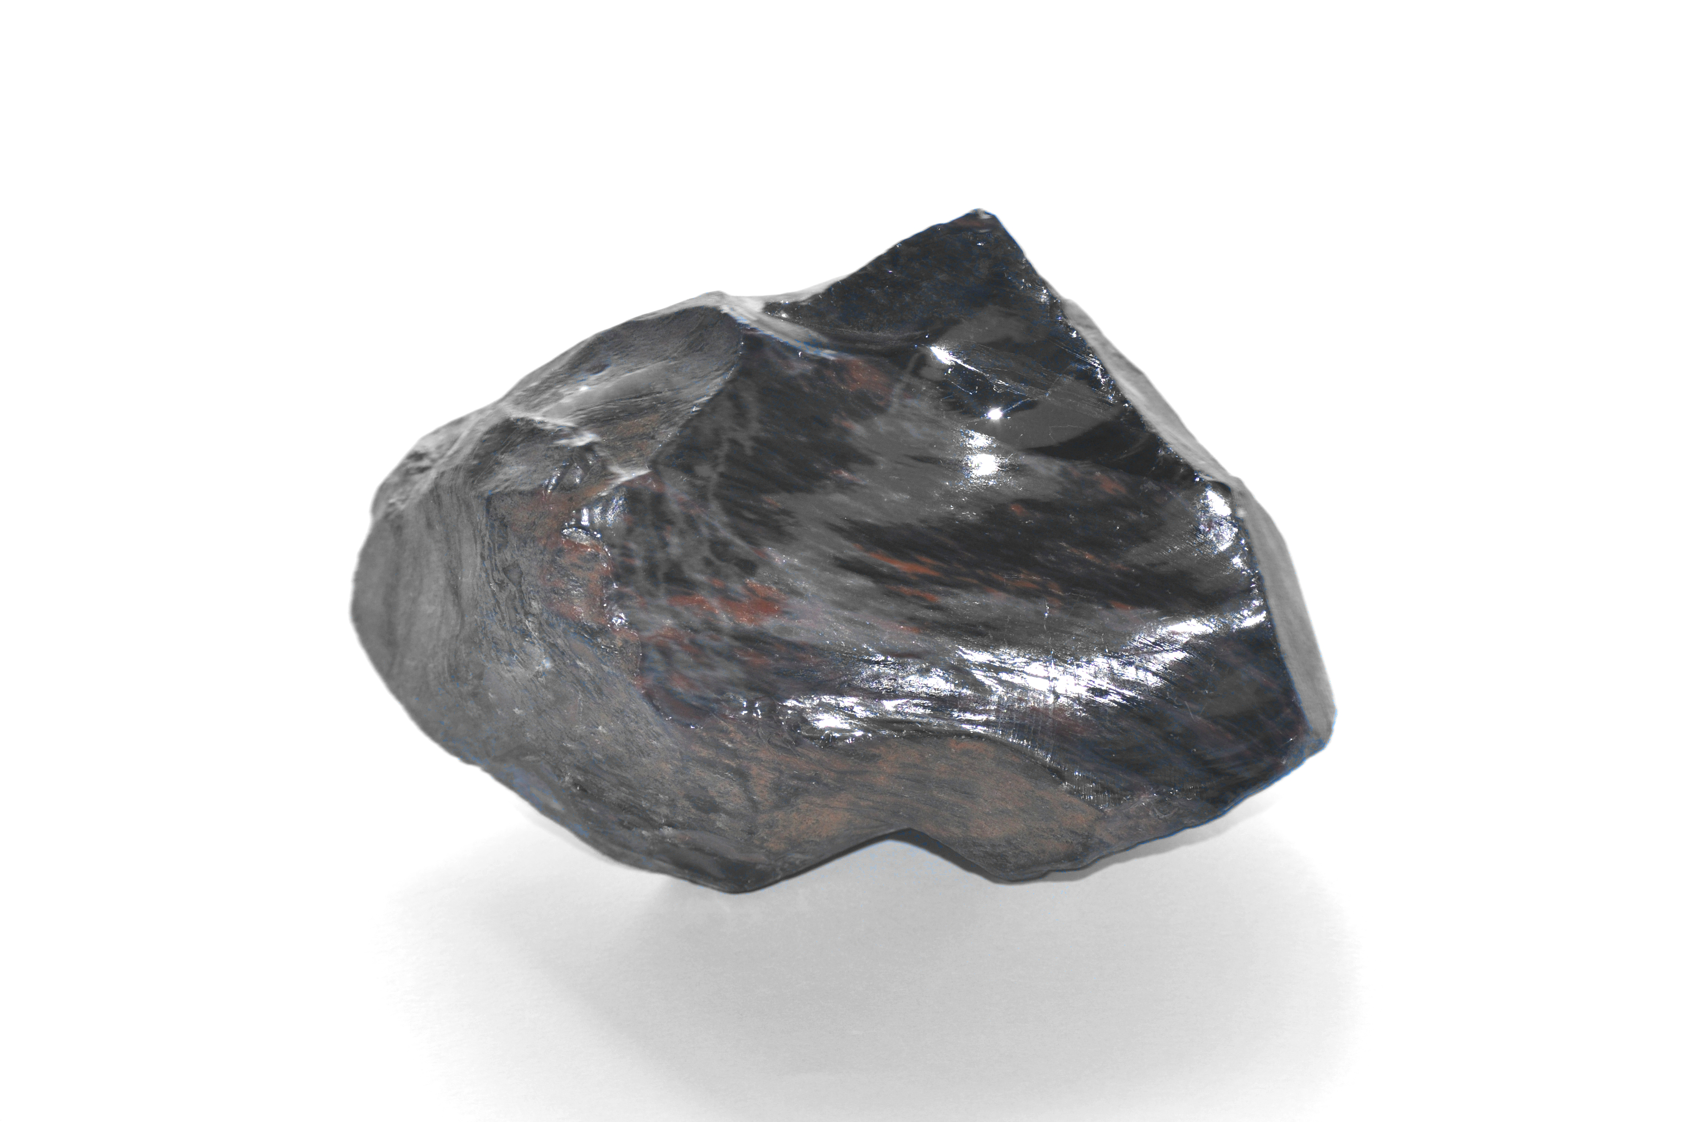
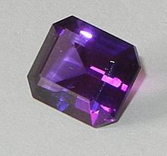
Pros of Crystal Therapy
Obsidian
Amethyst
(Rekstis, 2018)

Slide 11
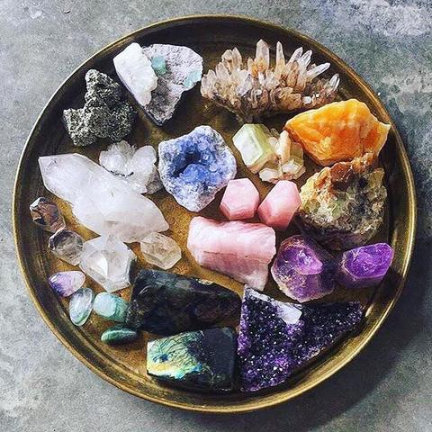
Contraindications
Are there potential risks?
Psychological characteristics of Crystal Therapy.
Vibrational energy.

Slide 12


Slide 13
Conclusion
Crystal Therapy is meant to harness healing through positive energy.
It is Known to have a placebo effect.
Crystal therapy holds healing power or is it misunderstood?
There is a limited amount of research on Crystal therapy – what appears to be clear is the claims of it being a pseudo-science?
It is still considered to be an effective treatment despite lack of research.
(TNN, 2019)

Slide 14
Summary
In essence, we have established the origins and purpose of Crystal Therapy. The success of crystal therapy can be questioned.
The question can be asked if whether by isolating crystal therapy, would we achieve the same results?
We have concluded that Crystal Therapy is ineffective due to the lack of scientific basis for the effectiveness. It may help others in terms of mental well-being however, there is not sufficient literature or evidence to corroborate physical healing from this treatment.

Slide 15


Slide 16
Reference List
Birde, G.S. and Yeh, G. (2010) Complementary and alternative medicine therapies for diaebetes: a clinical review. Available at: 147.full.pdf (diabetesjournals.org) (Accessed: 17/02/2021).
Butler, N. (2016) Chakras: A Beginner’s Guide to the 7 Chakras. Healthline. Available at: https://www.healthline.com/health/fitness-exercise/7-chakras#The-history-of-chakras (Accessed: 23 February 2021).
Crystal therapy: the power of placebo? | Living. Available at: <https://www.euronews.com/living/2018/09/18/crystal-therapy-the-power-of-placebo> (Accessed: 20 February 2021).
Deby, F.(2021) Amazing Health Benefits of Crystal Healing. Available at: www.facty.com/ (Accessed: 24 February 2021).
Ernst, E. and Terry, R. (2009) NICE Guidelines on complementary/alternative medicine: More consistency and rigour are needed. Available at: NICE Guidelines on Complementary/Alternative Medicine: More Consistency and Rigour are Needed | British Journal of General Practice (bjgp.org) (Accessed: 17/02/2021).
Gienger, M. (2009) Crystal power, crystal healing. London: Cassell Illustrated.

Slide 17
Kuman, M. (2018) Measuring the effect of Crystals on the body’s electromagnetic field (EMF) Available at: Maria Kuman. Measuring the Effect of Crystals on the Body’s Electromagnetic Field (EMF). J Nat Ayurvedic Med 2018, 2(2): 000119. (medwinpublishers.com) (Accessed: 21/02/21).
Palermo, E. (2017) Crystal Healing: Stone-Cold Facts About Gemstone Treatments | Live Science. Livescience.com. Available at: https://www.livescience.com/40347-crystal-healing. (Accessed: 23 February 2021].
Rekstis, E. (2018) Healing Crystals 101: Finding the Right One for You. [online] Healthline. Available at: https://www.healthline.com/health/mental-health/guide-to-healing-crystals (Accessed: 24 February 2021).
Thompson, M. (2019) Alternative Medicine Vs Complementary Healing: 4 Strategies. Available at: aurafcrystals.com>alternative-me... (Accessed: 24 February 2021).
The Times of India. (2019) The science behind healing crystals explained! - Times of India. Available at: <https://timesofindia.indiatimes.com/life-style/health-fitness/home-remedies/the-science-behind-healing-crystals-explained/articleshow/70482968.cms (Accessed: 22 February 2021).

