Slide 1
Cover Page
Student name/id: Abel Paul Sandu
Programme: Master of business Administration
Module name/Code: Human resource management lcmb7000
Lecturer: prof d g peple
Assessment title: Component 2 - PowerPoint presentation

Slide 2
Table of Contents
Introduction
Overview of Apple Inc.
Overview of the National Health Service (NHS)
HR Strategy of Apple Inc.
HR Strategy of the NHS
Effectiveness and Impact of HR Strategies
Competitive Advantages & Regulatory Strategies
Application of Resource-Based View Model
Conclusion
Reference list

Slide 3
Introduction
This presentation undertakes a comparative study of two distinct entities - Apple Inc., a private-sector multinational corporation that operates in the technology industry, and the National Health Service (NHS), a public-sector healthcare provider in the United Kingdom. The comparison involves a critical analysis of the Human Resource (HR) strategies each organization deploys, their effectiveness, and the subsequent impact these strategies have on each organization's overall strategy and competitive advantage.
The pivotal role HR plays in organizations is well-acknowledged, with many studies suggesting that effective HR strategies can contribute significantly towards achieving organizational objectives (Becker and Huselid, 2006). This presentation aims to validate this argument through an in-depth examination of the HR strategies of Apple Inc. and the NHS.

Slide 4

Overview of Apple Inc
According to (Apple Inc 2023)., Apple is a multinational technology company based in Cupertino, California, is a dominant player in the global market, recognized for its high-quality products, services, and a brand that inspires a near-cult following. Its product portfolio includes the iPhone, iPad, Mac, Apple Watch, and services like the App Store, Apple Music, iCloud, and more. The key to Apple's overwhelming success lies not just in its innovative product offerings but also in its unique corporate culture and human resource strategy.
Apple's HR strategy fosters an environment that encourages innovation and creativity. Employees are empowered to take risks and think differently, fostering a culture of innovation. Apple invests heavily in employee development and training, ensuring their skills stay relevant in the fast-paced technology sector. Apple also champions diversity and inclusion, believing that varied perspectives lead to better ideas and outcomes. Additionally, it is renowned for its competitive pay and benefits, which attract top talent worldwide (Apple Inc., 2023).

Slide 5

Overview of the National Health Service (NHS)
According to https://www.england.nhs.uk/ournhspeople/online-version/., The National Health Service (NHS) is the UK's publicly-funded healthcare system, committed to providing 'free at the point of delivery' health services. The NHS offers a comprehensive range of health services, from routine screenings, treatments for long-term conditions, transplants, emergency treatment, and more.
The successful operation of such an enormous system relies heavily on the skills, commitment, and wellbeing of its workforce, making HR management crucial in the NHS. To ensure it can deliver high-quality healthcare services, the NHS's HR strategy focuses on three key areas: workforce supply, employee engagement and leadership, and workforce development.
The NHS makes substantial efforts to increase its workforce supply by attracting talent from diverse backgrounds. It promotes an inclusive culture and works to reduce inequality. NHS leaders prioritize employee engagement, fostering a positive work environment that promotes communication, collaboration, and continuous learning. Further, NHS invests in ongoing staff training and development, helping to ensure the workforce remains skilled and up-to-date with the latest medical knowledge and practices (NHS, 2023).

Slide 6


HR Strategy of Apple Inc.
Apple's human resource strategy is built around fostering a culture of innovation.
The company values employees who think differently and challenge the status quo, allowing the company to continually break new ground in technology and design.
This culture of creativity and innovation is backed by a supportive and dynamic work environment. Apple encourages employees to communicate and collaborate freely, empowering them to contribute to the decision-making process.
The focus is on team performance and individual contributions that drive the success of the company.
Training and development are vital components of Apple's HR strategy. Apple invests heavily in employee learning, offering various programs to enhance employees' technical and leadership skills. This continuous learning approach helps Apple stay ahead in the fast-paced technology industry. Further, Apple champions diversity and inclusion.
It believes that innovation comes from diverse ways of seeing things. Hence, Apple promotes a culture where equal opportunities are provided regardless of race, religion, colour, national origin, sex, sexual orientation, gender identity, age, veteran status, and other individual characteristics (Apple Inc., 2023).

Slide 7
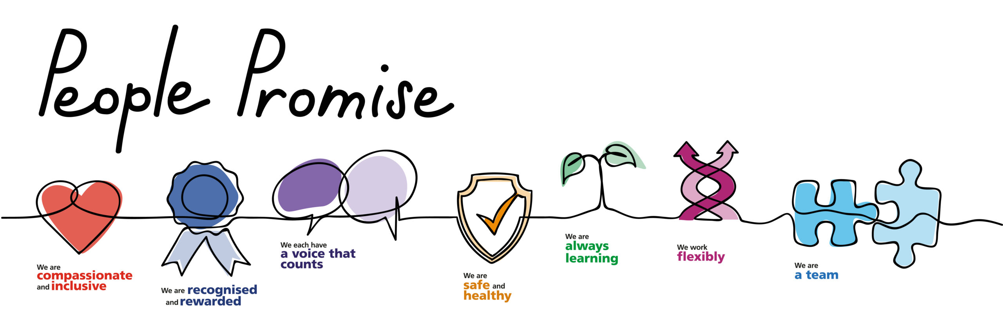
HR Strategy of the NHS
The NHS's HR strategy is based on creating a supportive, inclusive, and engaging work environment. It places considerable emphasis on diversity and inclusivity, believing that a diverse workforce enriches the workplace with a variety of perspectives, enhances decision-making, and reflects the diverse population the NHS serves. Investing in training and development is another cornerstone of the NHS's HR strategy. It offers various professional development opportunities to its employees, providing them with the knowledge and skills necessary to deliver high-quality patient care. By doing so, the NHS ensures it can meet the evolving healthcare needs of the UK population.
The NHS also prioritizes employee well-being. It recognizes that employee health and well-being are vital for maintaining a productive workforce capable of delivering high-quality care. Therefore, it provides numerous health and well-being resources to its employees, promoting a healthy work-life balance (NHS, 2023).

Slide 8


Effectiveness and Impact of HR Strategies
Both Apple and the NHS have witnessed significant benefits from their respective HR strategies. Apple's focus on fostering a culture of innovation and creativity has enabled it to stay ahead of competitors and continually redefine the technology industry. Its unique HR strategy aligns perfectly with its overall business strategy of creating cutting-edge technology, contributing significantly to Apple's success and growth (Ulrich, 1997).
In the case of the NHS, its HR strategy is central to its mission of delivering comprehensive, high-quality healthcare services. By prioritizing training and development, promoting diversity and inclusion, and prioritizing employee well-being, the NHS ensures it can attract, retain and develop skilled healthcare professionals. This approach has resulted in the NHS having a dedicated workforce that can meet the healthcare needs of a diverse population. This strategy is critical in maintaining high standards of patient care and in retaining public trust (Armstrong and Taylor, 2014).

Slide 9


Competitive Advantages & Regulatory Strategies
Apple's unique HR strategy and its innovative workforce constitute its main competitive advantages. Apple's focus on cultivating innovation and creativity among its employees allows the company to create products that redefine the market. These innovative products, in turn, provide Apple with a unique market position and substantial competitive advantage. Furthermore, its comprehensive HR policies comply with employment regulations, contributing to the firm's reputation and employee satisfaction (Becker and Huselid, 2006).
The NHS, on the other hand, gains a competitive edge through its workforce. The diversity, skills, and dedication of its staff enable the NHS to deliver a high level of service. Its comprehensive HR strategy helps ensure this workforce is equipped to meet the public's health needs. Furthermore, the NHS's HR practices strictly adhere to public sector employment laws, ensuring fair treatment of employees and reducing the risk of litigation.

Slide 10


Application of Resource-Based View Model
The Resource-Based View (RBV) model emphasizes that organizations should leverage their unique resources for a competitive advantage.
Apple's resource is its innovative workforce, which is fostered through its unique HR strategy. The company's culture of innovation and creativity, coupled with its commitment to training and development, help cultivate this resource, giving Apple a competitive edge (Barney, 1991).
For the NHS, its strength lies in its skilled and diverse workforce, cultivated through its focus on employee development, diversity and well-being. This workforce is a unique resource that allows the NHS to deliver high-quality healthcare services, thus providing it with a competitive advantage in the public healthcare sector.

Slide 11
Conclusion
Both Apple and the NHS have effectively used their HR strategies to contribute to their competitive advantages.
Apple's focus on fostering a culture of innovation and creativity aligns well with its business strategy and has played a key role in maintaining its market leadership.
In contrast, the NHS's HR strategy has been instrumental in ensuring it can deliver comprehensive, high-quality healthcare services while both organizations have been effective in using their HR strategies to achieve organizational objectives, Apple's HR strategy seems to have had a more significant impact due to its unique approach to innovation and the global influence and market dominance it has achieved.
The comparative study, thus, underscores the pivotal role effective HR strategies can play in achieving organizational objectives and competitive advantages. Comparing the two organizations, it's evident that both have used their HR strategies effectively to contribute to their competitive advantages.

Slide 12
References
Apple Inc., 2023. About Apple. Available at: https://www.apple.com/about/ [Accessed 7 July 2023].
Armstrong, M. and Taylor, S., 2014. Armstrong's handbook of human resource management practice. Kogan Page Publishers.
Barney, J., 1991. Firm Resources and Sustained Competitive Advantage. Journal of Management, 17(1), pp.99-120.
Becker, B.E. and Huselid, M.A., 2006. Strategic human resources management: where do we go from here?. Journal of management, 32(6), pp.898-925.
Boxall, P. and Purcell, J., 2008. Strategy and human resource management. Palgrave Macmillan.
NHS, 2023. Our People Plan. Available at: https://www.england.nhs.uk/ournhspeople/online-version/ [Accessed 7 July 2023].
Ulrich, D., 1997. Human resource champions: The next agenda for adding value and delivering results. Harvard Business School Press.
https://www.google.com/url?sa=t&source=web&rct=j&opi=89978449&url=https://www.apple.com/supplier-responsibility/pdf/Apple_SR_2023_Progress_Report.pdf&ved=2ahUKEwj7t8qm9oGAAxVJQkEAHTojBLQQFnoECCEQAQ&usg=AOvVaw23VQJ8Pu3s5

Slide 13


