Slide 1
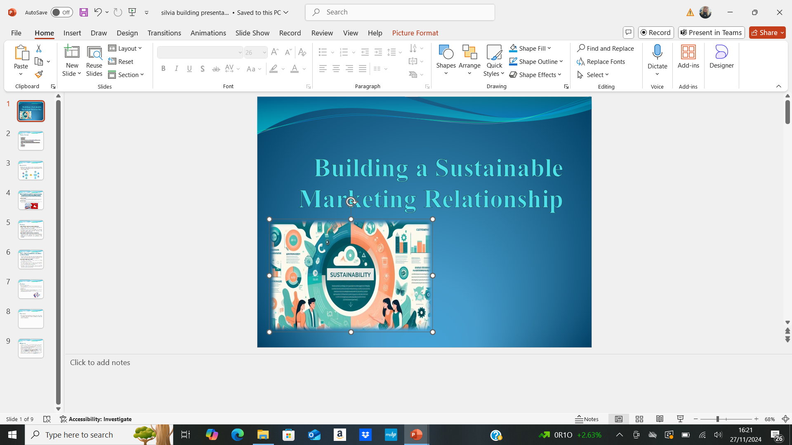
Building a Sustainable Marketing
Relationship
BMSW5007
Student name: Silvia Mita
Student ID: 2310673

Slide 2
Table of Content
Introduction
Main Body
Task 1: Definitions of Digital and Social Media in the Context of Customer Relationships
Task 2: Tesco’s Engagement with Digital and Social Media
Conclusion
References

Slide 3
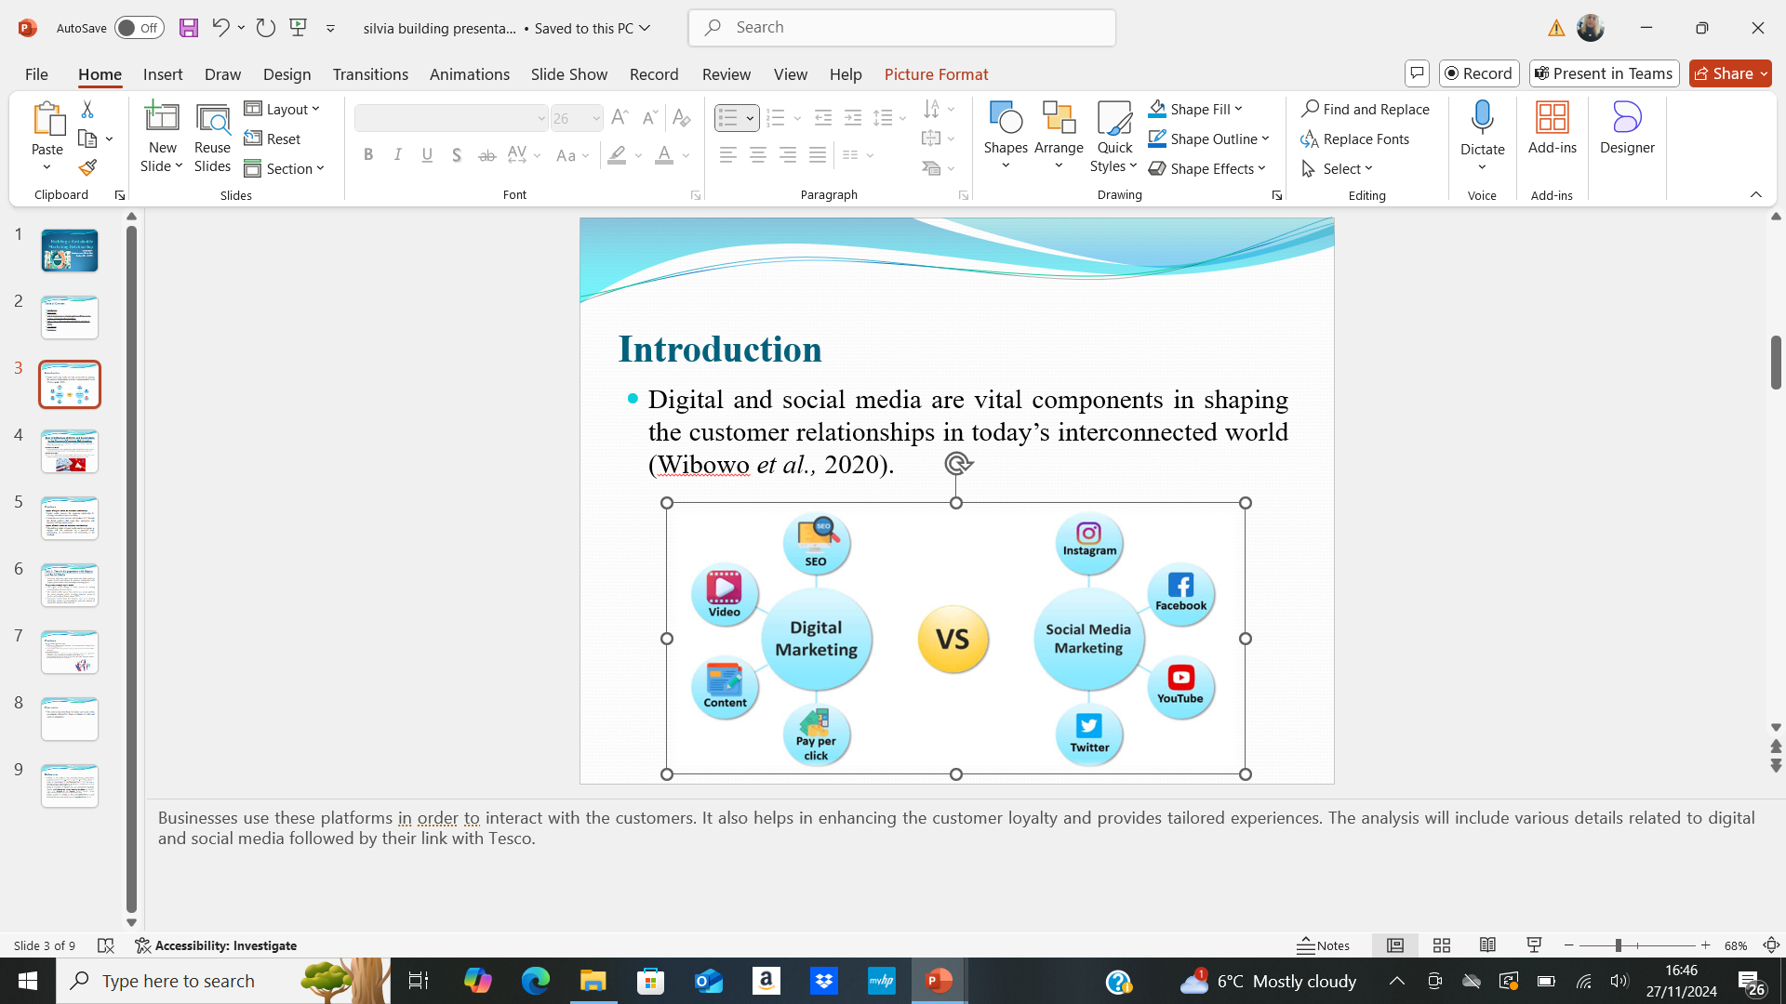
Introduction
Digital and social media are vital components in shaping the customer relationships in today’s interconnected world (Wibowo et al., 2020).
Businesses use these platforms in order to interact with the customers. It also helps in enhancing the customer loyalty and provides tailored experiences. The analysis will include various details related to digital and social media followed by their link with Tesco.

Slide 4
Task 1: Definitions of Digital and Social Media in the Context of Customer Relationships
Digital and social media are important in shaping the customer relationship in today’s interconnected world.
Defining digital media
Digital media refers to any communication channel that uses the electronic devices or internet to share data, content or the information (Johnstone and Lindh, 2022).
Defining social media
Social media efforts to the interactive platform that allow the users to share create exchange information in various virtual communities (Pandey et al., 2022).
Businesses use these platforms in order to interact with the customers, provide tailored experiences and also enhance the brand loyalty. Understanding these terms in the context of customer relationships shed light on how the company can promote meaningful connection within the digital age.
This includes email websites, mobile apps, e-commerce platforms and online advertisements. In the context of customer relationship, digital media serves as a bridge for businesses in order to engage with their audiences while offering convenient communication methods and offering personalised services.
For example, the use of Tesco related to the mobile app and website exemplifies the digital media and action. Customers can shop online; receive tailored offers and access loyalty programs based on their shopping habits. Digital media enable the company to analyse customer data and adapt their strategies in real time, promoting data driven and stronger relationship.
Examples include Instagram, Facebook, Twitter, TikTok, LinkedIn, etc. in customer relationship management, social media serves as a powerful tool for the two way communication that allow businesses to interact directly with the customers, address concerns, followed by building the brand affinity. Social media enhances customer relationship by creating a sense of community while providing a platform for immediate feedback. Tesco, for instance, uses Twitter to addresses the complaints and queries of customers in a prompt manner while demonstrating the commitment towards consumer’s satisfaction. This direct interaction builds loyalty and trust, which is an essential component of the lasting customer relationship.

Slide 5
Continue…
Impact of digital media on customer relationship
Digital media supports the customer relationship by offering convenience and accessibility.
Customers can access services and products 24×7 through the digital platform that make their interaction with business, efficient and seamless.
Impact of social media on customer relationships
The real-time nature of social media enables companies to engage with the customers on a personal level, participating in conversations and responding to the feedback.
Moreover, the data analytics tools embedded media allow the companies to anticipate customer needs, deliver exceptional experiences and also personalise interactions.
User generated content such as testimonials and reviews for the strength in the community building and credibility. Social media campaign, such as a use of Instagram, Tesco helps itself to promote sustainable practises while demonstrating how the businesses can align with customer values and enhance emotional connection.

Slide 6
Task 2: Tesco’s Engagement with Digital and Social Media
Tesco has effectively used social media and digital media to sustain, develop and enhance the customer relationship while aligning these efforts with broad range of strategy goals.
Engagement through digital media
The digital media strategy of Tesco focuses on offering personalisation and convenience.
The website mobile app of Tesco serves as a central platform for online shopping while providing seamless access to services and products (Pandey et al., 2022).
Customers benefit from the features such as a delivery scheduling, product, recommendations, and order tracking all powered by advanced data analytics.
By using social platforms and digital tools, Tesco has transformed customer interactions, promoted loyalty, and personalised experiences. However, while these efforts have largely driven success, challenges remain that need addressing.
The club Card loyalty program, integrated into this digital platform allow Tesco gather the detailed insights into preferences of customers while enabling personalise, promotions and discounts. Digital media also support the marketing efforts of Tesco through targeted email campaigns and online advertisements. For example, by analysing purchase history and browsing, Tesco delivers tailored offers to the customers followed by enhancing retention and engagement.

Slide 7
Continue…
Engagement through social media
Social media platforms, such as Instagram, Facebook, and Twitter are integral to the customer strategy of Tesco.
Tesco uses these channels to promote campaigns, share updates and interact with the customers.
Assessment of success
Engagement of Tesco with social media and digital media has significantly contributed to the organisational performance (Nozari et al., 2021).
Digital platform have driven online sales growth, particularly during the pandemic when the customer shifted to e-commerce.
For example, during the pandemic of COVID-19, Tesco effectively communicated the safety measures and various delivery options via social media while reinforcing the commitment towards customer welfare. Tesco also uses social media to address the feedback of customers in real time while showcasing its dedication and responsiveness to the customer satisfaction. Platforms such as Twitter are frequently used in order to resolve the complaints while turning potentially negative interactions into opportunities for relationship building. Furthermore, the Instagram campaigns of Tesco highlight sustainability initiatives such as reducing plastic waste while aligning the brand with customer values and also enhancing emotional connections.
The online grocery business of Tesco supported by the website and app has become a key revenue driver. The club cart program has also reinforced customer loyalty while evidence by higher retention rates and increase spending among the customers. On social media, Tesco has successfully built a brand image that resonates it with diverse range of audiences. Campaign highlighting ethical practices and sustainability has strength and reputation as a social responsible organisation.

Slide 8
Conclusion
The analysis has been based in digital and social media components followed by Tesco to enhance its sales and customer integration.
The discussion has also focused on the various details to engagement of Tesco with social and digital media.

Slide 9
References
Johnstone, L. and Lindh, C., 2022. Sustainably sustaining (online) fashion consumption: Using influencers to promote sustainable (un) planned behaviour in Europe's millennials. Journal of Retailing and Consumer Services, 64, p.102775.
Nozari, H., Szmelter-Jarosz, A. and Ghahremani-Nahr, J., 2021. The ideas of sustainable and green marketing based on the internet of everything—the case of the dairy industry. Future Internet, 13(10), p.266.
Pandey, N., de Coninck, H. and Sagar, A.D., 2022. Beyond technology transfer: Innovation cooperation to advance sustainable development in developing countries. Wiley Interdisciplinary Reviews: Energy and Environment, 11(2), p.e422.
Tesco, 2024. Overview of the Company [Online] Available Through <https://shorturl.at/xDrp3> [Accessed on 18 November 2024]
Wibowo, A., Chen, S.C., Wiangin, U., Ma, Y. and Ruangkanjanases, A., 2020. Customer behavior as an outcome of social media marketing: The role of social media marketing activity and customer experience. Sustainability, 13(1), p.189.

