Slide 1
Module LCHS4003
Introduction to
Health and Social Care
WEEK 4
Module Leader Dr Helen Parsons: h.parsons@uwtsd.ac.uk
Lecturer: [please insert here]
Notes:
Consider adding ‘Lecturer’ name and email to slide

Slide 2

WELCOME
Record the Session

Slide 3

Ice Breaker
Notes:
Plan an icebreaker of your choice or use the suggestion below
Suggestion
Ask students to think of one health or social care service they’ve interacted with either professionally or personally (or experienced via a family member or friend)
Write down one word or phrase that describes their experience.
Discuss in pairs
Ask some pairs to share with wider class
You can jot the words on the whiteboard or write on a blank slide (optional).
Latecomers can easily join by adding their word when they arrive.

Slide 4
Moodle Site Familiarity
All students:-
to log onto the Moodle site
to access slides week 4 teaching session slides and open up the slides (pop up PDF file)
to locate the group work activity sheet
open up the group work activity video link

Slide 5
Today we will…
Explore the different health and social care services across health and social care systems.
Consider strength-based approaches to person-centred care and planning for service delivery.
Provide an outline of systems theory.
Complete the group work activity and present back
Complete a weekly ‘Infoskills Gym’ activity.

Slide 6
Aims and Objectives of the session
Aims
To look at the different health and social care systems
To consider strength-based approaches and how these relates to person centred care and planning
Objectives
By the end of the session, you should have an insight of the different health and social care systems and have some knowledge of systems theory
You should be able to know what strength-based approaches are around person centred care and planning to meet service users' needs

Slide 7
Session 1
Setting the context

Slide 8
Person Centred Care Strength-based
Approaches

Slide 9
What is person-centred care?
Class discussion
Notes:
Seek to hold an open discussion with the student group around the opening question. This should help them consider the question before watching the video and going through the bullet points on the slides.
The person-centred care concepts in this session relates to service delivery on a daily basis to providing services directly with service users.
The following slides around this topic area is self-explanatory. Read the contents and expand as you see fit to bring in any ideas or examples you can bring to enhance the teaching session.
Ask students what they think person-centred care means?
Capture points on whiteboard (optional)
Then watch video on following slide and go through slides to see what they said and what they missed

Slide 10
What is person-centred care?
Watch video
https://www.youtube.com/watch?v=rM9QAxFSBMU
Notes:
Watch video

Slide 11
What is person-centred care?
Person-centred care is an approach to care delivery, which meets individual needs (Maclean Associates, 2015) as it places the person at the centre.
Glasby (2017) asserts that person-centred care and planning starts with the ‘individual rather than with the service’ (p.62).
Dignity of the service users is important as this helps to promote self-respect, self-confidence, autonomy, and integrity (Haugan & Eriksson, 2021).
It places the individual service user at the centre of what is being delivered:
  in the planning process;
  involvement in decisions about their care;
  considers their needs and preferences; and
  they are included in the care planning process.
Notes:
Class discussion BEFORE REVEALING POINTS on slide ask students what they think person-centred care means?
Capture points on whiteboard (optional)
Then go through slides to see what they said and what they missed
Highlight anything covered in the video

Slide 12
A person-centred plan is not only about wider goals and ambitions, but can also be about the little things e.g., enabling people to:
  make choices;
  to be told what services are available;
  to know the costs; and
  that the provision has clear information.
It's about seeking to focus on formal services to meet the aspirations of the service user and anyone important to them (Glasby, 2017).
It’s a ‘circle of support’(Glasby, 2017, p.62).
It requires the H &SC worker getting to know the individual as a unique person as a Very Important Person (VIP) (Maclean Associates, 2015).
It’s about working in partnership with the service user as an equal partner.
Notes:
The following slides around this topic area is self-explanatory. Read the contents and expand as you see fit to bring in any ideas or examples you can bring to enhance the teaching session.
It places the individual at the centre as the person should be included in the planning and assessment process.
It focuses on the desired outcome for the individual.
It recognises the individual as an expert in their lives as equal partners.

Slide 13
In person-centred care it is important to see the individual to help build up their resilience.
Consider how you build the service users enthusiasm and buoyancy for life. Important to build self-worth.
What do you do to support families effectively ensuring empowerment and control. .
How do you promote social participation within the wider community and family and ensuring the access to resources to connect with wider networks.
Building positive and creditable relationships with frontline workers.
There needs to be flexible and reliable service delivery.
That the service has an eye on valuing diversity needs.
Recognising the need to have consistent service delivery

Slide 14
Brook (2004) confirms that there are four elements to person-centred care:-
Valuing service users and those who care for them.
Treating the service user as an individual.
Looking at the world from the service user's perspective.
Providing a positive social environment to enable the service user to develop good well-being.

Slide 15
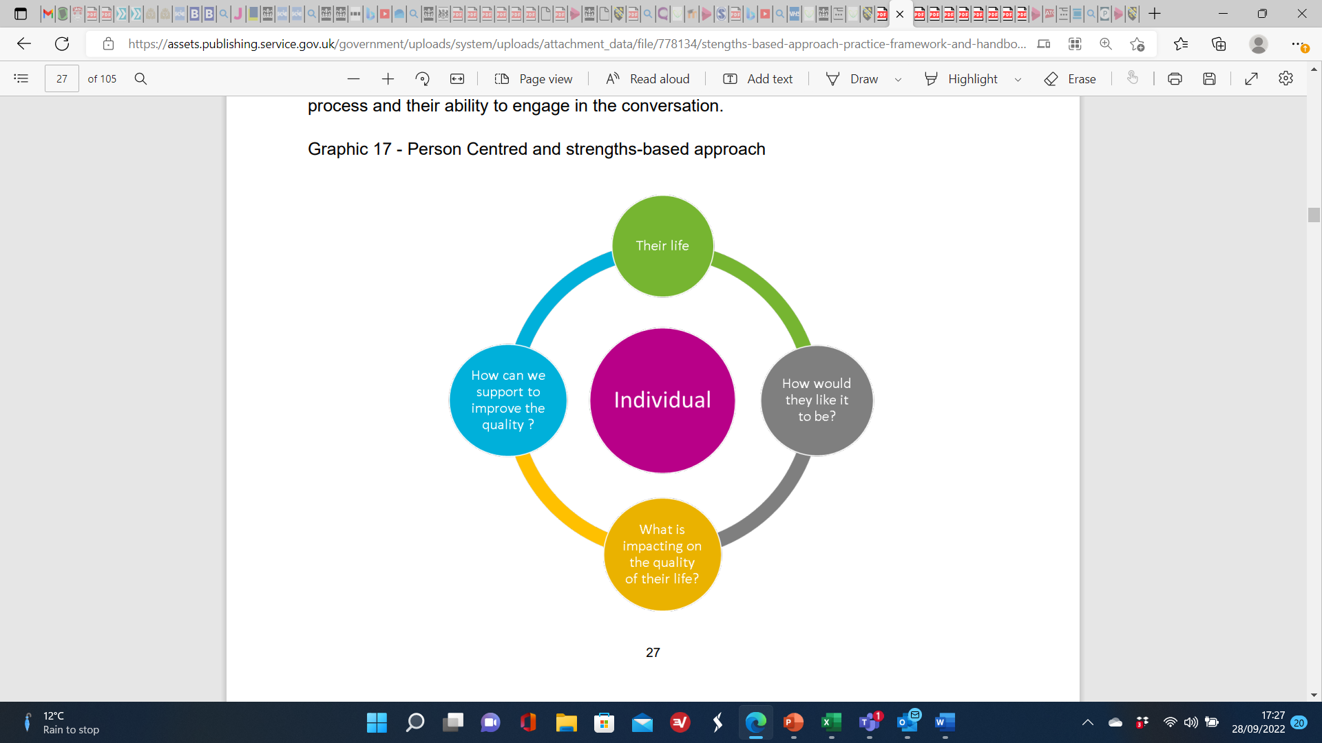
Person-Centred & Strength-based Approach
(DHSC, 2019, p.27)
Notes:
Take the students through the image on the slides which confirms that having a strength-based approach is being person centred.
Having a person-centred and strength-based approach to practice delivery requires that all social care professionals have excellent communication skills, and the ability to identify and apply the most appropriate communication mean, or a combination of means for each individual service user and intervention provided, with the necessary flexibility that each intervention requires (DHSC, 2019, p.28).
Professionals should have meaningful, collaborative conversations with service users where their skills and knowledge help the individual to identify their strengths, needs, desired outcomes, resources, potentialities and solutions to co-produce a way to maximise the individual’s quality of life (DHSC, 2019, p.28).
https://www.nhs.uk/conditions/social-care-and-support-guide/introduction-to-care-and-support/

Slide 16
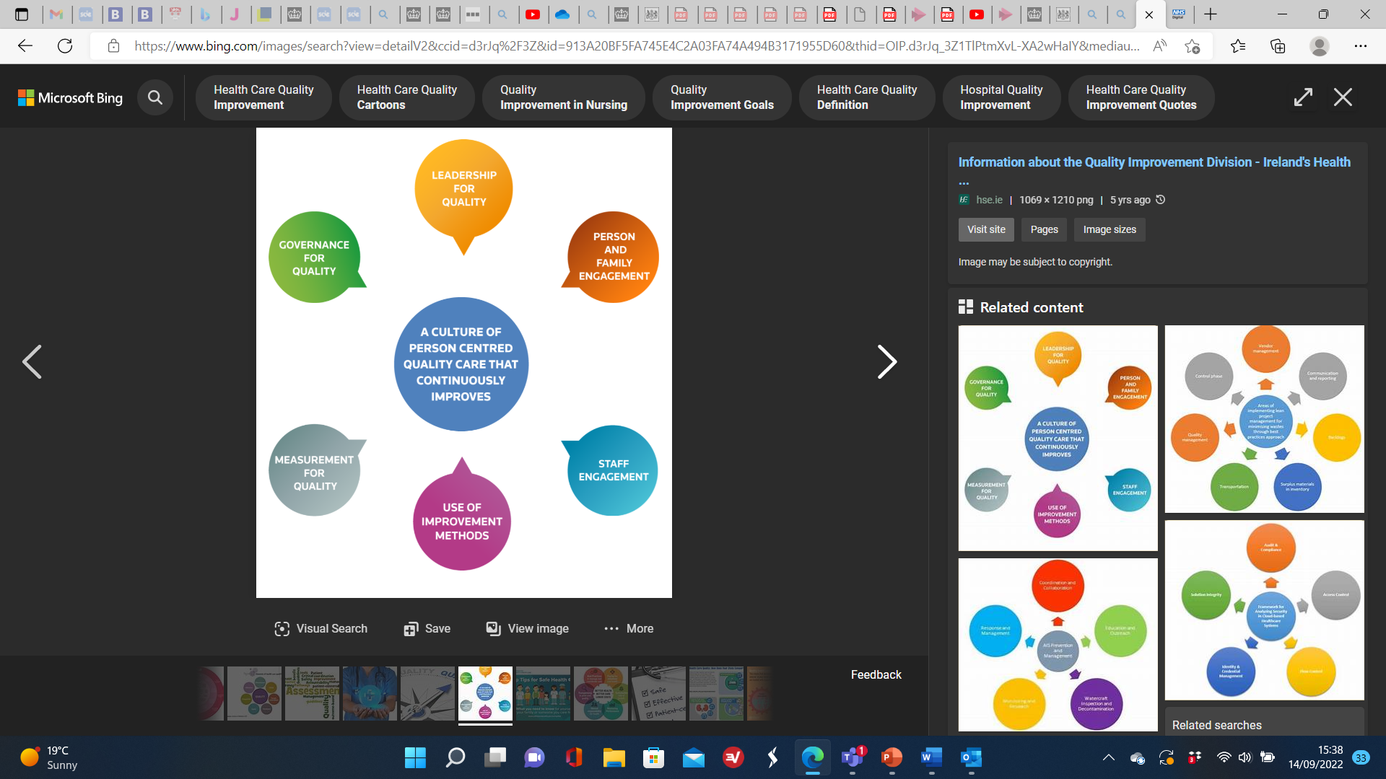
Person-centred Care
A person-centred care requires an embedded culture that looks for continued improvement in service delivery and practice delivery.
It should be person-centred and look to meeting individual needs and be a reassurance for families that the best possible care is given to the service user.
Notes:
A person-centred care requires a embedded culture that looks for continued improvement in service delivery and practice delivery.
It should be person-centred and look to meeting individual needs and be reassurance for families.
Staff should be willing to enhance their practice within their roles for a better delivery of service.
Social care and health organisations should aim to look for areas of improvement and draw upon tested methods and good practice principles in service delivery.
A culture of quality assurance in service delivery should meet quality measurements and standards set by governing bodies.
There should be a culture of governance in quality delivery in the leadership and management team.

Slide 17
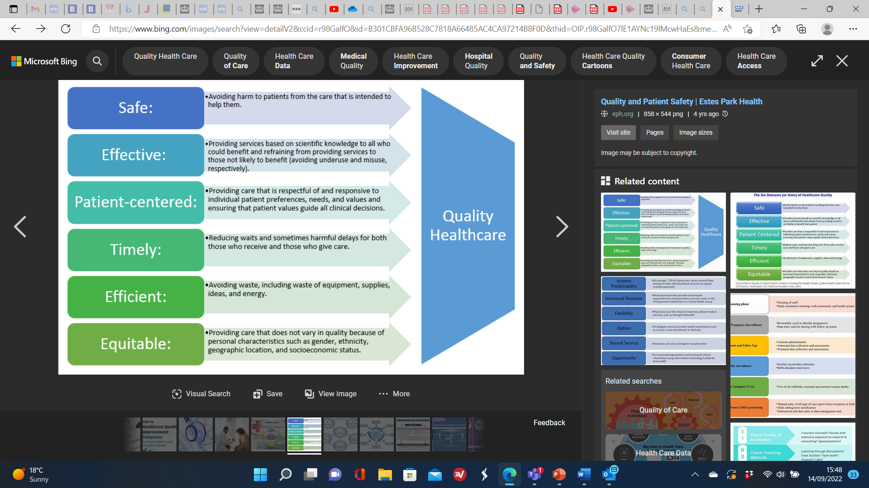
A person-centred approach to care
Notes:
Take the student through the contents of the slide as it has all the key elements for person-centred care and service delivery in practice.

Slide 18
There are five key features to person-centred care and planning
Service users are at the centre of service delivery with good open communication systems in place.
It includes stakeholders such as other professionals, family and key friends.
It will reflect the individual’s capacities to support their own needs and recognises them as experts.
There is a shared commitment to supporting the individual and upholding their rights.
It is about active listening, to help the individual get the best outcomes in life (Maclean Associates, 2015).
Notes:
The person is at the centre of service delivery.
Family members and key friends are full partners and are included to support the service user as key stakeholders.
Any planning process should reflect the persons capacities, consider what is important to him or her, and sets out the support and address their needs.
It builds a shared commitment to action with collaborative partners and ensure that the persons rights are upheld.
It is about continual listening, learning and action, and helps the person to get what he or she wants out of life.

Slide 19
Person-centred planning
Different services will use different methods of person-centred planning. This will require having dignity for the service user (Haugan & Eriksson, 2021).
There are different tools and documents to log the planning data and information about the service user so that there is a record of what has been agreed.
Such information might include: a profile of the service user which contains essential factual information e.g., name, address, DoB, gender, age etc.
Planning assesses the individual to address their needs to live a full and active life as far as possible.
Notes:
What needs to be emphasised is that if the health and social care worker is part of a team of professionals or network within the family and friends to support the service user to work towards achieving their goals.
Talk about having empathy with the service user which focuses on their needs, so that they are considering how the service user might feel about what is happening to them.
Its like ‘walking a mile in the service users shoes’. The Health and SC worker should be seeking to attune to the addressing the needs of the vulnerable service user.

Slide 20
What the person feels is important to them and what support they will need. This information might explore what makes them feel good, what a good day might look like and what a bad day might be feel and look like too.
What their goals are, what steps they and others would take to help to work towards or meet their goals.
Once the data set has been determined, Health and SC staff will work toward meeting the individual needs and or identify those who would best meet these needs.
A review process should be built into the planning process to monitor that things are on track and or to re-evaluate if other needs are required or things need to be removed.

Slide 21
Refreshment Break

Slide 22
Session 2
Presentation of Ideas

Slide 23
Systems theory within the health and social care sector
Areas of wellbeing – the Care Act 2014
Read contents of pages 62 and 63, and 137 to 160 in Glasby (2017)
Presentation of systems theory as it relates to service users
Different types of H & SC systems
The practitioners approach
Haugan & Eriksson (2021, pp 71 to 84)
Notes:
Ask students to read these pages, make notes of key points – remind them to note the reference both in-text citation and full reference
You could also use this for students to practice their paraphrasing skills
If the content is too long for your students to read, you could ask students to work in small groups, divide up the pages between them and pull their notes together
Alternatively, you could suggest this for an extension activity outside of class for those who wish to do additional reading

Slide 24
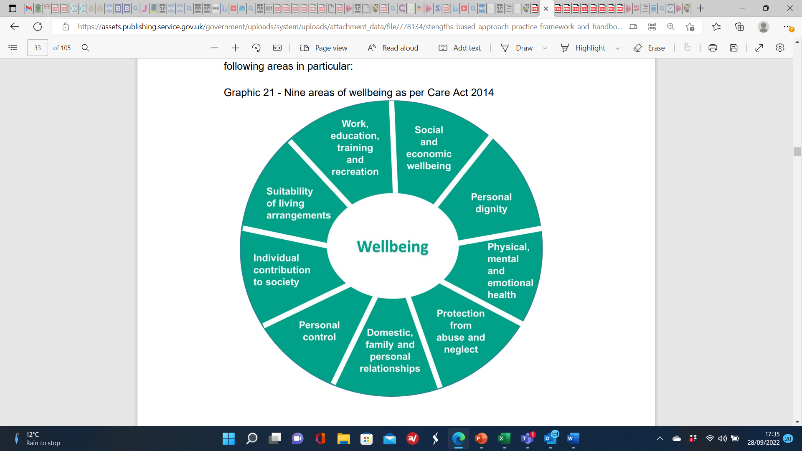
Areas of wellbeing – The Care Act 2014
(DHSC, 2019, p.33)
Notes:
Remind students that taking the needs of individuals into consideration in service delivery forms part of the Care Act 2014.
Take the students through the images which is self-explanatory around the key elements of wellbeing of the Care Act 2014.
The Care Act 2014 does not specifically give local authorities (LA) the duty to use a strengths-based approach in their practice, but the ideas presented within the Act makes it clear how important it is to consider the all-round needs of the individual.
It does however establish that they must or should perform their care and support functions in a particular way that is not dissimilar to, and incorporates the core elements of a strengths-based approach in their service delivery.
The ‘wellbeing principle’ and the core duty of ‘promoting individual wellbeing’ is placed on LA.
When LA exercise any care and support functions, emphasises is placed on the importance of working in a holistic way with the individual to meet their needs and promote good outcomes.

Slide 25
Systems Theory

Slide 26
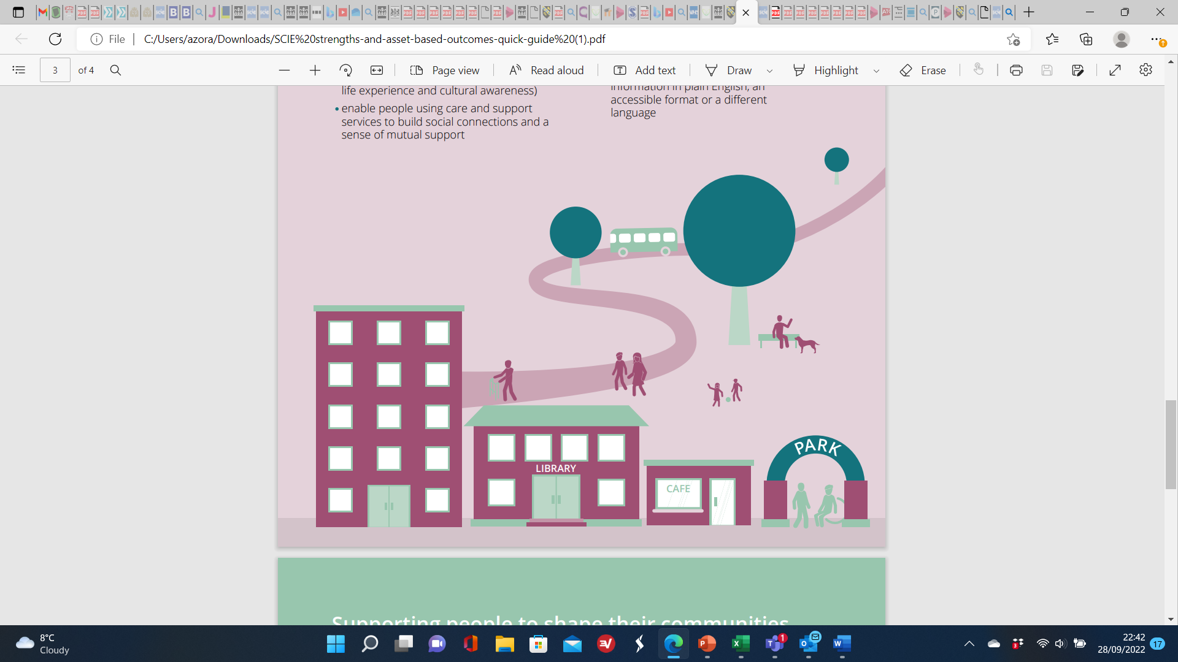
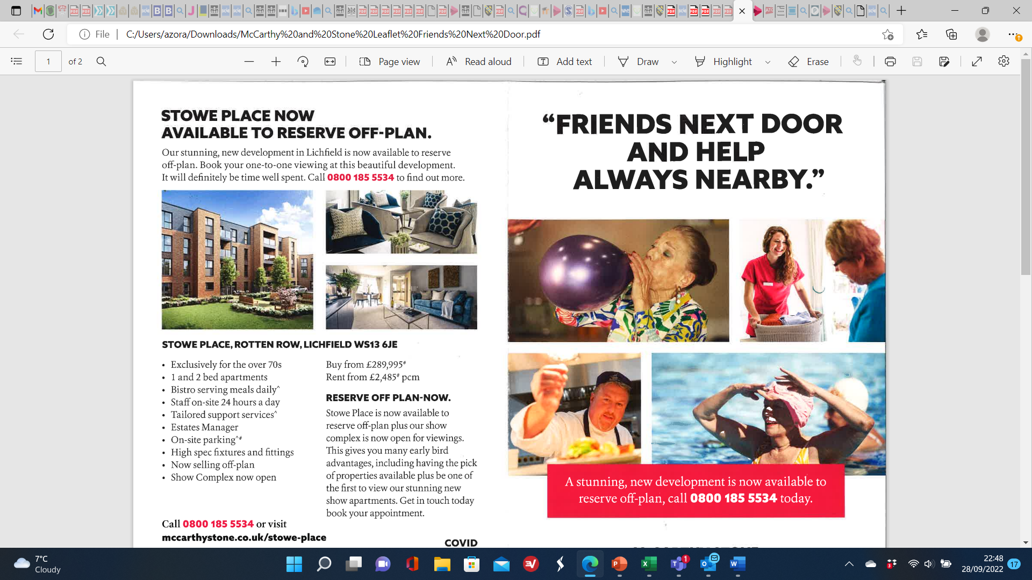
Systems Theory
Systems theory recognises that individual’s support networks is central to their lives.
Looking at a whole system is crucial to help support the individual to access services and have fulfilling lives.
There are three systems which can operate in a person’s life as follows:
1. Informal system
2. Formal systems
3. Public systems
(Maclean Associates, 2015).
Notes:
Expand on the three systems as follows:
Informal systems includes family members, friends, neighbours and work colleagues. They provide advice, emotional support and they can provide personal care and contribute to a sense of worth and personal functioning.
Formal systems include clues, societies, community groups, associations which offer a network of support on a regular basis.
Public systems include the public services such as local government services, the police, the fire service, LA councils, hospitals, primary care services, schools. These systems tend to have functions and duties and powers in their delivery to meet standards within the wider community.

Slide 27
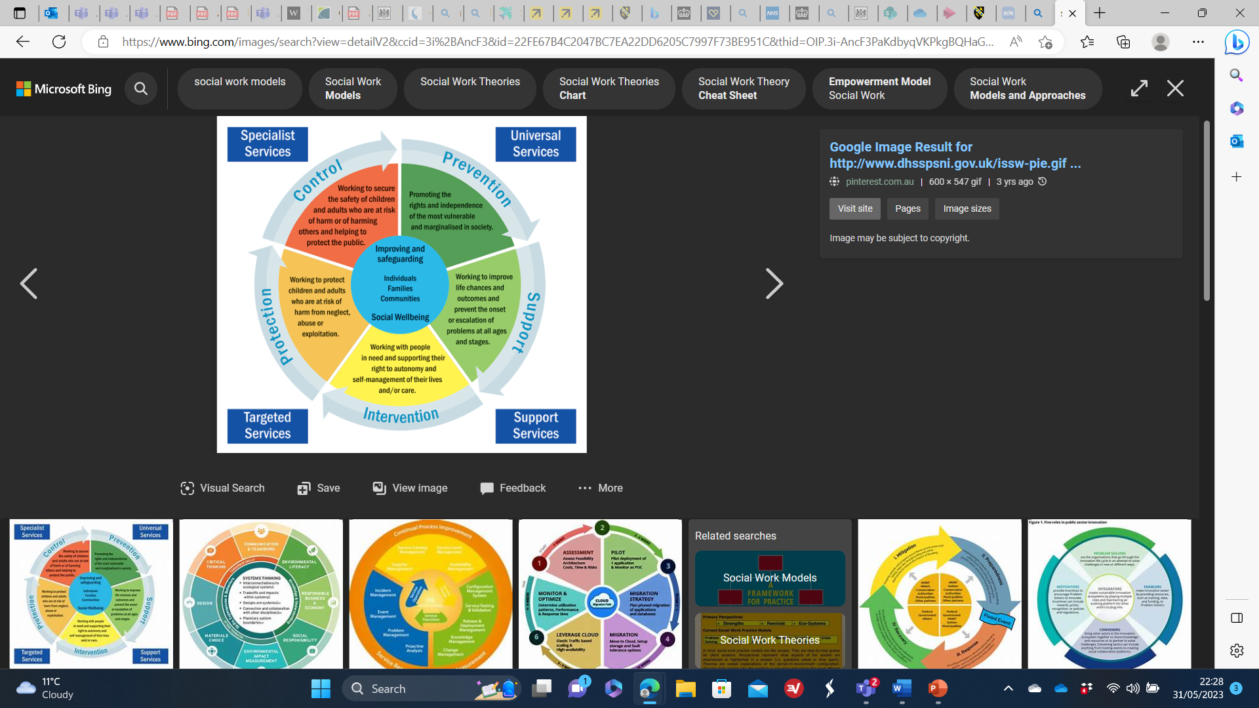
Systems theory in practice
Notes:
Present the contents of the slide image.
Take the students through each of the 4 areas where the application of systems theory in service delivery applies to the individual.
Start with universal services. Draw attention to the contents of the blue circle when you have gone through each of the segments.

Slide 28
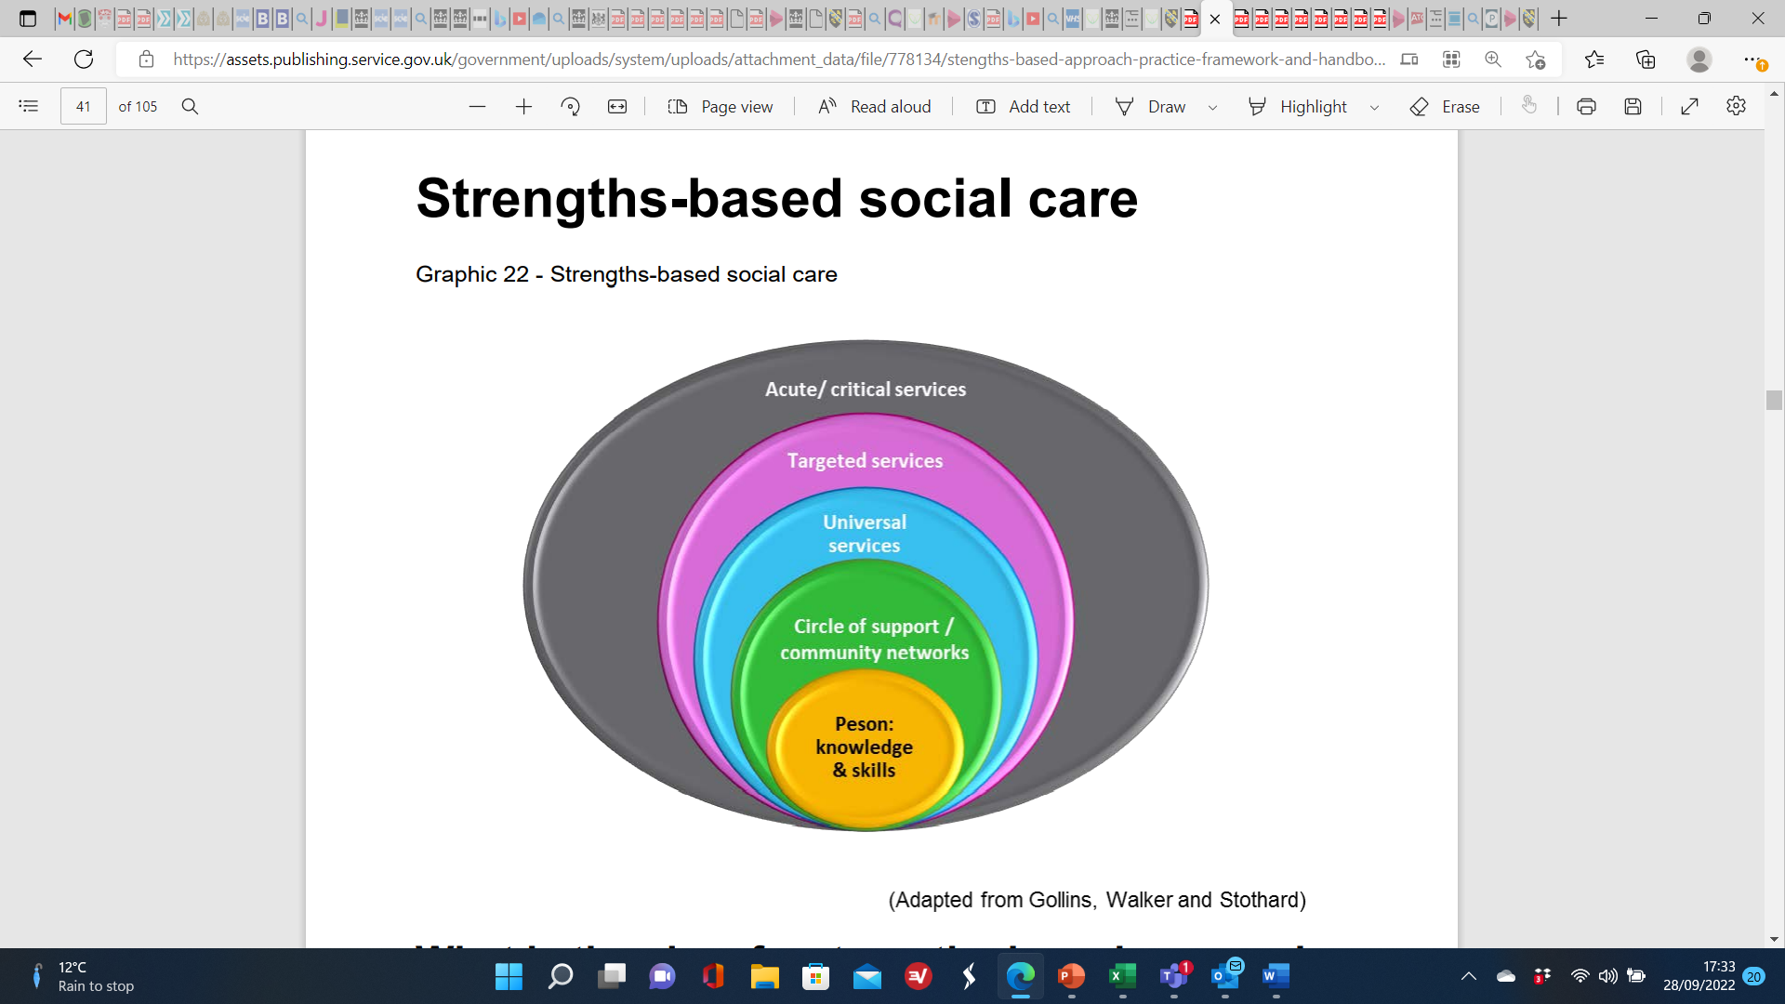
Different health and social care systems
(DHSC, 2019, p.41)
Notes:
Present the contents of the slides images. The images provides confirmation of the key strength-based approaches relating to the different social care systems which are in operation for example:
The acute or critical care systems (Acute and Short-Term Care | Standards of Care)
Targeted services systems
Universal systems
Support and community systems
Person-centred family and friends systems
2. Strengths-based systems in social are is about emphasising the use of professional engagement and judgement, as opposed to procedural approaches.
3. It will focus on the individual, taking a holistic and co-productive approach to keeping the person at the centre of all decisions.
4. It identifies what matters to the individual service user and how outcomes can be achieved.
5. It is about enabling people to find the best solutions for themselves.
6. It is about what help and support is needed to help them make independent decisions about how they live.
7. It is based on supporting individuals and empower people to live the lives they want. (DHSC, 2019, p23).

Slide 29
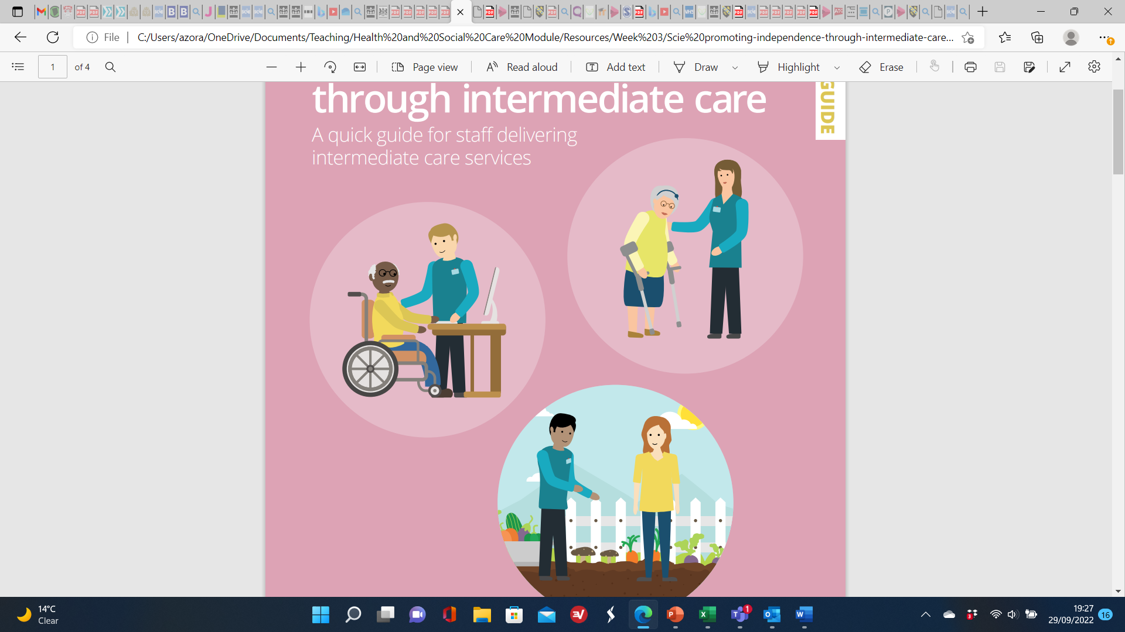
Universal health care systems
The NHS is a universal service and free to UK citizens. It is formal and a public system with lots of complex interconnections.
Medical services are covered through the NHS when accessing treatment or having immunisations programmes such the as Covid-19 vaccine.
The types of universal services include A & E, ambulance, emergency visits, preventative programmes, surgical procedures, and ongoing treatment packages.
Primary care services such as maternity care or GP services have their own systems to support individuals.
Hospital care is free of charge for UK citizens.
Notes:
Take the students through the bullet points. Have them consider other universal services and systems which are free at the point of delivery.
The United Kingdom has a universal healthcare system called the National Health Service/NHS which is free to all UK citizens.
All aspects of medical services are covered free of charge through the NHS.
The services include ambulance, emergency visits, preventative measures, surgical procedures, and ongoing treatment programmes like chemotherapy, primary care like maternity or GP services.

Slide 30
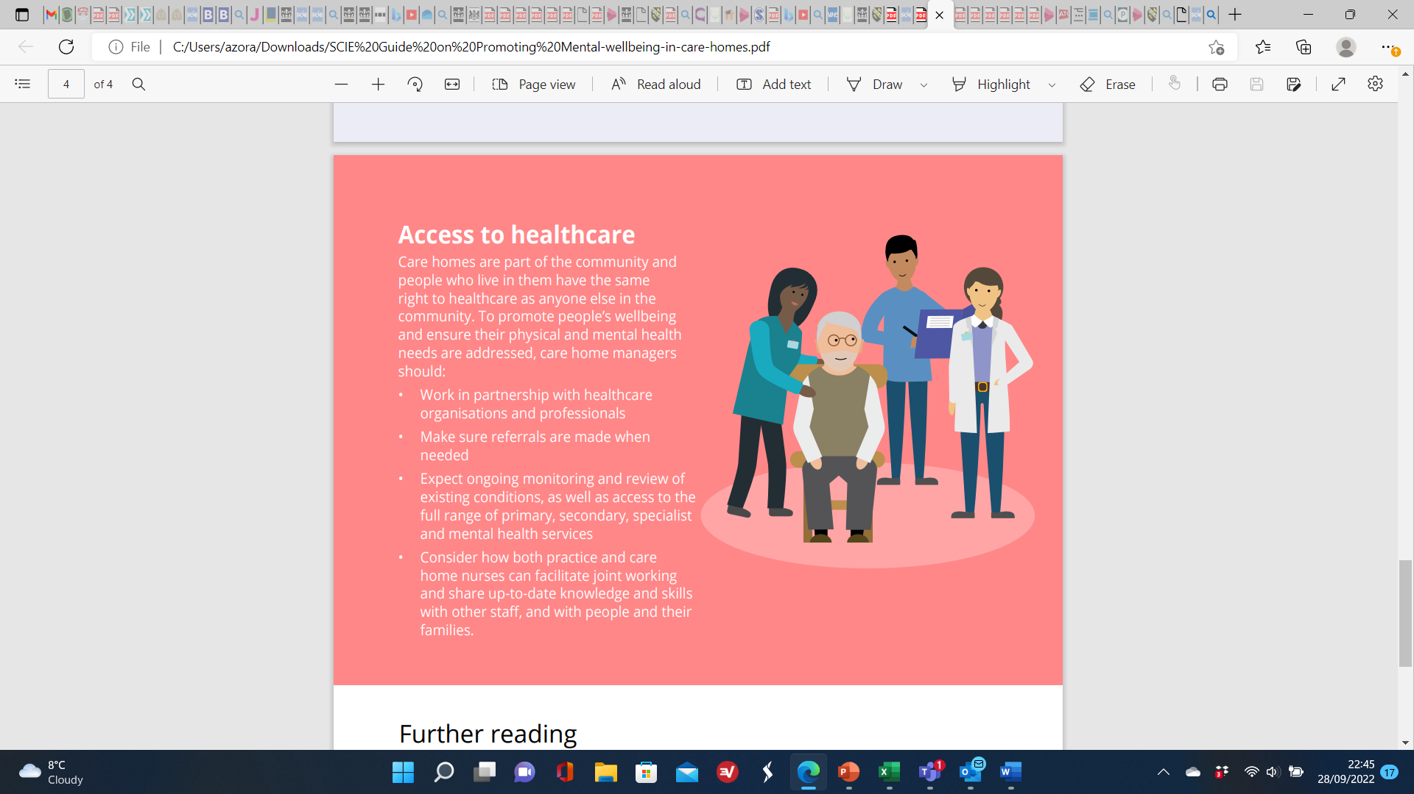
The acute or critical care systems
Acute/critical care is short-term health care that involves treatment and care which is immediate, but not over a long period of time.
It is a formal and public system with immediate interconnections at a time of crisis or critical need.
This type of care is typically used for injuries, illnesses, urgent and emergency needs, and for recovery or rehabilitation after surgery.
Acute care is in contrast to long-term care, sometimes called chronic care, for recurring illnesses and progressive or terminal conditions.
(Acute and Short-Term Care | Standards of Care Sept 2022)
Notes:
Acute and Short-Term Care | Standards of Care (Sept 2022)
Take the students through the contents of the bullet points. Here is some further information to help anchor some wider ideas around acute and critical care.
TYPES OF ACUTE CARE ARE - GO THROUGH THE LIST BELOW:
Acute care is a diverse group of medical specialties, but it can be organized into a few different types:
Emergency care. Emergency care is any acute treatment that is administered for a life-threatening illness or injury. It may also be used to treat illnesses or injuries that are causing severe pain or may lead to serious consequences if not addressed immediately.
Urgent care. This is a type of outpatient, or ambulatory care that is administered from a clinic rather than an emergency room and that typically does not require an appointment. Urgent care is used for pressing, but not emergency, health care needs.
Trauma and acute surgery. Acute surgery is used to treat patients with immediate needs, such as the removal of the appendix before it bursts. It may also be used for treating traumatic injuries, like internal bleeding after a car accident.
Prehospital care. This is care provided for a patient before they arrive at the hospital. It may be emergency care administered by paramedics or it may be evaluation by an urgent care or other doctor who then decides to transfer the patient to the hospital.
Critical and intensive care. Intensive or critical care units are typically found in hospitals and are used to treat and monitor patients who have life-threatening conditions but do not require emergency treatment. Patients are often transitioned from emergency to critical care after emergency treatment.

Slide 31
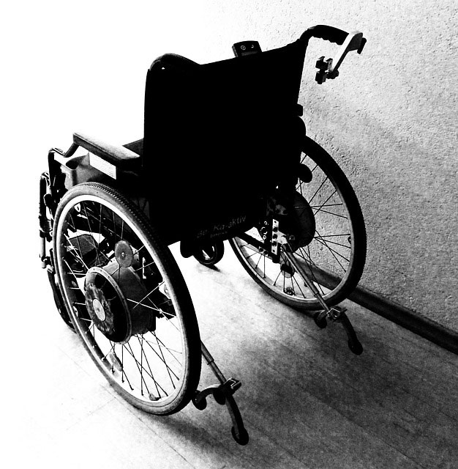
Targeted Systems
The services provided by a targeted system focuses on addressing the needs of the individual to help support them to improve their health and wellbeing. An example is people with disabilities who may experience barriers in accessing health or social care services, which may result in health inequalities.
It’s a formal system of health and or social care which targets the persons needs within the wider system for accessing services.
Notes:
Read the contents of the slide and speak widely about why there are targeted systems for specific groups in order to meet their needs such as those with a disability or mental health needs, dementia etc

Slide 32
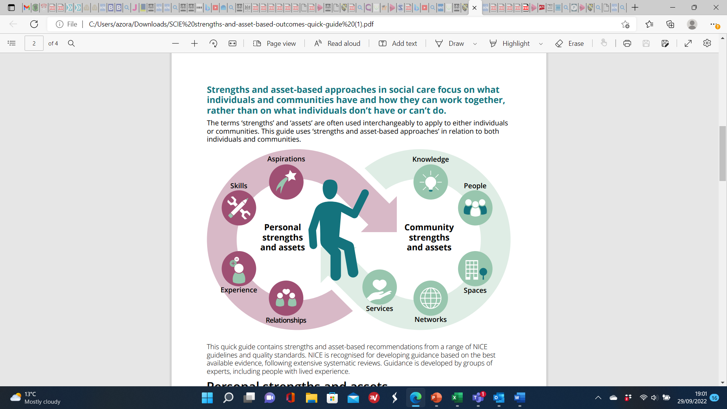
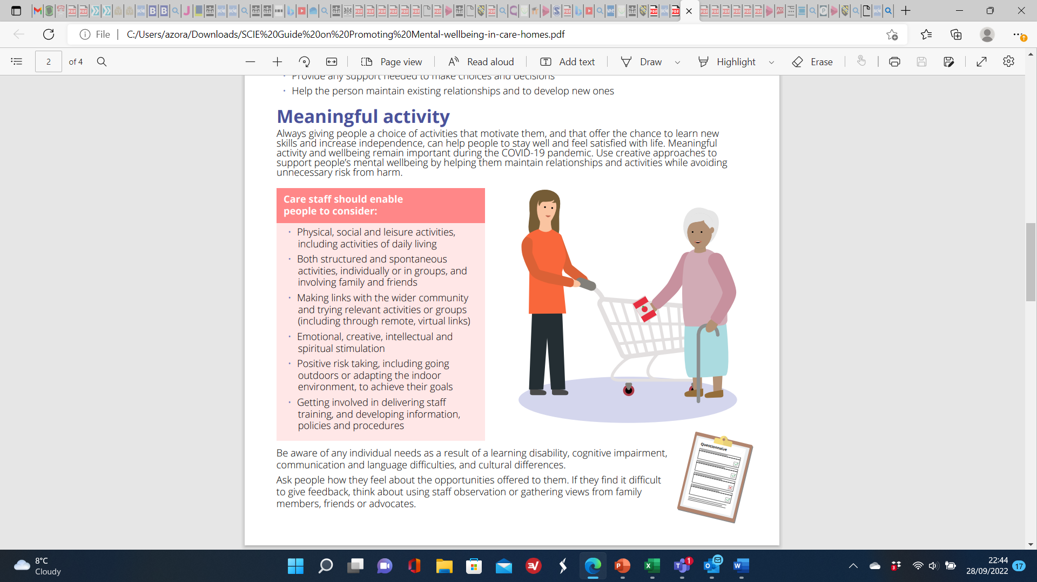
Family support and community care systems
Adult social care is part of a complex system of services and support – including the NHS.
This can be both a formal or informal system of health and social care.
Social care is delivered by a wide range of people, organisations and professionals, and within families and communities.
Community services play a key role in individual’s lives with a range of activities e.g., domiciliary care, home care, equipment adaptations, family support, day care etc.
Notes:
Adult social care is part of a complex system of services and support – including the NHS.
Social care is delivered by a wide range of organisations and professionals, and within families and communities.
Community services play a key role in keeping people well, treating and managing acute illness and long-term conditions, and supporting people to live independently in their own homes.
Community support includes a range of activities such as family support services, advisory services and advocacy, provision of equipment to manage disabilities, alarm systems, e.g., to manage the outcome of falls, home/domiciliary care or day care, housing options with levels of care support attached, residential or nursing home care, as well as support for informal carers.

Slide 33
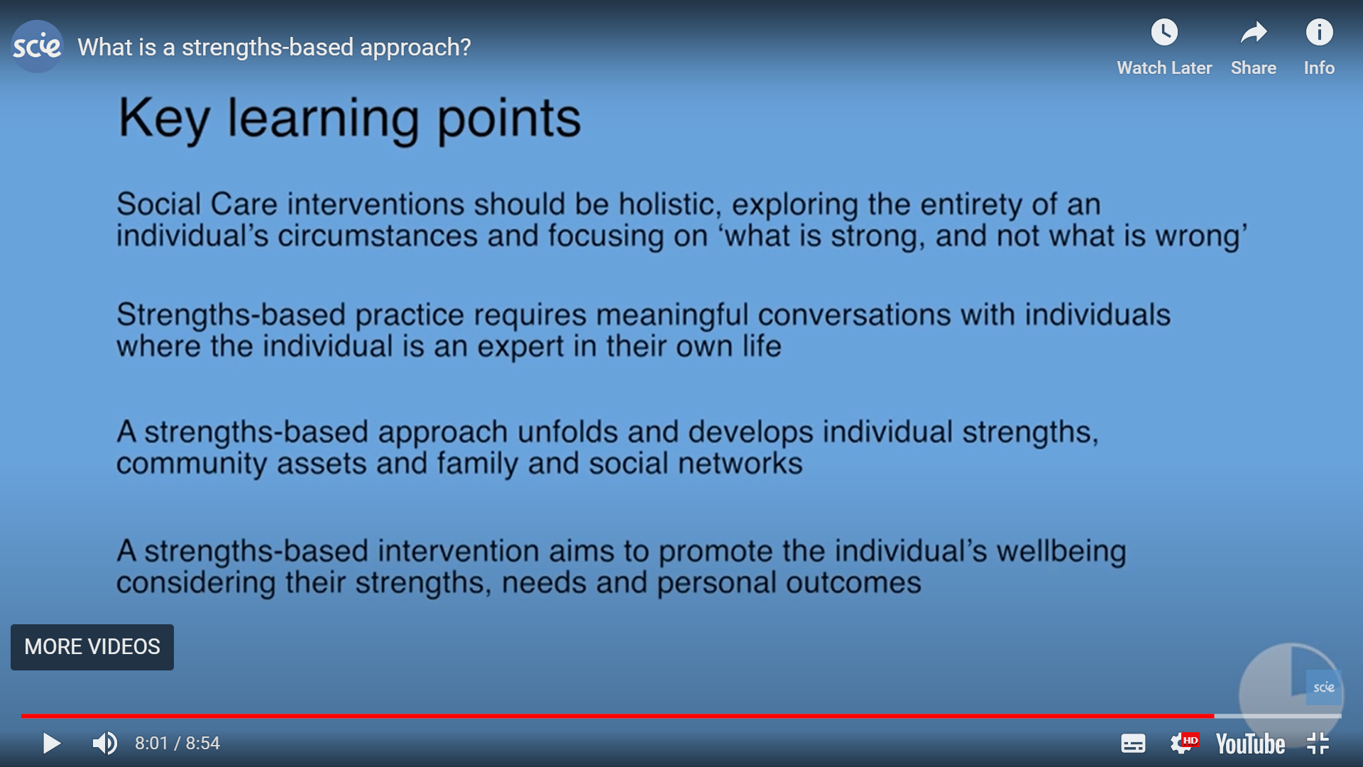
Holistic health and social care
Video: What is a strengths-based approach? | SCIE
Notes:
To summarise the key points of health and social care interventions.

Slide 34
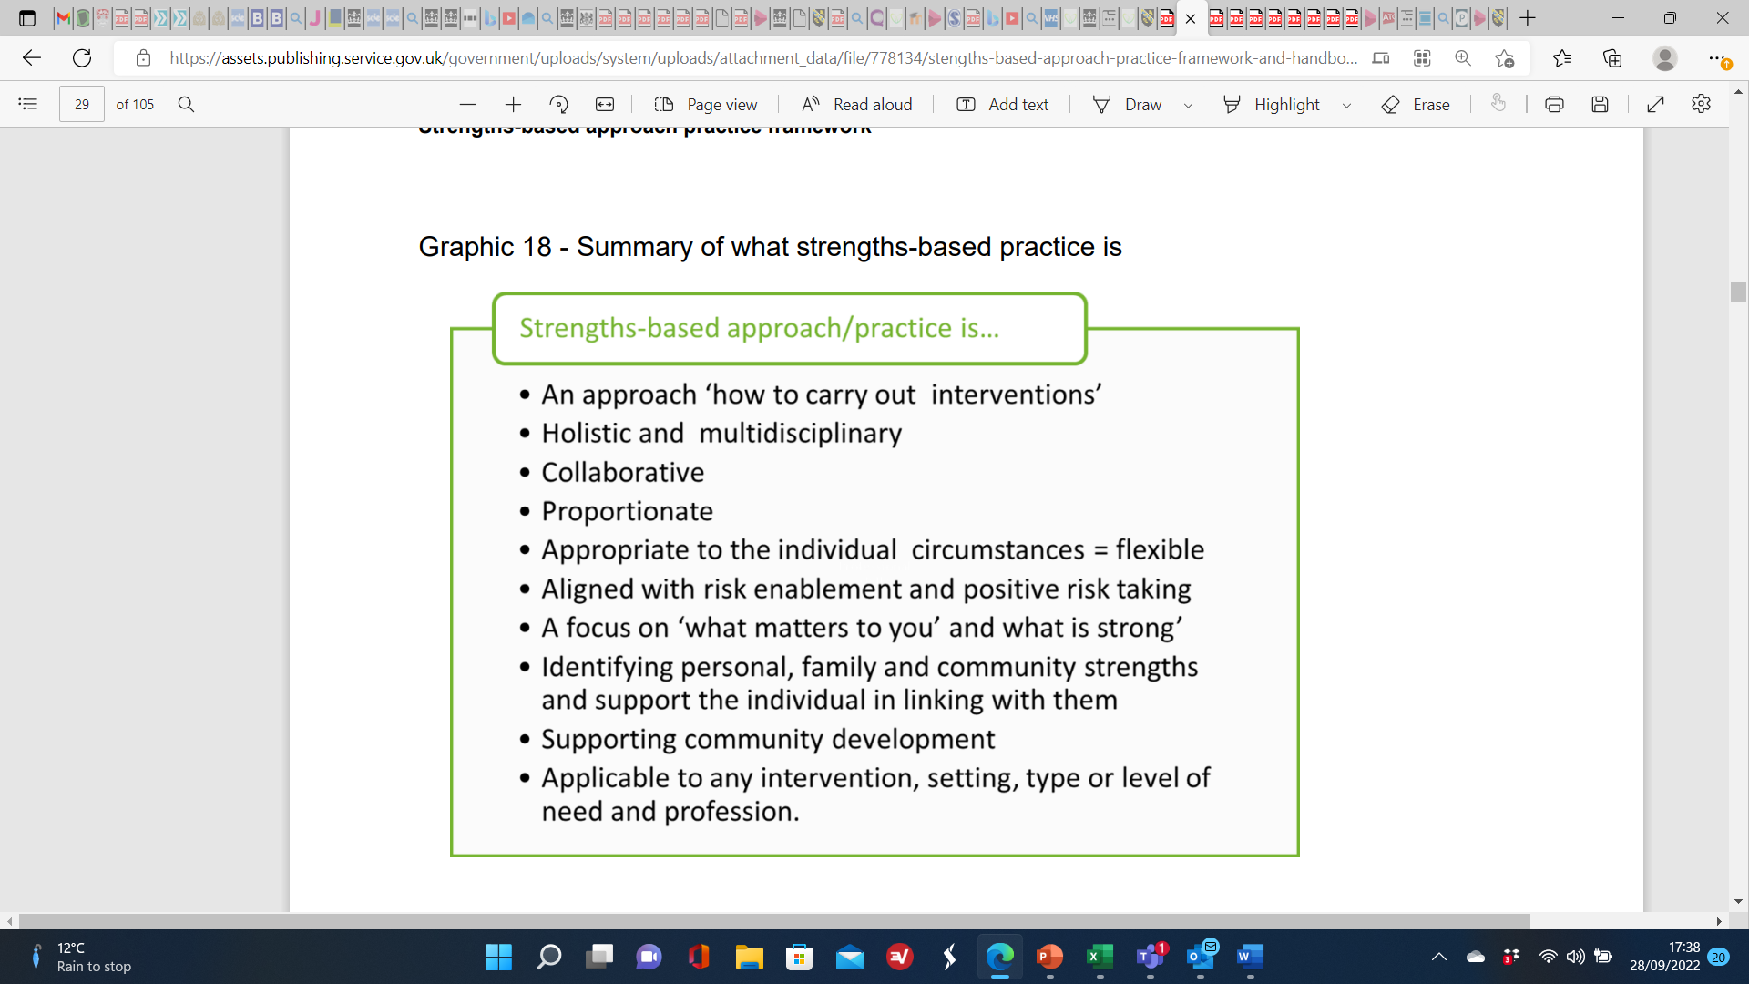
H & SC Practice in a strength-based approach includes …
(DHSC, 2019 p.29)
Notes:
Take the students through the contents of the bullet points in the slide which outlines the approach in practice delivery.
The approach is about meaningful lives, it is about the individual and their social and family networks and their communities and how all of them link together to help maximise good outcomes for individuals.
Community social care work and community development are fundamental in a strengths-based approach to practice delivery.

Slide 35
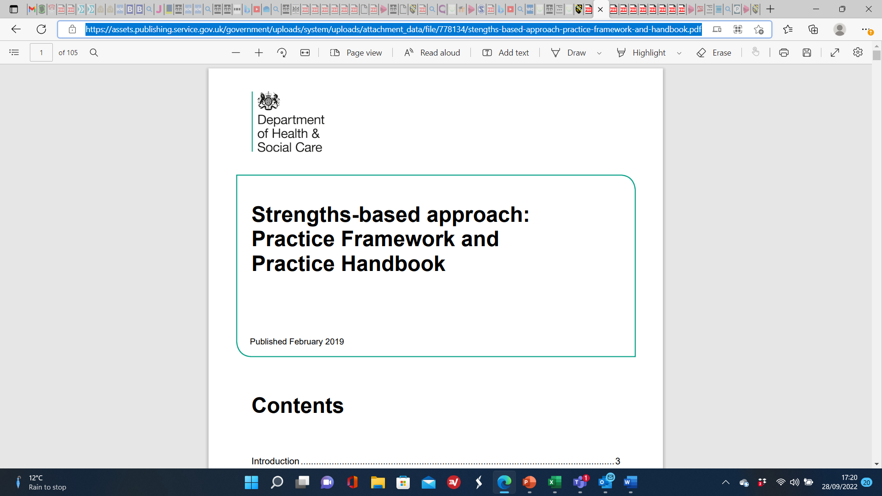
Additional Resources on
Strength-based Approach
Strengths-based approach: Practice Framework and Practice Handbook (publishing.service.gov.uk)
Notes:
Draw the students to this link of additional resources on strength-based approaches to practice.
Weblink for resource Strengths-based approach: Practice Framework and Practice Handbook (publishing.service.gov.uk) (Sept 2022)

Slide 36
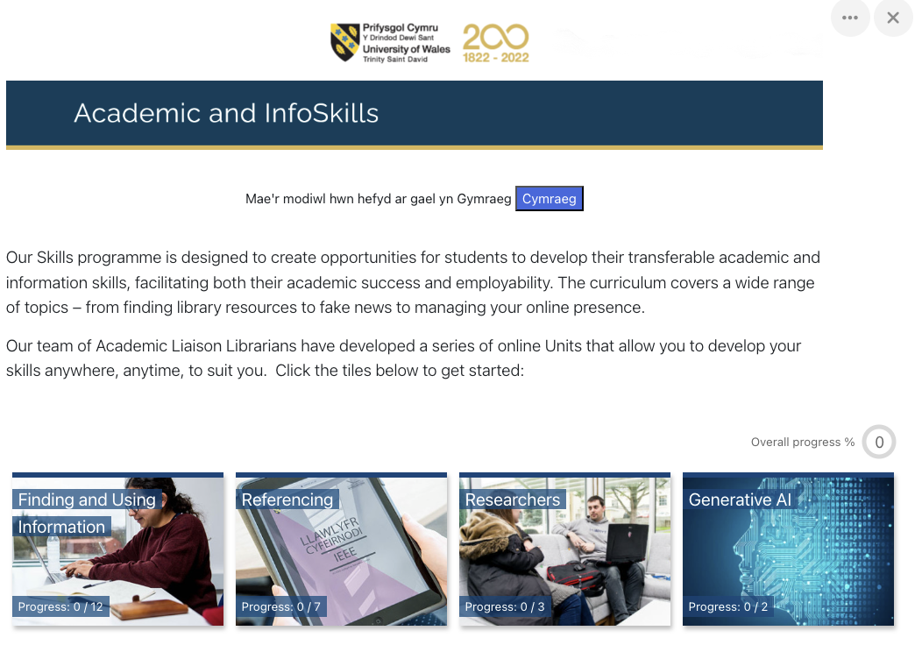
InfoSkills Gym
Build up your academic skill base
Access Academic & Infoskill via Moodle
Enrol if you have not already
Week 4:
Referencing Unit 4 – The Mechanics
15 minutes individual activity
Notes:
Each week allow 15 minutes* for students to access their Infoskills online course
Students should be enrolled on the infoskills module and have already completed 4 units in Term 1
If they are not enrolled, show them how to do this
> Moodle > Academic & Infoskills
In weeks 1 – 4 students can review units 1-4 (from term 1) or complete them if they have now
Weeks 6-10 complete further units (See Infoskills Suggested Outline document on Moodle Week 1)
*This may not be sufficient time for all students to complete the unit. There can complete in their own time.

Slide 37
Refreshment Break

Slide 38

Session 3
Group Work Activities
Notes:
Getty Images, photostorm (accessed 2 May 2023).

Slide 39
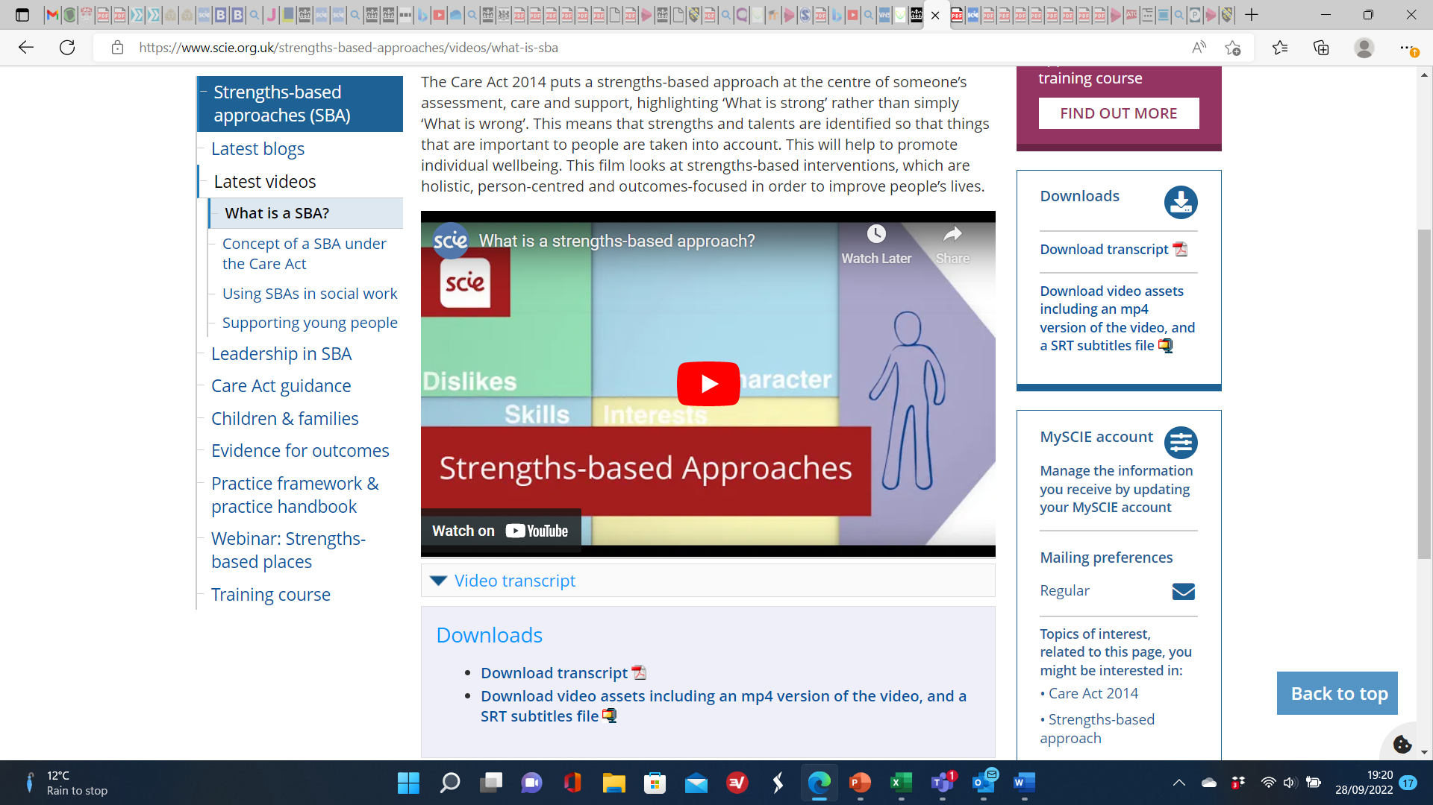

SCIE Video on Strengths-based Approached
Video: What is a strengths-based approach? | SCIE
Notes:
Video: What is a strengths-based approach? | SCIE (Sept 2022). This is an approximately 9 minutes in duration.

Slide 40
Groupwork Activity
Using the concepts for providing a holistic approach to person centred care within service delivery, make up a fictious person to illustrate what you would do to ensure you are person-centred and providing a strengths-based approach to support the individual.
Red group –. A male with mental health needs living in a supported living accommodation in the community.
Blue group – A elderly female living independently in their own home with caring support.
Yellow group – A young adult with a physical disability living at home with their parents' support.
Orange group – An older person living in residential care in a community village.
Green group – A person with dementia care needs with carers support in their own home.
Purple group – An older couple in private independent living accommodation.

Slide 41
Session 4
Group Presentations

Slide 42

Session 5
Recap and Self Reflection Point

Slide 43
REMINDER FOR NEXT WEEK
Week 5
Bring draft work to class to work on or show to lecturer
Notes:
Ask students to bring their draft work for component 1 to class in week 5 – they can use the time in class to work on it and get feedback from their lecturer

Slide 44

Questions?

Slide 45
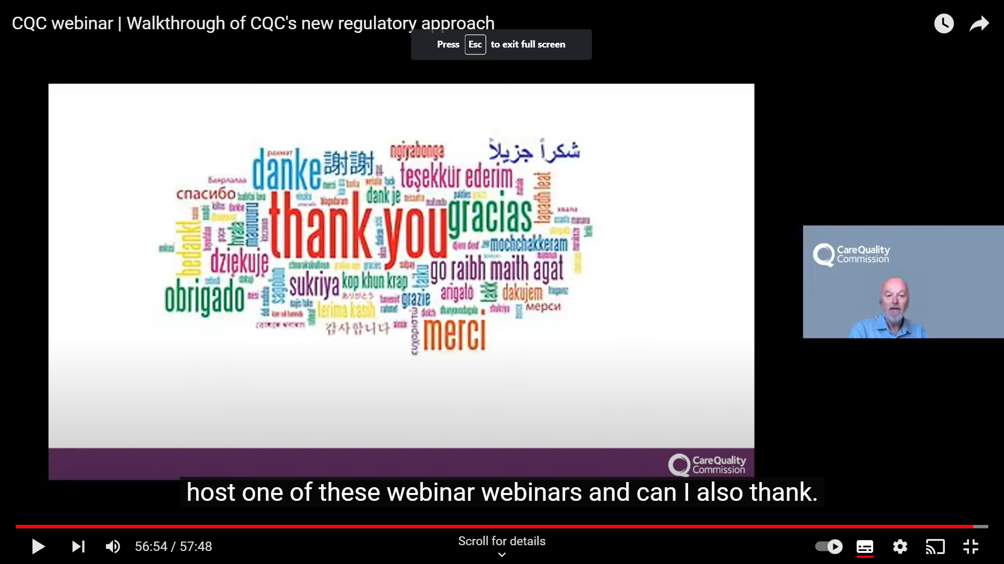
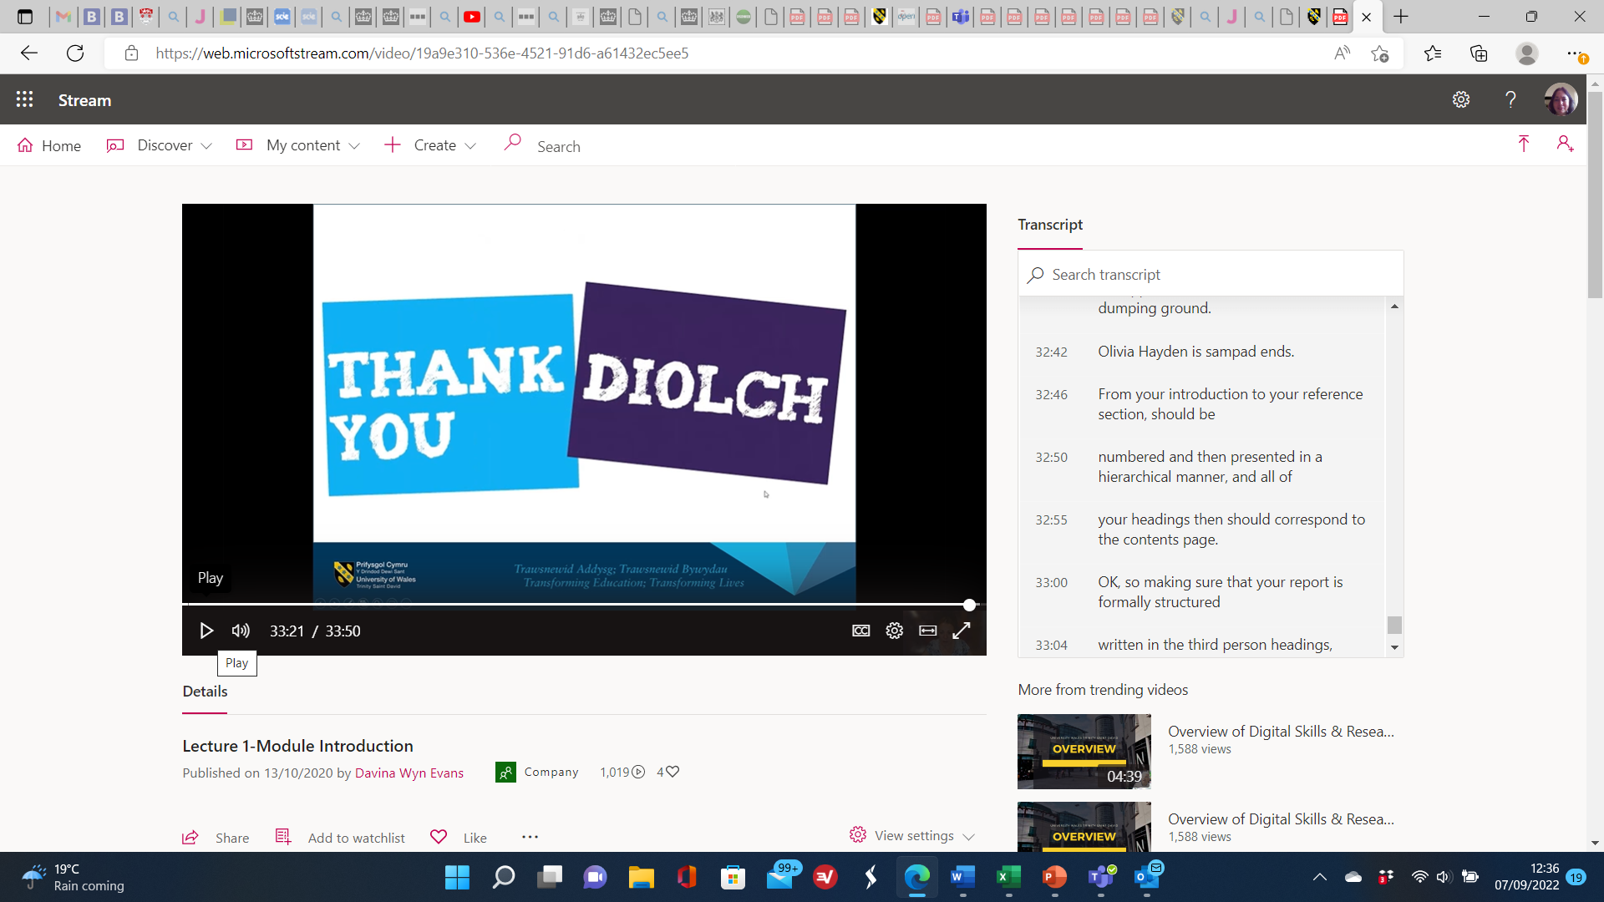

Slide 46
References
Brook, D. (2004) What is person-centred care in dementia? Reviews and Clinical Gerontology, Vol. 13, pp 2015-22.
Chambers, D. , Cantrell, A. and Booth, A. (2021) Rapid evidence review : challenges to implementing digital and data-driven technologies in health and social care. Report. The University of Sheffield , Sheffield.
DHSC (2019) Strengths-based Approach: Practice Framework and Practice Handbook. Dept of Health & Social Care: London.
Glasby, J. (2017) Understanding health and social care (3rd edition) Bristol: The Policy Press.
Glasby, J. & Dickinson, H. (2014) Partnership working in health and social care: what is integrated care and how can we deliver it? Bristol: The Policy Press.
Haugan, G. & Eriksson, M. (2021) Health Promotion in Health Care – Vital Theories and Research. Switzerland: Springer.
Maclean, S. (2015) Social Work Theory Cards. Kirwin Maclean Associates LTD: Lichfield.
Strengths-based approach: Practice Framework and Practice Handbook (publishing.service.gov.uk) (29th September 2022)
Video: What is a strengths-based approach? | SCIE (29th September 2022)

