Slide 1

Module Title: Psychology in Health and Social Care
Module Code: LCHS4010
Lecturer Name: Sam Parker
Component 1
Student Name: MD Ashraful Mokhlook Talukdar
Student ID: 2441949

Slide 2
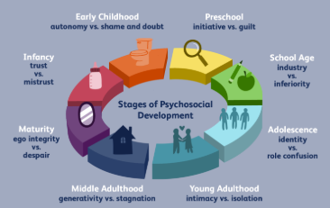
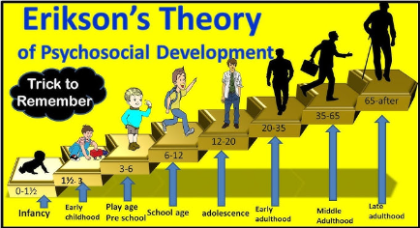
Introduction
Isaac is a four-year-old child with social and emotional problems.
Erikson’s Psychosocial Development Theory is used to understand his development (Maree, 2021).
The presentation appraises influences, interventions and application of theory.
Notes:
Isaac is a four-year-old child who is studying at a Children's Centre in London. Employees have seen separation anxiety, social withdrawal, language delay and challenges in engaging in group activities. These issues indicate difficulties in his psychosocial development in early childhood. Erikson's Psychosocial Development Theory was chosen for its exposition of the role of social experiences in emotional development, confidence, and behaviour. The theory is especially applicable since Isaac is in the Initiative versus guilt phase (Maree, 2021). This presentation will discuss how his development might be affected by biological and environmental factors, implement Erikson's theory in his life with practical interventions and analyse how useful the theory is.

Slide 3
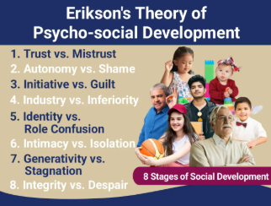
Erikson's Stages Relevant to Isaac
Autonomy vs Shame and Doubt supports autonomy and self-confidence.
Initiative versus Guilt stimulates exploration, socialising, and purpose (Rorije et al., 2023).
Unsuccessful resolution may result in withdrawal and low self-esteem.
Notes:
Two levels are of special interest to Isaac. In Autonomy versus Shame and Doubt, children acquire independence, self-control and confidence due to positive caring experiences. In Initiative versus Guilt, which normally takes place in the age range of three to six years, children are taught to explore and engage in activities and associate with other people without fear. The unwillingness to participate in group activities, clinginess to the mother, and reserved behaviour indicate that Isaac may experience various challenges in getting the positive results that are related to these stages (Rorije et al., 2023). Unless the developmental issues are addressed, children might develop a sense of incompetence, low self-esteem and inability to socialise with their peers and adults.

Slide 4
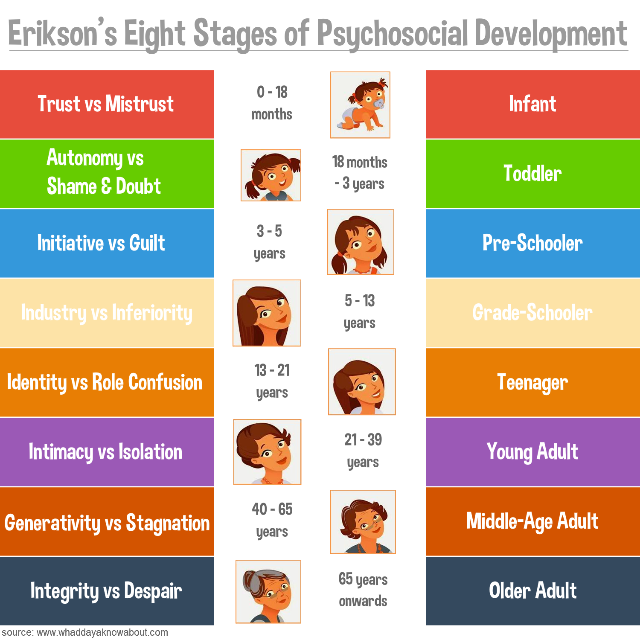
Applying Erikson's Theory to Isaac
Separation anxiety might indicate a lack of confidence and autonomy. (Zou et al. (2024),
Social withdrawal implies problems in gaining initiative and activity.
Language delays can limit children's social interactions and their ability to develop relationships within their social circle (Subbiah et al., 2024).
Notes:
Erikson's theory has been used to explain several issues about the behaviour of Isaac. His anxiety upon being separated from his mother can suggest that he is going through the challenges of building his confidence and independence linked to the Autonomy versus Shame and Doubt stage, as mentioned by Zou et al. (2024). In the same way, his rejection of free play and unwillingness to participate in a group activity can be indicative of difficulties in the Initiative versus Guilt stage, in which children are supposed to be free to explore and socialise. According to Subbiah et al. (2024), Language delays can also restrict access to communication with peers, making it unlikely to engage in social experiences that promote psychosocial development. As a result, Isaac may need more help to enhance confidence, autonomy and social competence.

Slide 5
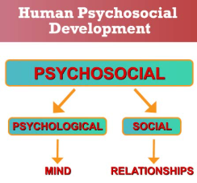
Biological Factors Influencing Isaac (Nature)
Temperament is a factor that affects emotional and behavioural responses of children.
Learning and self-regulation are influenced by sleep and brain development (Liu et al., 2024).
Confidence and communication skills could be framed by biological factors.
Notes:
There are biological factors that affect Isaac's development. Temperament can be defined as the natural behavioural and emotional inclinations of a child, and it may influence the reaction of a child to new circumstances and social interrelationships. Separation and problems in connecting with peers may be a source of distress to Isaac due to emotional sensitivity. Moreover, normal brain development in early childhood is strongly correlated with language acquisition, emotional regulation and social competence (Liu et al., 2024). The problems with sleep that Isaac has been reported to have can have a negative impact on attention, memory and emotional regulation. Such biological influences (in interactions with environmental experiences) can affect the confidence and learning skills, and psychosocial development of Isaac.

Slide 6
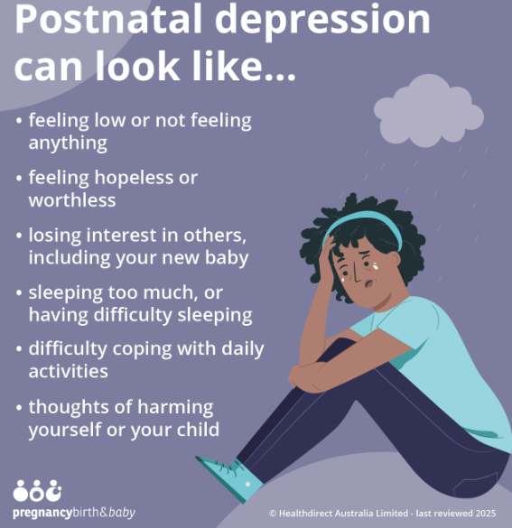
Environmental Factors Influencing Isaac (Nurture )
Maternal postnatal depression can lead to diminished quality of responsive care, gift-giving, and emotional support to Isaac.
Children with disrupted childcare systems and internel migration might have had fewer chances to experience stable social relationships and routines (King et al., 2023).
Such ecological issues can adversely affect the self-esteem, emotional stability and social growth of Isaac.
Notes:
The psychosocial development of Isaac is greatly affected by environmental influences. The presence of postnatal depression in his mother can influence the stability of emotional support and responsiveness that they provide at home. Knowingly, King et al. (2023) indicated that depression can impact parent-child emotional wellbeing, social competence and behavioural development. Moreover, Isaac has undergone disturbed childcare and a recent move, which can have disrupted essential relationships and routines. These experiences may minimise possibilities of social learning and confidence-building. Erikson’s theory suggests that positive psychosocial development of children through the attainment of autonomy, initiative, and support, and stable social environments is crucial.

Slide 7
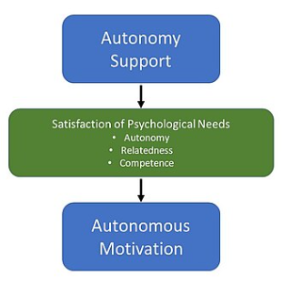
Intervention 1 – Supporting Autonomy
Incidental play will allow Isaac to become confident, learn to make decisions and be independent.
Giving him easy options in his daily routines can boost his confidence in being in control and competence.
The Erikson Autonomy versus Shame and Doubt stage can be promoted by positive reinforcement and help to achieve the successful progression (Bølstad et al., 2024).
Notes:
The first intervention is encouraging Isaac to maintain his autonomy by having guided activities of independent exploration and decision-making. Practitioners may promote self-initiated play and enable him to make simple decisions, including choosing activities or resources. These experiences enable children to become confident, responsible and self-controlled. Positive reinforcement is also important due to the ability of praise and encouragement to reinforce self-esteem and motivate to continue participation (Bølstad et al., 2024). Erikson believed that children who would develop autonomy successfully would be more inclined to become self-assured and independent. As such, fostering independence in the early years environment can possibly assist Isaac to feel less reliant on adults and be more inclined to explore new opportunities.

Slide 8
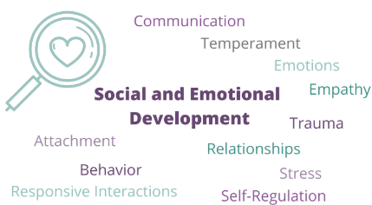
Intervention 2 – Supporting Initiative and Social Development
Social interactions can be promoted in small groups which minimise withdrawal.
Communication skills and imagination can be developed with the help of role-play and storytelling exercises (Pyle et al., 2022).
These strategies help them develop successfully at the stage of Initiative versus Guilt of Erikson because it promotes exploration and experience.
Notes:
Practitioners can enhance initiative and social confidence by offering him chances to cooperatively play and to take part in structured group activities. Children can be assisted in practising communication skills and learning friendship in a small-group learning environment. Role-play and storytelling activities encourage creativity, language development and self-expression (Pyle et al., 2022). Such experiences also enable children to take initiative through making decisions, leading activities and interacting with their peers. Erikson describes children in the Initiative versus Guilt stage as being able to explore and be actively involved in their surroundings. As a result, such interventions might enhance his interaction skills, self-confidence and desire to communicate with others, Isaac.

Slide 9
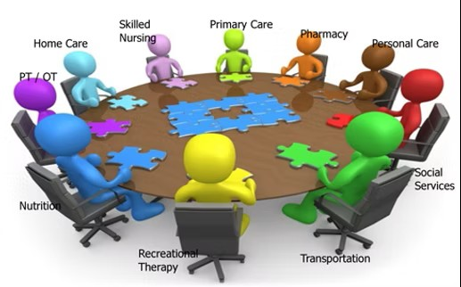
Multi-Agency Support Plan
Communication and social participation of Isaac can be enhanced through collaboration between early years practitioners and speech and language therapists.
Parental well being and enhancing the home environment can be achieved with the assistance of family support workers and health visitors (Marshall et al., 2022).
The collaboration of agencies fosters comprehensive treatment, which considers the developmental, emotional and educational needs of children concurrently (Wood et al., 2023).
Notes:
The multidisciplinary strategy is necessary to assist Isaac in terms of his complicated developmental requirements. The Children Centre can offer regular support to the early years practitioners, who can subsequently support communication delays by providing special interventions to the child through speech and language therapists. It is possible to collaborate closely with the mother of Isaac to enhance parental wellbeing and strengthen family resilience with the assistance of family support workers and health visitors (Marshall et al., 2022).. Professional collaboration enables the sharing of information and provision of coordination of support across various services. This is because such an approach appreciates the fact that the development of children can be attributed to various factors. Therefore, multi-agency working will be able to facilitate positive outcomes for the emotional, social and language development of Isaac (Wood et al., 2023).

Slide 10
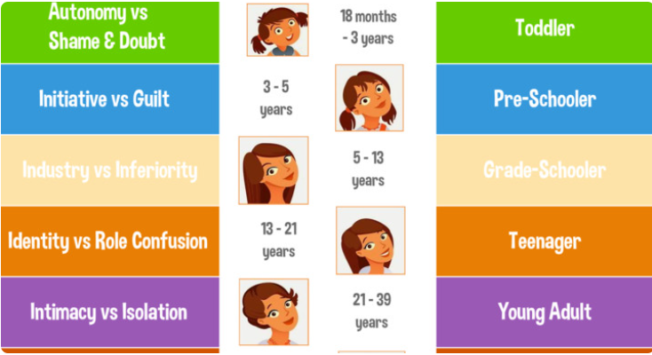
Critical Evaluation of Erikson's Theory
Erikson's theory by Erikson is effective in explaining the impact of social experiences on emotional growth and self-confidence (Orenstein and Lewis, 2022).
The theory offers practical advice when working with children in the context of health and social care.
The stage-based approach, however, might not consider cultural differences and individual variation in development (Syed and McLean, 2023).
Notes:
The Psychosocial Development Theory presented by Erikson has a number of strengths in relation to the case of Isaac. As Orenstein and Lewis (2022) note, the theory emphasises the role of social relations, emotional and environmental factors in childhood. The theory is also applicable in health and social care as it contains distinct developmental stages which can be used to determine interventions and assist in planning. However, certain disadvantages are to be recognised as well. Syed and McLean (2023) contended that psychosocial development does not necessarily take place in predetermined steps and that cultural background may have a more diverse impact on developmental experiences. Moreover, the theory does not emphasise biological processes as much as other perspectives on biological processes. In spite of these drawbacks, it is still very applicable in comprehending the needs of Isaac.

Slide 11
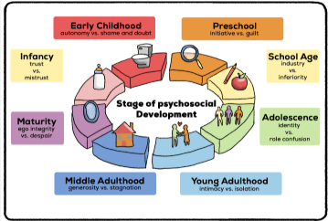
Conclusion
The Psychosocial Development Theory by Erikson was used to examine the developmental experiences of Isaac with the challenges he is facing at the moment.
Isaac had his problems connected with the psychosocial stages of Autonomy vs. Shame and Doubt and Initiative vs. Guilt.
Support strategies aimed at fostering independence, social involvement, family support and positive developmental achievements.
Notes:
In this presentation, the developmental needs of Isaac were explored using the Psychosocial Development Theory of Erikson. The discussion brought to the fore the ways that his experiences of maternal depression, childcare disruption and social withdrawal can affect his psychosocial development. The emphasis was placed particularly on the following stages: Autonomy versus Shame and Doubt and Initiative versus Guilt, which are particularly applicable in the early stages of childhood. Both biological and environmental factors have been taken into consideration, and based on practical interventions, interventions have been proposed that empower confidence, independence and social interaction. Therefore, the presentation revealed that one of the key elements in facilitating healthy psychosocial growth among young children is the existence of supportive relations, positive experiences and coordinated professional support.

Slide 12
References
Bølstad, E., Fandrem, H. and Roland, E. (2024) ‘Promoting autonomy and social competence in early childhood education settings’, Early Child Development and Care, 194(3), pp. 421–435. Available at: https://doi.org/10.1080/03004430.2023.2187125 [Accessed: 23 June 2026].
King, L.S., Humphreys, K.L. and Gotlib, I.H. (2023) ‘The impact of parental depression on child socioemotional development: recent advances and future directions’, Current Opinion in Psychology, 53, 101656. Available at: https://doi.org/10.1016/j.copsyc.2023.101656 [Accessed: 23 June 2026].
Liu, J., Tu, X., Wang, W., Li, Z. and Chen, X. (2024) ‘Sleep problems and emotional-behavioural development in preschool children: a longitudinal study’, BMC Pediatrics, 24(1), pp. 1–11. Available at: https://doi.org/10.1186/s12887-024-04654-5 [Accessed: 23 June 2026].
Maree, J.G. (2021) ‘The psychosocial development theory of Erik Erikson: critical overview’, Early Child Development and Care, 191(7–8), pp. 1107–1121. Available at: https://doi.org/10.1080/03004430.2020.1845163 [Accessed: 23 June 2026].
Marshall, J., Goldbart, J. and Phillips, J. (2022) ‘Interprofessional collaboration in early childhood intervention services: improving outcomes for children and families’, International Journal of Language and Communication Disorders, 57(5), pp. 1012–1025. Available at: https://doi.org/10.1111/1460-6984.12736. [Accessed: 23 June 2026].
Orenstein, G.A. and Lewis, L. (2022) ‘Eriksons Stages of Psychosocial Development’, StatPearls, updated review of psychosocial development theory and application in healthcare practice.
Pyle, A., DeLuca, C. and Danniels, E. (2022) ‘A scoping review of play-based pedagogies in early childhood education’, Early Childhood Education Journal, 50(6), pp. 1023–1036. Available at: https://doi.org/10.1007/s10643-021-01218-0 [Accessed: 23 June 2026].
Rorije, M., Damen, S., Janssen, M.J. and Minnaert, A. (2023) ‘Applying Erikson’s theory of psychosocial development to understand autonomy development in children and youths with deafblindness: a systematic literature review’, Frontiers in Education, 8, 1228905. Available at: https://doi.org/10.3389/feduc.2023.1228905 [Accessed: 23 June 2026].
Subbiah, G.K., Reijneveld, S.A., Hartman, C.A., van der Zee-van den Berg, A.I., Boere-Boonekamp, M.M. and de Kroon, M.L.A. (2024) ‘Impact of trajectories of maternal postpartum depression on infants’ socioemotional development’, Pediatric Research, 96, pp. 519–524. Available at: https://doi.org/10.1038/s41390-023-02697-w [Accessed: 23 June 2026].
Syed, M. and McLean, K.C. (2023) ‘Understanding identity development in cultural context: extending Eriksonian perspectives’, Human Development, 67(1), pp. 1–17. Available at: https://doi.org/10.1159/000528187 [Accessed: 23 June 2026].
Wood, R., Douglas, H. and Ponsford, R. (2023) ‘Multi-agency approaches to supporting children and families: evidence from integrated early intervention services’, Child Care in Practice, 29(4), pp. 421–438. Available at: https://doi.org/10.1080/13575279.2022.2045579 [Accessed: 23 June 2026].
Zou, S., Zou, X., Zhang, R., Xue, K., Xiao, A.Y., Zhou, M., Fu, Z. and Zhou, H. (2024) ‘Maternal depression and early childhood development among children aged 24–59 months: the mediating effect of responsive caregiving’, Annals of General Psychiatry, 23(30). Available at: https://doi.org/10.1186/s12991-024-00515-z [Accessed: 23 June 2026].

Slide 13
Bibliography
Erikson, E.H. (1963) Childhood and Society. 2nd edn. New York: Norton.

Slide 14


