Slide 1
Student Name. Amir Majeed
Student ID. 2315812
Module Title. Advance Cyber Security
Module Code. ACCB6000
Lecturer Name. Sana Jokhio

Slide 2
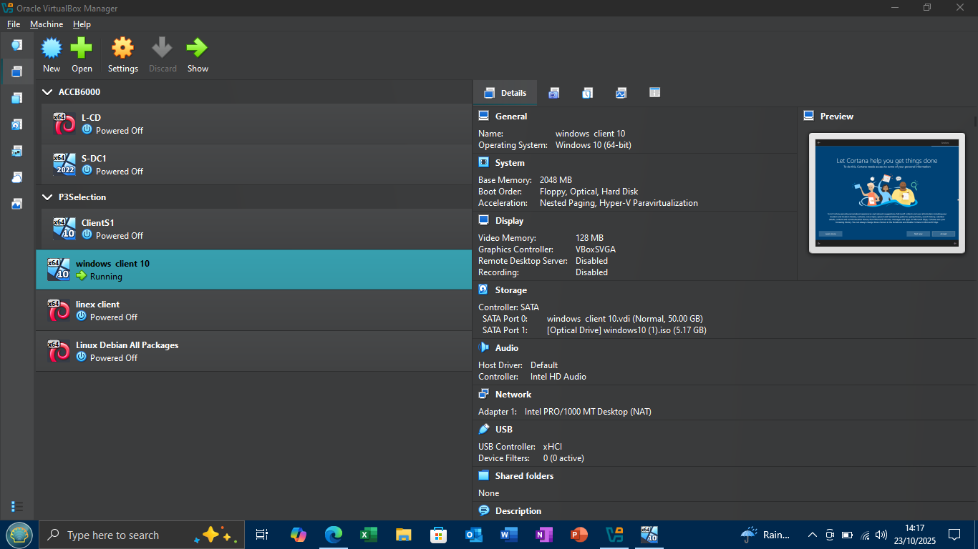
Slide 1: Initial network status shows machines connectivity

Slide 3
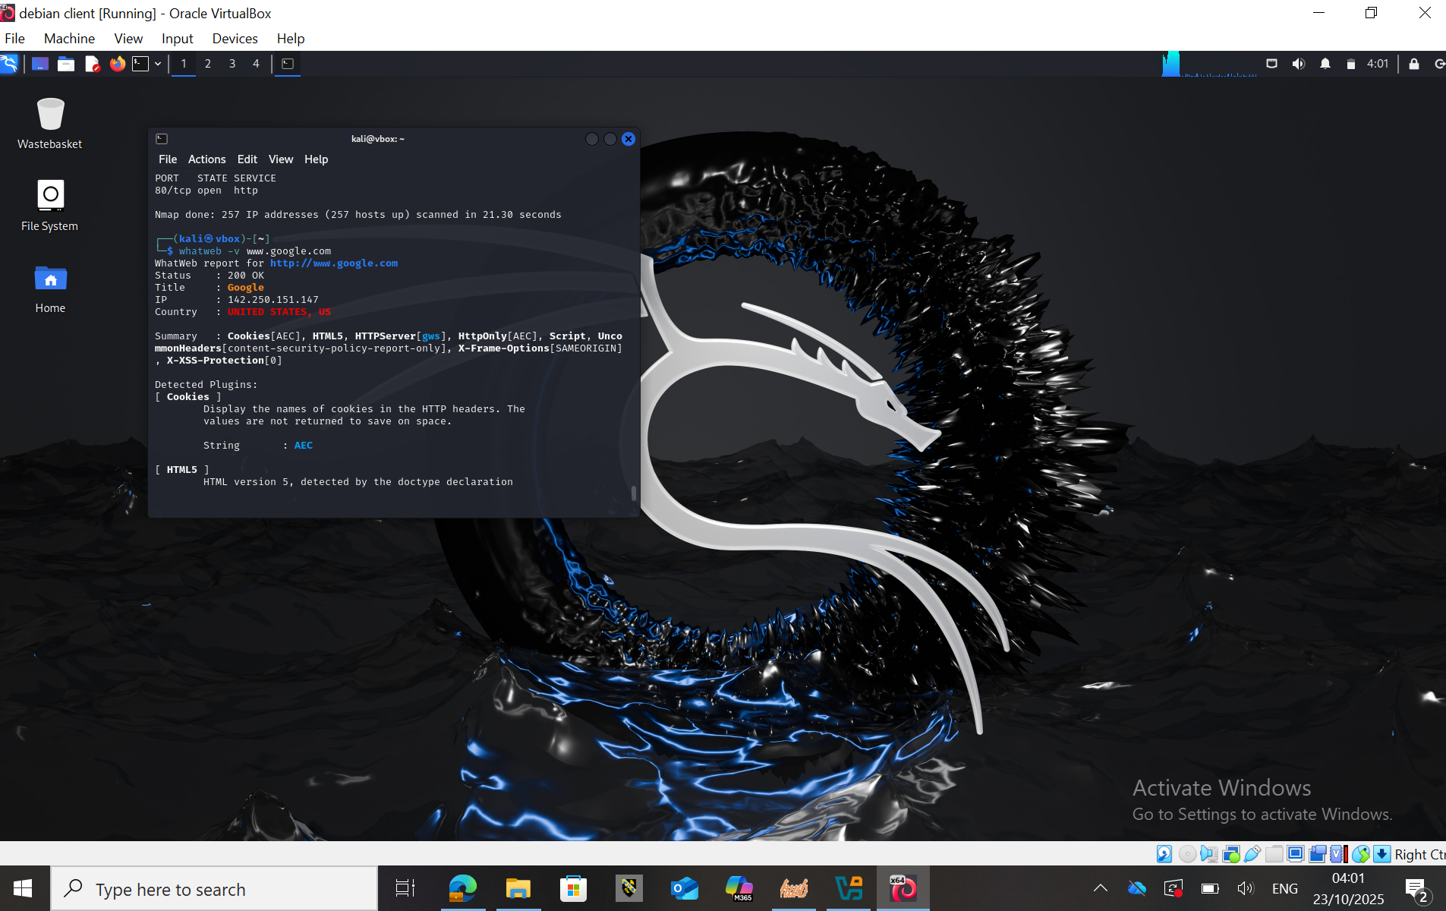
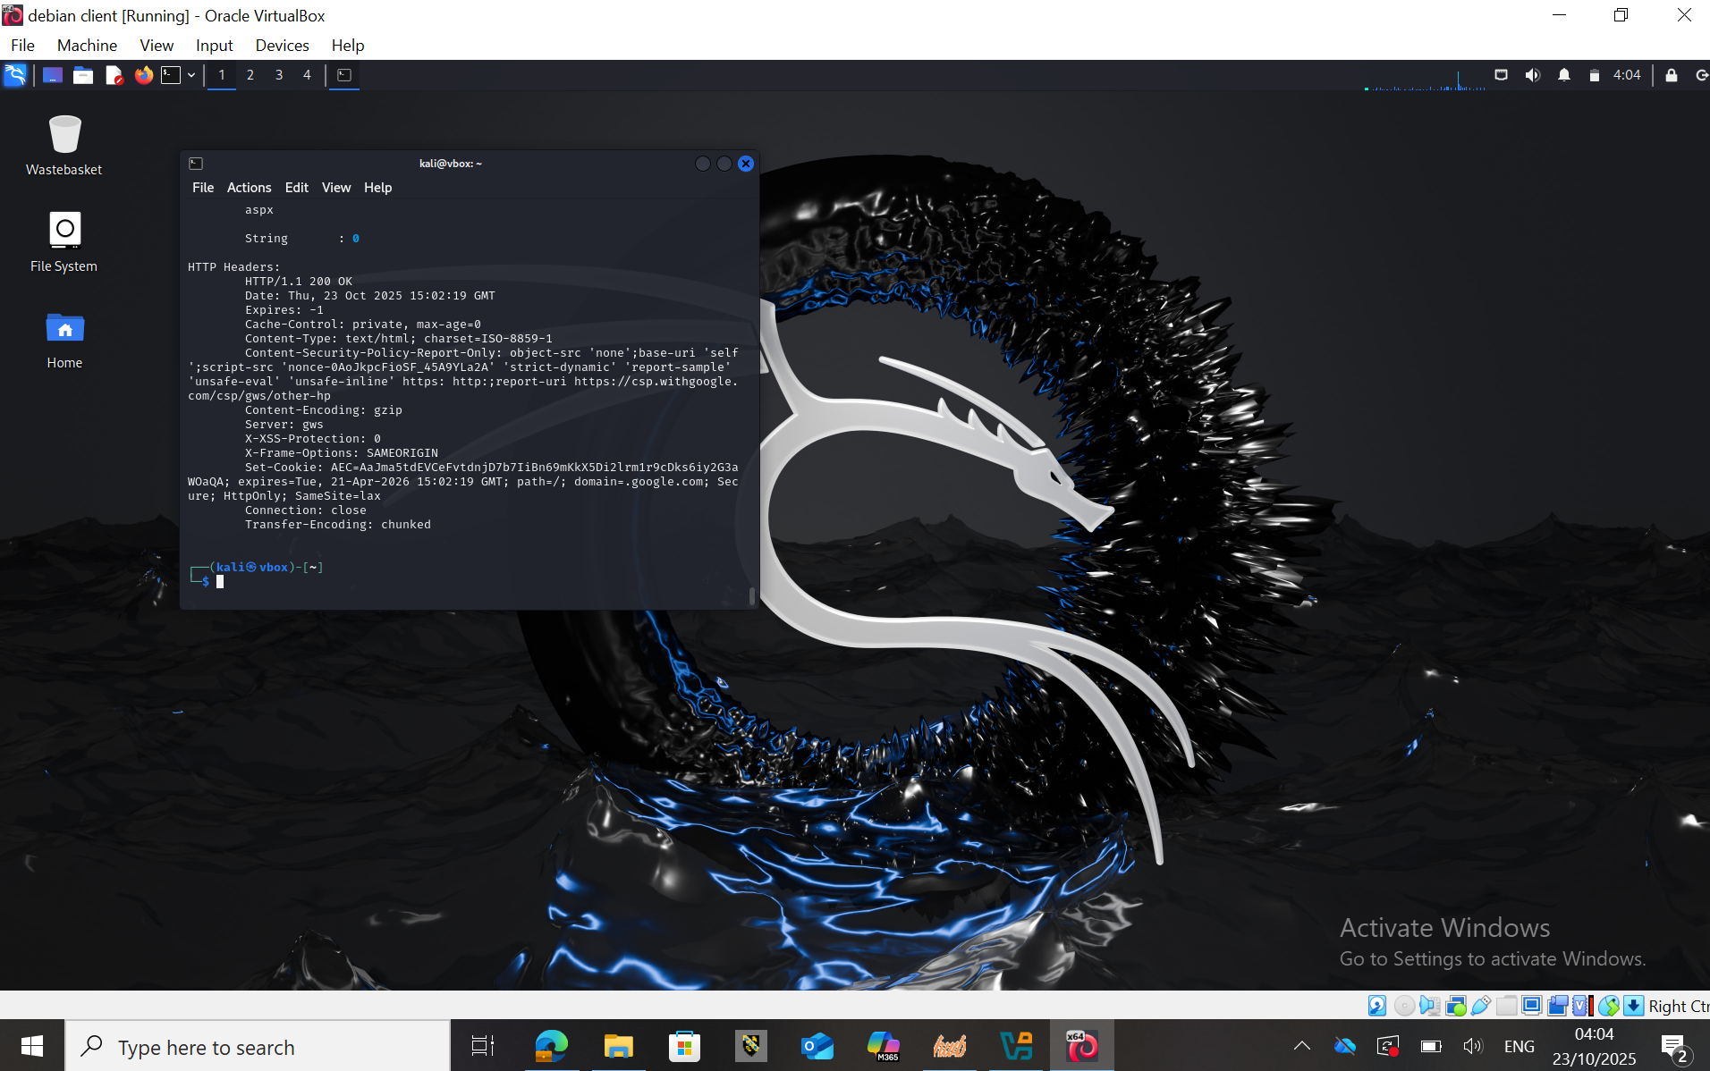
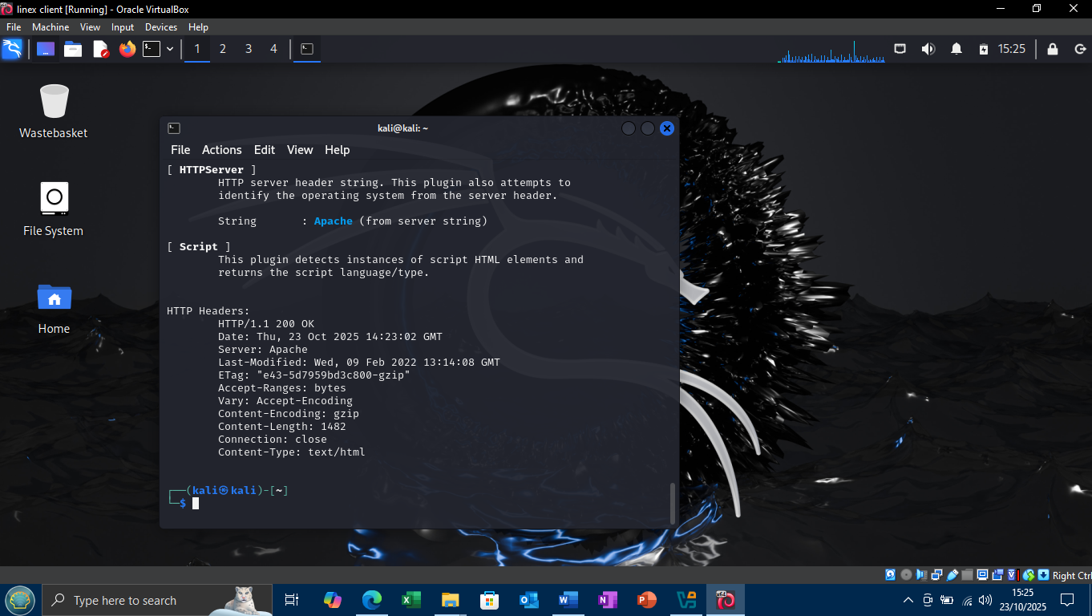
Slide 2 : Vulnerability Assessment Report using website

Slide 4
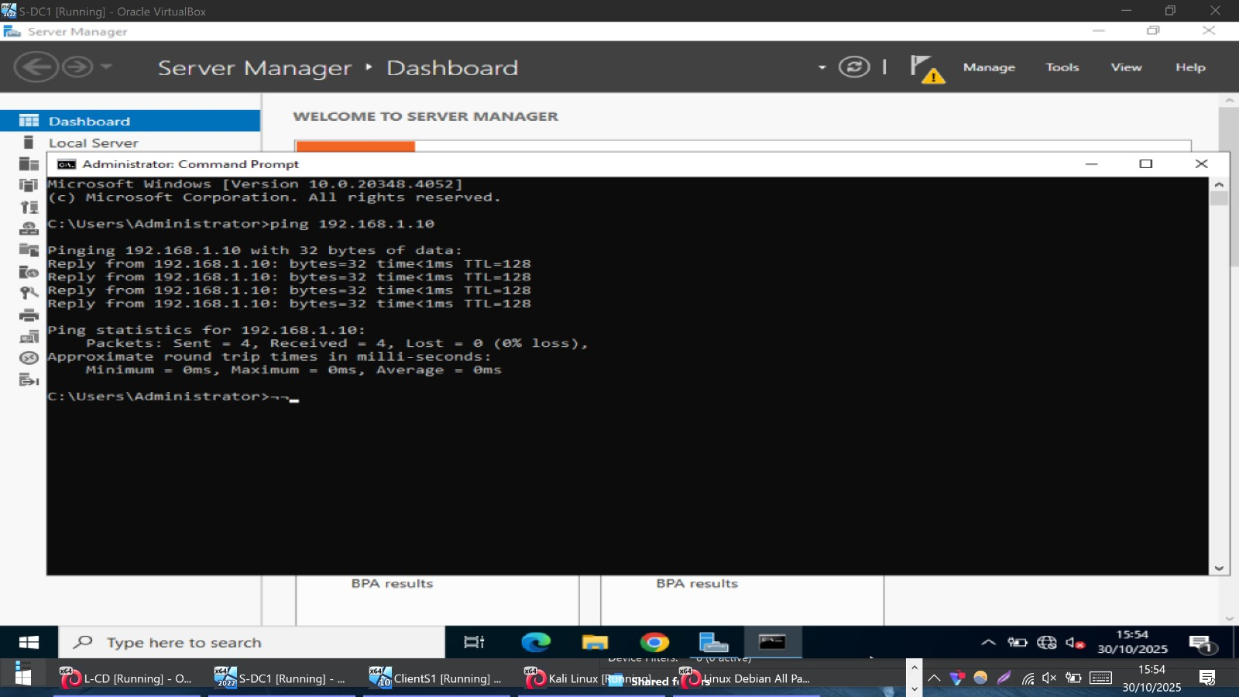
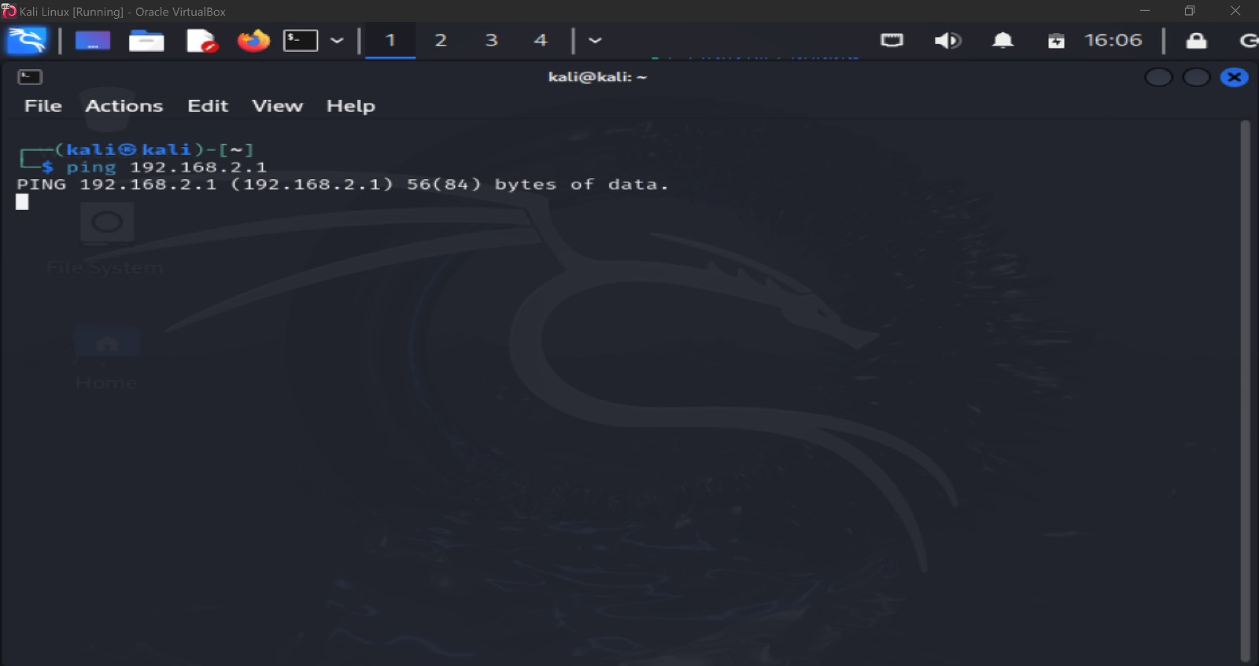
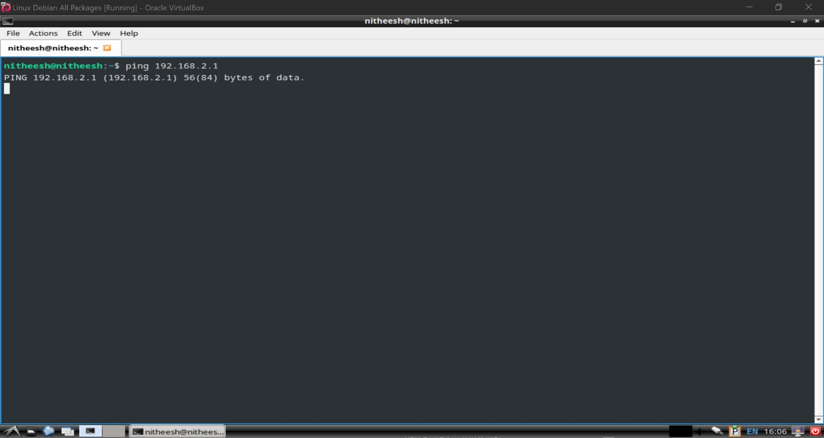
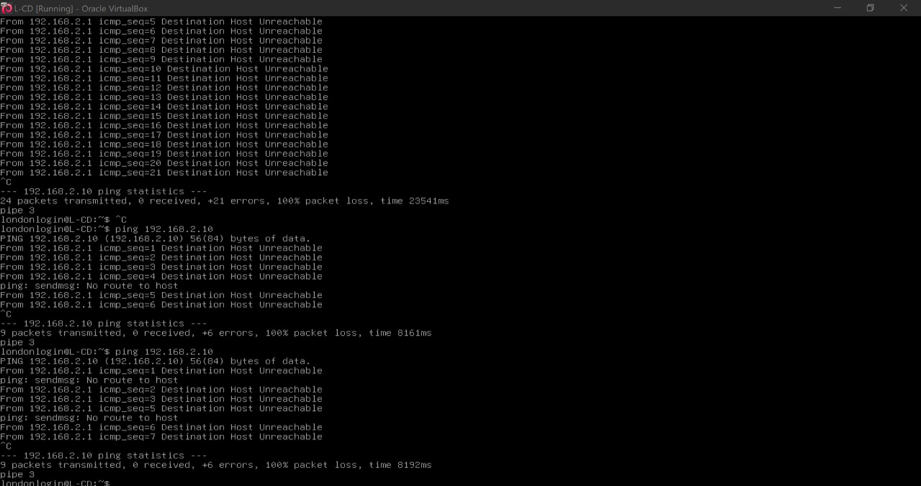
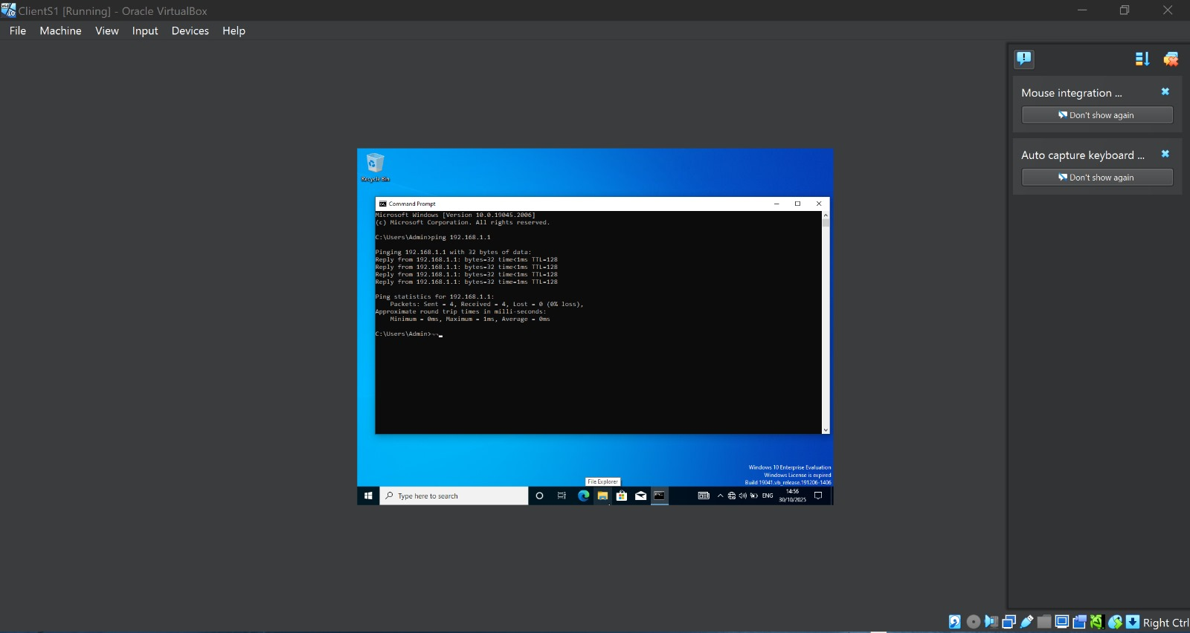
Slide 3: Screenshots of Ip address configuration in the OS Terminal (security-focused OS), Test connectivity (ping) with Swansea and London Servers and Clients.

Slide 5
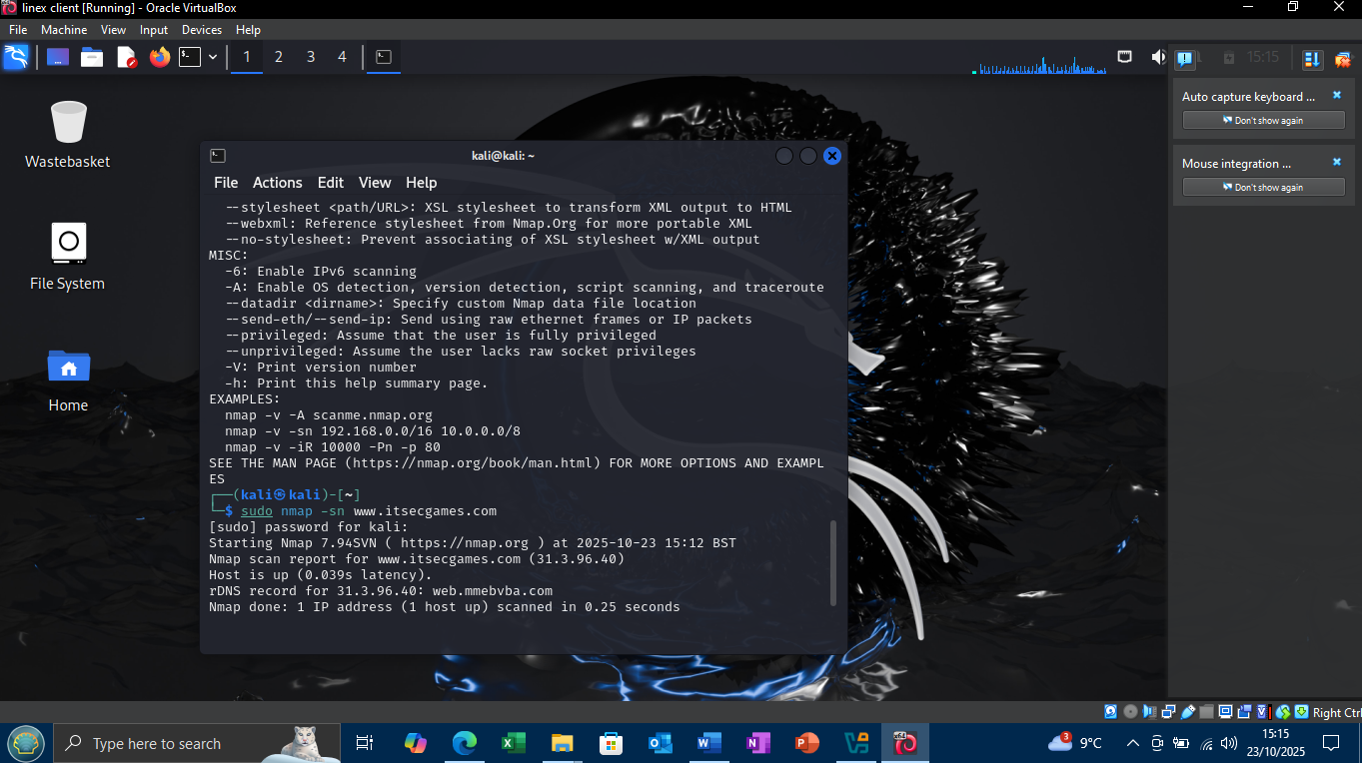
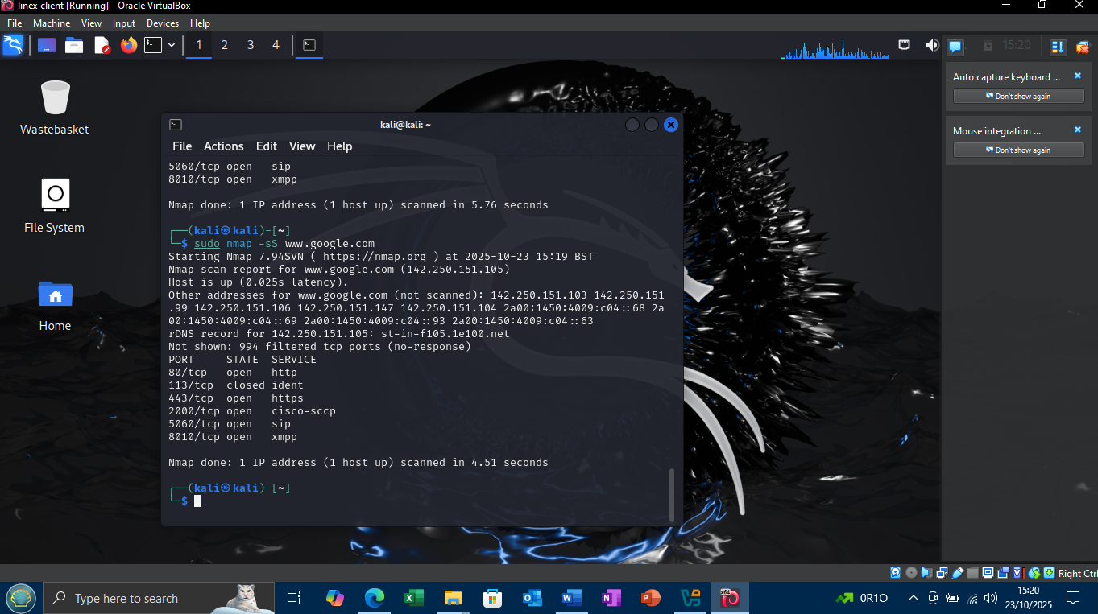
Slide 4: Summarizing the information gathered using website

Slide 6
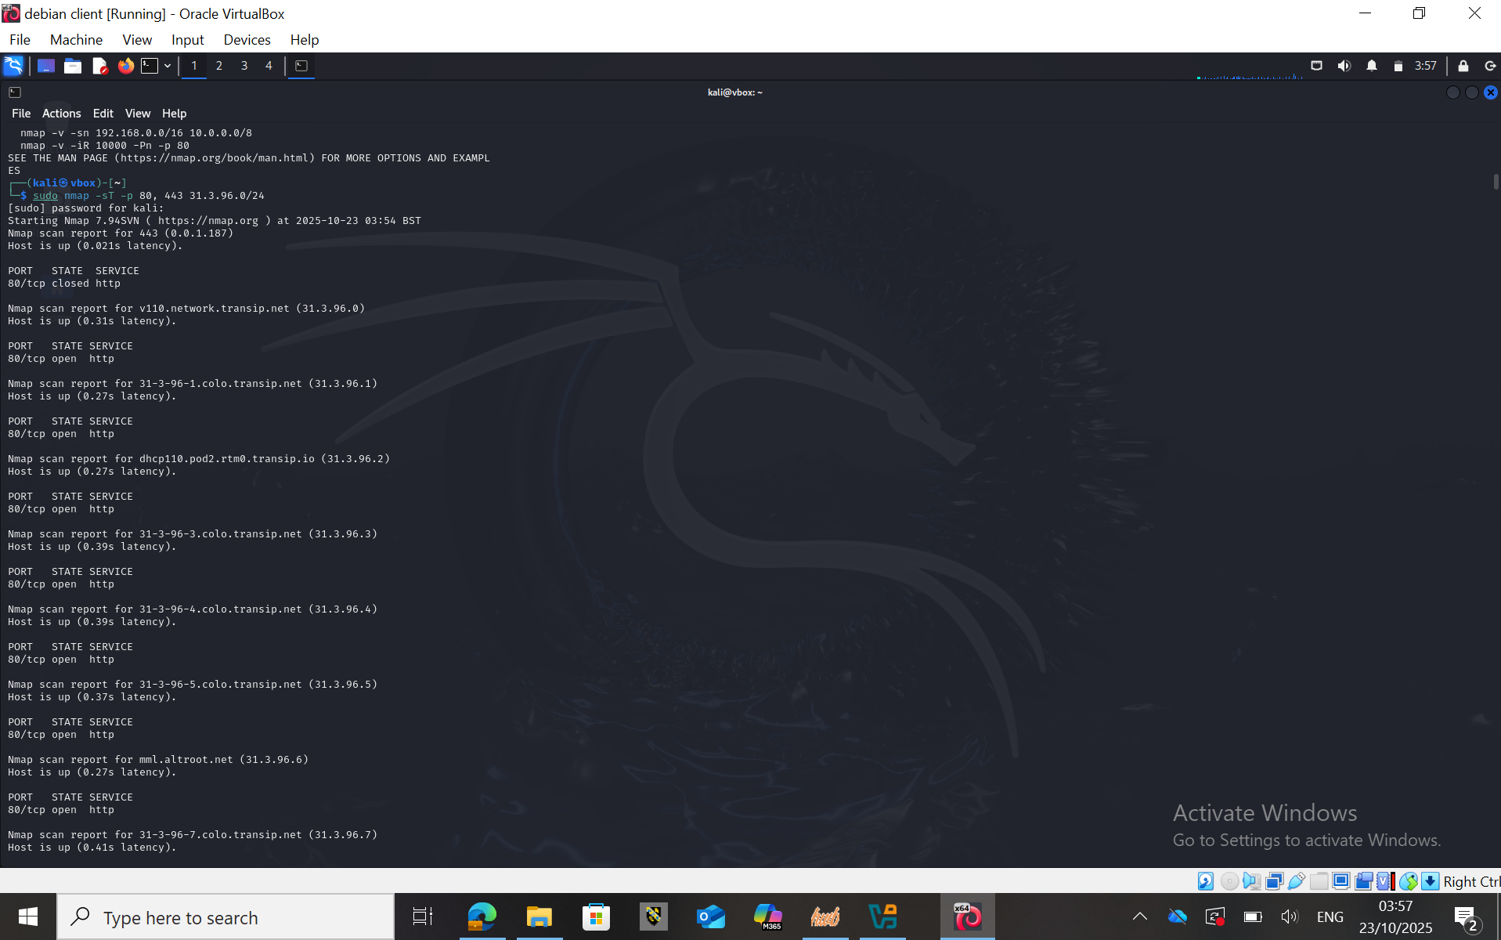
Slide 5: Present the Vulnerabilities using website.

Slide 7
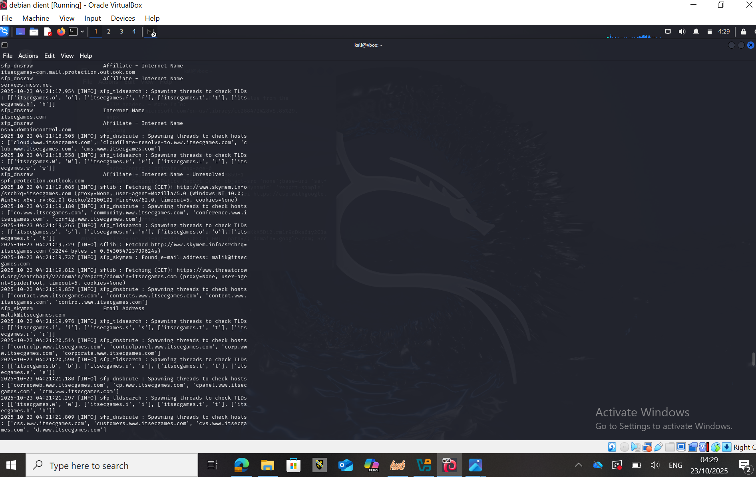


Slide 6: Highlights of Exploitation & Post Exploitation using Website

Slide 8

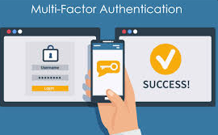
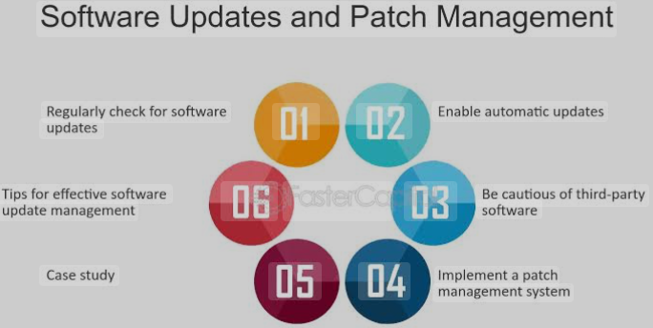
Implementing Security Measures
Preventive security measures are protections you implement before an attack occurs.
Making it more difficult for someone to attack, abuse, or misuse the network is their way of lowering the likelihood of a security issue. Consider them as security measures, such as firewalls, password, and regulations, intended to prevent dangers sooner rather than later [1].
1. Multi-Factor Authentication MFA
2. Regular Patch Management
In order to obtain access, MFA needs user to supply two or more verification factors [2].
Its role in security, even in the event its password hacked it greatly lower the chance of unwanted access [3].
Example: Enforce MFA for all user logins by combining biometric or onetime codes given by email or SMS with password [4].
Utilising the most recent security patches to keep system and software updated [5].
Its role is to prevent the exploitation of known vulnerabilities [6].
Example : Plan automatic upgrades and keep an eye on patch distribution for all apps and devices[7].

Slide 9

References
[1] E. von Faber, Managing IT Service Security: Methods and Recipes for User Organizations and Providers Along the Supply Chain. Germany: Springer Nature Switzerland, 2024.
[2] A. Ahmed, Elngar, R. Kumar, and S. Srivastav, Effective Strategies for Combatting Social Engineering in Cybersecurity. United States: IGI Global Scientific Publishing, 2024.
[3] M. Fanti, Implementing Multifactor Authentication: Protect Your Applications from Cyberattacks with the Help of MFA. Birmingham, U.K. Packt Publishing, 2023.
[4] J. S. Shin and T. Liu, Password Authentication for Web and Mobile Apps: The Developer’s Guide to Building Secure User Authentication. London, U.K.: Developer Press, 2022.
[5] J. R. Vacca, Computer and Information Security Handbook. Netherlands: Morgan Kaufmann, 2024.
[6] J. Edwards and G. Weaver, Building Effective Privacy Programs: Cybersecurity from Principles to Practice. United Kingdom: John Wiley & Sons, Limited, 2025.
[7] M. Chapple, J. Shelley, and J. M. Stewart, Information Security and Privacy Quick Reference: The Essential Handbook for Every CISO, CSO, and Chief Privacy Officer. United States: Wiley, 2025.

