Slide 1
INTRODUCTION TO PUBLIC HEALTH
Epidemiology
LCHS4008
WEEK 2

Slide 2
Learning outcomes
Upon successful completion of this module, you should be able to:
Understand different approaches and strategies used to measure, monitor and control the incidence of disease in communities
Investigate the implications of illness and disease in communities for the provision of health and social care services
Understand the factors influencing the health and wellbeing of individuals in health or social care settings.

Slide 3
Module Summary
The module aims overall to raise learners’ awareness and critical evaluation of factors influencing public health and the different approaches taken to reduce incidence of disease and illness in communities.

Slide 4
Lesson objectives
At the end of this session, students will be able to explain:
The meaning of Epidemiology
Role of epidemiology in public health
Broad aims of epidemiology
Some Epidemiology Terminologies
Who is an epidemiologist?
The term disease, illness and sickness
The term prevalence and incidence

Slide 5

What is epidemiology?

Slide 6
epidemiology
“The word epidemiology has its roots in the study of what happens in a population”.
(CDC, 2012)

Slide 7
Definition of Epidemiology
Epidemiology is the “study of the nature, cause, control and factors of the frequency and distribution of disease, disability, and death in human populations”.
IN SIMPLE WORDS….
Epidemiology is the method used to find the causes of health outcomes and diseases in populations

Slide 8
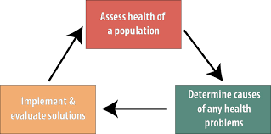
Epidemiology is

Slide 9
What is the role of epidemiology in public health?

Slide 10
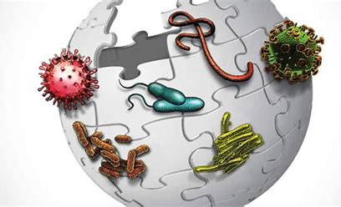
Role of Epidemiology in PH
Epidemiology is ”the science dealing with the spread and control of diseases and other factors relating to the health of the populations and other groups”.
.

Slide 11
What are the broad aims of epidemiology?

Slide 12
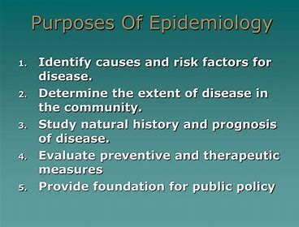
Purposes of Epidemiology
Notes:
Therapeutic means: curing

Slide 13
Some Epidemiology Terminologies

Slide 14
Activity
Working in a groups, research the following terminologies
Epidemic
Pandemic
Endemic diseases
Feedback your findings to the whole class
Notes:
Pandemic- SARS-Covid19, MERS, Cholera, Bubonic plague, HIV/AIDS
Epidemic-yellow fever, small pox, measles, polio, Ebola virus
Endemic-flu, malaria

Slide 15
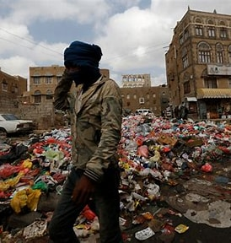
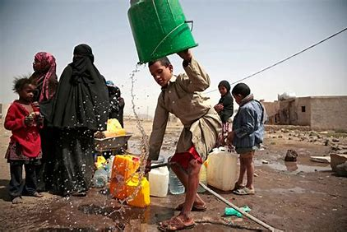
Epidemic
Epidemic diseases, are those that 'visit' a population and spread rapidly within the population.
(CDC, 2012)
Cholera Epidemic in Yemen

Slide 16
Epidemic
Epidemic is a disease occurring suddenly in numbers clearly in excess of normal expectancy.
A widespread occurrence of an infectious disease in a community at a particular time:
(CDC, 2012)

Slide 17
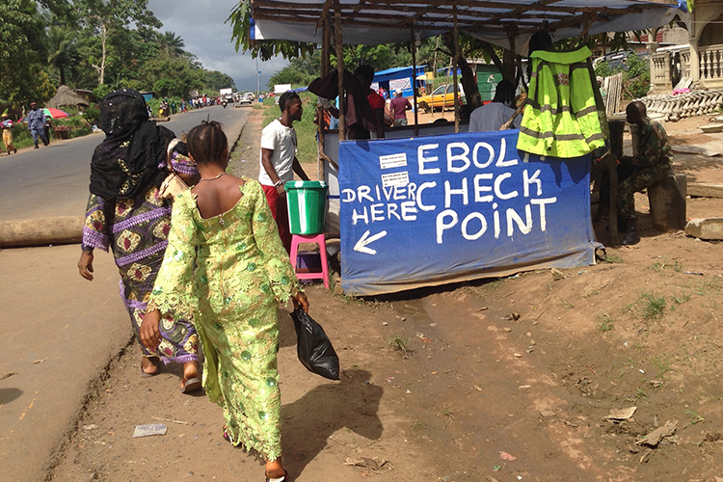
Endemic
Endemic is “a disease or pathogen present or usually prevalent in a given population or geographic region at all times”.
Endemic diseases are those that constantly 'live' in a particular region
(CDC, 2012)
Central Africa : Ebola
Notes:
A disease outbreak is endemic when it is consistently present but limited to a particular region. This makes the disease spread and rates predictable. Malaria, for example, is considered endemic in certain countries and regions.
Ebola is endemic to Central Africa

Slide 18
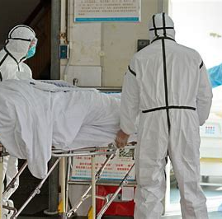
Pandemic
Pandemic is “a widespread epidemic distributed or occurring widely throughout a region, country, continent, or globally”.
(WHO, 2022)

Slide 19
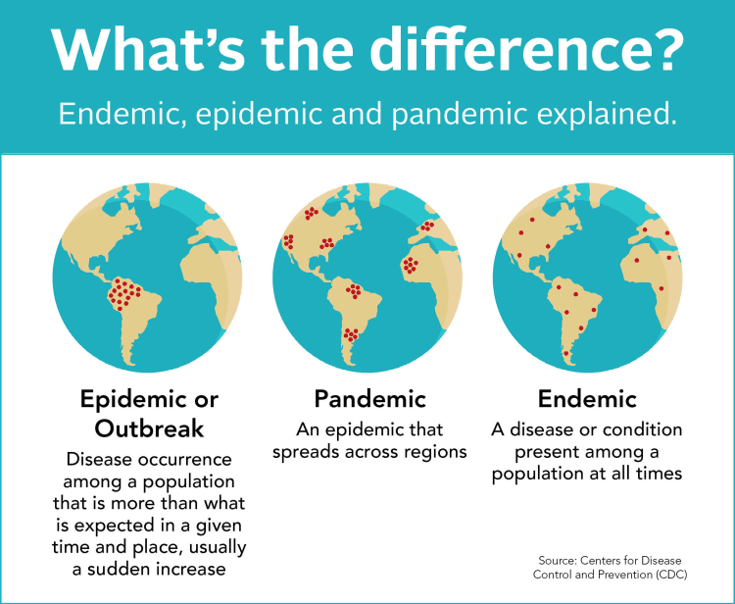

Slide 20
Activity
Working in pairs, match each term with the correct sentence.
A. endemic
B. pandemic
C. epidemic
Malaria is present in Africa at all times because of the presence of infected mosquitoes. So, Malaria is _____ in Africa.
2. HIV/AIDS is one of the worst global diseases in history. It is a/an _________.
20
Notes:
Q1. The correct answer is A, endemic.
Q3 The correct answer is B, pandemic.

Slide 21
Activity
Working independently, fill in the blank with the correct answer.
A. pandemic
B. intervention
C. epidemic or outbreak
D. prevention
A(n) ________________________ is a disease occurrence among a population that is in excess of what is expected for a given time and place.
Notes:
The correct answer is C, epidemic or outbreak.

Slide 22
Who is an epidemiologist?

Slide 23

Epidemiologist
An Epidemiologist is “a public health scientist, who is responsible for carrying out all useful and effective activities needed for successful epidemiology practice”.
(CDC, 2012)

Slide 24

Activity
Working in groups, brainstorm on this question
Do you all think the term disease and illness are conceptually different?
Why do you think so?
Feedback your findings to the whole class

Slide 25
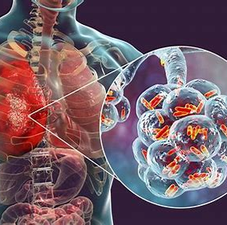
Disease
Disease, illness and ill health are often used interchangeably, although they have very different meaning
Disease is derived from the word desaise, meaning uneasiness or discomfort.
Disease is an objective state of ill health which can be verified through microscopic analysis.
For example, microscopic analysis of a particular cell may produce evidence of a change in structure resulting into diagnosis of cancer or disease.
Naidoo and Wills, 2009)

Slide 26
Disease
According to medicine, “disease ... is a pathological process or abnormality of the body, most often physical as in throat infection, or cancer of the bronchus, sometimes undetermined in origin, as in schizophrenia.

Slide 27
Activity
Working in groups, brainstorm on this question in relation to disease
What is the meaning of exogenous factors ?
What is the meaning of endogenous factors?
Feedback your findings to the whole class
Notes:
Disease can be due to exogenous factors meaning outside the body e.g viral infection.
Disease can be due to endogenous factors meaning inside the body e.g, inadequate thyroid function, not forming blood ceel

Slide 28
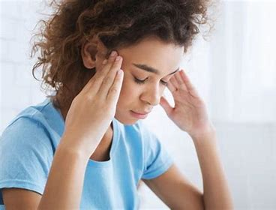
Illness
Illness refers to the experience of a kind of disease therefore deals with the subjective experience of bodily disorder and feelings of pain and discomfort (that is the human experience of sickness).
“Illness ... is a feeling, an experience of unhealth/ill health which is entirely personal, interior to the person of the patient.
Sometimes illness exists where no disease can be found.
(Naidoo and Wills, 2009)
Notes:
For example someone may be diagnosed with cancer through screening even when there have been no reported symptoms
Ill health is therefore an umbrella term used to refer to the experience of disease and illness.

Slide 29
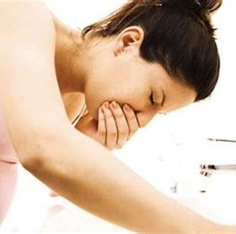
Sickness
“Sickness ... is the external and public mode of unhealth.
(Boyd, 2000)

Slide 30
Disease Illness and Sickness
Health
Illness
Disease
Sickness
Experience or feeling
Physical change to the body
Temporary/short term. Illness and disease. Identifies someone’s right

Slide 31
What are Public Health Indicators?

Slide 32
Public Health Indicators
Public health professionals use two important indicators to measure population health:
disease prevalence
disease incidence.

Slide 33
What is PREVALENCE AND INCIDENCE?

Slide 34
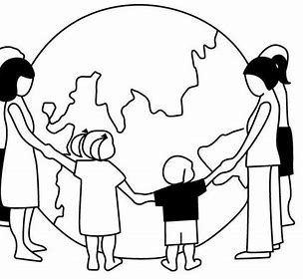
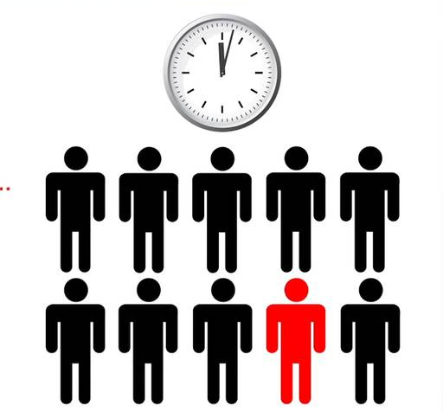
Prevalence and Incidence
Prevalence is a statistical concept referring to the “number of new and old cases of a disease that are present in a particular population at a given time”.
Whereas incidence refers to the “number of new cases of a disease that develop in a given period of time”.
OR

Slide 35
Prevalence and Incidence
Disease prevalence is “the number of individuals within a population who have a particular disease at a given time”.
Disease incidence is “the number of new cases of a particular disease within a population in a given time period”.

Slide 36
PREVALENCE AND INCIDENCE
Incidence is the rate of occurrence of an event;
That is “number of new cases of disease occurring over a specified period of time; may be expressed per a known population size”
Prevalence is “the number of cases of disease occurring within a population at any one given point in time”

Slide 37
Conclusion with the video
Watch the video
What is Epidemiology? - YouTube
Feedback your findings to the whole class
Notes:
Relationship Between Incidence and Prevalence – YouTube
Measuring disease frequency - Incidence and prevalence - YouTube

Slide 38
Activity
Working in a groups, research the current incidence and prevalence rate of Covid-19 and obesity in the UK
Feedback your findings to the whole class
Notes:
Transmission of Covid19

Slide 39
Activity 2
Solve the Outbreak Virtual Competition (use the link provided in the text).

Slide 40
REFERENCES
Brown L, ed. (1993)The new shorter English dictionary. Oxford: Clarendon
Boyd, K.M., 2000. Disease, illness, sickness, health, healing and wholeness: exploring some elusive concepts. J Med Ethics: Medical Humanities, 26(1), pp.9-17.
Centres for Disease Control and Prevention (2012) Available at: https://www.cdc.gov/csels/dsepd/ss1978/lesson1/section11.html (accessed date 22nd August 2022).
Morris JN. ( 1957) Uses of epidemiology. Edinburgh: Livingstone.
Naidoo, J. and Wills, J. (2009) Foundations for health promotion. Third edition. Place of publication not identified: Elsevier.
Last JM (1988), ed. A dictionary of epidemiology. 2nd ed. Toronto, Canada: Oxford University Press.
Last J.M., (2001) Dictionary of epidemiology. 4th ed. New York: Oxford University Press; p. 61.
The BMJ (2022) What is epidemiology. Available at: https://www.bmj.com/about-bmj/resources-readers/publications/epidemiology-uninitiated/1-what-epidemiology (Accessed date 20th August 2022).
YouTube (2018) What is Epidemiology? Explain Epidemiology, Define Epidemiology, Meaning of Epidemiology. https://www.youtube.com/watch?v=uU6MN603aP0
Notes:
https://openwho.org/courses/pandemic-epidemic-diseases
https://www.mphonline.org/worst-pandemics-in-history/
https://www.publichealth.columbia.edu/public-health-now/news/epidemic-endemic-pandemic-what-are-differences

