Slide 1
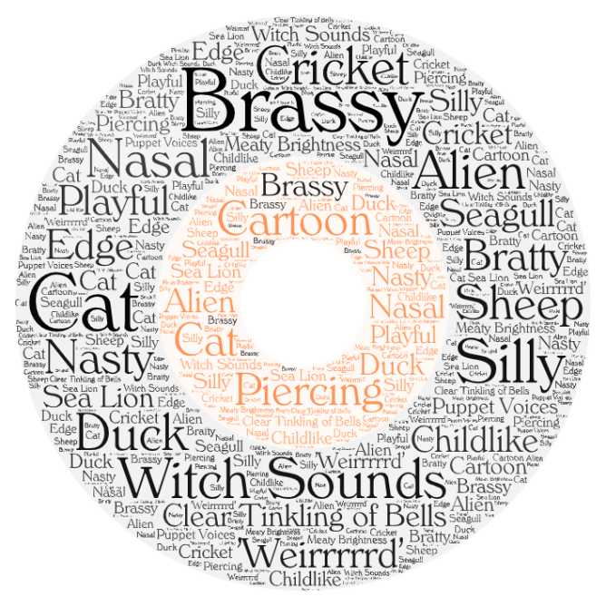
TWANG PRODUCTION: Comprehensive application in vocal pedagogy literature and online sources
Crystal Hanson
BMPF7010

Slide 2



Table of Contents
1. Introduction
  Personal/Background
  Reasoning/Rationale
  2. Context and Project Overview
  Research Questions
  Notable Sources
  What is Twang?
  Teaching and Learning Twang
  Obstacles
  Methodology/Methods
  Document Analysis
4. Findings
5. Conclusion
TWANG

Slide 3
TWANG PRODUCTION
PERSONAL INTRODUCTION/BACKGROUND
Researcher Bio:
Voice teacher and Vocal Coach.
Musical Theatre Instructor
Singer, Actor & ‘Getter of the Gigs’ (Band Leader)
Have taught hundreds of singers and actors between 5 – 85 years of age.
Have performed hundreds of times on stages large and small.
Possess great passion for the voice and voice training. For performance and Exploration.
Personal challenges with my own vocal function, led me to explore twang and have positive results.

Slide 4
?
WHAT is the significance of this study?
As a singer and a performer, stylistic appropriateness is key, Efficiency is necessary.
As a voice teacher and coach, I must be able to support the varied musical interests of my students and be able to teach them how use their voice efficiently and effectively.
The human voice is the most beautiful instrument of all, but it is the most difficult to play.
Richard Strauss

Slide 5

RESEARCH QUESTIONS
B) Through a prudent online search and selection of accessible resources on twang production, how do these resources compare and contrast in relation to each other and what do they have to offer the curious singer?
What is twang and what are the necessary elements required to create its distinct sound?

Slide 6

Literature Review
Literature on Twang Phonation:
Yanagisawa, et al. (1989). Landmark study (with Jo Estill - Estill Voice Training®)
‘The Contribution of Aryepiglottic Constriction to “Ringing” Voice Quality—A Videolaryngoscopic Study with Acoustic Analysis’
identifying aryepiglottic constriction as the prime articulator of twang.
Other significant resources:
Perta, Bae & Obert (2020); Obert (2023); Saldias et al. (2018; 2020); Sundberg (1977); Sundberg & Thalen (2010); Titze (2001; 2022).

Slide 7


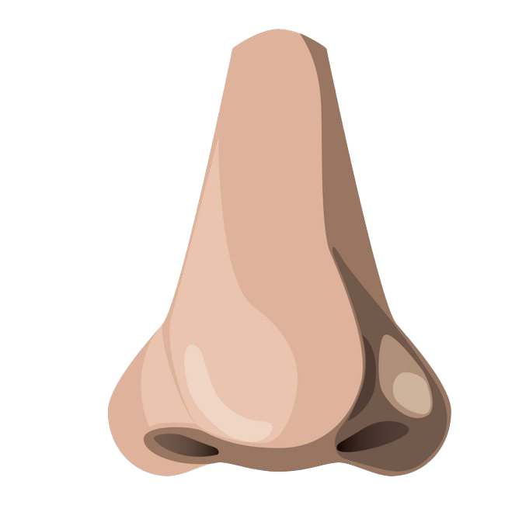

WHAT is Twang?!
No really, what is it??
“A disagreeable resonance in the voice from speaking through the nose” (Hensleigh Wedgwood Dictionary of English Etymology,1865, p.433).
“Associated with loud and high-pitched singing and is used to create an impression of energy and expressivity” (Sundberg & Thalen, 2010, p. 654).
Common in pop, rock, musical theatre and other contemporary styles (CCM) (Perta, Bae & Obert, 2020).
Low frequency spectral changes (under 2000 Hz).
Formants closer together. (Saldias, et al., 2020).
A completely separate voice quality category (Yanagisawa, et al. 1989).
Megaphone shape of the vocal tract.
Increased glottal closure (Saldias, et al. 2020).
Unsteady and transient.
Sound cannot stay constant and mellows, somewhat like a plucked guitar string.
Therefore, works well in speech mix types of vocal styles (Titze,2022).

Slide 8



OBSTACLES:
Terminology…What’s in a Word?
Sundberg & Thalen (2010) There is confusion with twang definition and voice terminology.
Coates (2016) calls for unification in vocal pedagogy a necessity.

Slide 9
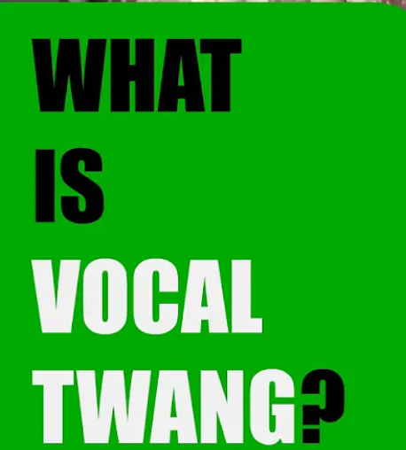
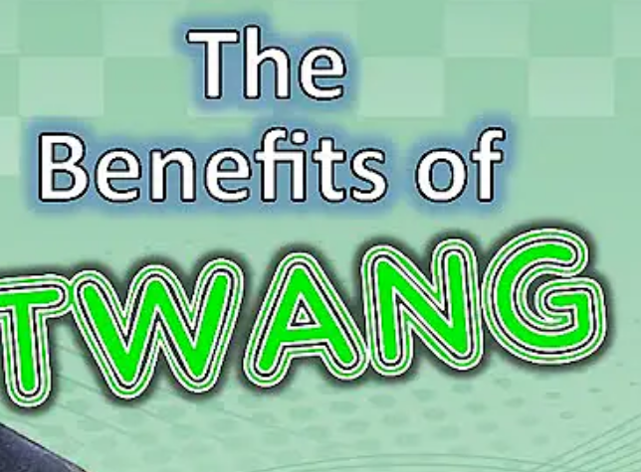
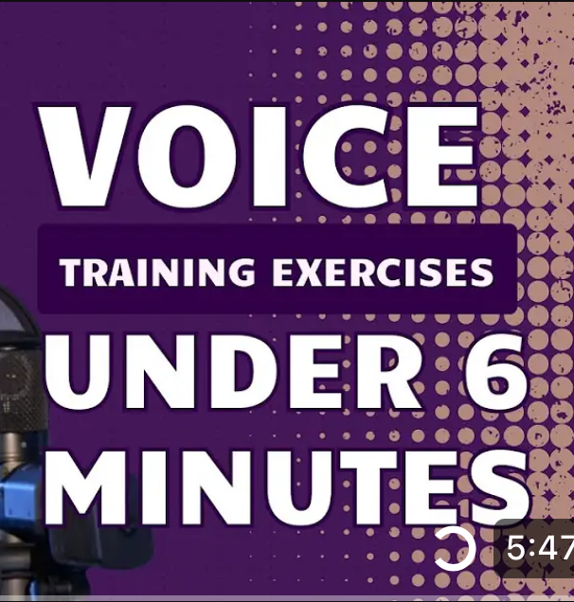



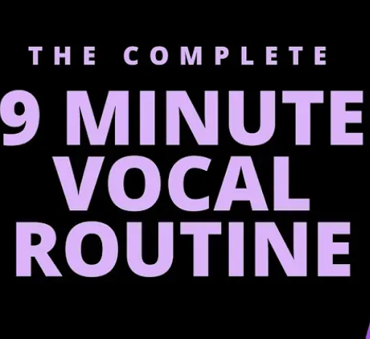
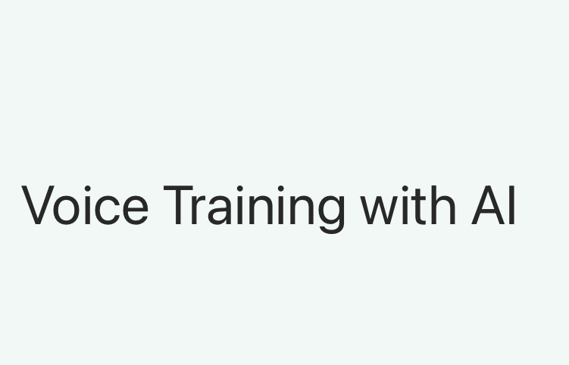
?
HOW Do We Teach/Learn Twang Effectively?
YouTube Videos
122 million users daily on YouTube Global Media Insight (2022)
How do we choose?
SO MANY
Singing Instruction Videos and Voice Methods

Slide 10
Methods/Methodology: Document Analysis
Document Analysis:
To seek”… convergence and corroboration through the use of different data sources and methods” (Bowen, 2009, p.28).
Exploration of practical application in relation to the literature.
Emergent themes building on evidence to further develop a theory (Charmaz, 2008; Mills, Bonner & Francis, 2005).
Ethical Considerations: Respect for all resources, Citing clearly and appropriately. Representing the literature appropriately and with integrity.
The Challenge: Accurately understanding all of the data.
Grounded Theory:
Data is "systematically gathered and analyzed through the research process" (Chun Tie, Birks, & Francis, 2019, p. 3).
Data Collection: Constant Comparative method (Glaser & Strauss, 1965).
Cycling between collecting and analyzing data (Corbin & Strauss, 1990; Mills, Bonner & Francis, 2006).
Insider Research: Awareness of my own obvious bias: Not a fan of following one singular vocal ‘method’ or ‘training program’
Locational bias.

Slide 11
PROCESS: DOCUMENT ANALYSIS
Video Analysis
Inclusion Criteria
Ep. 77 “What is Vocal Twang?” with Justin Stoney, New York Vocal Coaching – May 13, 2015.
NATS Chat – “Getting the Twang of It” with Kerrie Obert and Chadley Ballantyne, hosted by Kari Ragan - January 13, 2019.
“How to Sing with Twang “ with Kerrie Obert - Singing Teachers Talk Podcast - Mar 6, 2024.
Justin Stoney: Co authored book - “Sing Like Never Before”. Guest lecturer with the Voice Study Centre.
2) Dr. Chadley Ballantyne: A contributing author of The Evolving Singing Voice: Changes Across the Lifespan, by Prof. Karen Brunssen; Frequent guest speaker on ‘Applying Vocal Acoustic Pedagogy’.
3) Kerrie Obert - M.A. CCC, SLP: Is a leading expert in voice training and pedagogical practice. Co authored a published article on ‘twang ‘ using MRI with Karen Perta & Youkyung Bae, 2020).

Slide 12
PROCESS: DOCUMENT ANALYSIS (continued)
Print Material Analysis
Inclusion Criteria
Estill Voice Training Level 2 Workbook – Chapter ‘Oral Twang’.
‘Singing and the Actor’ by Gillyanne Kayes, Chapter 9, “Twang and the Singers Formant”
Jo Estill’s work investigated voice qualities found in a range of singing styles, primarily “Sob,” “Twang,” “Speech,” “Opera,” and “Belt”. In 1992 she founded the ‘Estill Voice Training Systems LLC. Her methodology is used around the globe.
Gillyanne Kayes is a writer, researcher, teacher and singing voice expert. In 2004, she published her book ‘Singing and the Actor’, cited in peer review literature.

Slide 13
Data Collection- A:
Thematic Analysis:
Inductive – themes linked to the data (Braun & Clarke, 2008)
Themes | Case Count | Code Count
Vowels | 4 | 9
Vocal Technique | 6 | 67
Twang | 6 | 49
Necessary Twang | 1 | 5
Exercises | 1 | 1
Distinct Twang | 1 | 6
Tongue | 4 | 18
Terminology Combos | 3 | 18
Specialty | 2 | 14
Ring | 2 | 5
Musical Styles | 5 | 23
Acoustics | 6 | 39
Modes | 1 | 10
Miscellaneous | 4 | 47
Epiglottic Funnel | 2 | 5
Belt | 1 | 3
Anatomy | 6 | 70
17 Themes
Nvivo 14

Slide 14
Data Collection- B:
Thematic Analysis
Acoustics
Anatomy
Nvivo 14
Technical Considerations
Practical Application
Excel/Word

Slide 15
Data Collection- C:
Approach Overview
YouTube Video Views and Selection: (See ‘Honourable Mentions’ for additional videos):
Titles with ‘How to’ or “What is” in search of practical application.
Inclusion of ‘Acoustics’ in the discussion.
Followed by:
Multiple views
Taking notes
Transcribing and reading
Identification of common terminology and application.
Categorize data into 4 themes: Acoustics; Anatomy; Technical Considerations & Practical Application.
Print Document Selection:
Identify Chapters referencing ‘twang’ and practical application.

Slide 16

Document Analysis: Purpose
The purpose of this document analysis is to investigate the link between accessible current practices (YouTube videos and print material sources) with peer-reviewed research -that is not typically accessed by the general public.

Slide 17


DOCUMENT BREAKDOWN- Video & Print Documents themes - Highlights & Findings
Acoustics
Chadley Ballantyne provides much insight:
Details the perception of ‘roughness’ we hear in rock and other CCM vocal sounds, explaining the unresolved harmonics from the 8th and above.
The prominence of F1 & F2 defining speech mix (Titze, 2020).
Obert attests that theory- smaller resonator (epilarynx) within a larger resonator (pharynx) at a 1:6 ratio (Sundberg, 1977) –has not been verified via endoscopy, suggesting the resonating and narrowing occurs within the pharynx.
Stoney notes the presence of overtones that enhance the sound while singing twang.
Estill makes little reference to acoustic involvement., Kayes explains the importance of acoustic involvement especially for an actor who must fill a large theatre space.

Slide 18

DOCUMENT BREAKDOWN- Video & Print Documents themes - Highlights & Findings (continued)
What about the Singer’s Formant ??
Singers Formant – A topic of debate over the years, Whether this is a part of twang or not. Obert notes the presence of the pyriform sinuses only in singer’s formant as is referenced in earlier texts (2023).
Kayes describes the singers formant as part of twang production. Again this causes some confusion. Taking into account that this book was published 20 years ago.
Comparable benefits of singer’s formant and twang is efficiency and ease in production and vocal fold adduction (Perta, Bae & Obert, 2020; Saldias, et al., 2020; Titze, Worley & Story, 2011; Titze, 2022)

Slide 19
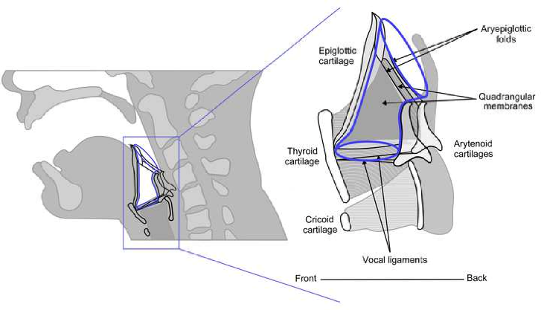
DOCUMENT BREAKDOWN- Video & Print Documents themes - Highlights & Findings (still continued)
Anatomy/Technical Considerations
Aryepiglottic Sphincter Narrowing
Relating back to Yanagisawa et al. (1989)’s research identifying this as a major contributor to twang resonance. This work references the Sundberg (1977) study on the 6:1 ratio narrowing theory (laryngeal/epilaryngeal resonating action).
Predominant in the Estill training method. Recommends mid – high laryngeal, tongue and velum position.
Kayes cautions that inappropriate tightening may cause negative constriction. Recommends mid – high laryngeal, tongue and velum position.
Stoney references aryepiglottic narrowing but does not explain in detail.
From:The Vocal Tract in Loud Twang-Like Singing While Producing High and Low Pitches (Saldias, et al., 2020).

Slide 20
DOCUMENT BREAKDOWN- Video & Print Documents themes - Highlights & Findings (Even More...)
New Hypothesis – currently not published.
High Twang - LMN (lateral medial narrowing), where pharyngeal walls move inward. Larynx ascends. .
Based on Kerrie Obert’s Findings:
Aryepiglottic narrowing NOT the prime activator in twang phonation.
Pharyngeal walls and tongue as main contributors to this twang quality.
Low Twang – APN (anterior posterior narrowing), where the tongue retracts backwards. Larynx may not ascend as much as in high twang. This increases the pyriform sinus space, a characteristic of singer’s formant.
This significant finding has not yet been published however, is hinted at in:
A previous article (Perta, Bae, Obert, 2020);
A conference paper (Obert, et al., 2023)

Slide 21


DOCUMENT BREAKDOWN- Video & Print Documents themes - Highlights & Findings
Making the Sounds
Practical Application
Common Theme: PLAY!!
Obert recommends playing with character voices; barnyard animals; imitation; pitch glides and hand gestures (engaging motor learning).
Kayes recommends exploring character voices through imitation; using bright vowel sounds and then adding these sounds to pitches.
Estill’s suggestion based on speaking then singing text using appropriate twang articulation. Using the bright word ‘neow’ to work through the phrases before applying it to the text.
Stoney suggests playing with bright vowels on simple arpeggios; animal sounds and character voices.
Offers audio examples – very helpful.
Ballantyne’s Retroflex /r/ exercise. On ‘weird’, engaging tongue retraction and affecting timbre and tonal colour.

Slide 22



Conclusion
Summary
A greater link between academic vocal pedagogy literature and practical application may be further achieved – with clear translation.
Knowing your audience goes a long way.
Twang is a utilitarian vocal approach that can be used in many ways.
There is more than one approach to teaching twang, but PLAY (imitation, sound exploration) is a practical, comprehensive approach for almost anybody.
Further research is always beneficial as long as we all pay attention to it.
Nothing ever ends, research never ends. New discoveries!!

Slide 23
REFERENCES
Braun, V. &. C. V., 2008. Using Thematic Analysis in Psychology. Qualitative Research in Psychology, 3(2), pp. 77 - 101.
Charmaz, K., 2008. Grounded Theory as an Emergent Method. In: S. N. &. L. P. Hesse-Biber, ed. Handbook of Emergent Methods. 1st ed. New York, NY: The Guildford Press, pp. 155-172.
Chun Tie, Y. & Birks, M. &. F. K., 2019. Grounded theory research: A design framework for novice researchers. SAGE Open Medicine, Volume 7, pp. 1-8.
Corbin, J. &. S. A., 1990. Grounded Theory Research: Procedures Canons, and Evaluative Criteria. Qualitative Sociology, 13(1), pp. 3-21.
Mills, J., Bonner, A. & & Francis, K., 2006. The Development of Constructivist Grounded Theory. International Journal of Qualitative Methods , 5(1), pp. 1-10.
Obert, K., 2023. Chapter 12. In: K. Obert, ed. Vocal Pedagogy in the Era of the Modern Voice Studio. Galloway, Ohio: Obert Voice Studios LLC (Kerrie B. Obert), pp. 1-7.
Obert, K. Y. J. E. D. R. M. R. H. &. M. K., 2023. Voice Quality: Interactions Among F0, Vowel Quality, Phonation Mode and Pharyngeal Narrowing. Sonderborg, Denmark, O. Niebuhr & M, Svensson Lundmark (eds), Proc. 13th Nordic Prosody Conference: Applied and Multimodal Prosody Research , pp. 190-199.

Slide 24
REFERENCES- Page 2
Saldias, M. et al., 2018. A Computerized Tomography Study of Vocal Tract Setting in Hyperfunctional Dysphonia and in Belting. Journal of Voice , 33(4), p. 412−419.
Saldias, M. et al., 2020. The Vocal Tract in Loud Twang-Like Singing While Producing
Sundberg, J. &. T. M., 2010. What is “Twang”?. Journal of Voice, 24(6), pp. 654-660.
Sundberg, J., 1977. The Acoustics of the Singing Voice. [Online]
Available at: www.scientificamerican.com
[Accessed 16 June 2021].
Titze, I., 2001. Acoustic Interpretation of Resonant Voice. Journal of Voice, 15(4), p. 519–528.
Titze, I., 2022. The Acoustic Characters of Vocal Twang. Journal of Singing, 78(5), p. 613–614.
Titze, I., Worley, A. s. & Story, B. H., 2011. Source-Vocal Tract Interaction in Female Operatic Singing and Theatre Belting. Journal of Singing, 67(5th), pp. 561-572.
Wedgwood, H., 1865. A Dictionary of English Etymology, London: Trübner & Co..
Yanagisawa, E., Estill, J., Kmucha, S. & Leder, S., 1988. The Contribution of Aryepiglottic Constriction to "Ringing" Voice Quality - A Videolaryngoscopic Study with Acoustic Analysis. Journal of Voice, 3(4), pp. 342-350.

Slide 25

Honourable Mentions
Honourable Video Mentions
These are additional sources I had explored before finalizing my decision. There is a lot of good information in the videos listed below and useful for singers of all levels.
New York Vocal Coaching with Justin Stoney
Voce di Strega - What is Scary Twang?
https://www.youtube.com/watch?v=qZ8UrMa1HeM&t=1s
The Visceral Voice Podcast with Christine Schneider and Tom Burke - Twang Farm and Aliens
https://www.youtube.com/results?search_query=twang+farm
Voice Masters series – Phillip Hall and Matt EdwardsTwang and Nasality
https://www.youtube.com/watch?v=UovlPhiMnBo&t=196s
Twang Positions
https://www.youtube.com/results?search_query=twang+voicemasters
Twang and Tongue
https://www.youtube.com/watch?v=wXPzgEs0bpM
Epi-laryngeal and Pharyngeal Narrowing
https://www.youtube.com/watch?v=fKdJgS3-R8Y

