Slide 1
Module Title: Operating Hotel Facilities
Assignment Type: Presentation
Student Name: Alexandra Gjoka
Student ID: 2224325

Slide 2
TABLE OF CONTENTS
Introduction………………………………3
Model of employee engagement……..4
Training strategies……………………..6
Conclusion………………………………. 8
References………………………………..9

Slide 3
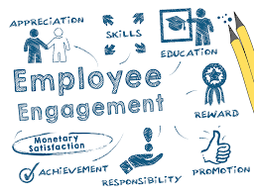
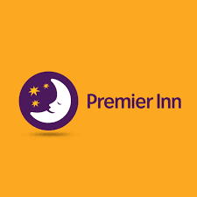
Introduction
Employee engagement refers to the active involvement and contribution of employees towards the economic growth of the organisation (Byrne, 2022)
Following that, the presentation will evaluate the set of standards employed by the housekeeping section of Premier Inn Leicester Fosse Park in order to maintain enhanced hygiene as per the specifications.
Moreover, certain employee engagement models will be emphasised to upgrade the customer service of the company.
(Byrne, 2022)
Notes:
Introduction
Employee engagement refers to the active involvement and contribution of employees towards the economic growth of the organisation (Byrne, 2022). Therefore, the following presentation will be created with the intent of highlighting the role of hospitality training programs in strengthening the productivity of the workforce in the hospitality industry to enhance their participation. Following that, the presentation will evaluate the set of standards employed by the housekeeping section of Premier Inn Leicester Fosse Park in order to maintain enhanced hygiene as per the specifications. Moreover, certain employee engagement models will be emphasised to upgrade the customer service of the company.

Slide 4
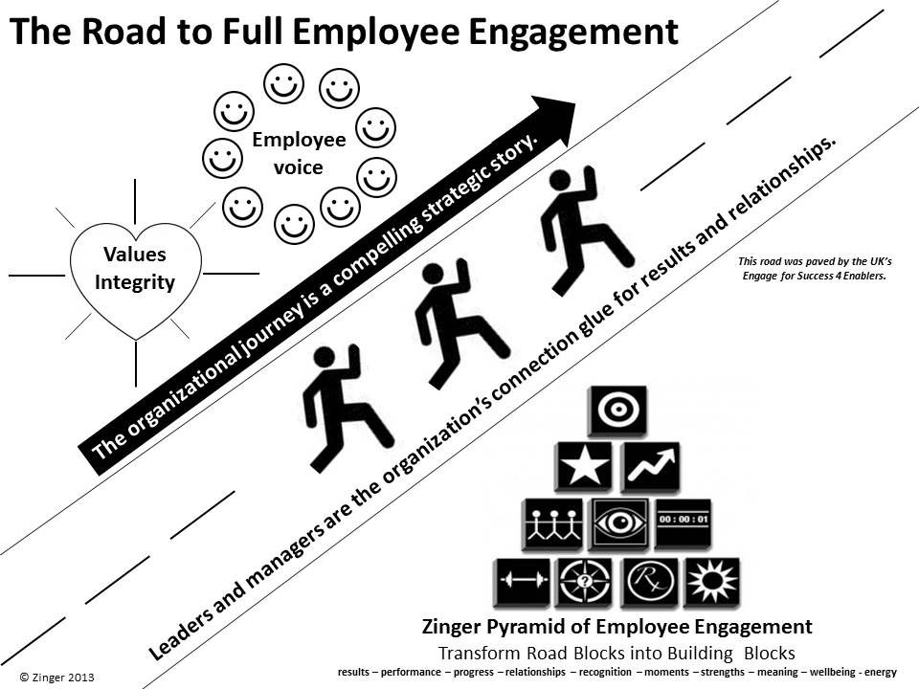
Model of employee engagement
Zinger Model
Bottom layer
This includes the basic necessities such as well-being, enlivening energy, making meaning, and leveraging strengths.
Second layer
The second layer consists of factors that could unite the company and build strong bonds between team members.
(Nienaber and Martins, 2020)
Notes:
Model of employee engagement
Zinger Model
There are plenty of models available that could be utilised by firms in order to make their employees more engaged with the operations. Some of the hotel chain firms already utilise them in order to achieve a better engagement rate within the workplace. One of the most prominent ones is the Zinger Model (ERESIA-EKE et al., 2023). As per this framework, there are around 10 essential actions that should be taken by the management of any firm. Furthermore, the actions are also divided into four segments in accordance with their prominence.
Bottom layer: This includes the basic necessities such as well-being, enlivening energy, making meaning, and leveraging strengths. Doing all of these can help the firms to motivate their employees and boost their satisfaction levels. As such, they will become more likely to engage more within the work premises (Zinger et al, 2022). EasyHotel UK is one noteworthy hotel chain that already provides work-life balance to employees. This helps to satisfy the well-being of the team members and they can also leverage their strengths.
Second layer: The second layer consists of factors that could unite the company and build strong bonds between team members. This typically includes building relationships, fostering recognition, and mastering each and every moment. Britannia Hotels is a noteworthy example of following these actions in order to create a better bond between the employees and the firm (Britannia Hotels, 2024).

Slide 5

CONTD….
Third layer
The performance of the workers is key to ensuring better engagement within the workplace.
Top layer
The topmost layer is the crucial one and involves achieving results and ensuring that all the workers are properly engaged.
(YOTEL, 2024)
Notes:
Third layer: The performance of the workers is key to ensuring better engagement within the workplace. As such, maximising performance and marking progress are a key part of this layer of the model. Companies like EasyHotel regularly monitor the performance of their workers in order to make sure that they can maintain overall productivity.
Top layer: The topmost layer is the crucial one and involves achieving results and ensuring that all the workers are properly engaged. Various target metrics are being used for this purpose including the use of team KPI. Yotel UK is a noteworthy hotel chain that used these actions for ensuring better engagement within the workplace (YOTEL, 2024).

Slide 6

Training strategies
Conducting employee surveys
Conducting various employee survey programs to determine major problems as well as understanding the employees more closely, employee engagement can be increased to a higher extent.
Uplifting the company's core values
Uplifting the core values of an organisation, employees can be managed better within a smooth hierarchical division.
(Byrne, 2022)
Notes:
Training strategies
According to David Zinger, finding the important strategies for better employee engagement is vital for any organisation. As of these, he developed the second point of crafting strategies within the Zinger model of employee engagement. Based on crafting the efficient strategies to increase the employee engagement, Premier Inn can increase their employee satisfaction and achieve better performance within the business simulation. This process involves various planning as well as consideration of the employees to select effective strategies and efficient implementation of them (Bailey, 2022). Major strategies of employee engagement Premier Inn can implement to increase their employee engagement rate are mentioned below.
Conducting employee surveys
Conducting various employee survey programs to determine major problems as well as understanding the employees more closely, employee engagement can be increased to a higher extent. Apart from that, concerning the problems of employees and implementing flexibility according to the demand of the plurality of staff can also enhance the employee satisfaction rate and finally uplift employee engagement (Nienaber and Martins, 2020). Through following the above-mentioned initiatives of the employee survey program, Premier Inn can increase their employee engagement as well as can also improve organisational performance affirmatively.
Uplifting the company's core values
Uplifting the core values of an organisation, employees can be managed better within a smooth hierarchical division. Contextually the notable aspect is that, by uplifting the core values of the company, employees remain more motivated and perform at their best (Riyanto et al., 2021). As for these motivational initiatives, employee engagement can be increased efficiently. Concerning this, Premier Inn needs to develop its core values by achieving a competitive advantage in the market to increase its employee engagement rate and lead the hospitality industry within the United Kingdom.

Slide 7

CONTD….
  Providing genuine feedback
Providing genuine feedback to the employees about their job, career and other relevant approaches, employee satisfaction can be enhanced to a higher extent.
Promoting transparency
Promotion of transparency between the authority or organisational proceedings and employees is also responsible for making the employees loyal in the long term.
(YOTEL, 2024)
Notes:
Providing genuine feedback
Providing genuine feedback to the employees about their job, career and other relevant approaches, employee satisfaction can be enhanced to a higher extent. In relation to this, through the feedback program employees also realise their mistakes and based on this they simultaneously improve their capabilities or talents (Riyanto et al., 2021). As of these, through providing genuine feedback to the employees and making them understand about the shortcomings, employee engagement can be increased in Premier Inn.
Promoting transparency
Promotion of transparency between the authority or organisational proceedings and employees is also responsible for making the employees loyal in the long term. Besides these, through promoting transparency employees can also remain clear and focused on their job role, reporting person and other relevant work roles, which influences the organisational performance (Bailey, 2022). Based on these initiatives, through improving transparency, Premier Inn can also make loyal employees for the long term to serve the community by conducting an effective business. On the contrary, transparency also encourages the organisation to achieve its objectives efficiently under the deadline.
Rewarding top performances
Rewarding extraordinary performances and talents can also increase employee engagement proficiently within any company or organisation. Through rewarding the best as well as top performers employees can be motivated easily to enrich their talents and work more effectively (Nienaber and Martins, 2020). Additionally, rewarding the best performances also influences each employee to perform better and achieve the reward on their next attempt. Based on these initiatives Premier Inn can also increase their employee engagement rate affirmatively.

Slide 8

Conclusion
This presentation has highlighted the importance of employee engagement and the ways to achieve them.
For this purpose, the Zinger Model has been thoroughly described to have a better understanding of employee engagement.
The layers of the engagement have been mentioned and the actions needed for employee engagement have been included.
(Byrne, 2022)
Notes:
Conclusion
This presentation has highlighted the importance of employee engagement and the ways to achieve them. For this purpose, the Zinger Model has been thoroughly described to have a better understanding of employee engagement. The layers of the engagement have been mentioned and the actions needed for employee engagement have been included. Some of the key actions include enhancing well-being, making meaning, building relationships, marking progress, and achieving results. Moreover, the strategies to properly improve engagement have also been noted. They include conducting employee surveys, uplifting the company's core values, providing genuine feedback, promoting transparency, and rewarding top performers.

Slide 9
References
Bailey, C. (2022). Employee engagement: Do practitioners care what academics have to say–And should they? Human Resource Management Review, 32(1), 100589.
Britannia Hotels, (2024). MODERN SLAVERY ACT 2015 STATEMENT. [Online] Available at: https://www.britanniahotels.com/modern-slavery-act-statement [Accessed 2 January 2024].
Byrne, Z.S., (2022). Understanding employee engagement: Theory, research, and practice. Routledge.
Notes:
References
Bailey, C. (2022). Employee engagement: Do practitioners care what academics have to say–And should they? Human Resource Management Review, 32(1), 100589.
Britannia Hotels, (2024). MODERN SLAVERY ACT 2015 STATEMENT. [Online] Available at: https://www.britanniahotels.com/modern-slavery-act-statement [Accessed 2 January 2024].
Byrne, Z.S., (2022). Understanding employee engagement: Theory, research, and practice. Routledge.
ERESIA-EKE, C., NDLOVU, O. and NYANGA, T., (2023). THE ROLE OF DIMENSIONS OF JOB ENGAGEMENT IN ORGANIZATIONAL PERFORMANCE. Prizren Social Science Journal, 7(1), pp.53-65.
Nienaber, H., and Martins, N. (2020). Exploratory study: Determine which dimensions enhance the levels of employee engagement to improve organisational effectiveness. The TQM Journal, 32(3), 475-495.
Riyanto, S., Endri, E., and Herlisha, N. (2021). Effect of work motivation and job satisfaction on employee performance: Mediating role of employee engagement. Problems and Perspectives in Management, 19(3), 162.
YOTEL, (2024). Why YOTEL. [Online] Available at: https://careers.yotel.com/?_gl=1*z5rtnb*_ga_Z2SX1JXWNT*MTcwNDM4MDI0MC4xLjEuMTcwNDM4MDI1Mi40OC4wLjA. [Accessed 2 January 2024].
Zinger, E., Murrain, S.Y. and Thomson, E., (2022). Cooperative models for digital archives. Journal of Digital Media Management, 10(3), pp.215-226.

