Slide 1
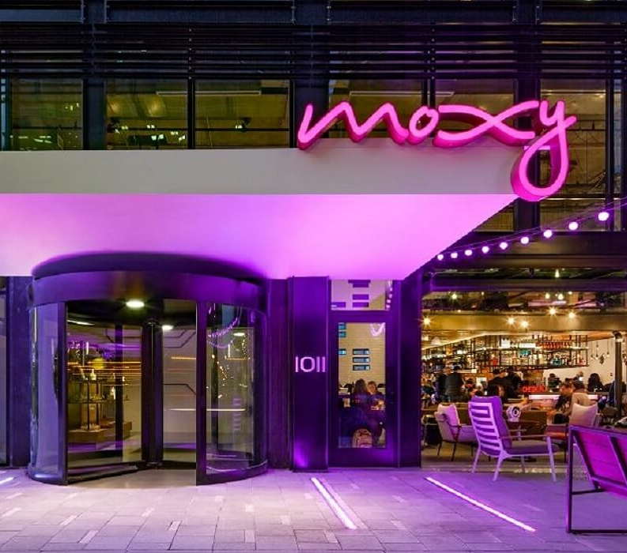

The role and importance of quality service, hospitality, and guest services within the hotel industry
Moxy by Marriott Inc
Presented by
Codruta-Daniela Bogatean
2210404
Lisa Bassler
The Leaders Globe (2021)

Slide 2
Table of content
Overview
Main consumers
Nature, scope, and role of the guest services and facilities
Role and function of guest services
Importance of hospitality and how hotels meet/exceed guest expectations
Conclusion
Reference list

Slide 3
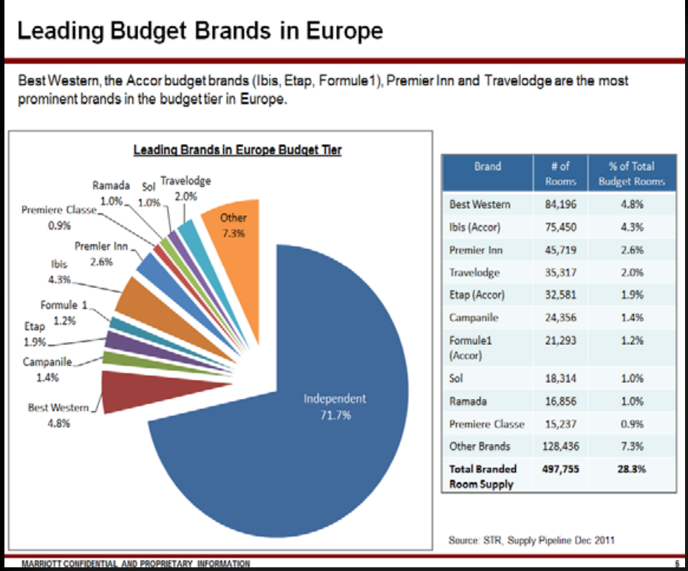
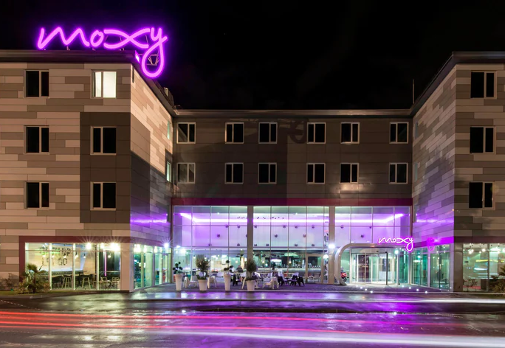
Overview
3-star hotel launched in 2013 and opened its first hotel in Milan in 2014 (Caswell,2013).
Created with Europe budget hotels in mind.
Partner with Ikea as an early investor (Jones 2022).
With 136 hotels at present.
Moxy Milan (2014)

Slide 4
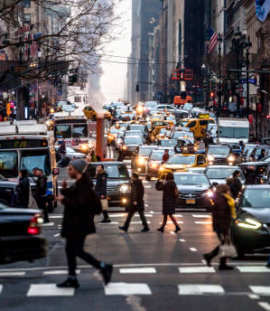
• country capitals
• commercial center
• metropolis
(Marriott 2023)
Moxy’s main locations are:

Slide 5

“When someone has guts ,
they have Moxy” (Sisk,2002)
“The ability to face difficulty with high
energy, spirit, and courage” (Chance,1880)
“We see the Moxy brand as a boutique hotel with the
heart of a hostel, that pushes boundaries” (Poulos,2019).
“We’re not creating things just to be different, but we’re trying to respond to the way guests’ needs are evolving,” (Hochberg,2019)

Slide 6

Main consumers
Awards (2021)
Created for millennial social media lovers,” fun lovers”, and open-minded (Peters,2020)
Encouraging guests to “play on”(Hospitalitynet 2023)
“Fun Hunters” who live in the moment, like to be in control, are independent, and “believe that self-service is the best service” (Paulos,2017)

Slide 7
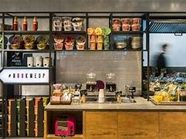
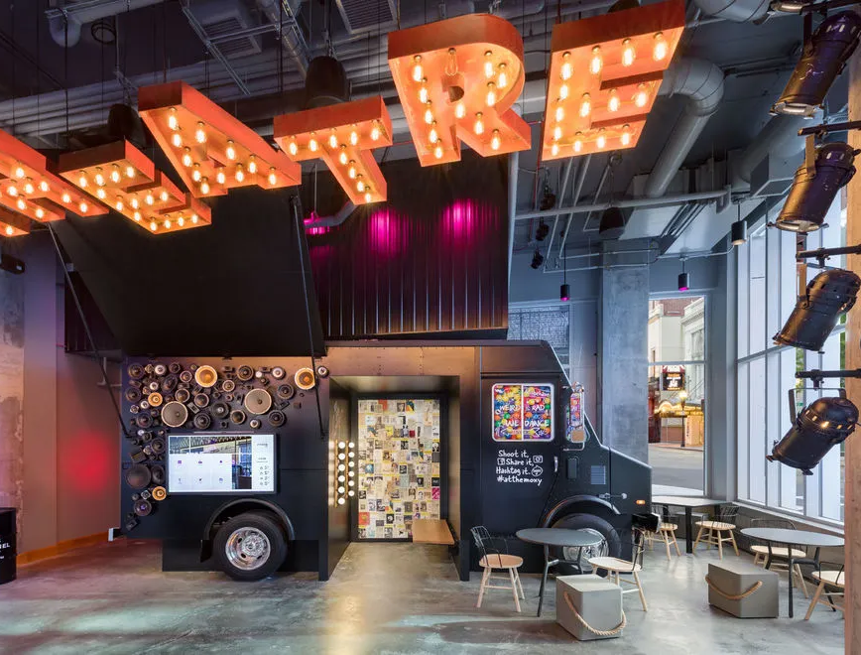
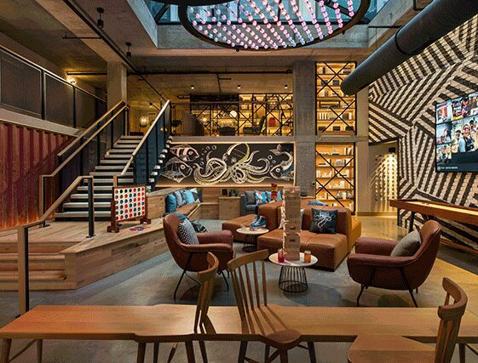
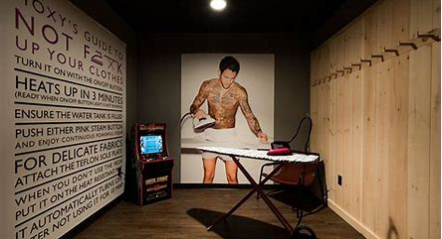
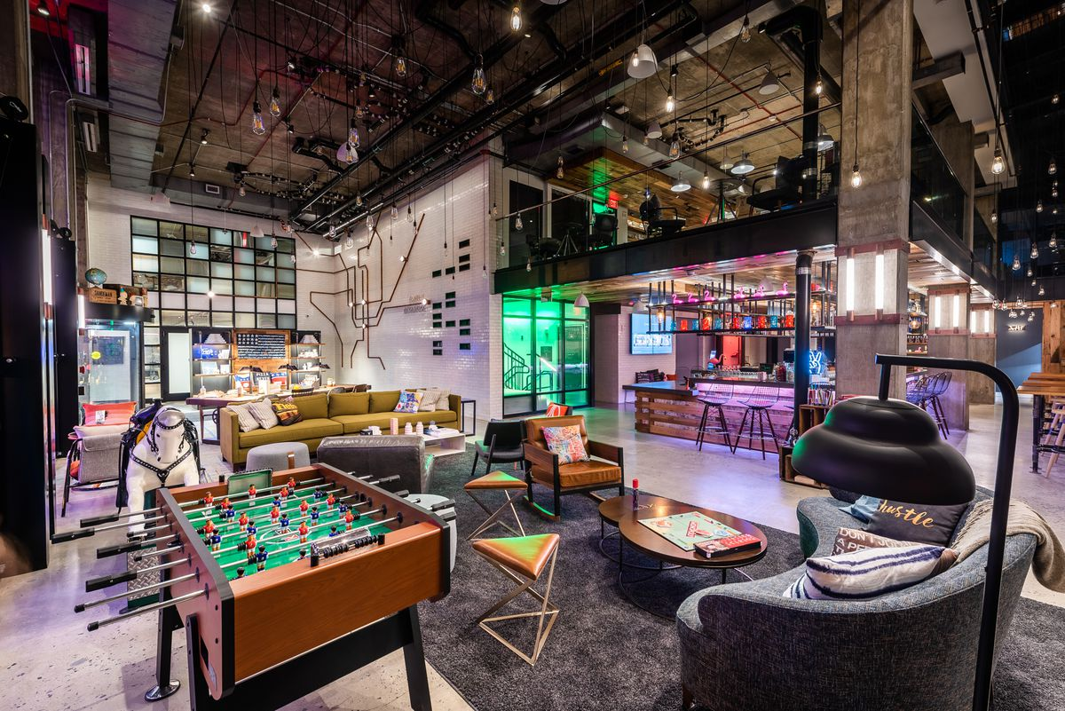
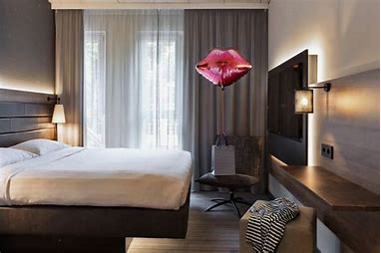
Nature, scope, and role of the guest services and facilities
Ultra-fast free wi-fi
24/7 grab-and-go services
Communal room, living room, and game room
Library
Stylish, small but well-organized rooms (Miceli 2022)
Communal ironing rooms
Frankfurt city (2018)

Slide 8
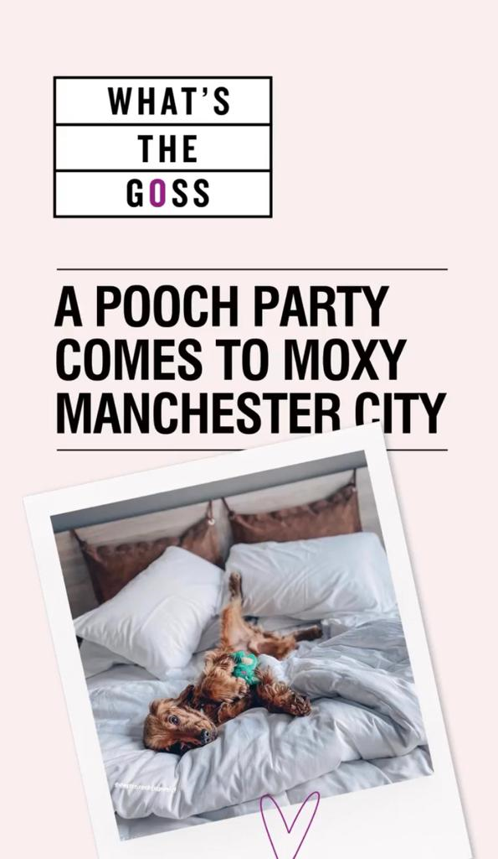
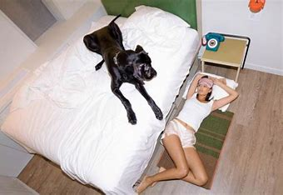
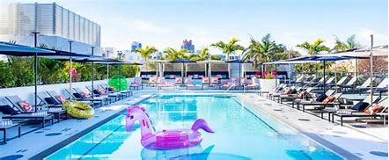
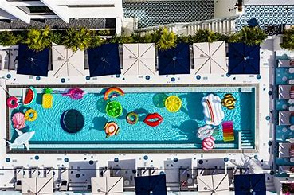
Some have pool service
Dogs welcomed in all locations
A lot of fun activities are offered by the cheeky programming (ex: lip sync battles, and acupuncture happy hour (Globetrender 2018).
Instagram Moxy Manchester City
Moxy Miami South Beach (2021)
Moxy Miami South Beach (2021)

Slide 9
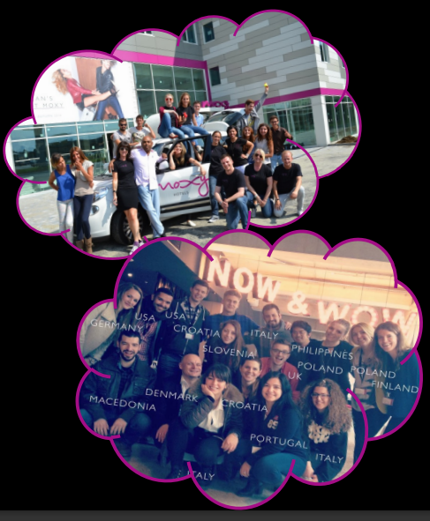
Role and function of guest services
Meet the MOXY CREW
Working together to encourage a collaborative atmosphere
Fun and involved in all the guest services(Worldwide Hospitality Awards 2021)
Awards (2021)

Slide 10
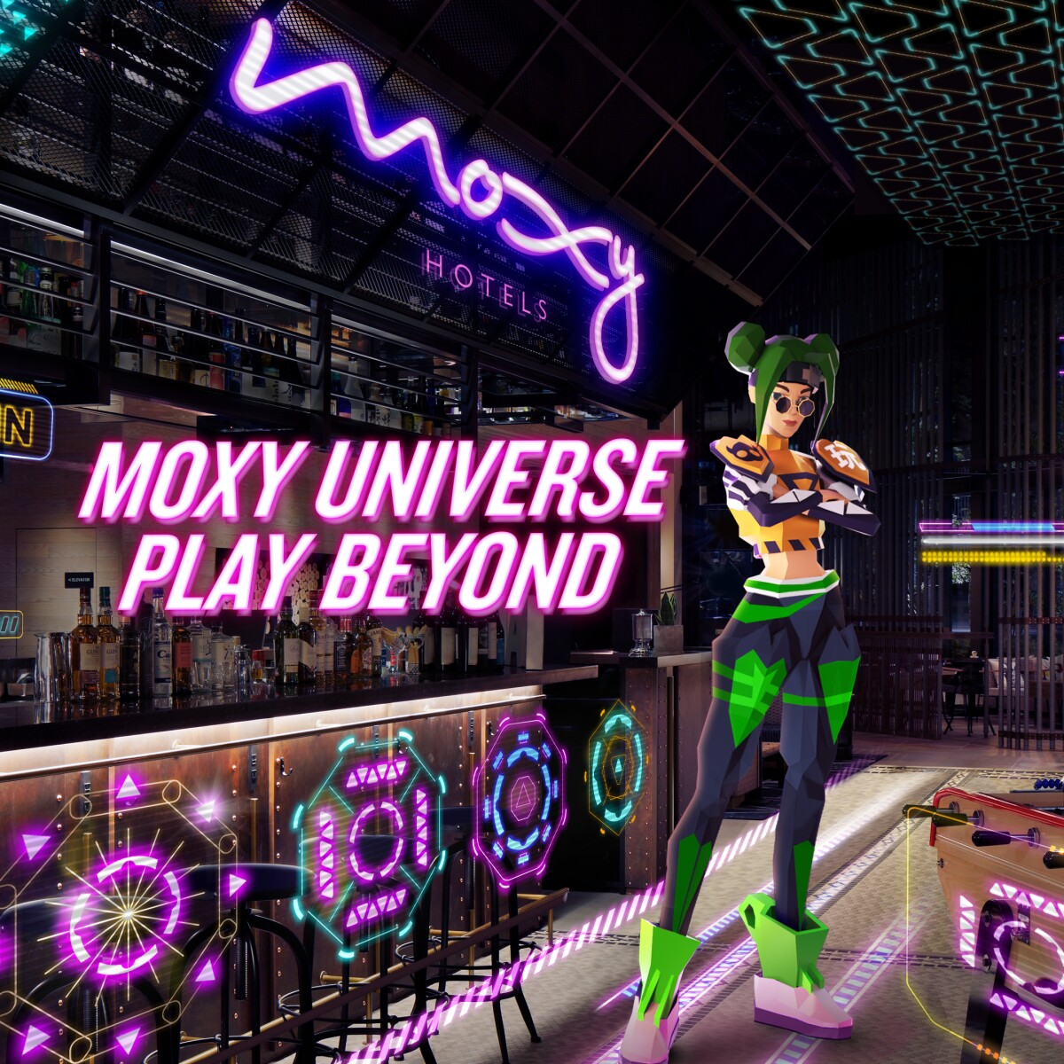
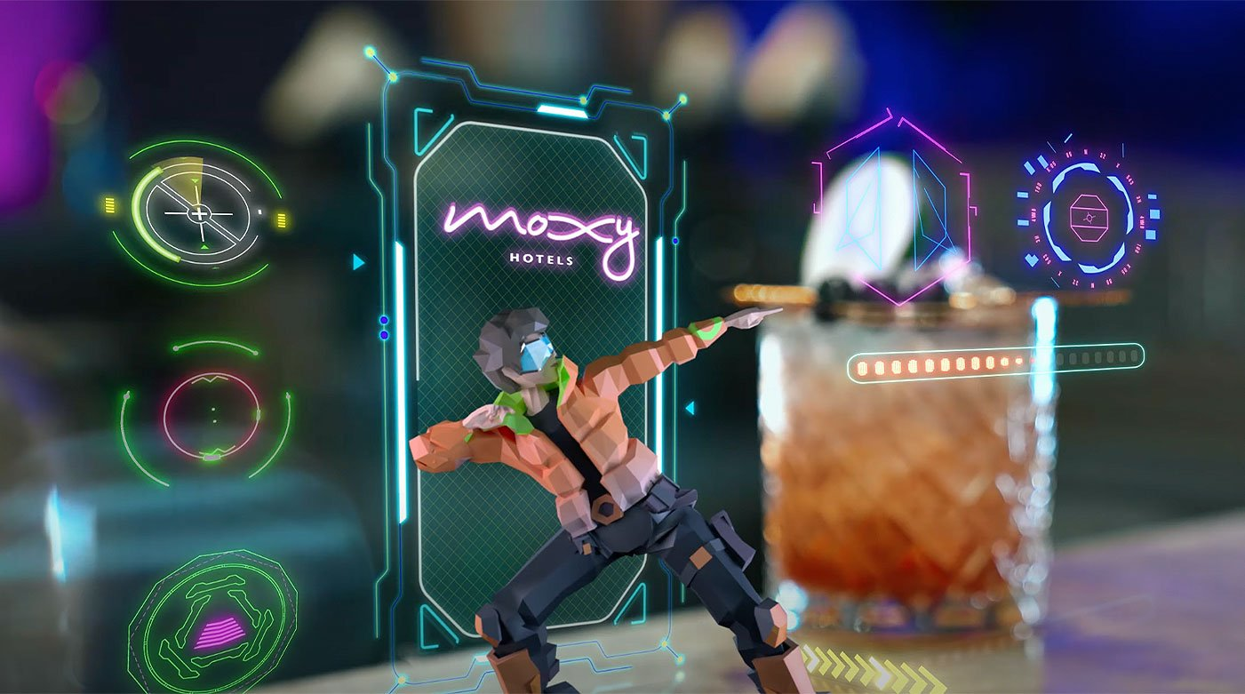
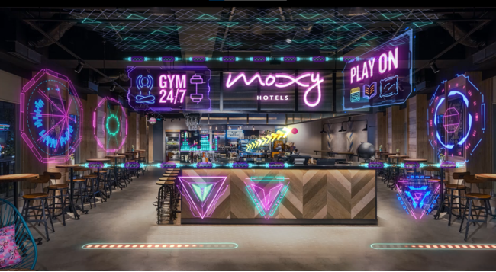
Importance of hospitality and how hotels meet/exceed guest expectations
Marriott Bonvoy membership
“Moxy Universe, Play Beyond” (Bethesda,2022).
Moxy Hong Kong (2022)

Slide 11
Conclusion
This presentation has the role to show the origin of the Moxy Hotel by Marriott International, starting with an overview of its origins, and progress made over the last 9 years since its first opening. Moving into finding who are their main consumers and targeted people. We also discussed the importance of the guest services and facilities that help to keep customers happy and make them come again and how important it is for the hotel to always be innovative and open-minded in the fast era we live in.

Slide 12
Reference list
1. Chance1880 (17 Mar 2015) Moxy, Urban Dictionary. Available at: https://www.urbandictionary.com/define.php?term=moxy (Accessed on 28.01.2023)
2. Craig Sisk (21 Mar 2002) Moxy, Urban Dictionary. Available at: https://www.urbandictionary.com/define.php?term=moxy (Accessed on 28.01.2023)
3. Cristina Miceli (9 Feb 2022) Everything You Need To Know About Moxy Hotels: Are They Worth It? Available at: https://www.pilotplans.com/blog/moxy-hotels-review (Accessed on 28.01.2023)
4. Globetrender (9 Feb 2018) WHY MOXY HOTELS TARGET GUESTS WHO ARE ‘FUN HUNTERS’. Available at: https://globetrender.com/2018/02/09/moxy-hotels-fun-hunters/ (Accessed on 28.01.2023)
5. Hospitalitynet (2023) Moxy. Available at: https://www.hospitalitynet.org/brand/23000273/moxy.html (Accessed on 28.01.2023)
6. Jenny Peters (6 Feb 2020) 4 Things you should know about Moxy Marriott’s new hotel brand. Available at: https://www.shermanstravel.com/advice/5-things-you-should-know-about-moxy-hotels (Accessed on 28.01.2023)
7. Mark Caswell (5 Mar 2013) Marriott unveils Moxy Hotel Brand. Business Traveller. Available at: https://www.businesstraveller.com/news/2013/03/05/marriott-unveils-moxy-hotel-brand/ (Accessed on 28.01.2023)

Slide 13
8. Marriott Hotels Locations (2023) Available at: https://moxy-hotels.marriott.com/our-locations/ (Accessed on 28.01.2023)
9. Mitchell Hochberg (19 Jun 2019) Brand Identity: Moxy, written by Matt Dougherty. Available at: https://hospitalitydesign.com/projects/hotels-resorts/brand-identity-moxy/ (Accessed on 28.01.2023)
10. MD Bethesda (12 July 2022) Let’s Play! Augmented Reality Takes Off at Moxy Hotels with the “Moxy Universe, Play Beyond” Asia Pacific Campaign. Available at: https://news.marriott.com/news/2022/07/12/lets-play-augmented-reality-takes-off-at-moxy-hotels-with-the-moxy-universe-play-beyond-asia-pacific-campaign (Accessed on 28.01.2023)
11. Rhys Jones (2 Oct 2022) What is a Moxy hotel? Everything you need to know about Marriott’s budget brand Available at: https://www.headforpoints.com/2022/10/02/what-is-a-moxy-hotel-like/ (Accessed on 28.01.2023)
12. Steven Bond (7 May 2017) A night at the Moxy with Marriott’s Brand Leader, Vicki Poulos. Available at: https://www.dotwnews.com/debut/a-night-at-the-moxy-with-marriott-s-brand-leader-vicki-poulos (Accessed on 28.01.2023)
13. Vicki Paulos (19 Jun 2019) Brand Identity: Moxy, written by Matt Dougherty. Available at: https://hospitalitydesign.com/projects/hotels-resorts/brand-identity-moxy/ (Accessed on 28.01.2023)
14. Worldwide Hospitality Awards (30 Nov 2021) Moxy Hotels -Best innovation in hotel concept. Available at: https://hospitality-on.com/en/worldwide-hospitality-awards/moxy-hotels/moxy-hotels (Accessed on 28.01.2023)

Slide 14
THANK YOU!

