Slide 1
How are Montessori methods effective to children’s learning?
2005395 Yoshino Deguchi

Slide 2
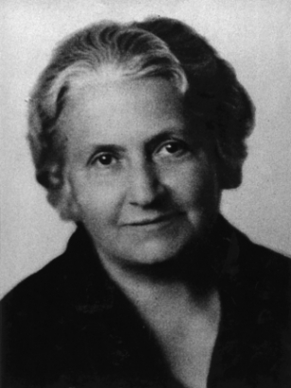
Maria Montessori
Born in 1870
Italy
No suitable environment for education
Study medicine at university
First female doctor in Italy
Study about education
Casa dei Bambini
[Parker, 2015]
[Montesssori Australia Group Pty Ltd, n.d.]

Slide 3
contents
Introduction : Montessori education
1. Freedom within limits
2. Case study
3. Comparison with Froebel
Conclusion

Slide 4
introduction : Montessori Education
Limited free play
Free play is constructed by specific objects, space and Montessori teachers.
Three ages grouping
Teachers group children together at the age of 3 to 6, 6 to 9 and 9 to 12.
Independent learning
Children learn on their own.
Hands-on activities
Children use real objects.
[Johnson, 2009] [Halula, 2016] [Lillard, 2013]

Slide 5
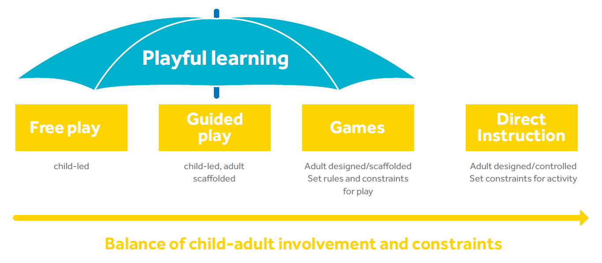
1. Freedom within limits
Free play constructed for effective learning = “work ”. [Lillard, 2013]
Freedom
-Choice of objects
-Play individually or in small groups
Guided play
-Children use particular toys.
-Teachers observe children and ask them questions.
-Teachers respect children’s curiosity and their pace.
[Lillard, 2013]
Limits
-Specific objects for learning
-Clean and tidy classrooms
-Instruction before playing and when children misbehave
[Lillard, 2013] [Feez, 2010]
Children are more likely to fair, cooperative, sophisticated, creative, positive and assertive.
[Kathryn Rindskopf Dohrmann; Tracy K. Nishida; Alan
Gartner; Dorothy Kerzner Lipsky; Kevin J. Grimm, 2007]
[Jennifer M. Zosh; Emily J. Hopkins; Hanne Jensen; Claire Liu; Dave Neale; Kathy Hirsh-Pasek; S. Lynneth Solis; David Whitebread, 2017]
Freedom within limits strengthens children’s ability to understand, cooperativeness, creativity and spontaneousness.

Slide 6
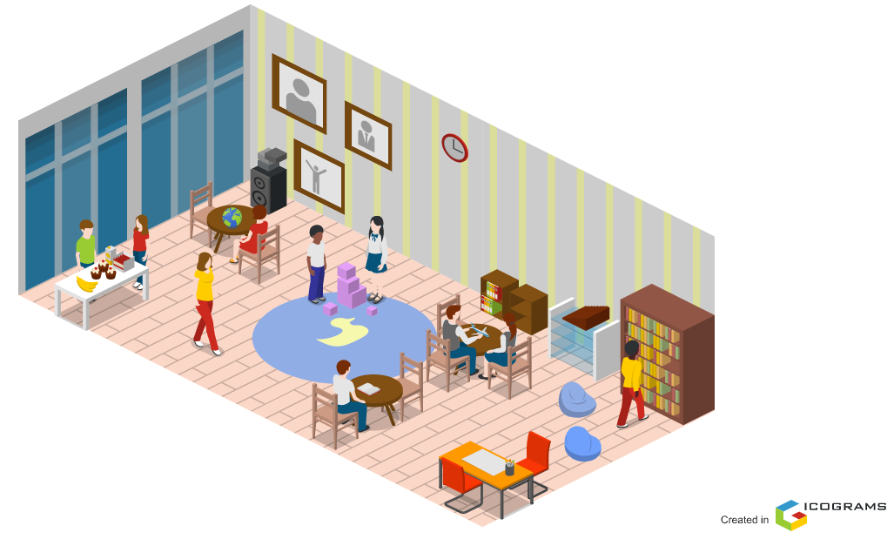
2. Case study
music
Pictures of musicians
Visible Montessori materials in order
Lead children to solve their problems and automatically cooperate with other children
[Bunnag, 2000]
Sandy’s classroom
Snack area
She skilfully guides children with respect. Her classroom stimulates their senses and blends academic factors into play.
Reading area
Carpet for timeline
Based on [Bunnag, 2000]
Academic material
Art area

Slide 7




3. Comparison between Montessori and Froebel
Free play and the use of toys in learning
Cooperation
Spontaneity
Montessori
Montessori materials
Separated space by activity
Guidance for the use of materials and proper behaviour
Froebel
A variety of toys
Indoor and outdoor activities
Minimal help
[Tovey, 2020]
The problem-solving ability
Independence

Slide 8
conclusion
Construct the surroundings for effective learning
Give choice and guide to the intellectual work
Montessori materials, well-designed classroom and guidance
‣‣‣ Develop children’s interest, creativity, consideration and independence besides knowledge
Free play within limits simultaneously enhance children’s ability, grow their humanity and boost their curiosity.

Slide 9
Bibliography
-Bunnag, D., 2000. ERIC. [Online]
Available at: https://files.eric.ed.gov/fulltext/ED470882.pdf
[Accessed 12 January 2022].
-Feez, S., 2010. Montessori and Early Childhood: A Guide for Students, Los Angeles: SAGE Publications Ltd..
-Halula, J., 2016. Alexander Street. [Online]
Available at: https://video.alexanderstreet.com/watch/child-development-theorists-freud-to-erikson-to-spock-and-beyond-2
[Accessed 3 January 2022].
-Jennifer M. Zosh; Emily J. Hopkins; Hanne Jensen; Claire Liu; Dave Neale; Kathy Hirsh-Pasek; S. Lynneth Solis; David Whitebread, 2017. Learning Through Play. [Online]
Available at: https://cms.learningthroughplay.com/media/wmtlmbe0/learning-through-play_web.pdf
[Accessed 13 January 2022].
-Johnson, E., 2009. Alexander Street. [Online]
Available at: https://video.alexanderstreet.com/watch/the-montessori-method-2
[Accessed 1 January 2022].
-Kathryn Rindskopf Dohrmann; Tracy K. Nishida; Alan Gartner; Dorothy Kerzner Lipsky; Kevin J. Grimm, 2007. High School Outcomes for Students in a Public Montessori Program. Journal of Research in Childhood Education, 22(2), pp. 205-217.
-Lillard, A. S., 2013. Playful learning and Montessori education. The NAMTA Journal, 38(2), pp. 137-174.
-Montessori Australia Group Pty Ltd, n.d.. Montessori Australia. [Online]
Available at: https://montessori.org.au/biography-dr-maria-montessori
[Accessed 14 January 2022].
-Parker, N., 2015. Alexander Street. [Online]
Available at: https://video.alexanderstreet.com/watch/maria-montessori
[Accessed 3 January 2021].
-Tovey, H., 2020. Freobel Trust. [Online]
Available at: https://www.froebel.org.uk/uploads/documents/FT-Froebels-principles-and-practice-today.pdf
[Accessed 13 January 2022].
Presentation Template: SlidesMania
Thank you for your attention:)

