Slide 1
LCHS7008: Practice-Based Research
Assignment Component 1: PPT Presentation
Topic: Exploring the Prevalence and Risk Factors of Stroke among South Asian Minorities in the UK: A Public Health Perspective
Student Name Adil karim
Roll No. 2426763

Slide 2
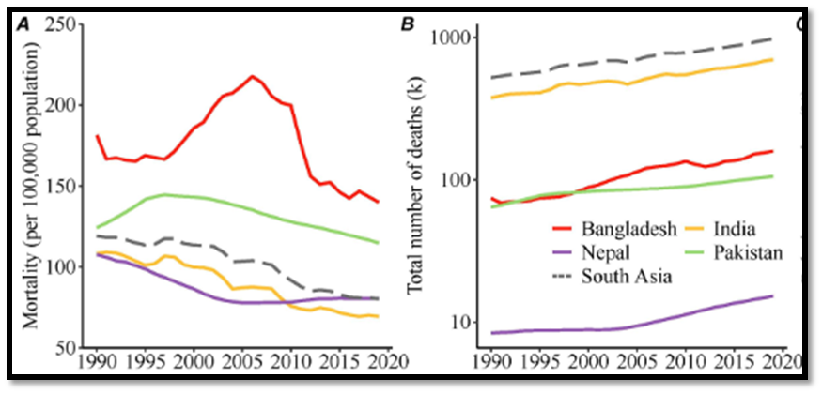
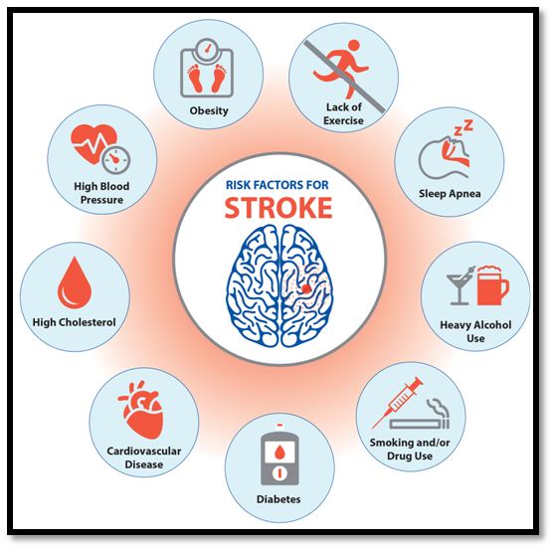
Prevalence
Trends in stroke mortality in South Asians from 1990 to 2019
(Source: Bai et al., 2024)
Onset of stroke among patients from ethnic minorities of the UK is 5 years earlier than British individuals, whereas in men, it is 69.5 years and in women 76.8 years on average (Fluck et al., 2023).
Key risk factors include diabetes, smoking prevalence, carbohydrate-rich diet, and lower physical activity in the South Asian population (Aurelius et al., 2023).
This highlights the disparities in stroke types and comorbidities among UK-living South Asians, especially in Bangladeshi subgroups (Bainbridge et al., 2024).
(Source: Costroke, 2022)

Slide 3
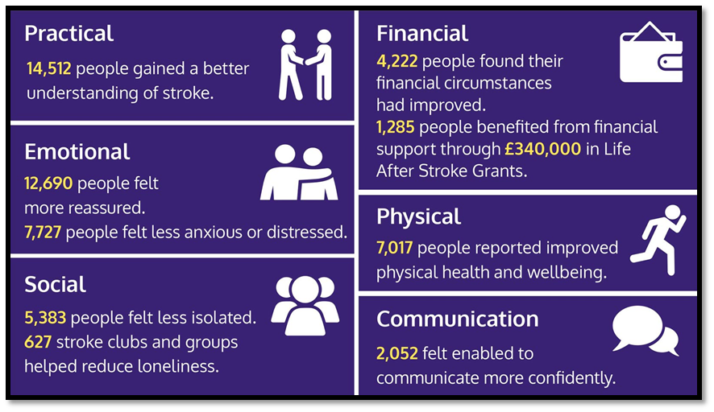
Language barriers and underrepresentation in support programs deprive South Asians of stroke recovery (McAllister et al., 2025).
Poor stroke outcomes occur due to stressors, like delayed diagnosis, cultural stigma, and limited access to healthcare services (Magwood et al., 2019).
This focuses on the impact of cultural and systemic barriers on affecting rehabilitation of stroke patients among them.
(Source: Stroke Association, 2025)
Quality of Life about Stroke among South Asians

Slide 4
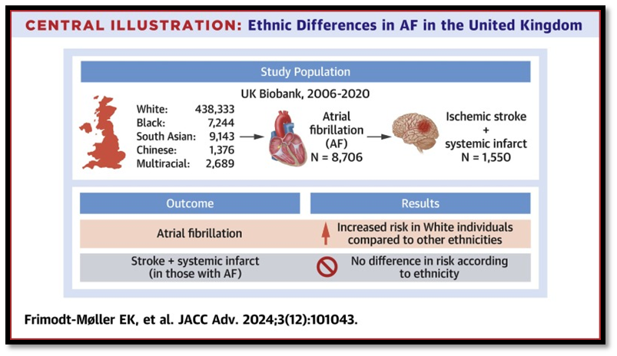
Rationale
Differences in Atrial Fibrillation in ethnic Groups
(Source: Frimodt-Møller et al., 2024)
About 13% of the UK population is South Asians, who are underrepresented in stroke research and support services (Different Strokes, 2024).
The risk profile of them includes earlier onset, metabolic comorbidities, and lower atrial fibrillation rates (Martinez-Amezcuaet al., 2020).
Lack of ethnic-specific adaptations and equitable care for stroke survivors’ points to the need to address ethnic disparities by tailoring urgent interventions (Chang et al., 2018).

Slide 5
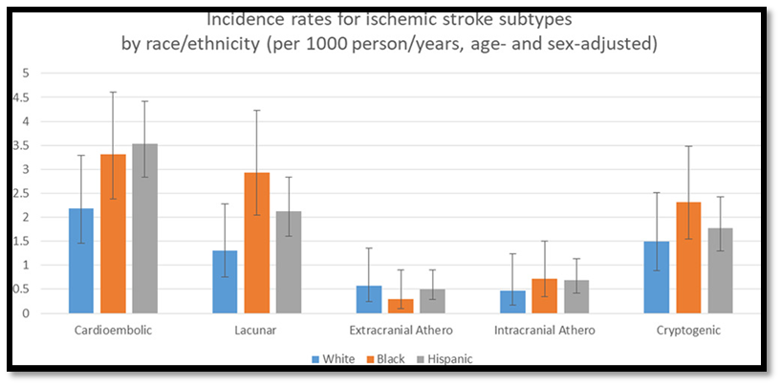
Research Aims and Objectives
Incidence rates for each ischemic stroke among ethnic groups
(Source: Gardener et al., 2020)
Aim:The research aims to identify stroke prevalence, risk factors, and post-stroke outcomes among South Asian minorities in the UK.
Objectives:
To evaluate epidemiological data on stroke occurrence
To explore key metabolic and lifestyle risk factors
To analyse culturally appropriate care for supporting South Asians in improving the quality of life post-stroke
These aims and objectives align with public health priorities for data analysis, risk profiling, and service evaluation for equitable stroke care.

Slide 6
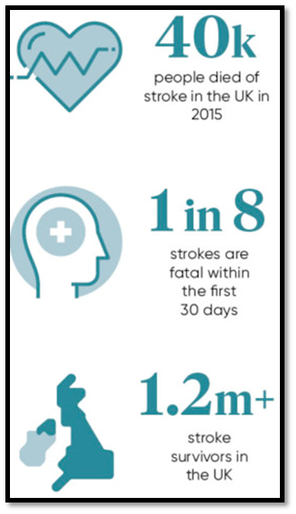
Research Questions
(Source: Barrow, 2017)
What is the prevalence of stroke among South Asian minorities in the UK?
How do the key risk factors contribute to stroke and affect the post-vent quality of life in the ethnic group?
What are the major barriers to accessing stroke care and rehabilitation?
These questions are framed to delve into epidemiology, risk factors, lived experience, and systemic challenges in stroke care for South Asian minorities in the UK.

Slide 7
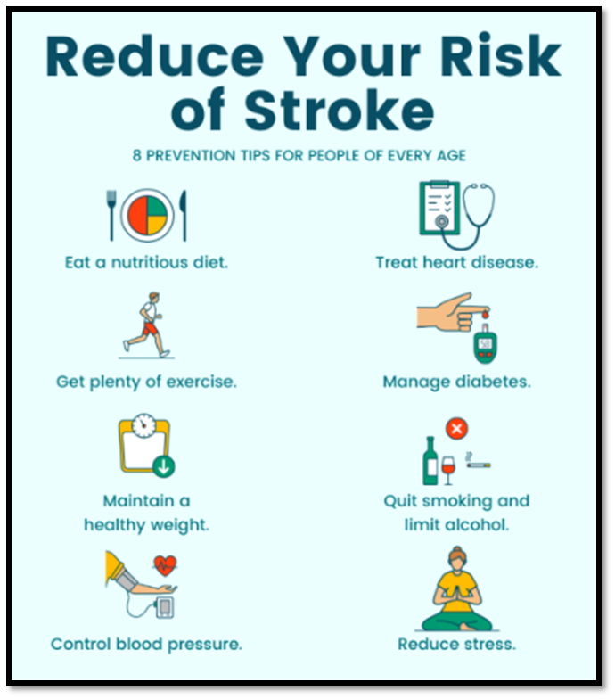
(Source: Gracebarkerhealth, 2021)
Research Impact
Outcomes of the study can support NHS goals to provide equity and targeted interventions for stroke in ethnic groups.
The findings will be culturally responsive stroke prevention and rehabilitation strategies.
This will be useful to reform policies, improve service design, and reduce stroke-related disability in South Asian communities.

Slide 8
Aurelius, T., Maheshwari, A., Ken‐Dror, G., Sharma, S.D., Amlani, S., Gunathilagan, G., Cohen, D.L., Rajkumar, C., Maguire, S., Ispoglou, S. and Balogun, I. (2023). Ischaemic stroke in south Asians: the BRAINS study. European Journal of Neurology, 30(2), pp.353-361. https://doi.org/10.1111/ene.15605
Bai, R., Li, M., Bhurtyal, A., Zhu, W., Dong, W., Dong, D., Sun, J., Su, Y. and Li, Y. (2024). Temporal Mortality Trends Attributable to Stroke in South Asia: An Age–Period–Cohort Analysis. In Healthcare (Vol. 12, No. 18, p. 1809). MDPI. https://doi.org/10.3390/healthcare12181809
Bainbridge, S., Webster, A., Smith, F., Vyas, S., Begum, S., Taylor, J., Sharpe, C., Autran, M. and Divajeva, D. (2024). City and Hackney Cancer Joint Strategic Needs Assessment 2024. Assessment, 2024. https://cityhackneyhealth.org.uk/wp-content/uploads/2024/10/Cancer-JSNA-FINAL-August-2024.pdf
Barrow, M. (2017). Call for a new national stroke standard of care. Available at: https://www.raconteur.net/healthcare/call-for-a-new-national-stroke-standard-of-care [Accessed 9 Oct. 2025].
Chang, E., Choi, S., Kwon, I., Araiza, D., Moore, M., Trejo, L. and Sarkisian, C. (2018). Characterizing beliefs about stroke and walking for exercise among seniors from four racial/ethnic minority communities. Journal of cross-cultural gerontology, 33(4), pp.387-410.
Costroke (2022). Learn About Strokes, Risk Factors, and Prevention. Colorado Stroke Advisory Board. Available at: https://costroke.org/stroke-prevention/ [Accessed 9 Oct. 2025].
Different Strokes (2024). Ethnicity and Stroke | Different Strokes. Available at: https://differentstrokes.co.uk/ethnicity-and-stroke/ [Accessed 9 Oct. 2025].
Fluck, D., Fry, C. H., Gulli, G., Affley, B., Robin, J., Kakar, P., Sharma, P., & Han, T. S. (2023). Adverse stroke outcomes amongst UK ethnic minorities: a multi-centre registry-based cohort study of acute stroke. Neurological sciences: official journal of the Italian Neurological Society and of the Italian Society of Clinical Neurophysiology, 44(6), 2071–2080. https://doi.org/10.1007/s10072-023-06640-z
Frimodt-Møller, E.K., Tang, J.J., Biering-Sørensen, T., Delling, F.N., Jackson, L.R. and Marcus, G.M. (2024). Ethnic differences in atrial fibrillation in the United Kingdom. JACC: Advances, 3(12_Part_2), p.101043. https://doi.org/10.1016/j.jacadv.2024.101043
Gardener, H., Sacco, R.L., Rundek, T., Battistella, V., Cheung, Y.K. and Elkind, M.S. (2020). Race and ethnic disparities in stroke incidence in the Northern Manhattan Study. Stroke, 51(4), pp.1064-1069. https://doi.org/10.1161/STROKEAHA.119.028806
Gracebarkerhealth (2021). Infographic: Reduce Your Risk of Stroke - Grace Barker Health. Available at: https://www.gracebarkerhealth.com/infographic-reduce-your-risk-of-stroke/ [Accessed 9 Oct. 2025].
Magwood, G.S., Ellis, C., Nichols, M., Burns, S.P., Jenkins, C., Woodbury, M. and Adams, R. (2019). Barriers and facilitators of stroke recovery: perspectives from African Americans with stroke, caregivers and healthcare professionals. Journal of Stroke and Cerebrovascular Diseases, 28(9), pp.2506-2516. https://doi.org/10.1016/j.jstrokecerebrovasdis.2019.06.012
Martinez-Amezcua, P., Haque, W., Khera, R., Kanaya, A.M., Sattar, N., Lam, C.S., Harikrishnan, S., Shah, S.J., Kandula, N.R., Jose, P.O. and Narayan, K.V. (2020). The upcoming epidemic of heart failure in South Asia. Circulation: Heart Failure, 13(10), p.e007218. https://doi.org/10.1161/CIRCHEARTFAILURE.120.007218
McAllister, J., Harrison, M., Lawson, C.A. and Singh, S.J. (2025). Identifying barriers and enablers to cardiac rehabilitation participation and completion unique to South Asian individuals: a qualitative systematic review. European Journal of Cardiovascular Nursing, p.zvaf044. https://doi.org/10.1093/eurjcn/zvaf044
Stroke Association (2025). Life After Stroke Services. Available at: https://www.stroke.org.uk/professionals/life-after-stroke-services [Accessed 9 Oct. 2025].speak to them
References

