Slide 1

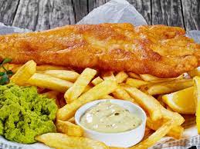

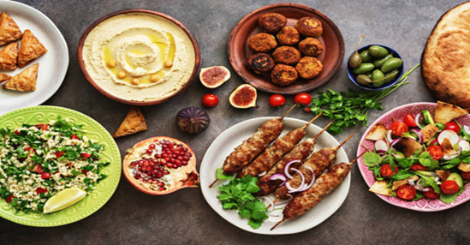
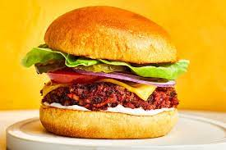





Take Away Menu
Fish & chips –cod/ haddock/ plaice + large chips 6.50£
Fried chicken – 10 spicy wings 6£
Quarter Pounder Beef Burger – 3£
Cheese Burger- 3£
Veggie Burger -3£
Fish Burger -3£
Pepperoni pizza- large-10£
Hawaiian pizza- large- 10£
Chicken pizza – large 10£
Cheese and tomato pizza- large 10£
Available every day from 5 pm.
Free delivery on orders over 25£.
01380222222
Adress: 15 Long Street Sn102PQ

Slide 2

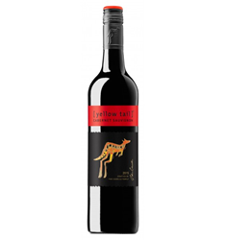
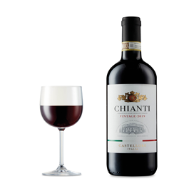

Steak & Cabernet Sauvignon
Who doesn’t love a big plate of steak and the most popular red wine? Enjoy the bold tannings and fruity flavor.
Spaghetti +Meat Balls & Chianti
Why wont you try red wine with a bold fruity flavor that pairs well with the acidity of tomatoes?
Fish Tacos & Chardonnay
Light Fish recipe is the best known friend to Chardonnay
BEEF FILLET CARPACCIO served with rocket and parmesan- 9.95£
CALAMARI lightly seasoned fried -6.50£
SALMON FILLET served with sesonal vegetables and pea puree-14.95£
SIRLOIN STEAK- 20.95£
T-BONE STEAK-23.95£
If you suffer from any allergies please inform your waiter at the time of your order and we will inform our kitchen staff

