Slide 1
Session 2
From personnel management to HRM
Personnel management Human Resource management
Traditional model Strategic
Reactive Business Focus
Social work Hard data
Admin Proactive

Slide 2
HRM Core Module
Introduction
Evolution of the HR Function in Management
Torrington, D. and L. Hall (1987) Personnel management: a new approach. New York, London, Prentice Hall.

Slide 3
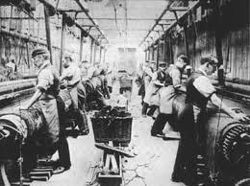
The evolution of personnel/human resource management
The social reformer
  Origins of PM lie in 19th century;
  Lord Shaftesbury, Robert Owen, Rowntrees and other social philanthropists;
  Criticisms of the free enterprise system and the hardship created by the exploitation of workers by factory owners led to the first ‘personnel’ managers be appointed – essentially welfare officers.

Slide 4
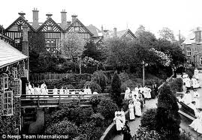
The evolution of personnel/human resource management
The ‘acolyte of benevolence’
  Late 19th and early 20th centuries;
  Welfare officer;
  Unemployment benefit, sick pay, subsidised housing;
  Pension schemes, childcare facilities and health-screening programmes

Slide 5
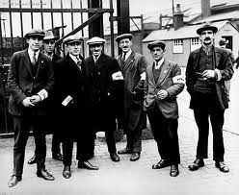
The evolution of personnel/human resource management
The ‘humane bureaucrat’ – 1930’s<
  A move away from a sole focus on welfare issues towards the meeting of various other organisational objectives;
  Staffing, training and organisation design;
  Administration
  Fostering the social relationship in the workplace and employee morale (Elton Mayo)

Slide 6
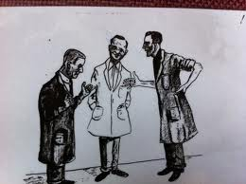
The evolution of personnel/human resource management
the ‘consensus negotiator’
  After Second World War – 1945<
  A growth of trade union membership;
  The government encouraged the appointment of personnel officer and set up the first specialist courses in the universities.

Slide 7

The evolution of personnel/human resource management
‘organisation man’
  Late 1960s<
  A switch in focus - away from dealing with employee towards dealing with management itself and the integration of management activity;
  The development of career paths and opportunities within organisations for personal growth

Slide 8

The evolution of personnel/human resource management
The ‘workforce analyst’
  1980s<
  Assessing what employees/workers will be needed in the short and long term;
  of what different grades, categories and skills
  Deciding what ‘manpower’ an organisation is likely to have in the future, based on current trends and anticipated external circumstances;
  Taking action to ensure that supply meets demand

Slide 9

The evolution of personnel/human resource management – 21st Century
Becomes more ‘professional’
A recognised senior management and ‘strategic’ function
Main concern – performance management
Questions of integrity and ‘whose side are we on’ continue.

Slide 10
Group exercise 2
Consider the organisations you have worked for (either in the UK or back home )
Would you consider the organisation was operating PM ( personnel management ) or HRM ( Human resource management ) What are the reasons for this?

Slide 11
Session 2 Programme
Review of Session 1
Your programme and discussion
The CIPD
Concepts of ‘ strategy’
Vision and values
From Manpower planning to HR planning

