Slide 1
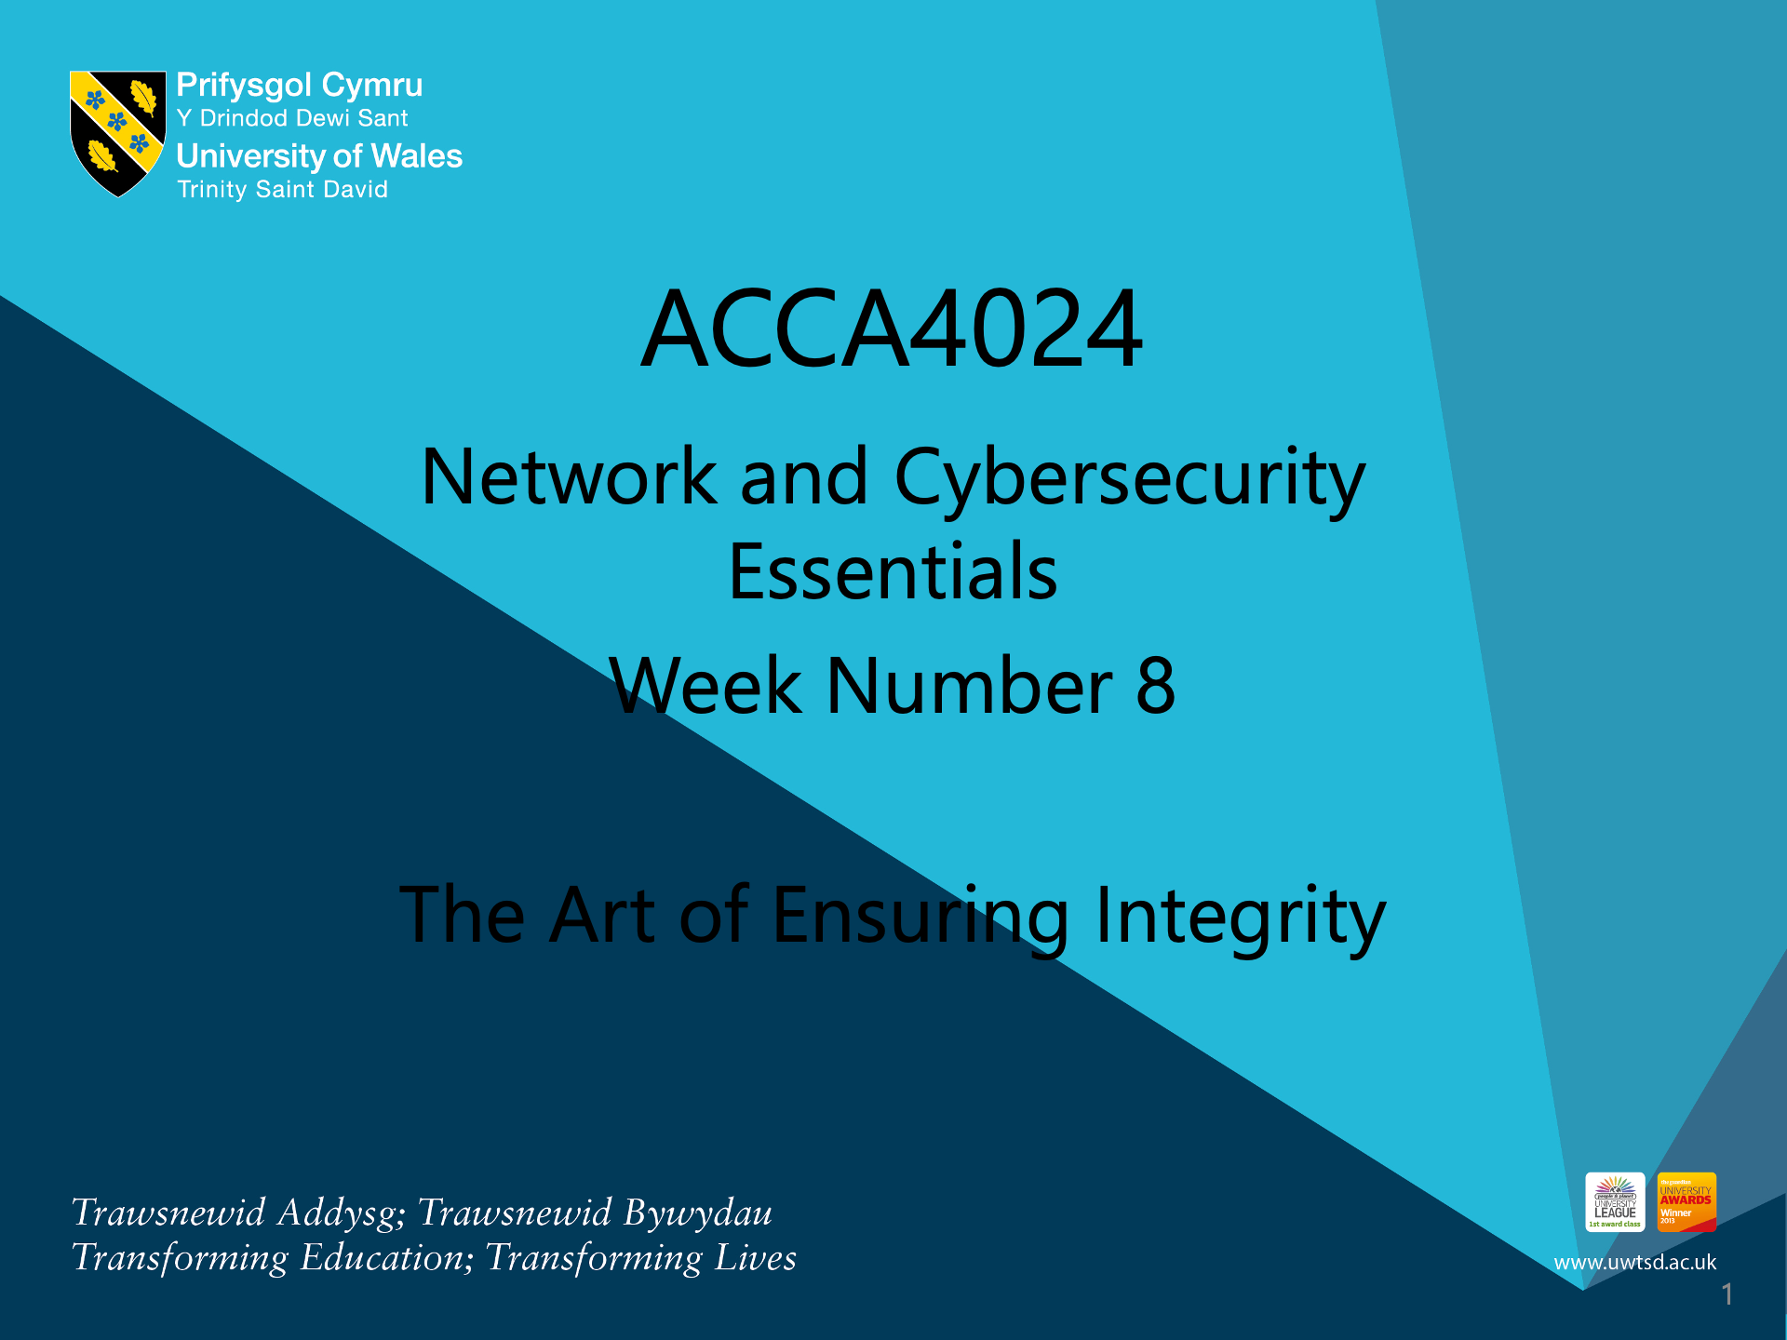


Slide 2
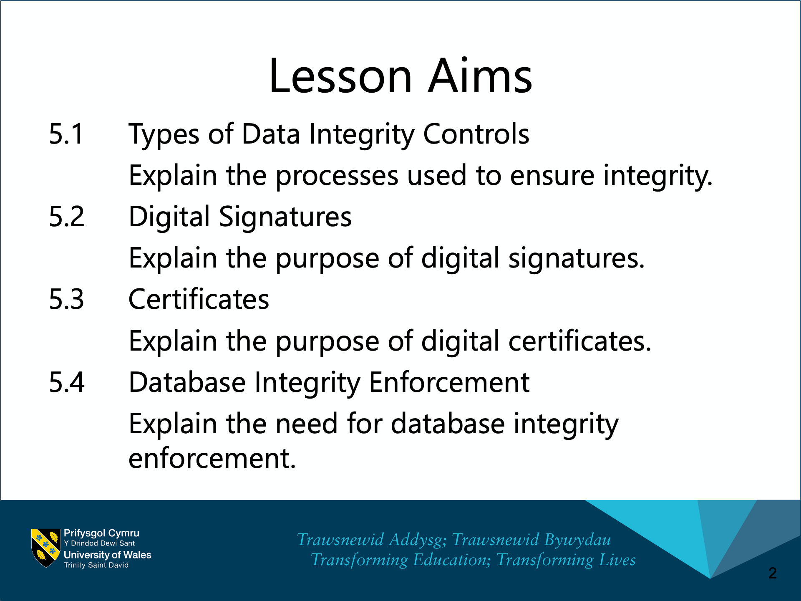

Slide 3
Chapter 5:
The Art of Ensuring Integrity
Cybersecurity Essentials v1.1
Notes:
Cisco Networking Academy Program
Cybersecurity Essentials v1.1
Chapter 5: The Art of Ensuring Integrity

Slide 4
Chapter 5 - Sections & Objectives
5.1 Types of Data Integrity Controls
Explain the processes used to ensure integrity.
5.2 Digital Signatures
Explain the purpose of digital signatures.
5.3 Certificates
Explain the purpose of digital certificates.
5.4 Database Integrity Enforcement
Explain the need for database integrity enforcement.
Notes:
4

Slide 5
5.1 Types of Data Integrity Controls
Notes:
Cisco Networking Academy Program
Cybersecurity Essentials
Chapter 5: The Art of Ensuring Integrity

Slide 6
Types of Data Integrity Controls
Hashing Algorithms
Hashing is a tool that ensures data integrity by taking binary data (the message) and producing a fixed-length representation called the hash value or message digest.
Hashing is a one-way mathematical function that is relatively easy to compute, but significantly harder to reverse. Grinding coffee beans is a good analogy of a one-way function. It is easy to grind coffee beans, but it is almost impossible to put all of the tiny pieces back together to rebuild the original beans.
  A cryptographic hash function has the following properties:
  The input can be any length.
  The output has a fixed length.
  The hash function is one way and is not reversible.
  Two different input values will always result in different hash values.

Slide 7
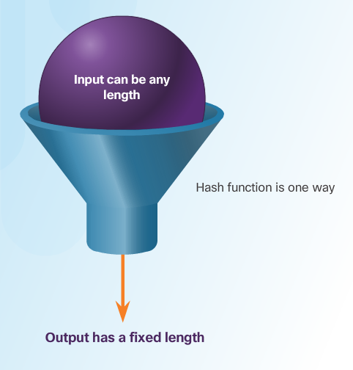
Types of Data Integrity Controls
Hashing Algorithms
There are many modern hashing algorithms widely used today. Two of the most popular are MD5 and SHA.
Message Digest 5 (MD5) Algorithm - is a hash algorithm developed by Ron Rivest that produces a 128-bit hash value.
Secure Hash Algorithm (SHA) – was developed by the U.S. National Institute of Standards and Technology (NIST) and can be implemented in different strengths:
SHA-224 (224 bit)
SHA-256 (256 bit)
SHA-384 (384 bit)
SHA-512 (512 bit)

Slide 8
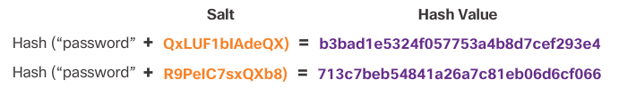
Types of Data Integrity Controls
Salting
Salting is used to make hashing more secure. If two users have the same password, they will also have the same password hashes. A salt, which is a random string of characters, is an additional input to the password before hashing.
This creates a different hash result for the two passwords as shown in the figure. A database stores both the hash and the salt.

Slide 9
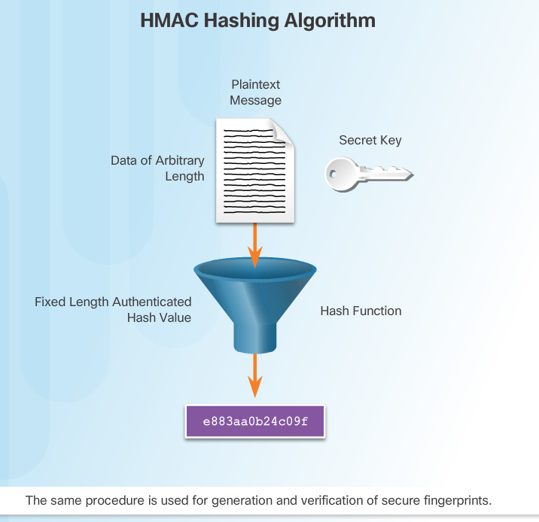
Types of Data Integrity Controls
HMAC
HMACs strengthens hashing algorithms by using an additional secret key as input to the hash function.
The use of HMAC goes a step further than just integrity assurance by adding authentication.
An HMAC uses a specific algorithm that combines a cryptographic hash function with a secret key, as shown in the figure.

Slide 10
5.2 Digital Signatures
Notes:
Cisco Networking Academy Program
Cybersecurity Essentials
Chapter 5: The Art of Ensuring Integrity

Slide 11
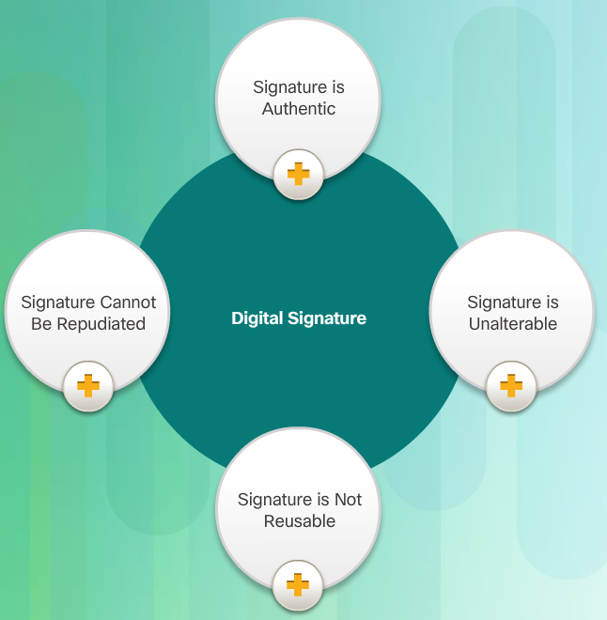
Digital Signatures
Signatures and the Law
Digital signatures provide the same functionality as handwritten signatures for electronic documents.
A digital signature is used to determine if someone edits a document after the user signs it.
A digital signature is a mathematical method used to check the authenticity and integrity of a message, digital document, or software.
In many countries, digital signatures have the same legal importance as a manually signed document.
Digital signatures also provide repudiation.

Slide 12
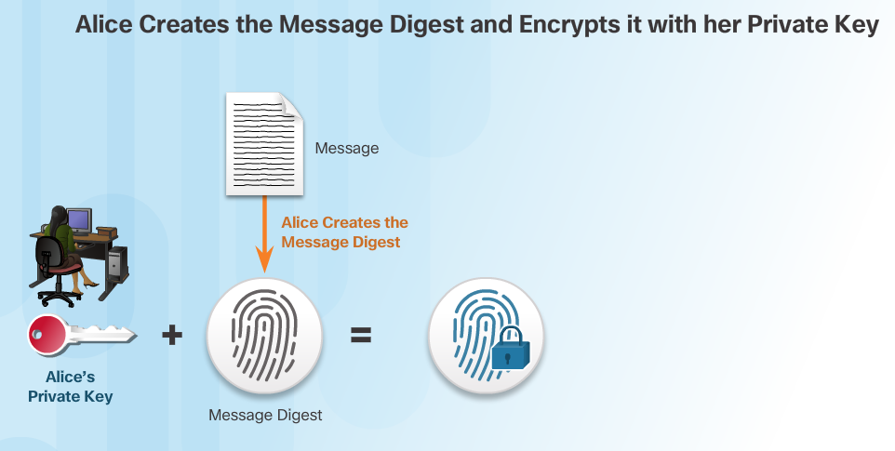
Digital Signatures
How Digital Signature Technology Works
Asymmetric cryptography is the basis for digital signatures. A public key algorithm like RSA generates two keys: one private and the other public. The keys are mathematically related.

Slide 13
5.3 Certificates
Notes:
Cisco Networking Academy Program
Cybersecurity Essentials
Chapter 5: The Art of Ensuring Integrity

Slide 14
Certificates
The Basics of Digital Certicates
A digital certificate is equivalent to an electronic passport.
Digital certificates enable users, hosts, and organizations to exchange information securely over the Internet.
A digital certificate authenticates and verifies that users sending a message are who they claim to be.
Digital certificates can also provide confidentiality for the receiver with the means to encrypt a reply.

Slide 15
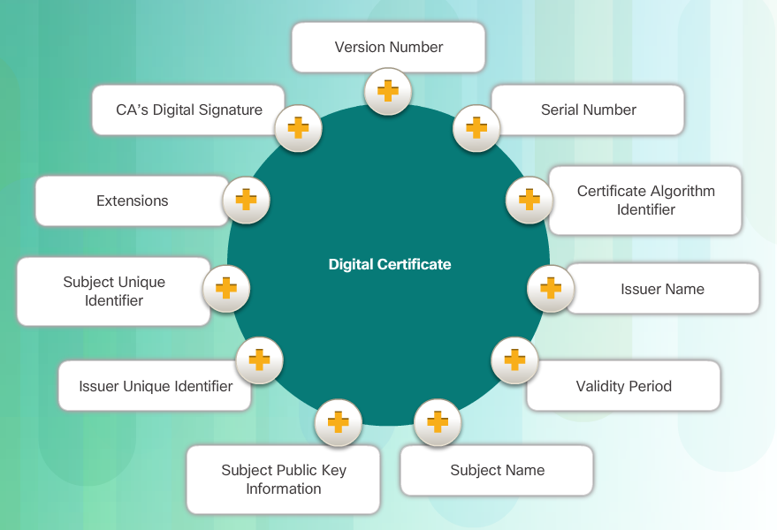
Certificates
Constructing a Digital Certificate
Digital certificate must follow a standard structure so that any entity can read and understand it regardless of the issuer.
TheX.509 is the standard for construction of digital certificates and the public key infrastructure (PKI) used to manage digital certificates.
PKI is the policies, roles, and procedures required to create, manage, distribute, use, store, and revoke digital certificates.

Slide 16
5.4 Database Integrity Enforcement
Notes:
Cisco Networking Academy Program
Cybersecurity Essentials
Chapter 5: The Art of Ensuring Integrity

Slide 17
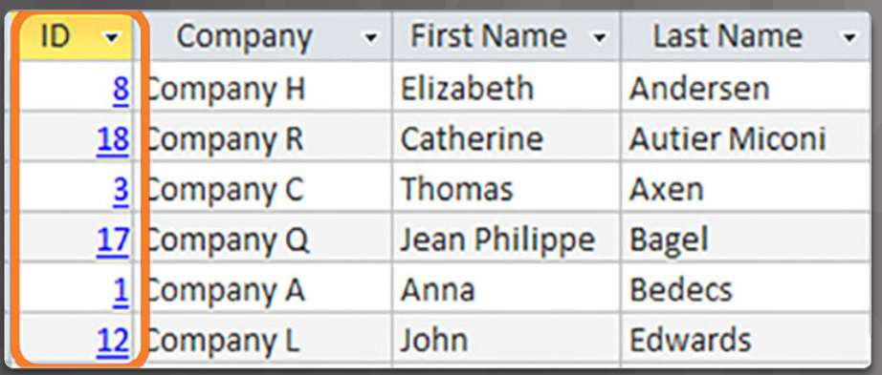
Database Integrity Enforcement
Database Integrity
Databases provide an efficient way to store, retrieve, and analyze data.
As data collection increases and data becomes more sensitive, it is important for cybersecurity professionals to protect the growing number of databases.
Data integrity refers to the accuracy, consistency, and reliability of data stored in a database.

Slide 18
Database Integrity Enforcement
Database Integrity (Cont.)
The four database integrity rules or constraints are as follows:
Entity Integrity: All rows must have a unique identifier called a Primary Key.
Domain Integrity: All data stored in a column must follow the same format and definition.
Referential Integrity: Table relationships must remain consistent. Therefore, a user cannot delete a record which is related to another one.
User-defined Integrity: A set of rules defined by a user which does not belong to one of the other categories. For example, a customer places a new order. The user first checks to see if this is a new customer. If it is, the user adds the new customer to the customers table.

Slide 19
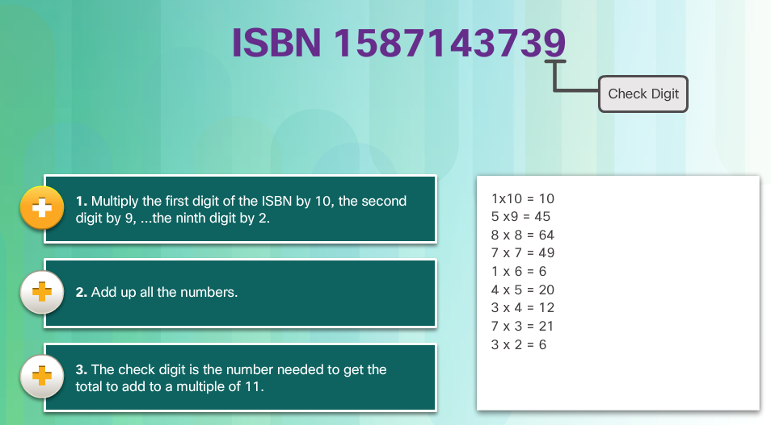
Database Integrity Enforcement
Database Validation
A validation rule checks that data falls within the parameters defined by the database designer. A validation rule helps to ensure the completeness, accuracy and consistency of data. The criteria used in a validation rule include the following:
Size – checks the number of characters in a data item
Format – checks that the data conforms to a specified format
Consistency – checks for the consistency of codes in related data items
Range – checks that data lies within a minimum and maximum value
Check digit – provides for an extra calculation to generate a check digit for error detection.

Slide 20
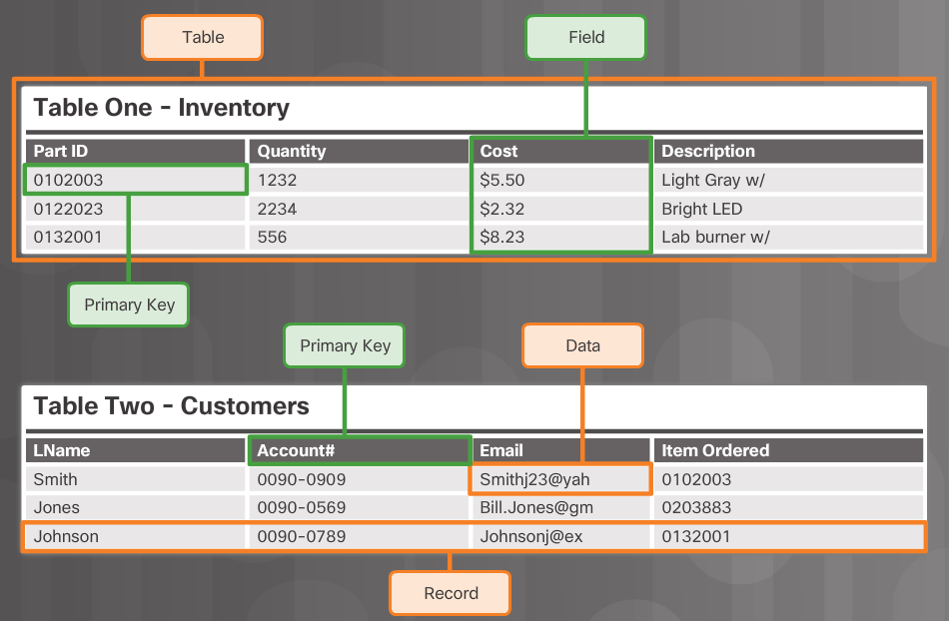
Database Integrity Enforcement
Database Integrity Requirements
Maintaining proper filing is critical in maintaining the trustworthiness and usefulness of the data within the database.
Tables, records, fields, and data within each field make up a database.
In order to maintain the integrity of the database filing system, users must follow certain rules.
Entity integrity is an integrity rule, which states that every table must have a primary key and that the column or columns chosen to be the primary key must be unique and not NULL.
Null in a database signifies missing or unknown values. Entity integrity enables proper organization of data for that record.

Slide 21
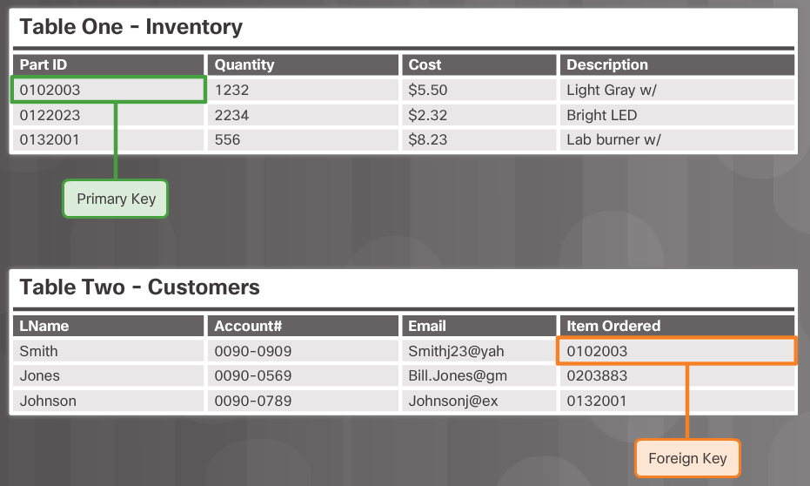
Database Integrity Enforcement
Database Integrity Requirements (Cont.)
Another important integrity check is referential integrity which deals with foreign keys. A foreign key in one table references a primary key in a second table. The primary key for a table uniquely identifies entities (rows) in the table. Referential integrity maintains the integrity of foreign keys.

Slide 22
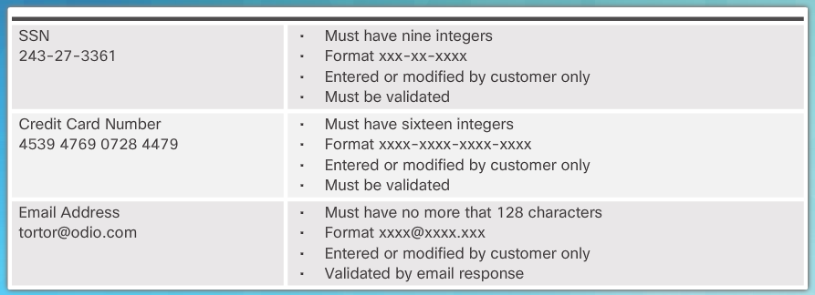
Database Integrity Enforcement
Database Integrity Requirements (Cont.)
Domain integrity ensures that all the data items in a column fall within a defined set of valid values. Each column in a table has a defined set of values, such as the set of all numbers for credit card numbers, social security numbers, or email addresses. Limiting the value assigned to an instance of that column (an attribute) enforces domain integrity. Domain integrity enforcement can be as simple as choosing the correct data type, length and or format for a column.

Slide 23
5.5 Chapter Summary
Notes:
Cisco Networking Academy Program
Cybersecurity Essentials
Chapter 5: The Art of Ensuring Integrity

Slide 24
Chapter Summary
Summary
Chapter five presented the art of integrity which is used to ensure that data remains unchanged by anyone or anything over its entire life cycle.
The chapter introduced types of data integrity controls including:
  hashing algorithms
  password salting
  keyed-hash message authentication code (HMAC)
These tools provide a way for cybersecurity specialists to verify the authenticity of messages and documents.
The chapter concluded with a discussion of database integrity enforcement.
Having a well-controlled and well-defined data integrity system increases the stability, performance, and maintainability of a database system.

Slide 25
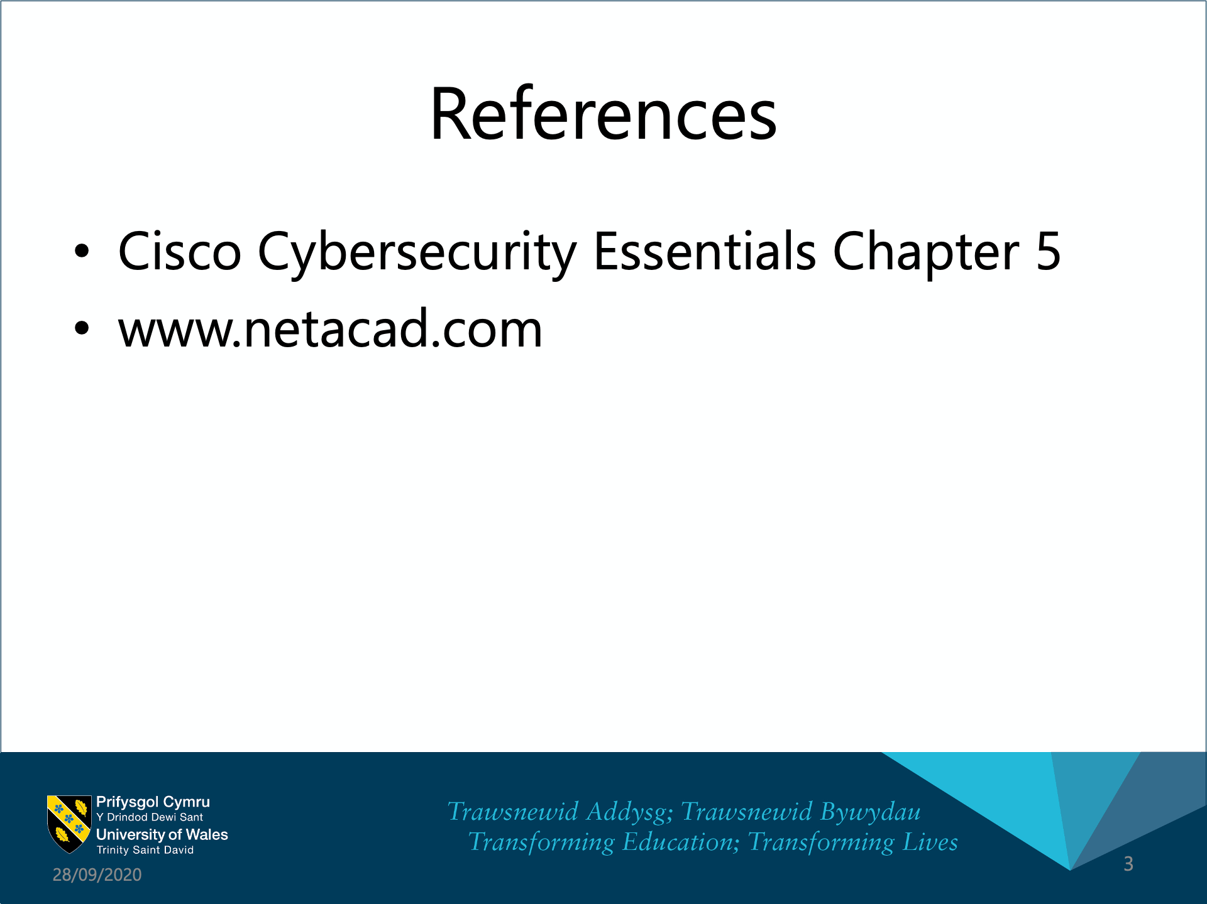

Slide 26


Slide 27


