Slide 1
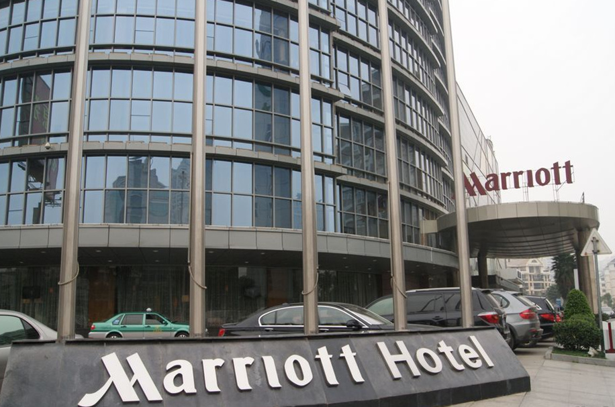
guójì jiǔdiàn
国际酒店 international hotel
Wànháo jiǔdiàn
万豪酒店

Slide 2
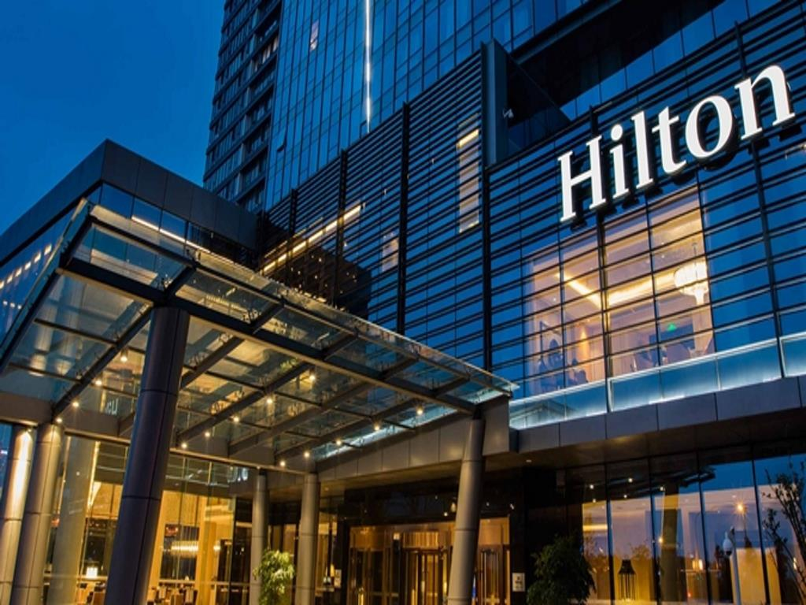
Xī’ěrdùn jiǔdiàn
希尔顿酒店

Slide 3

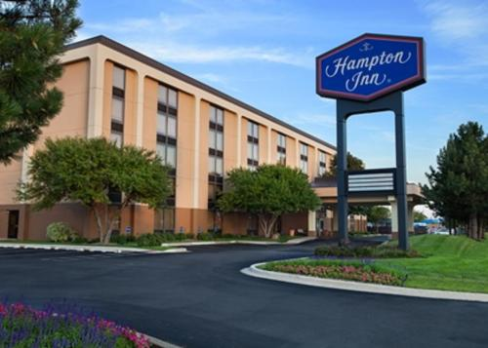
Hànpǔdùn jiǔdiàn
汉普顿酒店

Slide 4


Xǐláidēng jiǔdiàn
喜来登酒店

Slide 5
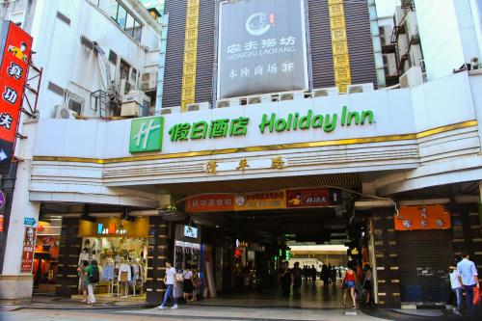
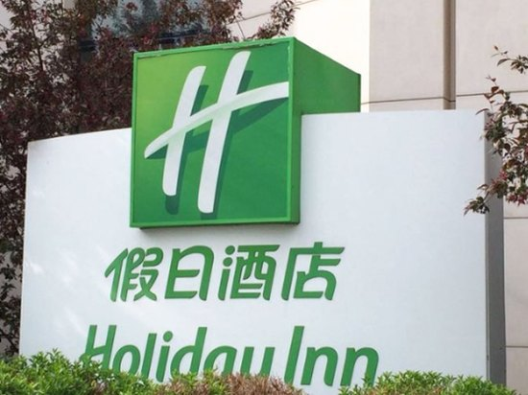

Jiàrì jiǔdiàn
假日酒店

Slide 6


Zhōujì jiǔdiàn
洲际酒店

Slide 7

shāngwù míngpiàn
商务名片business card

Slide 8
míngzi
名字name
diàn zǐ yóu xiāng
电子邮箱 e-mail address
zhíwù
职务position
chuánzhēn
传真fax
diànhuà
电话telephone
yóubiān
邮编zip code/post code
dìzhǐ
地址address
wǎngzhàn
网站website

Slide 9
zhíwù
职务position／job title
jīnglǐ
经理 manager
surname + title
Wáng jīnglǐ
王 经理 Manager Wang

Slide 10
address
jiē
街: street
lù
路：road
hào
号：number;date
lóu
楼：floor;building

Slide 11
guó shěng /zhōu chéngshì jiē/ lù hào fángjiān
国 省/州 城市 街/路 号 房间
nation province/state city street/road building number/name room
英国 西米德兰兹郡 伯明翰 爱德华路 威尔士三一圣大卫大学伯明翰学习中心 第3教室
the UK—West Midlands—Brimingham— Edward Road—Birmingham Learning Centre, University of Wales Trinity Saint David—Lecture Room 3

Slide 12
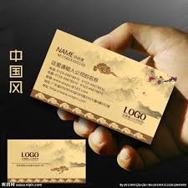




Slide 13
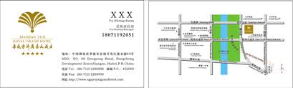
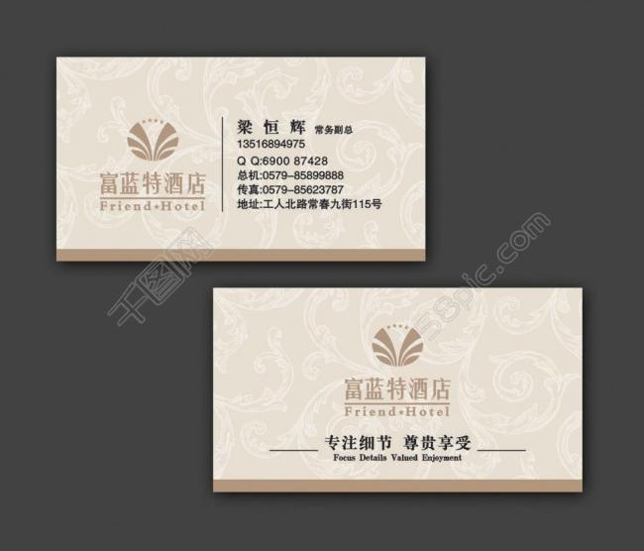

Slide 14
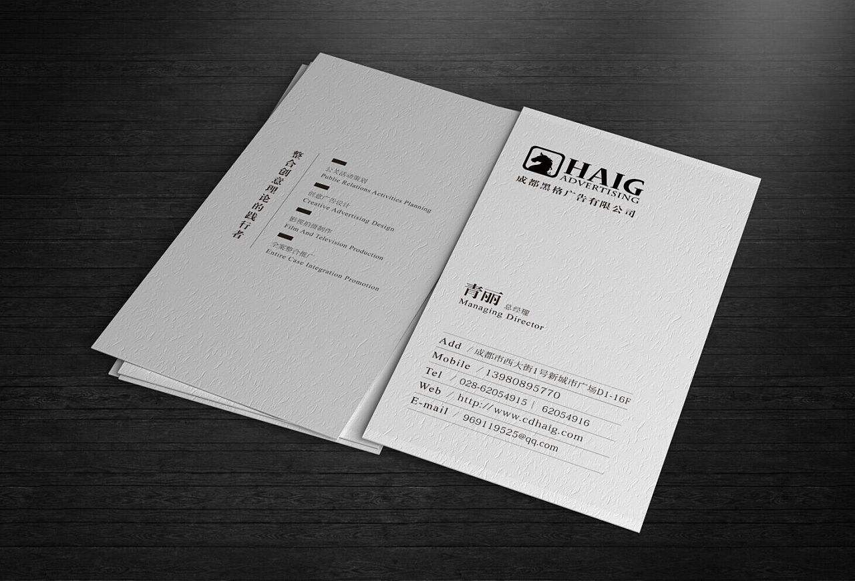


Slide 15

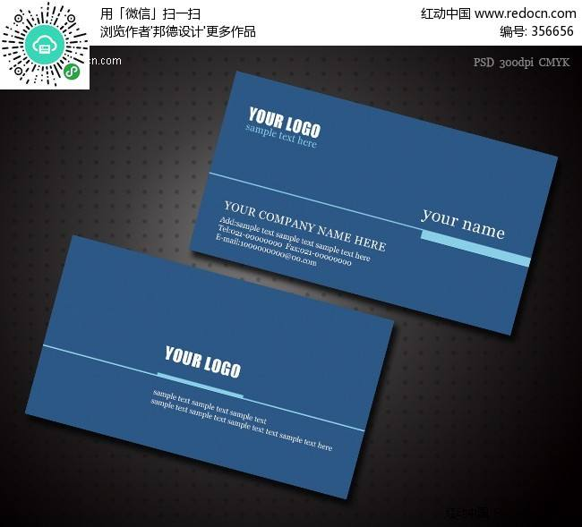

Slide 16


Slide 17
First assignment !!!
Make a business card of an international hotel, there should be the title(manager) ,the name, phone number, address and zip code of the hotel. If there are fax number and website of the hotel, that will be better.
You should write down all the information in Chinese( characters) except the name of the street or road.
You should write down all the information in Chinese(characters).
If you can put some design on it, that will be great.

Slide 18
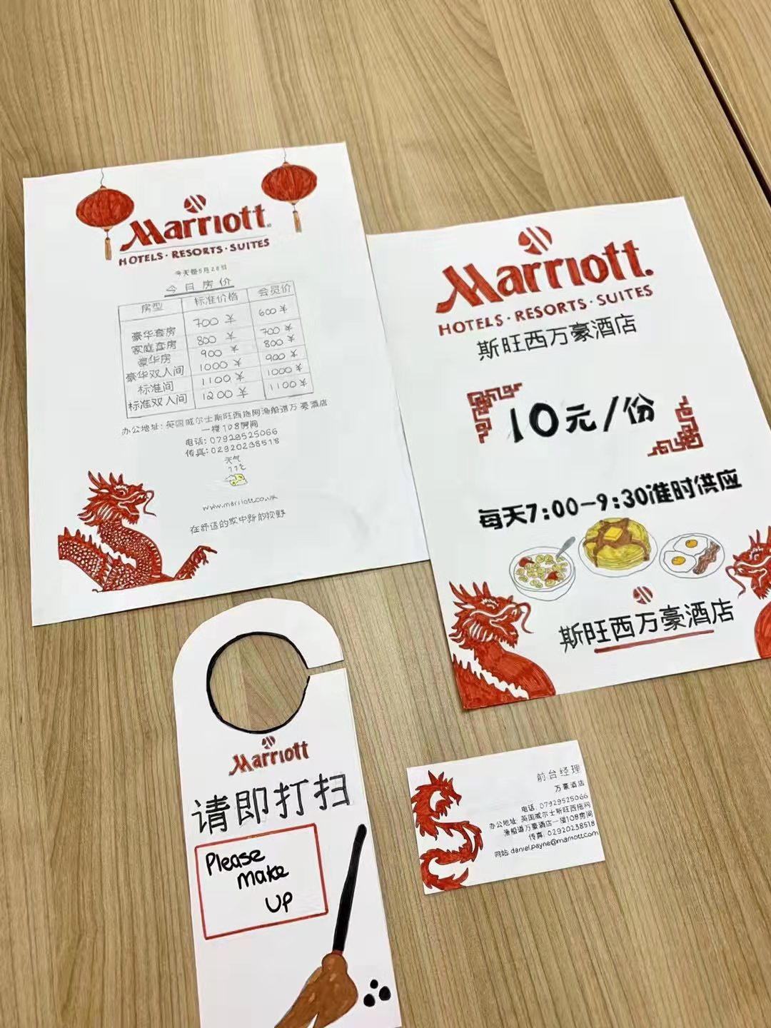

Slide 20
First assignment !!!
Make a business card of an international hotel, there should be the title(manager) ,the name, phone number, address and zip code of the hotel. If there are fax number and website of the hotel, that will be better.
You should write down all the information in Chinese( characters) except the name of the street or road.
You should write down all the information in Chinese(characters).
If you can put some design on it, that will be great.

